Slide 1
Referral ERRA Trending Analysis Tool (RE-TAT)
Sponsor - QTC
Emanoel Khachadorian, Daniel Limas, Wilson Thomas, Henry Liwag, Xiaoye Li, and Philip Tran,
ERRA = EXAM Request Routing Assistant

Slide 2
Team Introduction

Slide 3
Teams
Advisor: Dr. Yuqing Zhu
Liaisons
Kelly Hernandez
Neil DeJesus
Grace Pang-Truong
Martin Nikoukar
Wilson Thomas
Emanoel Khachadorian
Xiaoye “Mark” Li
Daniel Limas
Philip Tran
Henry Liwag

Slide 4
Agenda
Introduction
Features
Work Environment
Challenges / Implementation
Summary
Future recommendation

Slide 5
About our Liaison
Company overview

Slide 6
About QTC
QTC is the largest provider of government-outsource disability and occupational health examination services in the nation.

Slide 7
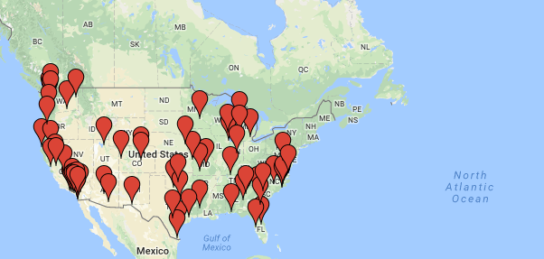
Clinic Locations
Their network consist of more than 1,000 clinical, corporate and operational associates.
And more than 70 clinic locations that include physicians, registered nurses, and support personnel.

Slide 8
About our Project
Goal

Slide 9
Referral / ERRA Trending Analysis Tool (RE-TAT)
A tool created that will use data from ERRA, weekly provider zip code report, and historical referral data to identify:
Areas that are missing providers and display the nearest provider.
Track referrals assigned to QTC.
EXAM Request Routing Assistant -A system for the VA to know which contractor to send the referrals to by location

Slide 10
Project Requirements

Slide 11
RE-TAT Core Requirements
Allow for Basic Commands
Add, Delete, Upload files
User Friendly
A straightforward and easy to use interface.
Admin User
Add and delete Users + access to all features
User
Access to all features
Reliable Tool
Safe and ready to go all the time.
Notes:
Update, insert, delete, and upload files. change it

Slide 12
Features
Emanoel

Slide 13
Two Main Features
1. Referral Confirmation
Check between referrals assigned with referrals received
Provide comparison data of referrals
2. Required Provider Check
Find providers where referrals are assigned
If no providers are available, mark area
Ensure coverage in all required areas.

Slide 14
Demo
Mark

Slide 16
Work Environment
Daniel

Slide 18
Excel files are formatted as a .xlsx and is used to test our two main features.
Java servlets are used for writing controllers for our web pages and connecting to our database.(Apache file upload, jBCrypt)
JSP are used to create GUIs.(Bootstrap)
Eclipse is our main tool, and this is where we write our controllers, pages, and models.

Slide 19
Github is our version control of choice. (Centralized)
phpMyAdmin is used to administer our MySQL database.
Apache tomcat as our web server.
Our host server. Setup by our group member Mark. (eCryptFS)

Slide 20
Challenges and Implementation
Philip

Slide 21
Challenge #1: Finding Zipcode Longitude and Latitude
Finding a longitude and latitude zip-code database is essential for the Referral and Provider Check.
Number of zipcode in US approximately 42,000
States
U.S. territories
Native American land

Slide 22
First Approach: Google Map API
Advantages
Cost Effective
Less data overhead
Accuracy information
Trade-offs
Speed bottleneck
Limited location lookup

Slide 23
Solution: Creating an offline Zipcode List
Custom zipcode list made from multiple zipcode list.
Advantage
Publicly available list
Cost Effective
Offline access
Trade Off
Determining accuracy
Not an up-to-date list

Slide 24
Challenge #2: Reducing Search time
Referral Excel file – ~200,000 data entries
Provider Excel file – ~3,200 data entries
Zipcode list – ~42,000 areas
Issues:
Repetitive search comparison
Heavy computational calculation

Slide 25
Solution: Zipcode filter
Reprogramming implementation
Using hash table and hash set
Reduce loop checking repetition
Bounded comparison setup
Bounded longitude and latitude range
Multithreading
search multiple zipcode at same time

Slide 26
Summary & Timeline
Henry

Slide 27
Summary
Our goal is to create a convenient tool to compare and analyze QTC’s referral and provider data
With the two main features (referral confirmation and provider check), the tool will be able to quickly and effectively identify any provider gaps based on the referral needs and analyze referral trends for forecasting purposes.

Slide 28
Timeline (of Events)
Planning for the whole project occurred from October to November with QTC. The next stages are as follows:
Work on database, the web pages, the functionalities, and the server started during mid-December (winter) and finished in late January.
After a couple of demonstrations with QTC, the team started debugging and improving the whole tool, tweaking the design, adding more features, etc.
As of today, (May, 2018) the team is about to be finished debugging the tool and almost ready for turning it over to QTC.

Slide 29
Future recommendations
Adding the overused and underused feature.
Upgrading our Referral and Provider Check (Zip-code Database)

Slide 30
Thank you!

