Slide 1
Visualization Tool for Composition of Cloud Computing Services
Faculty Advisor: Dr. Jiang Guo | Advisor: Davis Louie
Notes:
Visualization Tool for Composition of Cloud Computing Services. It is sponsored by NASA’s DIRECT-STEM. Our advisors are Dr Jiang Guo and Davis Louie

Slide 2
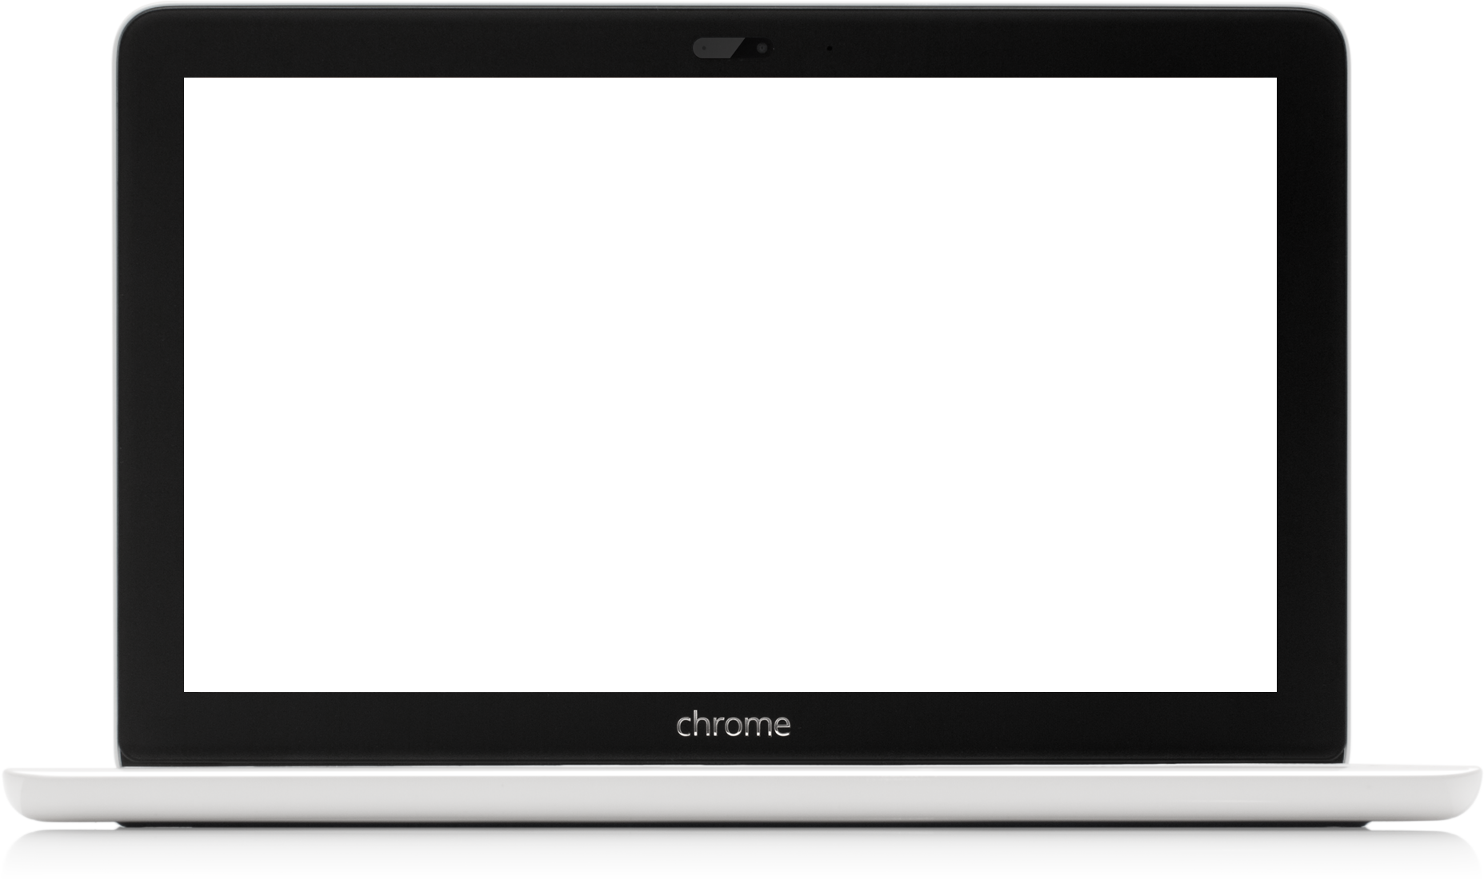
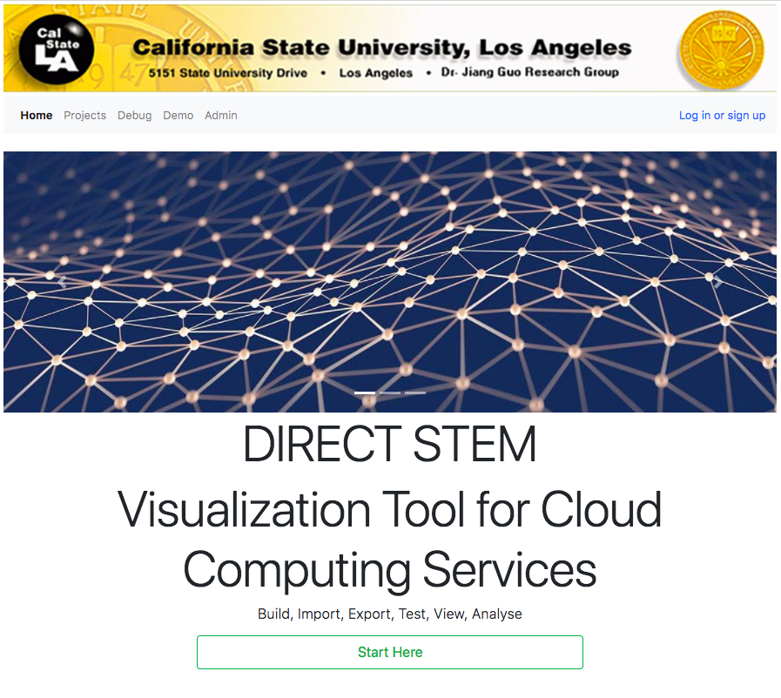
Team
Zolangi Ramirez – Project Team Lead
Hongsuk Choi – QA Lead
Johnson Truong – Requirements Lead
Gonzalo Serrano – Documentation Lead
Sudip Baral – Components Lead

Slide 3
Outline
Project Description
Project Setup
Project Composition
Client-side
Server-side
Data Collected
Results
Project Challenges
Future Plans
Notes:
This is our outline to the Presentation
Project Description - Describe what the project is
Project Setup -
Tools Required - Describe the tools needed to run the program
Project Composition - description of what it does, then describe how it works, and then transition to progress
Project Challenges - Describe any challenges faced while working on the project
Project Components - Describe the components our project uses
Back End - how the backend was implemented and challenges encountered here

Slide 4
What is the Visualization Tool for Composition of Cloud Computing Services?
Project Description

Slide 5
Visualization Tool for Composition of Cloud Computing Services
(VTCCCS)
Purpose:
A Software Tool to support the composition of cloud computing web services
Users are able to use this tool to model the architectures of cloud computing services based systems.
Example: Weather & Maps = get temperature for location
Temperature in Fahrenheit? Use Celsius conversion service, get new service
- for more detailed information refer to the Requirements and Design Documents on csns Projects page
Notes:
What is the Visualization Tool for Composition of Cloud Computing Services?
A combination of Web services. A web service being a service offered by an application to another application, communicating with each other via the World Wide Web. It is a web application used to create a web service out of already existing web services. It will support the composition of cloud computing services. Users will be able to use this visualization tool to model the architectures of cloud computing services based systems.
The purpose of the Visualization Tool for Composition of Cloud Computing Services (VTCCCS) is to develop a software tool to support the composition of cloud computing web services. Users will be able to use this visualization tool to model the architectures of cloud computing services based systems. The system is designed to facilitate the process of tracking and displaying the composition of cloud services and the results of these composite services. Potential scenarios include processing satellite data and then passing the processed data to another service to analyze
For example, you have weather and maps and you want to get the temperature from a certain region. From a weather web service, you get the temperature and from a map service you get the longitude and latitude once you combine them, you get a new web service giving you the temperature for that location

Slide 6
What is the Visualization Tool for Composition of Cloud Computing Services?
Project Setup

Slide 7
Tools
Front End
Angular 4
Node.js
Npm
Angular CLI
D3.js
Chart.js
Back End
Java
Apache Tomcat
Maven
MySQL
Notes:
Tools used to setup Project
Front End
Angular 4
Node.js
Npm
Angular CLI
D3
Back End
Java
Apache Tomcat
Maven
MySQL
Some tools used to communicate, keep our documents together, and organize our code

Slide 8
What is the Visualization Tool for Composition of Cloud Computing Services?
Project Composition

Slide 9
Project Components
Composed of two main components
a client-side application
served over the web
a server-side
supports and interacts with various client-side features
Notes:
Cloud computing architecture is composed of front-end and back-end platforms. Both components interact with each other to output value product. Visualizing the service is one of the key role our software does. The Front-end for the VTCCCS is responsible for enabling the user to handle the nodes which are the composition of single or multiple services. Managing users and filtering inputs are other functions front-end is devoted to. On the other end of the spectrum, back-end manages the storage, by running the server and maintaining the session.
Composed of two main components
a client-side application
Served over the web,
a server-side
Supports and interacts with various client-side features.
The Internet is a constant constraint as the Tool needs to be connected to use web services and to communicate with the server side functions. This is crucial as it is the only way to accurately simulate cloud computing as well as store and load information from the database.
External web service API can be a constraint since we need to know what data we will need to parse out of the service results as well as if authentication is needed to use a web service.

Slide 10
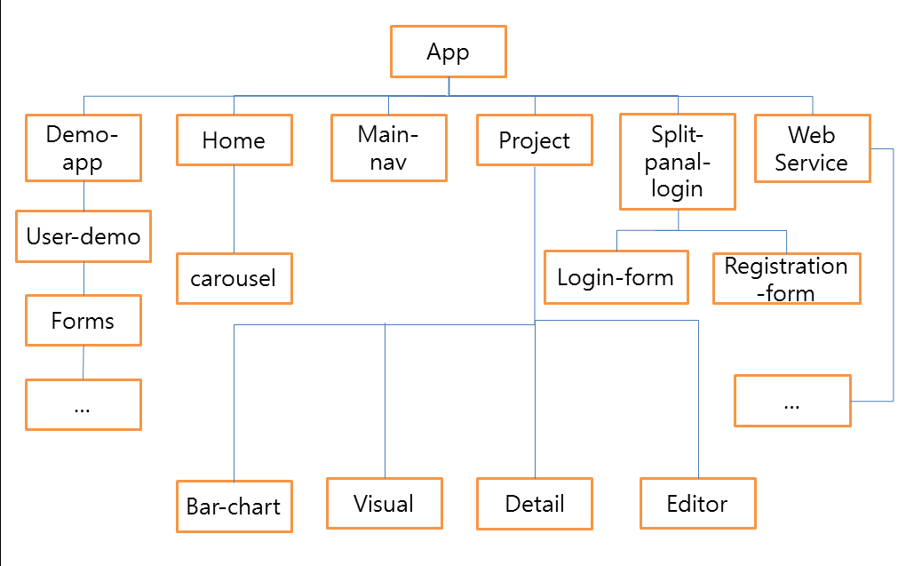
Notes:
The VTCCCS web application is responsible for managing web services. The entry point for the service is the main app component. On the basis of the functionality and nature of job a branch is created which we call component here. Some important subdivided components can be listed as: demo-app, projects, main-nav, etc. The application being built is equipped with the tool which allows us to visually manage services and control parameters.

Slide 11
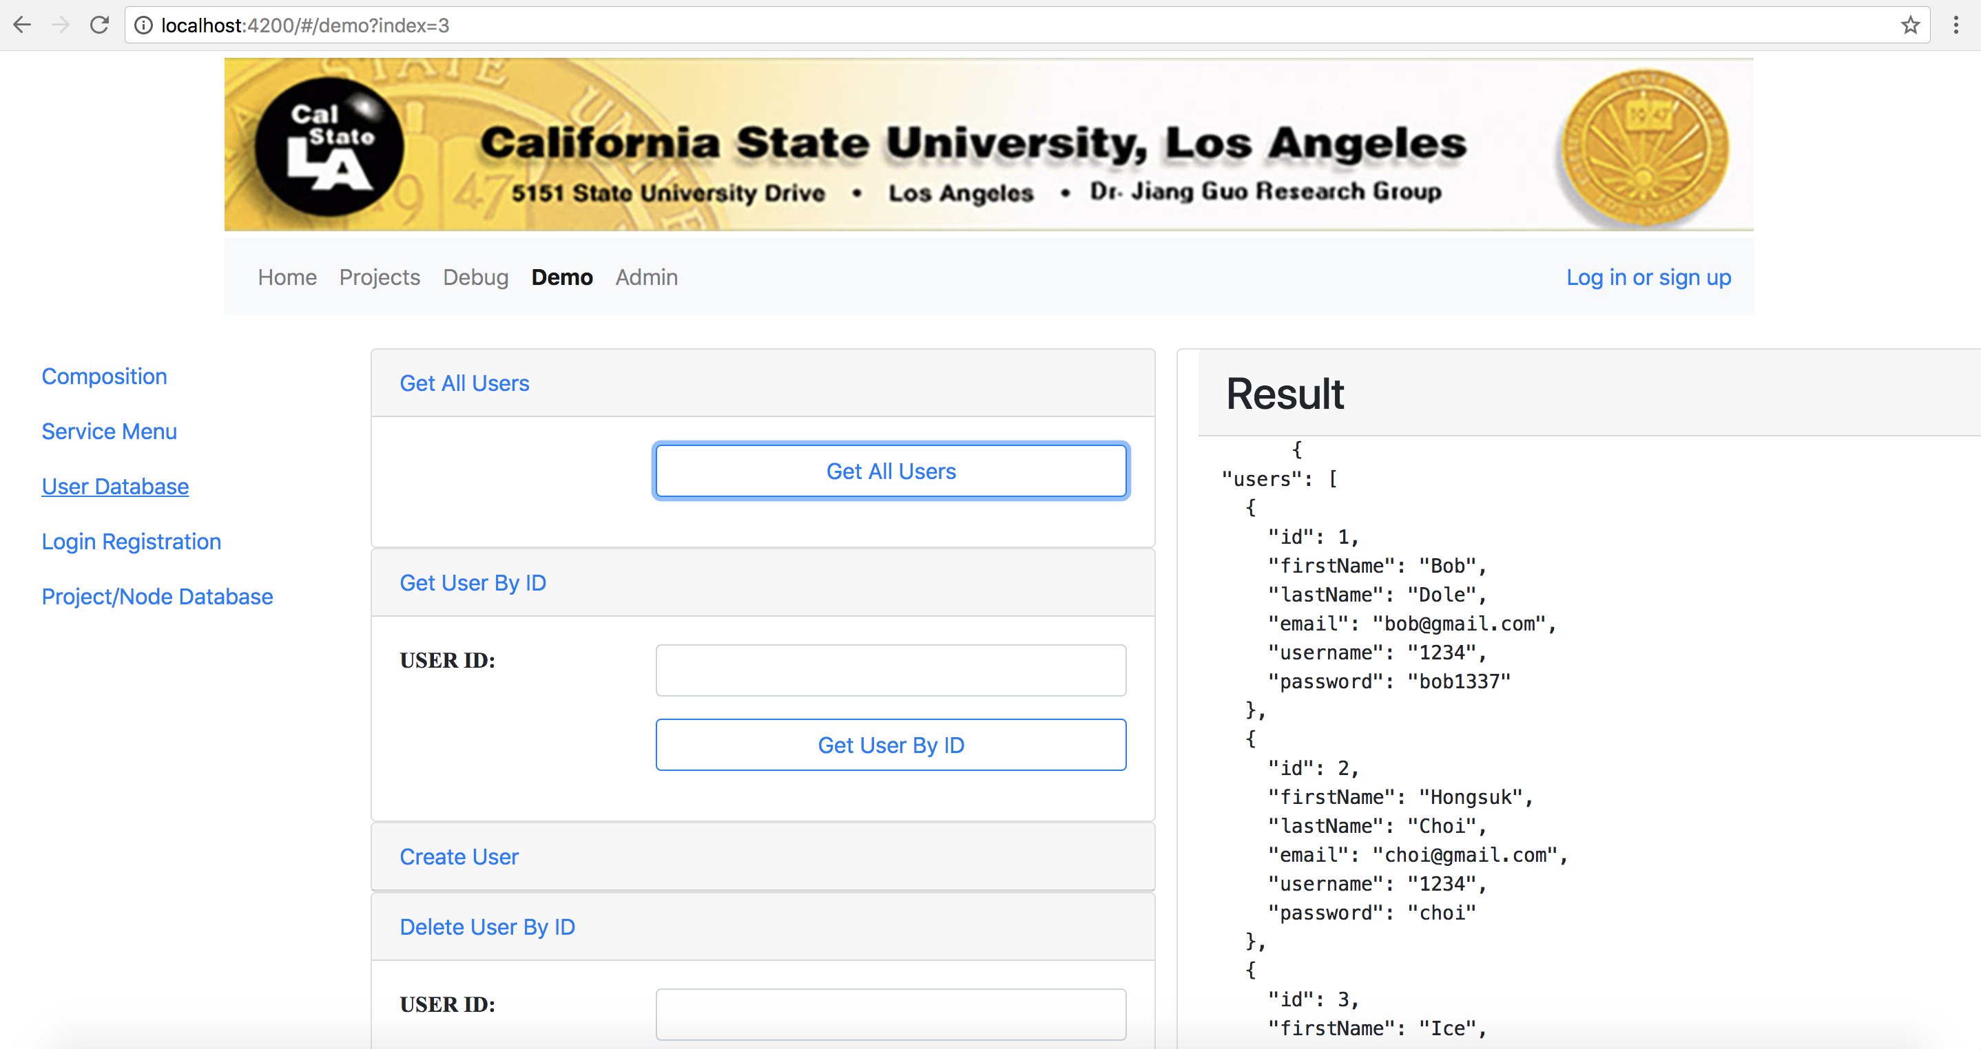

Slide 12
Client-Side of Application
Two Web Portals
Users
Admins
User Portal
Create, Save, Load, Delete, and Modify Projects
View QoS of Projects
Administrator Portal
manage users
view user session times
view user login dates
Notes:
Once a user chooses to load or create a new project, they will be taken to the View Block. Nodes can be created and displayed in the View Block. The View Block displays the nodes depending on the View selected of which the user can choose based on their preference.
The Users will use the major functions of the Tool, which is to create projects to simulate cloud computing. This means the user should be capable of navigating around the web portal and manage their projects as well as being able to execute the project to retrieve relevant information.
However, admins will not be able to modify users' projects or view them. They are only able to manage user data, such as adding new users, editing a user's information, deleting a user, and view details of the user

Slide 13
What is the Visualization Tool for Composition of Cloud Computing Services?
User Portal

Slide 14
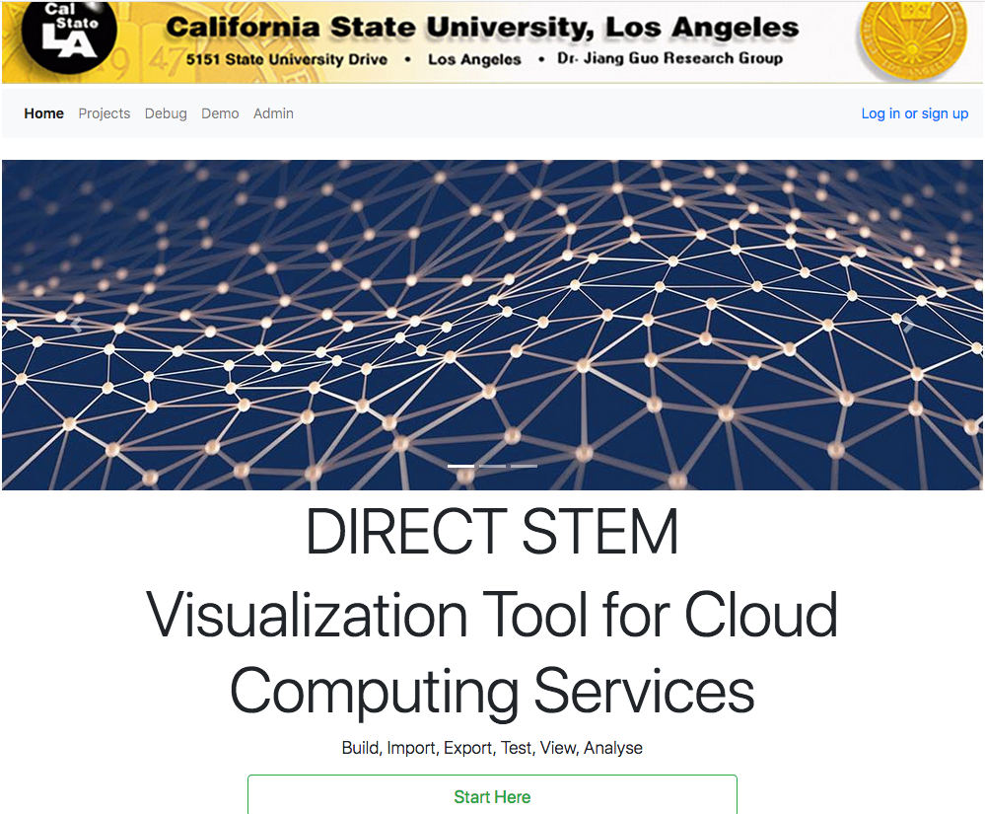
Notes:
At the web portal, the user will be met with a home page where the user may login.

Slide 15
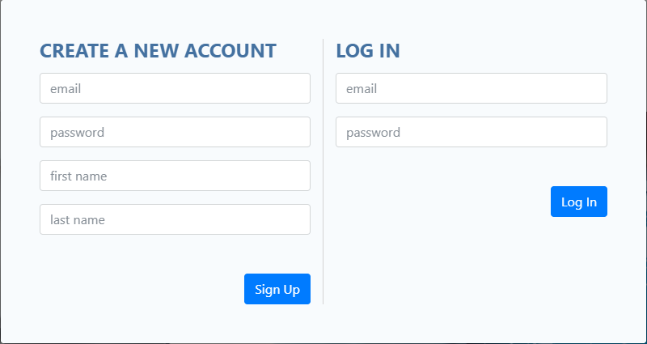
Questions?
Notes:
Once the user clicks the link login/signup, he/she will be directed to the Login Form as shown above. If the user is a first time user, then they may register for an account. User shall provide username, password, and email address. If the user is returning user or has just registered, they may login. This modal will allow the user to input email, password, first name and last name if the user is registering as a new user or can sign in if account has already been created.

Slide 16
What is the Visualization Tool for Composition of Cloud Computing Services?
Administrator Portal

Slide 17
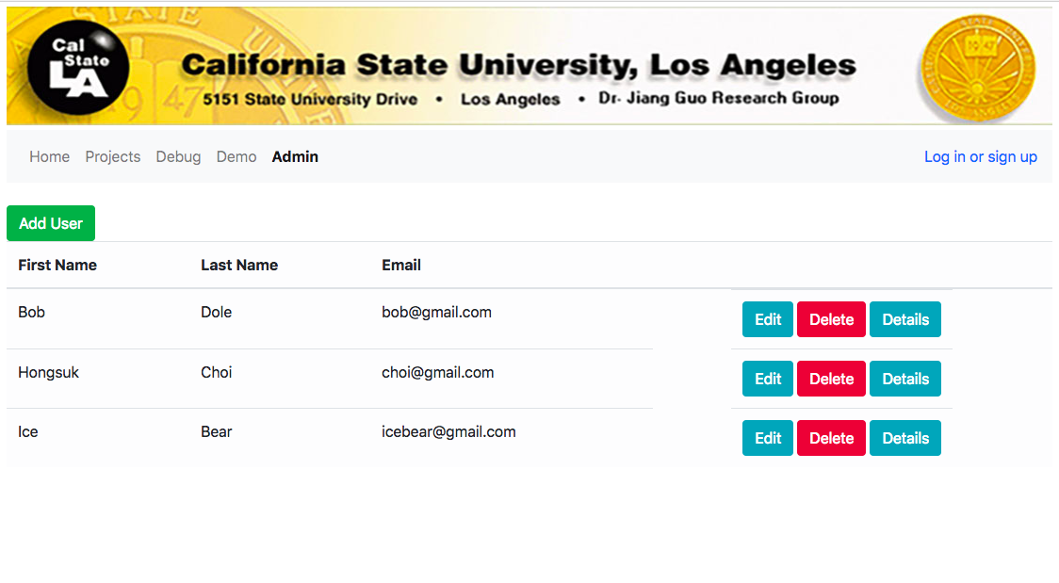
Questions?

Slide 18
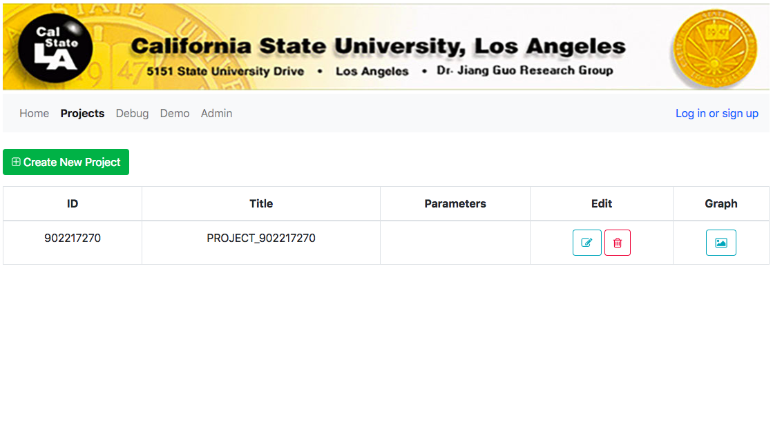
Questions?
Notes:
Once user has logged in, they will be directed to the project list to create or edit existing projects. It will be initially empty if the user is newly registered. User may choose to create new projects, edit existing projects, and view projects.
Users can then analyze projects through graphs. The Graph View will bring the user to the View Block to graphically display their project and allowing the user to edit it.
The Projects menu lets us create a new project. Every new project is assigned a unique id with some default name. Composition of the service is injected by the user. Project can be edited through graphically or through menu options. Debug component allows us to see the nodes in JSON format. It includes information of the node along with its neighbors and child nodes. Demo menu has options to get all the users in the database and delete or modify user if it is needed. This component also lets us register a new user by an administrator.

Slide 19
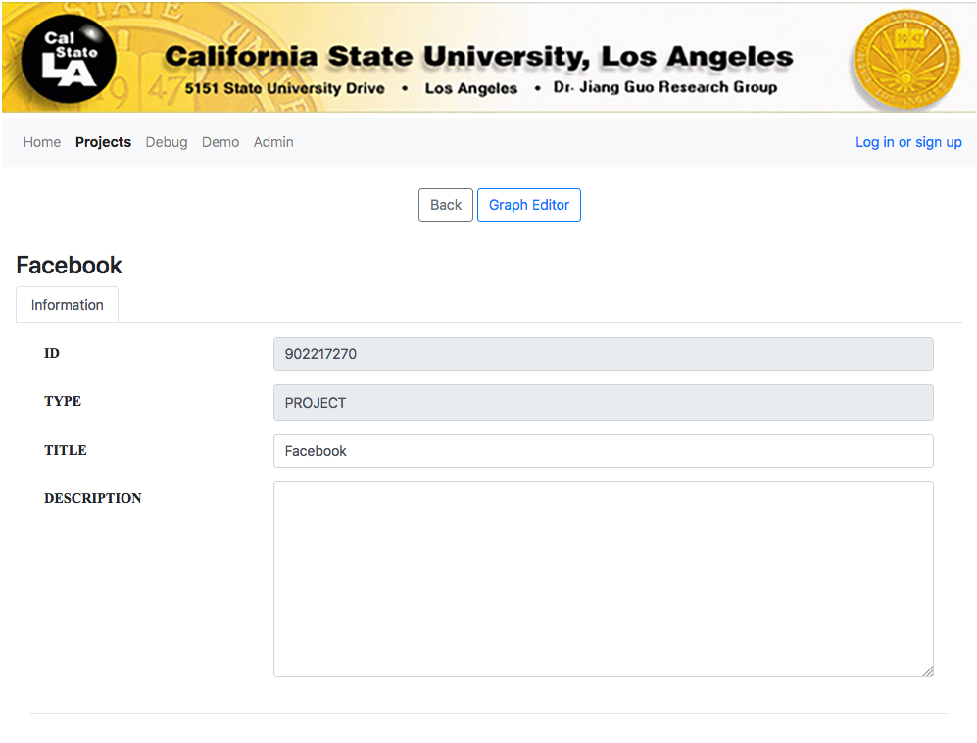
Questions?
Notes:
This is the Editor View in the View Block. Here users may edit their projects by creating, modifying, and deleting nodes. The root node will be displayed by default with its children, or none if it is a new project. The user may right click on the View Block to list out a number of options to choose from.
Run All: All Nodes shall begin calling web services
Insert: Creates a new node in the View Block
Composite: Creates a Node that can be linked to another project of other nodes
Performance: A window will popup detailing QoS information of all the nodes

Slide 20
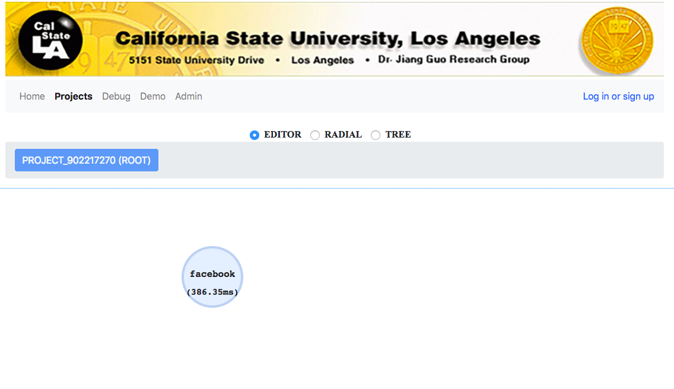
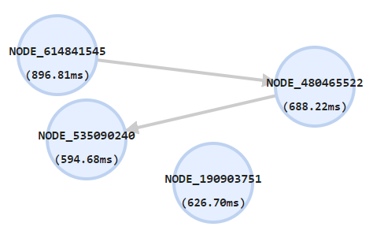
Questions?
Notes:
The first View displays the children nodes of a parent node. The root node is displayed by default. In this View, users can edit and run their projects. The user shall be able to right click an empty spot in the View Block to bring up a number of options, such as creating nodes, or right click on an existing node, if the node has been highlighted, for other options.
Users are able to modify nodes to their preference and how the execution of the simulation would proceed. Users can drag and hold nodes to change its position. If holding shift, users can draw arrows from a node to another node, to indicate that node is outputting to the node the arrow points to. Users may run their projects, or individual nodes, and each node will call the web services and return a response. The time it took to retrieve the response will be displayed on each node.

Slide 21
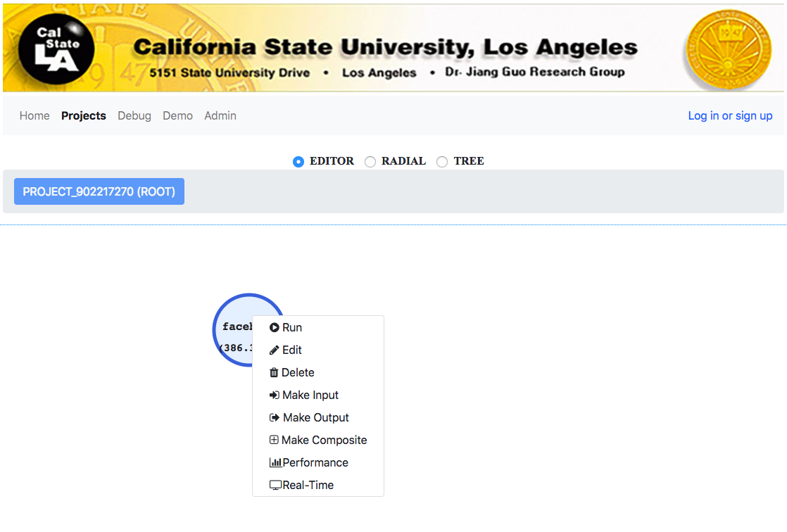
Questions?
Notes:
Clicking a Node will highlight it, indicated by the bolded lines. Clicking it again will deselect it. Once a node is selected, right clicking will display a list of new options pertaining to the highlighted node.
Run: Node shall attempt to run the web service
Edit: An edit window shall appear to allow user to edit Node details
Delete: Will delete Node from project
Make Input: This will specify the node will only take inputs
Make Output: This will specify the node will only make outputs
Make Composite: This will specify the node to be a composition node, allowing the user to link it to another project
Performance: A window will popup detailing QoS information of all this node

Slide 22
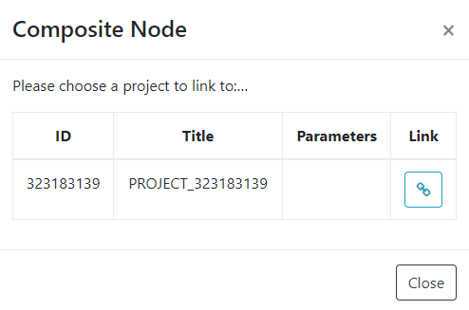
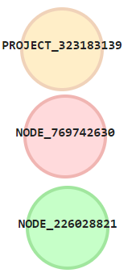
Project Node
Output Node
Input Node
After Linking the Project:
Notes:
A user may create composite nodes by creating a new node or using an existing and linking it to an existing project. A window will open listing all projects that can be linked. Once linked, the node will become a composite node and will display the name of the project. Composite nodes can be treated as regular nodes. A new option will appear when selected and right clicked.
Composition: Nodes within this composite node will be displayed upon the View Block.
Users can also enter into a node by selecting Composition and the View Block will repopulate with the children of the new parent node or it will be empty if parent node does not have children. Users may also determine which composition of nodes can be displayed using the tab above the View Block.

Slide 23
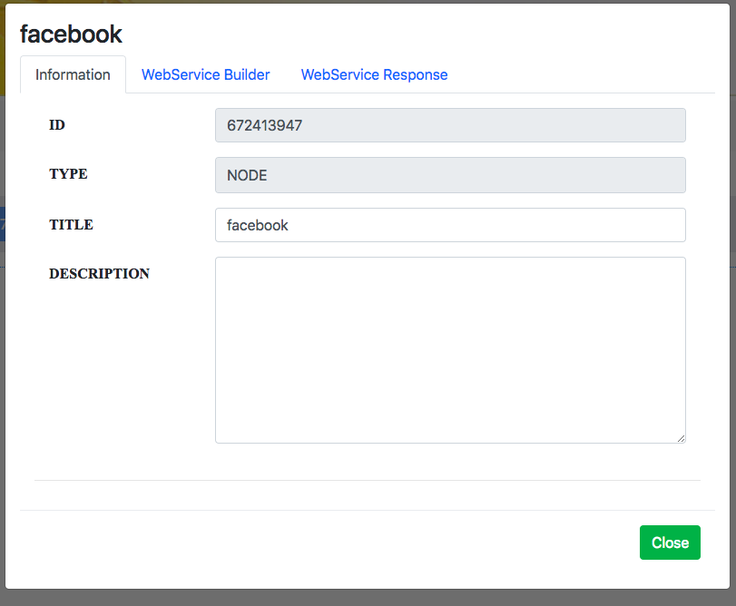
Questions?
Notes:
When creating or modifying a node, the user will be prompted to enter in relevant information in the appropriate fields, such as node title and/or the URL of the webservice.
If a user chooses to edit a node, they will be taken to this page where they may modify node details, add a web service, and analyze responses.
Information
ID: The ID of the node, cannot be edited.
TYPE: The type of node
TITLE: Name of node
DESCRIPTION: A text block describing the node

Slide 24
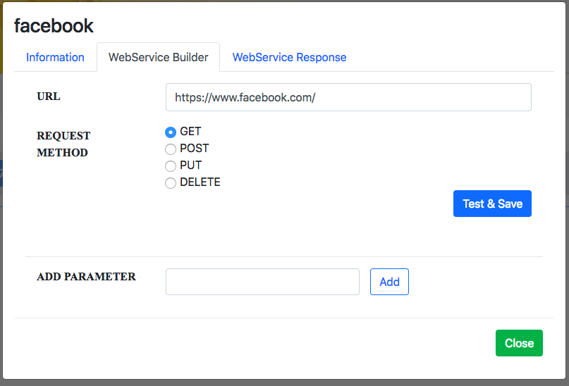
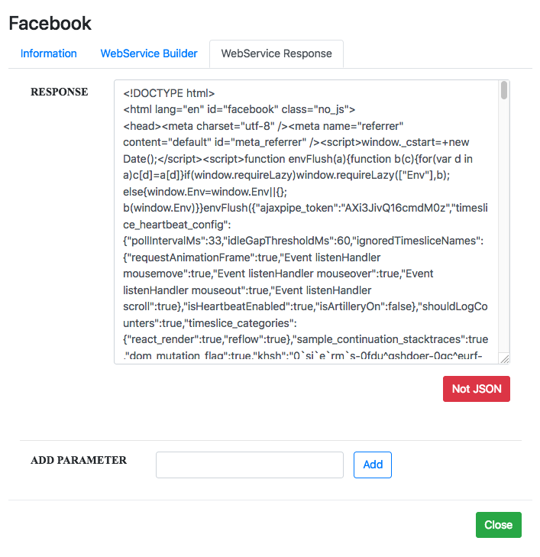
Questions?
WebService Response
WebService Builder
Notes:
Once a user run their project, the nodes will attempt to establish a connection with a webservice using the URL the user would have provided. It will return a response, depending on the parameters set by the user, and the node shall display the time it took to retrieve the response and will determine whether the response is valid JSON. Google Gson is a dependency to convert a class into a JSON message to the RESTful functions. If this library were to declare deprecated functions we would need to update the backend functions.
WebService Builder
URL: The URL of the web service to be tested
REQUEST METHOD: The type of method specified for the URL
ADD PARAMETER:
Input that can be sent along with the URL to the web service
Can be specified to receive output from other nodes
WebService Response
RESPONSE: The response received from the web service
determine if web service response is valid JSON or not

Slide 25
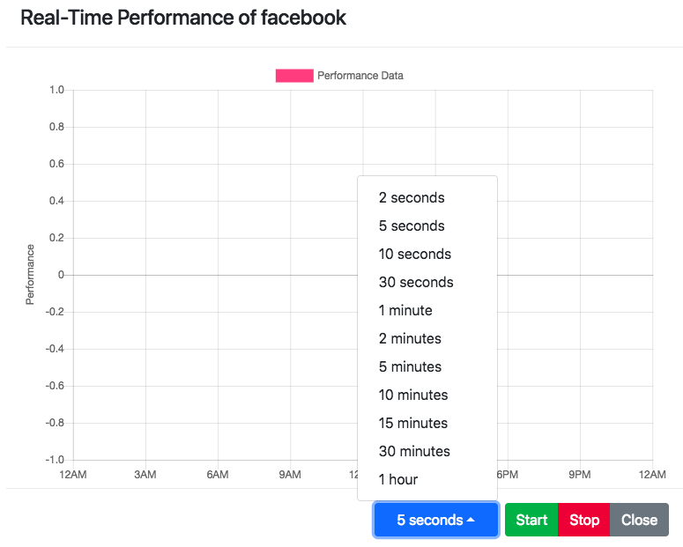
Questions?

Slide 26
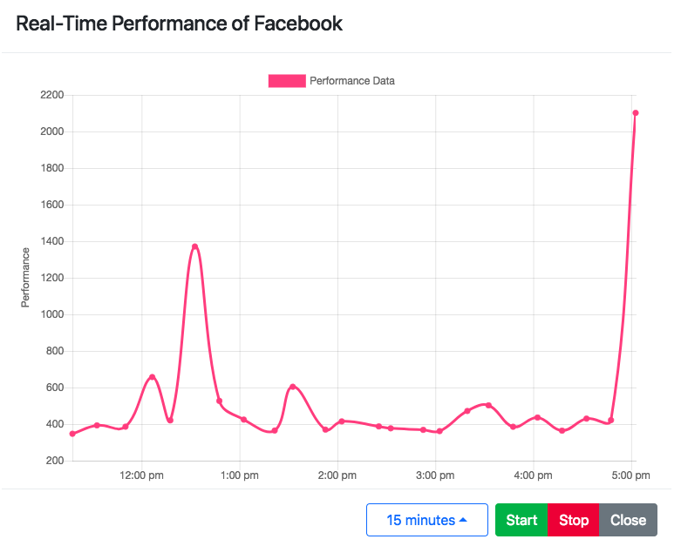
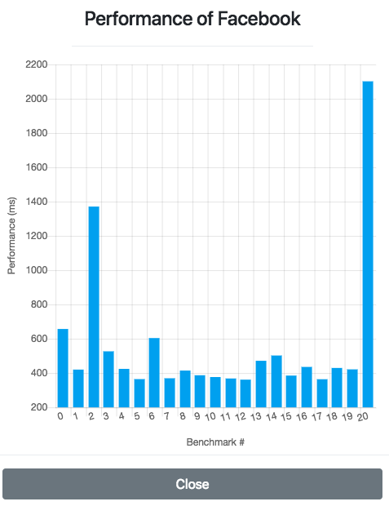
Questions?

Slide 27
What is the Visualization Tool for Composition of Cloud Computing Services?
Server-Side of Application

Slide 28
Backend
Implemented MySQL Database Schema
Learning Angular to connect backend to frontend
REST web services
CRUD operations in Angular
Implemented/Modified Node classes and other Java code

Slide 29
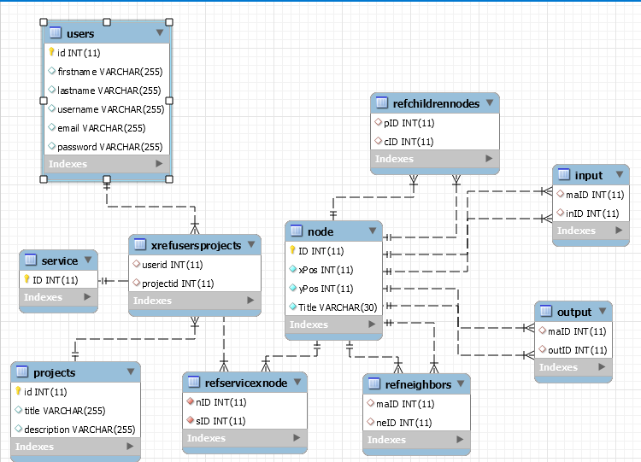
Old Database EER Diagram
Notes:
On the server side of the application
USERS: The user shall store their account information on the database.
SERVICE: Users shall store URL addresses to external Services on the database.
PROJECTS: Users shall store project hierarchies on the database..
NODE: Users shall store nodes which represent services on the database.
INPUT: Users shall store Inputs required by services on the database.
OUTPUT: Users shall store Outputs required by the tool on the database.
XRefUsersProjects: Users shall store projects associated with their account on the database.
RefServiceXNode: Nodes shall be stored with information about the service they represent on the database.
RefNeighbors: Nodes shall be stored with information about other nodes it interacts with.
RefChildrenNodes: Nodes shall be stored with information required by other nodes.

Slide 30
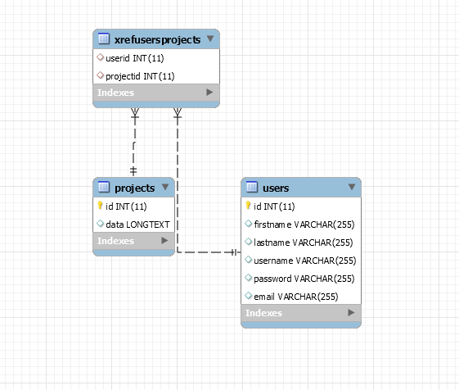
New Schema
Notes:
On the server side of the application
USERS: The user shall store their account information on the database.
SERVICE: Users shall store URL addresses to external Services on the database.
PROJECTS: Users shall store project hierarchies on the database..
NODE: Users shall store nodes which represent services on the database.
INPUT: Users shall store Inputs required by services on the database.
OUTPUT: Users shall store Outputs required by the tool on the database.
XRefUsersProjects: Users shall store projects associated with their account on the database.
RefServiceXNode: Nodes shall be stored with information about the service they represent on the database.
RefNeighbors: Nodes shall be stored with information about other nodes it interacts with.
RefChildrenNodes: Nodes shall be stored with information required by other nodes.

Slide 31
Data Collection
Want to detect QoS of Webservices
Collected Data from popular sites e.g. Facebook, Google, Amazon, etc.
Test Period:
Every 15 minutes for 24 hours
10 sites per person

Slide 32
Stats
Twitter
Performance, Runtime
Amazon
Performance, Runtime
DigitalOcean
Performance, Runtime
Notes:
Stats for the digital services offered by the biggest companies

Slide 33
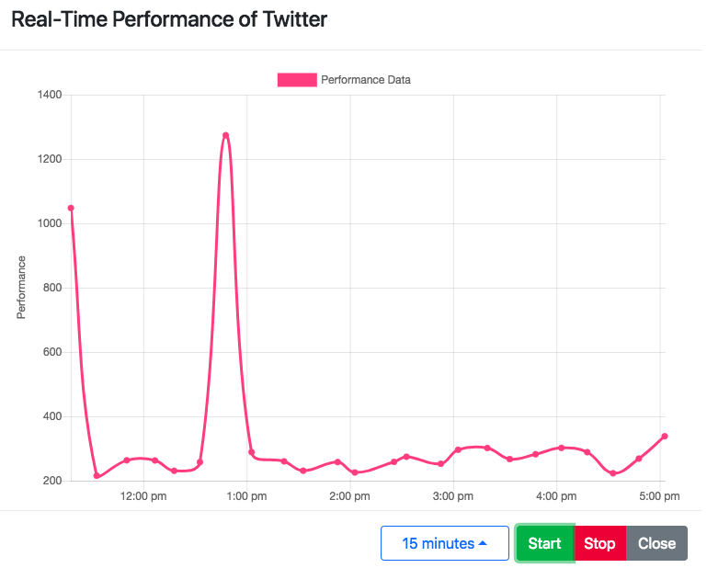
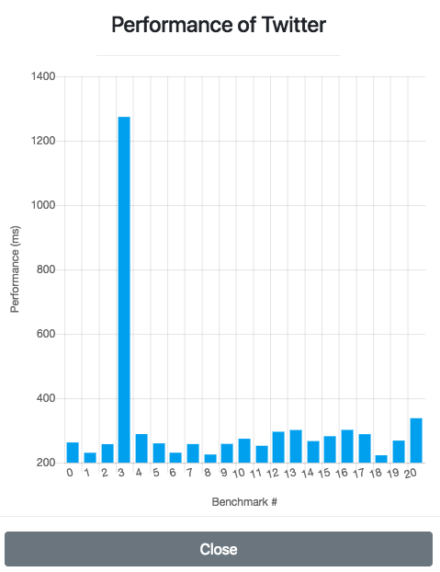
Questions?
Notes:
The Internet is a constant constraint as the Tool needs to be connected to use web services and to communicate with the server side functions. This is crucial as it is the only way to accurately simulate cloud computing as well as store and load information from the database.
detail the QoS data of the selected node to the user.

Slide 34
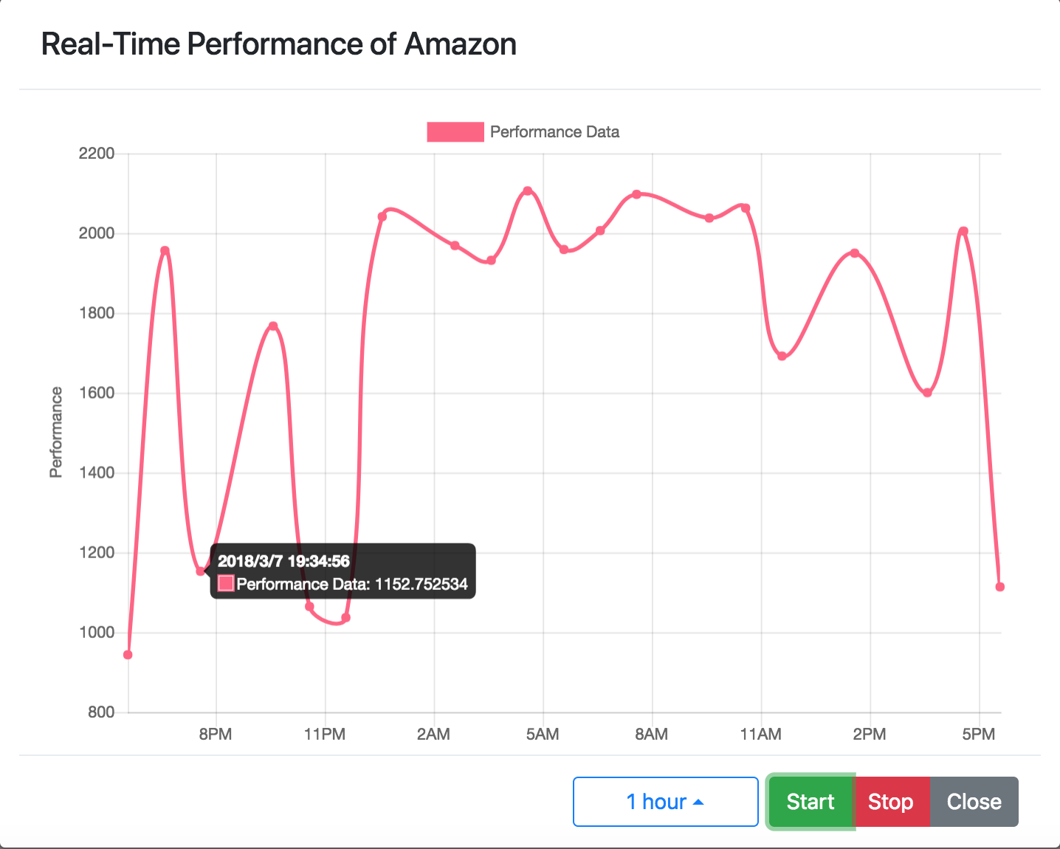
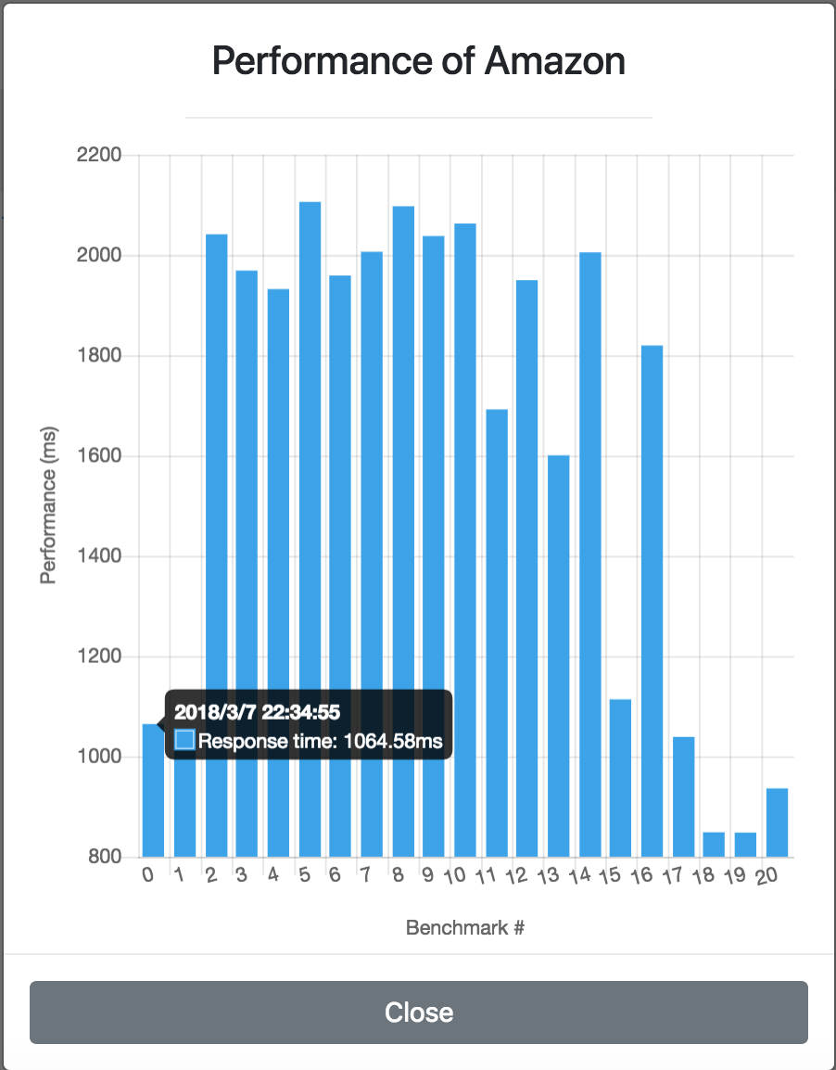
Questions?
Notes:
detail the QoS data of the selected node to the user.

Slide 35
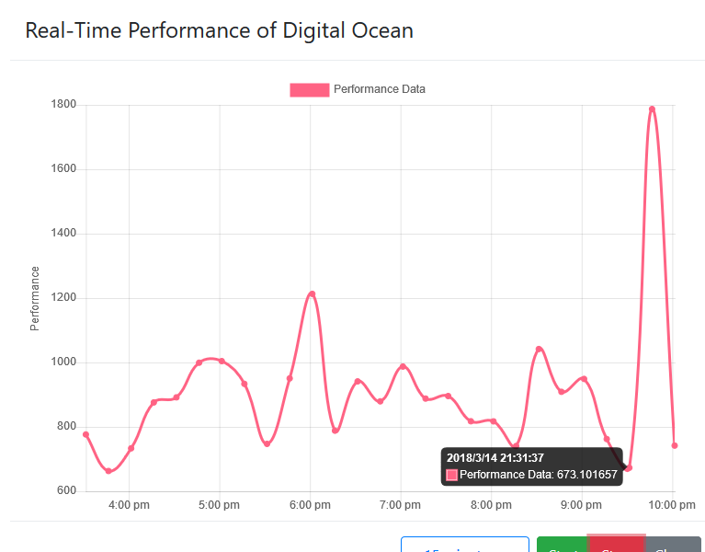
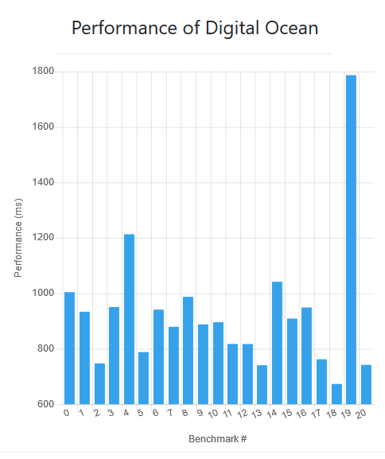
Questions?
Notes:
detail the QoS data of the selected node to the user.

Slide 36
Comparison
Can compare two nodes
Option to select nodes for comparison
Real-Time Performance Graph
Tested 4 sets
CognitiveScale & Oracle AI
Facebook, Twitter & Instagram
AWS, GitHub & Digital Ocean
OneDrive, Dropbox, iCloud & Google Drive

Slide 37
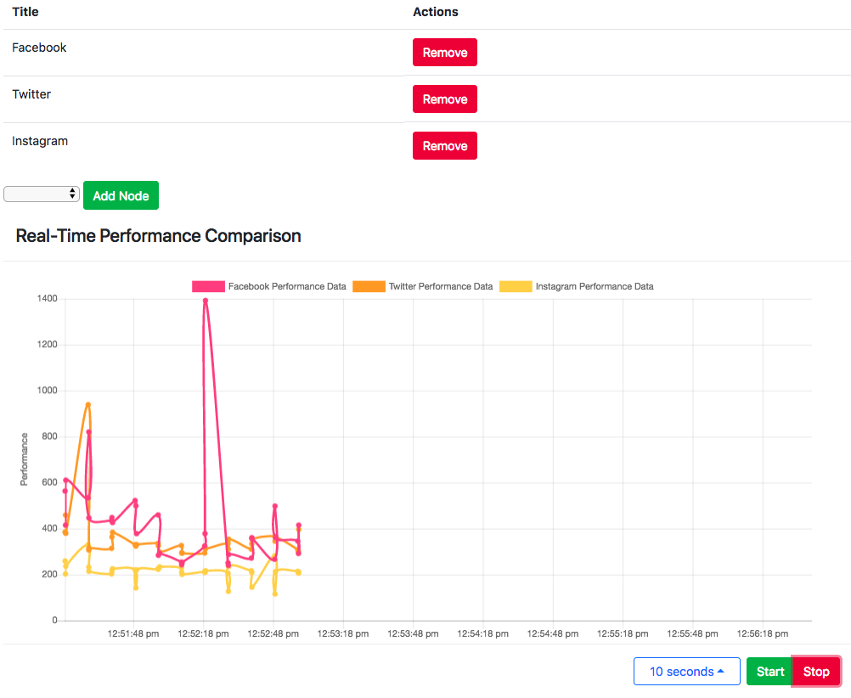
Questions?

Slide 38
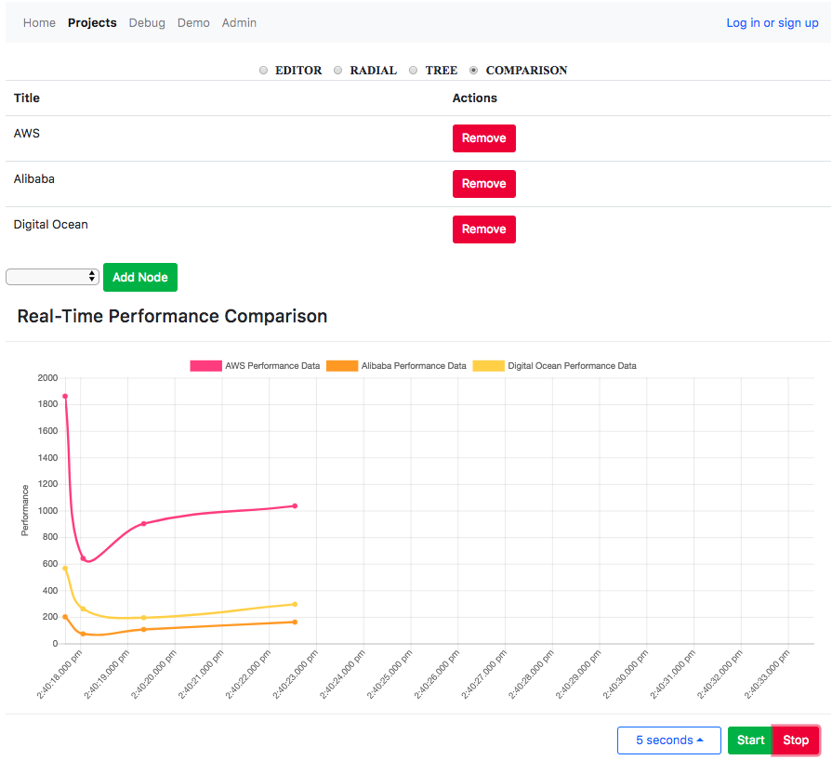
GitHub
Questions?
GitHub Performance Data

Slide 39
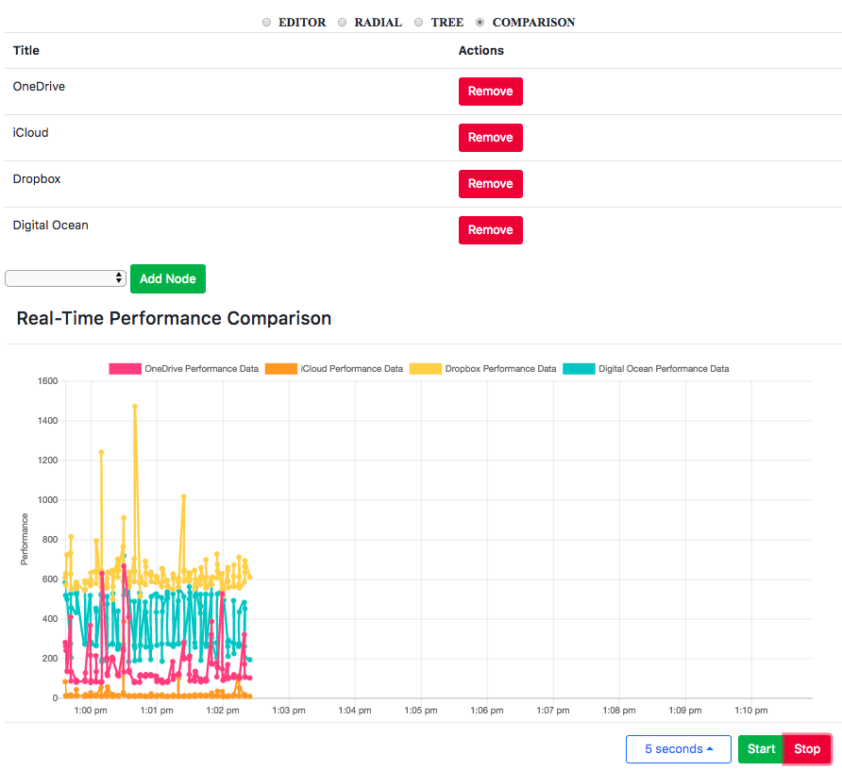
Google Drive
Google Drive Performance Data

Slide 40
Result
Retrieve Real-Time Data
View Performance Chart for Web Services
Compare Multiple Web Services with Real-Time data collection
Notes:
The purpose of this project is to retrieve real-time data of different websites with certain time intervals and visualize them in a chart. This project is capable to compare the multiple web services with real-time data. Collected data is analyzed and make an informed choice. As we know in today's world data carry a lot of importance. Analyzing, manipulating, and visualizing the data has a tremendous potential in any sector to prosper.

Slide 41
Project Challenges
Depending on Third-Party Webservices
Results rendered
Internet Connection for Data Collection
Loss of Data
Data Errors
Longer to Collect Data
Notes:
Since we are depending on third party web services a constraint is the result these external services render. External services have different ways of presenting information and a potential problem will be extracting only the information crucial to the execution of this project.
Every action using the Tool should have no delays, and operations involving the database should be performed in less than 5 seconds.
If there is a problem with internet connection, there may be potential of data loss or errors when attempting to execute projects.

Slide 42
Future Plans
Improve database schema
Authentication
Fix Minor Bugs
Notes:
As we all know developing any software comes with the price. The most important price we have to keep in our mind is maintenance. Obviously we are reluctant to use software which are not well-kept and upgraded periodically. So, in near future our plan is to improve database schema to fit with the upcoming nature of data. Authentication is another topic we will be looking into rigorously as security flaw comes really handy to bring our server down by hacker if poorly maintained. Fixing bugs is always there in every step of the way so debugging is crucial.

Slide 43
Questions?
Notes:
This concludes our presentation. We will be taking questions now.

