Slide 1
Improve the WiFi Coverage and Quality in Cal State LA
Daniel Xu
Steven Castro
Albert Ting
Jorge Lima
Paul French

Slide 2
Acknowledgements
Advisor
Dr. Guo
Liaisons
Mr. Jason Solis
Mr. Michael Lee
Mr. Edmund Gean
Cal State LA Computer Science Department

Slide 3
Agenda
Introduction
Difficulties
Requirements
Frontend
Backend
Test
Demo
Future Work

Slide 4
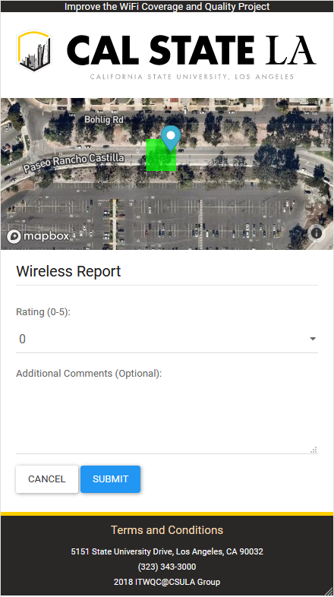
Introduction
WIFI is important to us as students
Problems at Cal State LA
Blind spots, Poor speeds, Connection issues
Eg. Salazar Hall, Food Court
WIFI Reporting Application (GETmobile)
Collect data such as:
Geolocation, Ping, Header Information, time
Implement a database to store data
Visualize this data

Slide 5
Introduction cont.
How will our project improve the WIFI
Identify trouble areas
Improve user experience
Optimizing infrastructure
Mission Statement:
Help ITS identify and reduce problematic WIFI areas by collecting and analyzing user submitted data, thus improving the WIFI coverage and quality here at Cal State LA

Slide 6
Project Requirements
As stated in the introduction we needed a way to easily track problem areas. The simplest solution was to develop an application that most students would be able to access.
The application initially needed to:
Track your location through taking the current wifi access point’s location to see exactly where the issue is at.
Display information related to internet speed (ping, download speed, upload speed).
Be a native application for IOS and Android to collect additional statistics to help the user fill out the form automatically depending on where they were at.

Slide 7
Project Difficulties
Developing two native applications ended up becoming a problem due to:
Budget (lack of IOS devices and Developer license).
Time
Experience
Advertising campaign for users to download a seperate application to report WiFi outages.
Lack of IOS version means we will lose most users.

Slide 8
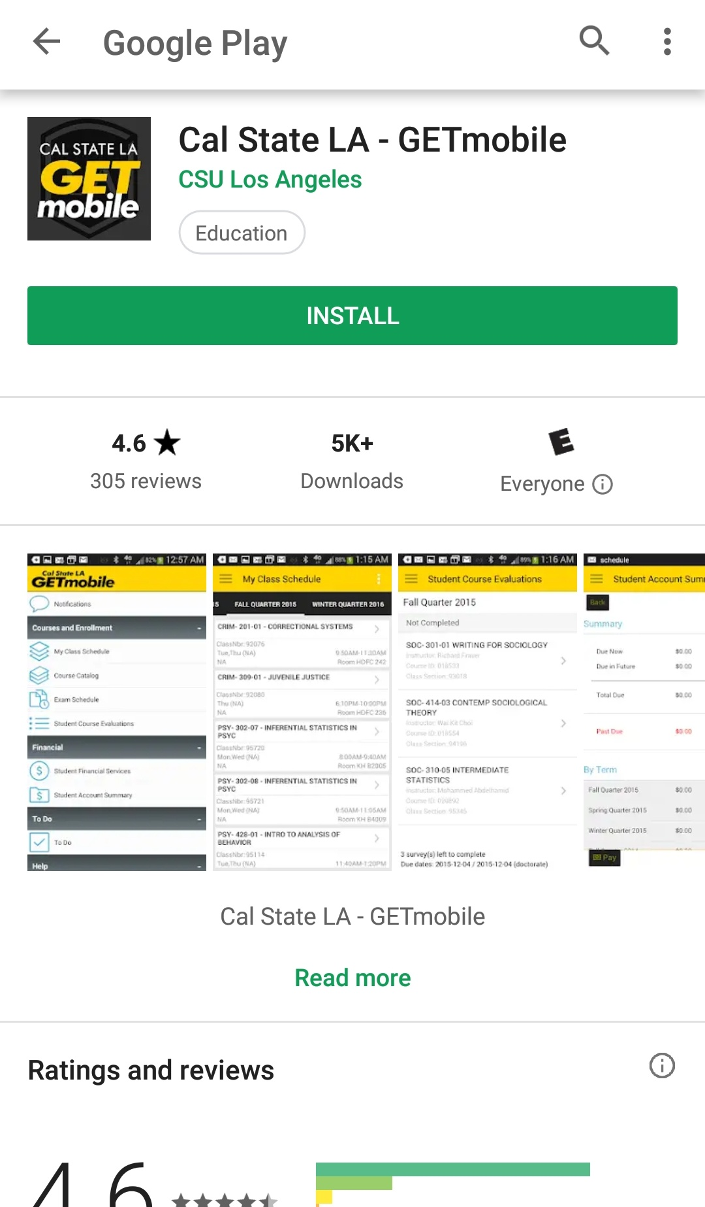
Project Requirements
Going native ended up having more cons than pros.
We ended up deciding on prioritizing reach over accuracy.
The new application was to be implemented onto the CSULA’s GETmobile application.
Implementation restriction meant application had to be web-based.

Slide 9
Project Requirements
After deciding on the platform we were able to decide on project requirements. Some of the main ones were:
The server for the database and the website are to be seperate.
PhP prepared statements to protect against SQL injection.
Mobile view optimization.
‘Heatmap’ to view problem areas around user.
Form to report wifi outage with hidden prefilled data.
Backend to view raw data and report statistics.

Slide 10
Core Features
Provide a link to the application within the CSULA GET mobile app.
Show a ‘heatmap’ of reported Wi-Fi outages within the CSULA campus.
Provide a form for a user to report a Wi-Fi outage within CSULA. The form will have been partially completed if location (via GPS) is given permission by the user.
Backend view for viewing report raw data and statistics.

Slide 11
Front End
Created with PHP and JavaScript
PHP
Prepared statements
Javascript
Autofill fields
APIs
HTML5 Geolocation
GPS coordinates(if available), otherwise wi-fi + cell tower
Mapbox
Highcharts
Scripts
Latency

Slide 12
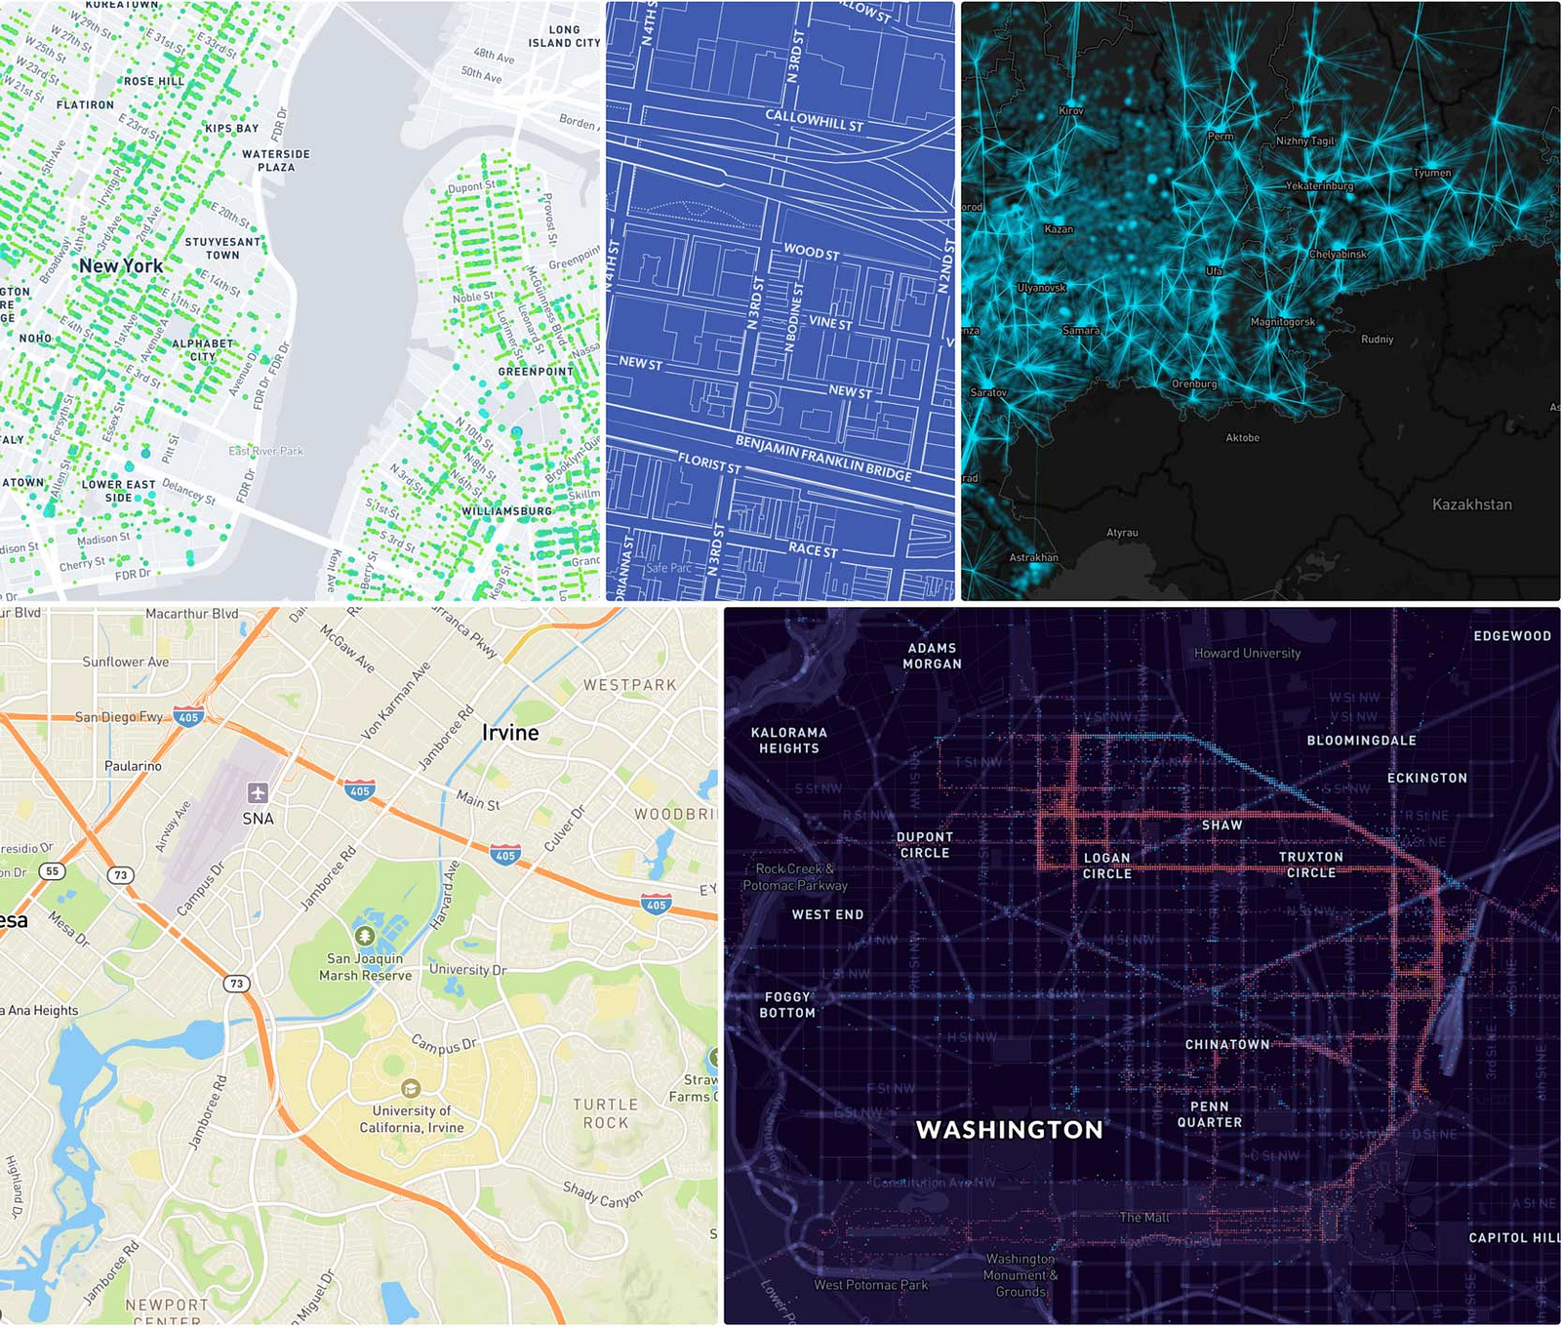
Mapbox
Location data platform for mobile and web applications
Provides the tools needed to create custom maps and layers
API Utilization
Map and location rendering
Heatmap layer

Slide 13
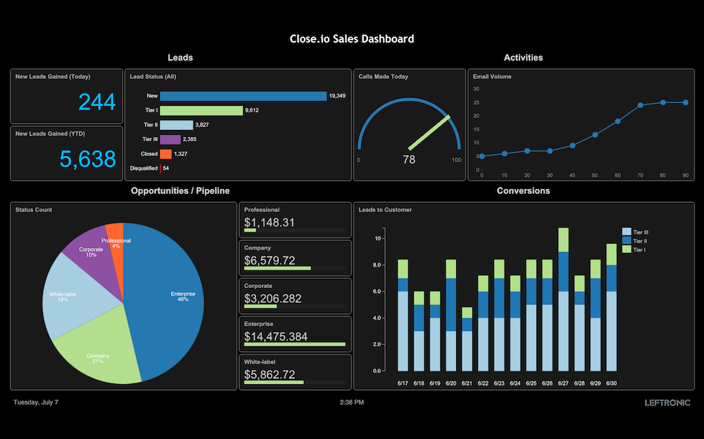
Highcharts
Charting library written in JavaScript
Offers a way of adding interactive charts to websites, web and mobile applications
API Utilization
Graphically represent data from user submitted reports

Slide 14
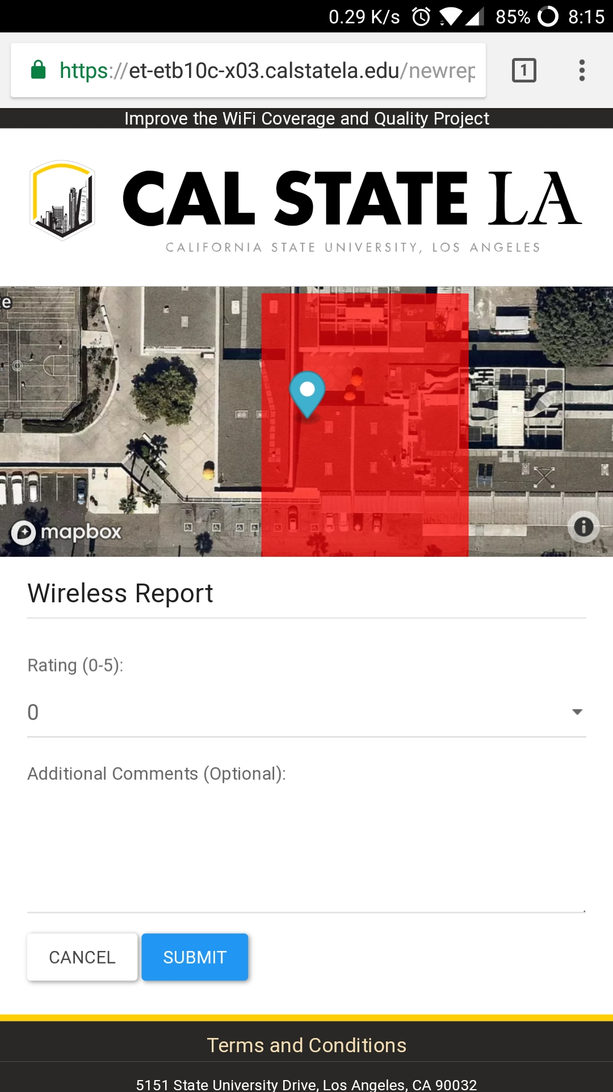
Front End (User)
Web application
Integration with Cal State LA’s GETmobile app
Allows the user to report the status of their Wi-Fi connection
The map shows the user’s location and the current Wi-Fi quality of the user’s zone

Slide 15
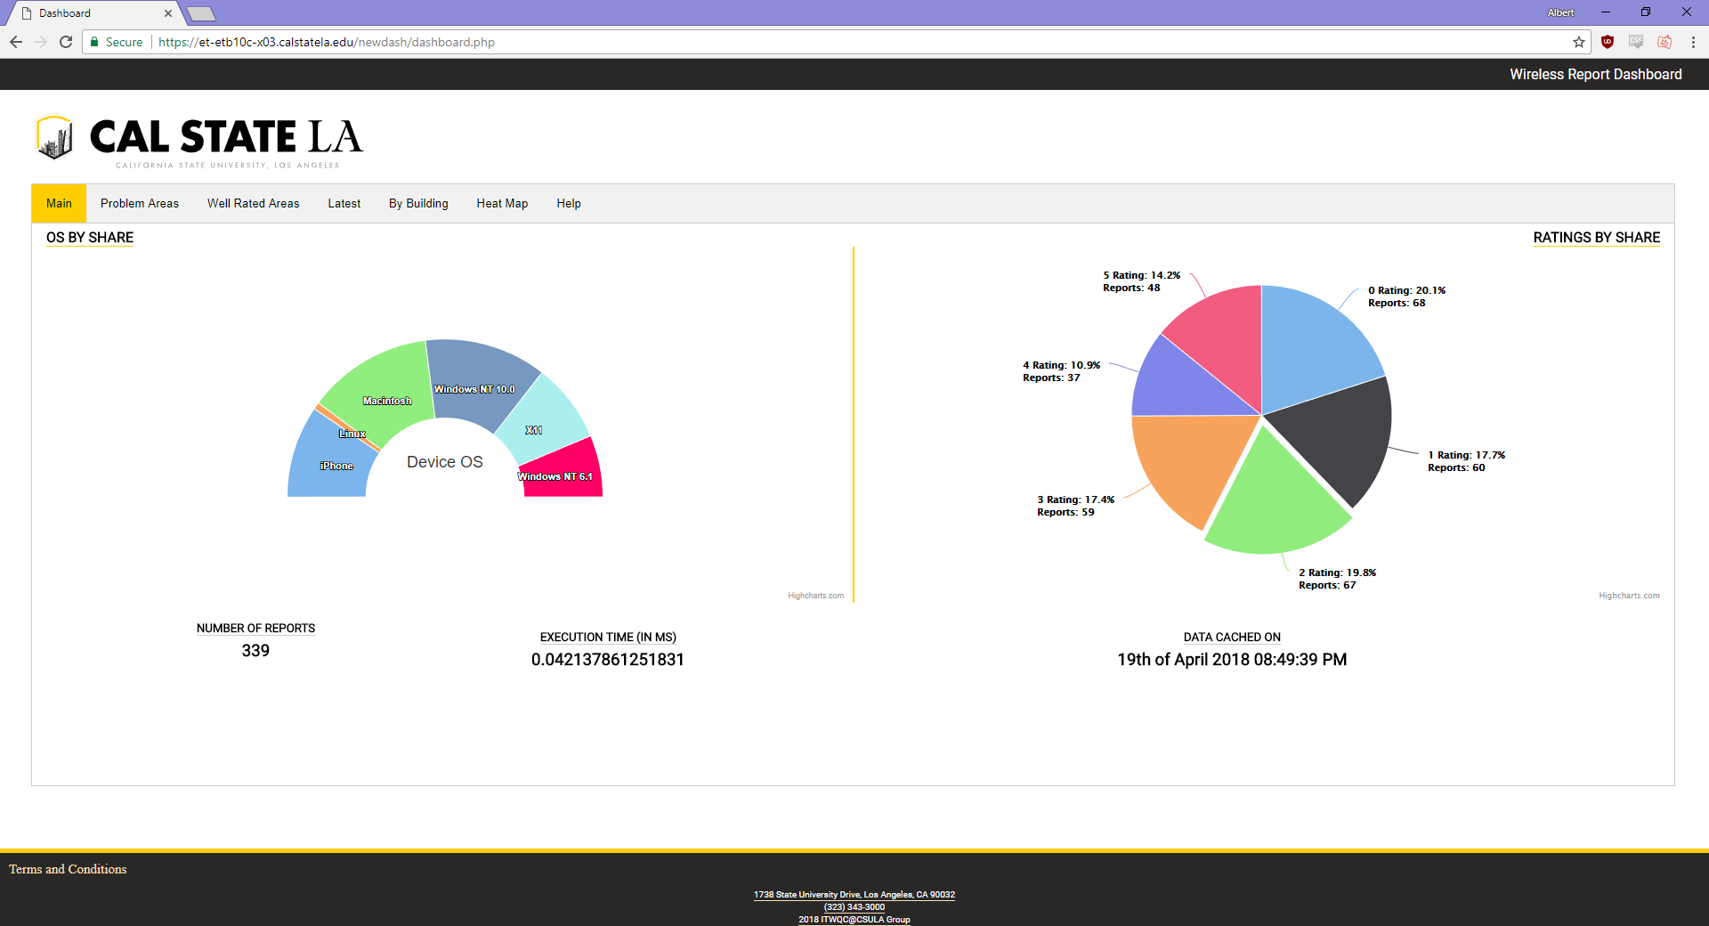
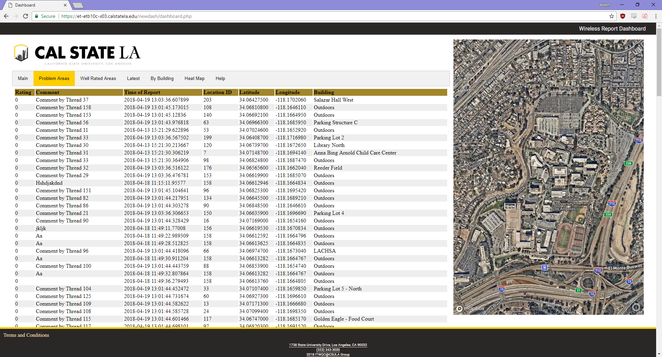
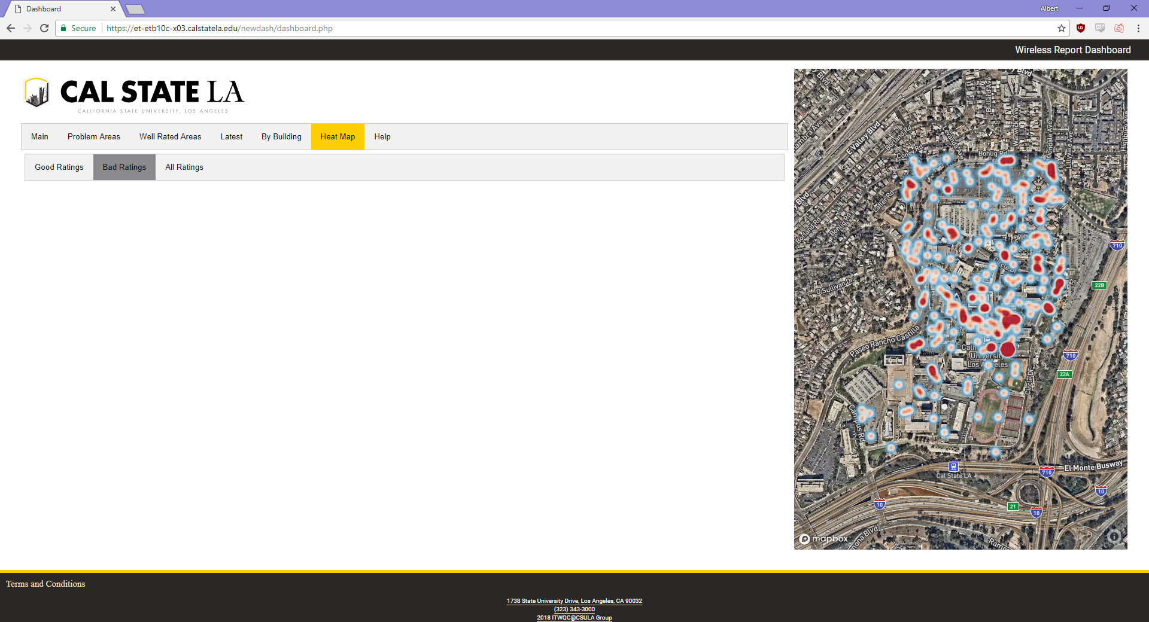
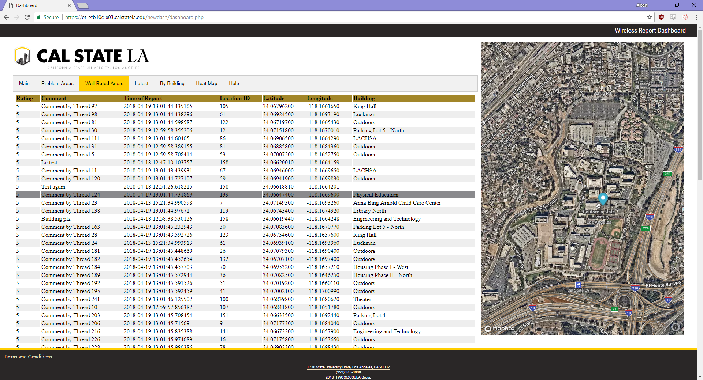
Dashboard

Slide 16
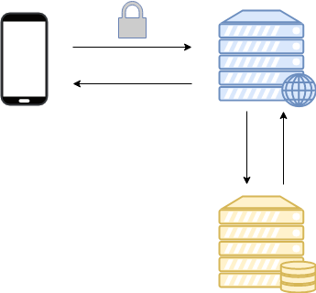
System Architecture
2 servers running on campus
Dependencies
Ubuntu 16.04 Base Install
Apache
PHP
PostgreSQL
Memcached

Slide 17
Back-end
Web server
Serving both web applications with Apache
HTTPS setup for secure reporting
Memcache to lessen load on database server
Database server
Separate machine running PostgreSQL
Meant to separate running webserver from database in case of intrusion

Slide 18
Information Gathered
Sandboxing restricts amount of information that can be gathered.
User fills in:
Rating and optional comment
Gathered automatically on submission:
Time of report
Geolocation
Ping, User Agent, and IP Address

Slide 19
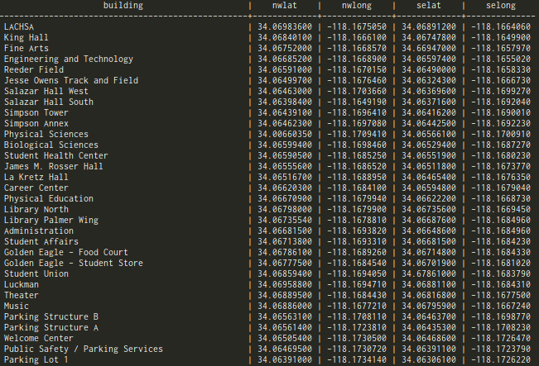
Geolocation Problem
We can get user’s geolocation in their report with HTML 5 APIs
How do we use it to help pinpoint problem areas on campus?

Slide 20
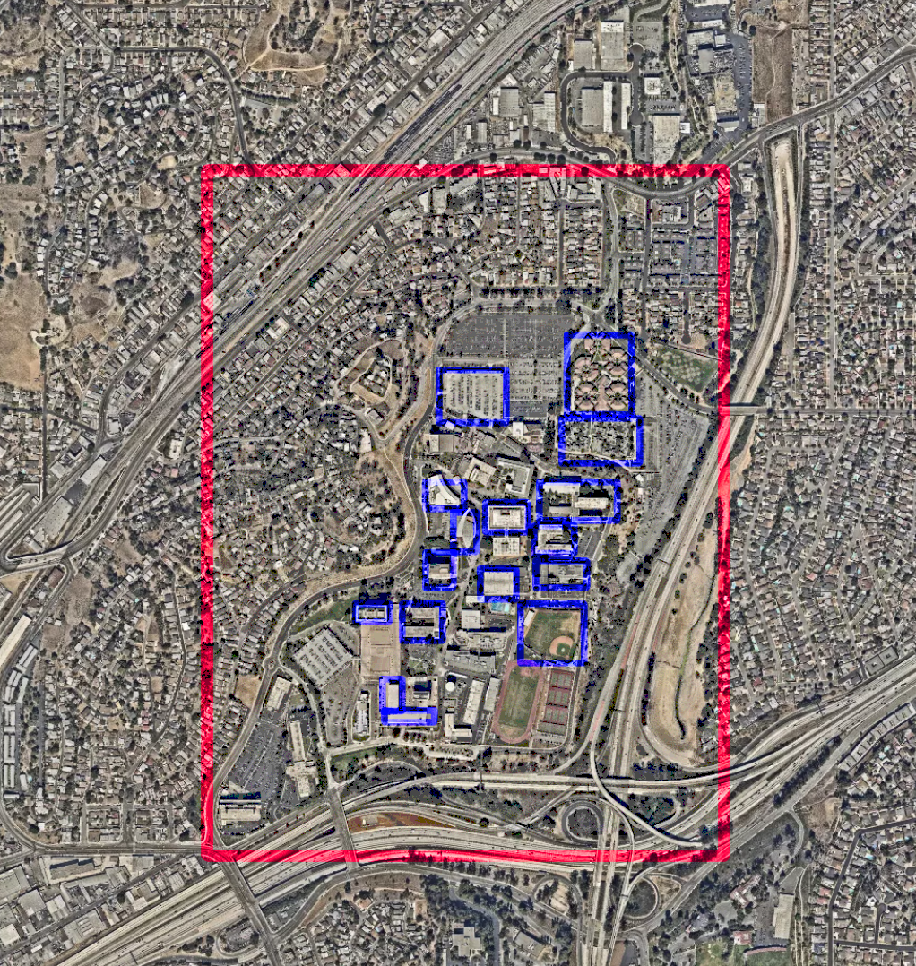
Geolocation Solution
Cut up map into two layers
One outer uniform layer into a grid with 300+ boxes
One inner layer solely for known buildings
Helps in keeping reports only if they come from campus
Helpful in keeping track of building rating averages
Once gathered by hand, shouldn’t change at all.

Slide 21
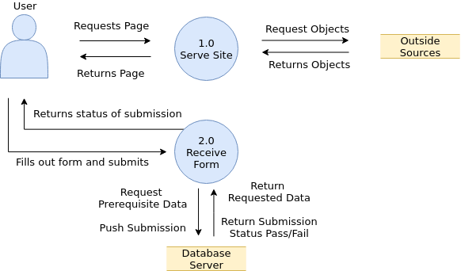
Data Flow at Report Page

Slide 22
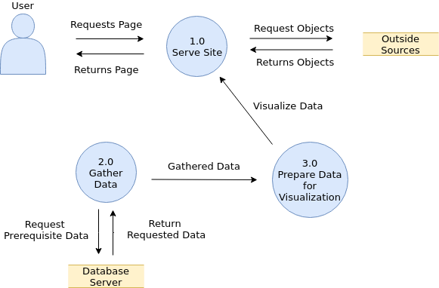
Data Flow at Dashboard Page

Slide 23
Stress Testing with JMeter
Apache JMeter is an open-source Java application that creates load tests.
It is used to test the integrity and performance of Web Applications
Acts as a browser to bombard the application with requests in order to test server load
Our Server Test Statistics for 20,000 Samples

Slide 24
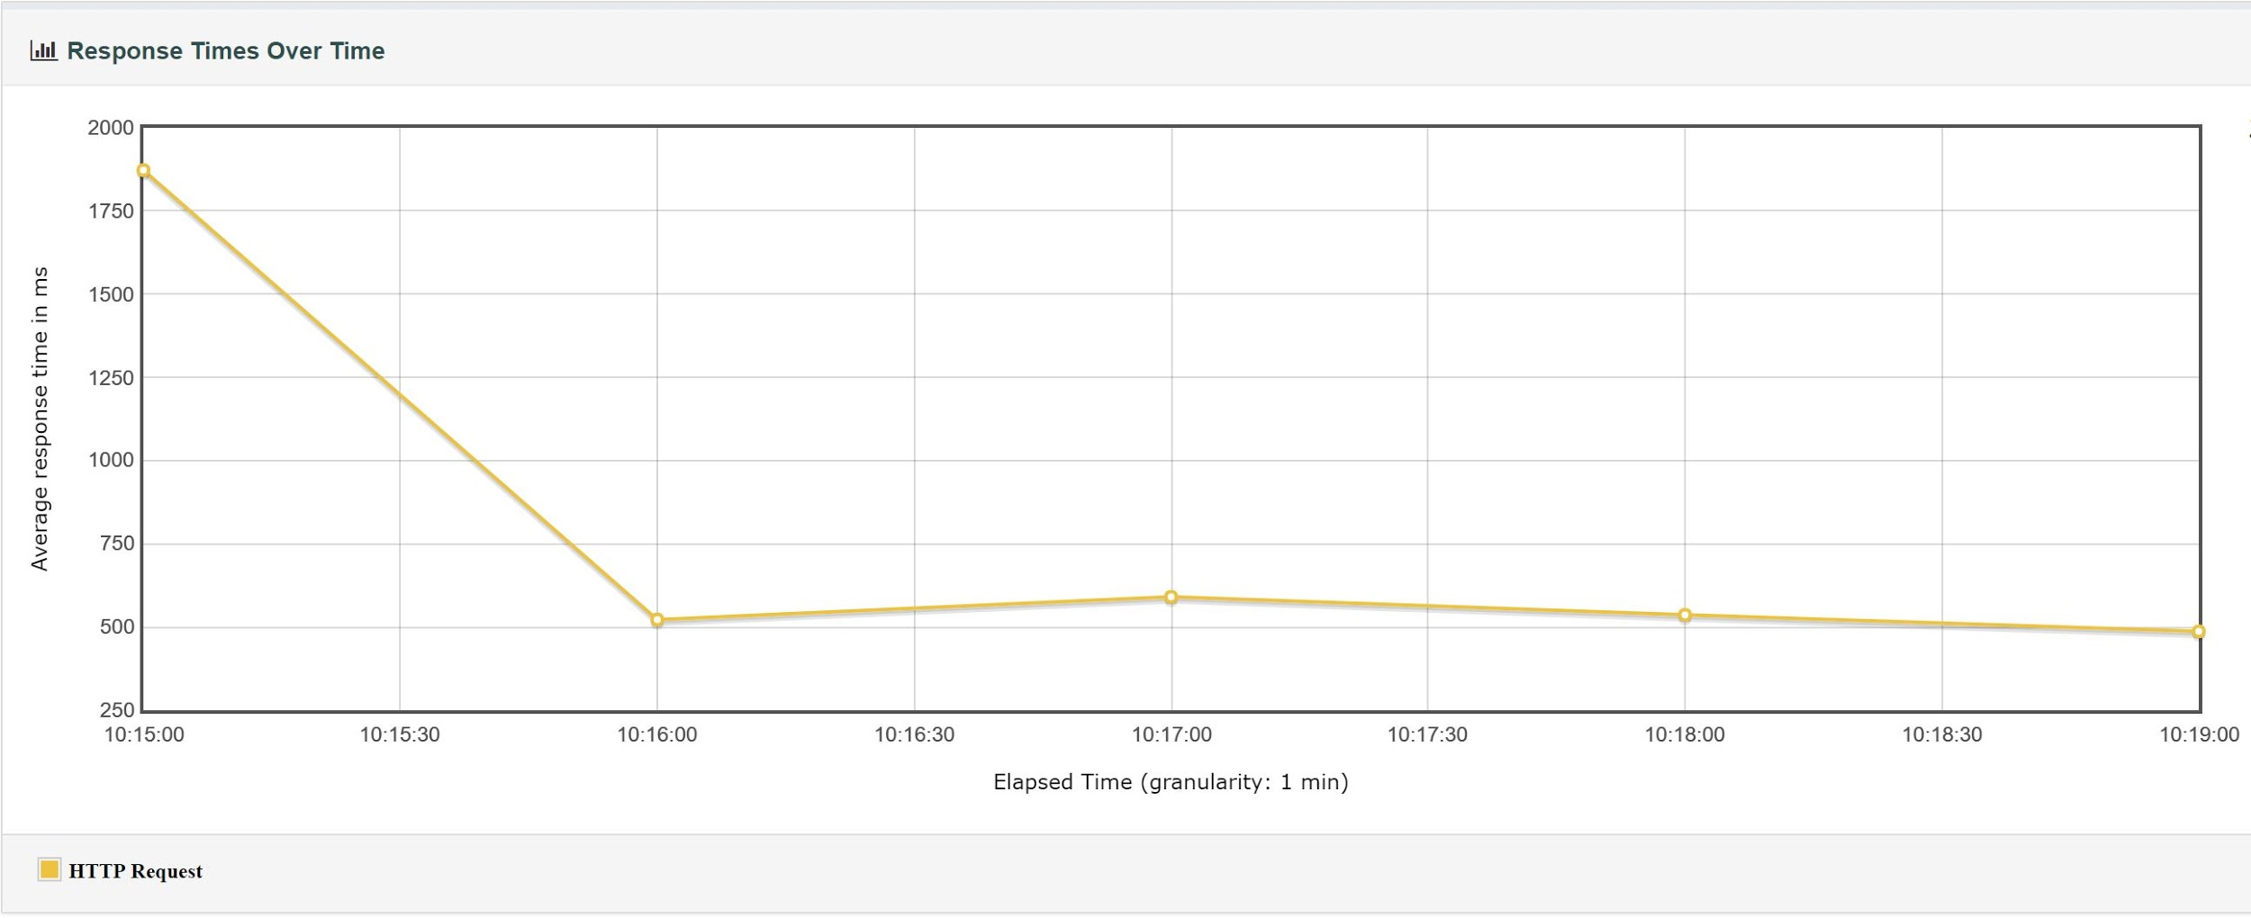
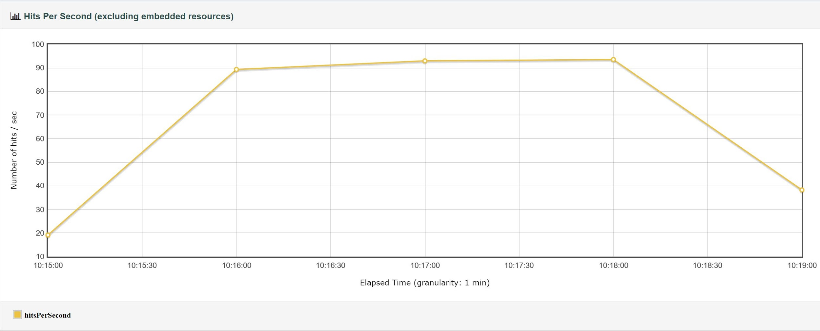
This chart shows the response times of the test across the entire time of the test
This chart shows the number of hits per second across the entire time of the test

Slide 25
Demo
Report Dashboard

Slide 26
Future Work
Implement IP Location Based on ITS Access Point Database
Pop-Up Window to Inform Users Off-Campus That Their Report Will Be Discarded
Load All Rectangles in the Report Map so Users Can Find Locations with Better Wi-Fi
Limit the Map Rectangle Colors to the Last 50 Reports or the Last 24 hours
Create a Backend for ITS That Allows Them to Report Problem Areas as Fixed

Slide 27
Thank you!!!

