Slide 1
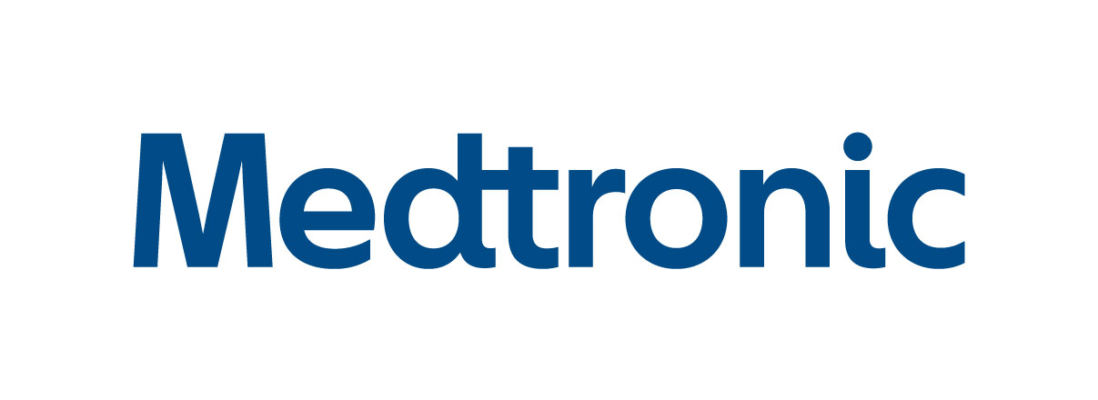
CSULA Medtronic
Advisor(s):
Dr. Mohammad Pourhomayoun
Students:
Yosep Kim
Christopher Fong
Wun Woo
Koenrad Macbride
Andrew Padilla

Slide 2
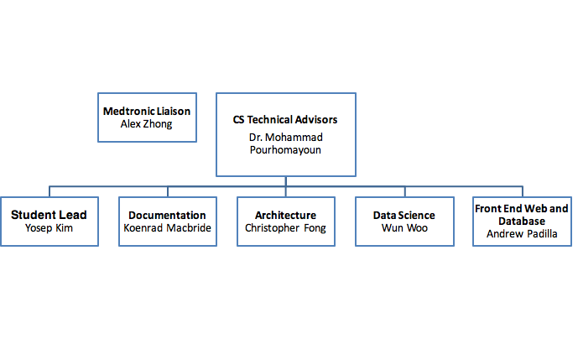
Organizational Chart

Slide 3
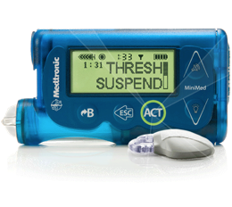
Contents:
Project Background
Programmatics
Scope
DFD
Real Time Data Stream
Feature Extraction Engine and Insight Engine
Technologies and Future Implementation

Slide 4
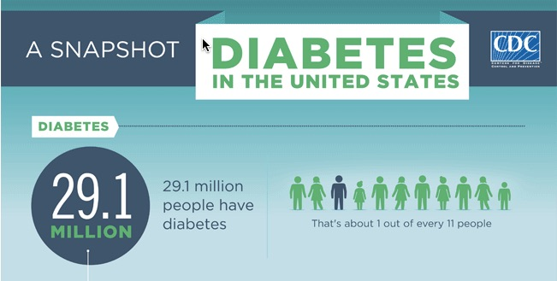
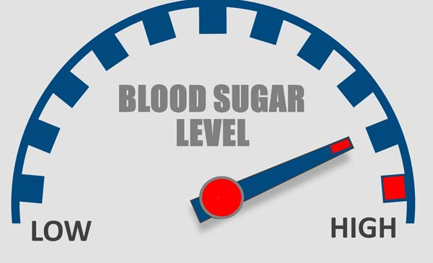
Project Background
Diabetes is a problem with your body that causes blood glucose (sugar) levels to rise higher than normal
CDC: 1 in 11 Diabetes
1 out of 3 adults, 86 million have PreDiabetes
3 in 15 Americans by 2050
Type 1 Diabetes have total lack of insulin.
Type 2 Diabetes are non-insulin dependent and are insulin resistant.
Lower​ ​ than​ ​ ​ below​ ​ 70​ ​ mg/dL​​ ​ is​ ​ hypoglycemia,​ ​ 180​​ ​ mg/dL​​ ​ higher​ ​ is​ ​hyperglycmia

Slide 5
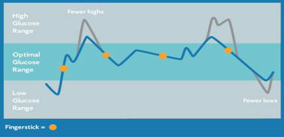
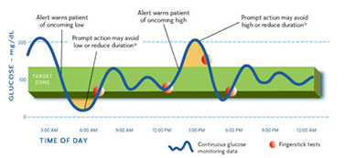
Scope
Purpose:
The purpose of this project is to design a Microservices Architecture that uses Data Science and Data Analytics to process data in real-time.
Obtain insight on glucose levels using FitBit activity levels, and find any correlations between them.
Come up with a solution to predict glucose levels using FitBit metrics in real-time.
Notes:
Our prediction engine will be able to warn patients not to go over the hyperglycemia threshold or under hypoglycemia threshold.
Prediction engine will be able to display information to patients and their doctors.
ie.
(contact the patient by telling them to eat more because their blood sugar will be too low, or to exercise because their blood sugar is going to be too high)
1:20

Slide 6
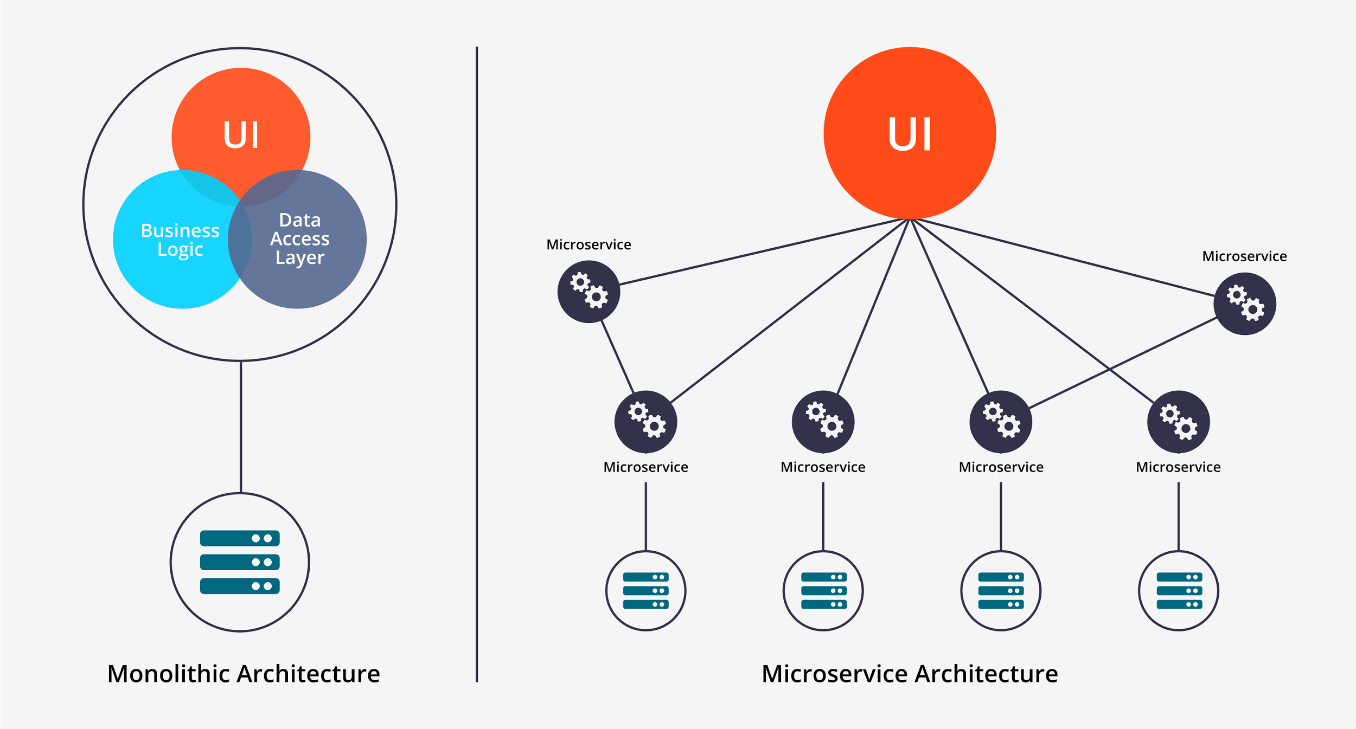
Monolithic vs Microservices Architecture
Notes:
Most programs are built using a monolithic architecture.
This means your application is written as one cohesive unit of code whose components are designed to work together, and they share the same memory space and resources
Whereas a Microservice Architecture means that your app is made up of lots of smaller, independent applications capable of running their own memory space and scaling independently from each other.
Microservices are a fairly new technology
Not language dependent **
Monolithic: All code is written in a same language
A microservice can be written in java, and another can be written in python for example.
Each microservice works independently, and communicates with others using an API such as RESTful
Updating Code **
Monolithic: Make sure that when you update code, all parts that it is connected to has to be changed as well
It wont affect other parts of the program when adding more and more microservices.
Scalability ******
Monolithic: can get disorganized when adding more and more to your application.
The bigger your microservice gets, it will still be easy to manage, because you don’t need to update other parts of the project.
2:30

Slide 7
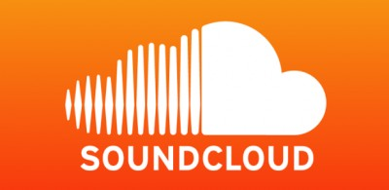

Slide 8
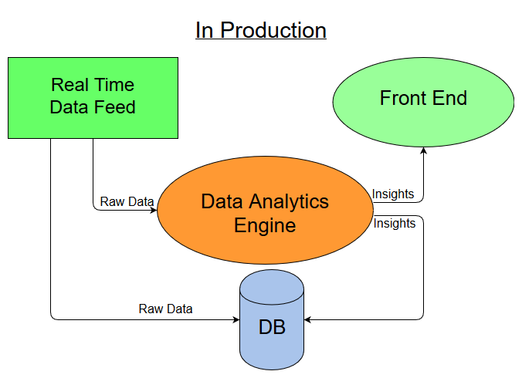
DFD

Slide 9
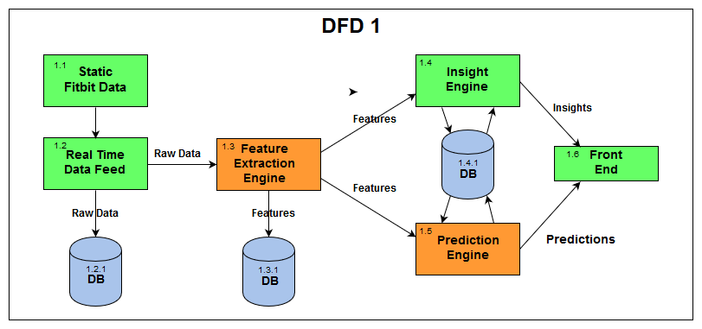
Notes:
Microservices Architecture

Slide 10
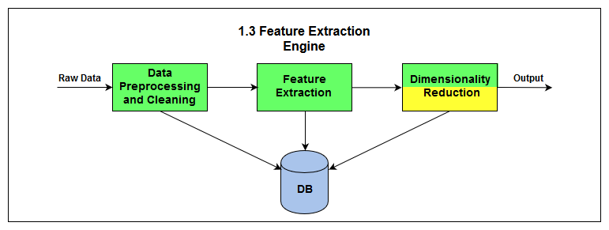

Slide 11
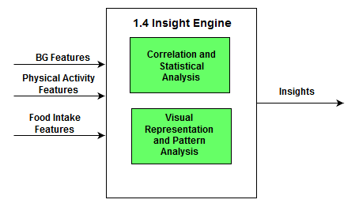

Slide 12
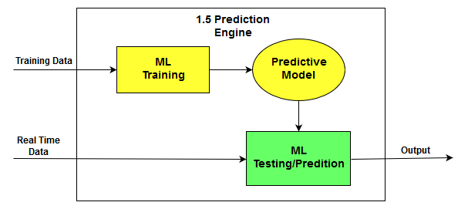

Slide 13
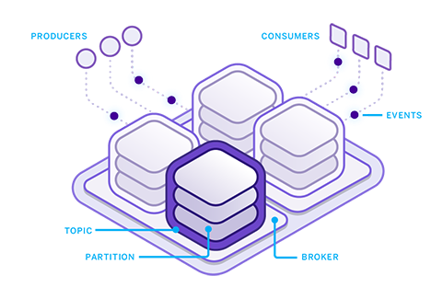
Apache Kafka Basics
Producer
Processes, “Cleans” and formats data into streams
Our java based producer encapsulates patient JSON data into “feature packets”
It also serves as a real time data packet simulation program
“Feature packets” are sent to the Broker.
Broker
A medium for Consumers to access Producer streams through a topic
Brokers are scalable: many computers can be part of a single broker to accommodate for larger stream throughput.
Consumer
One of our consumers is part of our Feature Extraction Engine. It takes the data and adds it to a dataframe for the insight engine.
Our second consumer aggregates stream data into a patient JSON file in a Cassandra DB for our prediction engine to take care of offline
Notes:
Start with why we need apache kafka (real time data in microservices system, big data)
Process data from many patients into a stream

Slide 14
Notes:
Brokers are scalable to accommodate for high data throughput
They are managed by a zookeeper

Slide 15
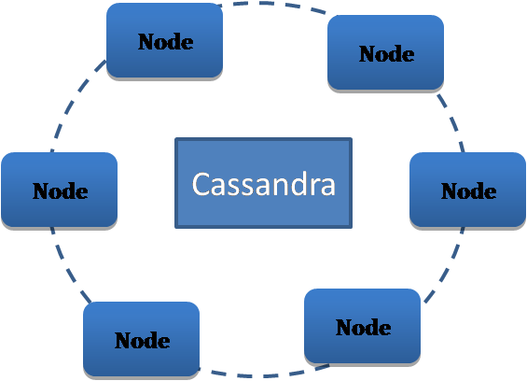
Apache Cassandra DB
Cassandra DB is a noSQL data store by Apache
Our Cassandra DB
1.3.1 will create patient file logs by incoming “feature packets”.
This will act as a master patient record to map patients to their data.
Our Cassandra DB
1.4.1 will be used to store Patient Data Frames and a General Master Data Frame which will be used as a basis for new patient data frames and prediction.
Our Cassandra DB 1.2.1 will store raw incoming FitBit and Blood Glucose levels and log by time.
This will act as a preventive measure in case any hardware down the line goes down, data will not be lost.
Notes:
We use cassandra as a database because it is easy to integrate with kafka and it is nosql/

Slide 16
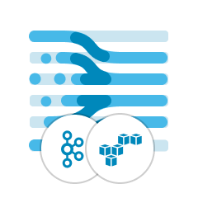
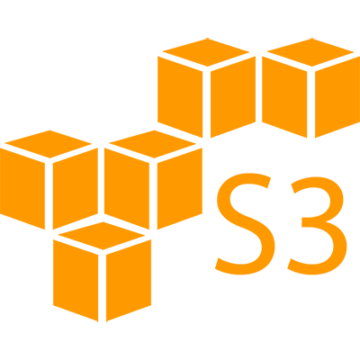
Data Packet Simulator
Our Kafka Producer is equipped with a data packet simulator.
The simulator takes existing patient JSON data and creates data packets per feature per patient then puts them into a list.
The simulator then sorts the list of data packets by date and time and transmits data to the Kafka Producer
Each data packet contains a Patient ID, Data Type, Data Value and TimeStamp
Notes:
Fitbit devices that count floors have an altimeter sensor that can detect when you're going up or down in elevation. Your device registers one floor when you climb about ten feet at one time. It does not register floors when you go down.

Slide 17
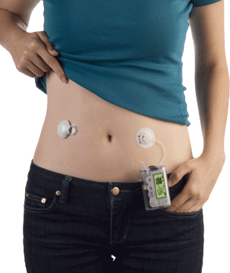
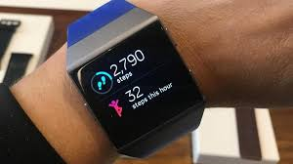
Specific Features of The Json Data
Fitbit Data
1) CaloriesOut
CaloriesOutDt
2) metabolic
metabolicDt
3) Steps
StepsDt
4) floor
floorDt
5) Heartrate
HeartrateDt
CGM Data
1) SG
SGdt
Notes:
Fitbit devices that count floors have an altimeter sensor that can detect when you're going up or down in elevation. Your device registers one floor when you climb about ten feet at one time. It does not register floors when you go down.

Slide 18
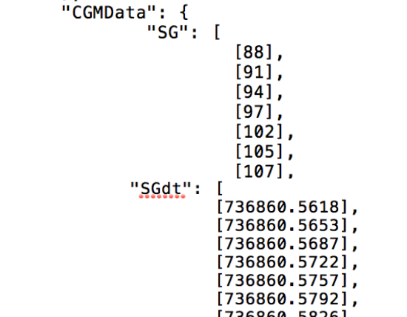
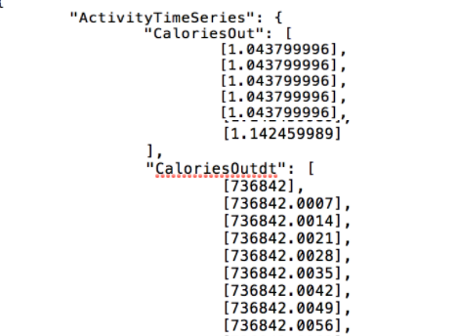
Patient Data

Slide 19
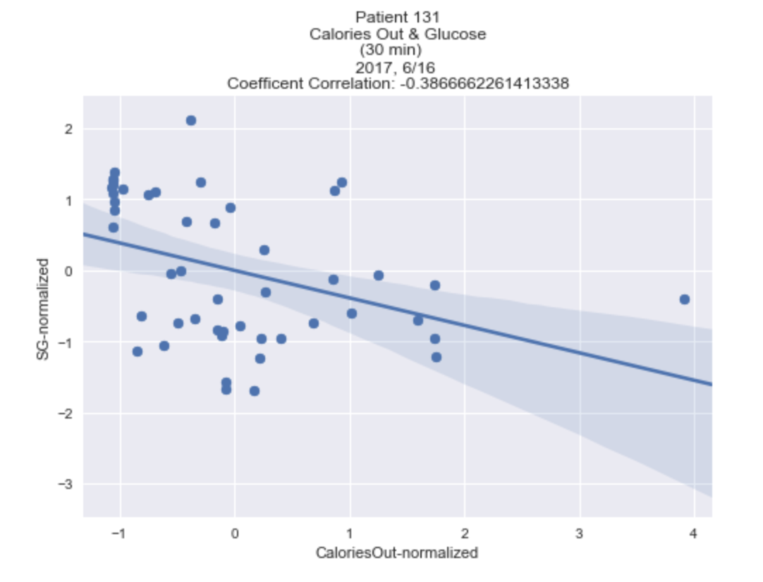
Calories Out VS SG (One Day)

Slide 20
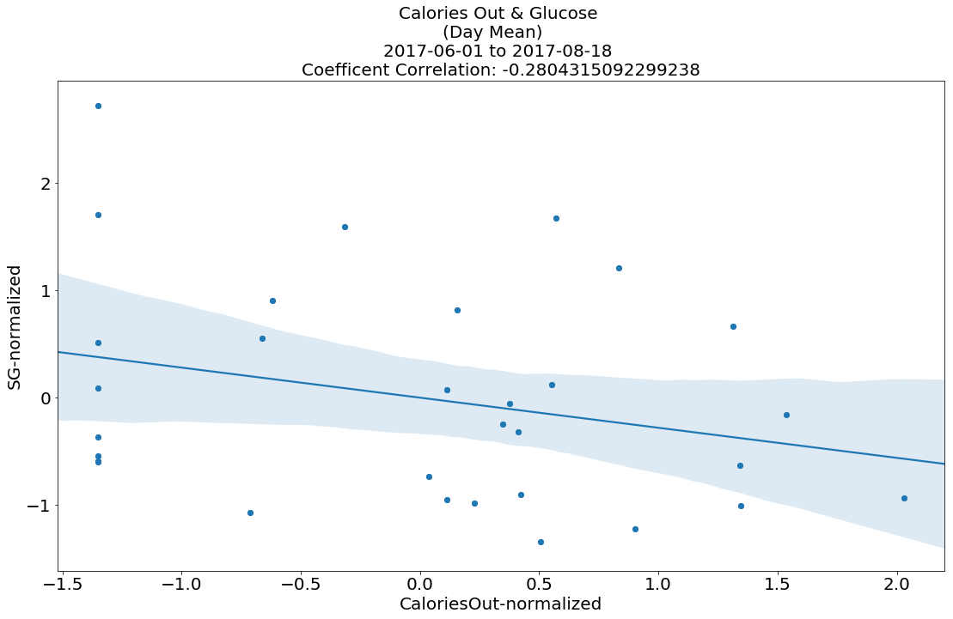
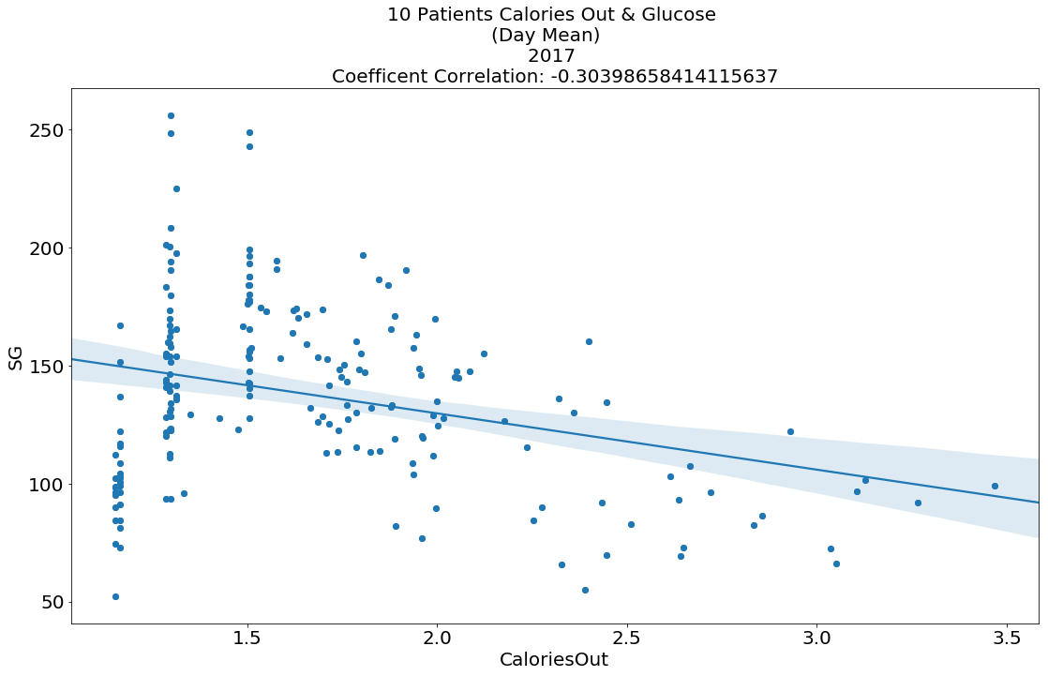
One Year

Slide 21
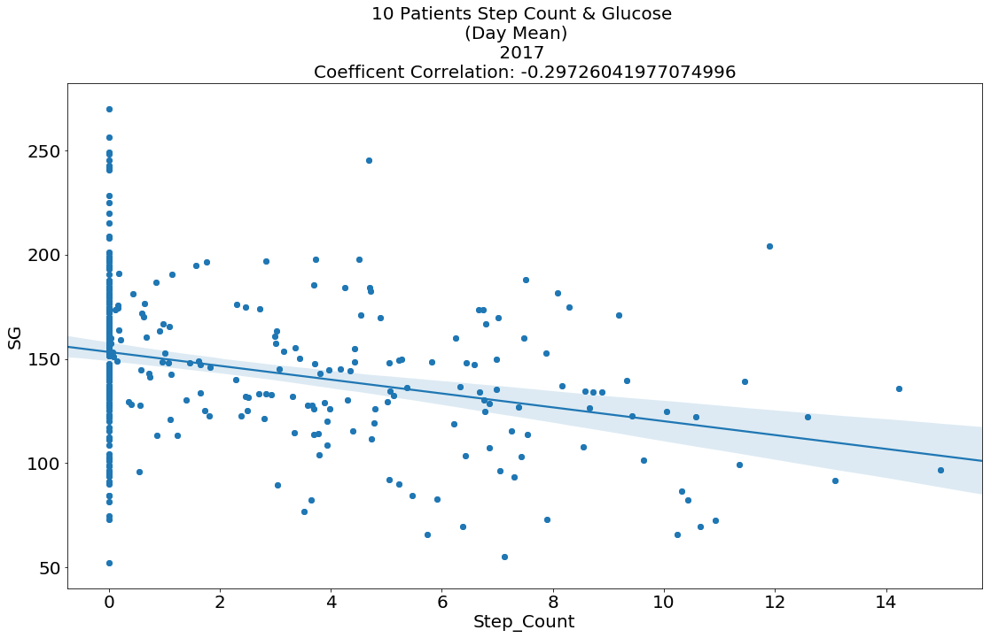

Slide 22
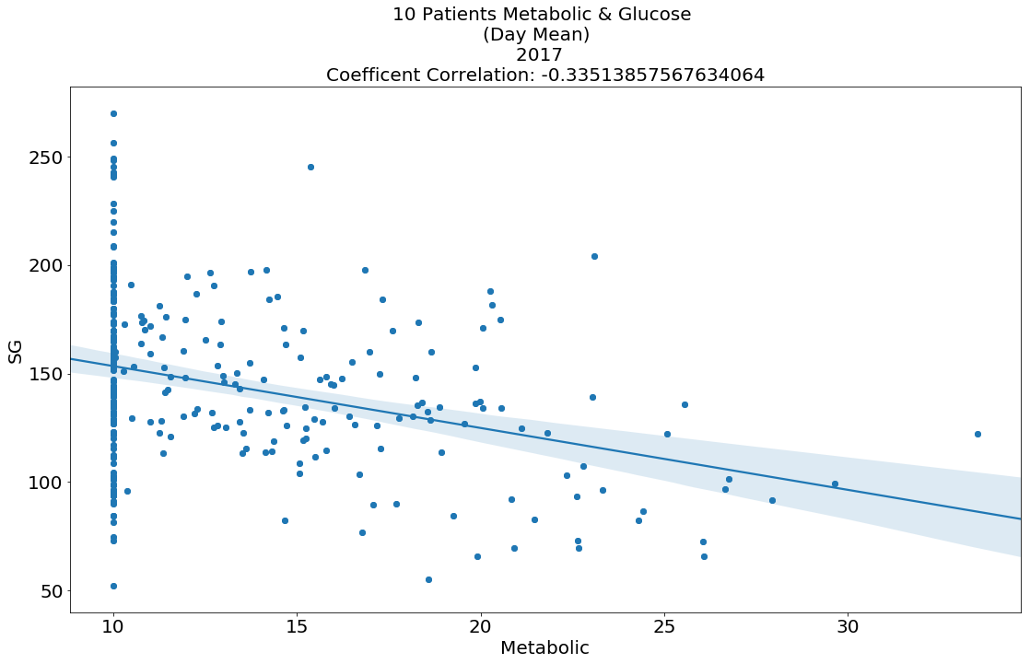

Slide 23
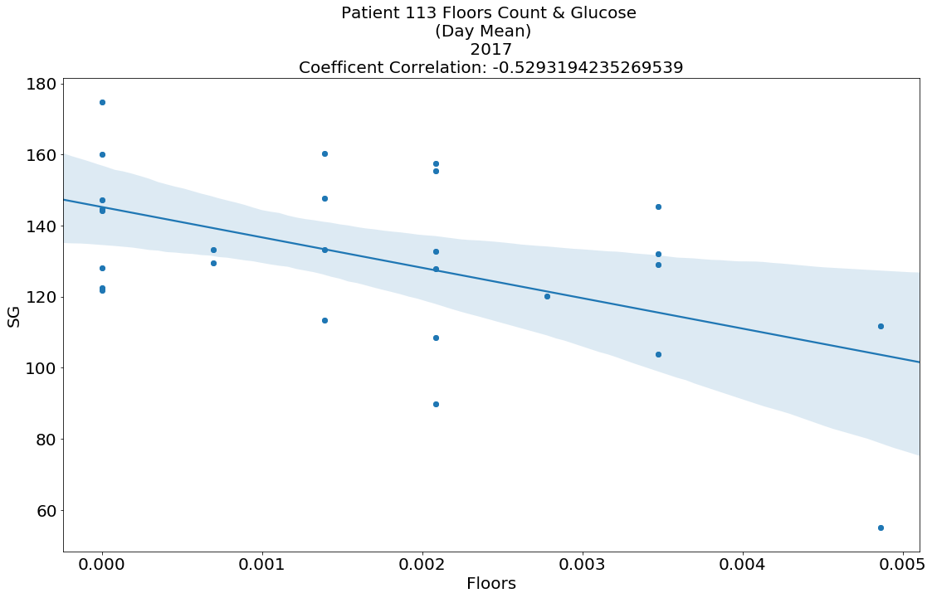

Slide 24
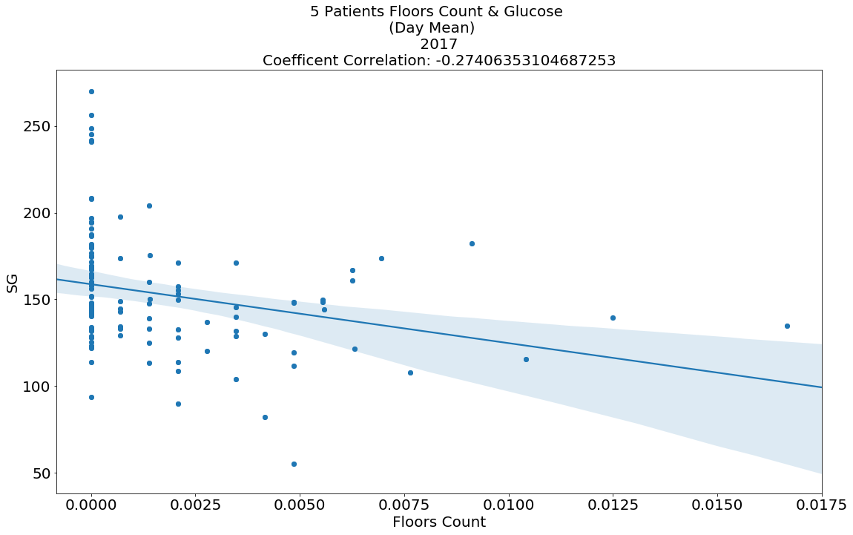

Slide 25
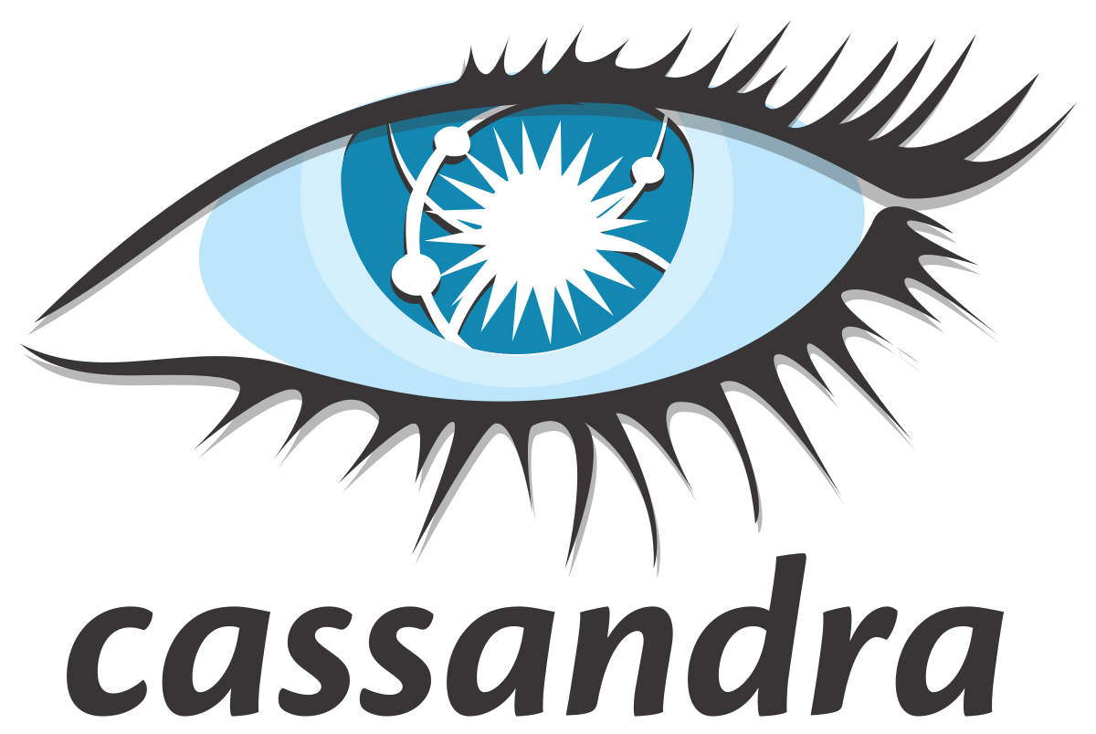
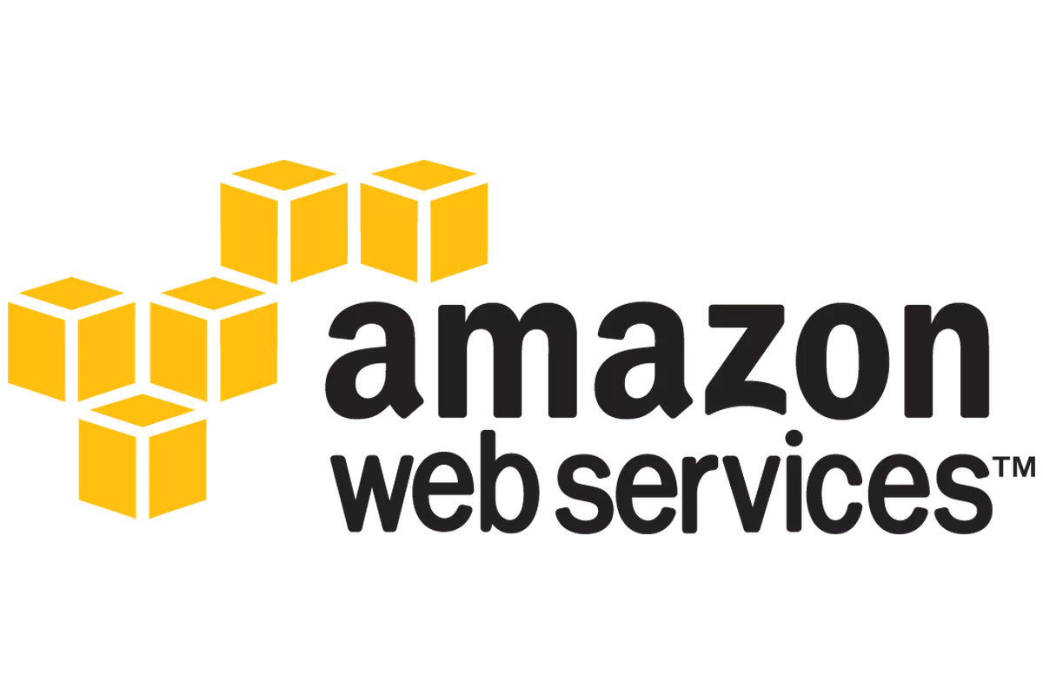
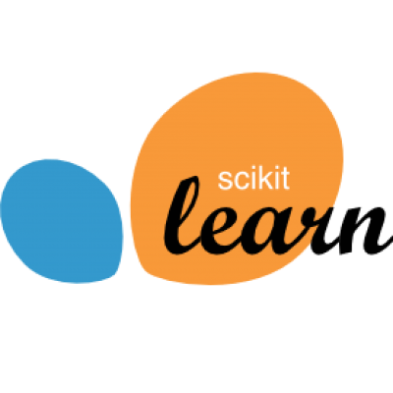
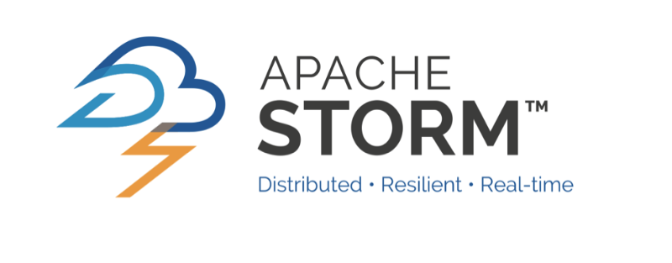
Technologies and Future Implementations
Look at more Features in patient data for correlations.
Develop Prediction Engine
Add Cassandra DB with our MicroServices
Connect all microservices in Restful API
Develop batch processing / real time processing for patient data

