Slide 1
Collaborative Visualization for Solar System Treks (CVSST)
Senior Design 2020-2021
Presented by: Montague La France, Stanley Do, Abdullah Alshebly, Christopher Smallwood, Jose Garcia, Johnny Lee, Odasys Soberanes, David Tang, Zipeng Guo, Miguel Sanchez
Project Advisor: Dr. David Krum
Liaison: Emily Law

Slide 2
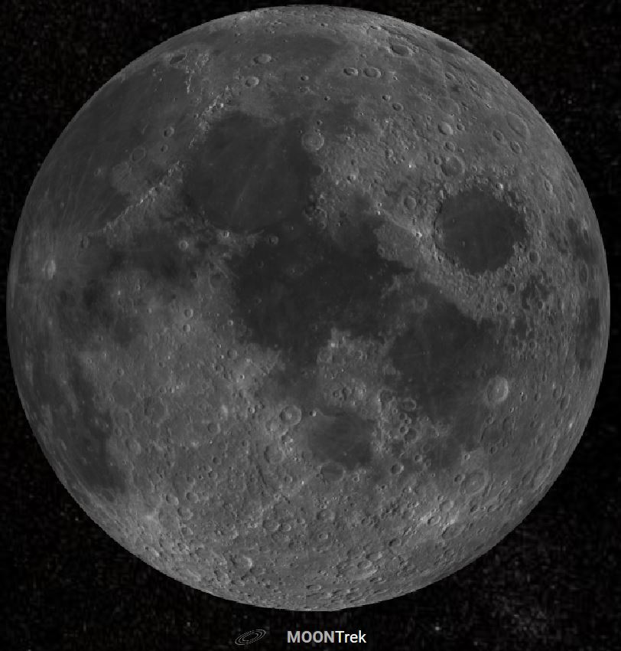
Overview
Solar System Treks (SST)
JPL web portal
NASA data of planets, asteroids, and moons
Satellite photography and 3D terrain models
Collaborative Visualization (CV)
Multiple users can examine the data together
Collectively work on new ideas and projects in real time
Miguel Sanchez

Slide 3
Outline
Introduction
Project Planning
Feasibility Assessment
Feasibility Assessment (Web)
VR & AR
Feasibility Assessment (Unity)
Decision
Requirements Document
Personas, Use Cases, Scenarios
Things We Were Not Expecting
Project Timeline & Next Steps
Conclusion
Miguel Sanchez

Slide 4
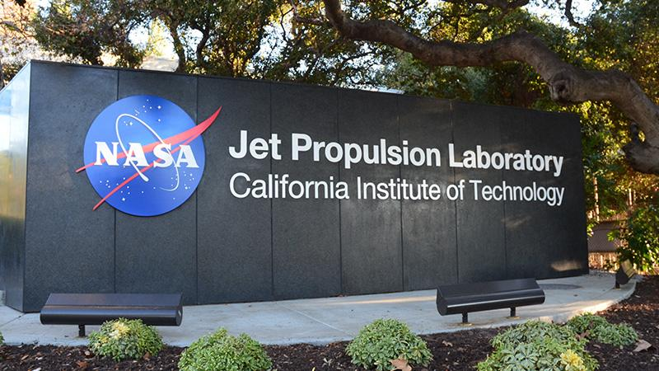
Introduction
Sponsor: JPL
Liaison: Emily Law
JPL Team: Eddie Arevalo, George Chang, Richard Kim, Shan Malhotra
Goal:
Develop networked visualization software to support collaborative markup of solar system terrain.
Miguel Sanchez

Slide 5
Introduction: Members and Roles
Project advisor: Dr. David Krum
Project lead: Montague La France
Project co-lead: Stanley Do
Customer liaison/requirements lead: Christopher Smallwood
Architect lead: Abdullah Alshebly
Documentation lead: Zipeng Guo
Demo/presentation lead: Miguel Sanchez
QA lead: David Tang
Components (UI, backend, database): Jose Garcia, Odasys Soberanes, Johnny Lee
Miguel Sanchez

Slide 6
Project Planning
Optimistic Beginnings
Rough Middle
Streamlined End
Discord
Outlook
Zoom
Asana
Sharepoint
Lack of Use/Need of Asana
Disorganized Meeting Agenda
Disorganized Email
Smartsheet
Meeting Template
Email Template
Christopher Smallwood

Slide 7
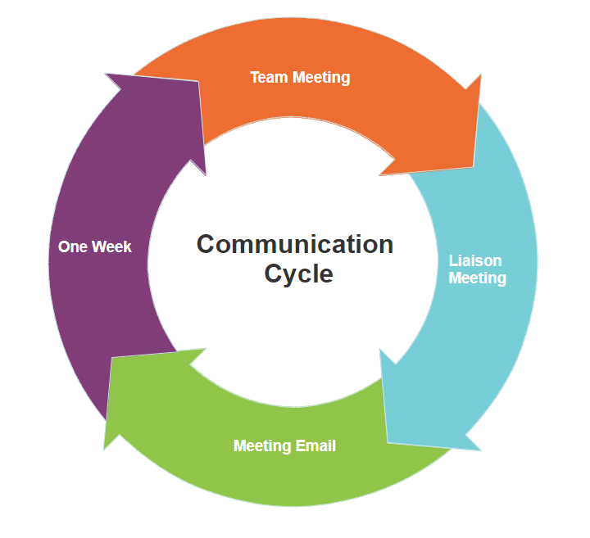
Project Planning: Communication
Communication is Key!!!
Christopher Smallwood

Slide 8
Project Planning: Software Development Life Cycle
Agile Project Management
Freedom and Flexibility
Christopher Smallwood

Slide 9
Feasibility Assessment
Research & Discovery
Risk Assessment
Feasible Development Paths
Decision and Requirements
How does it help us?
Lets us learn about the current software and technologies in use.
Keeps the amount of time, resources, and documentation available in mind.
Builds a path towards a more successful project.
Helps the customer know our limitations and clarifies requirements.
Stanley Do

Slide 10
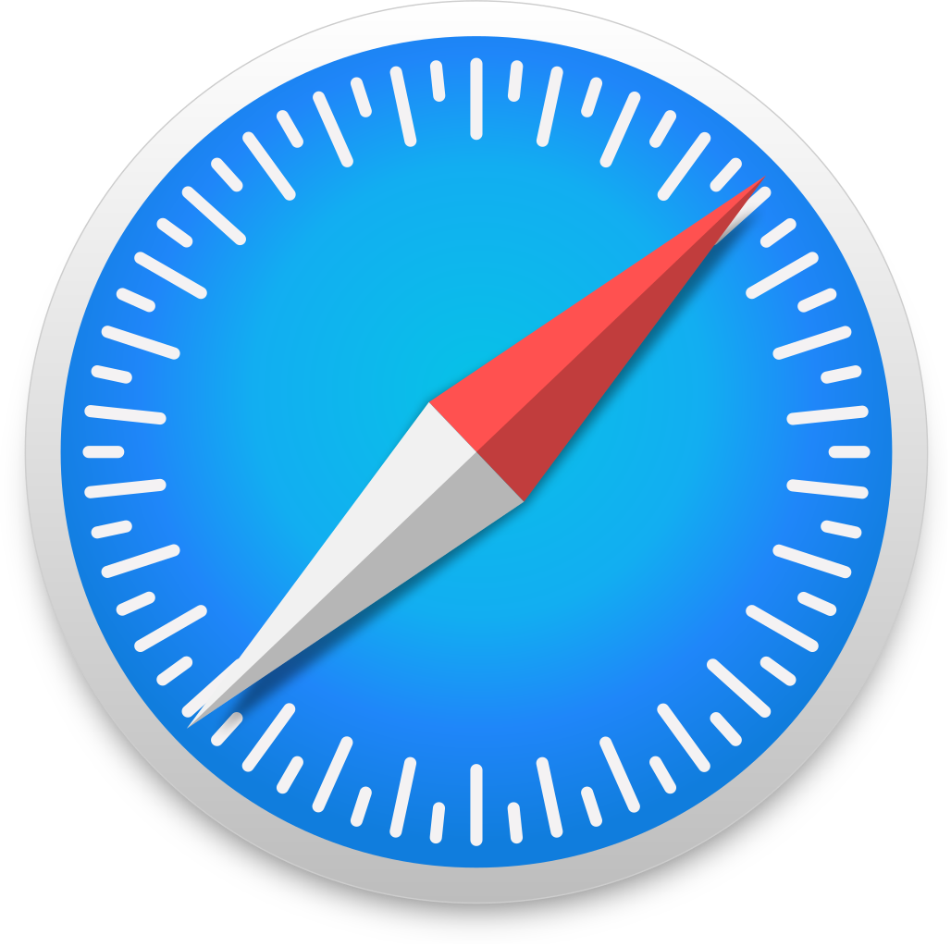
Feasibility Assessment (Web)
Web-based collaboration over existing Trek software:
CesiumJS is an extremely powerful framework for 3D geospatial visualization.
More access to users and the public.
Seamless integration with existing software.
Supports large amounts of users.
Stanley Do

Slide 11
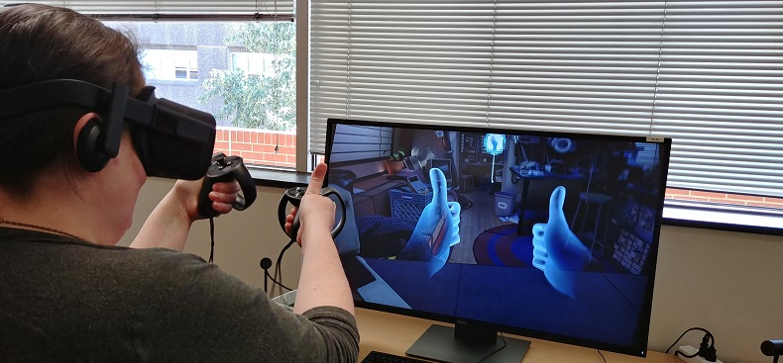
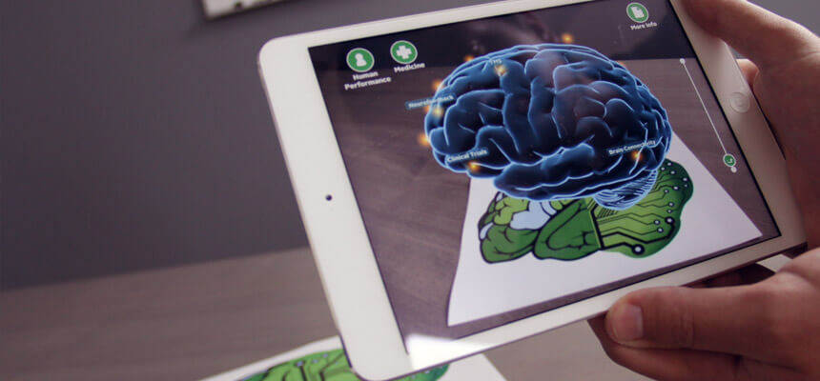
VR & AR
Virtual reality (VR):
Use computer technology to create a simulated environment.
VR places the user inside an experience.
Users are immersed and able to interact with 3D worlds .
Augmented reality (AR):
Blends what the User sees in their real surroundings
with digital content generated by computer software.
AR systems layer virtual information over a camera live feed.
Abdullah Alshebly
Notes:
VR was an interest, not a requirement.

Slide 12
VR & AR
How this is useful for this project ?
Collaborative visualization, in (VR) and (AR) can be helpful in generating new insights.
Team of researchers or students can examine the data thoroughly together in simulated environment where they can easily move around and manipulate the environment.
Abdullah Alshebly

Slide 13
Feasibility Assessment (Unity)
What it is:
How it helps us:
Real time development platform
Video Games
Automotive Transportation & Manufacturing
Film Animation & Cinematics
Architecture, Engineering & Construction
Powerful platform
Ease of manipulation for 3D data
VR & AR quality support
Takes out the technical work
Montague La France

Slide 14
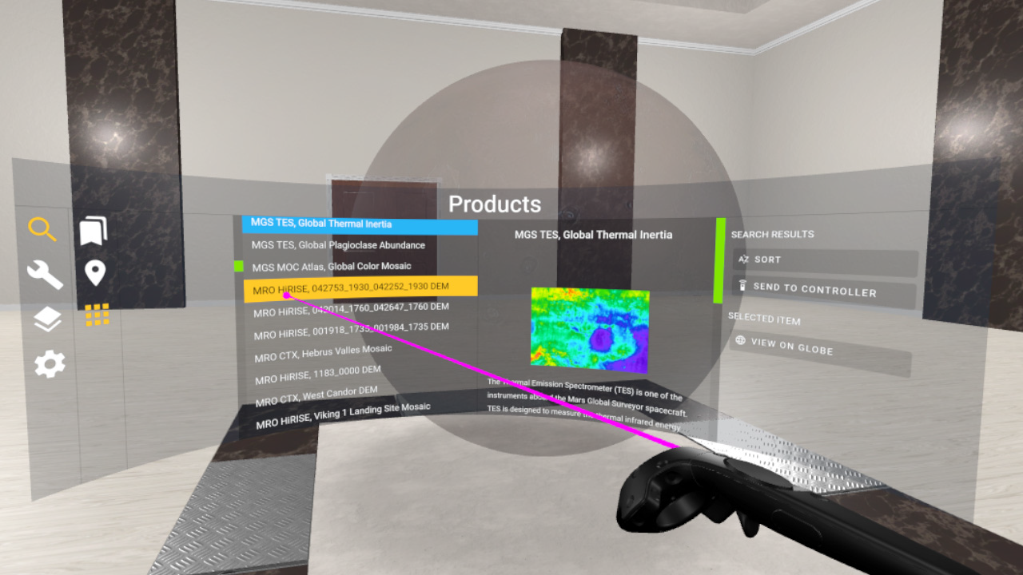
Feasibility Assessment (Unity - VR Room)
What it is:
How it works:
Desktop application
VR Implementation of SST
HTTP & JSON Requests
XR Browser
HTC Vive (Steam)
Montague La France

Slide 15
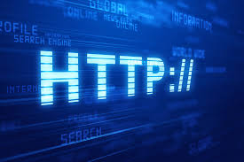
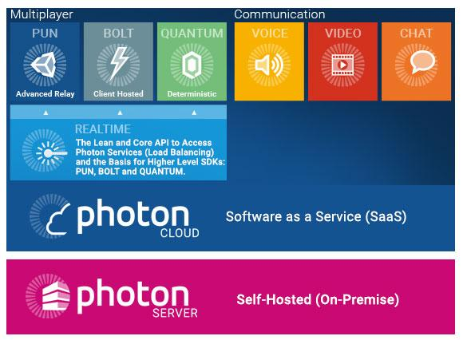
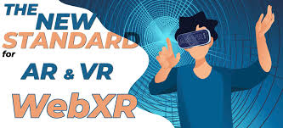
Feasibility Assessment (Unity - Possible Approach)
HTTP/JSON Requests
Photon Networking API
Web XR
Get Requests
Using links to NASA SST
Pull data
Layers & 3D models
Implement JPL toolkit for interactions with data
Bolt Matchmaking
Sessions
Client Hosted
Communication
Voice, video, chat
Virtual Reality (VR)
Augmented Reality (AR)
Montague La France

Slide 16
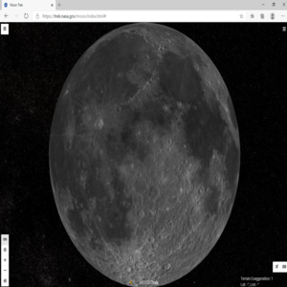
Decision
Presented both components (Web and Unity Components) to the customer
Decision:
Web Technology Component
Focus on Collaborative Sessions
Future development: VR and AR capabilities
Front-end Frameworks
JavaScript libraries (Socket.io and Cesium)
Database
Jose Garcia
Notes:
Based on feasibility assessments.

Slide 17
Requirements Document
Draft requirements from Personas, Use cases, and Scenarios
Need more time
In Progress:
Section 4: Requirements Specification
Section 5: Other Nonfunctional Requirements
Revise document throughout the project
Odasys Soberanes

Slide 18
Personas, Use Cases, Scenarios
Represents different user types.
Personas examples:
John is an ex-military, 35-year-old Mission Planner who works for NASA.
Nick is a 20-year-old college student with a love for space.
Tom is a 40-year-old high school teacher who is currently teaching a science class.
Zipeng Guo

Slide 19
Personas, Use Cases, Scenarios
Use Cases and Scenarios
Provides one or more scenarios.
Illustrates interaction between end users and the system.
Importance:
Shows how our software might be used.
Draft requirements.
Example:
Nick is a 20-year-old college student with a love for space.
Nick and his friends want to be able to collaborate in a smooth way
We provide: Create a room, share the waypoint location, Real Time Collaboration (Send Live Chat Messages)
Zipeng Guo
Notes:
Each use case provides one or more scenarios, which illustrate how the system interacts with end users or other systems, that is, who can use the system to do what to achieve a clear business goal.

Slide 20
Things We Were Not Expecting
Decision made at end of October
Stronger focus on Use Cases, Personas
Avoid choosing specific technical solutions (for now)
Need more time to draft requirements
David Tang
Notes:
First part (research technologies for Unity vs Web decision) was very different from second part (avoid technical solution/implementation to draft requirements) of Fall semester. Challenging to adapt to second part’s mindset.
Example: ability to exchange information vs chat room

Slide 21
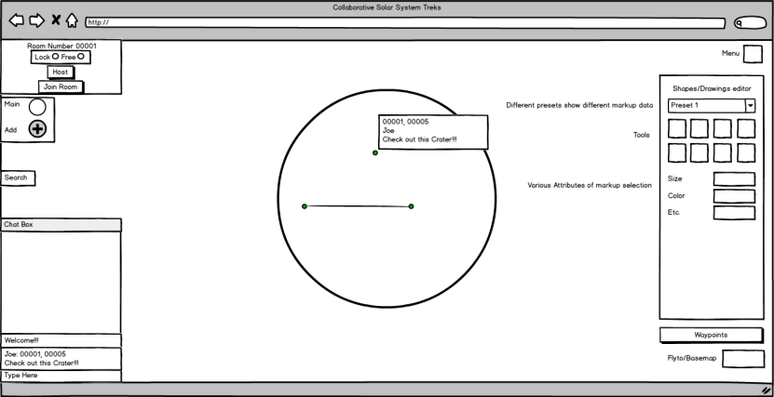
Project Timeline & Next Steps
Planning (8/28/20 - 10/30/20)
Requirements (10/26/20 - 12/11/20)
Design (11/27/20 - 1/5/21)
Implementation (1/5/21 - 2/26/21)
Testing (2/26/21 - 4/30/21)
Closure (5/1/21 - 5/14/21)
Johnny Lee

Slide 22
Conclusion
We want to implement Collaboration onto Solar System Treks.
Created a project plan following SDLC (Software Development Lifecycle) for the software.
Current Path
Explored two routes (Unity vs Web).
Going forward with design in Web.
Now focused on Requirements and early Design document.

Slide 23
Questions?
Notes:
Empty Slide

