Slide 1
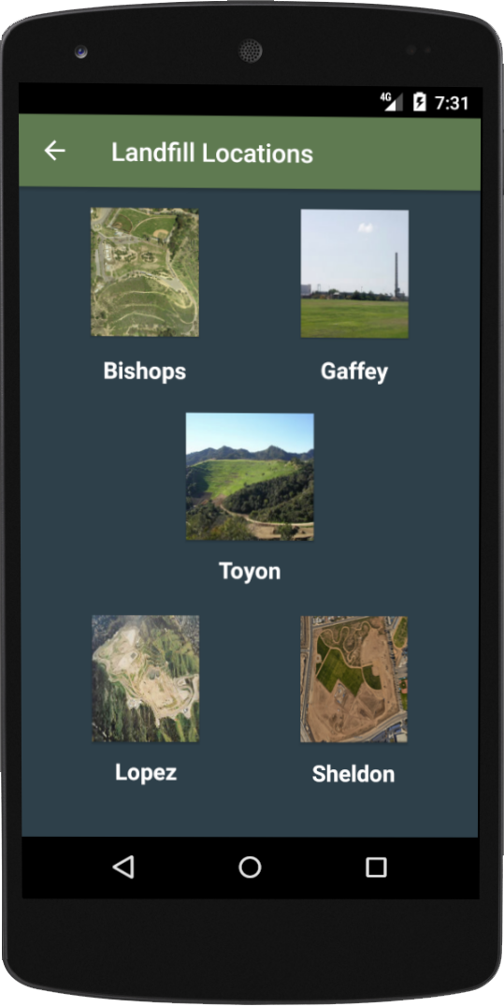
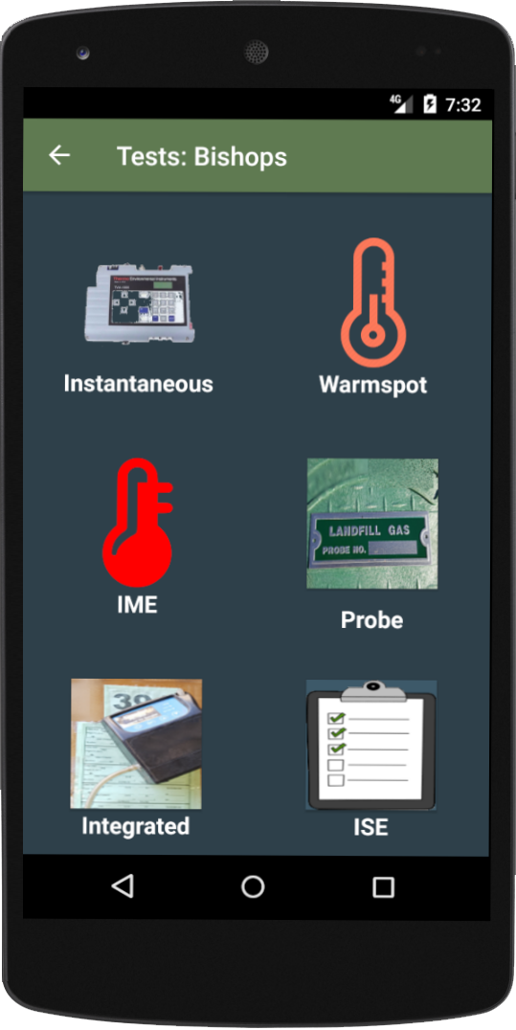
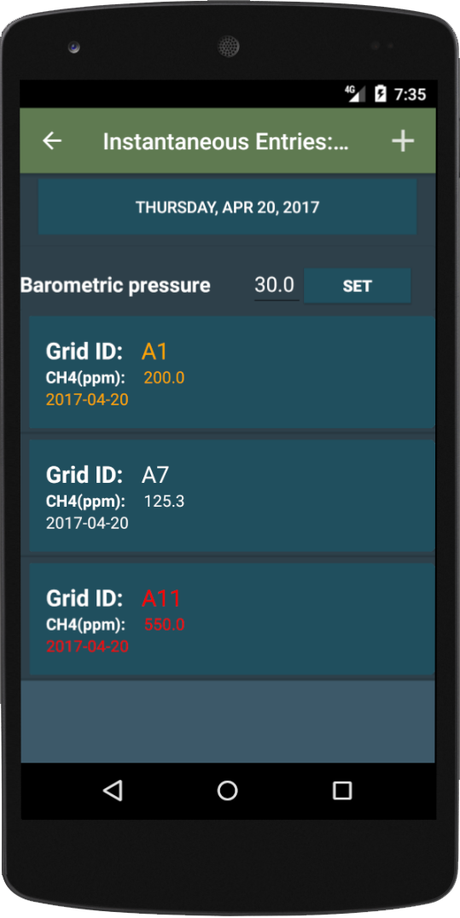
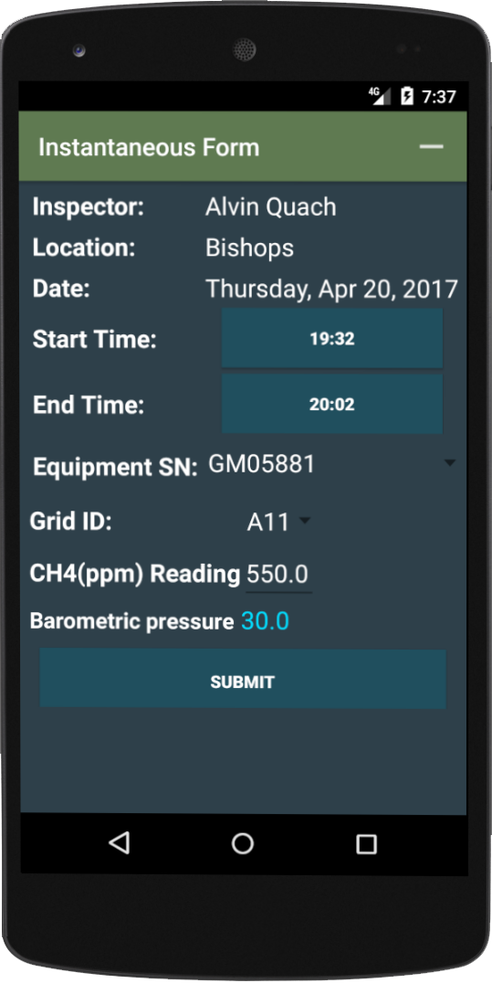
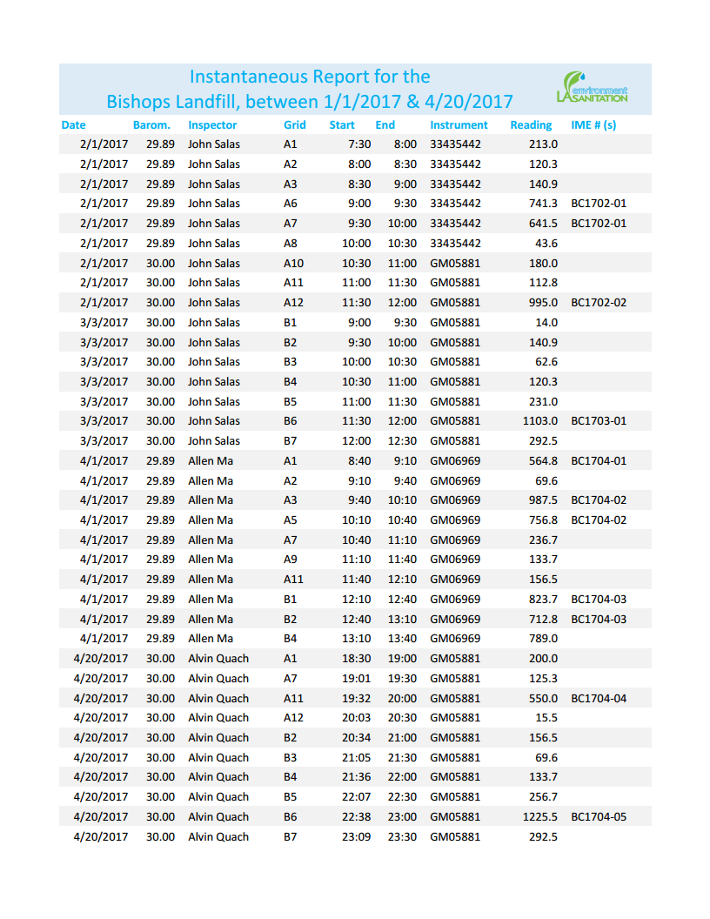
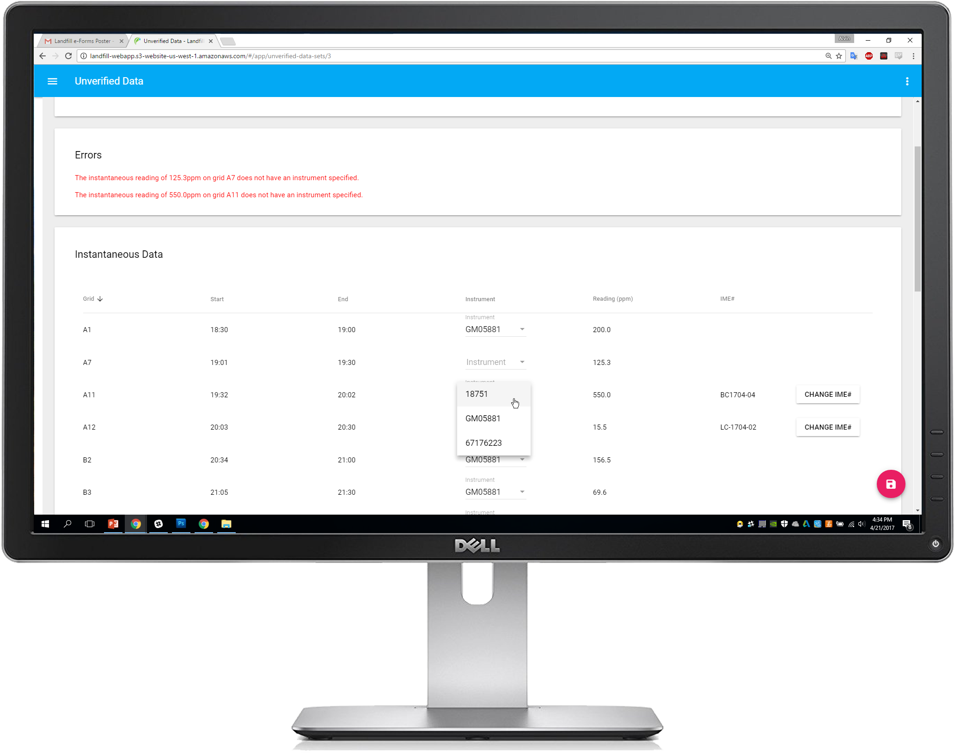
Team Members: Andres Adame, Teky Alvarado Faculty Advisors: Dr. Russell Abbott, Dr. Jungsoo (Sue) Lim LA Dept. of Sanitation: William Andrews, Francis Castillo, John Hamilton, George Yu
Landfill e-Forms Application
Sponsor Logo
Department of Computer Science College of Engineering, Computer Science, and Technology California State University, Los Angeles
Goals
Develop a software system consisting of:
An Android application to collect emission data out on the field.
A web application to upload, audit, and store the data in a centralized database.
Mobile Application
Select Location
Select Test
Add/Review Entries
Enter/Edit Data
Web Application
Transfer and Review Data
Generate Reports
Technologies
Future Plans
Add automated GPS location tracking to the mobile application.
Add image tagging capabilities to data entry.
Implement additional test forms.
Automated two-way data sync between the mobile application and the web application.
Enhance report formatting.
Android
SQLite
Angular 4
Spring
Hibernate
SQL Server
Notes:
Have students check that the logo is the appropriate one to use.

