Slide 1
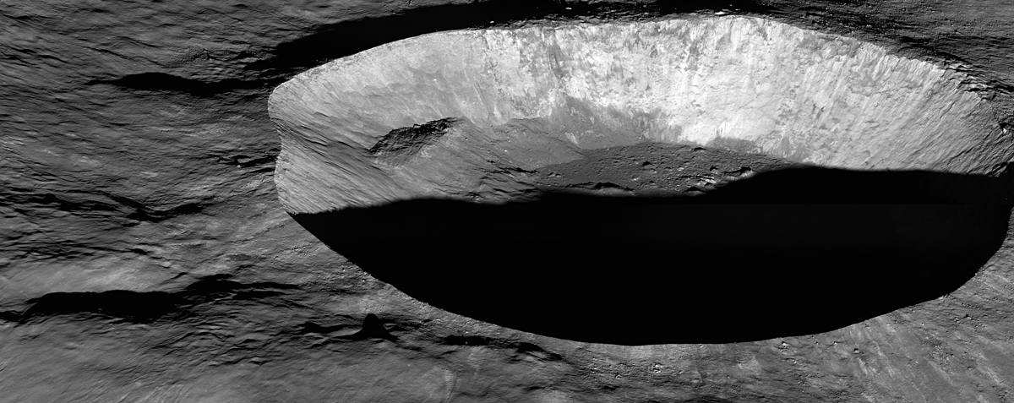
Lunar Crater Detection and Recognition
Natalie Gallegos, Tony Liang, Marvin Mendez, Raul Ornelas, Alberto Serrano
Sponsor: Jet Propulsion Laboratory (JPL)
Advisors: E. Y. Elaine Kang, Saman Saeedi, Richard K. J. Cross
JPL Liaisons: Emily S. Law, Shantanu Malhotra, George W. Chang

Slide 2
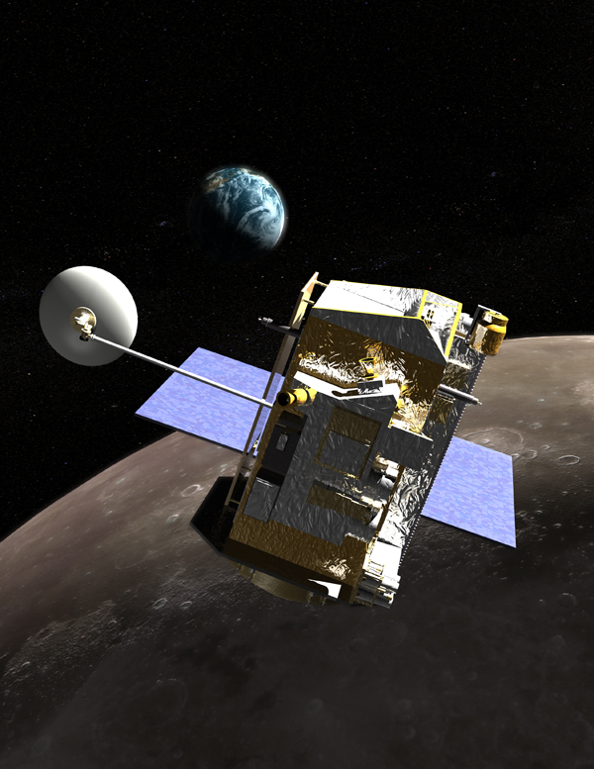
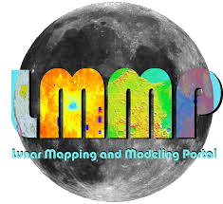
Objective
The Lunar Mapping and Modeling Portal (LMMP) team at JPL tasked our LCDR team to develop an algorithm that will automatically detect lunar craters using images from the Lunar Reconnaissance Orbiter Camera (LROC). Final program should estimate the shape of the crater, as well as the crater’s approximate depth and diameter.
M1150763131RC
Notes:
Show LROC image(s), what it is about?

Slide 3
Motivation
Why detect craters?
Crater detection and avoidance is critical for spacecraft landings
and mapping of lunar terrain.
Crater detection is an important task for many space exploration missions. Crater detection is used for a number of applications, including mapping celestial bodies, hazard detection, and updating spatial and temporal stratigraphy and topography of the body in question. Resources for crater detection are proprietary, and new approaches or methods are always welcome.

Slide 4
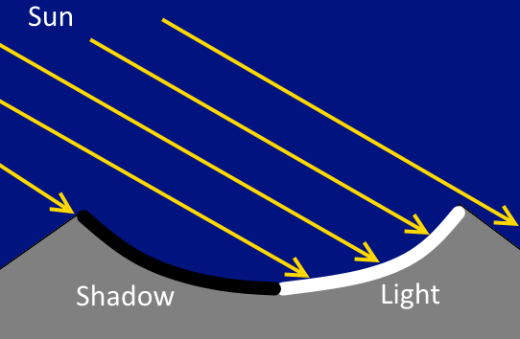
What is a crater?
Crater side view
Crater top view
Craters are physical depressions in the surface of a planetary body. These depressions are characterized by circular and elliptical shapes and their images are comprised of light & dark patches, outlining the shape.

Slide 5
RINGTOSS
The culmination of our work

Slide 6
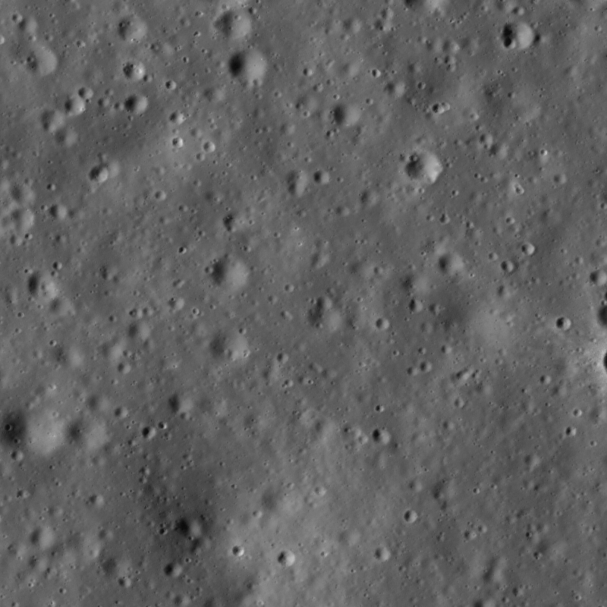
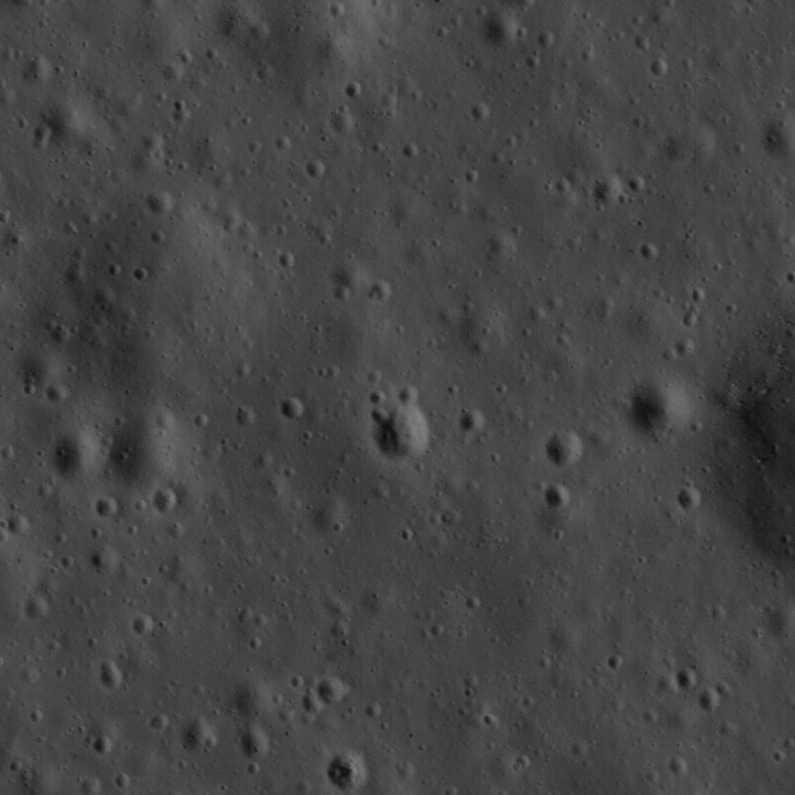
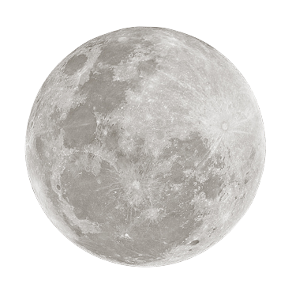
Ringtoss - Pipeline
Input Image
Crater Detection
Duplicate Removal
Ellipse Fitted Candidate Craters
Crater Recognition using Neural Network
Input Image
Crater Detection
Duplicate Removal
Ellipse Fitted Candidate Craters
Crater Recognition using Neural Network
Dark & Light Pairing
Dark & Light Pairing
Circular Hough
Circular Hough
Download
Download
Select Area
Template Matching
Shadow Extraction,
Depth & Diameter
Calculation
Crater Description
Select Area
Template Matching
Shadow Extraction,
Depth & Diameter
Calculation
Crater Description
DB
DB
Notes:
Color coordinate Saman’s work with our work
Why use three different approaches?

Slide 7
Detection of Craters
Ellipse Bounding Algorithm
Albert Serrano
Raul Ornelas

Slide 8
Ellipse Bounding Algorithm
Lunar Image
Erosion and Dilation of Image
Centroids Detection
Rgb2Hsv
Thresholding
Distance and Angle Determination
Lunar Image
With Detected Craters
Save as a crater list
Ellipse Fitting Method
Draw Ellipse on Craters
Based on proposed methodology from ”Detection of Craters and Its Orientation on Lunar” by Nur Diyana Kamarudin, Kamaruddin Abd. Ghani, Siti Noormiza Makhtar, Baizura Bohari and Noorlina Zainuddin

Slide 9
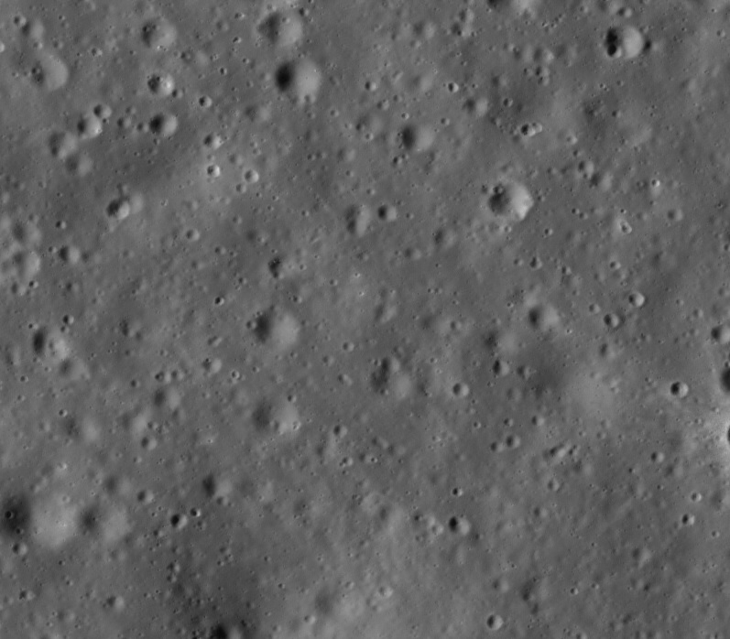
Thresholding image
Ellipse Bounding Algorithm - Image Preprocessing
We performed some preprocessing to the crater images. These methods helps us with:
Retrieve brightness from the image
Retrieve location of each light and dark patch
Eliminate extra unwanted noise
Make potential craters more visible
Original Image

Slide 10
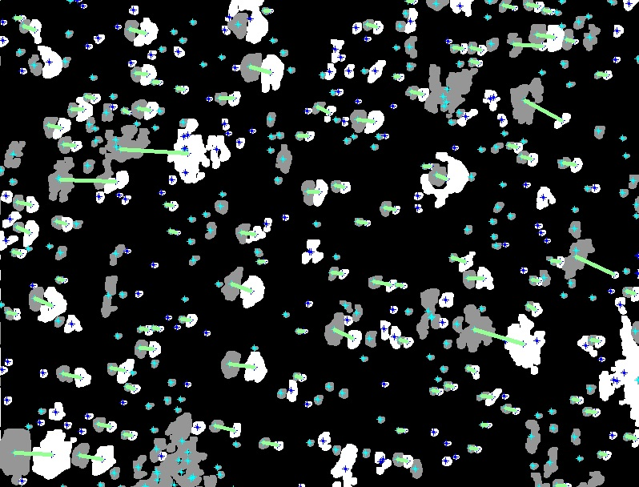
Ellipse Bounding Algorithm - Ellipse Fitting
After image processing, we proceed on
to the ellipse fitting
Matched light and dark patches according to distance and angle
Draw ellipses around the potential craters
We run the algorithm 3 times using parameters ideal for small, medium, and large craters
We save the craters into a list
Light and Dark Patch Pairing

Slide 11
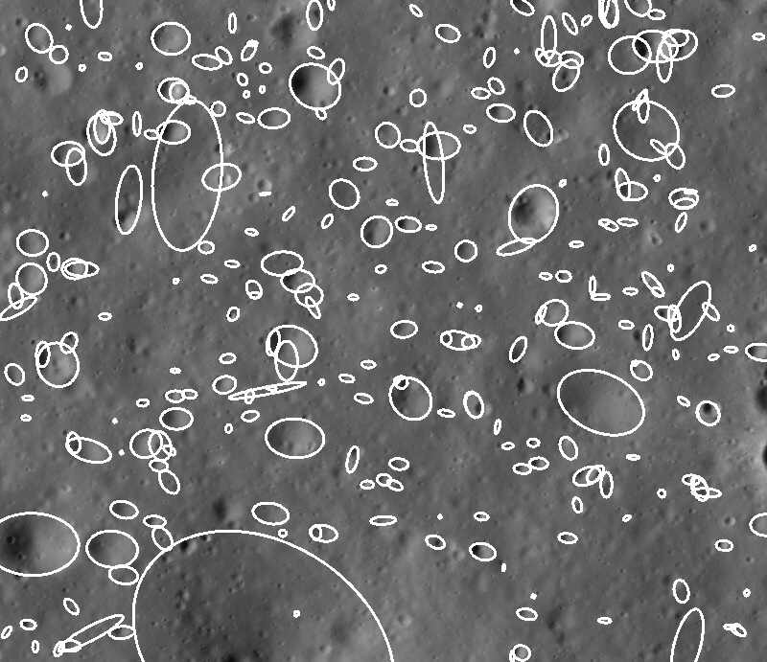
Ellipse Bounding Algorithm - Results

Slide 12
Crater Detection
Circular Hough Transform
Marvin Mendez

Slide 13
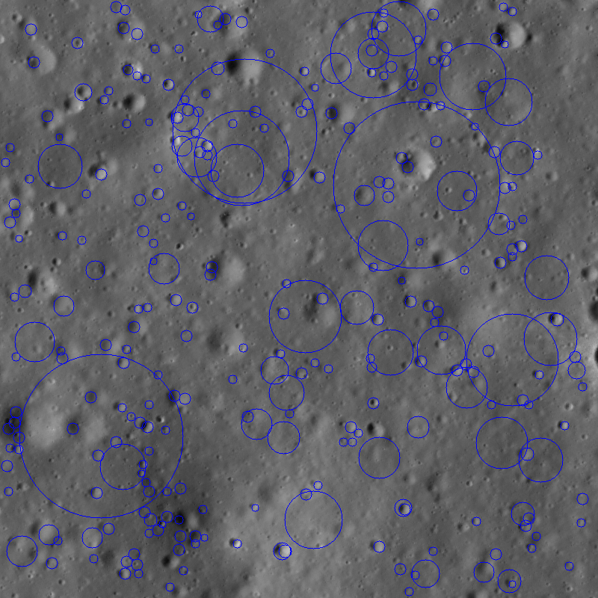
Circular Hough - Pipeline
Lunar Image
With Detected Craters
and list of Crater information
Median and Gaussian Filters
Canny
Edge Detector
Lunar Image
Circular
Hough
Transform
Retinex
Preprocessing
Edge Detection
Circle Detection
Proposed methodology in “Linear and Non-Linear Feature Extraction Algorithms for Lunar Images” by Tamililakkiya V, Vani K, Lavanya A, and Anto Michael

Slide 14
Crater Depth and Diameter
Natalie Gallegos
Tony Liang

Slide 15
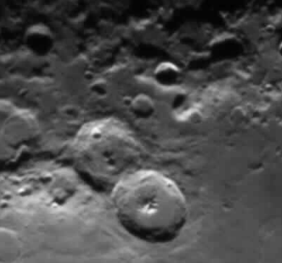
Crater Data Extraction
Our goal was to calculate the diameter and depth of a crater using illumination techniques.
Our approach was adapted by a paper, “Diameter and Depth of Lunar Craters”, by Andre James Clayden.
Image used by Clayden for measuring crater diameters and shadows.

Slide 16
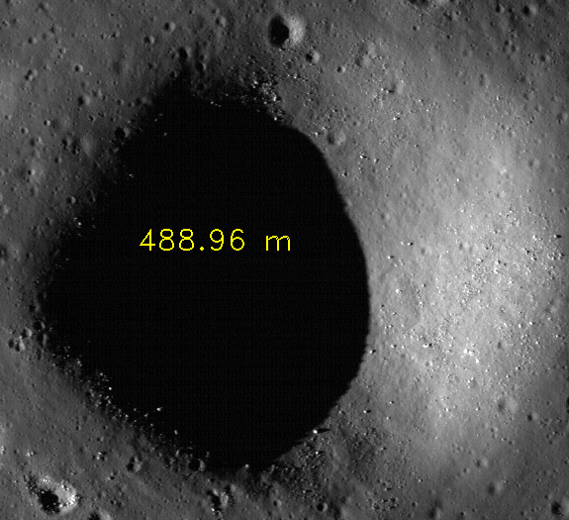
Crater Data Extraction - Measuring Diameter
According to Clayden, the diameter of the crater can be calculated using the following data: the exact time the image was taken, longitude and latitude of crater’s location, distance from the moon to the earth.
Challenge: How to scale the images and calculate measurements in relevant units for LRO images .
The Yoshi Crater, cited to be 500 meters in diameter

Slide 17
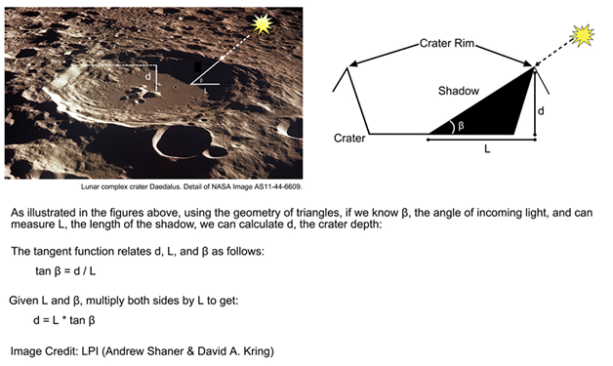
Crater Data Extraction - Measuring Depth
Depth can be calculated by measuring the length of the shadow in the direction along the sun angle, and use the elevation angle to compute the depth. [Clayden]
Challenge: Extract shadows for each crater, and compute depth using sun angles with crater shadows.
Image from Lunar and Planetary Institute

Slide 18
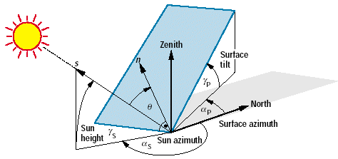
Crater Data Extraction - Angles
Which angle is the right sun angle? How do we get it?
Image of different sun angles from www.volker-quaschning.de

Slide 19
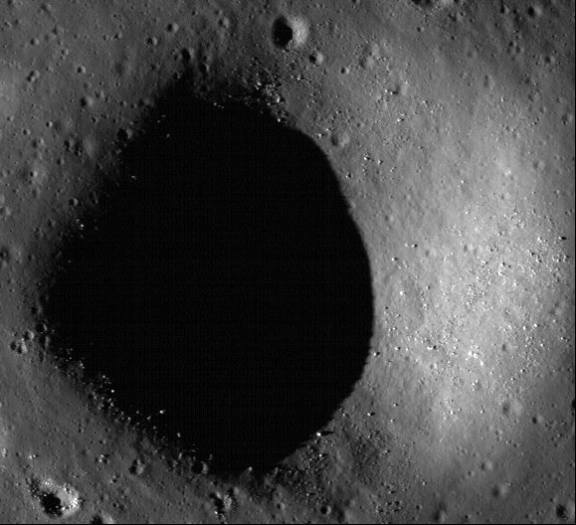
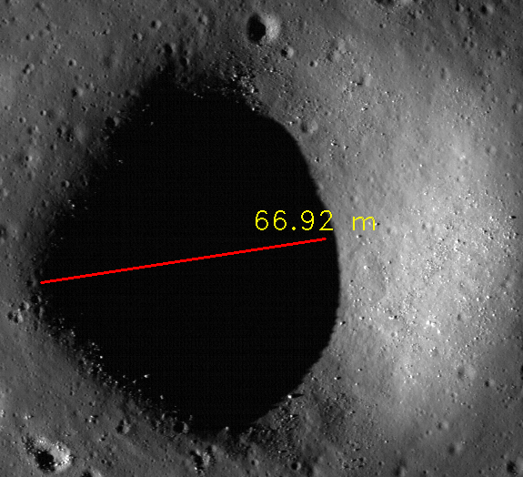
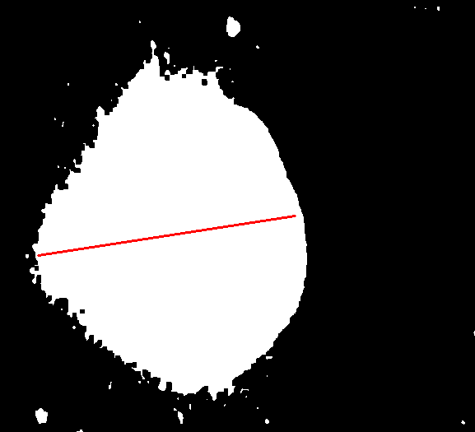
Crater Data Extraction - Depth Calculations
Extract shadows with some image processing, and find the shadow length along the sun angle.
Original crater image
Image of shadow and red shadow line
Depth for yoshi crater cited to be 70m.

Slide 20
Ringtoss - Results

Slide 21
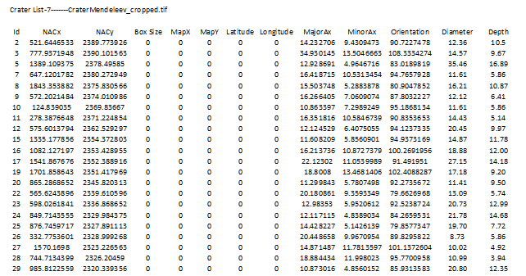
Output File
Notes:
Placeholder

Slide 22
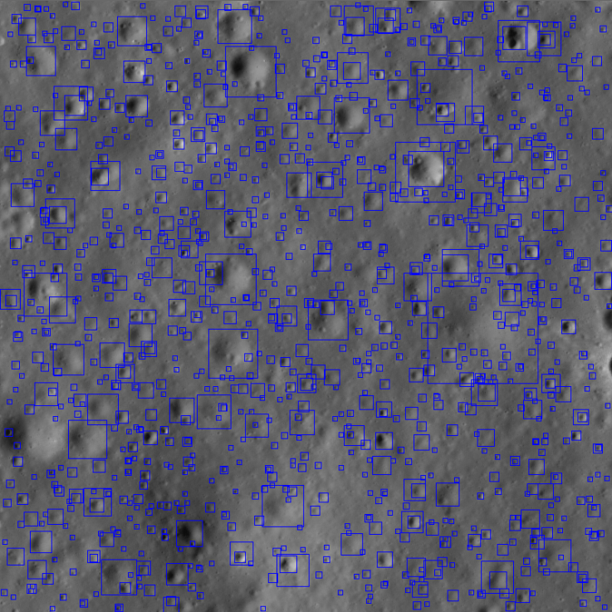
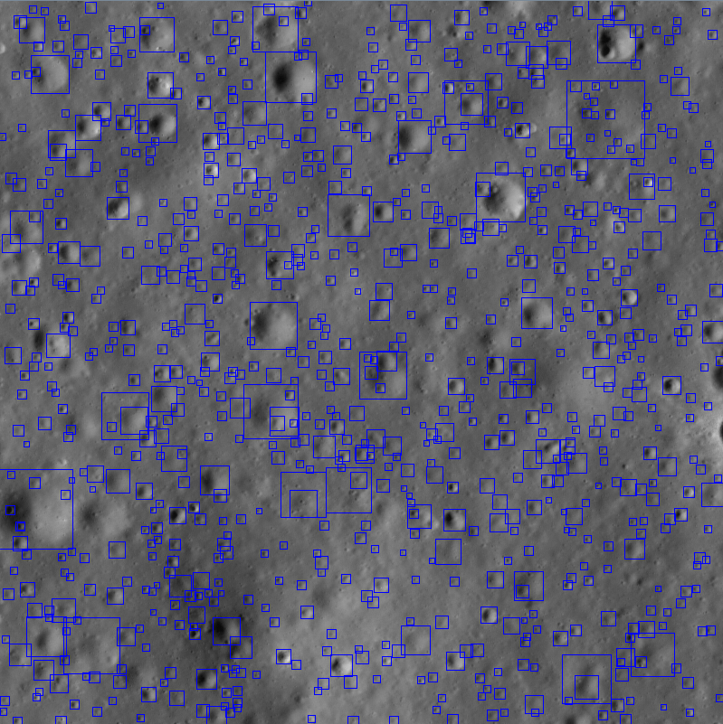
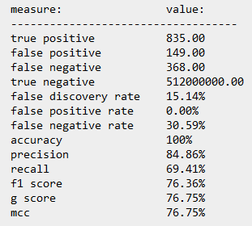
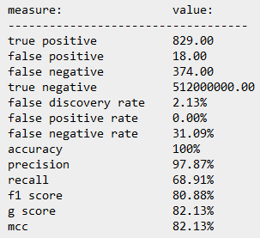
Ringtoss - Results
RINGTOSS
JPL
RINGTOSS
JPL
Notes:
Add performance data

Slide 23
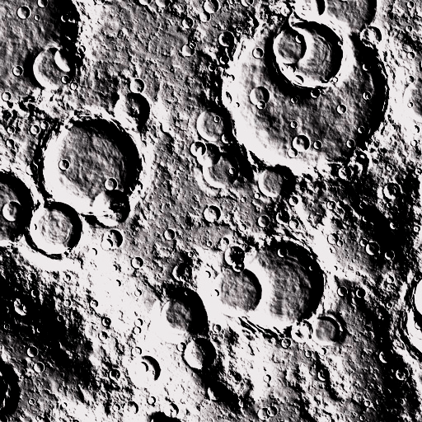
LIVE DEMO

Slide 24
Conclusion
Ringtoss - hybrid approach to crater detection
Advantages:
Uses different methodologies to try and detect various craters, (crisp, old, distinguishing shadows, etc)
Disadvantages:
Over detection of craters and other features.
Notes:
conclusion

Slide 25
Future Work ?
Incorporate RINGTOSS into LMMP website. (http://lmmp.nasa.gov)
Improve latitude and longitude interpolation.
Multiple image processing.
Employ unsupervised learning techniques to improve machine learning.
Distinguish craters from boulders using sun angles and crater shadows.
Parallelization of crater detection algorithms.
Notes:
Update to include parallelization

Slide 26
References and Sources
[Tamililakkiya 2011] “Linear and Non-Linear Feature Extraction Algorithms for Lunar Images” by Tamililakkiya V, Vani K, Lavanya A, and Anto Michael
[Clayden] DIAMETER & DEPTH OF LUNAR CRATERS by Andre James Clayden
[Kamarudin 2012] ”Detection of Craters and Its Orientation on Lunar” by Nur Diyana Kamarudin, Kamaruddin Abd. Ghani, Siti Noormiza Makhtar, Baizura Bohari and Noorlina Zainuddin
Notes:
Add tools
Format (font and lower/upper case usages, etc) should be uniform.

Slide 27
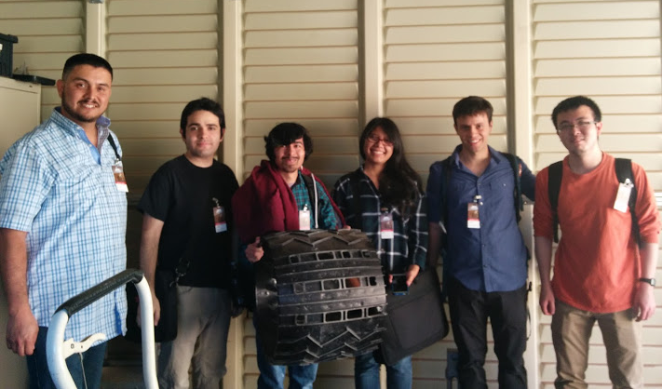
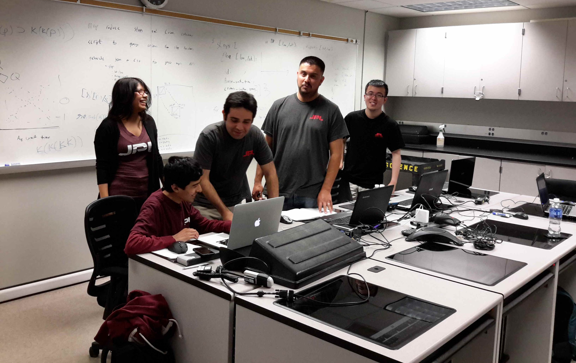
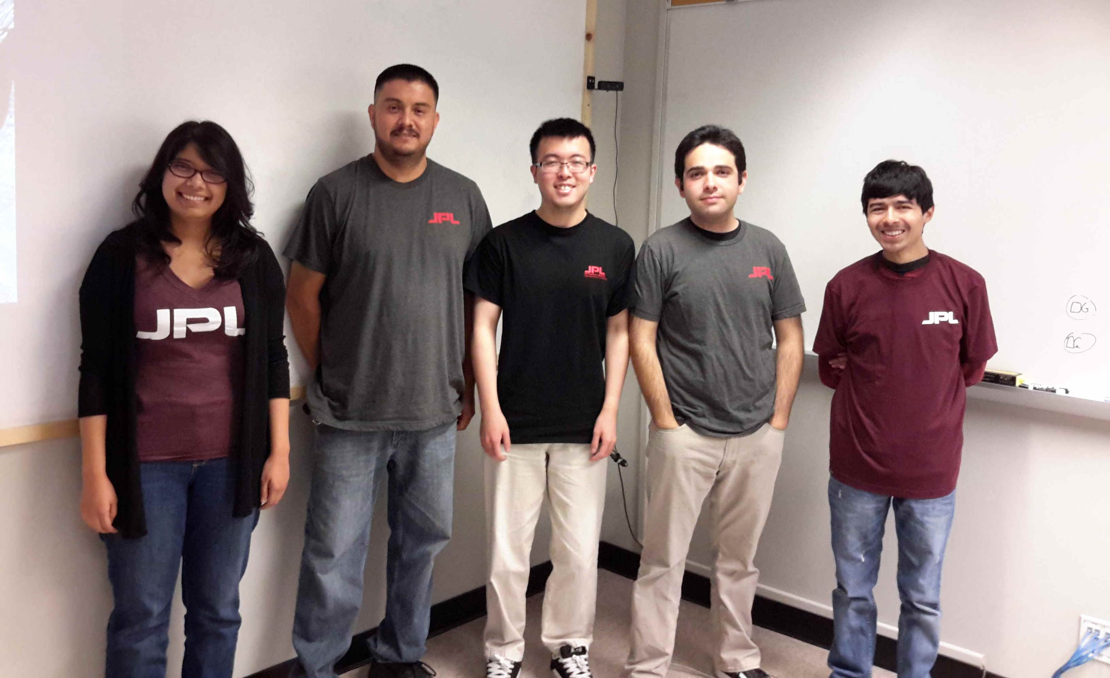
Questions and Answers
Notes:
Add group pic and image from visiting JPL

