Slide 1
Parameterized Model for Mobility Project Scoring and Estimation of Benefits
LA City Data Science

Slide 2
Team:
Project Lead: Elizaveta Sokolova (sokolovatennis@yandex.ru) Architecture / Design lead: Alvin Nguyen (anguyen8613@gmail.com) QA Lead: Kevin Lam (klam30@calstatela.edu)
Documentation Lead: Kevin Gamboa (kbgamboa92@gmail.com)
Advisor:
Mohammad Pourhomayoun
Liaisons:
Hunter Owens - hunter.owens@lacity.org
Karina Macias - karina.macias@lacity.org
Team Members

Slide 3
1. Introduction & Overview
2. Arcgis
3. user view
4. scoring
5. Conclusion
Agenda

Slide 4
1. Introduction & Overview

Slide 5
The Los Angeles Department of Transportation (LADOT) has partnered with the City’s Information Technology Agency Data Science Federation and California State University Los Angeles to develop a Parameterized Model for mobility project scoring and estimation of benefits.
Introduction

Slide 6
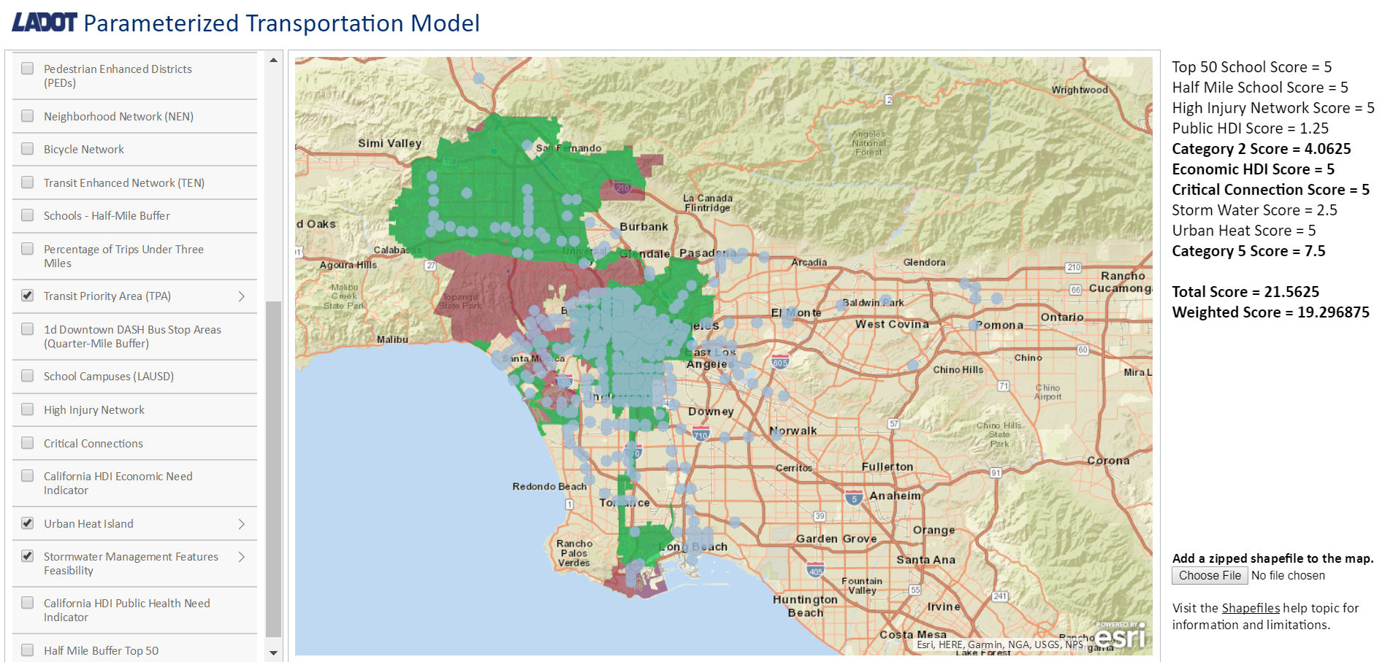
automated mapping tool based on ArcGIS that gathers transportation capital project data and score projects based on LADOT priorities and City mobility goals.
In the next stage of the project, we also plan to use data-driven approaches including machine learning algorithms to automatically design the best weights and scores rather than using pre-defined parameters.
Deliverables

Slide 7
This project will create a web map based on ESRI ArcGIS mapping tools that allows LADOT project managers to locate mobility investments within the City and use automate overlay analysis to apply a weighted scoring model to the proposed projects, calculating how consistent the investment is with the City’s mobility goals and policies.
The project will enable LADOT staff to justify mobility investment according to their relative advancement of City mobility policy priorities and anticipated benefits to Angelenos in terms of safety, access, sustainability, and livability.
The project would also use data on existing conditions to forecast the influence of individual projects to street users’ experience by travel mode.
our goal

Slide 8
The overlay analysis includes data layers relating to the City’s vision for its transportation system, as described in the adopted Mobility Plan 2035: the Circulation Element of the General Plan, and goals for mobility as described in the LADOT 2018 - 2020 Strategic Plan.
Mobility plan 2035

Slide 9
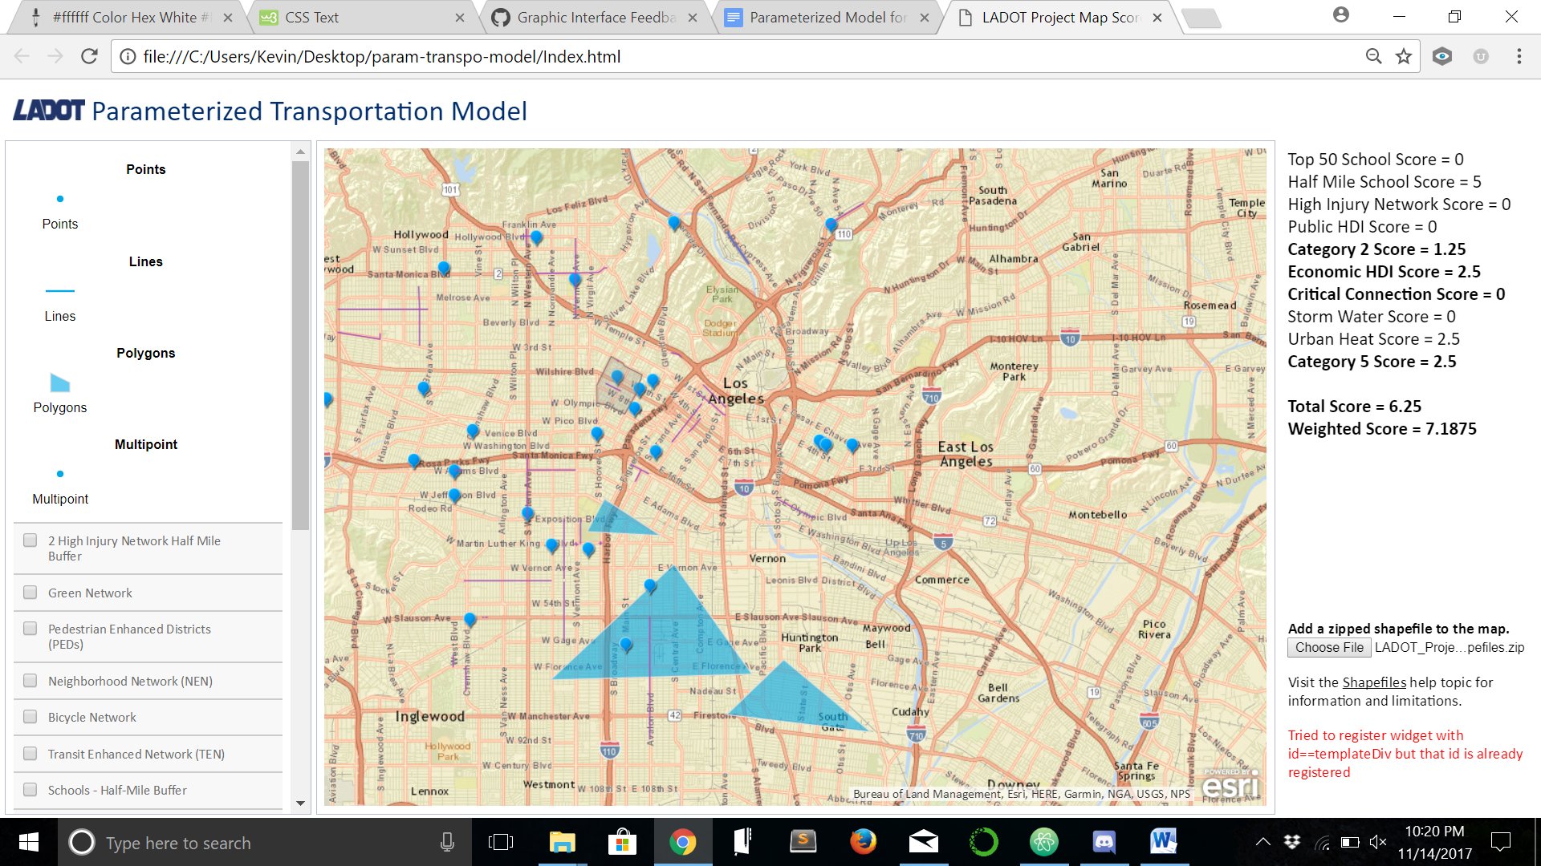
automate weighted score modeling of proposed transportation projects based on City mobility policy priorities
support strategic mobility investment planning and project development
forecast influence of project on existing transportation system and travel behavior using empirical methods.
THIS MAPPING TOOL CAN …

Slide 10
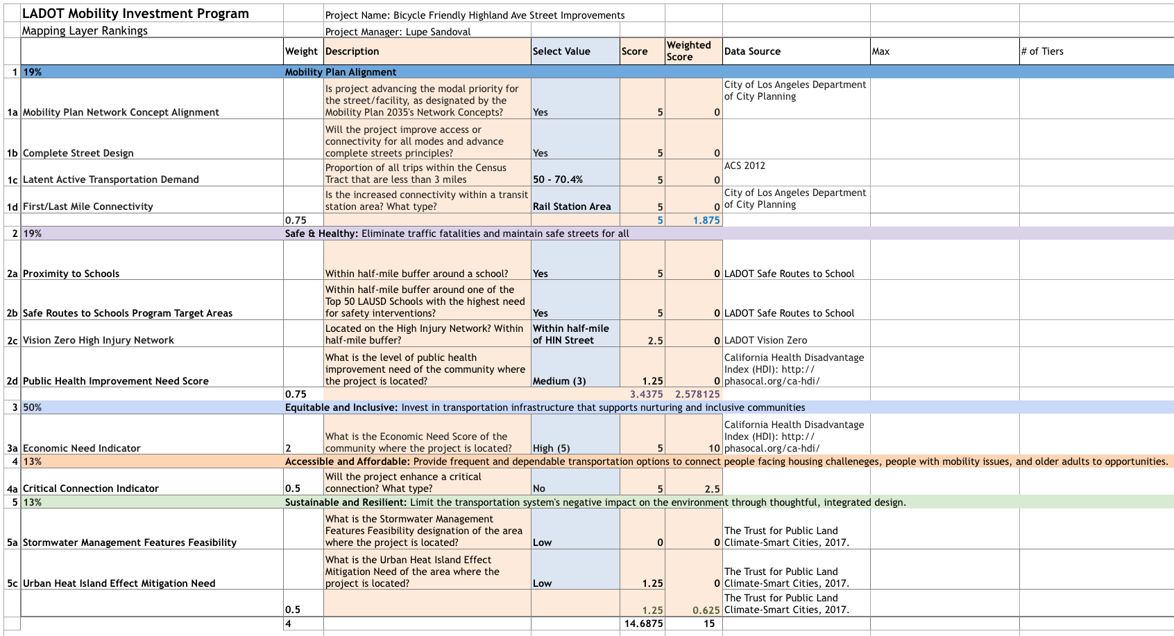
BEFORE OUR APP

Slide 11
2. Arcgis

Slide 12
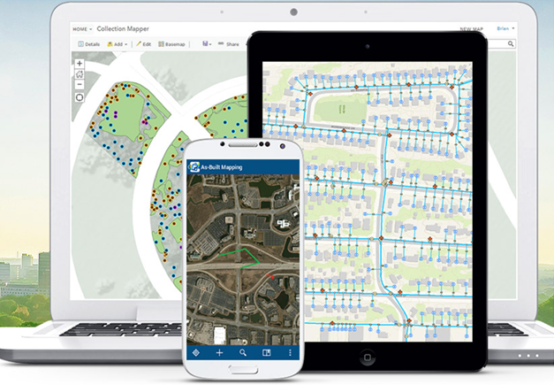
- Allows you to use, create, and share maps, scenes, apps, layers, analytics, and data. - GIS → Geographic Information System - Visualize, question, analyze, and interpret data to understand relationships, patterns, and trends. - Access to Living Atlas of the World, apps, and Esri’s secure cloud, where you can add items and publish web layers. - Can use it to extend the capabilities of ArcGIS Desktop, ArcGIS Enterprise, ArcGIS Web APIs, and ArcGIS Runtime SDKs.
What is ArcGIS Online?

Slide 13
- ArcGIS Online it’s the place to explore data, create maps, and share stories. Capabilities: - Use and create maps and scenes - Access ready-to-use maps - Layers and analytics from Living Atlas of the world - Publish data as web layers - Collaborate & share - Access maps from any device - Make maps with business data - View status reports
What can you do with ArcGIS Online?

Slide 14
EXPLORE DATA
ArcGIS Online includes interactive maps and scenes that allow your entire organization to explore, understand, and measure your geographic data. - Access a dynamic collection of maps, scenes, data layers, imagery, analytics, and apps from the ArcGIS community, and apply them with your own data to reveal patterns, answers, and relationships about your community and the world. - Use the analysis tools included in the map viewer to reveal new patterns, find suitable locations, enrich your data, find out what's nearby, and summarize your data.
More on arcgis

Slide 15
YOU CAN CREATE MAPS, SCENES, AND APPS ArcGIS Online includes everything you need to create maps, create scenes, and create apps. - Map Viewer and Scene Viewer - Can access a gallery of basemaps & tools for adding your own layers and configuring mashups that you can share with others. - You also have access to easy-to-use tools for creating apps that you can publish to ArcGIS Online.
More on arcgis

Slide 16
ALLOWS US TO COLLABORATE AND SHARE - Enable interaction with your organizational data - share content related to a common activity. - Set up groups that are private and by invitation only, or public groups that are open to everyone.
More on arcgis

Slide 17
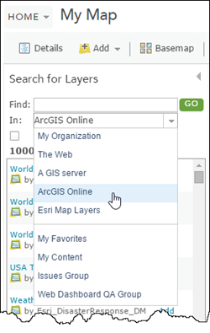
CAN PUBILISH DATA AS WEB LAYERS
- Publish your data as web layers on ArcGIS Online. - This frees up your internal resources, since these web layers are hosted in Esri’s cloud and scale dynamically as demand increases or decreases. - Add your layers to web, desktop, and mobile apps and allow others to use them as well. - Publish your data directly from ArcGIS Desktop or the ArcGIS Online website without needing to install your own server - Share them with others in your organization who can add map layers or geoprocessing tools to their own maps and apps.
MORE ON ARCGIS

Slide 18
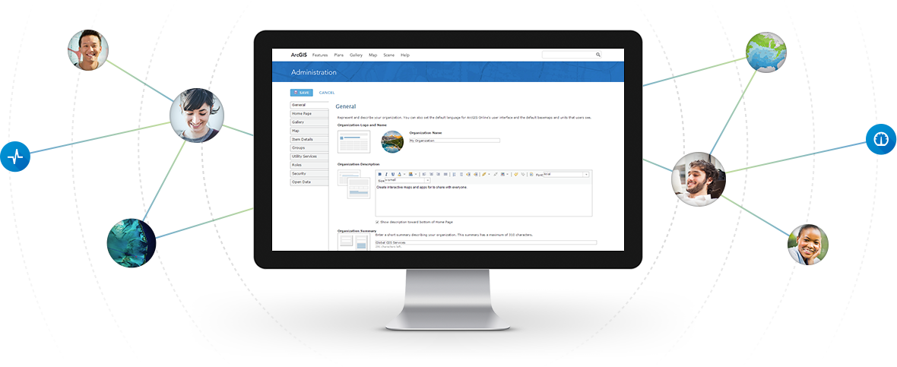
MORE ON ARCGIS
Administrator can:
Configure website
Invite / add members
Determine their roles
Manage content and groups
Set the security policy
CAN ADMINISTER YOUR ORGANIZATION
ArcGIS Online includes tools and settings that allow the administrator of the organization to not only customize the home page but also manage the organization as a whole.

Slide 19
3. user view

Slide 20
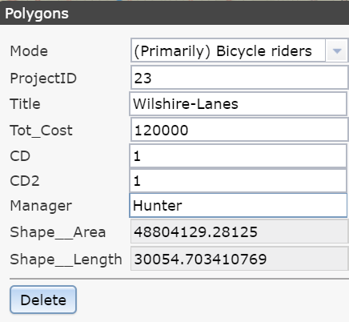
Project Properties

Slide 21
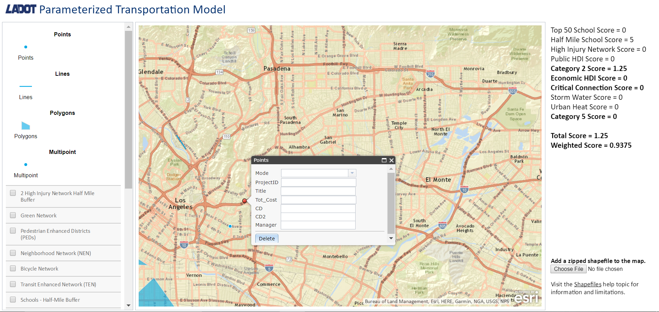
Selecting the Points feature enables the user to click anywhere to propose a project that can be represented as a point on a map (stop signs, traffic lights).
Point feature

Slide 22
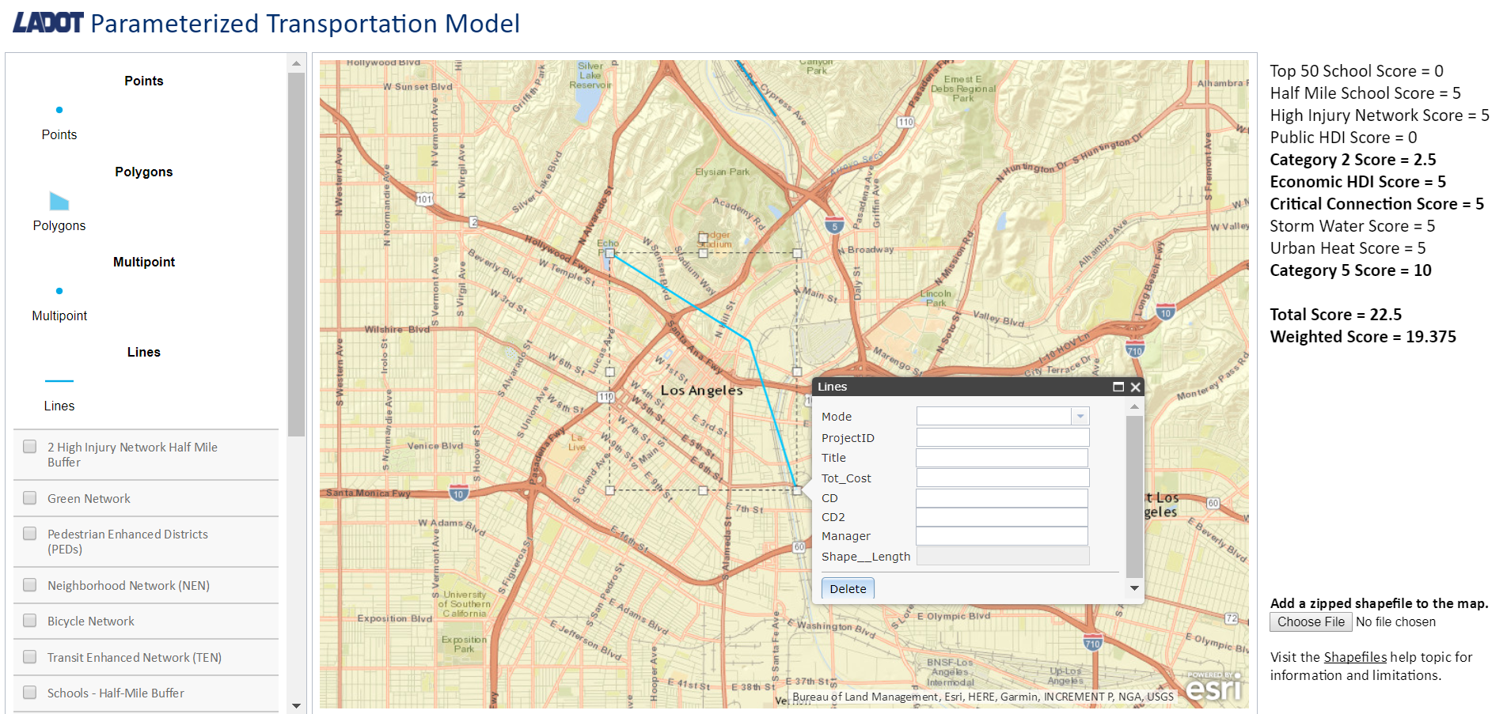
Selecting the Lines feature enables the user to click anywhere on the map multiple times to propose a project that would have a physical representation of a line on a map (road construction, bicycle lanes).
Line

Slide 23
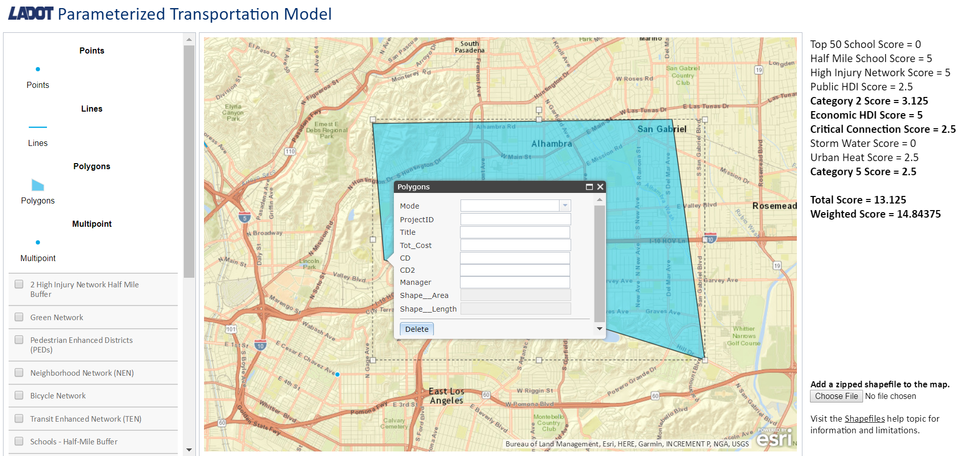
Selecting the Polygons feature enables the user to click anywhere on the map multiple times to propose a project that has a physical representation of a polygon on a map(schools, parks).
Polygons

Slide 24
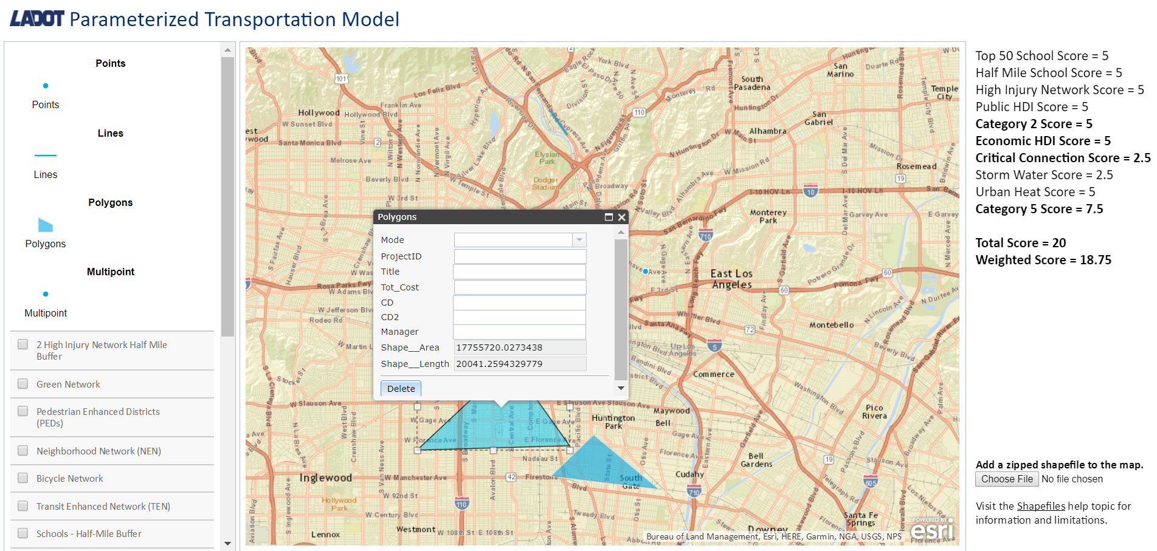
The positioning of projects, in terms of its layers, determines how the scoring will be calculated. The calculations are based upon LADOT priorities and City mobility goals.
Scoring feature

Slide 25
The “Choose File” button allows the user to upload a shapefile with pre-existing projects.
Adding Shapefiles

Slide 26
4. scoring

Slide 27
SCORE CATEGORIES
MOBILITY PLAN ALIGNMENT
SAFE AND HEALTHY
ACCESSIBLE AND AFFORDABLE
SUSTAINABLE AND RESILIENT

Slide 28
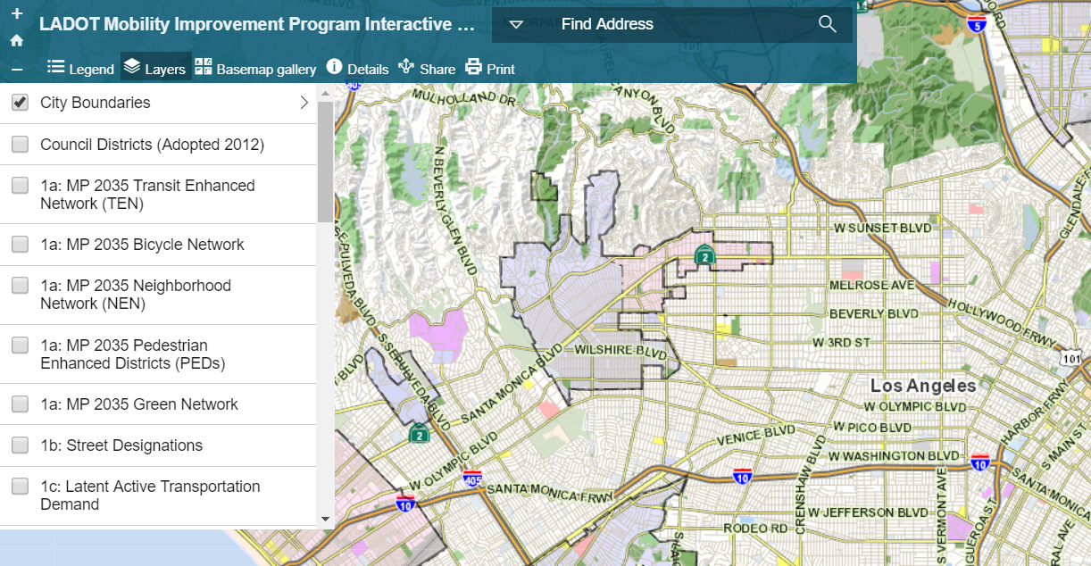
Current scoring method

Slide 29
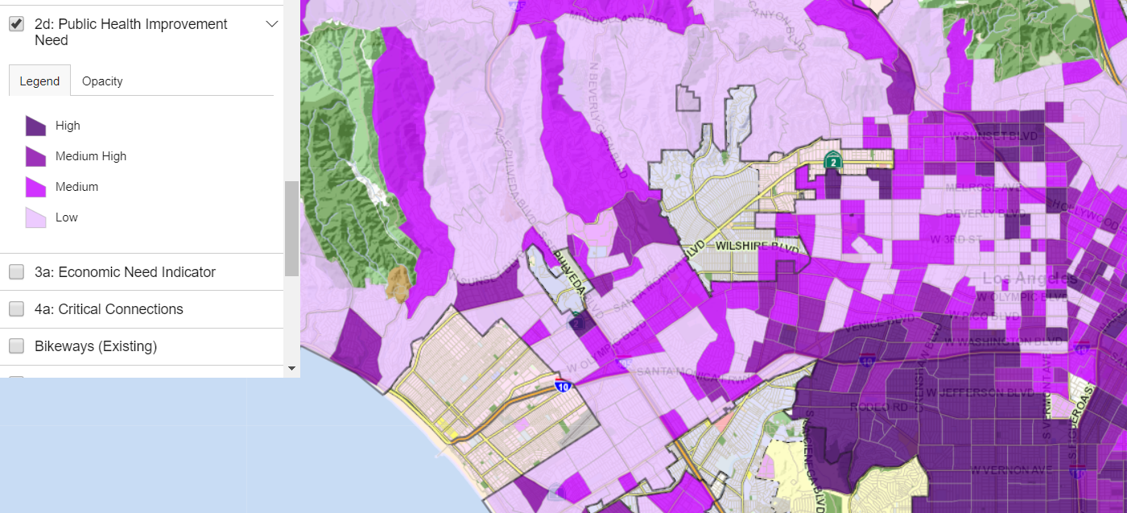
Current scoring method – step 2

Slide 30
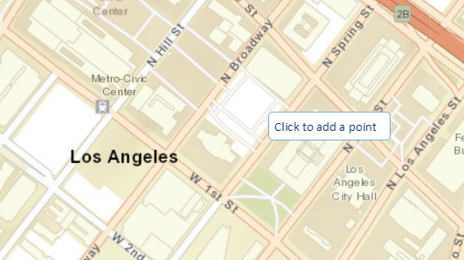
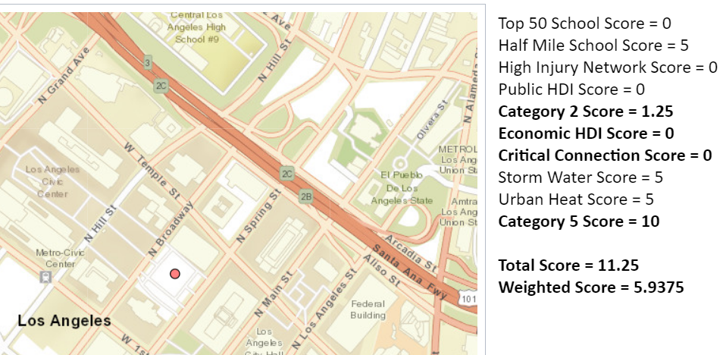
Improved scoring method
DRAW PROJECT ON MAP
GET SCORE INSTANTLY

Slide 31
5. Conclusion

Slide 32
Future tasks :
Web Application Tasks
Machine Learning Tasks

Slide 33
Thank you!

