Slide 1
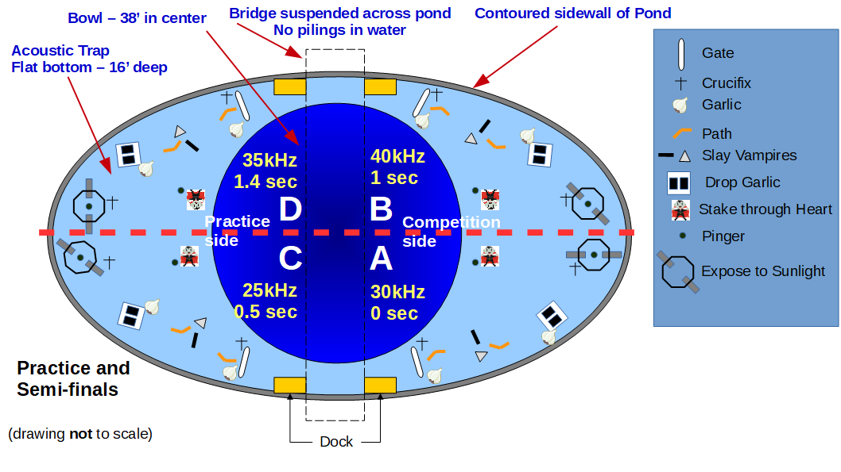
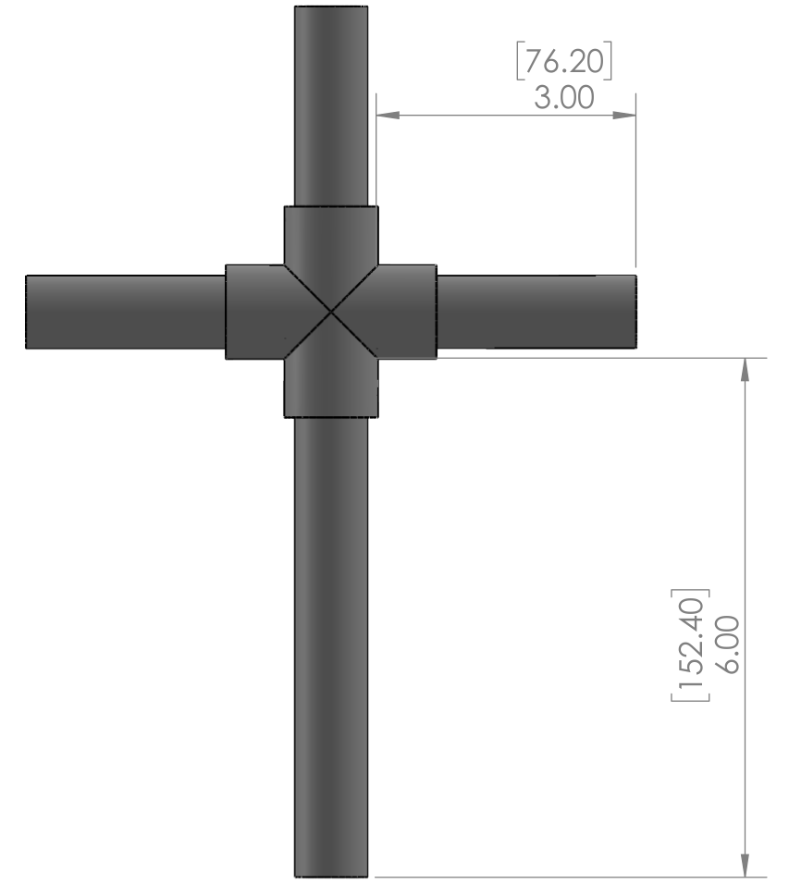
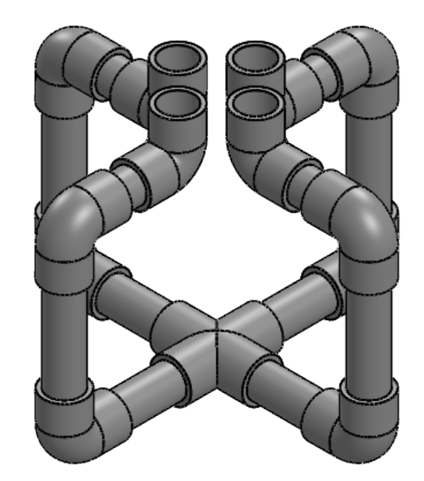
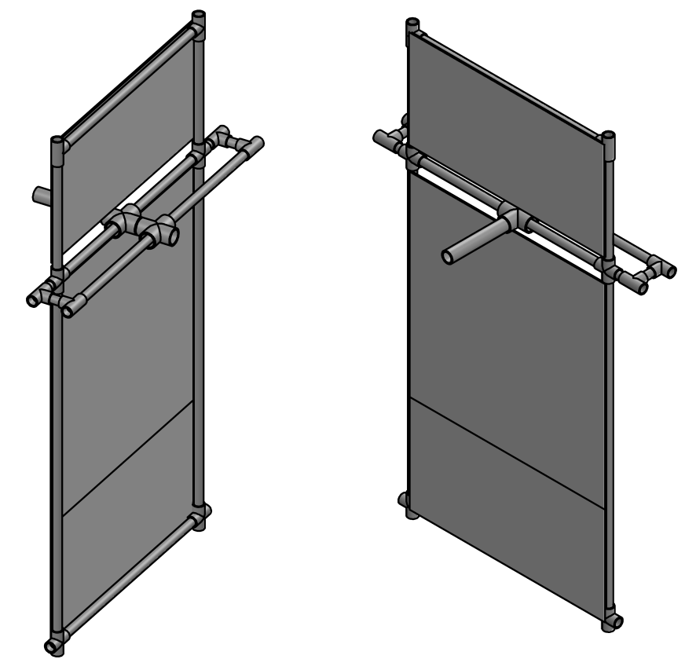
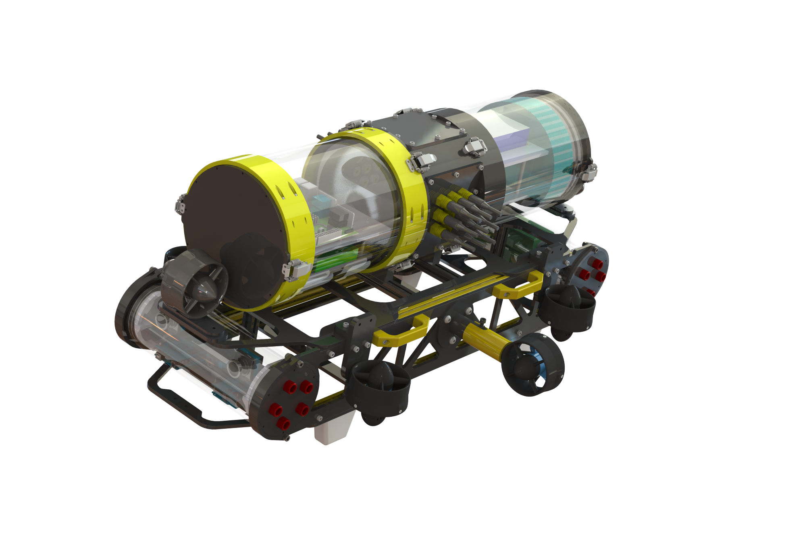
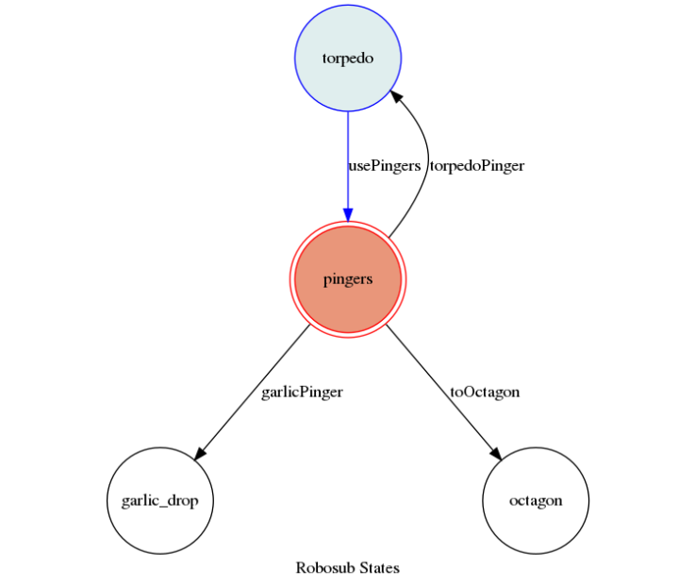
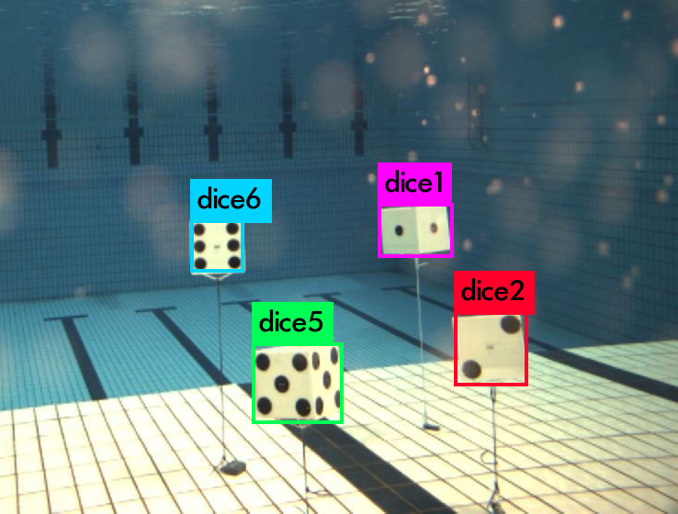
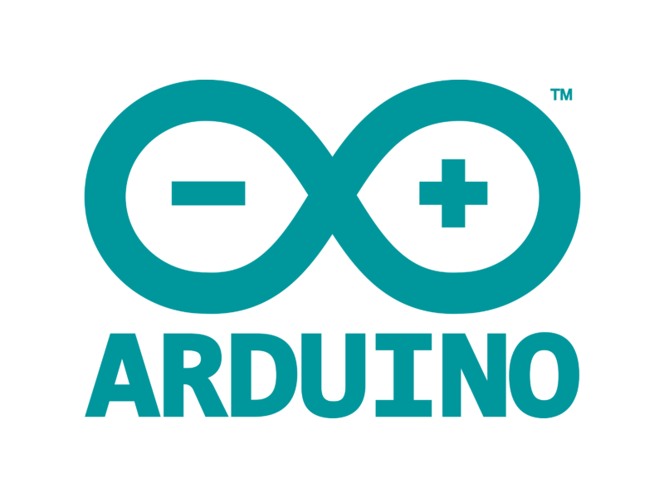
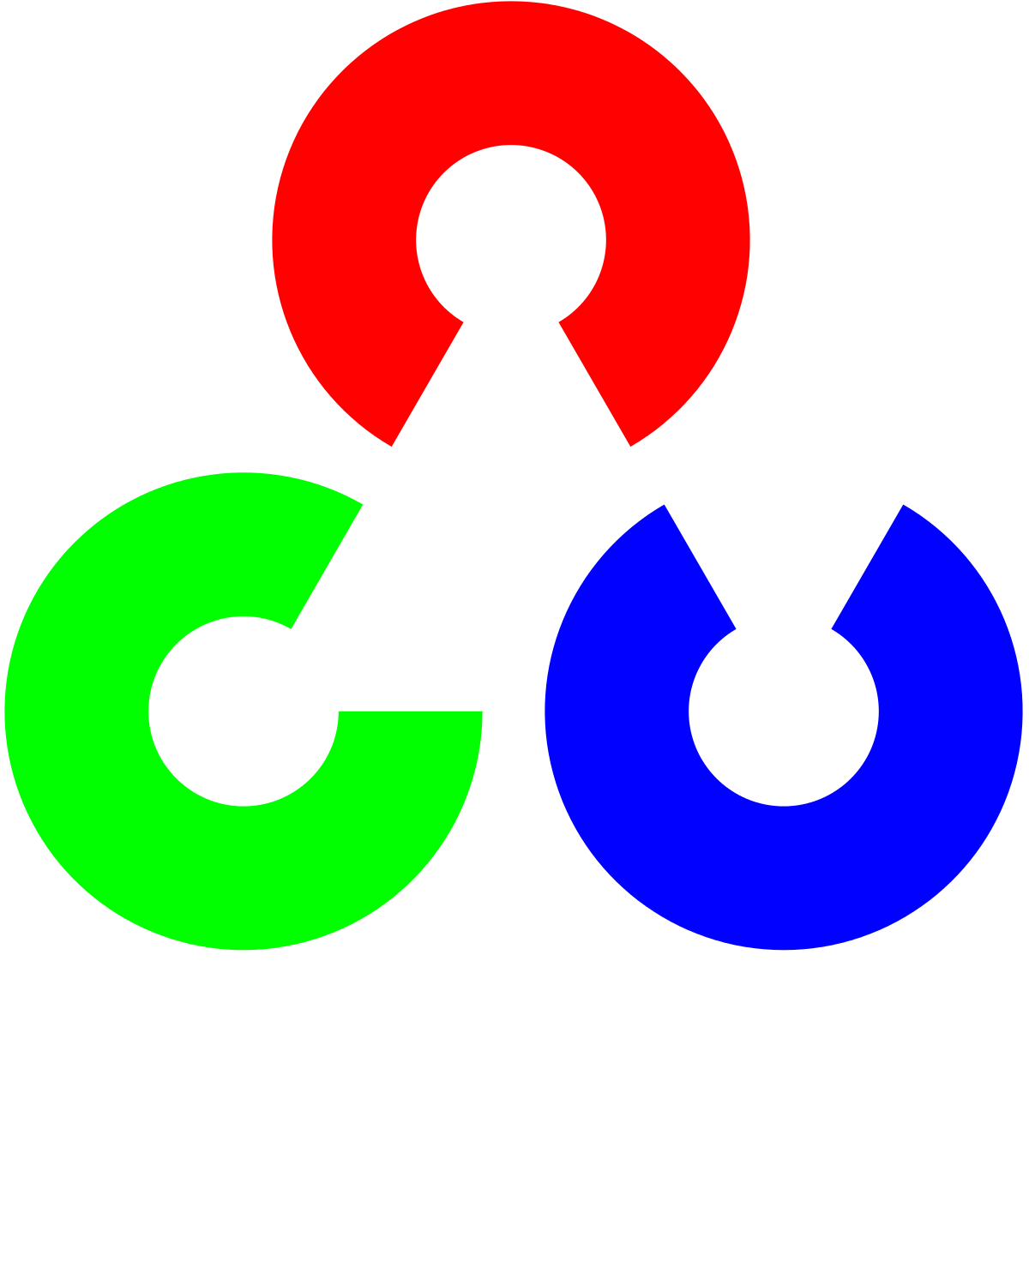
http://www.bluerobotics.com/wp-content/uploads/2017/01/br-full-logo-1.png
ROBOSUB Team Members: Jin Chiu | Erika Estrada | Kunal Juneja
David Krystal | Jesus Lopez Faculty Advisor: Dr. Sargent
Robosub Liaison: Diego Santillan Department of Computer Science College of Engineering, Computer Science, and Technology California State University, Los Angeles
[ Background ]
[ Tasks ]
GY4R4D05 is an autonomous underwater vehicle that will be used in an international competition. It is a joint project that requires collaboration between Electrical, Mechanical and Computer Science students. The AUV must complete a series of tasks without user interference. The sub must see, understand, and localize objects in its surroundings so it can respond and interact with them.
[ Objectives ]
Implement state machine design pattern and YoloV3 object detection algorithm
Modularize code for future teams reusability
Train a neural net with custom images
Create search strategies for course navigation
Design algorithms for obstacle completion
Crucifix
Garlic
Slider
[ Results ]
GY4R4D05
Example of early implementation of machine states in AUV.
AUV was trained to recognize different die faces. It uses the YOLOv3 algorithm with labeled images to train. The same concept is then utilized when applying the algorithm with other objects.
Tools &
Technologies
Notes:
‹#›
Have students check that the logo is the appropriate one to use.

