Slide 1
Alvarez, Olín
Song, Jonathan
Tran, Kevin
Ho, Henry Padilla, Danny

Slide 2
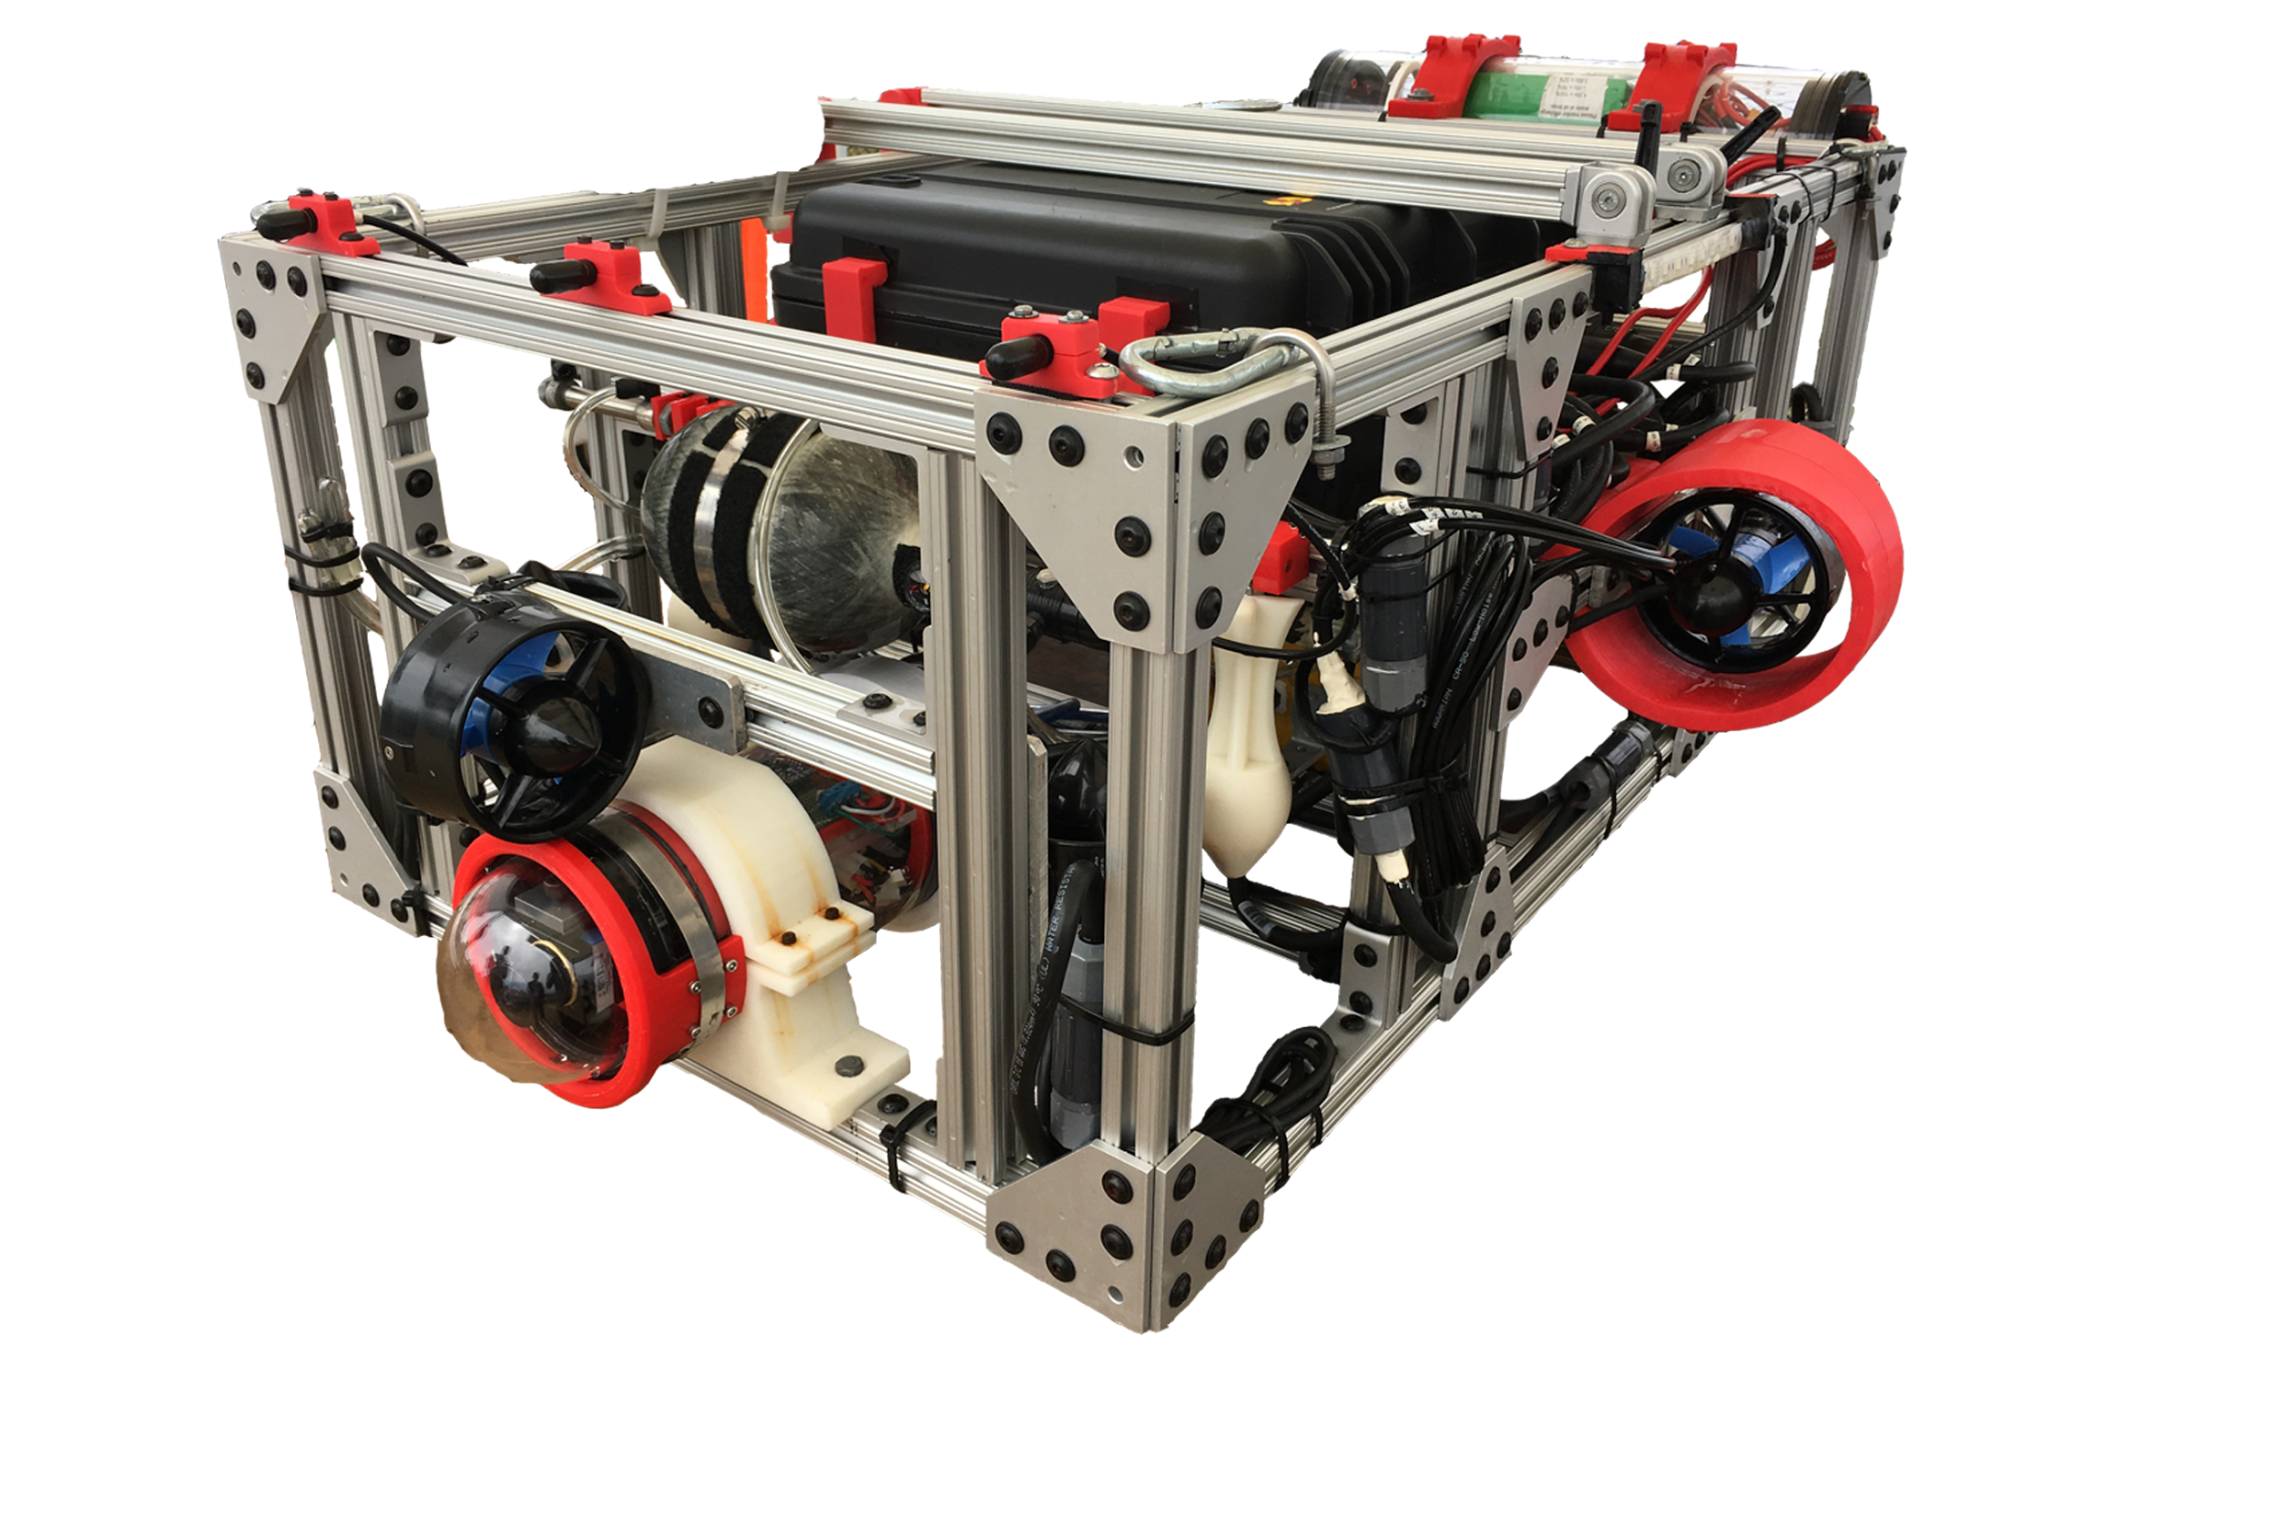

Slide 3
Objectives
Olín Alvarez :: Overview
Work in combination with a team of Electrical and Mechanical engineers to design an Autonomous Underwater Vehicle (AUV)
Create software that will power an AUV which will take part in an international “Student-Designed-and-Built” Competition.
Have the AUV software interpret information from hardware such that it completes as many tasks as possible.

Slide 4
Software
Olín Alvarez :: Overview
Responsible for controlling the navigation of the AUV, including stabilization
Must use different Audio-Visual signals to locate different tasks
Determines task requirements by interpreting visual indicators

Slide 5
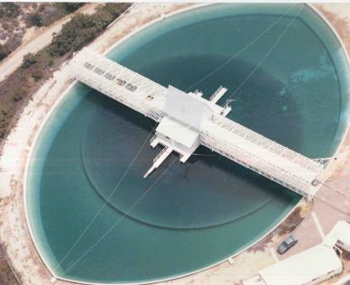

Slide 6
Competition
Olín Alvarez :: Overview
Takes place July 30th - August 5th in San Diego, CA
A qualification round, followed by a series of tasks the sub must complete within a given amount of time
Each task has an amount of units that can be distributed determined by how much of each respective task is completed

Slide 7
Tasks Overview
Olín Alvarez :: Overview
Tasks will test the object detection capabilities.
Examples of tasks are passing a gate, detecting dice buoys and adding the values
Most important task is the qualification task which is passing under an orange gate and circumnavigating a pole and returning under the same gate.

Slide 8
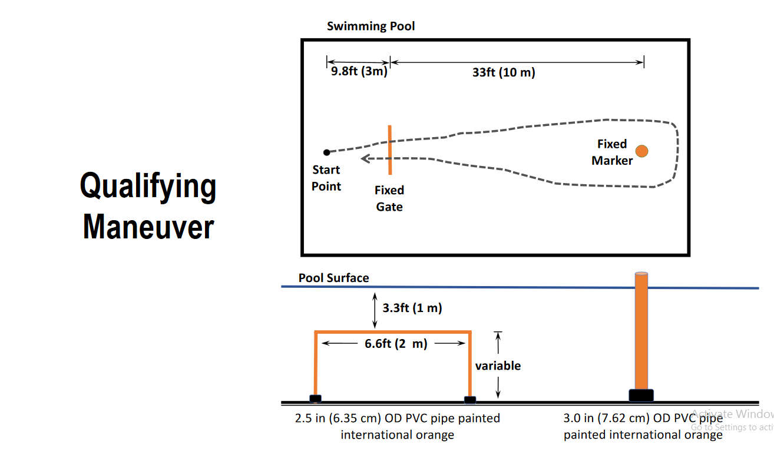
Olín Alvarez :: Overview

Slide 9
Hardware
Jonathan Song

Slide 10
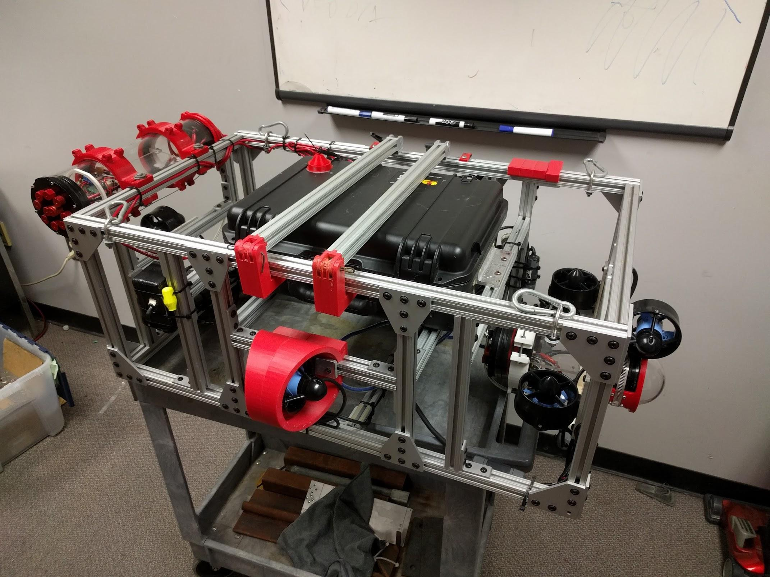
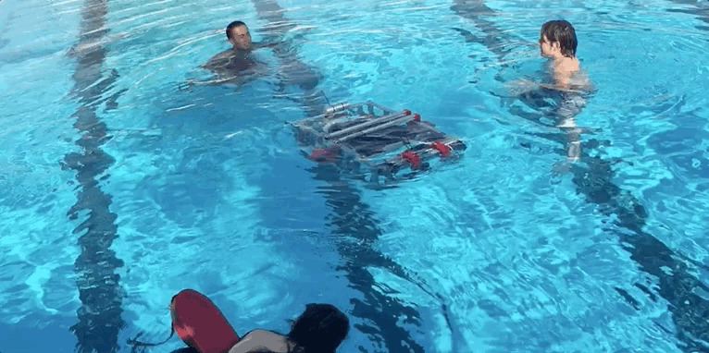
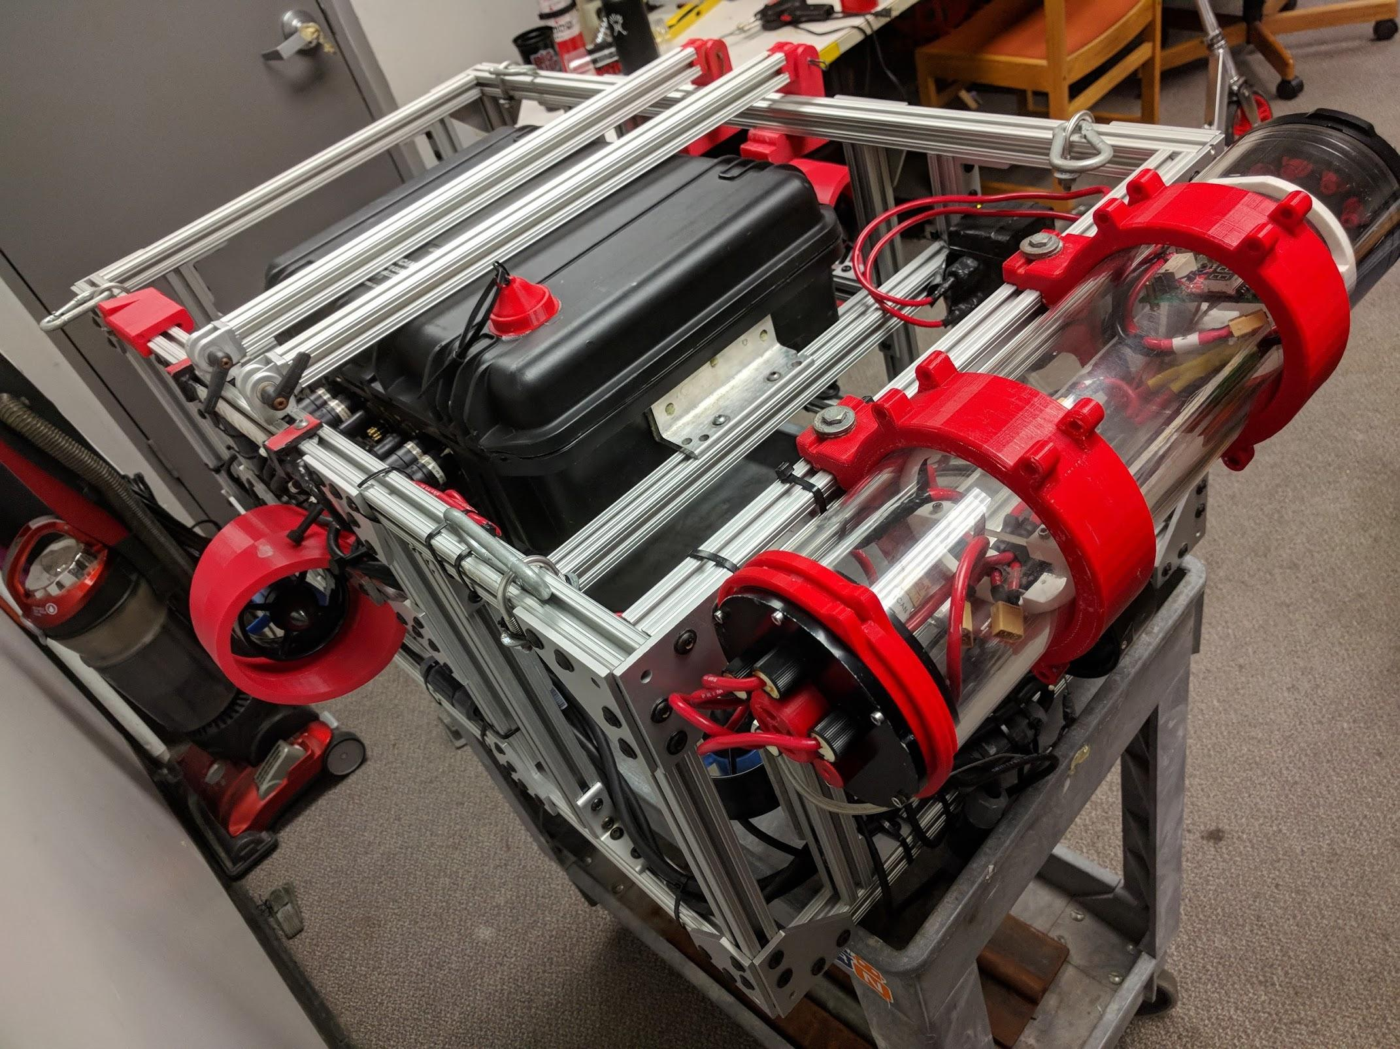
Eagle One
Jonathan Song :: Hardware

Slide 11
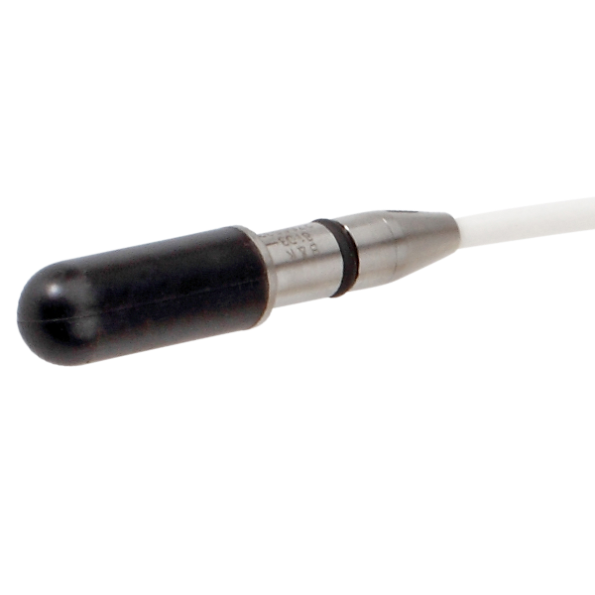
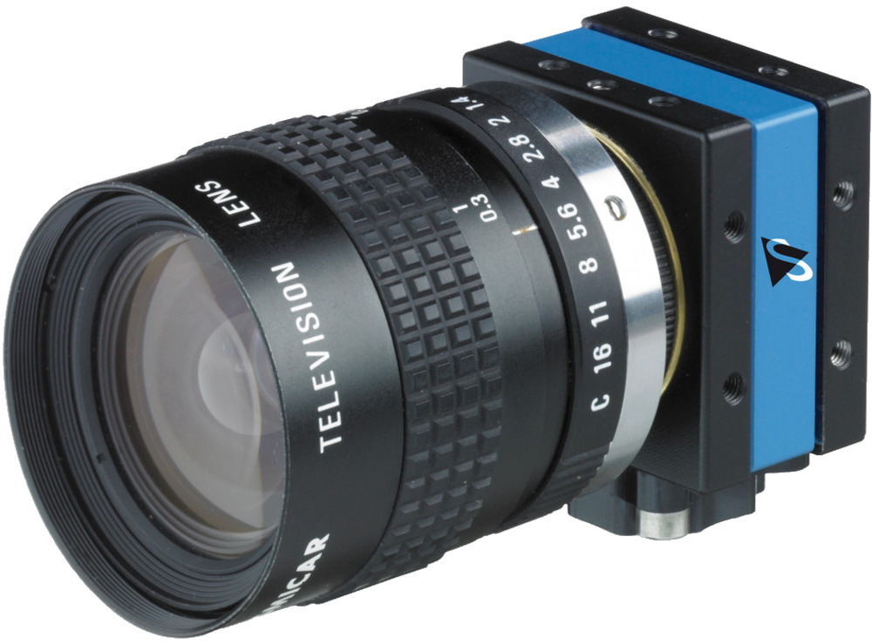
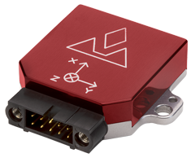
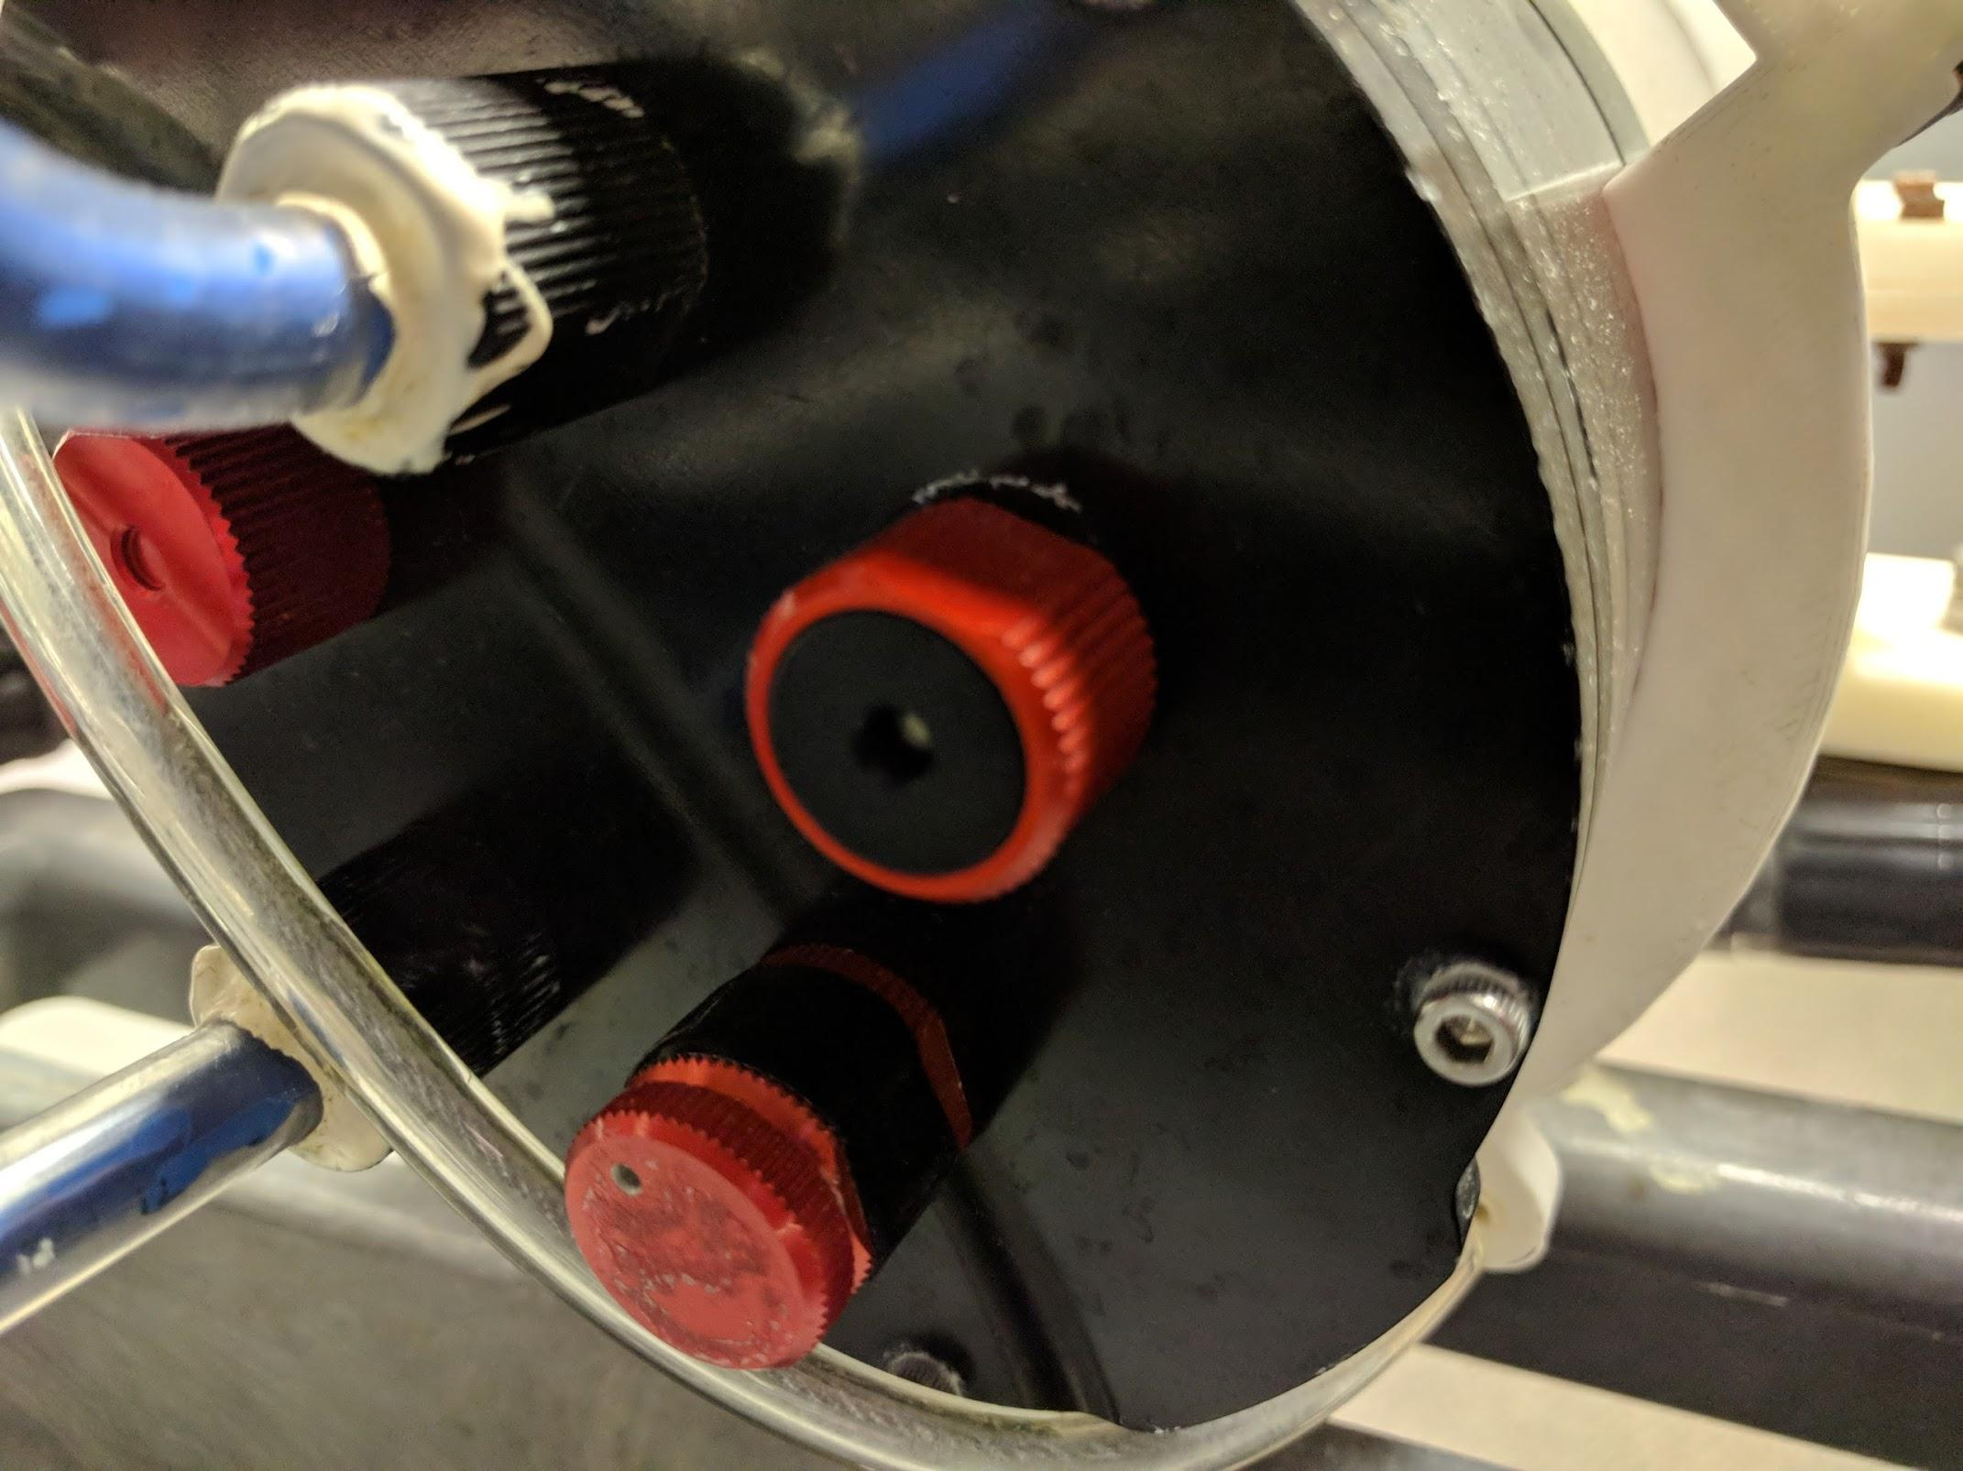
Hardware - Sensors
Jonathan Song :: Hardware
Cameras
Hydrophone
Barometer
Inertial Measurement Unit aka IMU
Doppler Velocity Log aka DVL (maybe)

Slide 12
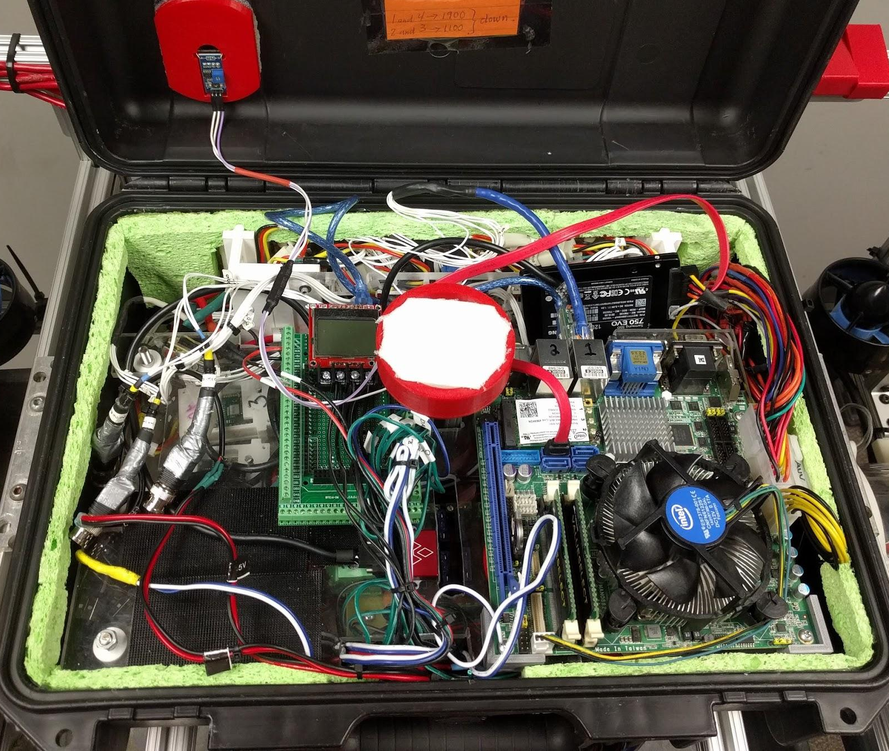
Hardware - Computing Power
Jonathan Song :: Hardware
Computer in a Box
Intel i7 CPU
8GB RAM
Samsung 750 Evo SSD

Slide 13
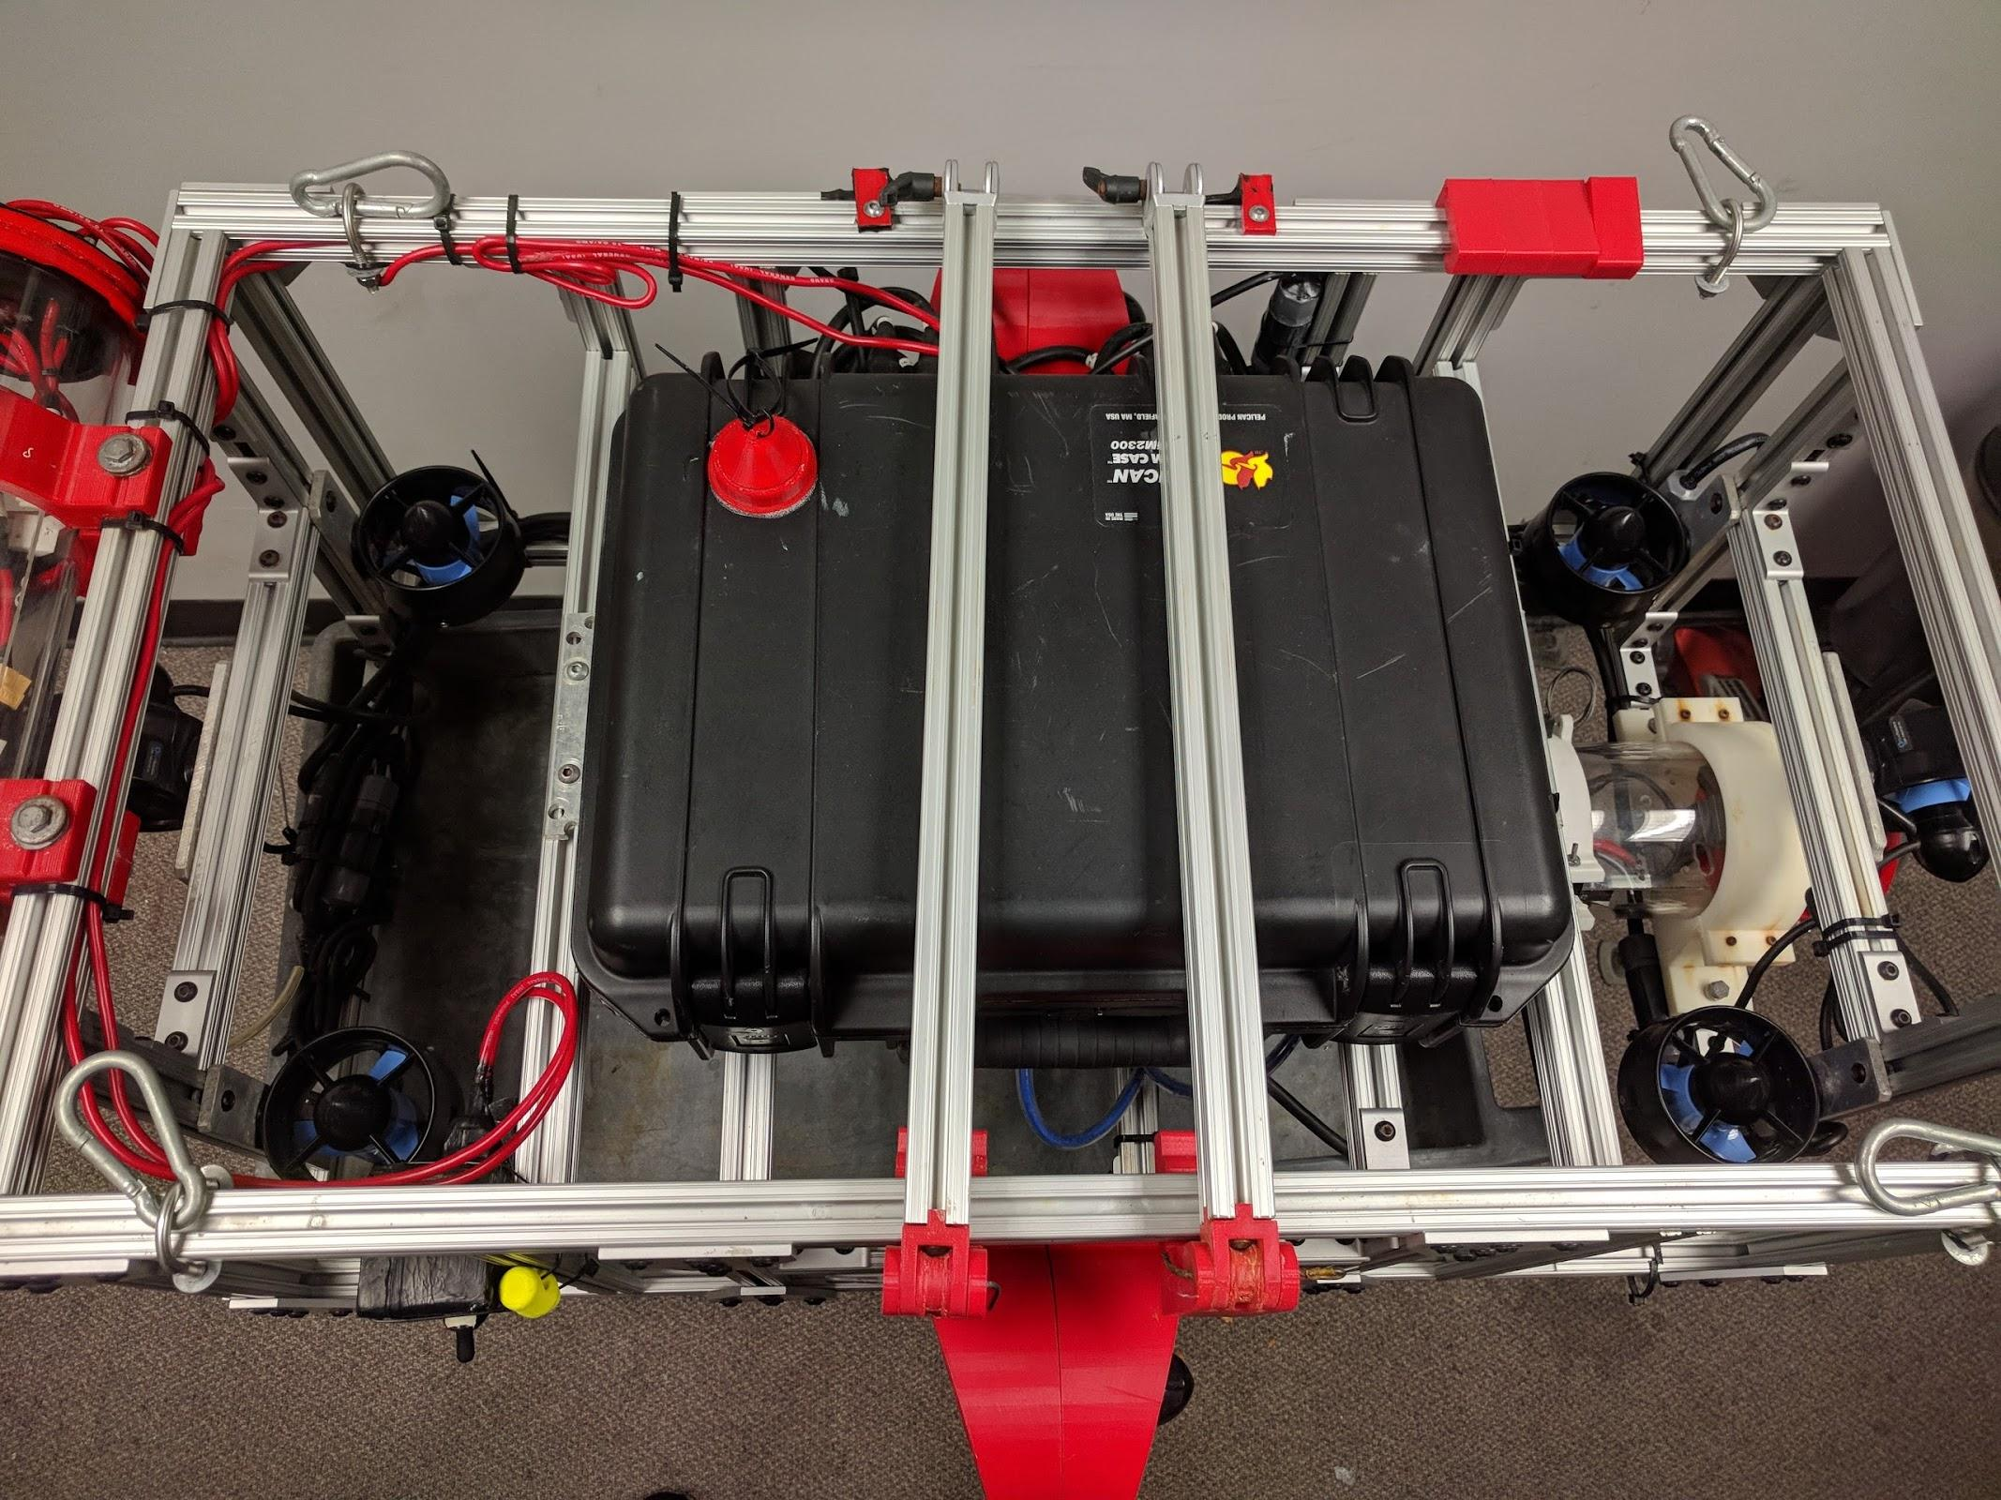
Hardware - Power and Movement
Jonathan Song :: Hardware
Two 14.8v Batteries
Motors
Vertical
Horizontal

Slide 14
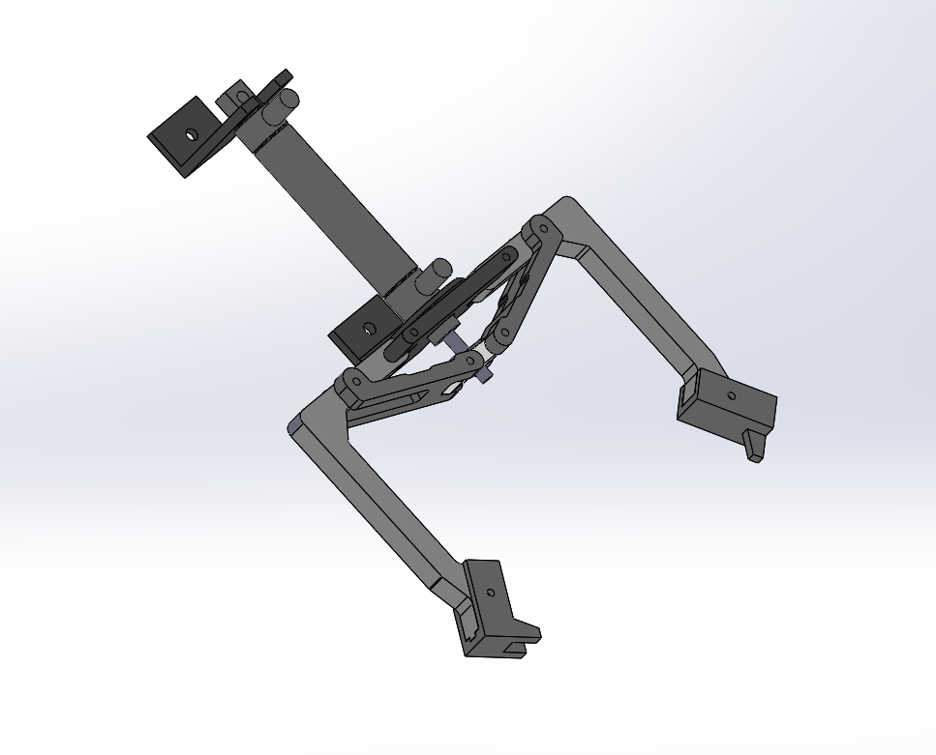
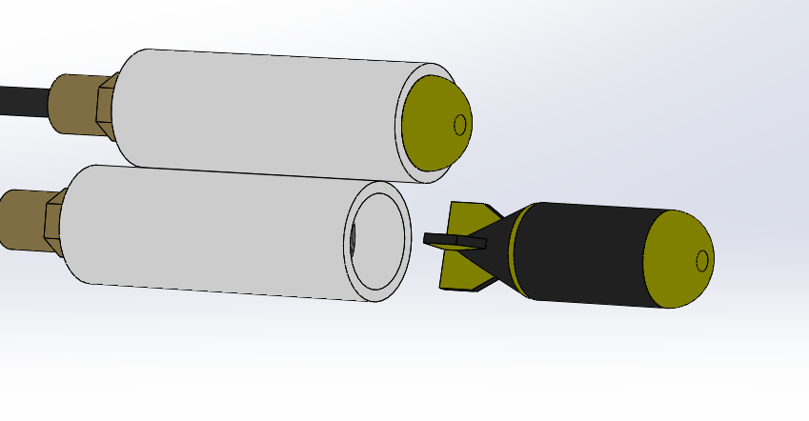
Hardware - Pneumatics
Jonathan Song :: Hardware
Torpedoes
Claws

Slide 15
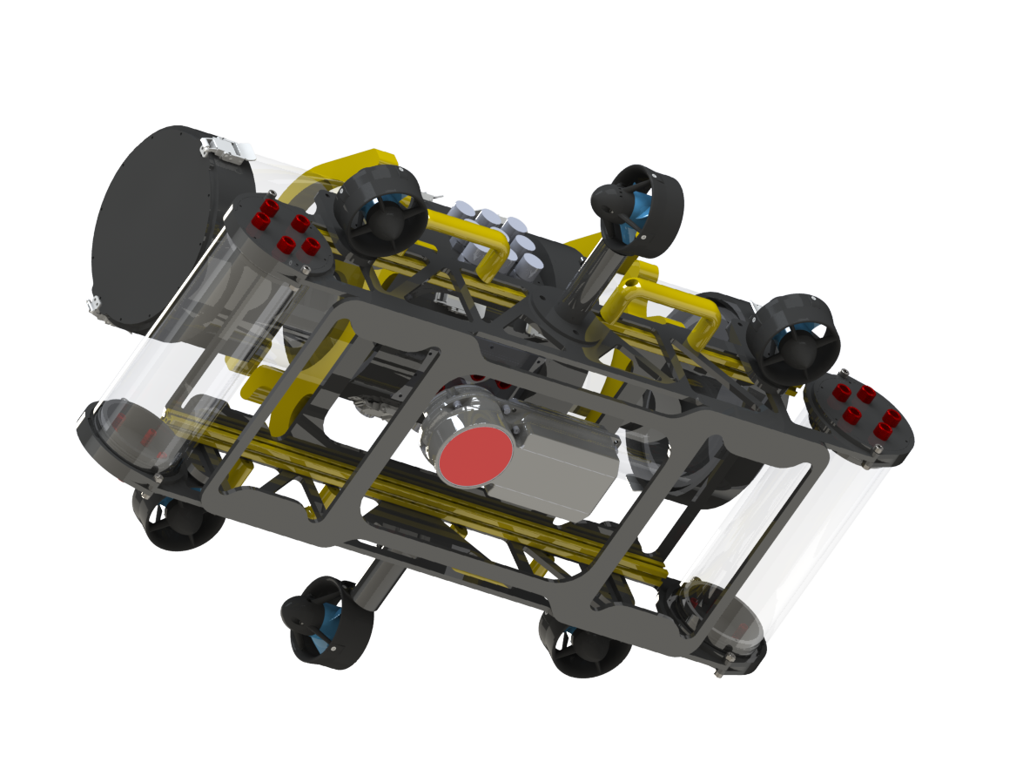
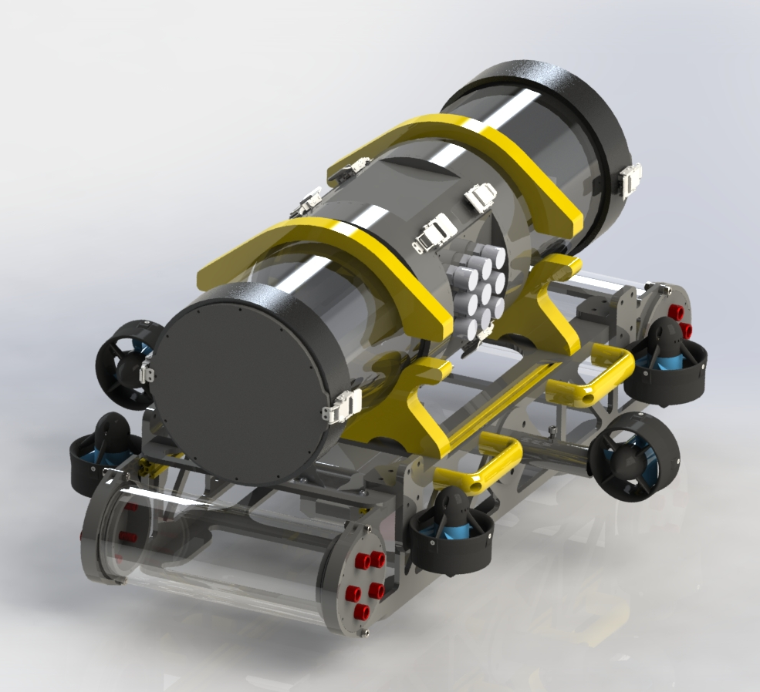
Eagle Two
Jonathan Song :: Hardware

Slide 16
Arduino
Kevin Tran

Slide 17
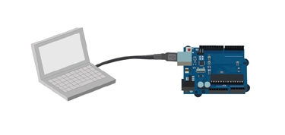
Arduino - interface
Kevin Tran :: Arduino
The Arduinos will be used to connect the hardware to the main computer
All the instructions will come from the main computer, sent to the Arduino, then finally sent to each piece of hardware
Notes:
So the next pieces of hardware that are very vital to the AUV that Jon has not mentioned yet are the microcontrollers, which will be Arduinos
The arduinos will be used to connect most of the hardware Jon had previously mentioned to the main computer
All of the instructions will come from the main computer, sent to the arduino, then finally sent to each piece of hardware

Slide 18
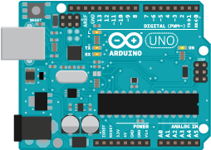
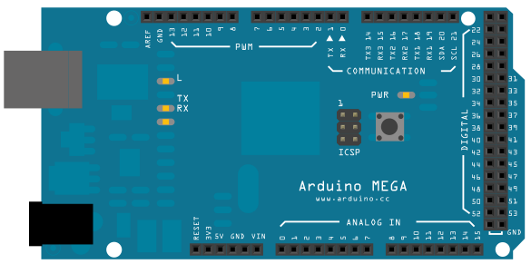
Arduino - 2 types used
Kevin Tran :: Arduino
We will be using 2 different types of Arduinos for the AUV
Arduino UNO
Microcontroller: ATmega328
Operating Voltage: 5V
Analog Input Pins: 6
Flash Memory: 32 KB
SRAM: 2 KB (ATmega328)
Clock Speed: 16 MHz
Arduino Mega
Microcontroller: ATmega2560
Operating Voltage: 5V
Analog Input Pins: 16
Flash Memory: 256 KB
SRAM: 8 KB
Clock Speed: 16 MHz
Notes:
So there will be two different types of arduinos that we are going to be using
Here i have listed both arduinos with their respective specifications
One of the reasons we are using the Arduino mega with the uno is because the mega has more input pins than the Uno
This will help us if we wanted to add any other piece of hardware or additional arduinos to the setup
The 2nd reason why we are using the mega with the uno is because the mega much more flash memory than the uno
The larger capacity enables us to store larger programs in memory
The Arduinos are programmed by the Arduino language which is a combination of C and C++

Slide 19
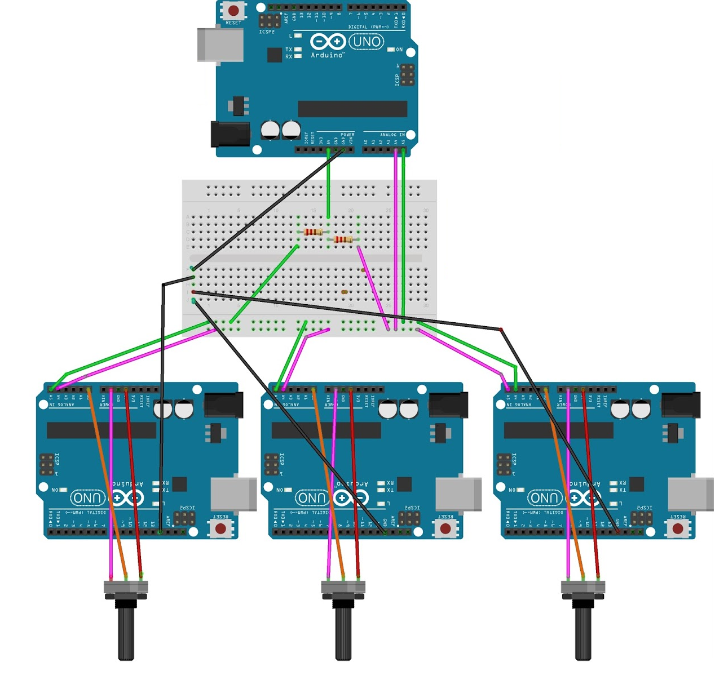
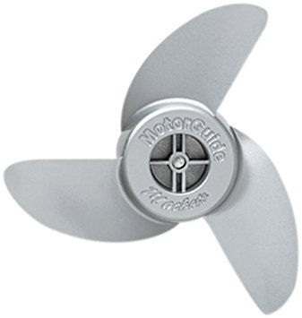
Arduino - master and slaves
Kevin Tran :: Arduino
We will be using 1 master Arduino Mega and 3 Arduino Uno Slaves
These arduinos will be communicating through the Wire(), which is an Arduino Library
Notes:
Here we have a diagram of how the arduinos will be confirmed
They will configured into master and slaves
The slave arduinos are connected to the hardware
Here we have the barometer, the missile and the motors for example
The slave arduinos must be programmed to interpret incoming data from the hardware to send to the master, such as that connected to the barometer
Or programmed to send commands to the motors or missile from the master
Each slave arduino is then connected to the master arduino
The master arduino will be the only arduino connected to the main computer, which will be over a serial usb connection using ROS which Henry will discuss in the next slide
The master and slave arduinos each must be programmed with Wire() function to enable communication to each other
All the arduinos will be set up in a master and slave configuration
Here is a diagram to show how the arduinos will be used
Do not mind the arduino uno here, it will actually be a mega that is connected to a computer over a serial usb connection
The main computer will be using ROS which Henry will discuss in the next slide to send or receive data to and from the arduino, which will send or receive data from each of the hardwares
So how does it all work?
Say for example, the AUV is not leveled
The IMU will always be sending the raw data of its yaw, pitch and roll to the uno, the data will then get sent to the mega
Then finally to the main computer where the data will be processed
Once it is done making the correct calculations for adjustments, the data will go down the line through the mega, to the slave arduino and finally to the motors which will now level the AUV
The same process is done with the cameras to help the AUV navigate through the obstacle
All the arduinos communication to each other through the Wire() which is an Arduino Library
The arduinos are used to help convert the raw data for each hardware to interpretable data

Slide 20
Robot Operating System (ROS)
Henry Ho

Slide 21
Robot Operating System (ROS)
Henry Ho :: ROS
Flexible framework for writing robot software
Libraries for Python, Arduino, and C++
Rosserial_arduino - Communication between Arduino and computer
Sends and receives messages with publishers and subscribers
Notes:
ROS is Robot Operating System
It is a flexible framework that is popularly used in robotics.
We use the libraries for Arduinos and Python to help us communicate between the hardware and software
Rosserial is a protocol that allows communication between Arduino and computer through a serial port by wrapping data values as messages
Communication is done by sending messages between nodes

Slide 22
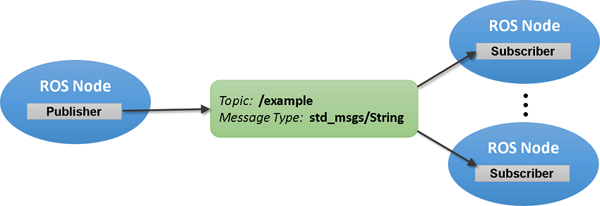
Publishers and Subscribers
Henry Ho :: ROS
Node
Topic
Publisher
Subscriber
Notes:
These messages are sent through nodes, which are processes that performs computation that is operated by an arduino or computer.
There are many nodes that are combined together into a graph and communicate with each other using streaming topics
Topics are named connections where nodes exchange messages
A message can be sent with a specific topic name by a publisher
A subscriber can then receive that message by listening to that specific topic name

Slide 23
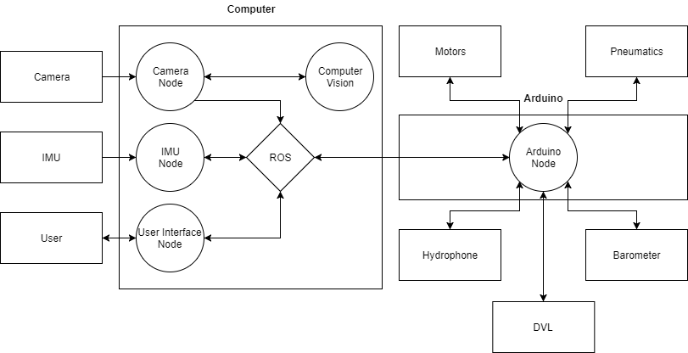
Architecture
Henry Ho :: ROS
Notes:
As you can see in this diagram there are different nodes that are used to control the robosub
These nodes are all connected through ROS so that they can communicate with each other
Each node can have many publishers and subscribers if necessary
Ros is main communications hub it communicates between all the nodes on the Arduinos which will interface with all the hardware
The computer vision node is isolated for modularity

Slide 24
Computer Vision
Danny Padilla

Slide 25
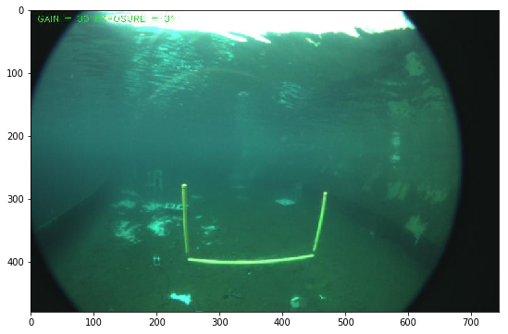
Object Detection
Danny Padilla :: Computer Vision
Recognition
Detection

Slide 26
Recognition
Danny Padilla :: Computer Vision
Labels
HOG
Features
Training
Notes:
Training VS Real Time

Slide 27
Detection
Danny Padilla :: Computer Vision
Video Source
Image
Classification
Movement
Preprocess
ROI
Notes:
Training VS Real Time

Slide 28
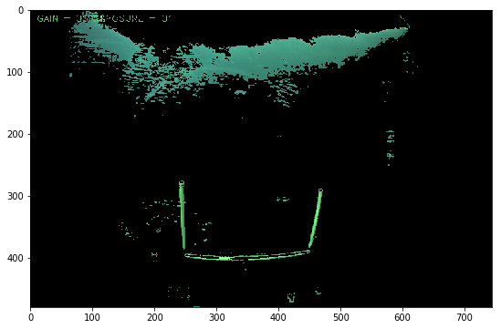
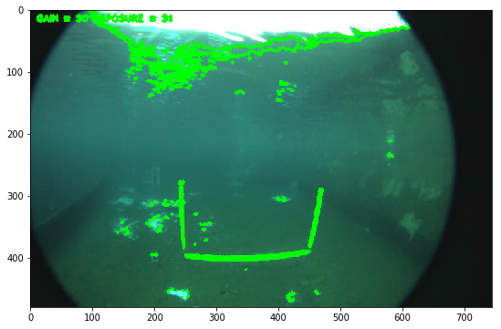
Preprocessing
Danny Padilla :: Computer Vision
Filtering Out Colors
Find Contours

Slide 29
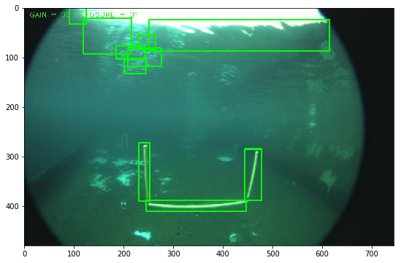
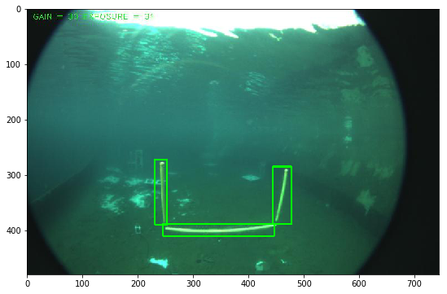
Classification
Danny Padilla :: Computer Vision
Before Machine Learning
After Applying Machine Learning

Slide 30
Fín Thank You

