Slide 1
Layer Analysis
By: Edwin Ruiz, Alyssa Solon, Christopher P Nguyen, Elizabeth Sanchez, Ken Luo, Kimberly Reyes
Advisors: Elaine Kang, Yuqing Zhu
Liaisons: Emily Law, Shan Malhotra, Mike Rueckert, George Chang

Slide 2
Agenda
Introduction
Project Goals
Project Requirements
Layers
Libraries
DFDs
Conclusion

Slide 3
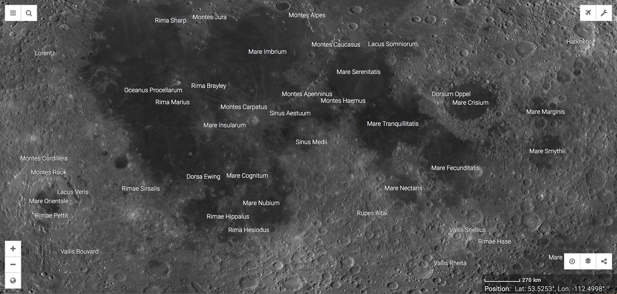
Overview
https://moontrek.jpl.nasa.gov

Slide 4
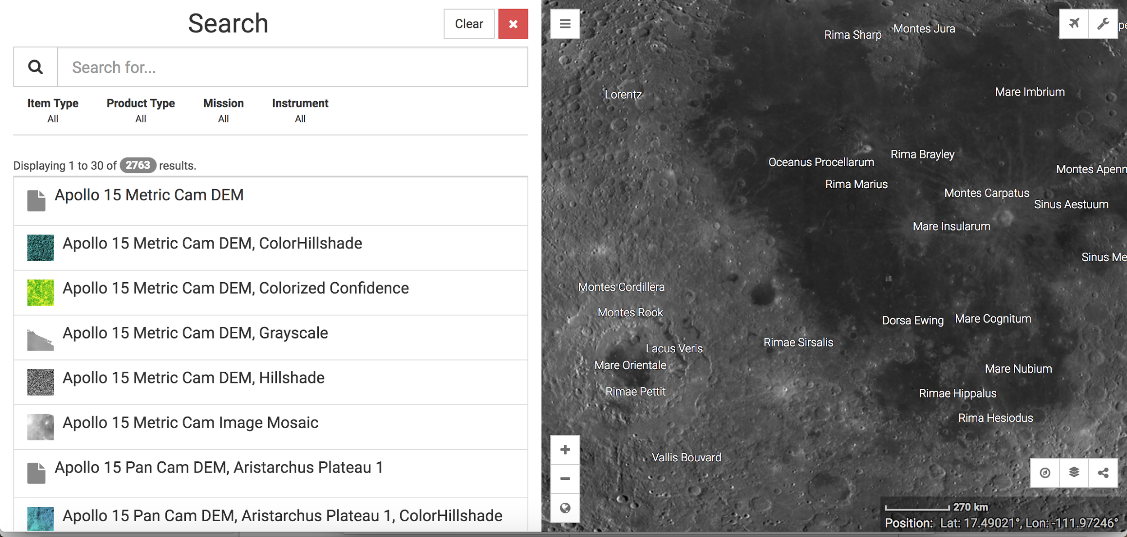

Slide 5
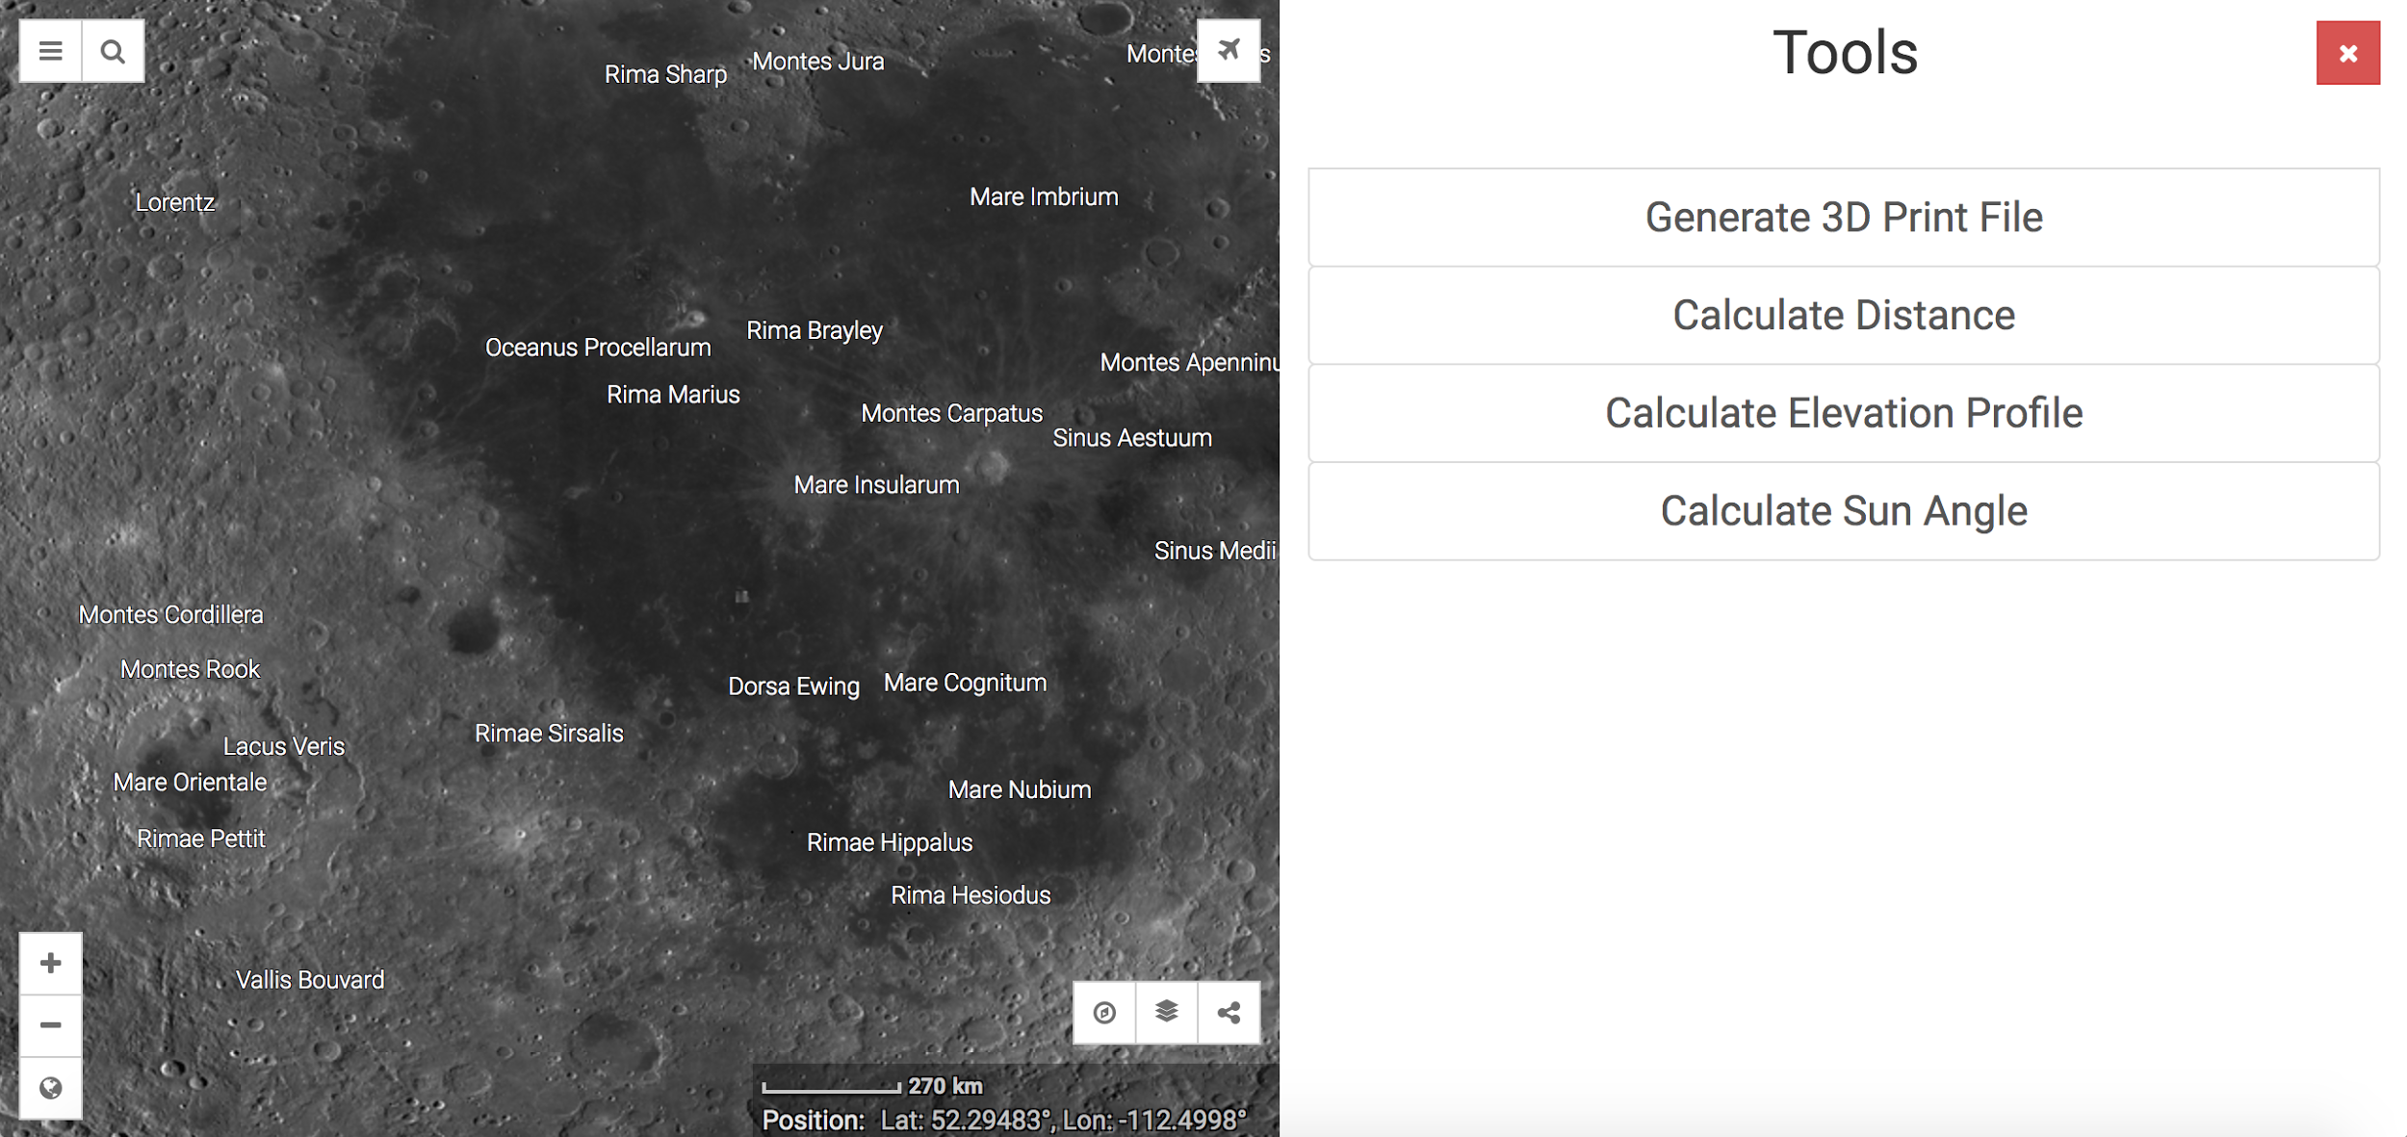

Slide 6
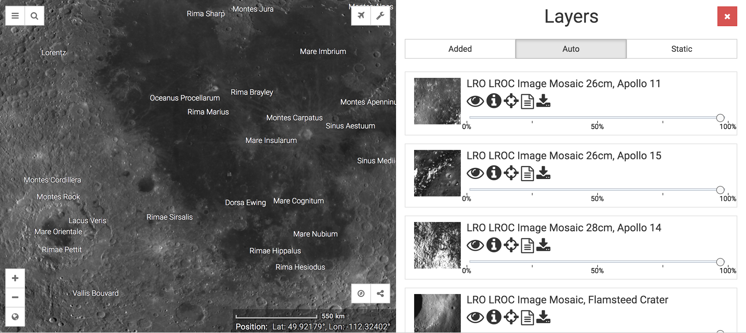

Slide 7
Project Goals
Process data of large sizes from layers to discover information about various parts of the moon
Cross examine data from any combination of two layers
Calculate large amounts of data in a short amount of time
Notes:
After project goals
Put some issues/obstacles delicately
How did we solve those issues

Slide 8
Challenges
Initially had little to no knowledge of Python
Downloading GDAL
Execution of the standalone Moon Trek API
Creating a Histogram for one of the layers
Long loading/data processing time
Converting pixel data to decimal degrees

Slide 9
Solutions to the Challenges
Learned and became familiar with Python and the libraries that will be used in the project
Did more research
Standalone Moon Trek API
A couple of files were missing
Histogram
Loading/Data Processing Time
Planning to look into Spark
Pixel Data Conversion

Slide 10
Project Functional Requirements
The system shall take in geoTIFF and .xyz files.
The system shall output statistical data from the geoTIFF or xyz file.
The system shall read in raster bands from geoTIFF files and translate the bands into a data structure suitable for analysis
The system shall output calculations such as average, standard deviation, minimum and maximum values, and median

Slide 11
Project Functional Requirements (Cont.)
The system shall be written in Python.
The system shall integrate the following Python libraries: GDAL, NumPY, matplotlib, pandas, and seaborn
The system shall convert and return latitude-longitude coordinates from a pixel coordinate system
The system shall represent the data in graphical formats such as histograms.

Slide 12
External Interface Requirements
geoTIFF
Description: A file that contains raster bands that are used to hold data
Source of input: During testing: from local disk, in deployment: from database server
Range and Accuracy: Range and accuracy varies depending on the file
Unit of measure: Unit of measure varies per file, from meters to Kelvin

Slide 13
External Interface Requirements (Cont.)
.xyz file
Description: File contains data for a period of time at specific intervals
Source of input: File is taken from local disk
Range and Accuracy: Range is 24 hour range, with data recorded once every hour.
Unit of Measure: Kelvin

Slide 14
What are Layers?
Layers from the Moon Trek API
These layers hold different type of information such as elements, temperature, gravity, and slope
Layers are passed into the function as either geoTIFF files, xyz files, or ndarrays
The layers contain “raster bands,” which hold data we wish to process.

Slide 15
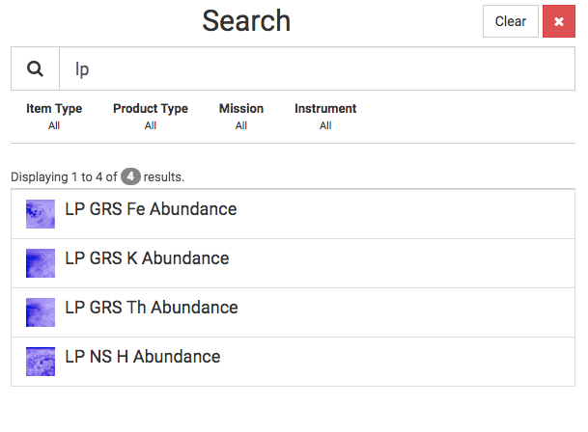
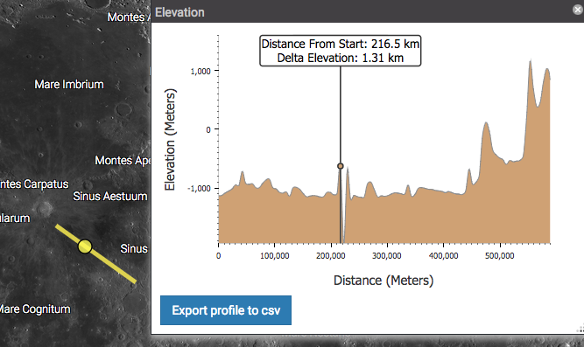
Layers
Elements
Hydrogen
Iron
Potassium
Thorium
Slope
Uses elevation points
Based on the elevation difference between different points in a selected area
Temperature
xyz files
Gravity
**To be provided**

Slide 16
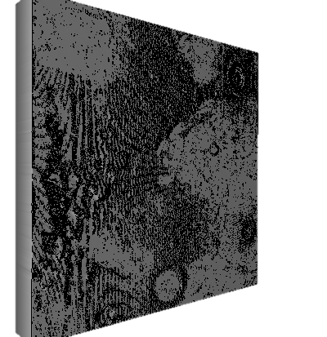
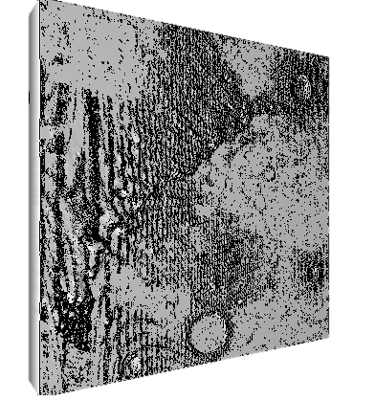
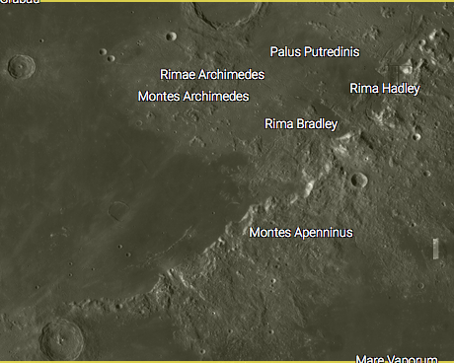
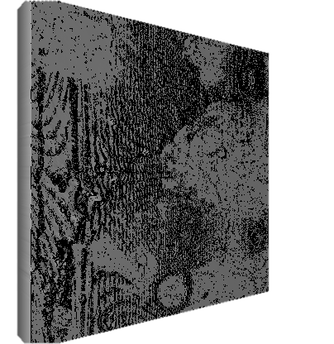
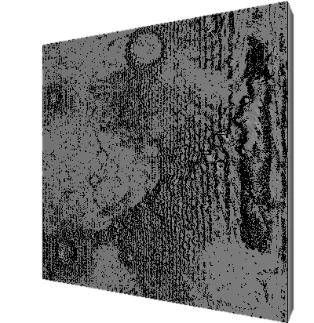
Elements
Layers:
Thorium
Hydrogen
***colorized examples used for illustration purposes***
Iron
Potassium

Slide 17
Python- Libraries
GDAL
NumPy
Pandas
Matplotlib
Seaborn

Slide 18
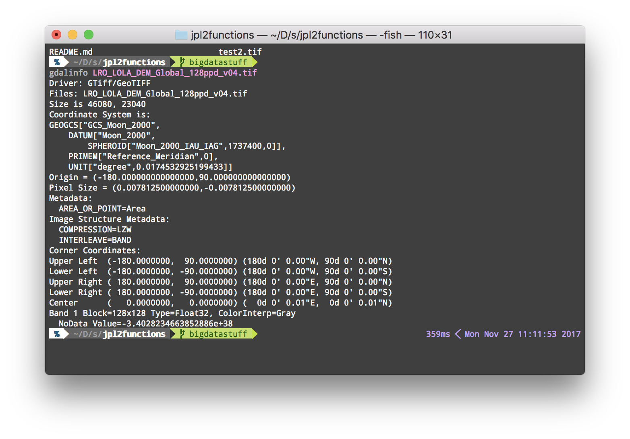
GDAL
Gives Coordinates
How many bands
Pixel size
Origin
No data values

Slide 19
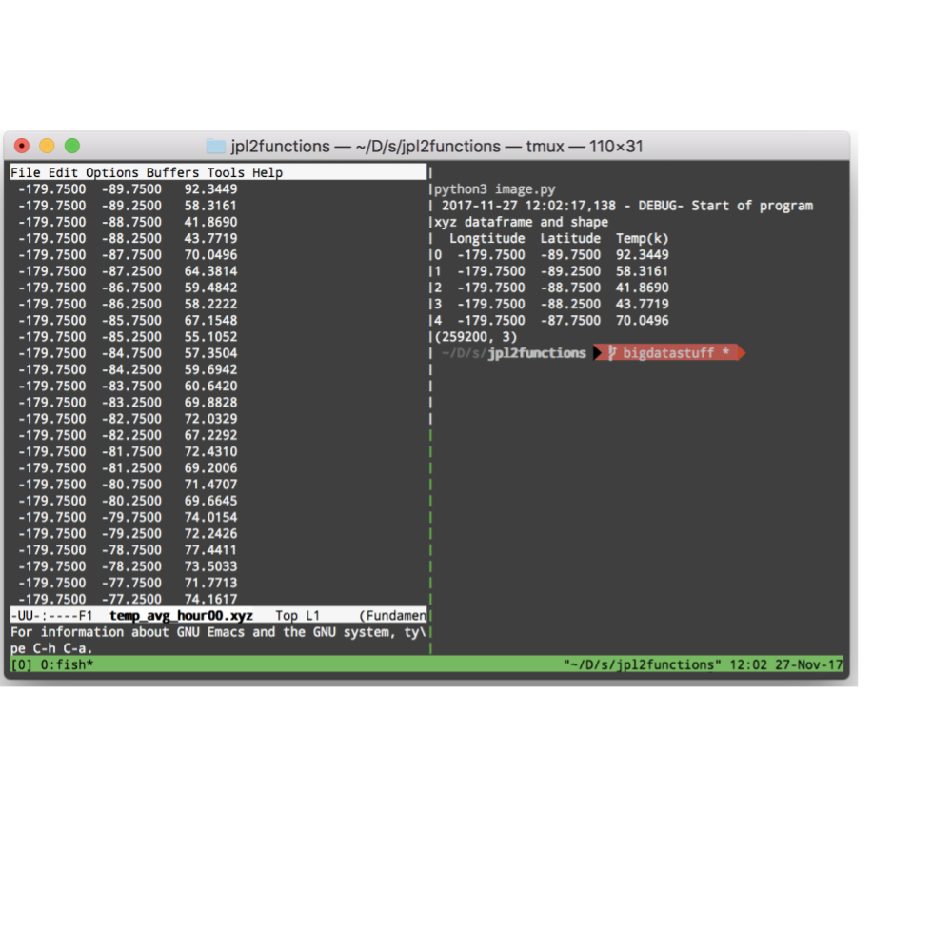
Numpy and Pandas
Able to separate features
Do basic computing (min, max, std, mean)

Slide 20
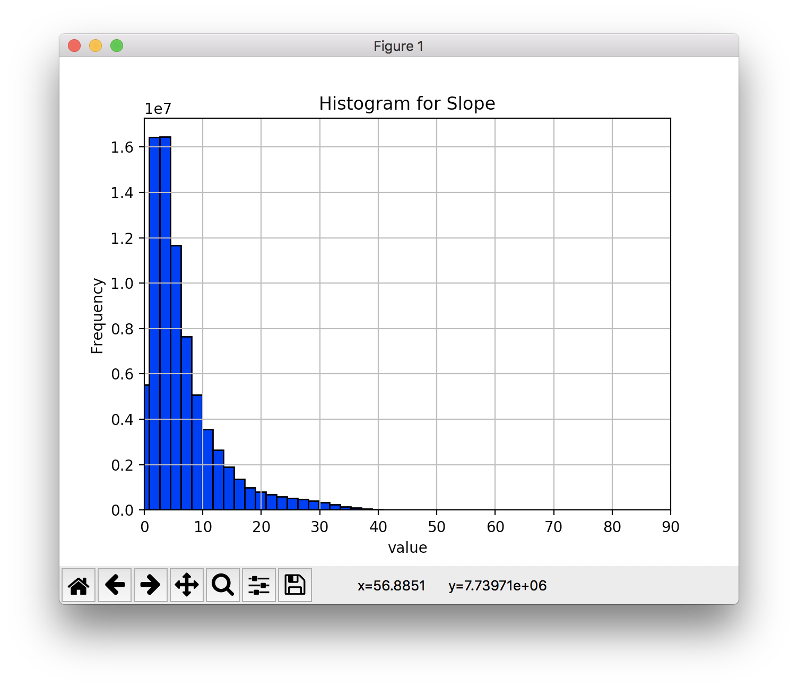
Matplotlib
Visual representation library
Scatterplots
histograms

Slide 21
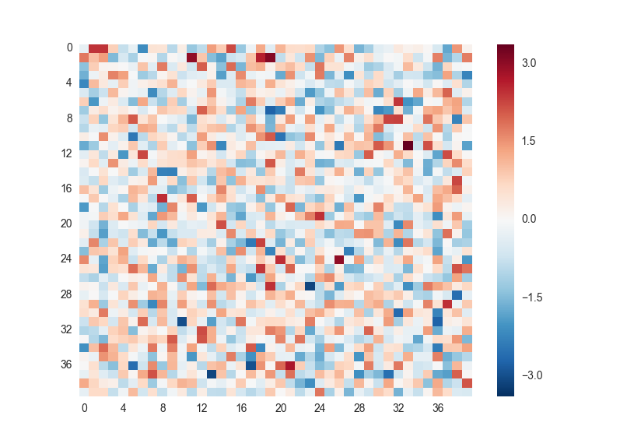
Seaborn
Heatmaps
Notes:
Seaborn is another high level library we use to visually display our data such as the .xyz file.

Slide 22
Apache Spark
Parallelize process for faster computing
Computing big data set quickly
Notes:
Spark is a big data parallelization library. Apache spark is the successor of hadoop which was a map reduce library and spark runs about 10x faster than hadoop.

Slide 23
DFD Level 0
Moon Trek Database
Retrieve Selected Layers
Layers
Function
Module
Output
Data
User Input
User
Display

Slide 24
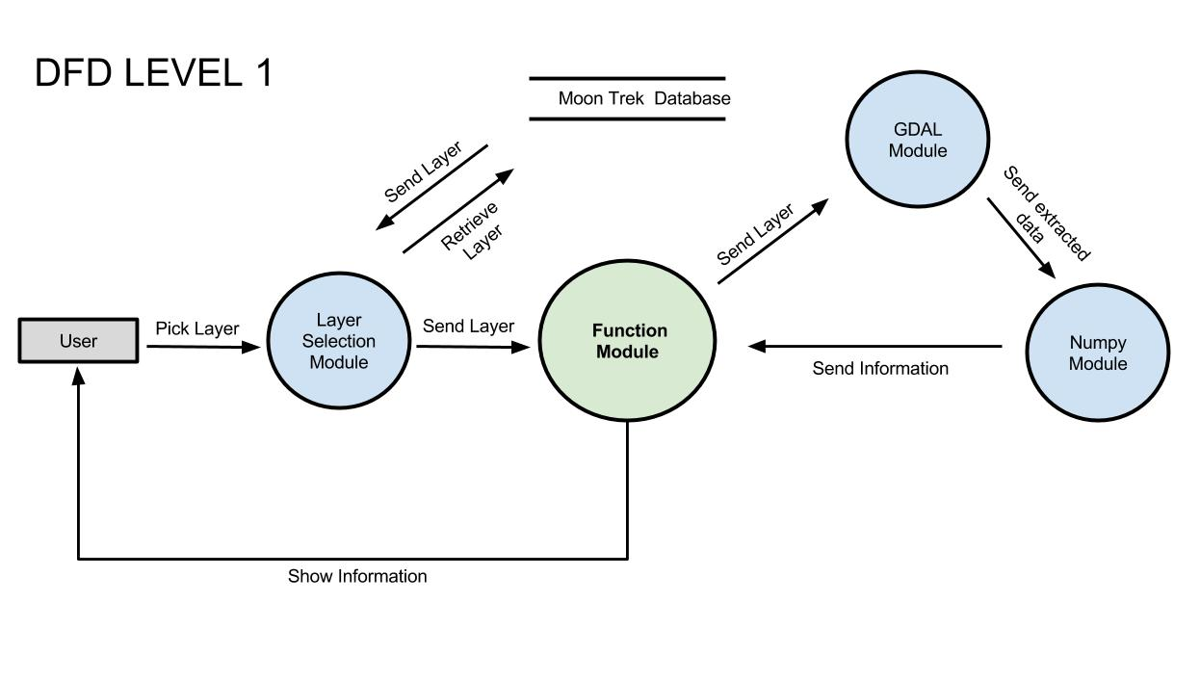

Slide 25
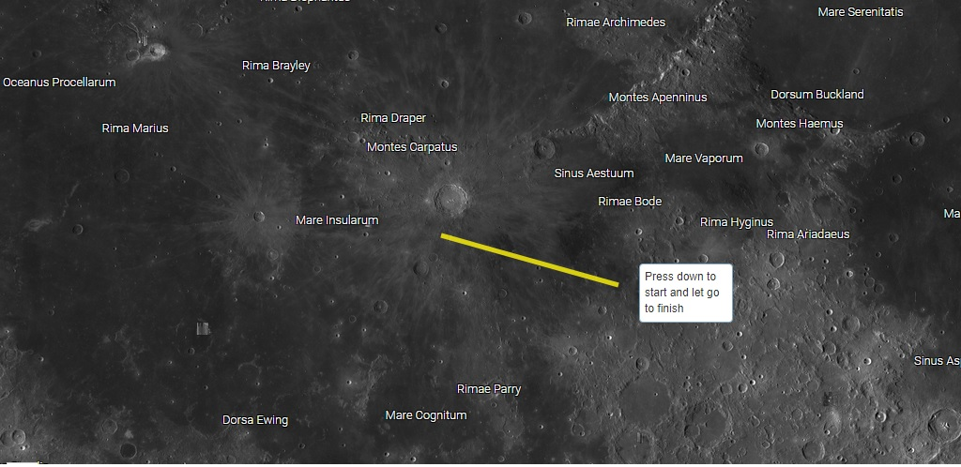
FUNCTION MODULE

Slide 26
Function Module
The system should output calculations
Average
Standard deviation
Minimum and Maximum Value
Median Value
Notes:
**INSERT sample output code pic the calculations for further explanation if needed***

Slide 27
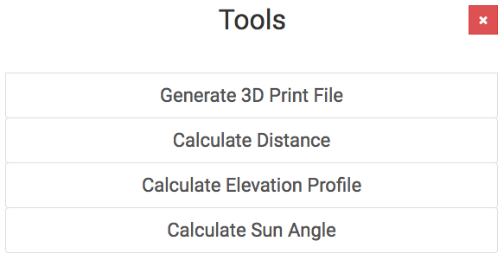
Milestones/Plans
Larger data handling
1 vs 30 bands
Speed
User accessibility and ease
Remove user going through the “middle man”
Backend code implemented onto Moontrek GUI
Notes:
As of now only one band is being handles. Handling tiff files that have 30 bands is uses far more memory handling that deriving values for tiff files that only contain 1 raster band.
Provide a way for users to only interact with moon trek program to find values.

Slide 28
Conclusion

