Slide 1
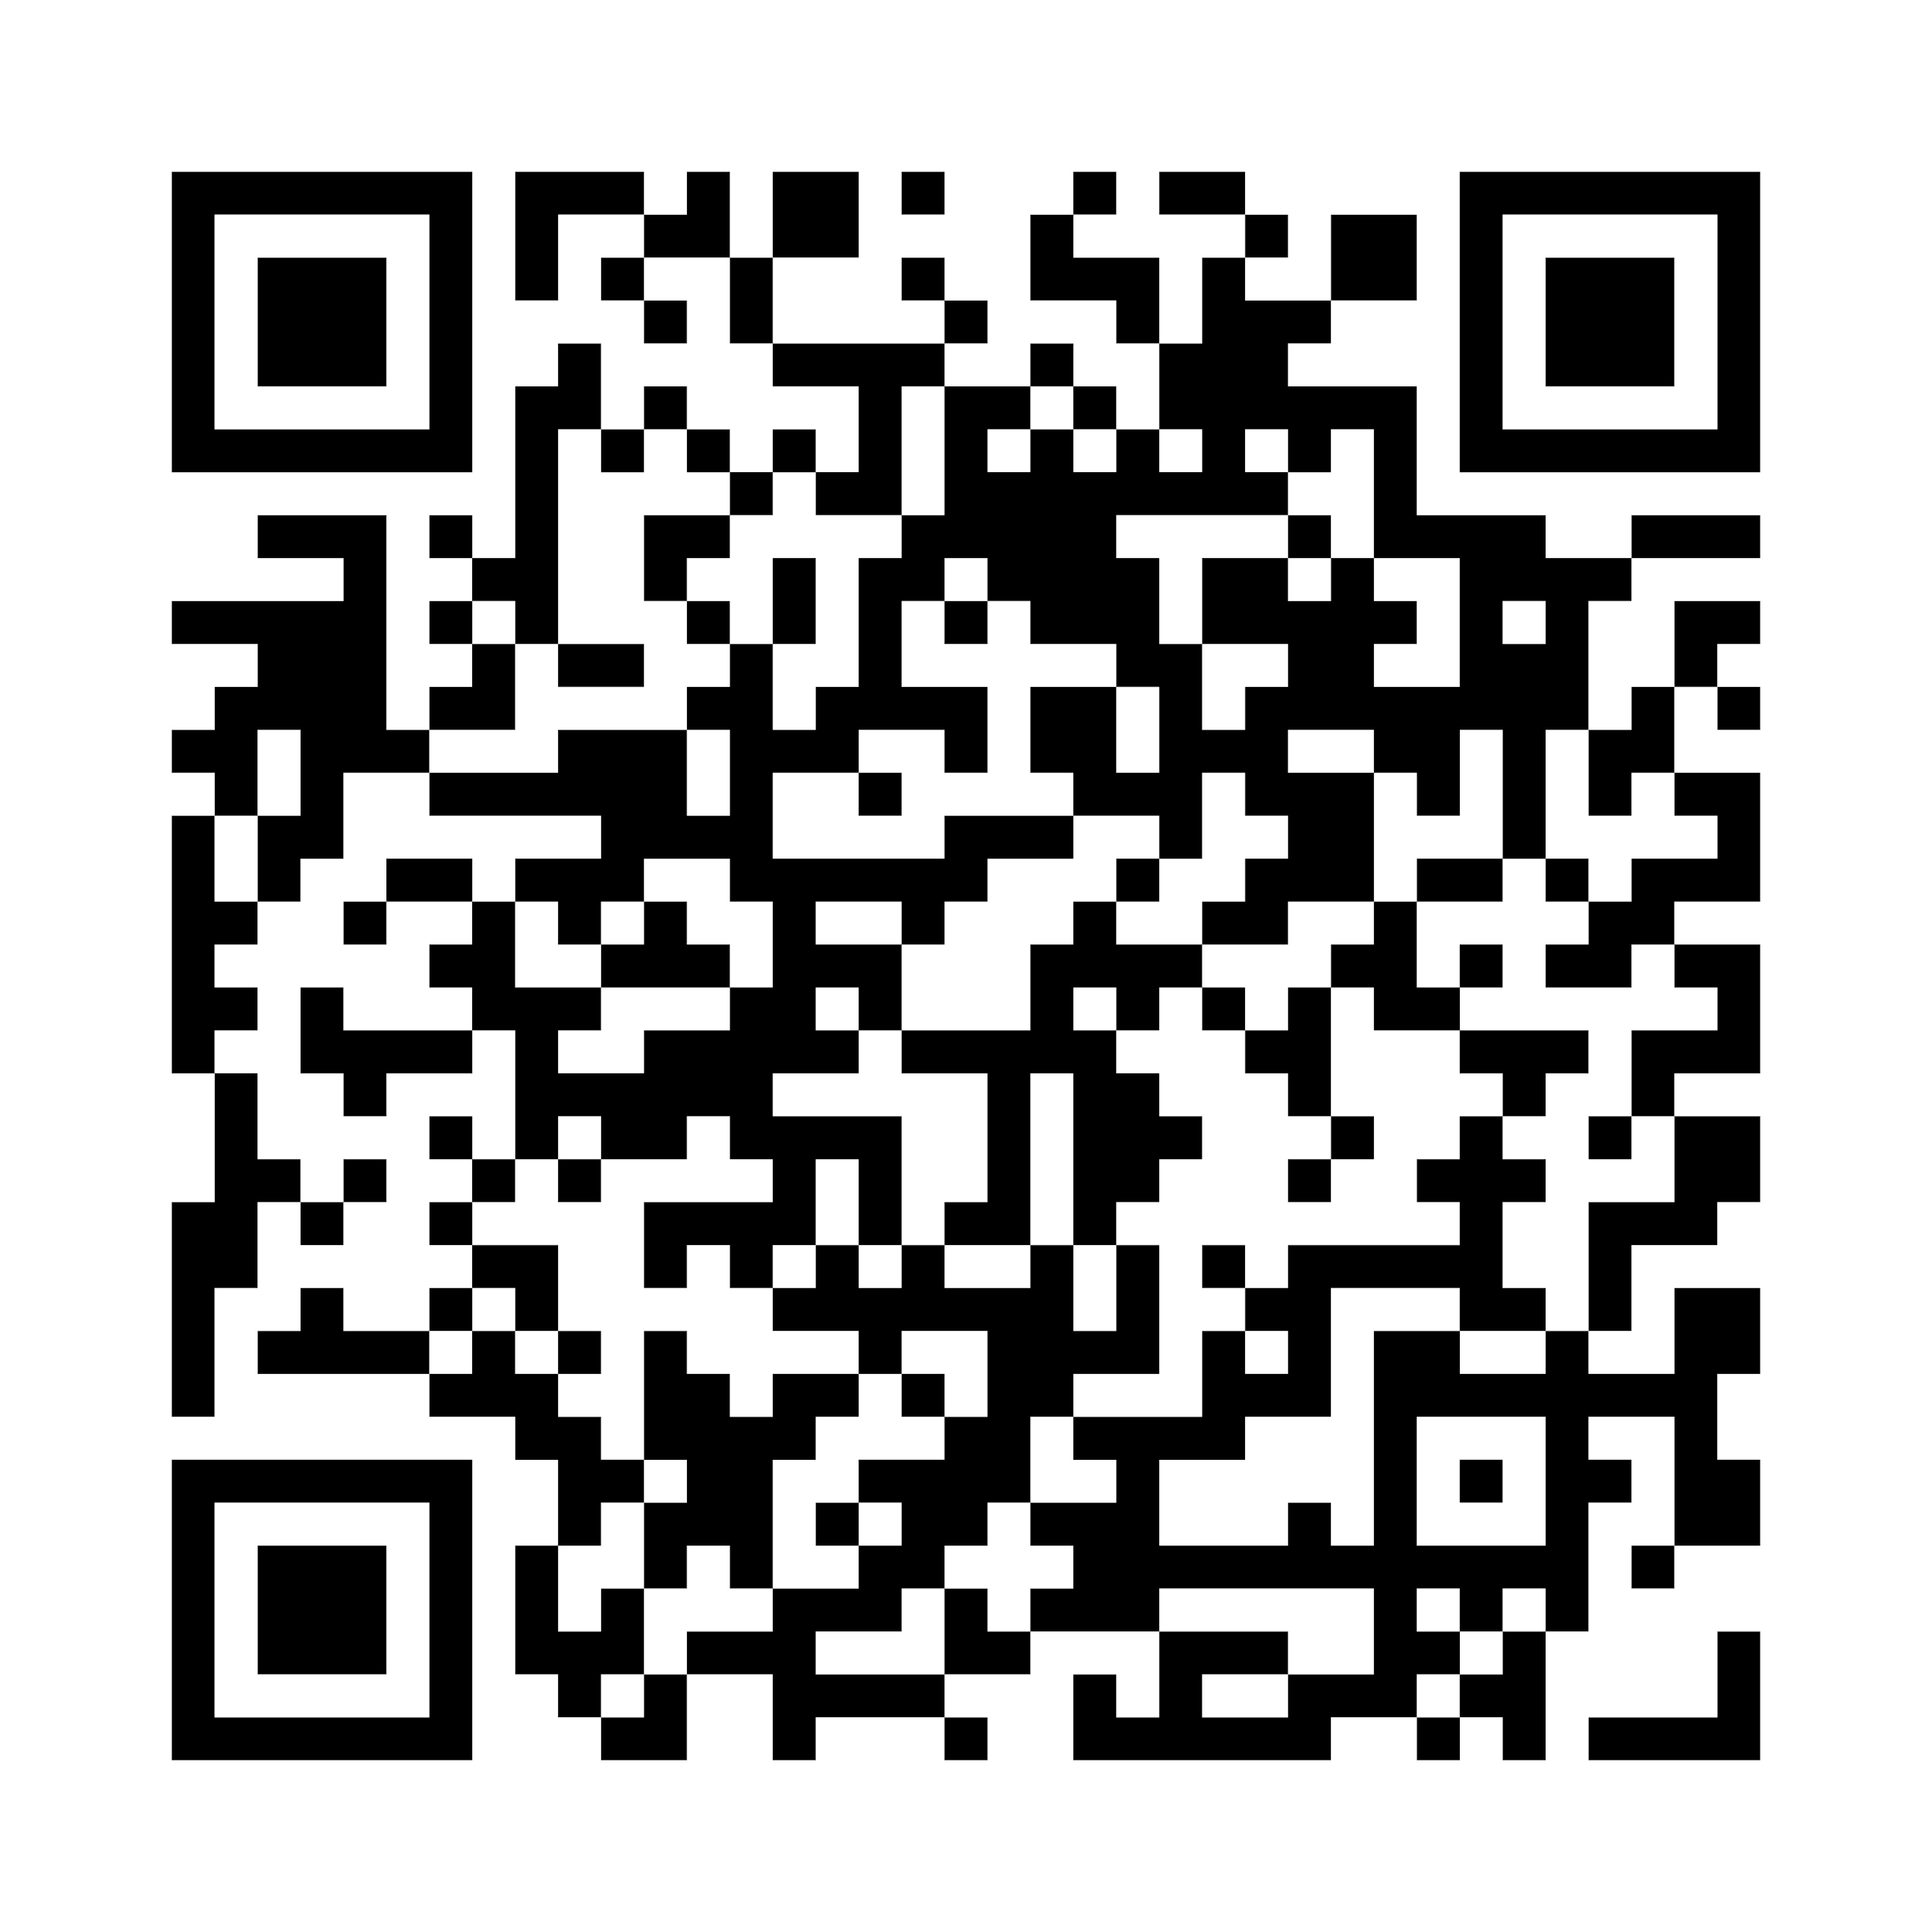
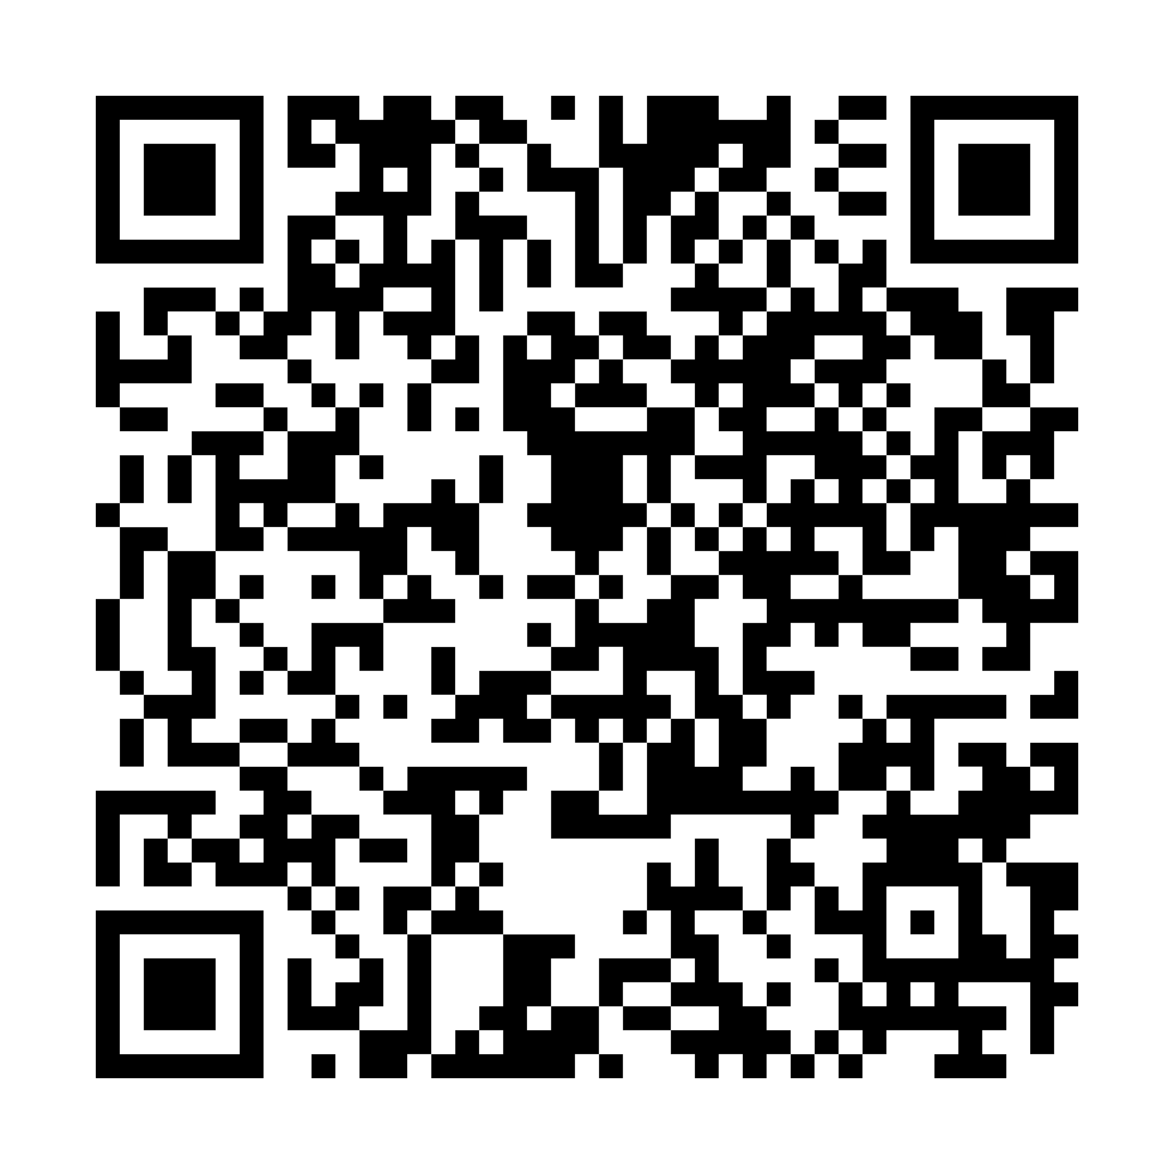
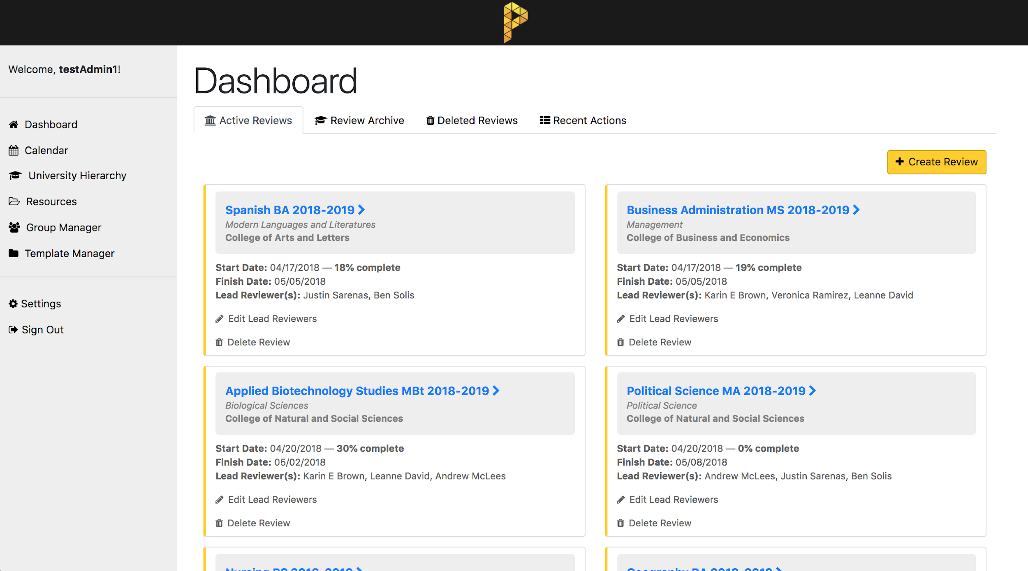
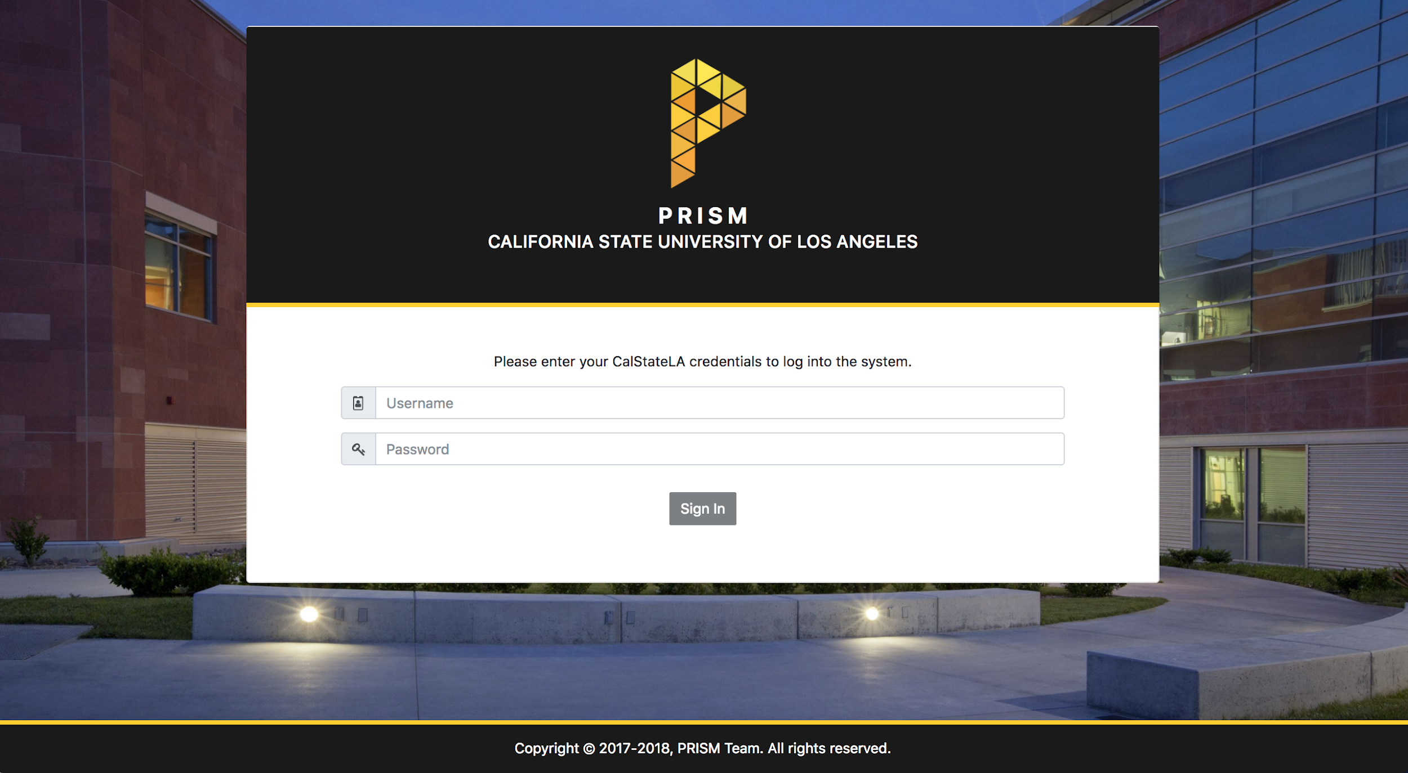
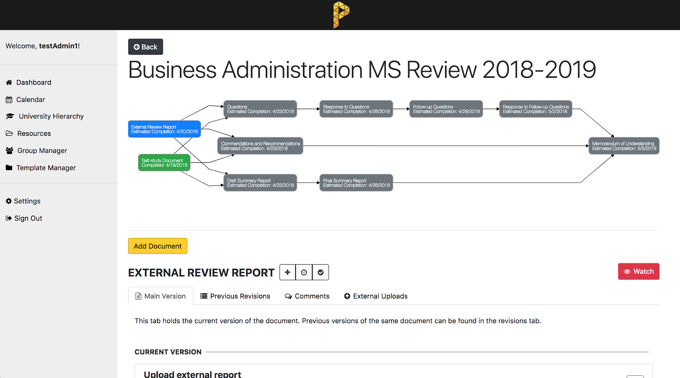
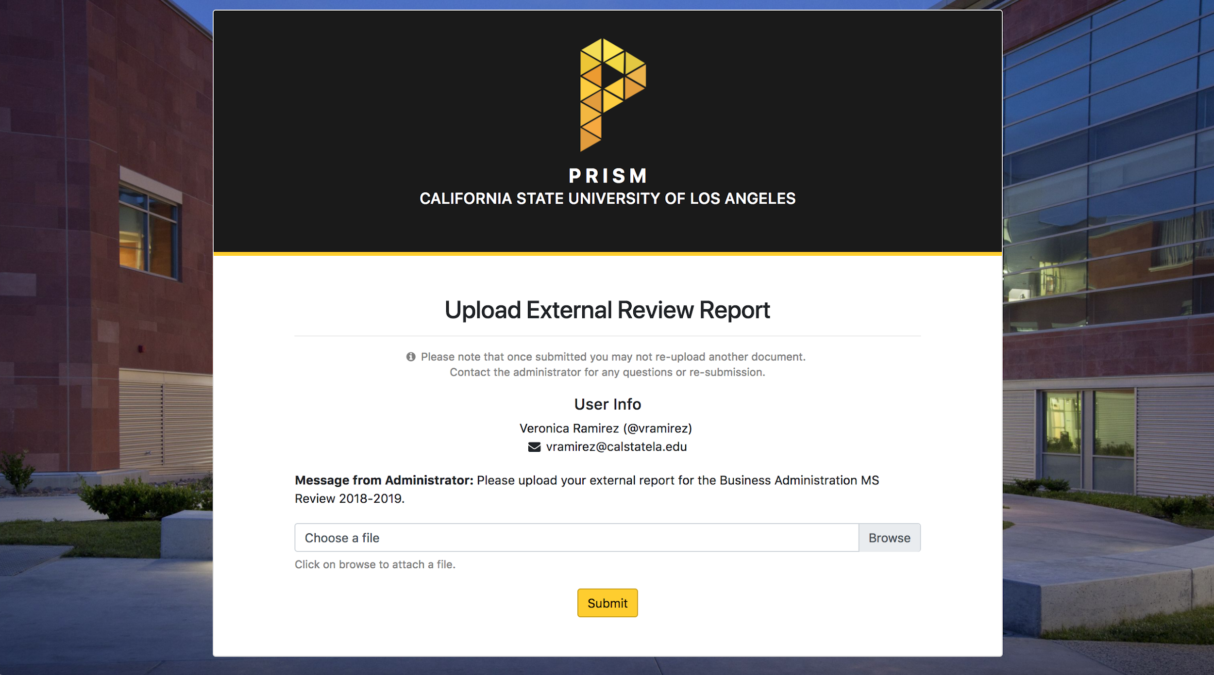
Program Review Information System Management (PRISM) Team Members: Leanne David, Andrew McLees, Justin Sarenas, Ben Solis Faculty Advisor: Dr. Chengyu Sun Office of Graduate Studies Liaisons: Dr. Karin Brown, Veronica Ramirez Department of Computer Science College of Engineering, Computer Science, and Technology California State University, Los Angeles
Background
Source Code
The Program Review Subcommittee (PRS) reviews degree programs at CSULA on a regular basis. The original process involved collaboration and coordination manually over e-mail, but the goal of PRISM is to provide a system that automates the review process and streamlines collaboration workflow.
Challenges
prism-api
prism-frontend
Technologies
Asynchronous Functionality
The variety of asynchronicity schemes utilized in JavaScript made certain tasks difficult. Knowing how to use callbacks, Promises, async/await, and RxJS Observables were necessary to understanding how PRISM operates across the entire stack.
PrimeNG UI library
Initially, an Angular UI library, PrimeNG, was chosen for use on the frontend. It eventually became clear that it was too unstable for use in production, and the project was converted to use Twitter Bootstrap. This change came after a significant portion of the PRISM frontend had already been implemented using PrimeNG.
Database Design
Designing a NoSQL database is very different from designing a MySQL database, particularly in determining whether to use references to foreign objects or to embed the objects within a single model.
Performance
Latency is always present for HTTP requests and database queries. Limiting these requests and queries without limiting functionality was a consistent concern for the frontend and backend portions of PRISM.
… and over 300 npm packages
Workflow
Consists of a side menu that is accessible on all authorized pages in the system that turns to a hamburger menu on smaller screens.
Dashboard includes quick access to active reviews, review archive, and user action logs upon login.
Calendar contains events that store all agendas and meeting minutes.
University Hierarchy lists the current active programs found in CSULA with their next review date.
Resources holds all available files for users to download and/or upload at any given time.
Group Management handles all access control for internal users.
Settings is where users can update their information and/or password.
External Upload is a separate and public page where external reviewers are invited by an administrator to upload their reports for a given active review.
Email Notifications are sent to users involved in changes for a review, deadline reminders, calendar events, uploads and approval of certain documents.
Majority of adding, deleting, and manipulating data was done using modals for simplicity and easy flow.
Reviews
Acyclic graph that reflects the current status of individual documents for a review.
A blue tile indicates a document is ready to be worked on
A green tile indicates a document is finalized and can no longer be edited
A gray tile indicates a document needs its prerequisites completed first to be worked on
Email notifications
Individual versioned documents consist of multiple revisions
Allow creation of miscellaneous documents
Completion estimates for the entire graph
Comment support for a particular revision
Automatic templating
Access control for deans, department heads, and PRS members
Send invites to external reviewers to upload their reports
Future Improvements
Add a real-time in-browser document editor utilizing WebSockets
Review graph customization
Upgrade to Express 5 when it is out of alpha for HTTP/2
Allow attaching multiple documents to Calendar events
Implement more sorting and filtering functions for data tables
Customizable email notifications for various documents and comments
Allow replies and discussions for previous comments
Notes:
‹#›
Have students check that the logo is the appropriate one to use.

