Slide 1
First Generation
Joseph Crisolo
Maximiliano Barragan
Junghwan Park
Alisha Shahbazian
Daniel Arroyo
Faculty Advisor: Dr. Elaine Kang
Project Liaison: Prof. Sylke Rene Meyer
Notes:
Add Screenshots
Sponsor Logo
Interactive Arts

Slide 2
Computer Science
Team
Art
Team
Faculty Advisor:
Dr. Elaine Kang
Game Design
Team
Project Liaison:
Prof. Sylke Rene Meyer
Art / Animation
Faculty Advisors:
Prof. Sarah Beeby
Prof. Jim Ovelman
Senior Design
Programming Team
Lead Game Design:
Megan Reynolds
Lead Programmer:
Joseph Crisolo
Implement and Code
Integrate Art Assets
Student Artists / Animators
Lead Artists:
Ilan Conrado
Angelica Conde
Create art assets:
2D Sprites
3D Models
Animations

Slide 3
Outline
Project Overview
Game Design and Development
Level Design & 3D Visual Asset Management
Non-Player Character (NPC) Management
Dialogue & NPC Interactions
User Interface (UI), Heads Up Display (HUD), & Mini-Map
Audio Management Controller
Software Tools
Game Demo

Slide 4
Project Overview
Notes:
What is the game?

Slide 5
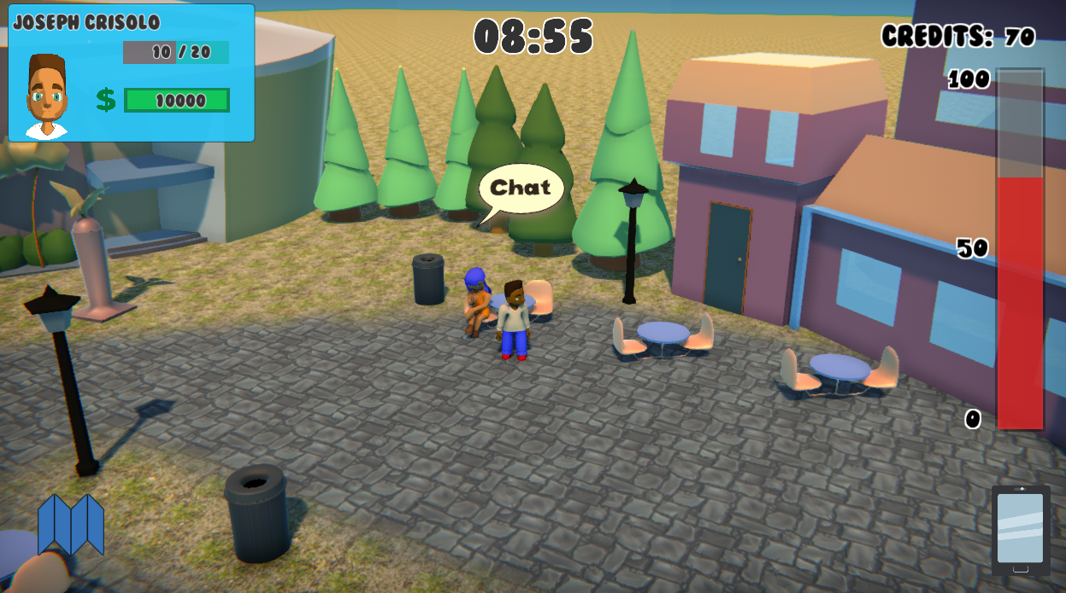
Notes:
Screen Shot of Gamplay
Talk about gameplay
Purpose
Initial First Generation Project
New Decision: Create a mobile game to simulate an interactive, explorable college campus.
Gameplay Design Overview
3D Environment & Models / 2D Sprites
NPCs / Dialogue System
Game Progression: Timed Gameplay
Resource Management: Money, Energy (Stamina)
Complete Quests to Earn Credits
GOAL: At end of time limit, calculate final score based on Money left and Credits earned

Slide 6
Game Design & Development:
Level Design
& 3D Visual Asset Management
Notes:
List All Art models / animations / images
Boast about what has been done in this game
3D Visual Asset Management
Newly introduced features may cause old levels to become obsolete, so the levels developed early on may be repeatedly developed and discarded. Because of the dynamic environment of game development, the design of early levels may also change over time. It is not uncommon to spend upwards of twelve months on one level of a game developed over the course of three years. Later levels can be developed much more quickly as the feature set is more complete and the game vision is clearer and more stable.
Type of Art?
Separate titels

Slide 7
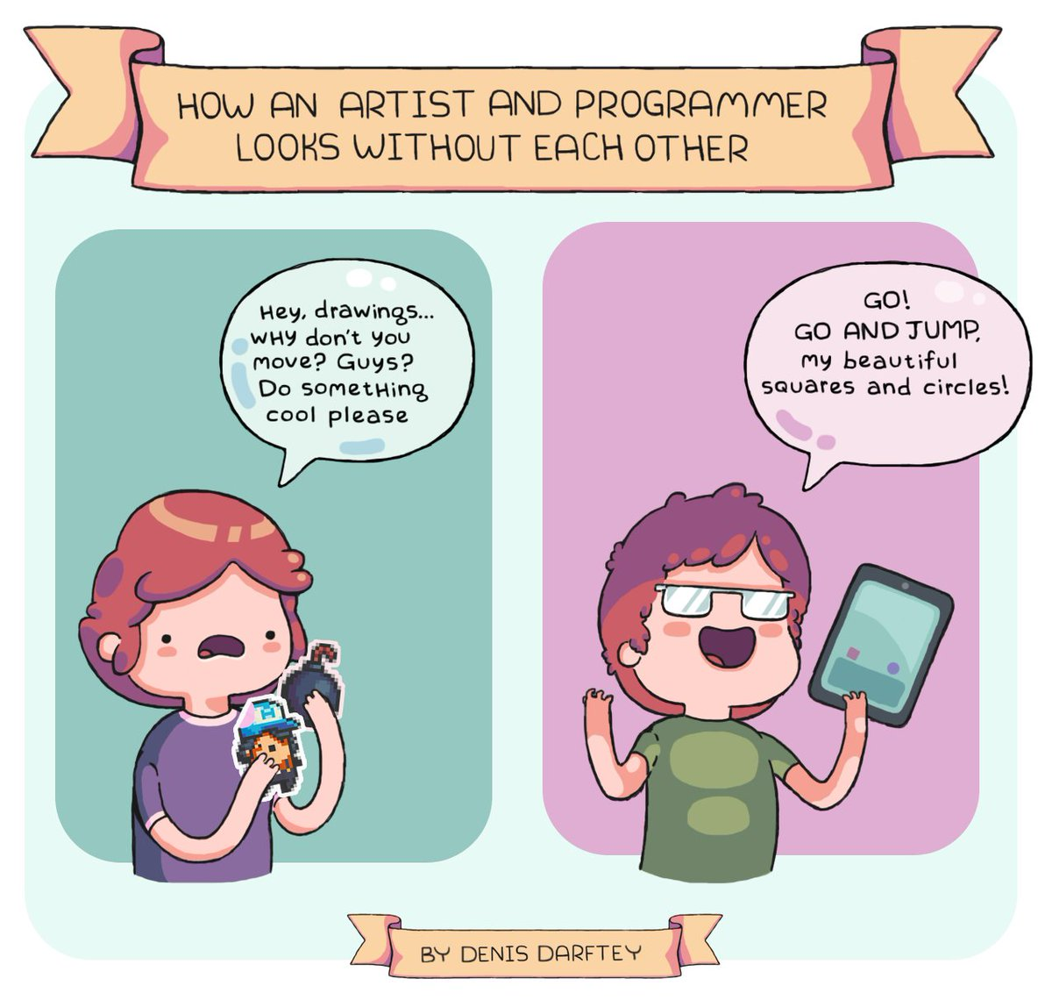
@darftey
Notes:
Transition?
Work close with art team
URL source link

Slide 8
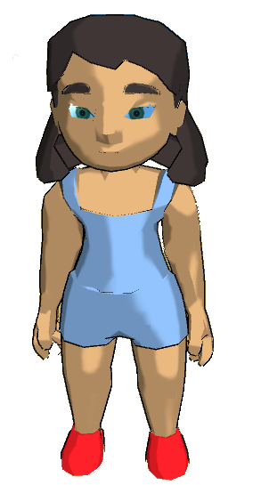
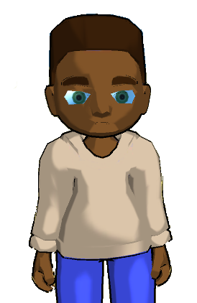
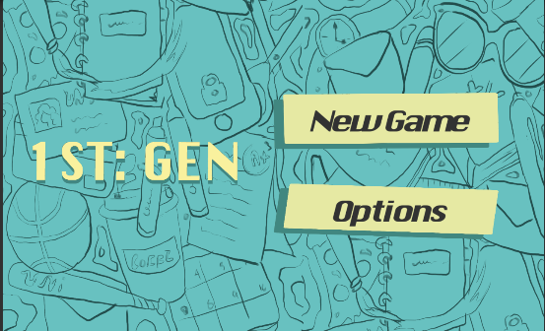
Art
Cartoon-style
Simple and colorful
Notes:
Game Design Mood / Art style
Why game designed this way artistically?
Game Design team decided to pursue this art style because we thought it would be more appealing to our target audience.
Add environment images

Slide 9
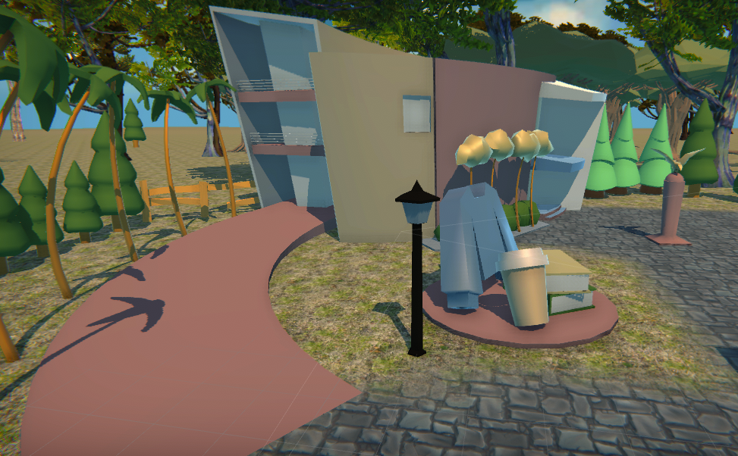
Asset Production
3D
2 -- Character Models
Textures
Rigs
3 Animations
11 -- Campus Buildings
1 -- Art Hallway
1 -- Art Room
Tables
Chairs
Props
Texture
2D
Main Menu Sprites
Buttons
Phone Menu sprites
App icons
Dialogue
Character Sprites
Speech Bubbles

Slide 10
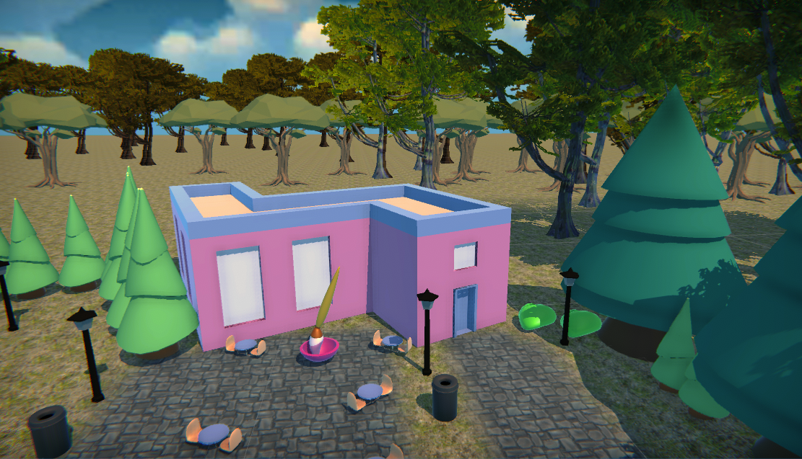
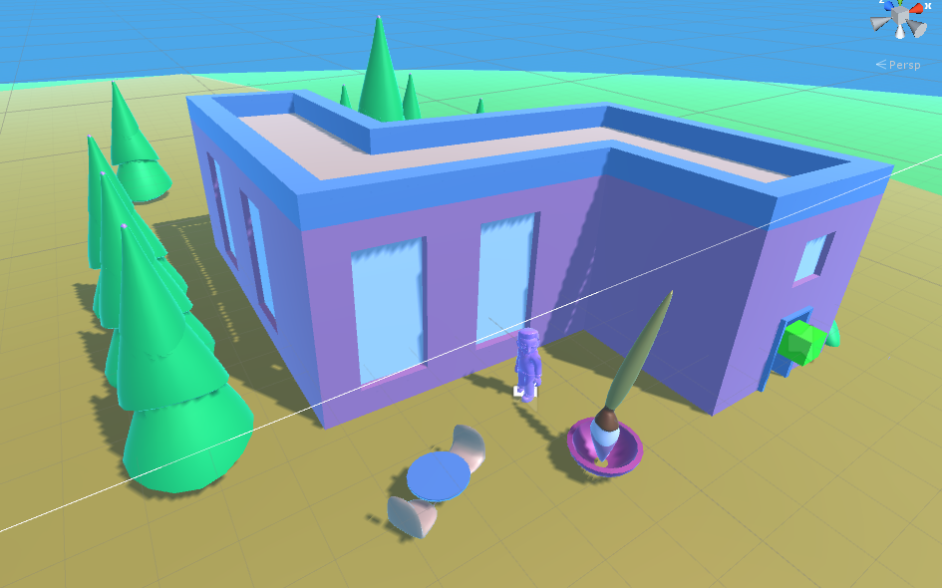
3D Environment
Art Building
Notes:
Science Building, Music Building, Language Arts Building, History/Social Sciences, Math Building, Financial Aid Building, Library Building, Gym/Physical Education Building, Student Store, Administration Building, Student Health Building

Slide 11
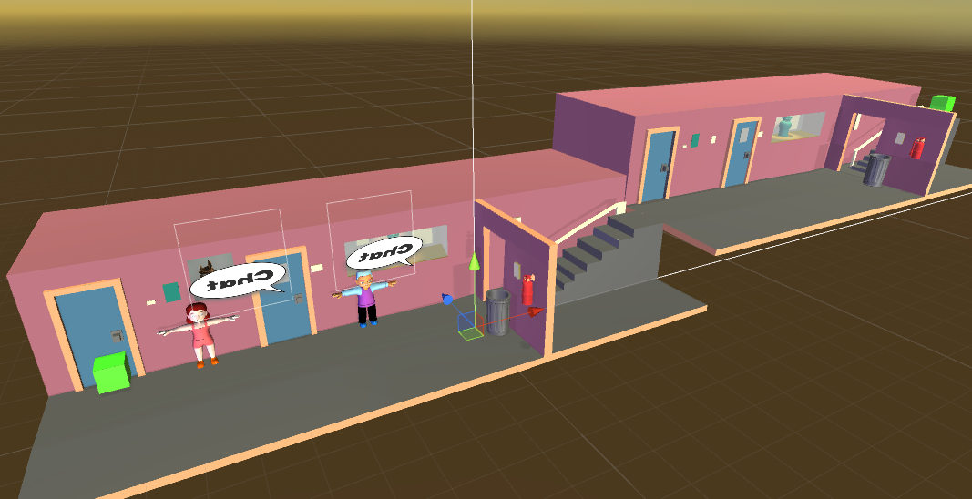
3D Environment
Art Hallway
Notes:
Science Building, Music Building, Language Arts Building, History/Social Sciences, Math Building, Financial Aid Building, Library Building, Gym/Physical Education Building, Student Store, Administration Building, Student Health Building

Slide 12
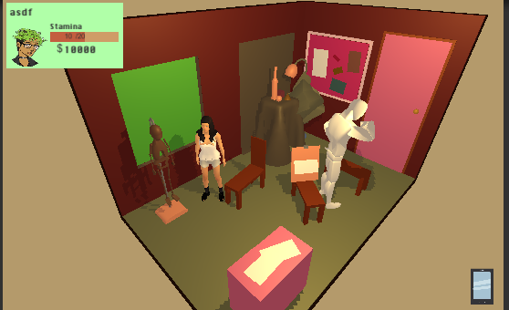
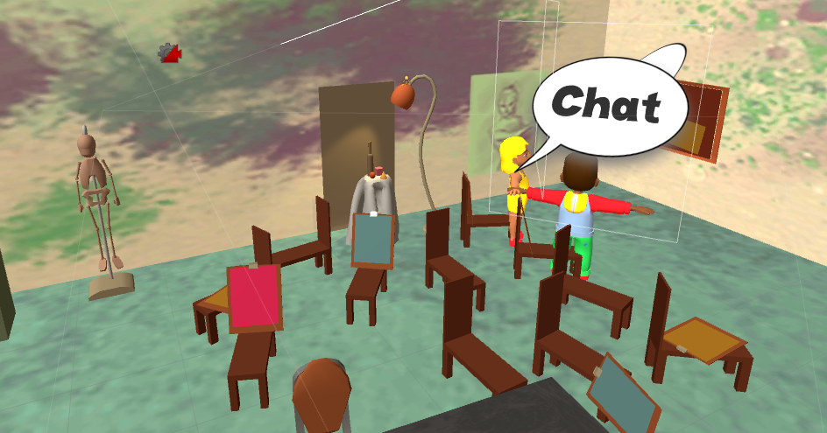
3D Environment
Art Room
Notes:
Science Building, Music Building, Language Arts Building, History/Social Sciences, Math Building, Financial Aid Building, Library Building, Gym/Physical Education Building, Student Store, Administration Building, Student Health Building

Slide 13
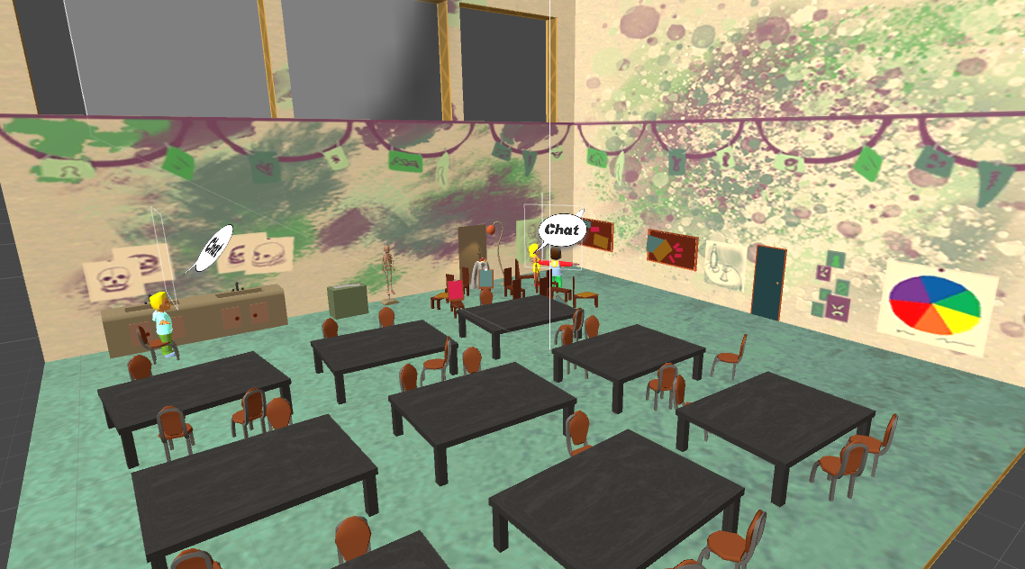
3D Environment
Art Room
Notes:
Science Building, Music Building, Language Arts Building, History/Social Sciences, Math Building, Financial Aid Building, Library Building, Gym/Physical Education Building, Student Store, Administration Building, Student Health Building

Slide 14
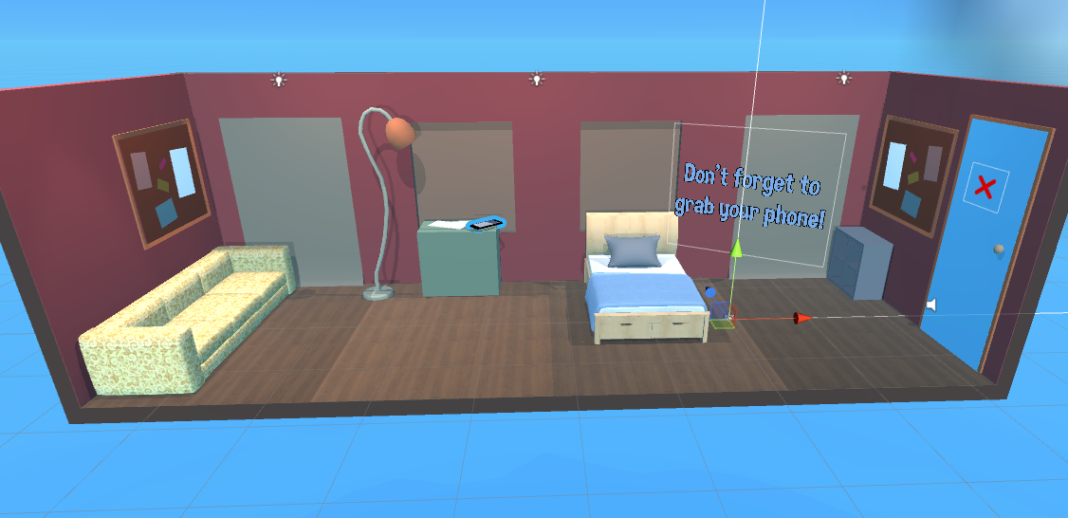
3D Environment
Dorm
Notes:
Science Building, Music Building, Language Arts Building, History/Social Sciences, Math Building, Financial Aid Building, Library Building, Gym/Physical Education Building, Student Store, Administration Building, Student Health Building

Slide 15
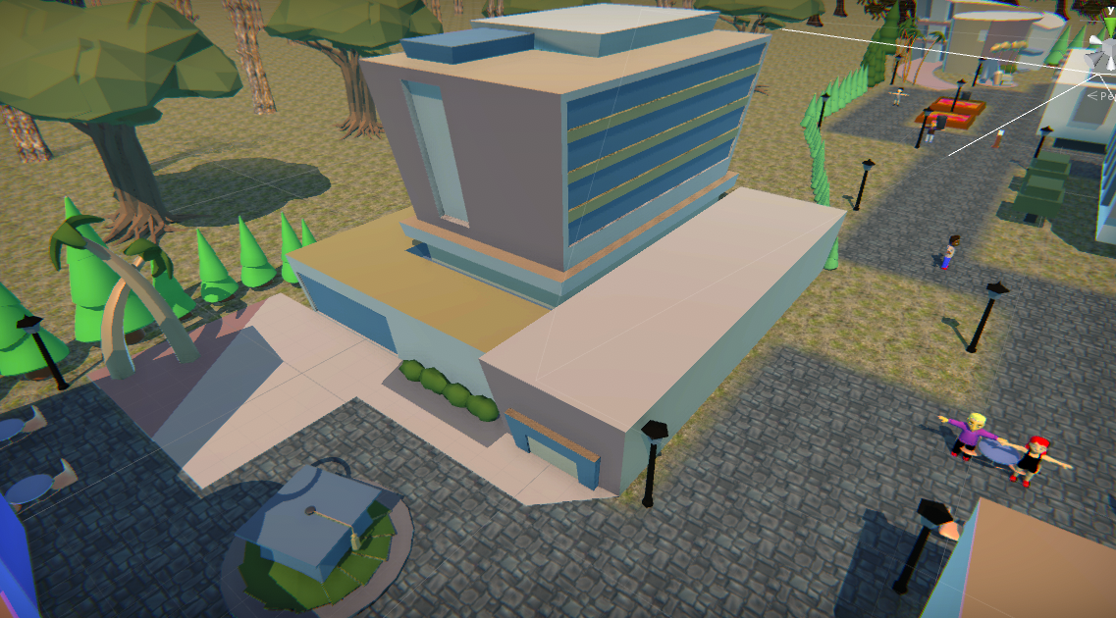
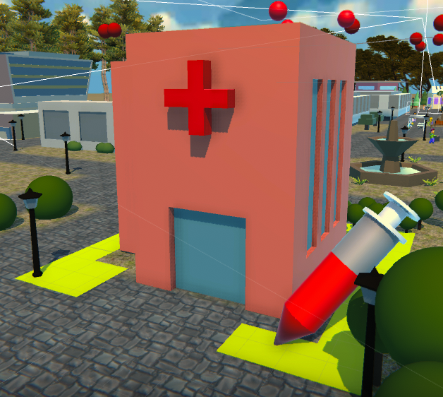
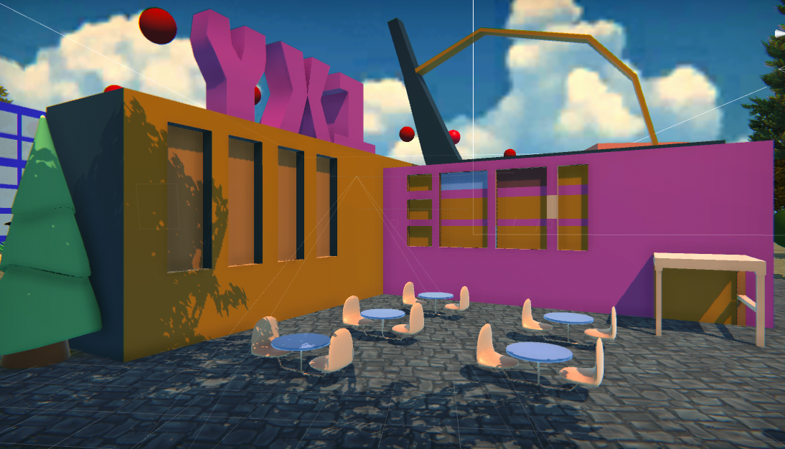
Campus Buildings

Slide 16
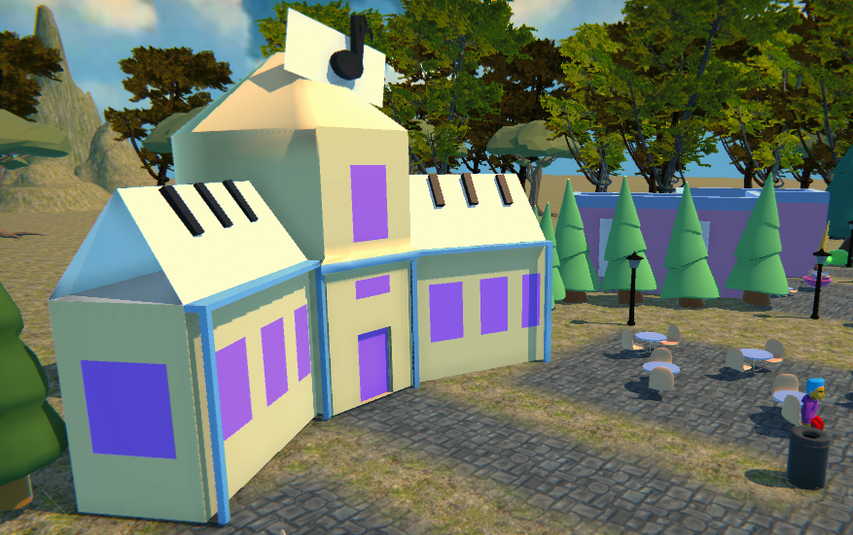
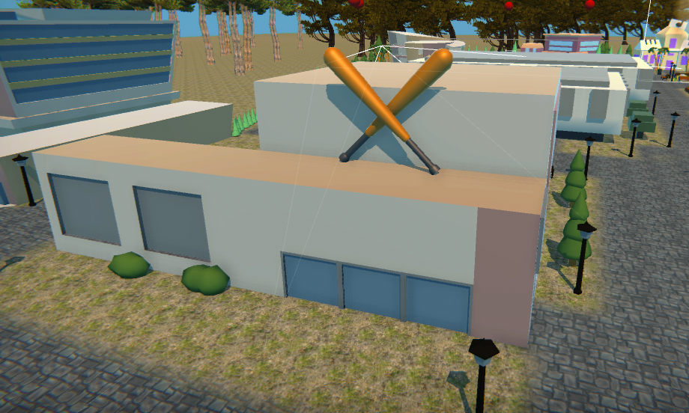
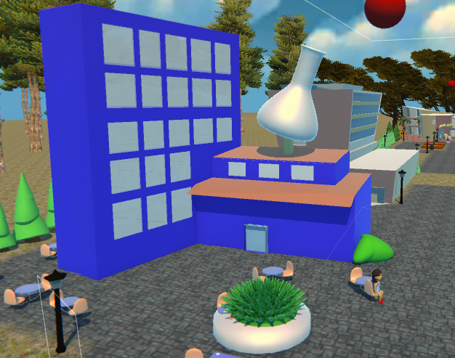
Campus Buildings

Slide 17
Game Design & Development:
Non-Player Character (NPC) Management
Notes:
Game View

Slide 18
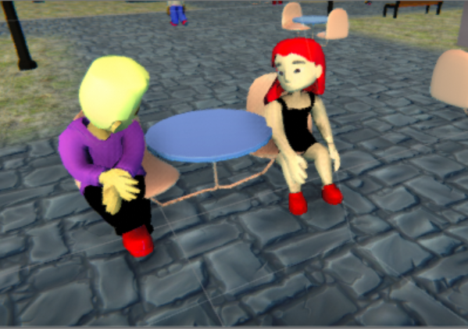
What is NPC?
What is NPC and how is it controlled?

Slide 19
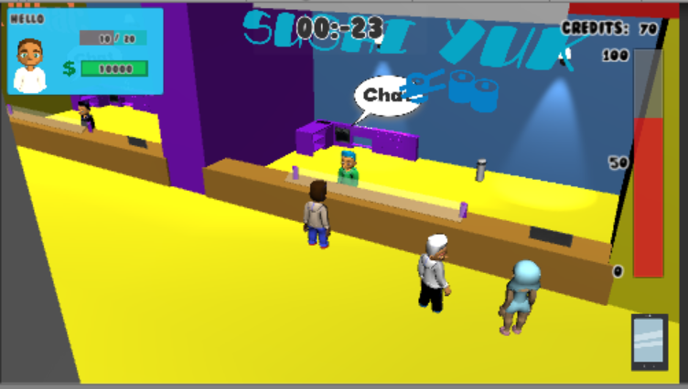
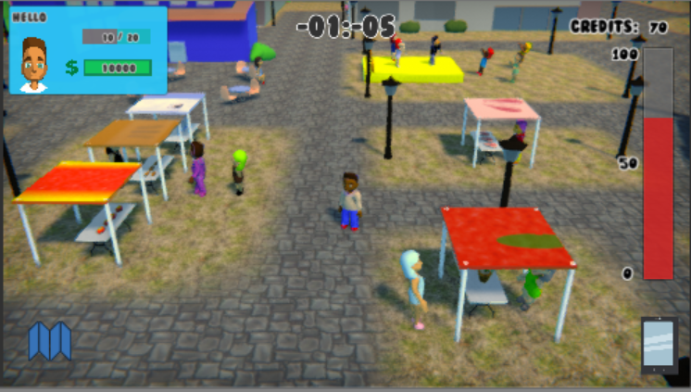
Why use of NPC?
Having NPCs makes the single player game more entertaining throughout the game.
Guides the player by giving them hint to progress the game.
Restoring Energy
Campus like Feel
Notes:
Be more specific about bullet points
Single player game & npc interacton

Slide 20
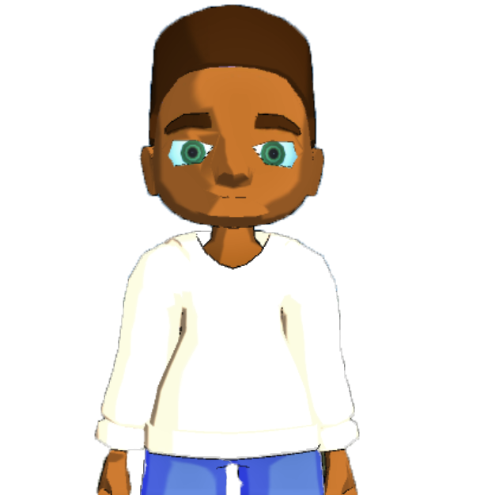
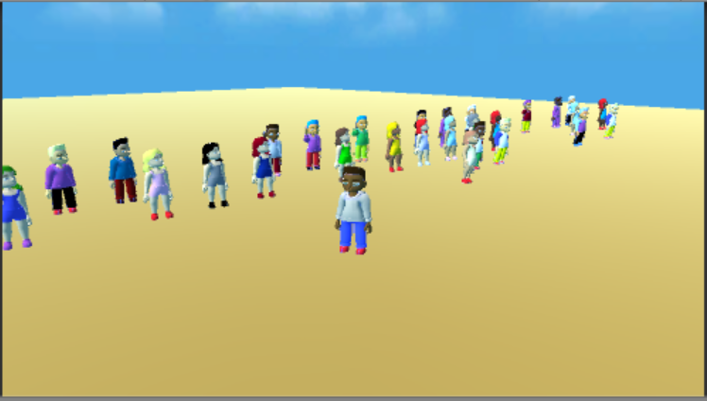
NPC Art
Cartoon
3D model
Created over 30 different Customized NPCS
Notes:
Customized over 30 NPCs

Slide 21
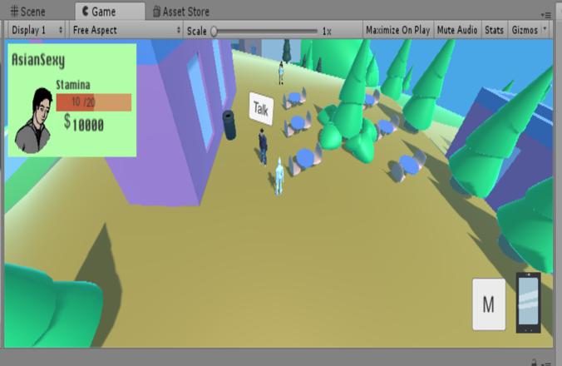
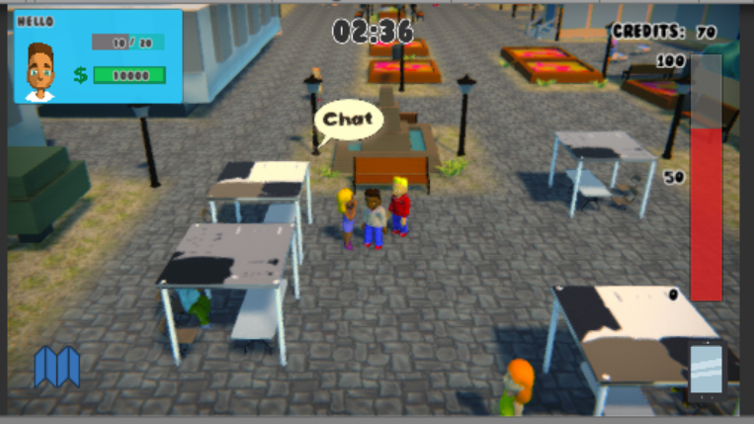
From Old NPCs to New NPCs
NPC PROTOTYPE
NEW NPC
Notes:
Consistent Models
Created from scratch
Attatcheed Animations

Slide 22
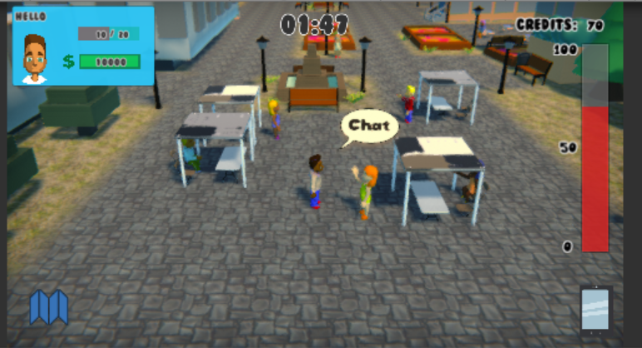
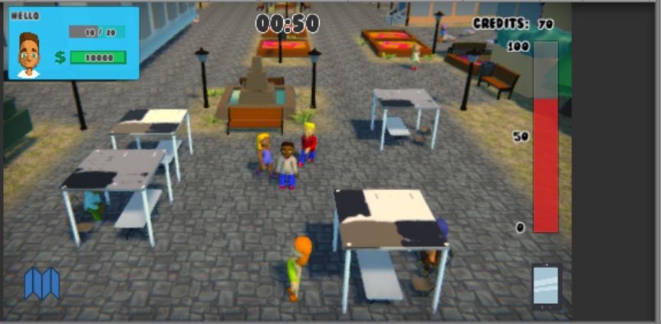
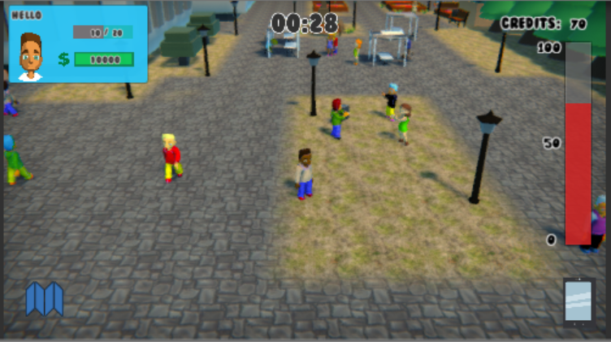
What we did to make NPC SMART
Random Spawn
Walking NPC (random/paths)
Dancing NPC
Following NPC
Reaction to player character

Slide 23
Game Design & Development:
Dialogue
&
NPC Interactions
Notes:
Player / College / NPC Stats
When does dialogue happen?
What does dialogue affect?

Slide 24
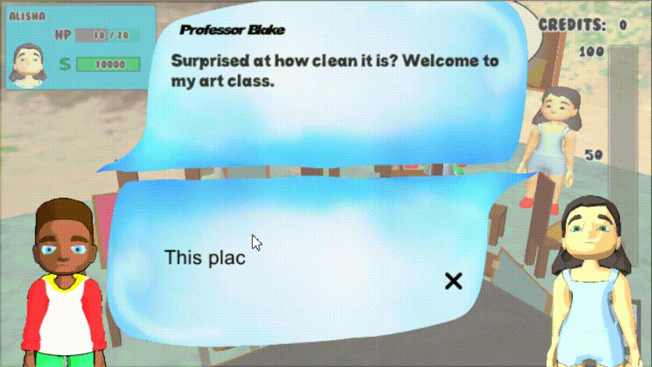
Quest Dialogue

Slide 25
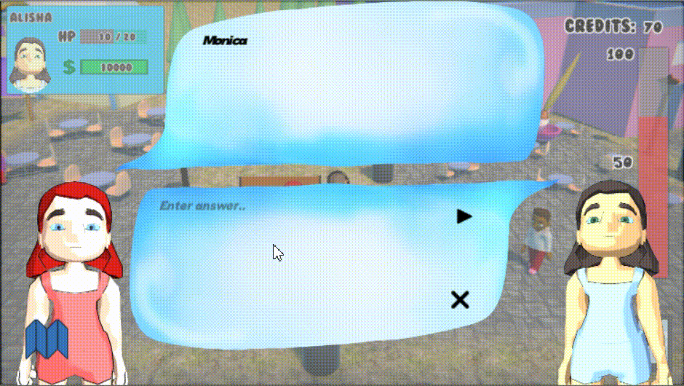
Random Dialogue

Slide 26
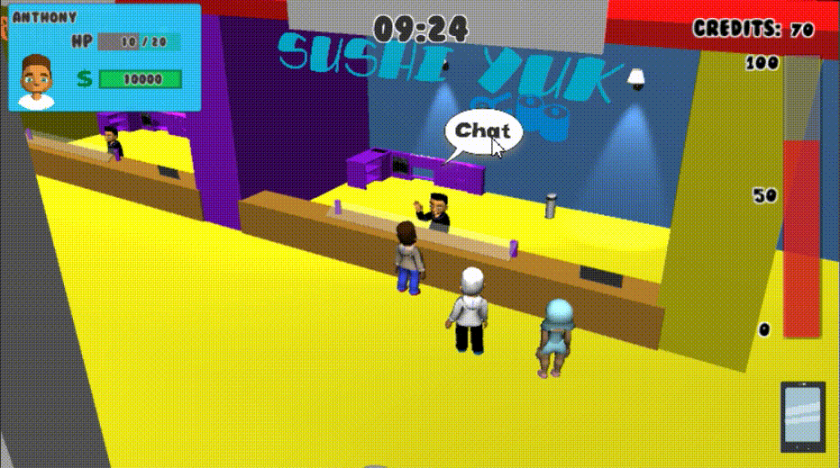
Choice Dialogue

Slide 27
Game Design & Development:
User Interface (UI),
Heads Up Display (HUD),
&
Mini-Map

Slide 28
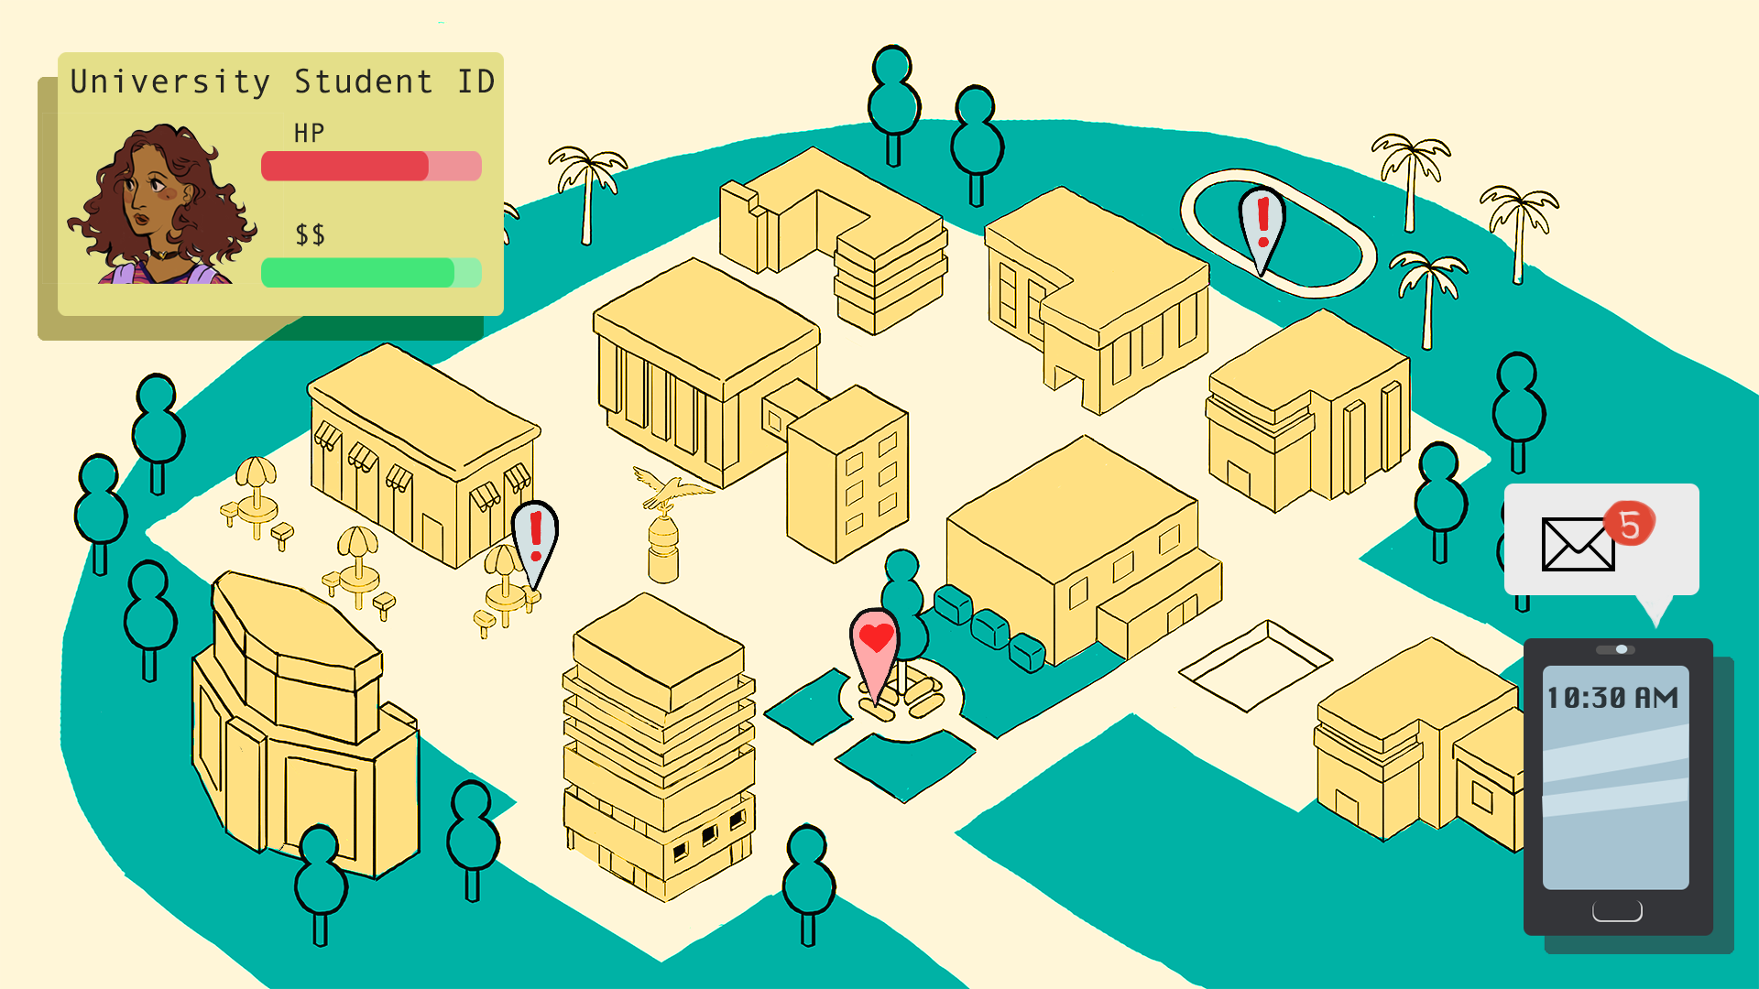
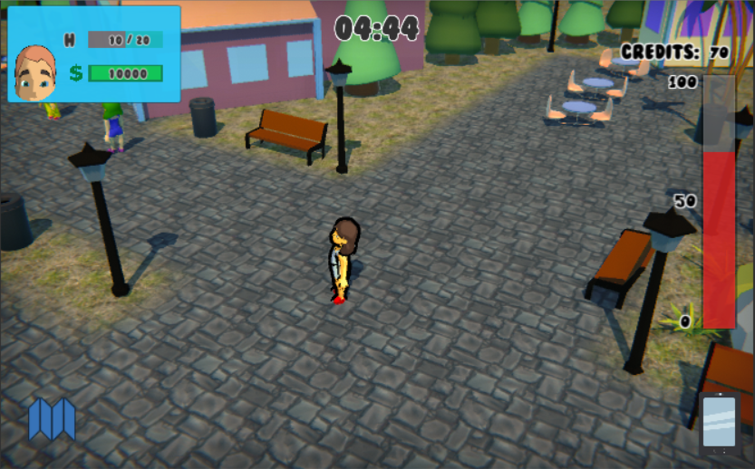
HUD
Provide basic information
Cannot clutter the screen too much

Slide 29
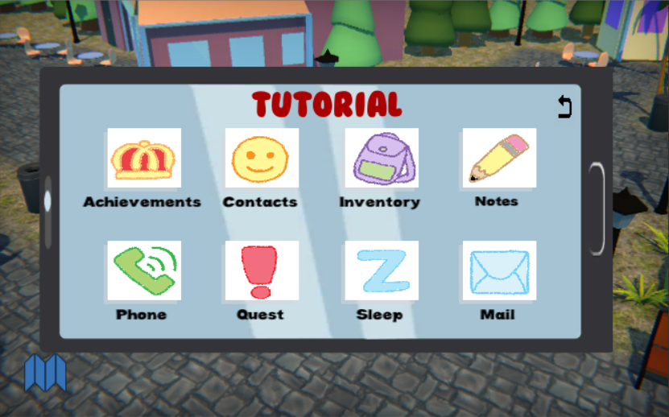
Phone Menu
Button for Phone Menu
Simple, Bold, Clear

Slide 30
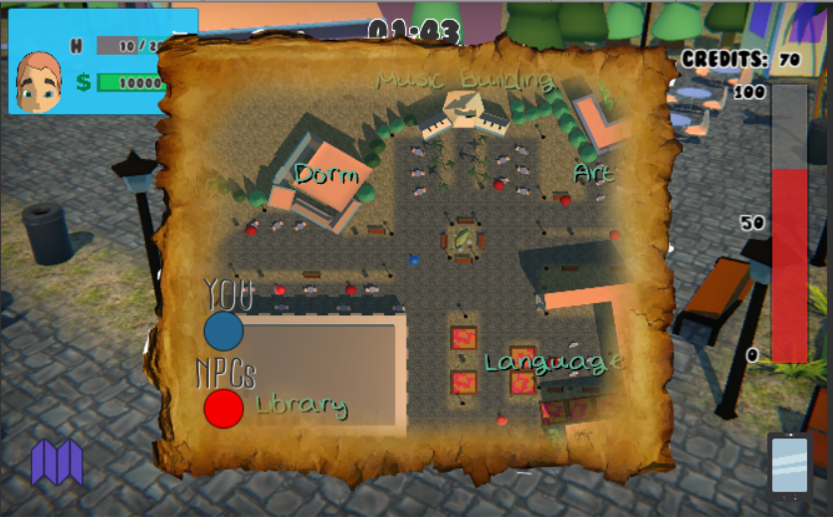
Mini-Map
Button for Mini-Map
GamePlay View
Mini Map View
What is Mini-Map?
Why we implemented the Mini-Map?

Slide 31
Game Design & Development:
Audio Management
Controller
Notes:
Composing Music
What software?
Style?
Move mini-map section to Map section

Slide 32
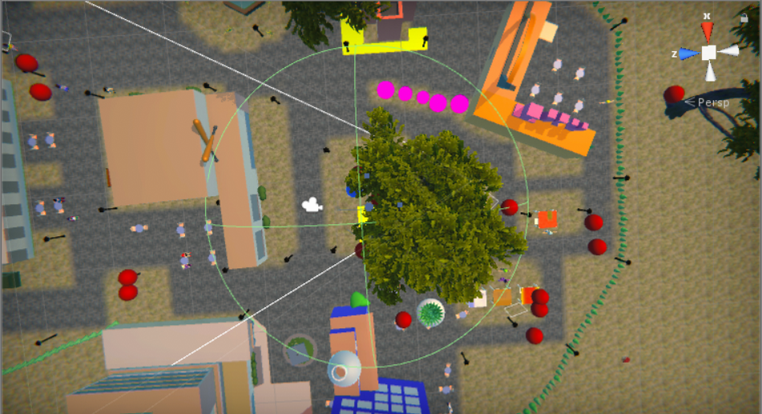
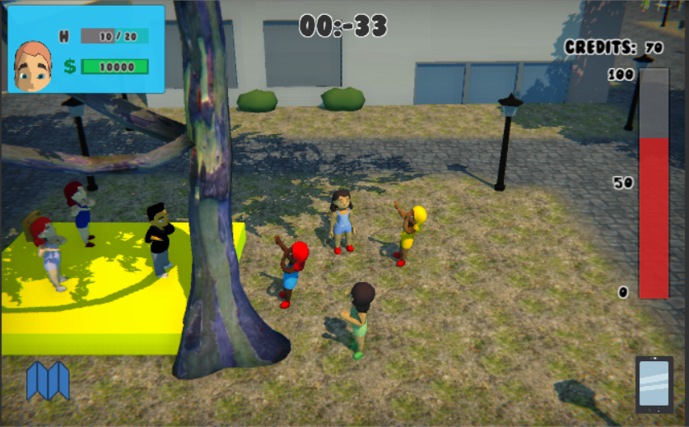
Video Games NEED
Background Music
and Sound
Effects

Slide 33
Software Tools
Unity3D
C#
Collaborate
Maya
Animation
Modeling
Adobe Photoshop
Microsoft Paint
Music and Sound
Sibelius
Freesound.org
Team Communication
Slack
Discord
Google Docs

Slide 34
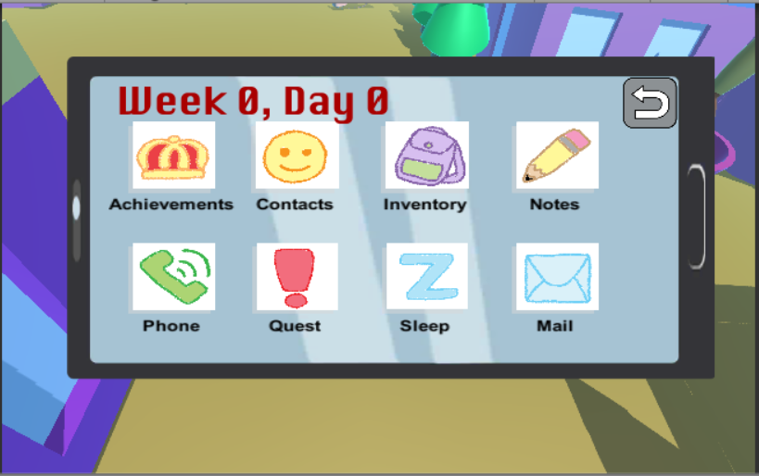
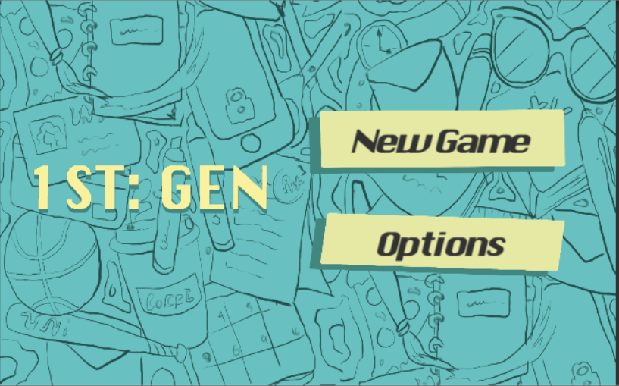

Slide 35
Game Demo Here
Notes:
Intended for mobile devices but for demonstration purposes Unity allows the game to be downloaded onto different platforms
Tapping works the same way as clicking

