Slide 1
INART VR
PROJECT

Slide 2
Team Roles
Team Lead:
Documentation:
Communication:
Project Planners:
Architecture:
Software Engineers:
Kevin Diaz-Lopez
Taha Kamran, Steve Galvan
Daniel Ramirez
Kiet Hoang, Noah Castro
Jessy Francisco
David Hermosillo, Zudong Li

Slide 3
Agenda
Project Overview
Functions & Uses
Functional/Non Functional Requirements
Unreal Environment
Recap
Steve Galvan

Slide 4
Project Overview
INART VR is an interactive, photorealistic 3D environment used to portray a digital story
The 3D setting is used as a production set
Provides tools to simplify virtual filmmaking
Developed in Unreal Engine 4
Steve Galvan

Slide 5
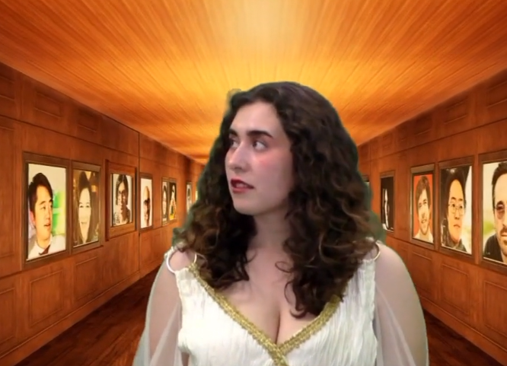
Unreal Realities
Short film for the book launch of Interactive Storytelling for the Screen
The book discusses interactive storytelling as a form of participatory narrative practice
The film follows a protagonist that gets pulled into a digital world where she encounters the book as an interactive experience
Inspired by The Wizard of Oz
Steve Galvan

Slide 6
Client Goals
Book lounge about storytelling
Functionality for live actors to navigate through the world
Rabbit NPC that is a guide for the user
Various virtual sets such as a desert, hallway, book nook, office, and city
Steve Galvan

Slide 7
Client Challenges
Setting the Environment for the book
Creating an AI Bunny
Camera angles
Lighting
Daniel Ramirez

Slide 8
The Problems & Challenges with Virtual Communication
Contact Liaison/Team
Make Changes to the Model
Send Sample to Liaison
Get feedback
Daniel Ramirez

Slide 9
OUR CONSULTANTS
David Krum (Advisor)
Sylke Meyer (liaison)
Daniel Ramirez

Slide 10
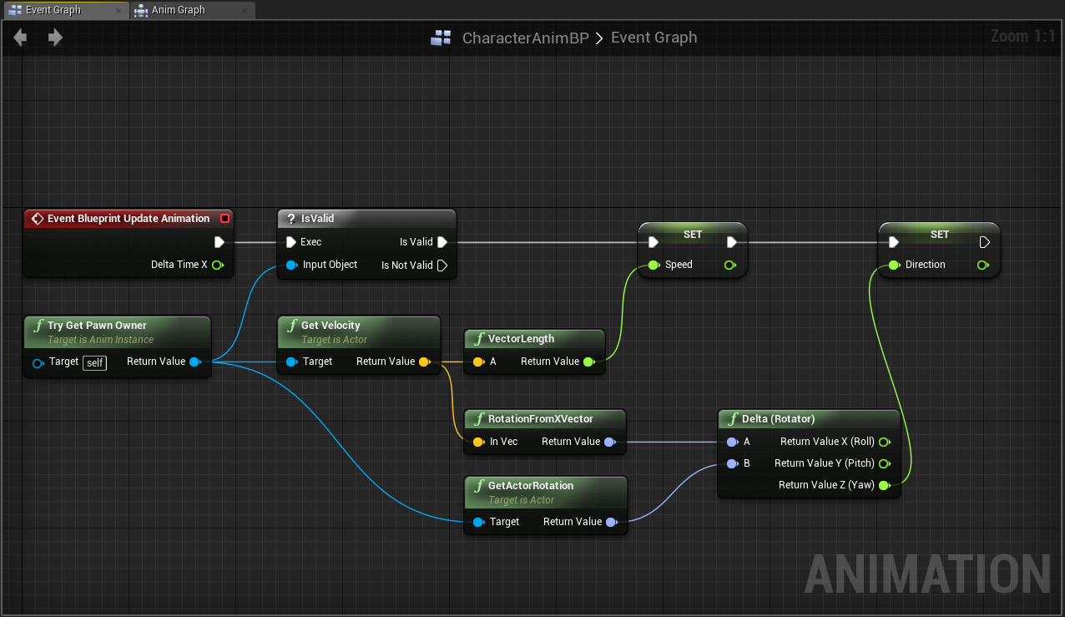
How Does it Work?
- Assets are merged, modified, and repurposed to create desired scenes for filming
- 3D Models are controlled via UE blueprints to change animations and behavior
- Sequencers and Camera Rigs used to manipulate cameras to get desired shots
- Chroma Key materials used to bring visual media into the 3d environment (pictures and video recordings)
Noah Castro

Slide 11
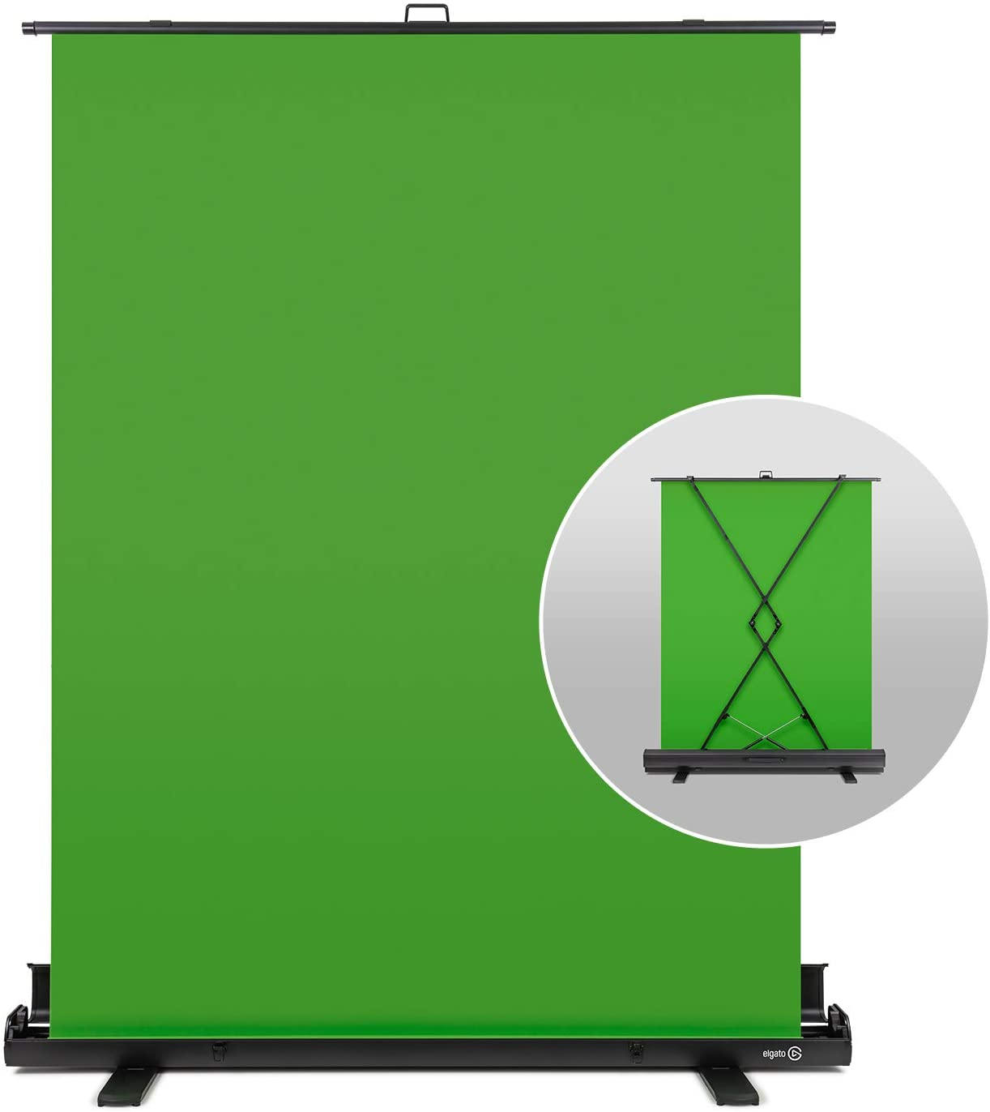
Interface and Constraints
- Computers lacking sufficient hardware will struggle to run the Unreal Engine 4 (UE4)
- Environment must run in the UE4
- Cameras and lighting capabilities are limited to software restraints in UE4
- For chroma keying, the user needs proper chroma key technology such as a green screen.
Noah Castro

Slide 12
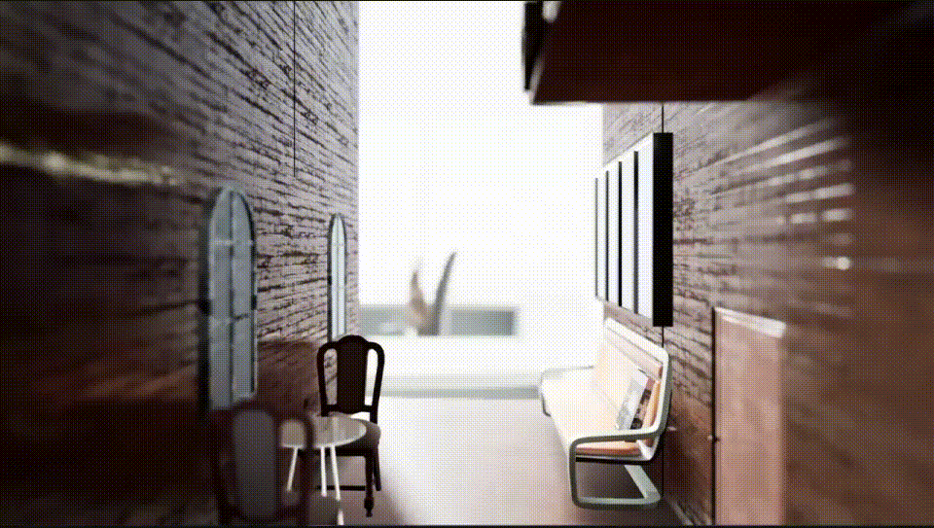
Goals
Create a VR set to match the mood and setting of the liaison’s story
Create interactables/AI to display certain topics of the book
Create keybinds to activate certain interactables/AI during the recording sessions
Kevin Diaz-Lopez

Slide 13
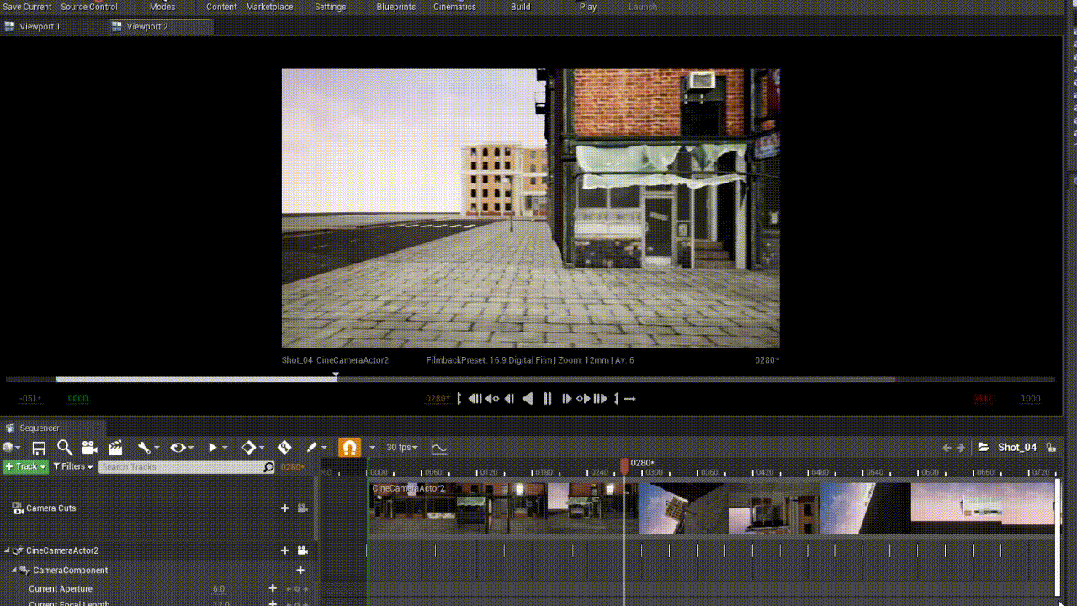
Sequencers
Sequencers allowed the team to create short clips/setup shots for the liaison
These short clips were used to plan the recordings of the actors and then incorporate them into the video
The use of sequencers involved placing keyframes for the camera to follow throughout the time frame
Kevin Diaz-Lopez

Slide 14
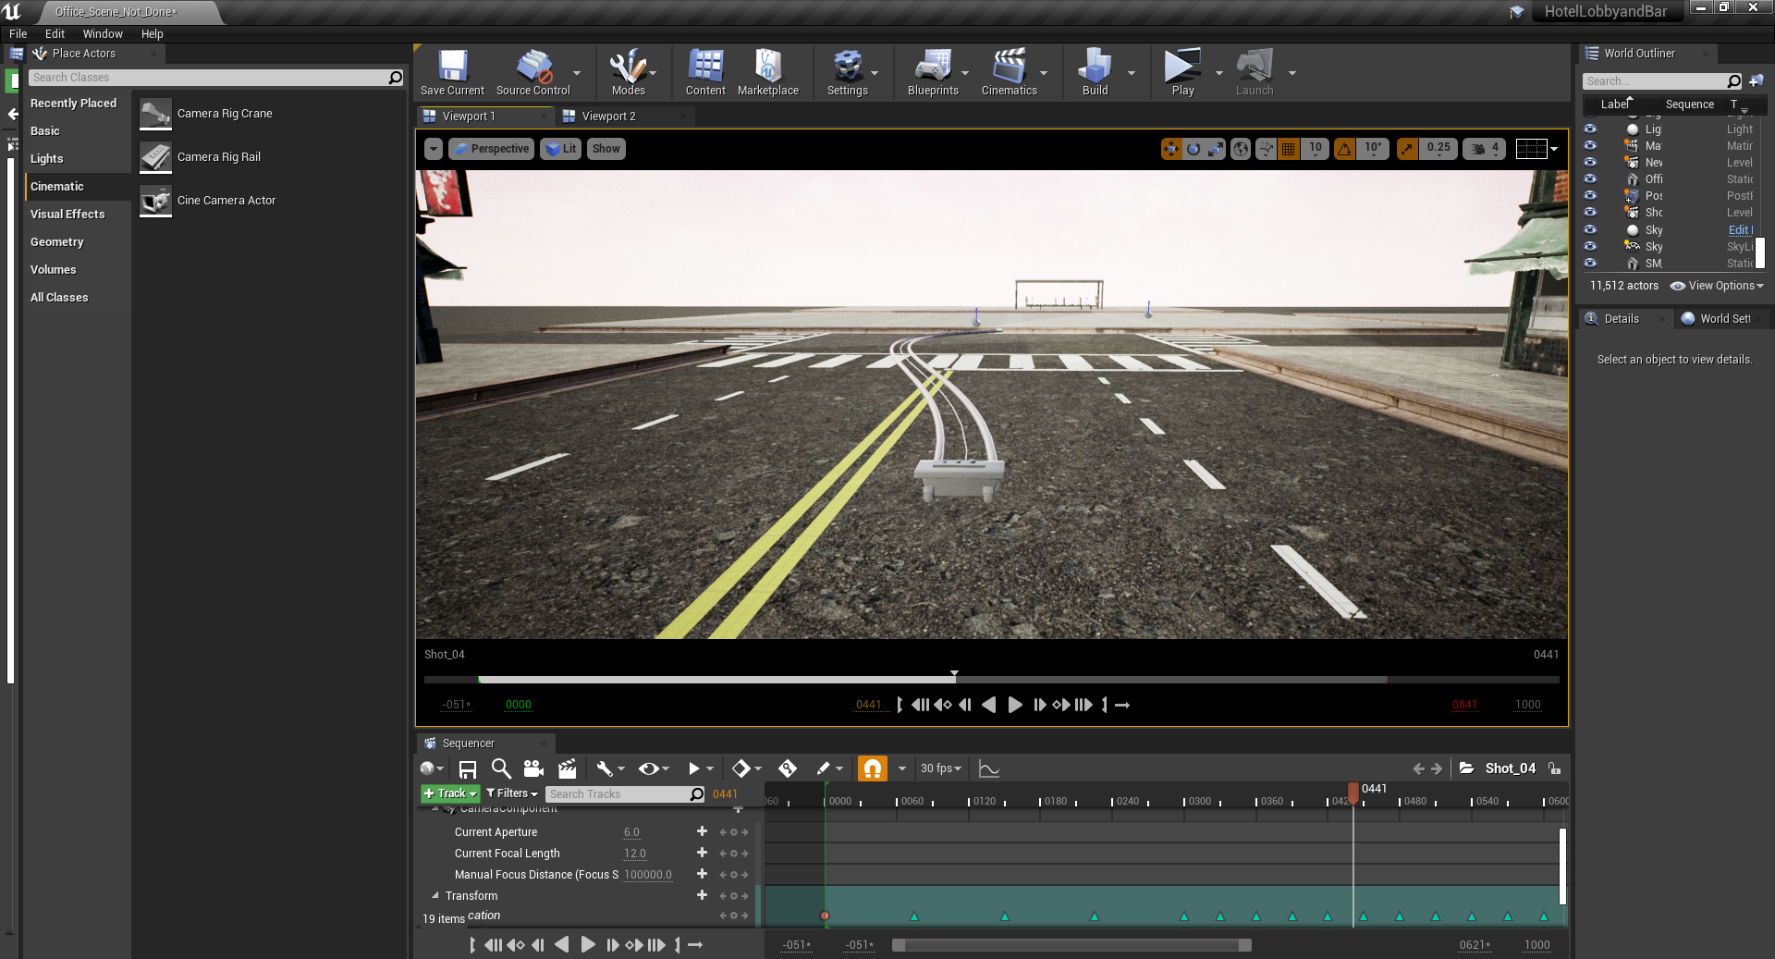
Camera Rig Rail/Cine Camera
Camera Rig Rails are used for a more defined path for the Cine Camera to take
Whether it be to match specific movements of the live actor or to ensure the camera did not collide/overlap with any objects
Kevin Diaz-Lopez

Slide 15
Functions & Uses
Creating a virtual world with multiple scenes
Customizable environment to fit the customer demand
Allow for imports of recordings into the environments
Create a camera to be set on a course for common pans/shots
Zudong Li

Slide 16
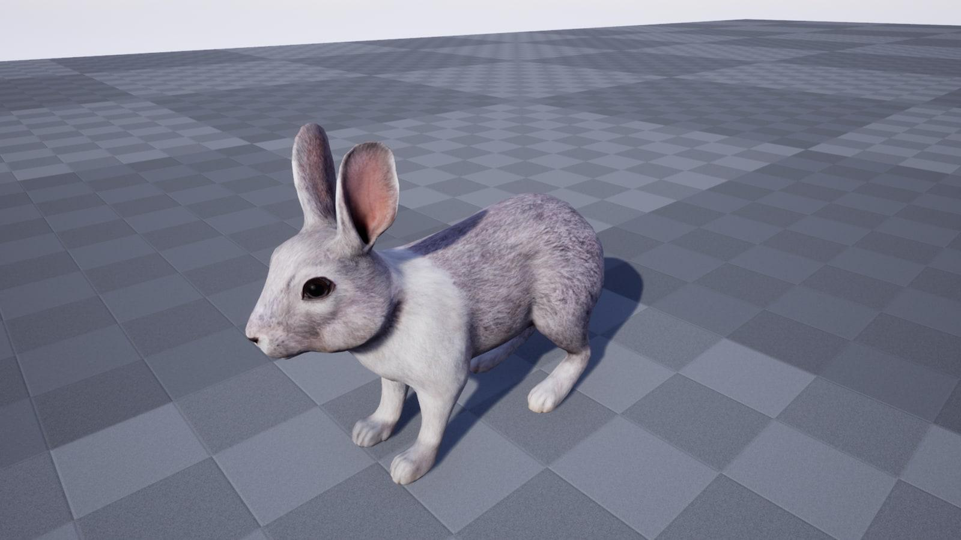
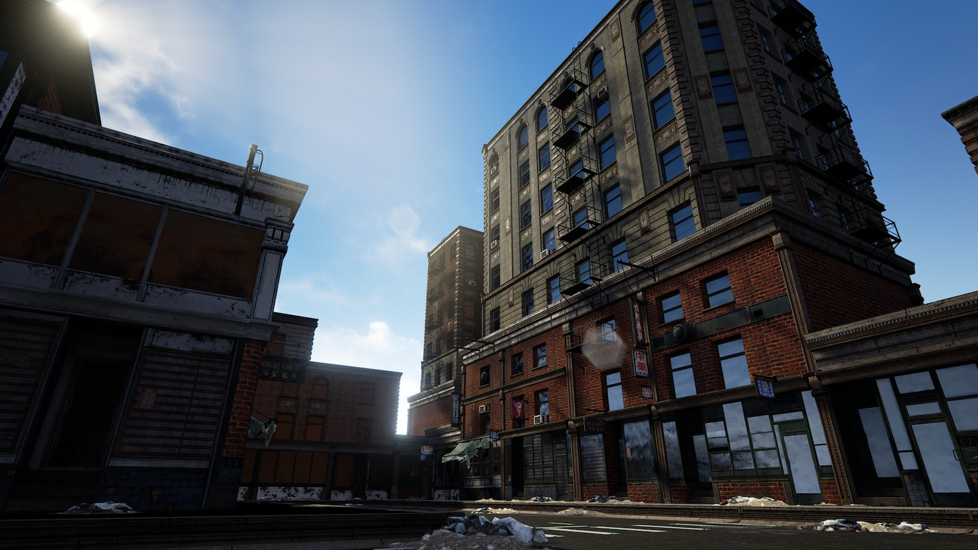
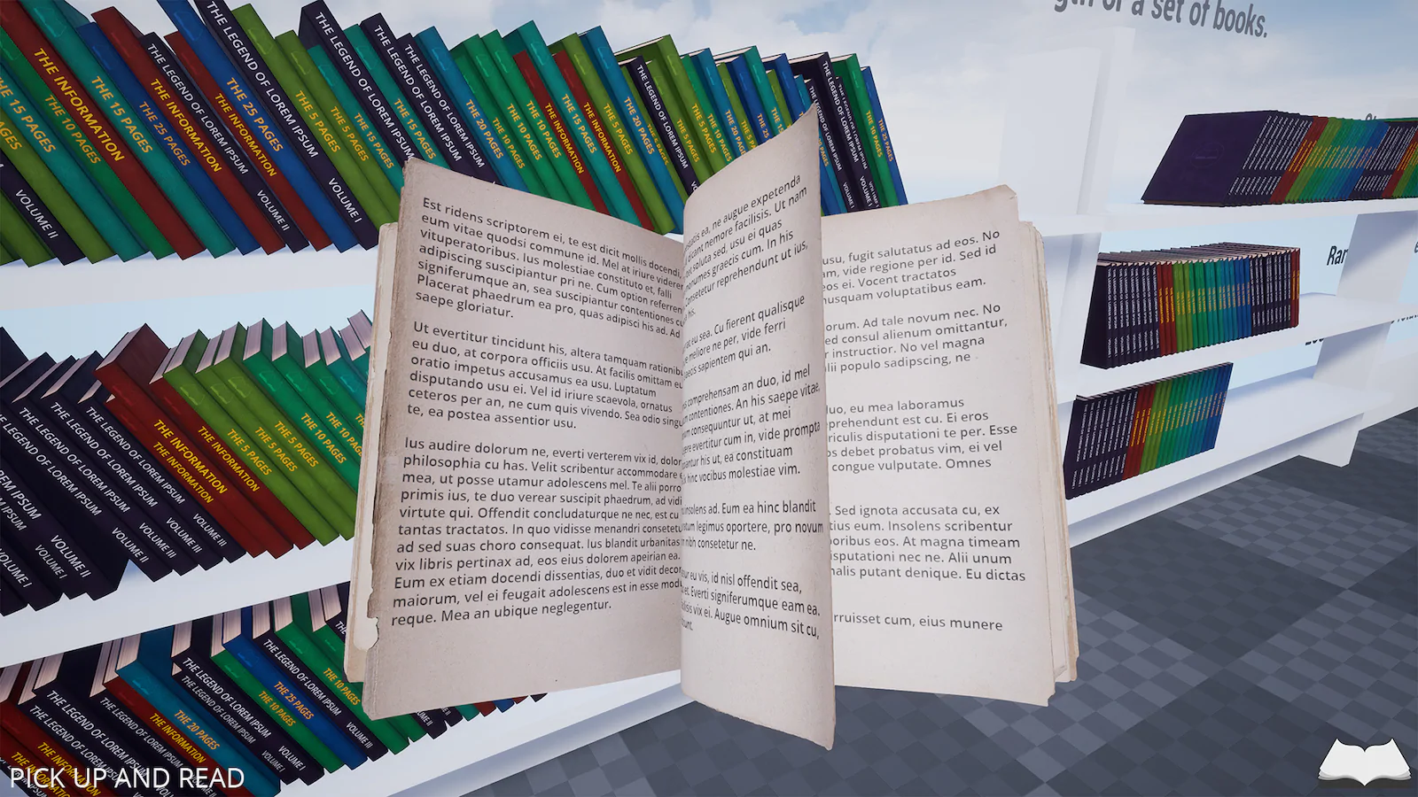
Unreal Engine Asset Store
Zudong Li

Slide 17
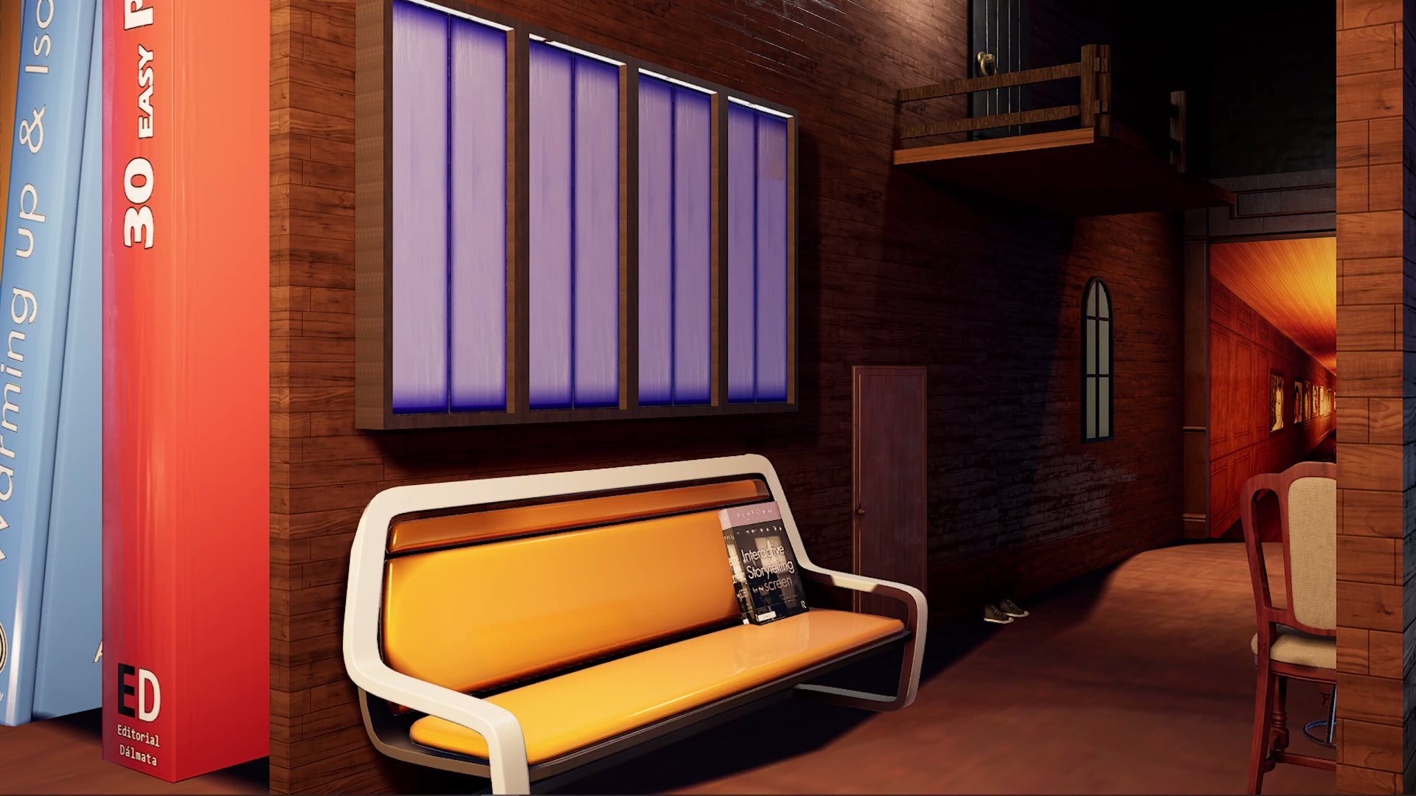
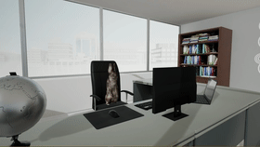
Examples
Zudong Li

Slide 18
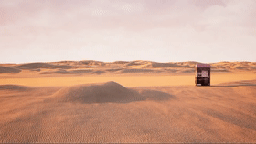
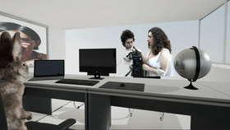
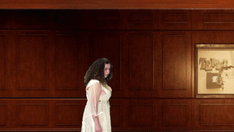
Uses of Work
Zudong Li

Slide 19
Virtual Environment Requirements
Environment
Create objects that the actors can interact with.
Users must be able to make changes to any objects
Importing levels.
Lighting
Add or remove light sources.
Adjust the atmospheric lighting and reflections.
Should have the option to transfer the virtual environment lighting over to actor, vice versa
Virtual Character
Must be able to adjust it’s position and body parts individually.
Must have the ability to animate the stand-in.
Taha Kamran

Slide 20
Recording in the Virtual World
Basic features of screen recording, import live video, pre-rendered video and audio.
Multiple cameras.
Chroma key videos within the set
Movable camera to pan and record different types of shots
Taha Kamran

Slide 21
Performance Requirements
Virtual Characters need to guide the user through the book world
Characters will ask questions and talk
Actions between the actor and the objects need to be synced
The world must be photorealistic
Some objects need to be able to be interacted with
Taha Kamran

Slide 22
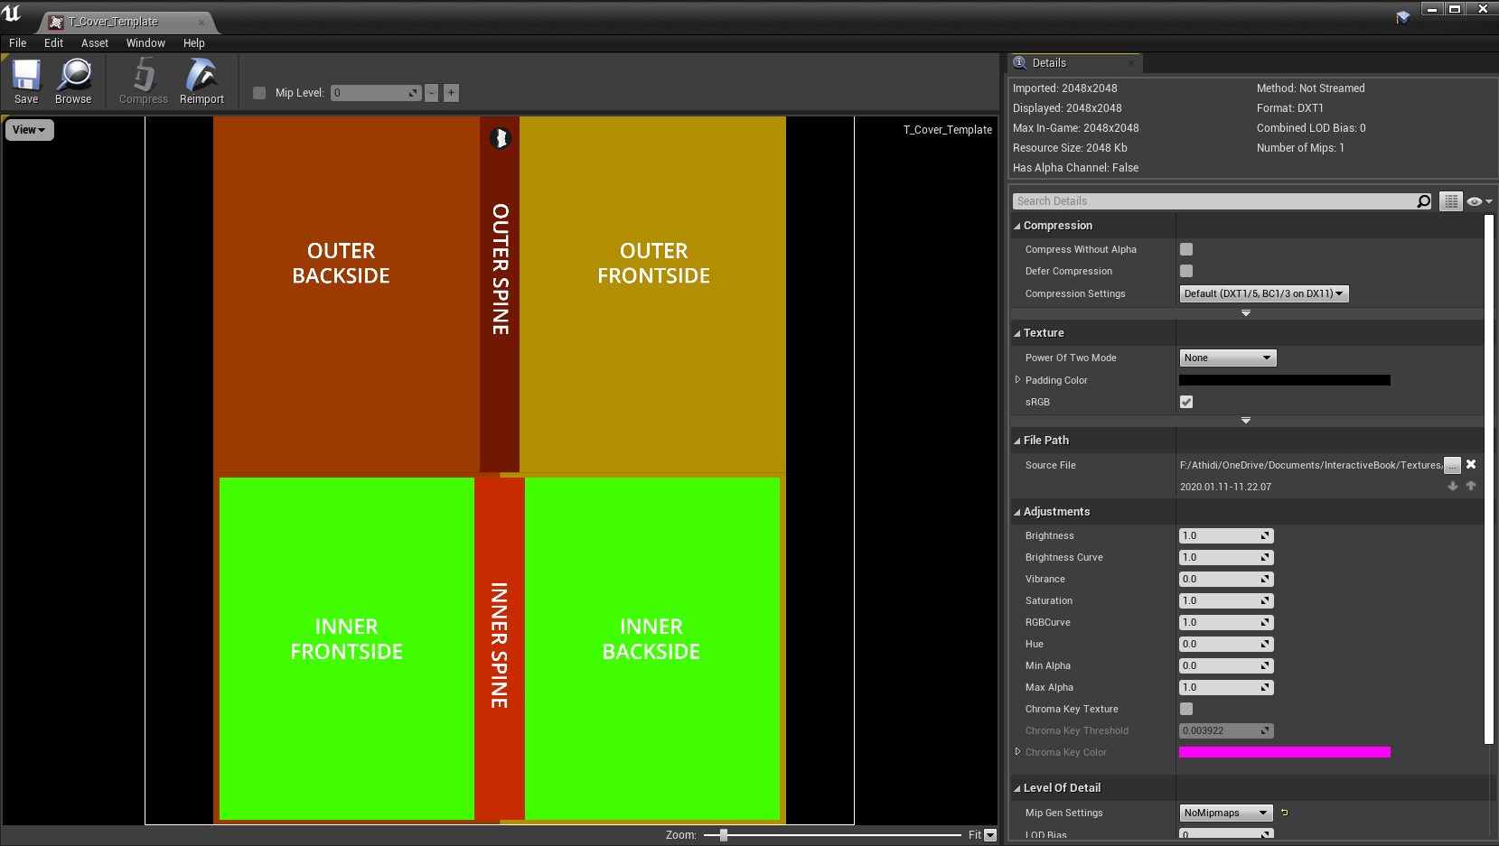
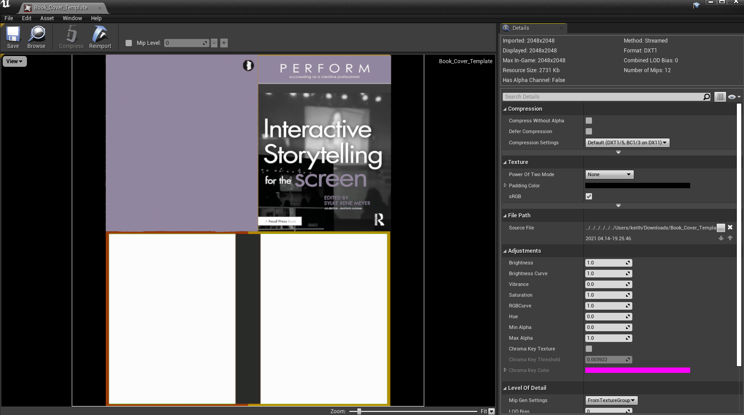
Changes to Unreal Assets
Liaison’s book cover placed onto the template.
Author of the “Interactive Book” asset said to use Substance Painter.
Used a image editing software instead.
Kiet Hoang

Slide 23
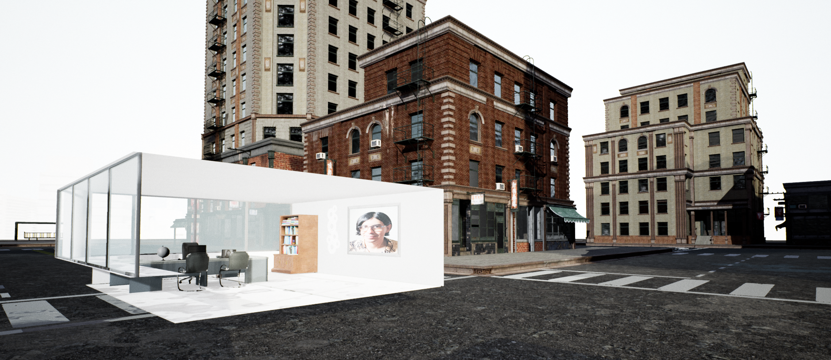
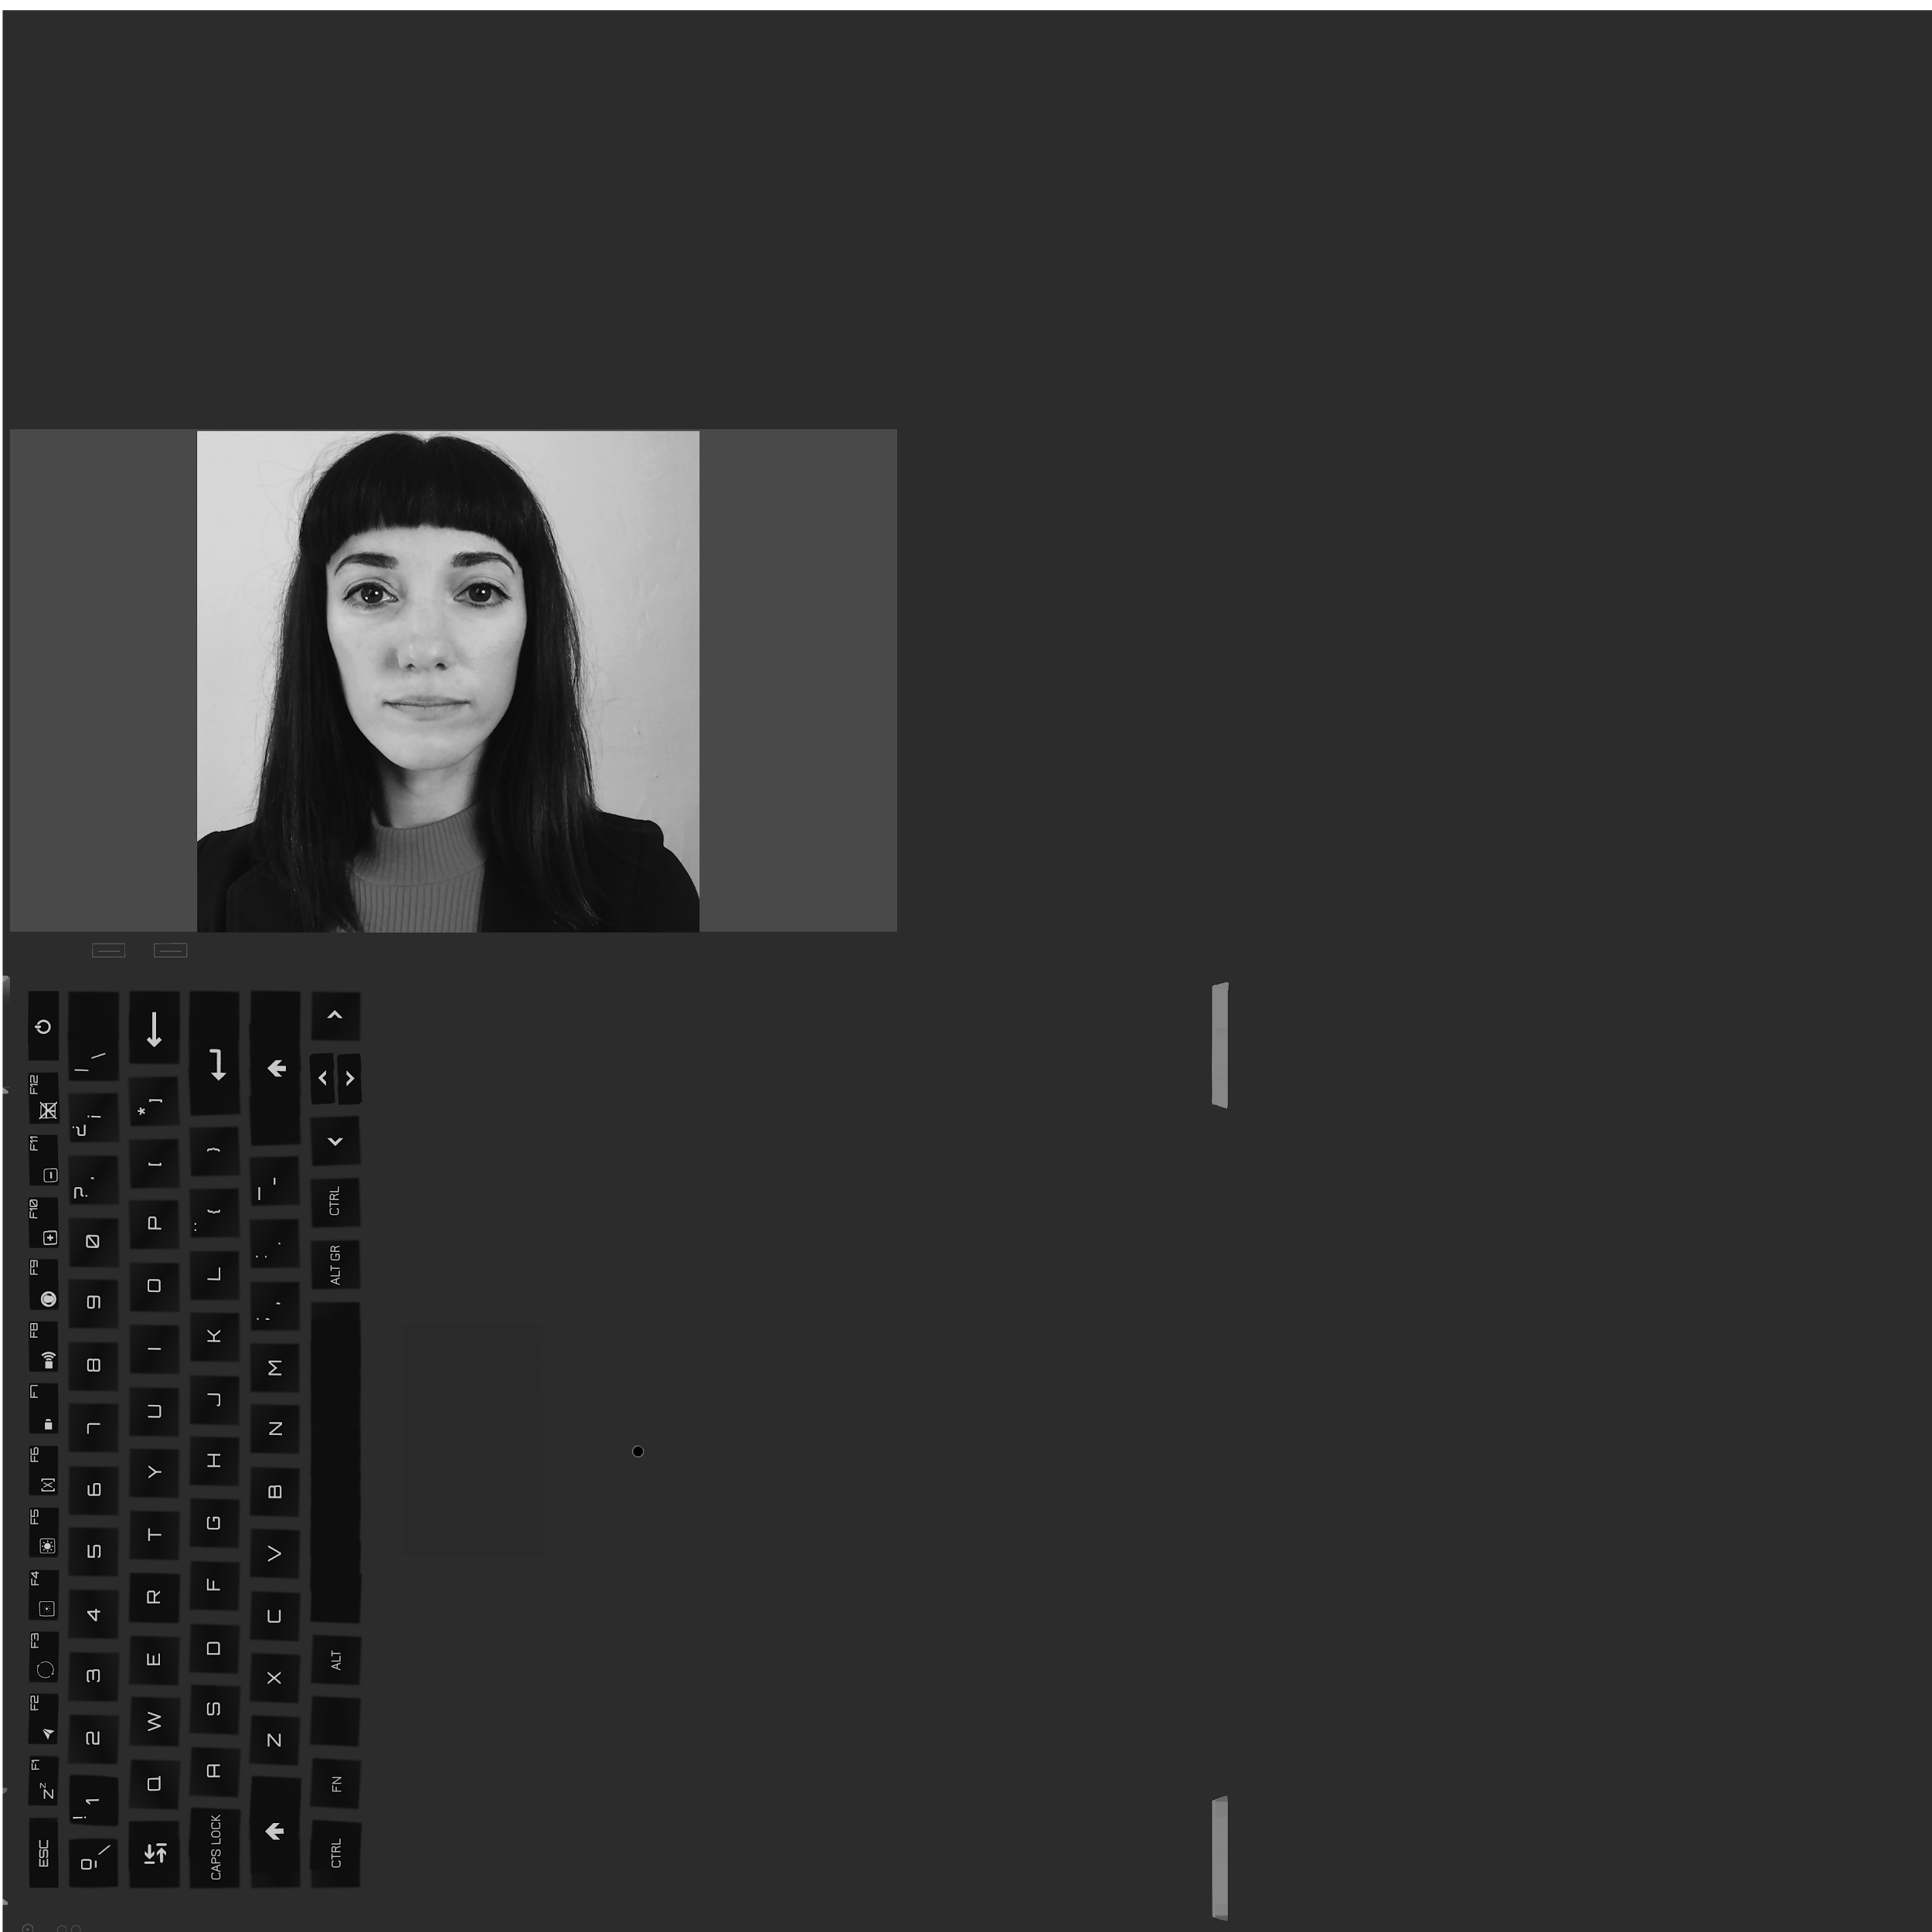
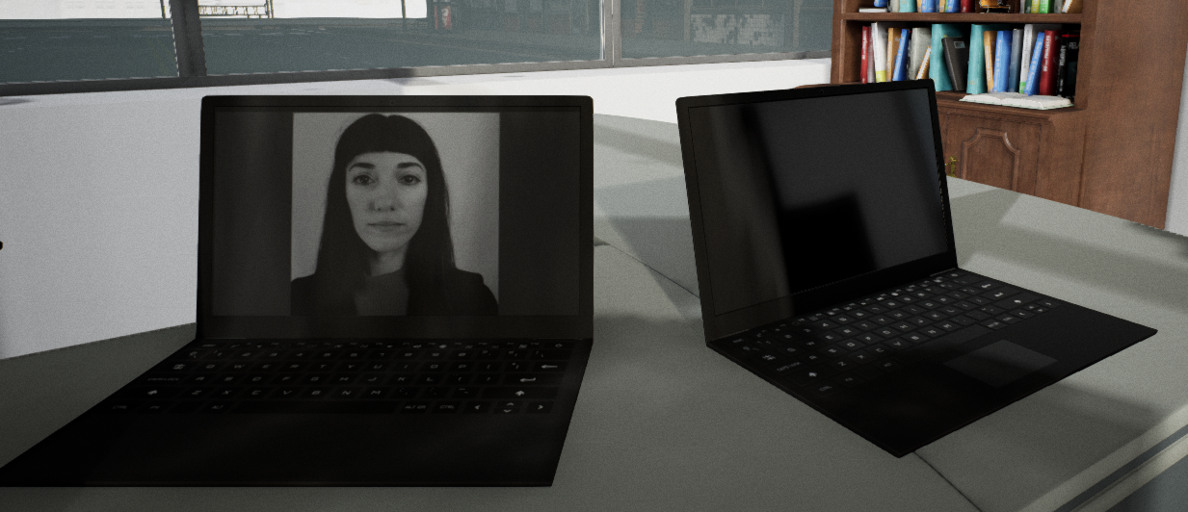
Changes to Unreal Assets Cont.
Merging two assets together: Modular
City Buildings and Office
Added one of the book’s contributor to the texture mapping
Kiet Hoang

Slide 24
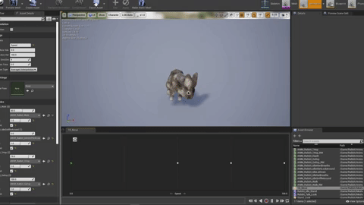
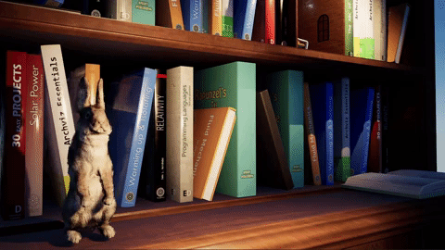
Rabbit Animations
Animation Blendspace
Animation Montage
Animation Blueprint/Stage Machine
Kiet Hoang

Slide 25
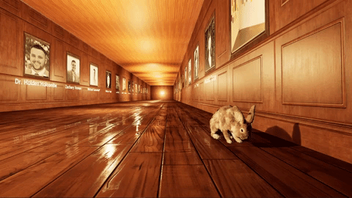
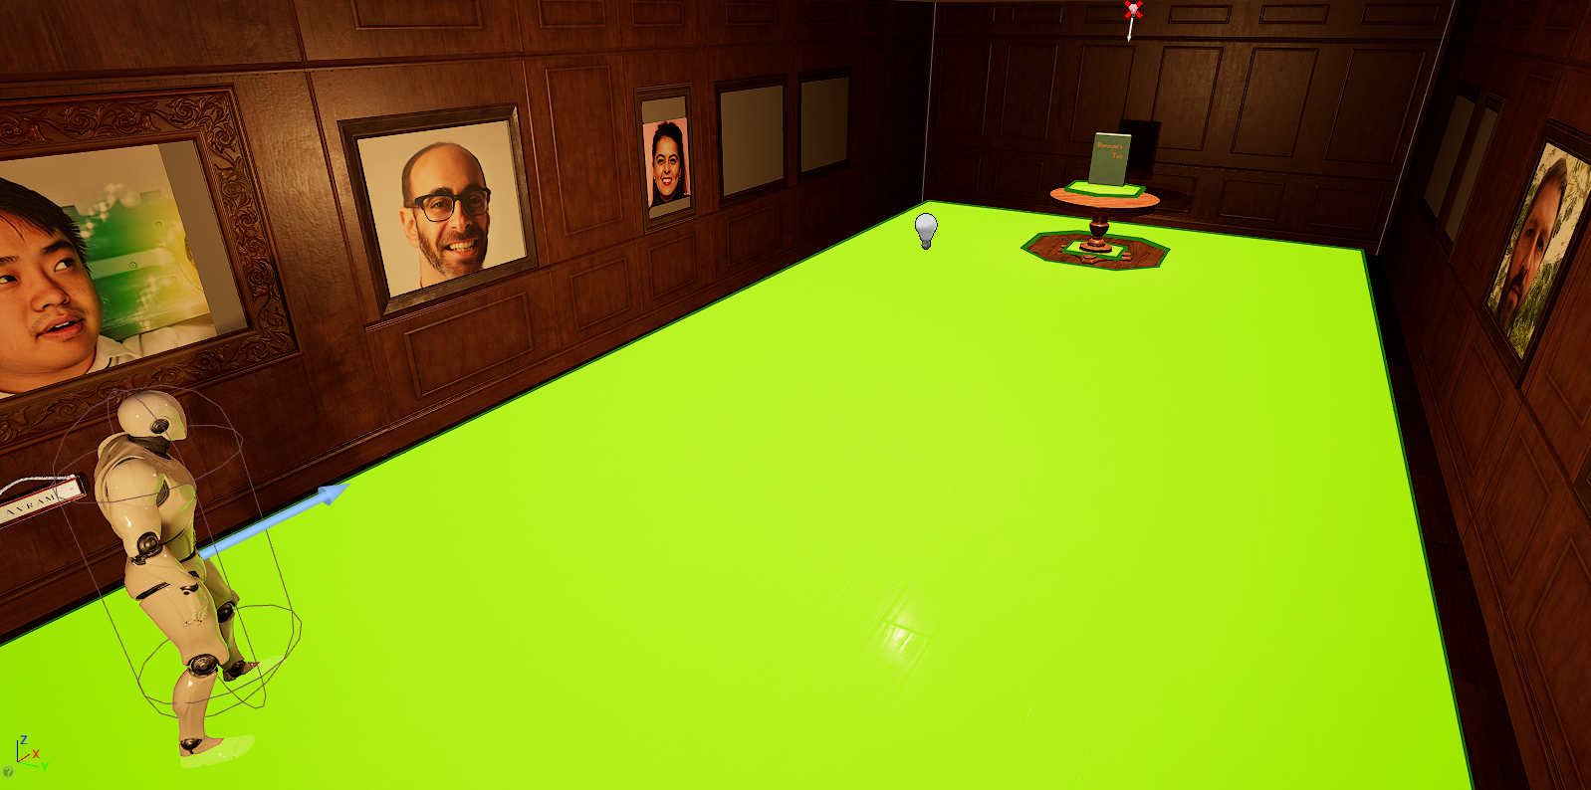
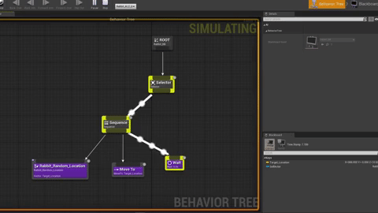
Rabbit A.I. and Behavior Tree
Giving a character limited artificial intelligence with blueprints.
Create an area that the rabbit can traverse.
Create a algorithm where the rabbit checks its radius and moves to location.
Kiet Hoang

Slide 26
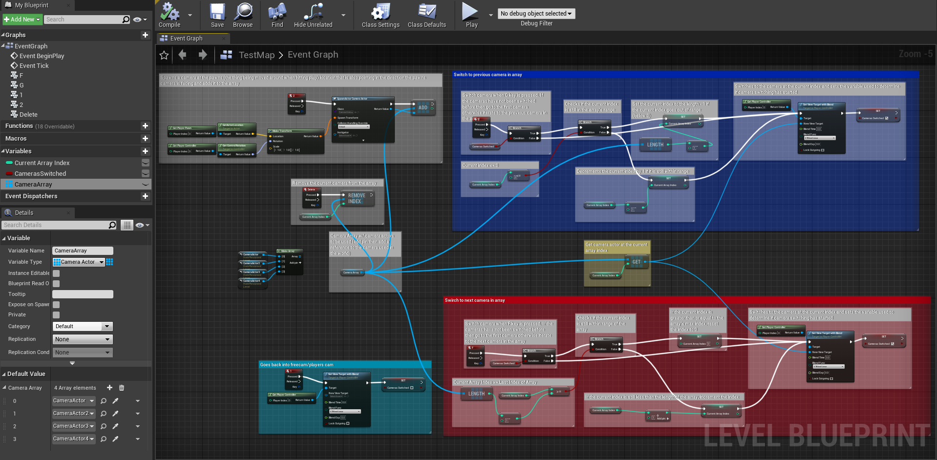
Camera Bookmarking
Switch between preplaced cameras
Add more cameras to the scene
Delete cameras that are no longer needed
David Hermosillo

Slide 27
The Problems and Challenges
Creating a film while working from home
Texture streaming pool overflow
Working with camera rig rails
Chroma keying images of contributors into the set
Learning how to use Unreal Engine’s Blueprints
Working with asset animations
Manipulating AI and creating their behavior
David Hermosillo

Slide 28
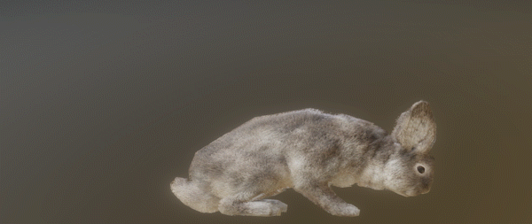
What we need to Improve...
More AI functionality
Ex. Being able to switch animations
Incorporation of live actors into the scenes
Caused by equipment constraints
Jessy Francisco

Slide 29
Recap
What the project is about
Creating a 3D photo realistic environment to be used in a film production
Problems and Challenges
Learning how to use UE’s blueprints
Working with asset animations
Functions and Uses
Allow for imports of recording into the 3D environment
Create camera(s) to be set on for common pans/shots
Jessy Francisco

Slide 30
Thanks for watching!
a
a

