Slide 1
Layer Analysis
By: Edwin Ruiz, Ken Luo, Christopher P Nguyen, Elizabeth Sanchez,
Kimberly Reyes, and Alyssa Solon
Advisors: Dr. Elaine Kang and Dr. Yuqing Zhu
Liaisons: Emily Law, Shan Malhotra, Mike Rueckert, George Chang

Slide 2
Agenda
Introduction
Objective
DFD
Features (CLI, Layer Selection, Function Selection, Demo, Graph Types)
Python-Libraries
Learning Experiences
Challenges
Future Plans
Notes:
Edwin

Slide 3
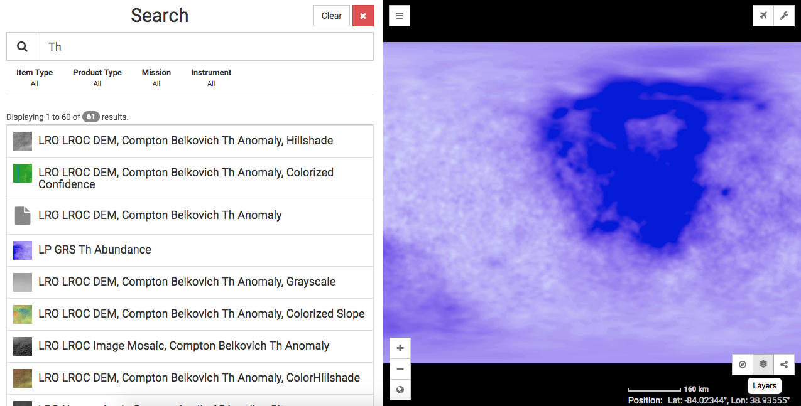
Introduction
MoonTrek - https://moontrek.jpl.nasa.gov
Limitation - does not allow statistical analysis of layers selected
Notes:
Edwin
JPL has MoonTrek (https://moontrek.jpl.nasa.gov) that allows visualization of layers gathered from the Moon. We created analytical tools that will analyze a single or multiple layers. Such calculations will include minimum, maximum, average, median, standard deviation, variance, histogram, etc. for a single layer. Analysis of multiple layers will include correlation, covariance, clustering, and visual representation of the results. Such analysis will provide more insight about the Moon and the elements there to the user and perhaps more importantly to scientists.

Slide 4
Objective
Create tools to :
Discover information about the various layers available on Moon Trek
Cross examine data from any combination of layers
Notes:
Edwin

Slide 5
Data Flow Diagram Level 1
Moon Trek Database
GDAL Module
Send layer
selection(s)
Retrieve
Layer(s)
Send layer(s)
Send extracted
data
Execute CLI
Layer Selection
Module
Numpy/
Pandas/
Georasters Module
User
Function Module
Command Line
Pick
layer(s)
Send layer(s)
Send information
Display
output to
user
Show Information

Slide 6
Command Line Interface
System executed in CLI
Developed to visualize project results without integrating to Moontrek
User presented with prompts throughout execution:
Layer Selection
Function Selection
Data Returned
Notes:
Kimberly

Slide 7
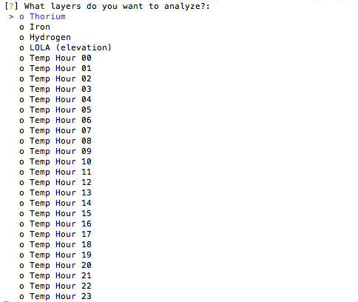
Layer Selection
Provided with 4 layers
Iron
Thorium
Hydrogen
Elevation (LOLA)
Temperature files (spanning 24 hours)
Notes:
Kimberly
talk about why thorium is important to analyze in the moon

Slide 8
Preprocessing
File to Dataframe: geoTIFF/xyz to Dataframe
Conversion
Removal of NaN values: Interpolation
Normalization
Notes:
Chris

Slide 9
Function Selection
Certain set of functions displayed depending on how many layers chosen by user
Multiple functions available
Stats, Covariance, Subsample Correlations, Clustering, etc.
Notes:
Chris

Slide 10
Demo-Clustering
Notes:
Chris

Slide 11
Demo-Graphs
Article: Tokuda, Tomoki, et al. "Visualizing distributions of covariance matrices." Columbia Univ., New York, USA, Tech. Rep(2011): 18-18.
Notes:
Elizabeth
Article information on the slides before playing videos

Slide 12
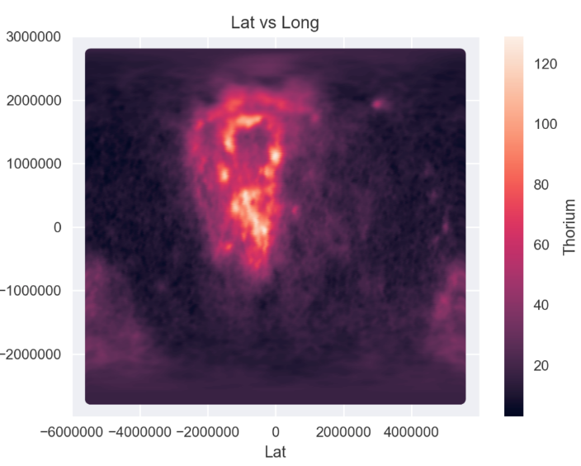
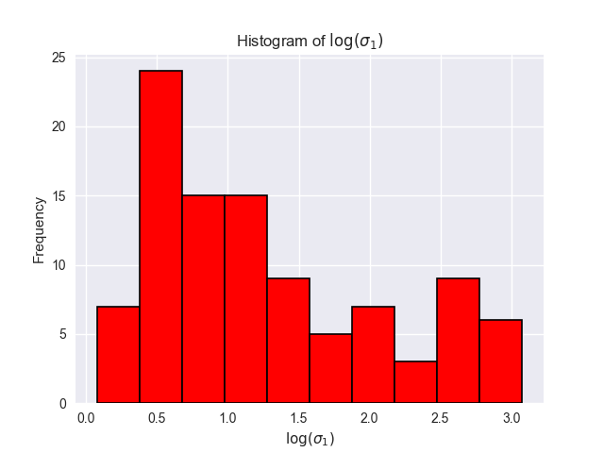
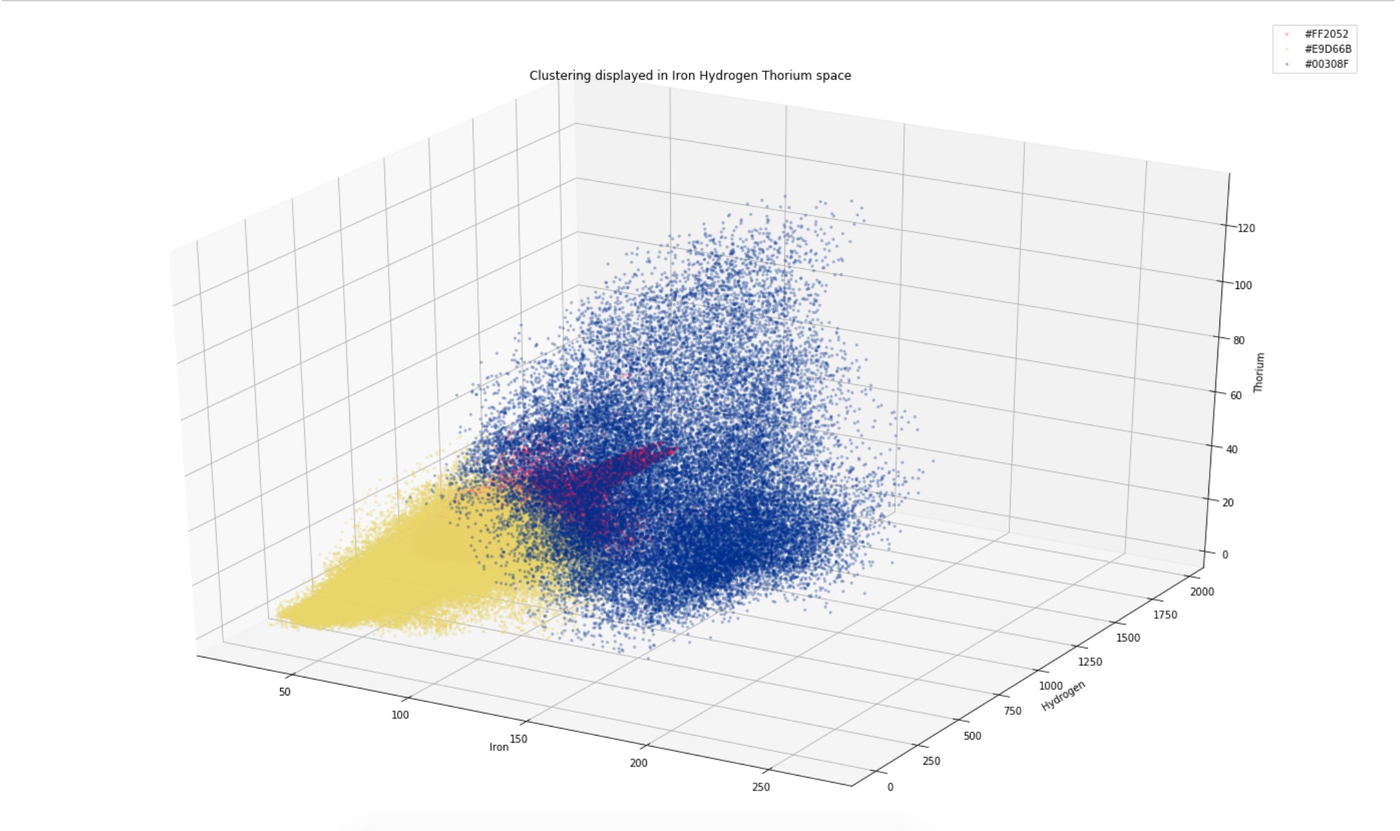
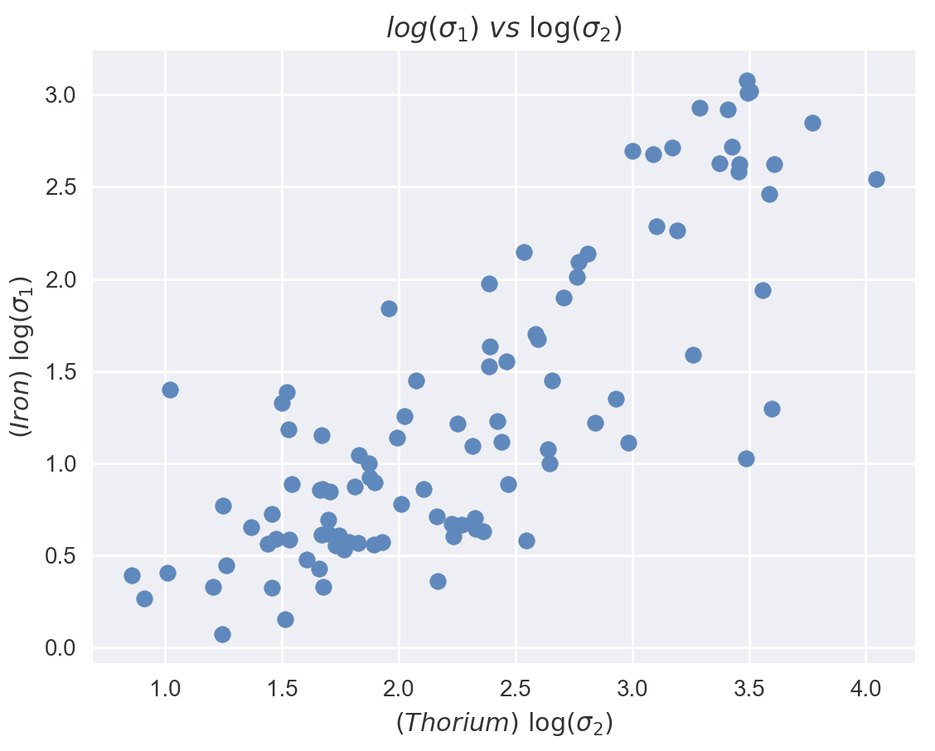
Graph Types
Heatmap
Matrix
Histograms
Cluster
Scatterplots
Notes:
Elizabeth

Slide 13
Heatmap
Per element graphs
Light - more abundant
(dark - less abundant)
Takes in location parameters
Latitude & Longitude
tif->xyz files in x, y, value column format
Notes:
Elizabeth
Best used with one element to prevent confusing visual
Value is used to accurately display results in the color scale
The columns are used to determine the axis and compare them against one another

Slide 14
Matrix
Usage:
Visualize correlation coefficient between layers
Taking in arrays to produce a matrix
Single element values vs elements
Notes:
Elizabeth
1 -1 0
Positive. Negative. No correlation.
More correlation
Perfectly psotive vs close to zero
Add the matrices into an array to produce a covariance matrix
Finds the correlation between the values in 1 element
Correlation between 2 elements

Slide 15
Histogram
Displays the frequency of values
A single array is passed as a parameter
Notes:
Alyssa

Slide 16
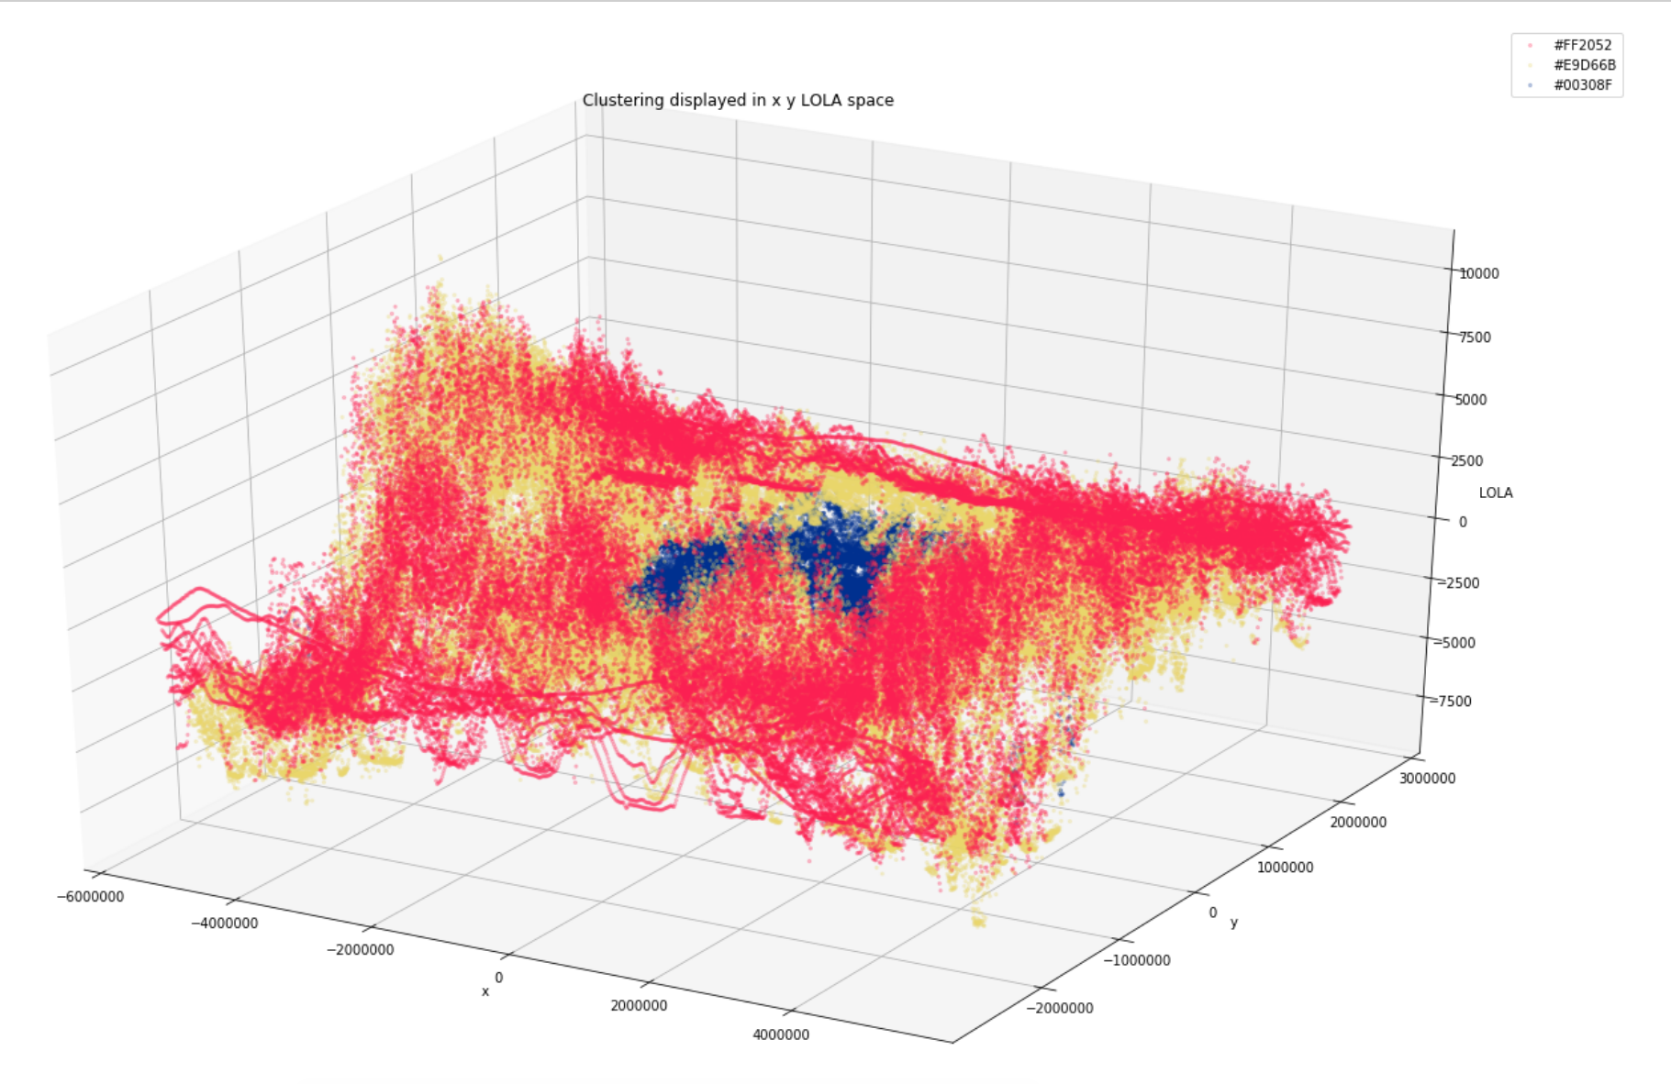
Cluster
Data is passed in and is grouped based on the similarity of the values
Takes in dataframes as input
Developed by using the k-means algorithm
Notes:
Alyssa
spend more time explaining this
bottom pic - LOLA
top pic - three elements (Iron, Hydrogen, Thorium)
3 clusters
Values normalized
“A lunar scientist can use this data to look for correlations between elements”
Depicts values that are related to one group
Each color is a different cluster

Slide 17
Scatter Plot
Used to depict possible correlation between two elements
Takes in two arrays as parameters
Notes:
Alyssa

Slide 18
Python-Libraries
Georasters
Notes:
Edwin

Slide 19
Learning Experiences
Syncing team progress
Libraries
Scikit Learn
Matplotlib
GDAL
Notes:
Ken

Slide 20
Challenges
Integration of functions for CLI
Converting to decimal degrees
Machine Learning
Algorithms
NaN Values
Contourplot
Notes:
Ken

Slide 21
Future Plans
Selecting all layers from Moontrek
Multiband files
Notes:
Ken

Slide 22
Thanks!
Any questions ✋ ?
Notes:
Ken

