Slide 1
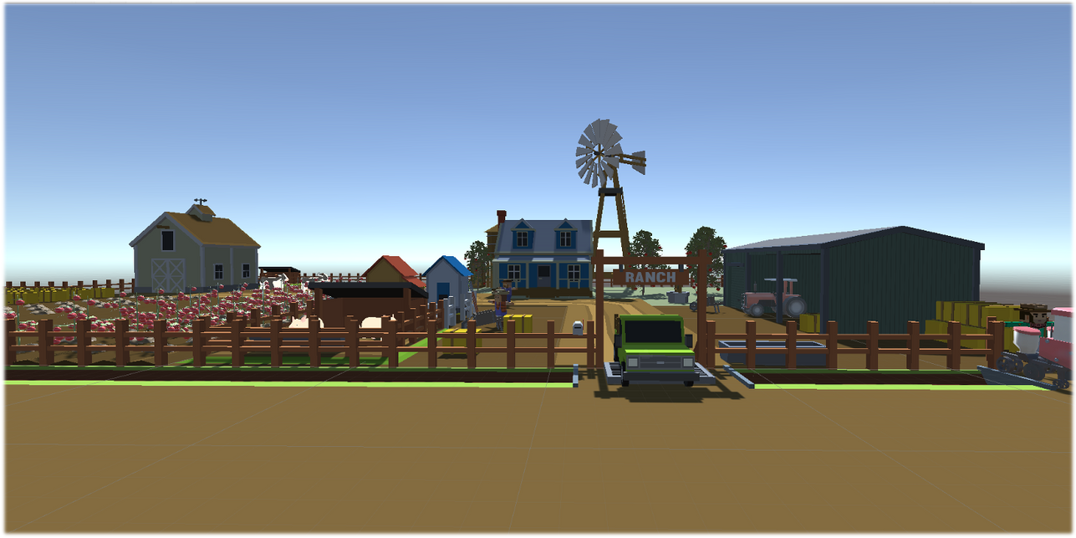
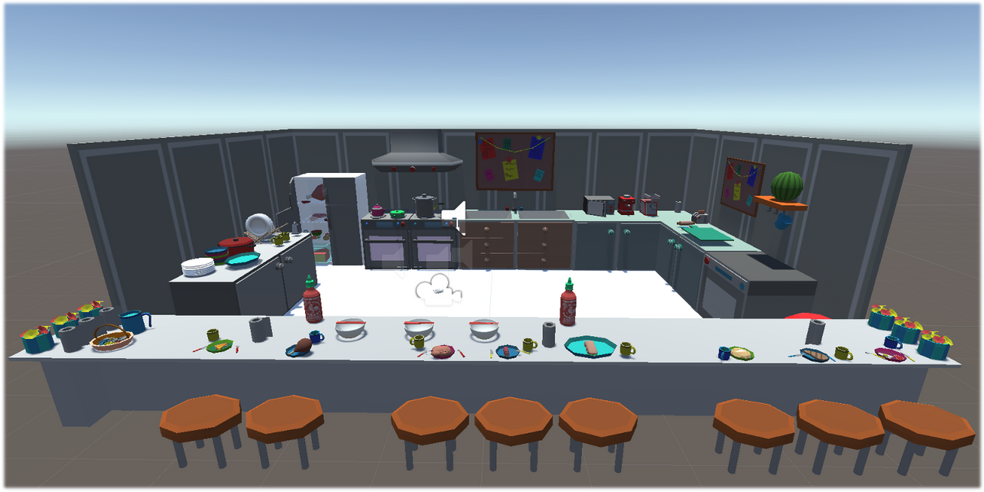
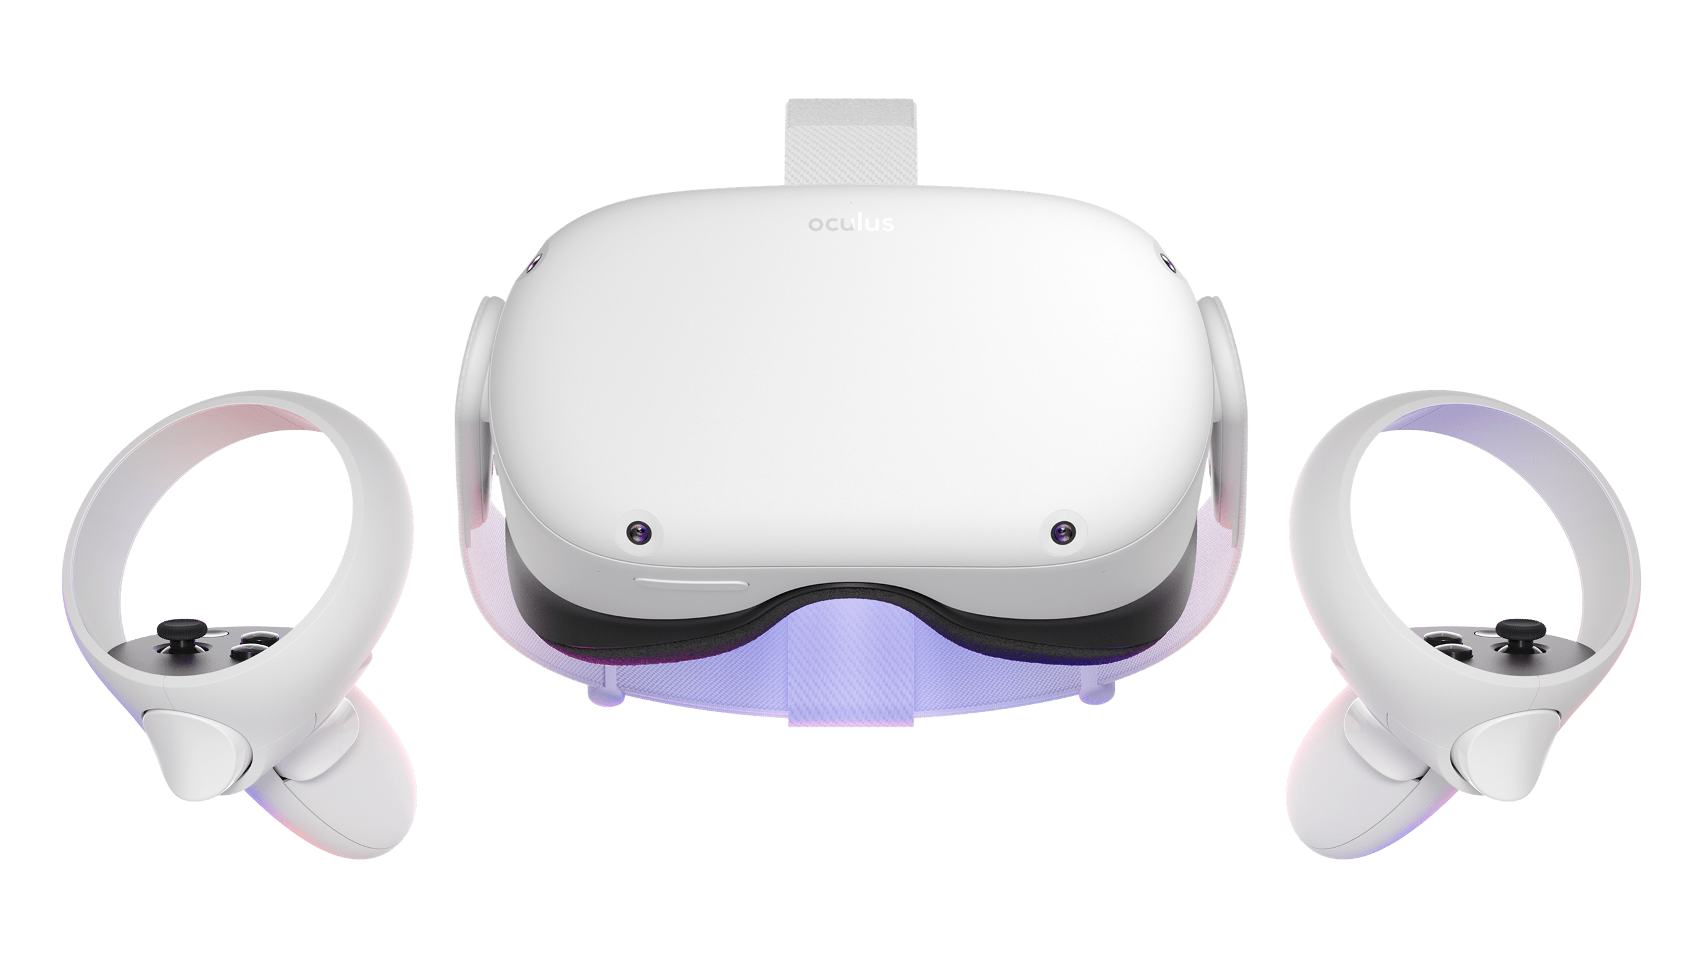
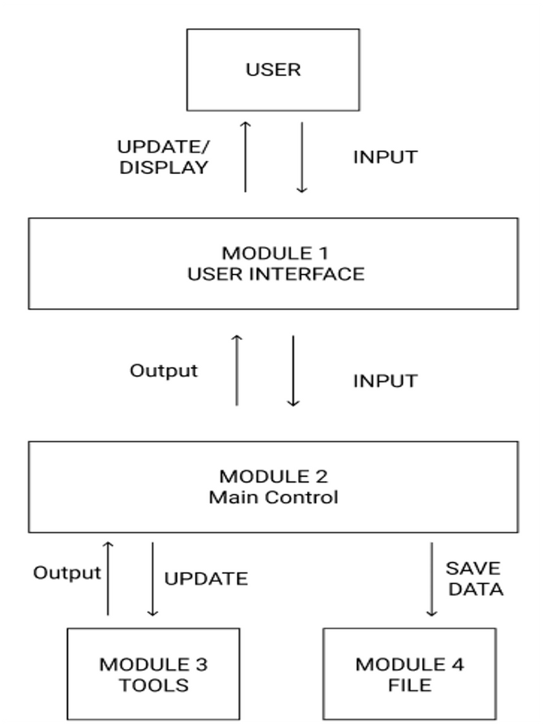
Immersive Storytelling with Engaging Physical Actions
Team Members: Joseph Chong, Jimmy Hernandez, Edwin Hernandez,
Jaquan Jones, Alberto Landeros, Tony Lee, Jennelle Maximo,
Eduardo Meza, Dean Nguyen, Anthony Viramontes
Faculty Advisor: David M. Krum
Institute for Interactive Arts, Research, and Technology Liaison: David M. Krum
Department of Computer Science
College of Engineering, Computer Science, and Technology
California State University, Los Angeles
Farm Level Design
Kitchen Level Design
Background
System Architecture
Immersive experiences, such as those created by virtual and augmented reality, represent a new medium for audiences and for storytellers. Virtual Reality (VR), a relatively new technology, allows users to explore these immersive worlds of endless possibilities.
Our team was inspired by the stories of our own families and found similarities of most members being 1st / 2nd generation immigrants. Discussing the dehumanizing history many immigrants have faced, we chose to create a VR experience that pays homage to refugee and immigrant culture and allow users to step into their shoes and see the world from their perspective.
User Interface Module
User input/interaction
3D Environment and visual display
Main Control Module
Core gameplay functionality and logic
Input/Output handling
Gesture interpretation
Tools Module
3rd party tools
Dependencies, and plugins
File Module
User data/progress
Save/Load data
Oculus Quest 2
Objective
The objective of our project is to create an impactful, immersive, story-driven gameplay utilizing VR technology. Specifically, our gameplay aims to diversely recreate scenarios and struggles experienced by immigrants in America. Ultimately, we aspire to shift negative perceptions on immigration into positive ones and humanize this issue that’s consistently been dehumanized.
Results
Technologies
We were able to successfully implement two levels of gameplay. Each level is an independent, immersive short story. Active participation is required from the user to accomplish each level’s primary objective.
Notes:
<number>
Have students check that the logo is the appropriate one to use.

