Slide 1
Walking A Mile In My Shoes
Immersive Storytelling with Engaging Physical Actions
California State University, Los Angeles • Spring 2022
Advisor Sponsor
Dr. David M Krum InART
Students
Joseph Chong, Jimmy Hernandez, Edwin Hernandez,
Jaquan Jones, Alberto Landeros, Tony Lee, Jennelle Maximo,
Eduardo Meza, Dean Nguyen, Anthony Viramontes

Slide 2
Team Members
Anthony Viramontes
Dean Nguyen
Edwin Hernandez
Jennelle Maximo
Joseph Chong
Alberto Landeros
Eduardo Meza
Jaquan Jones
Jimmy Hernandez
Tony Lee

Slide 3
InART
Advisor
Dr. David M Krum
Sponsor
InART
Institute for Interactive Narrative, Research, and Technology

Slide 4
Overview
Project Overview
What is “Walking a Mile In My Shoes” about?
Goals
Background
Major Design Decisions
Planning & Design
Tools & Software
Oculus Quest 2 + Unity + Blender
Jira + Zoom + Discord
VR Development
Challenges
Accomplishments
Level Progress
3D Models
Jaquan

Slide 5
What is “Walking A Mile In My Shoes” about?
“Walking A Mile In My Shoes” is an interactive VR experience, built in Unity Game Engine, telling a story of two immigrants in America, allowing users to step into their shoes for a day.
Farm Level
Kitchen Level
Our game aspires to shift negative perceptions on immigration into positive ones and humanize the experiences of immigrants seeking a better life for themselves and their families
Jaquan

Slide 6
Background
Previous themes:
Environmentalism
Family
Loss
Existentialism
Space and Fantasy
Sharing personal and family stories
Immigration
Sacrifice and hardships
Public’s treatment towards immigrants and refugees
Jennelle

Slide 7
Major Design Decisions
Environment
Forest, Train, Homes, Kitchen?
Emotional tones
Lighthearted, funny, emotional?
Subject
What culture to focus on?
Hand Gestures
Symbolic. Tech limitations.
Gameplay
Interactive or mainly narrative
Graphics
Using online assets and which style?
How to display next user tasks?
Audio
Different languages or gibberish
Jennelle

Slide 8
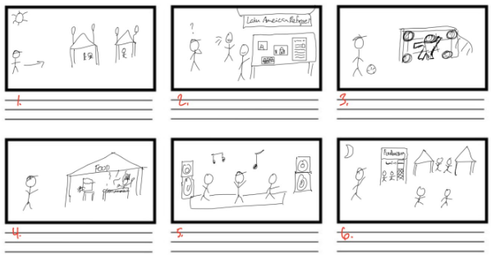
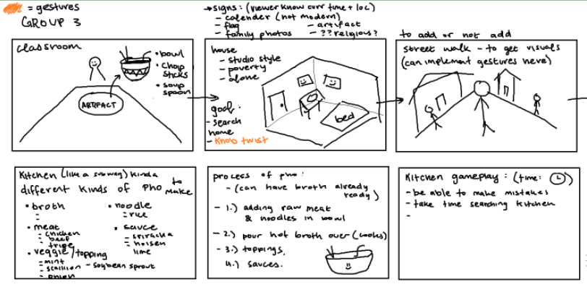
Planning & Design: Rough Storyboarding
Farm Level Kitchen Level
Jennelle

Slide 9
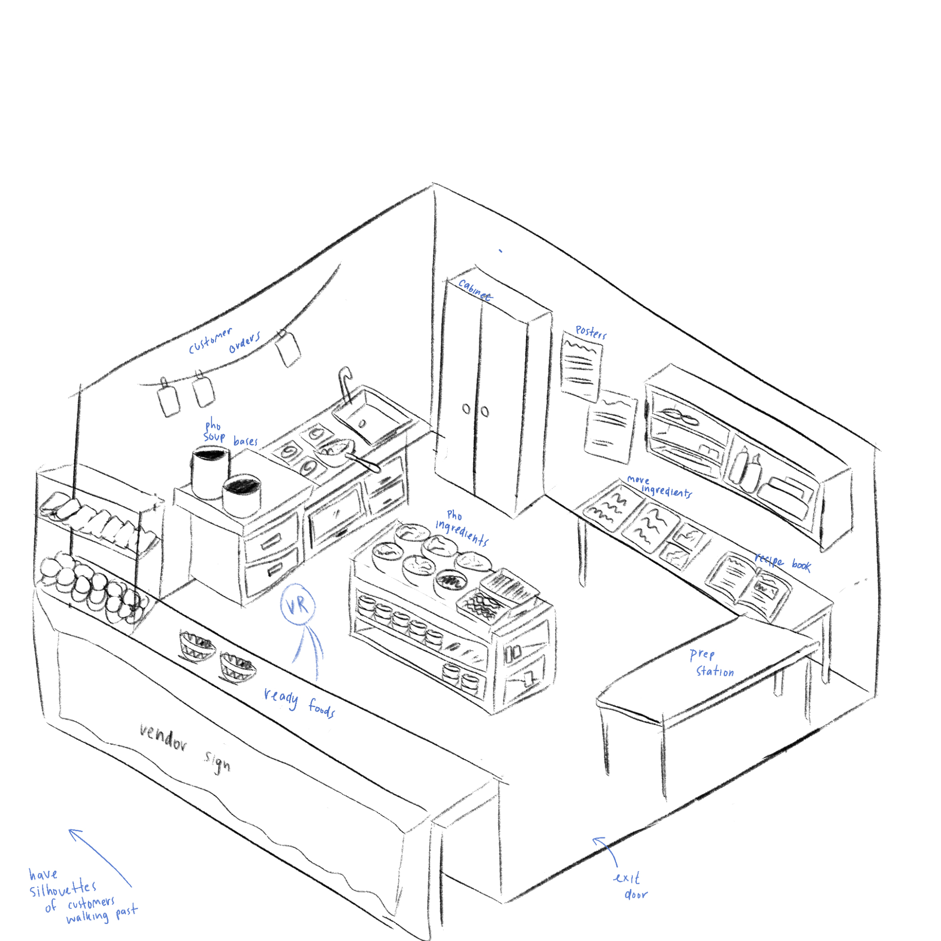
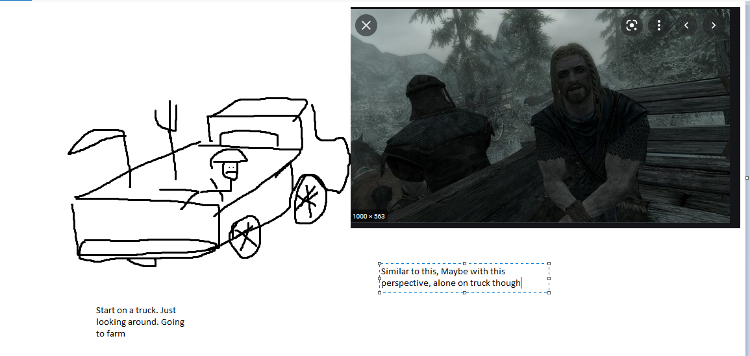
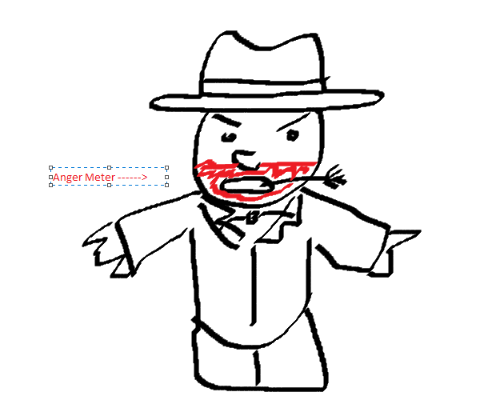
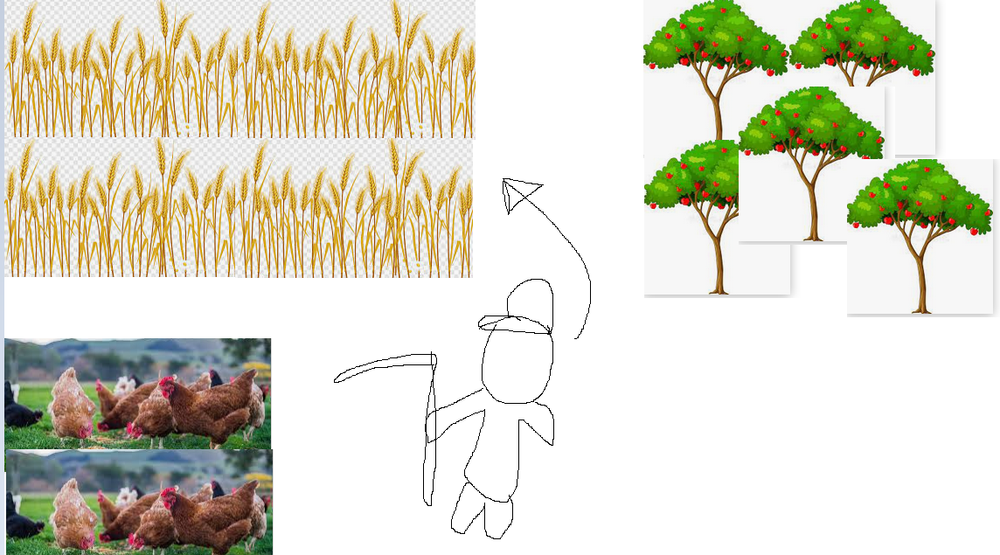
Planning & Design: Early Sketches & Inspiration
Farm Sketches Kitchen Sketch
Jennelle

Slide 10
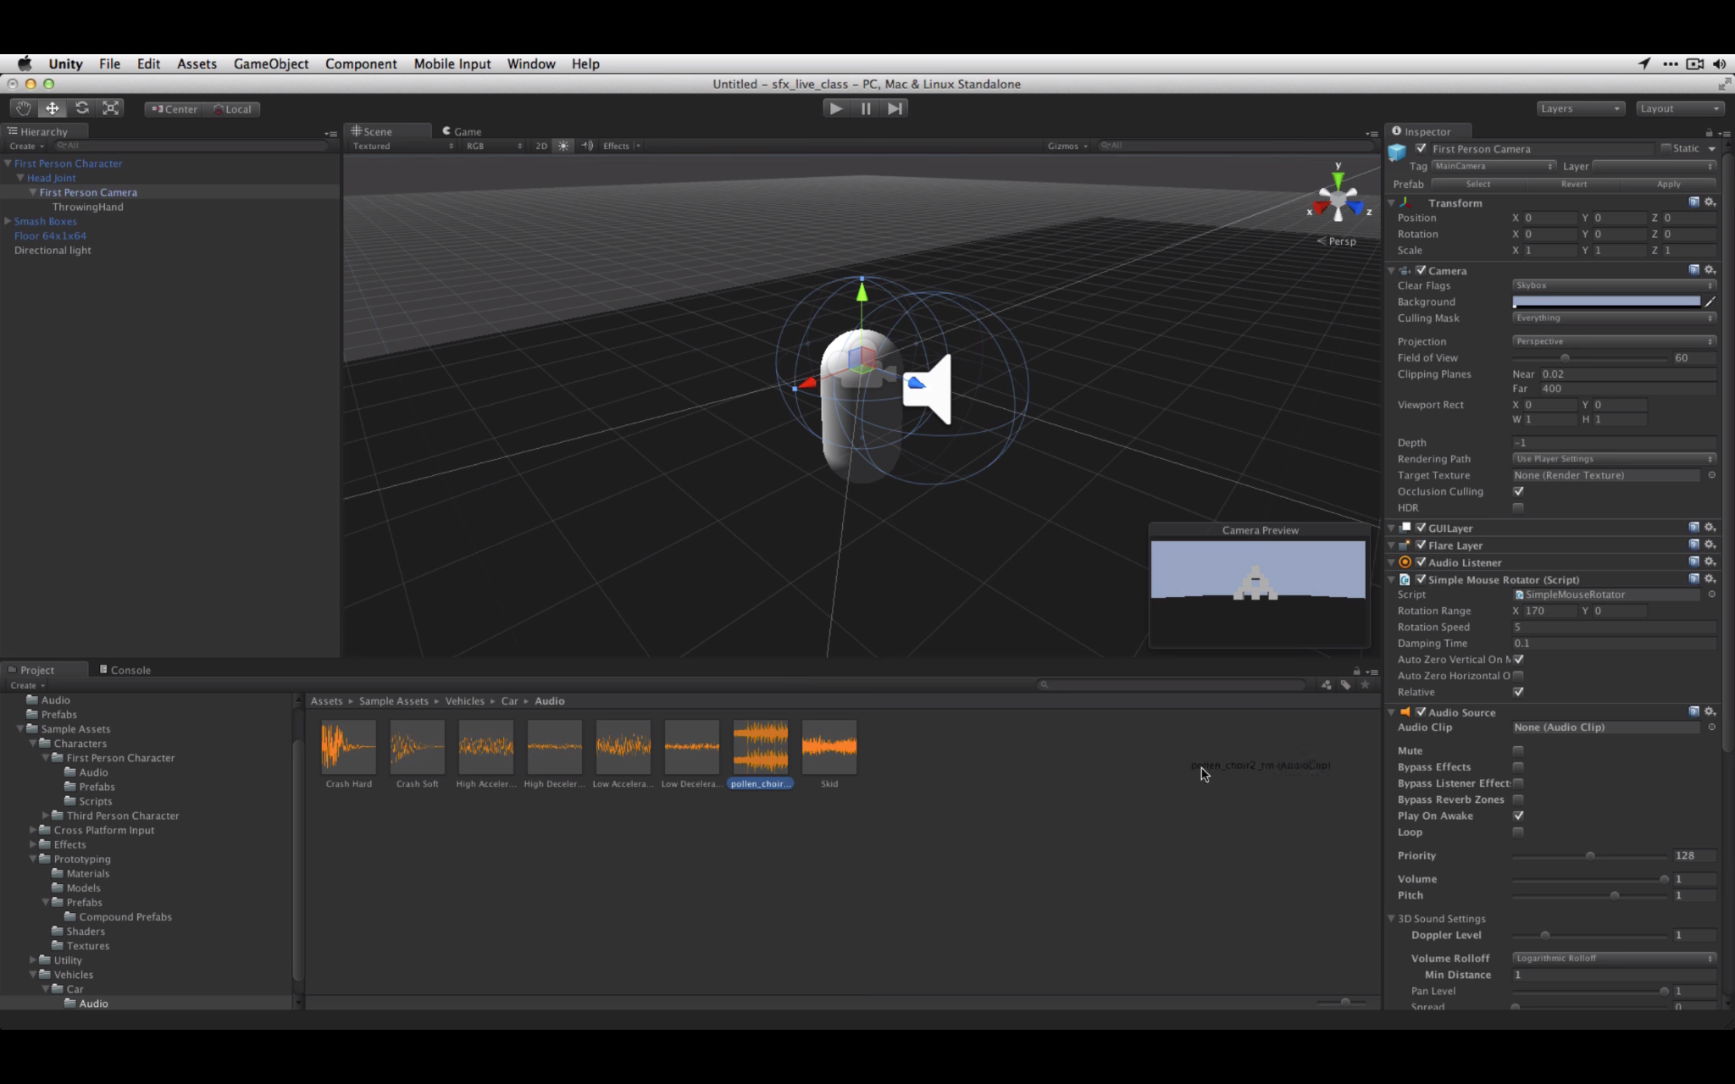
Sound Engineering
Sounds implemented in the Oculus to represent real life experience
The noise implementation get into details as the user is in different levels
The sounds help give the player “life-like” experiences
Jimmy

Slide 11
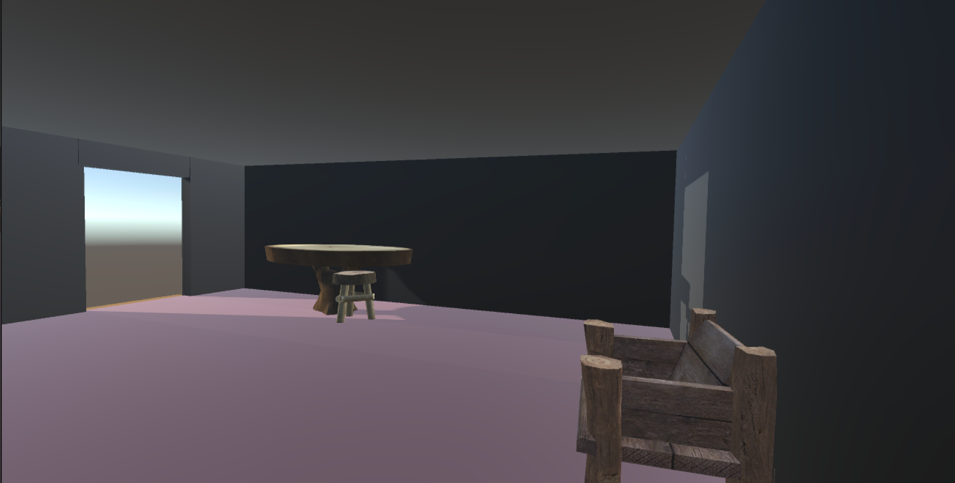
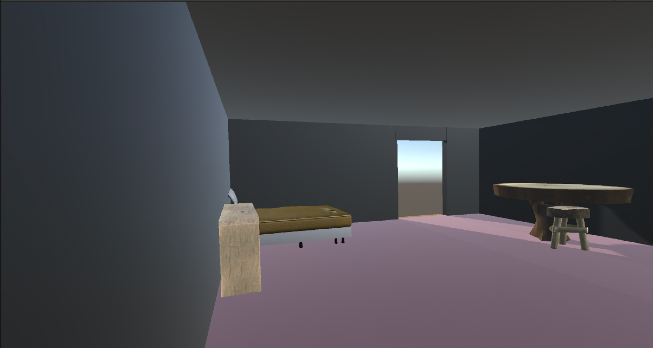
Programming
The programming to implement some of the materials/assets from the unity store was helpful
This allowed the team to advance quickly
Some of the materials that seems so simple were created using outside sources other than unity
Jimmy

Slide 12
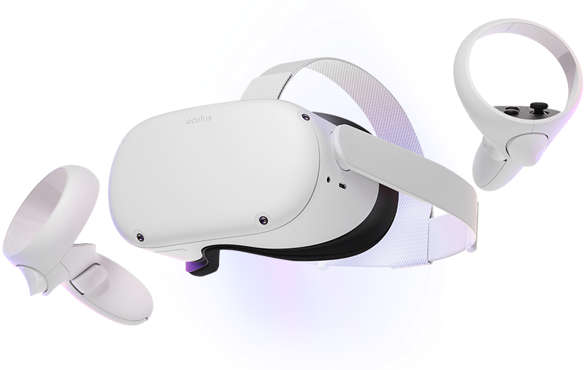
Tools: Oculus Quest 2
The VR headset we decided to use for our project
Relatively cheap entry to the world of virtual reality
No wires needed is a big positive
Runs an android-based OS
Edwin

Slide 13
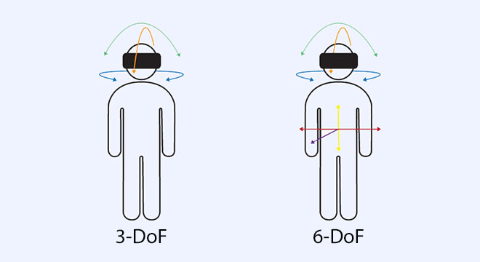
Degrees of Freedom
Describes how an object or person moves through 3D space
Oculus Quest 2 has 6- DoF
3 for rotational movement:
Movement around X, Y, Z axis
Pitch, yaw, and roll
3 for translational movement:
backwards/forwards
left/right
up/down
Edwin
Edwin

Slide 14
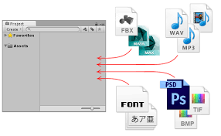
Unity Asset Store
Main place to buy assets to use for Unity projects
Limited amount of free assets
We had to resort to using Blender for making certain assets
Buying every asset we needed would have been pricey
Edwin

Slide 15
Tools for development: Blender
Blender is a free 3D modeling software.
Create models for assets that are not available in the unity asset store.
Tony

Slide 16
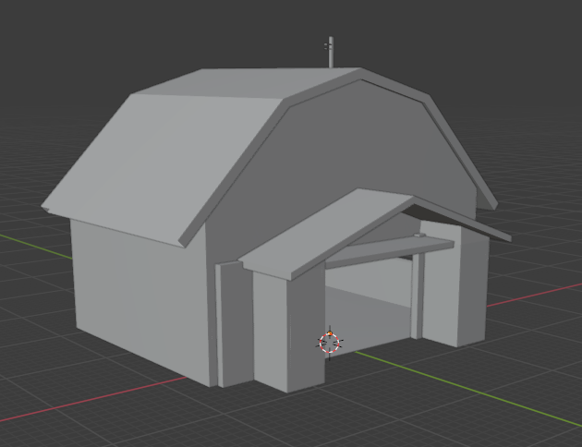
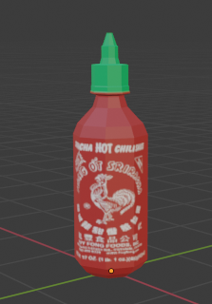
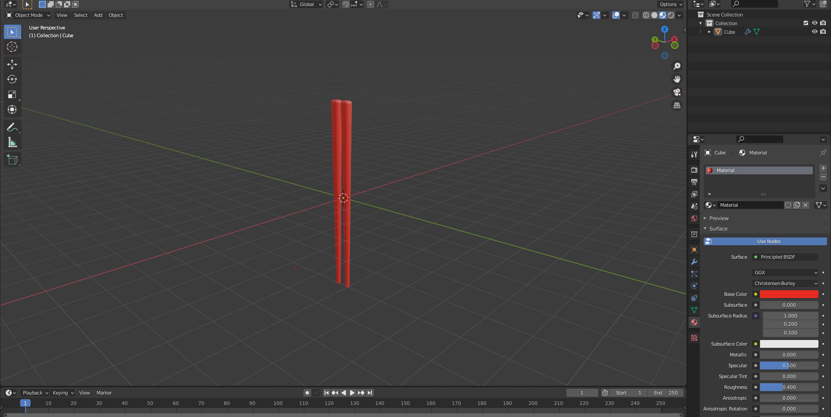
Blender Models
Barn
Chopsticks
Sriracha bottle
Tony

Slide 17
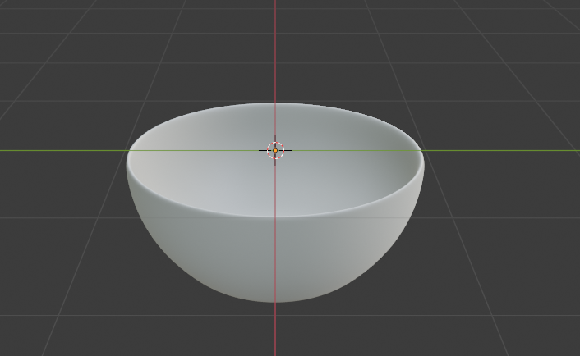
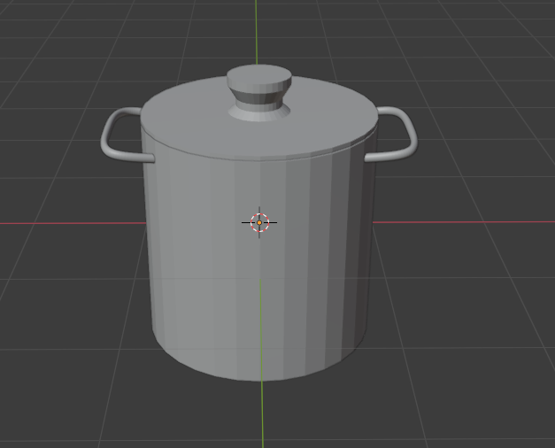
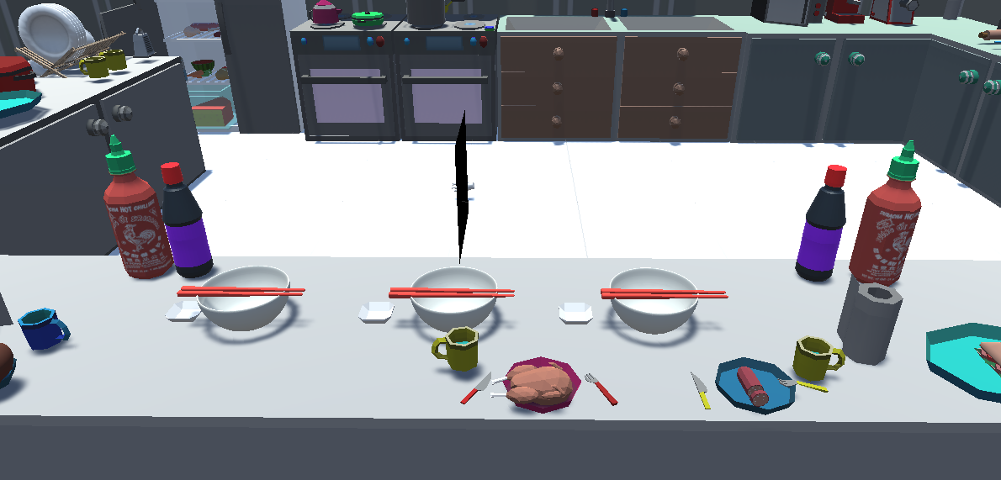
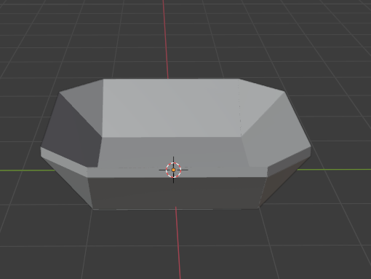
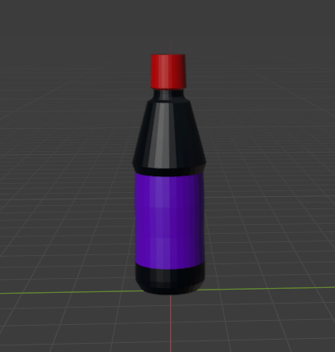
Blender Models Continued
Chopsticks
Bowl 1
Cooking Pot
Bowl 2
Table Counter
Hoisin Sauce Bottle
Tony

Slide 18
Jira
Jira allowed the team to overview development across each team member.
Tracked team issues and development in real time.
I would recommend Jira to all future InART teams.
In terms of keeping track of each teammate and their personal task, Jira was the glue of this operation because we would know if someone hasn’t started their task yet, if it was in progress, if it was being reviewed, or we would know when someone is done.
Anthony

Slide 19
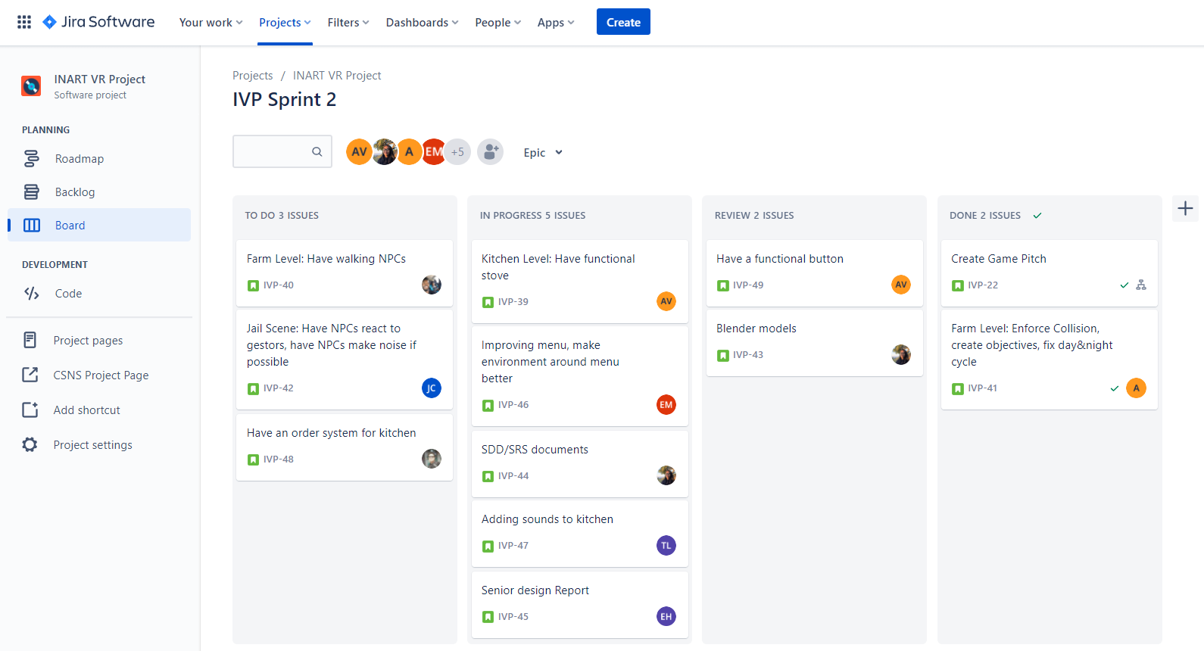
Jira Example
Anthony

Slide 20
Team Meetings
ZOOM was used to host our weekly meetings every friday from 8am - 11am.
Everyone got the opportunity to speak.
What they got done?
What will they do next to further development?
What issues did you have that the team should know about
This would help the team further development so we can focus on the goals that would help us reach a deliverable project
Discord was used for 1 on 1 meetings.
Anthony

Slide 21
Kitchen Level
Vietnamese Chef
Getting the design right
Getting the VR body and hands interacting with kitchen items
Getting the materials needed to cook
Development 80% complete
User can spawn items they need with a push of a button
Collision detection
What is needed?
Food orders from NPCs
Delivering food to NPCs to complete objectives
Anthony

Slide 22
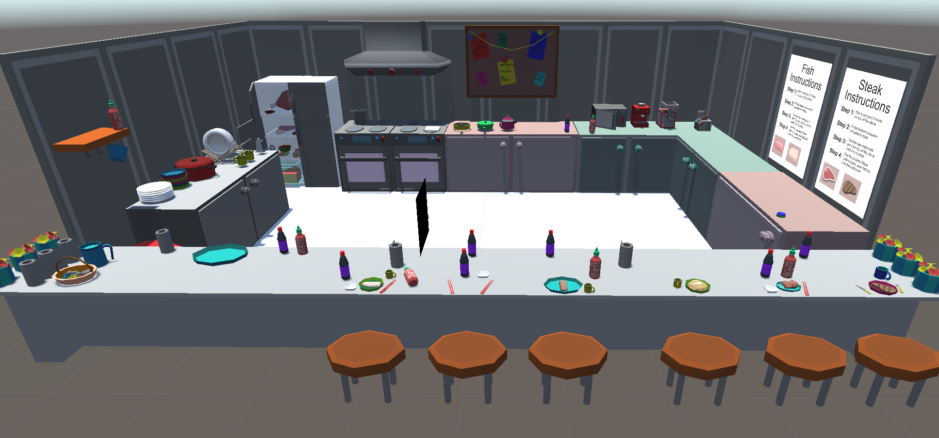
Kitchen Level
INPUT KITCHEN PICTURE HERE
Anthony

Slide 23
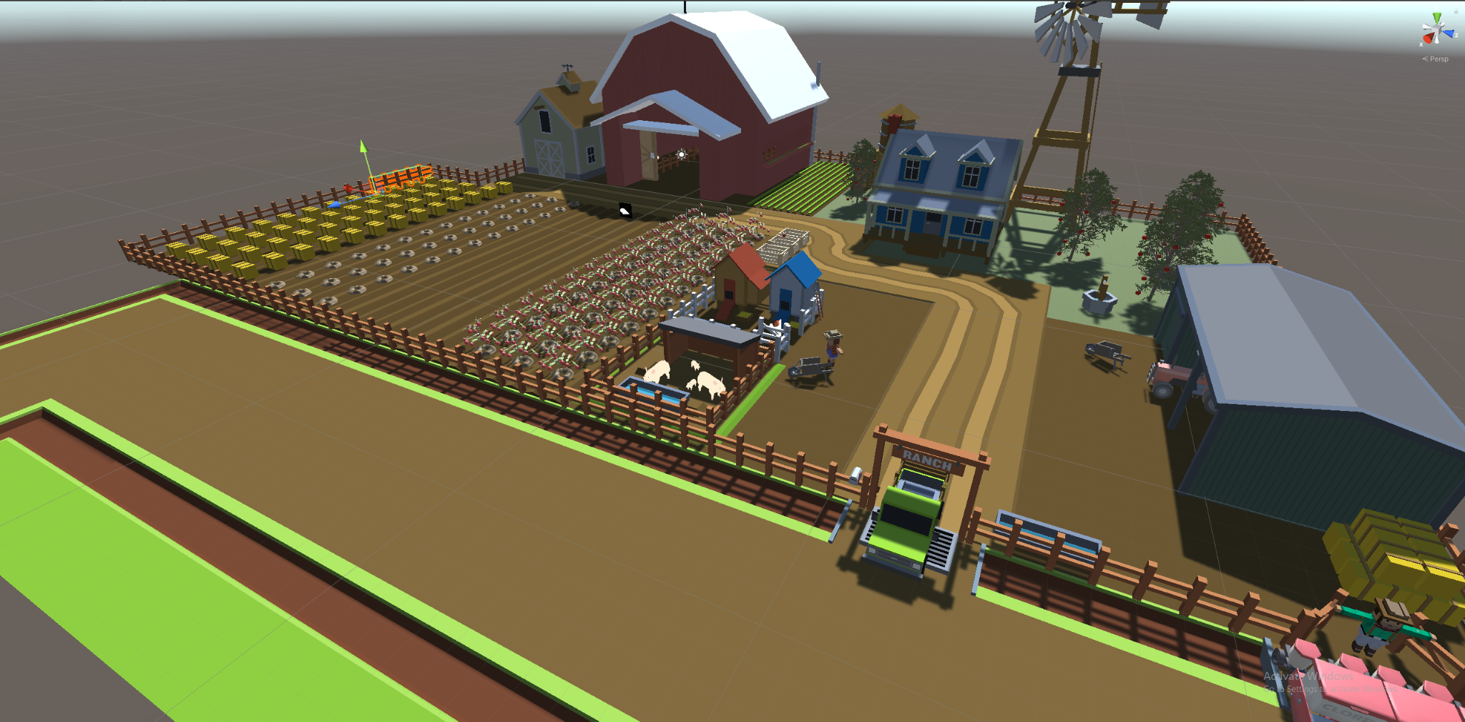
Farm Level
Alberto

Slide 24
Goal of the Farm Level
Immersion of poor immigrant farmer
Grab tools
Sound
Visual realism
Historical realism
Working for an abusive boss
Alberto

Slide 25
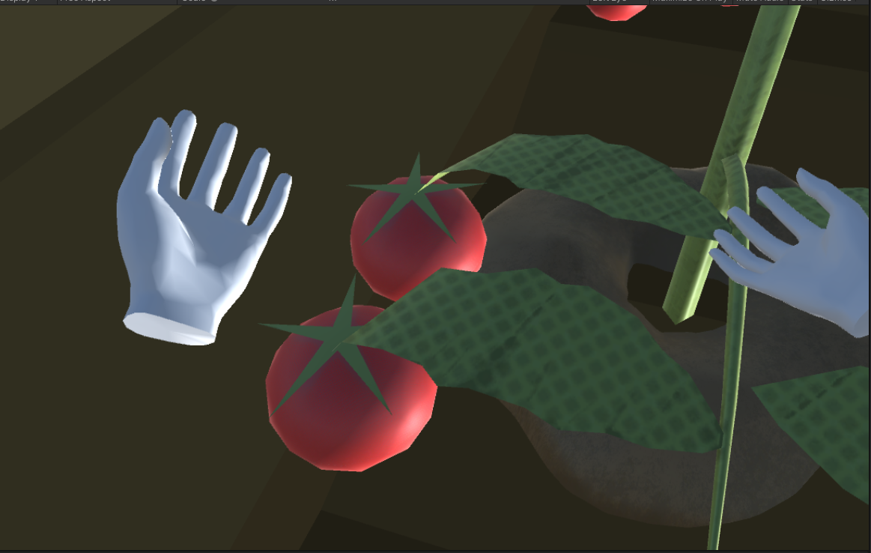
Objectives
Utilization of Hands
One or Two handed
Grab tools
Audio clips
Cows mooing
AI NPCs talking
Footsteps of the player
Completing Objectives
Moving hay bales
Alberto

Slide 26
Unity
Engine for developing games
Target single or multiple platforms (PC, Android, iOS, consoles, etc.)
Eduardo

Slide 27
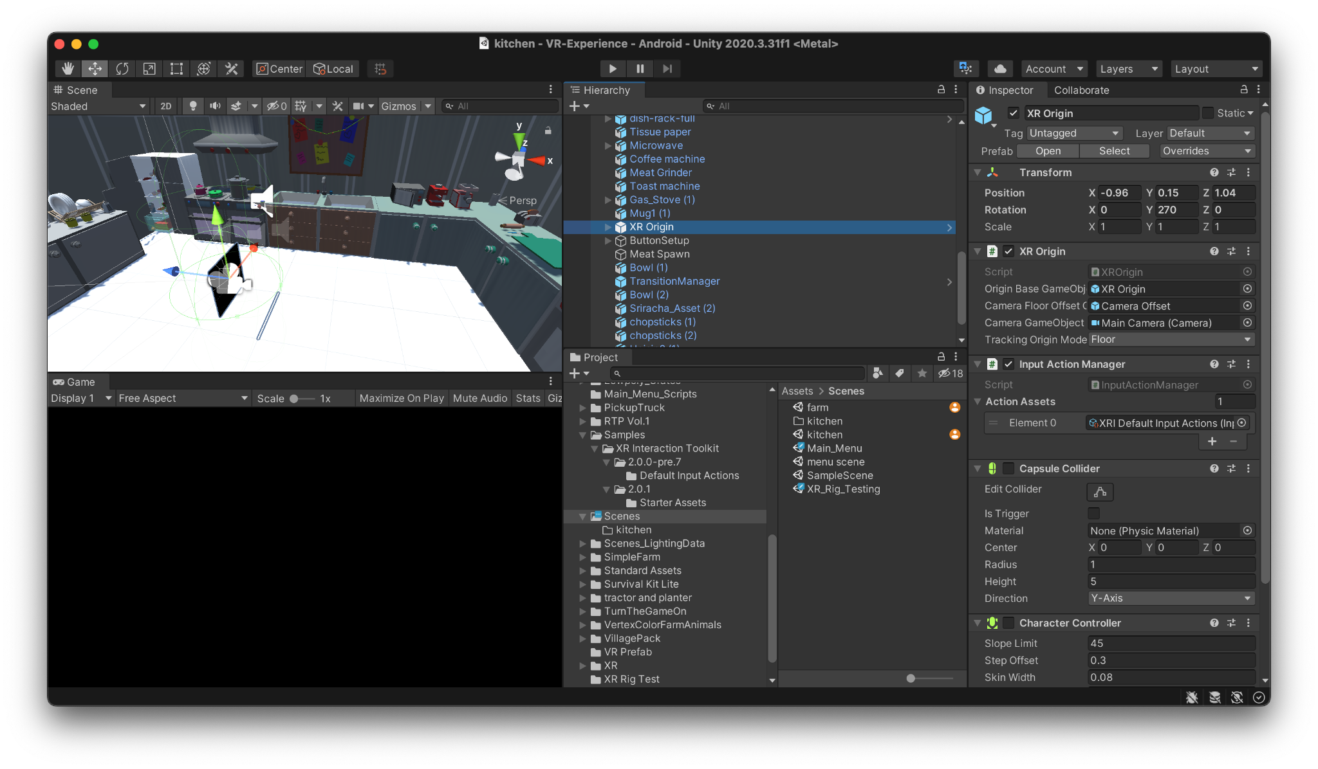
The Unity Editor
Integrated development environment
Eduardo

Slide 28
VR Development using the Unity XR Toolkit
Unity provides the XR Toolkit (extended reality toolkit) for developing virtual reality (VR), mixed reality (MR), and augmented reality (AR) applications
The XR tech stack supports platform integration these and more popular platforms:
ARKit (Apple)
Playstation VR
Oculus
HoloLens (Microsoft)
Eduardo

Slide 29
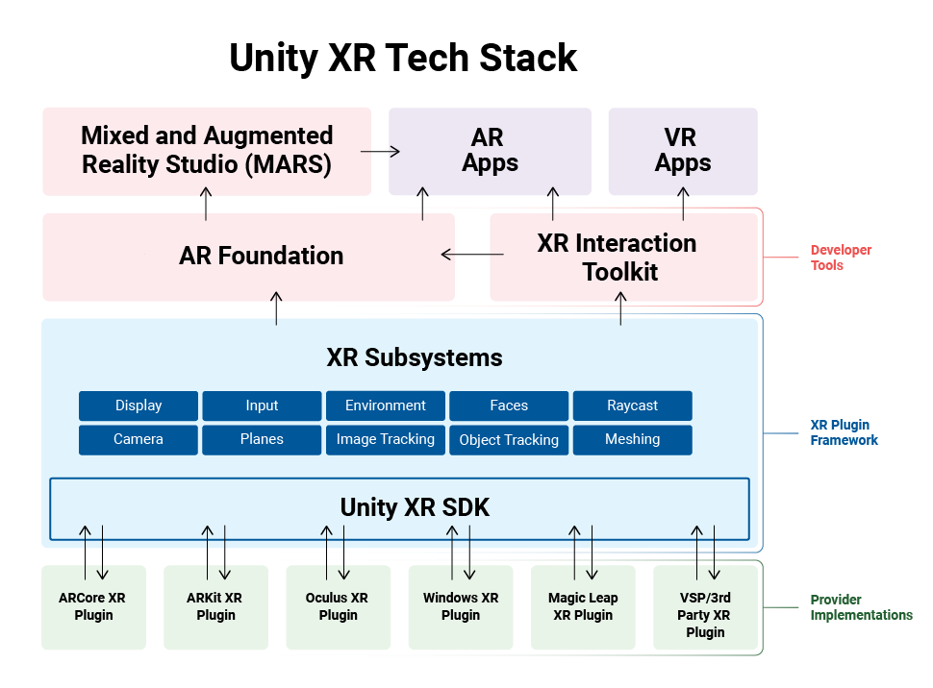
Unity XR Plugin Framework
The XR Toolkit includes a plug-in framework called XR SDK that supports XR devices and runtimes
This framework allows developers to focus on their applications and leaves the details of the implementation to the Unity Engine
Eduardo

Slide 30
XR Compatibility With Oculus Devices
In order to develop VR applications with Unity for the Oculus Quest 2 platform, we require the following plugins from the XR Toolkit:
OpenXR: An open royalty free standard that aims to simplify AR/VR development, it allows developers to target a wide range of platforms
XR Interaction Toolkit: A high-level component based interaction system that makes 3D and UI interactions possible from device inputs (controller/headset movement, button events, gesture interactions, haptic feedback, etc.)
Oculus XR Plug-in: This optional plug-in includes Oculus platform specific assets for development of XR apps.
Eduardo

Slide 31
Developing For VR
Organization of game levels is separated into self contained scenes within the Unity editor.
All 3D assets, sound effects, and UI interfaces are known as game objects
Game objects can have components attached to them that modify their properties or add certain functionality
The virtual game environment can be explored by the player through a XR Origin game object
Eduardo

Slide 32
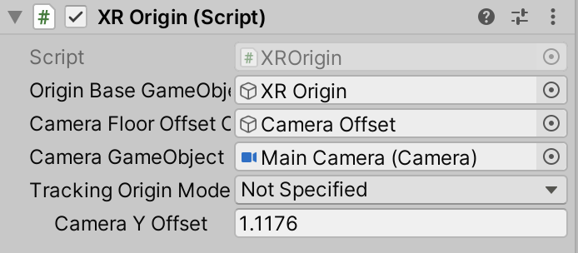
The XR Origin Game Object
The XR Origin is a collection of game objects and components that work together to enable the player to interact with the virtual environment
Game camera
Left/right controller
Locomotion/teleportation
XR Interactable
Eduardo

Slide 33
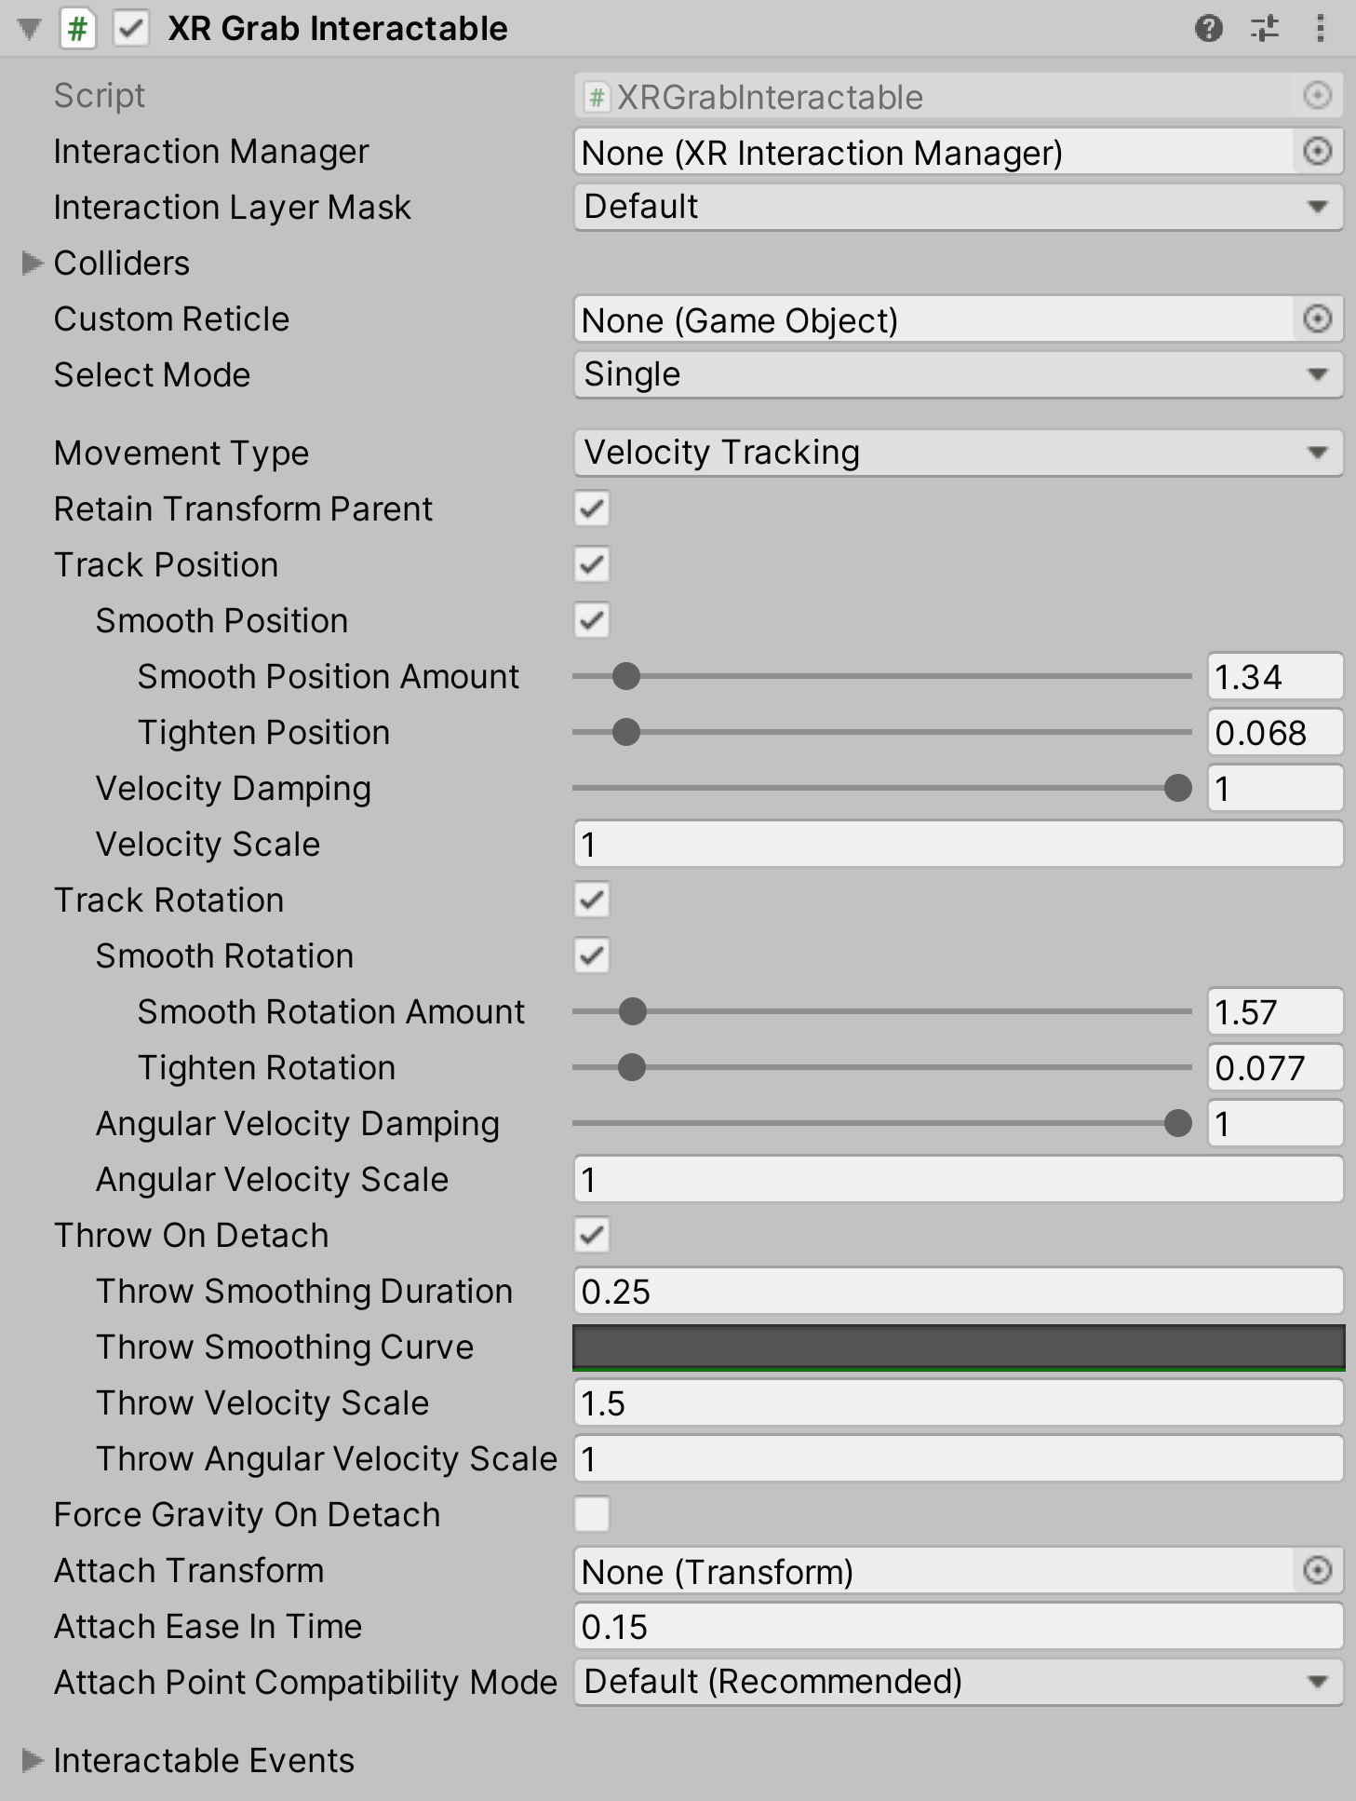
Interaction With Virtual Objects
The XR Grab Interactable component allows the player to virtually interact with 3D objects within the scene
The XR Ray Interactor component allows the player to interact with the user interface
Eduardo

Slide 34
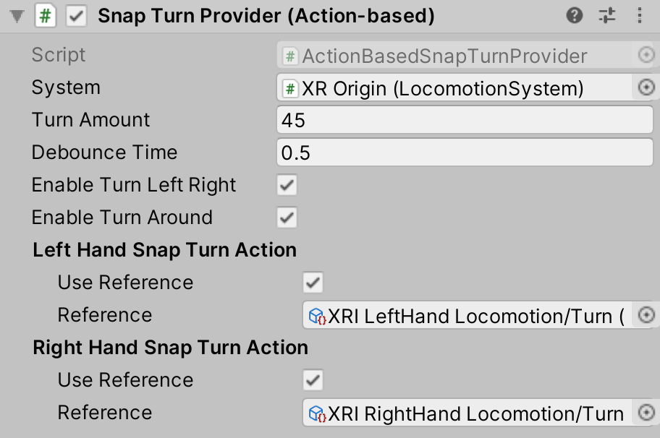
Movement In VR
The Locomotion System component allows the player to move throughout the game environment in a Unity scene
The Teleportation Provider component allows the player to instantaneously move to certain points in a Unity scene
Requires a Ray Interactor component to target and select valid teleportation areas
The Snap/Continuous Turn Provider components allow the player to rotate its perspective within a scene through controller input
Eduardo

Slide 35
Challenges
Lack of VR Headsets for every person on the team
Lack of resources
Needing to purchase assets from Unity Asset Store
Getting Unity Teams set up
Joseph

Slide 36
Demo
Walking a Mile
in My Shoes

