Slide 1
Santa Barbara Public Defender Data Dashboard Using PowerBI
Presented by: Yara Ajjawi, Markniel Cruz, Jevon Fan, Suresh Ghimire, Jiajun Gu, DeQing
Liang, Elton Lin, Edwin Lugo Bautista, Tommy Ly, Winston Pham, Alvin Truong
Project Advisor: Dr. Chengyu Sun
‹#›
Notes:
Winston

Slide 2
Overview
Sponsored by: Santa Barbara County Public Defender
Liaisons: Deepak Budwani, Sarah Rothschild , Bryan Burzon, Angella Stokke, Aidan Bassett
Mission, Vision, Values
Protect and defend the rights of their clients.
Provide effective, vigorous and loyal advocacy.
Provide these services in the most economical and efficient manner possible.
Notes:
Winston

Slide 3
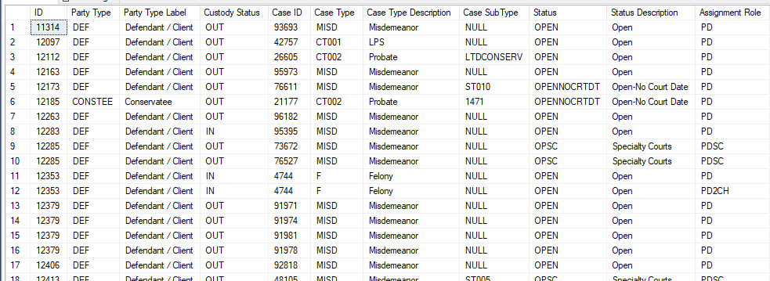
Understanding Data
1200+ tables of raw data.
Incredibly difficult to read and understand.
Necessary to have understandable and easy to use visualizations.
‹#›
Notes:
Winston

Slide 4
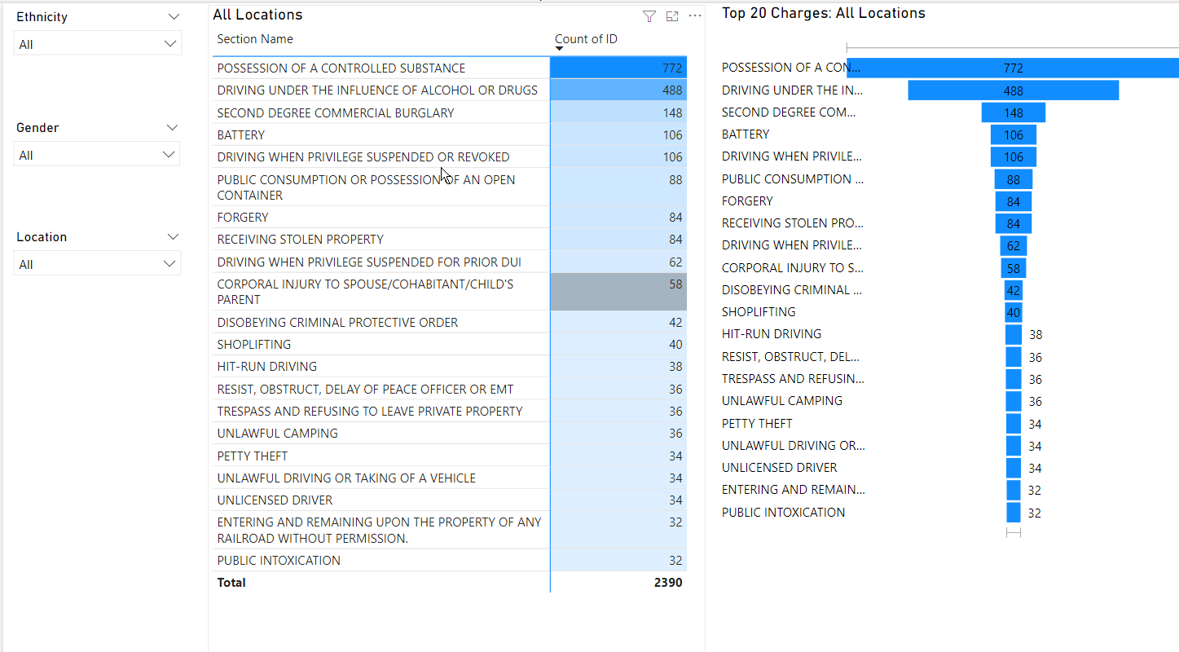
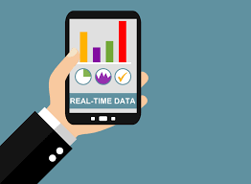
Goals
Develop and display an interactive, real-time data dashboard to increase data transparency.
Understand pattern and trends in local criminal justice system.
Use evidence-based models to drive policy and system change.
‹#›
Notes:
Winston

Slide 5
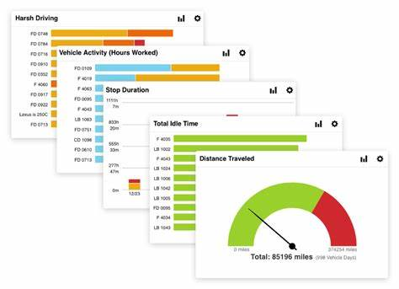
Notes:
Edwin

Slide 6
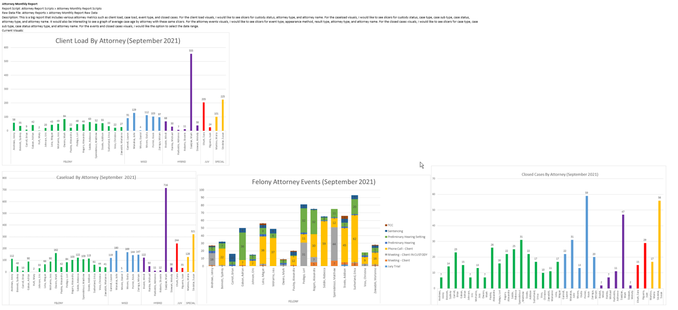
‹#›
Notes:
Edwin

Slide 7
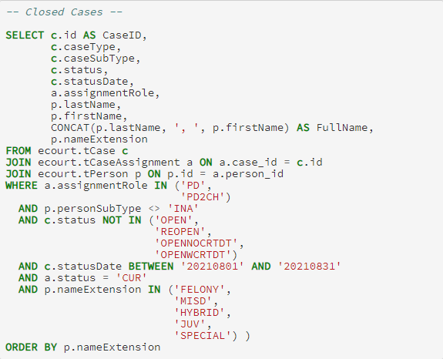
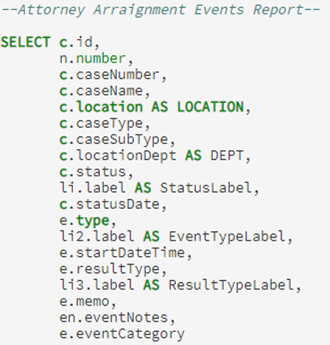
Datasets and Reports
Select location
Select case type
Select case date
Sort by name extention
Notes:
Jiajun Gu

Slide 8
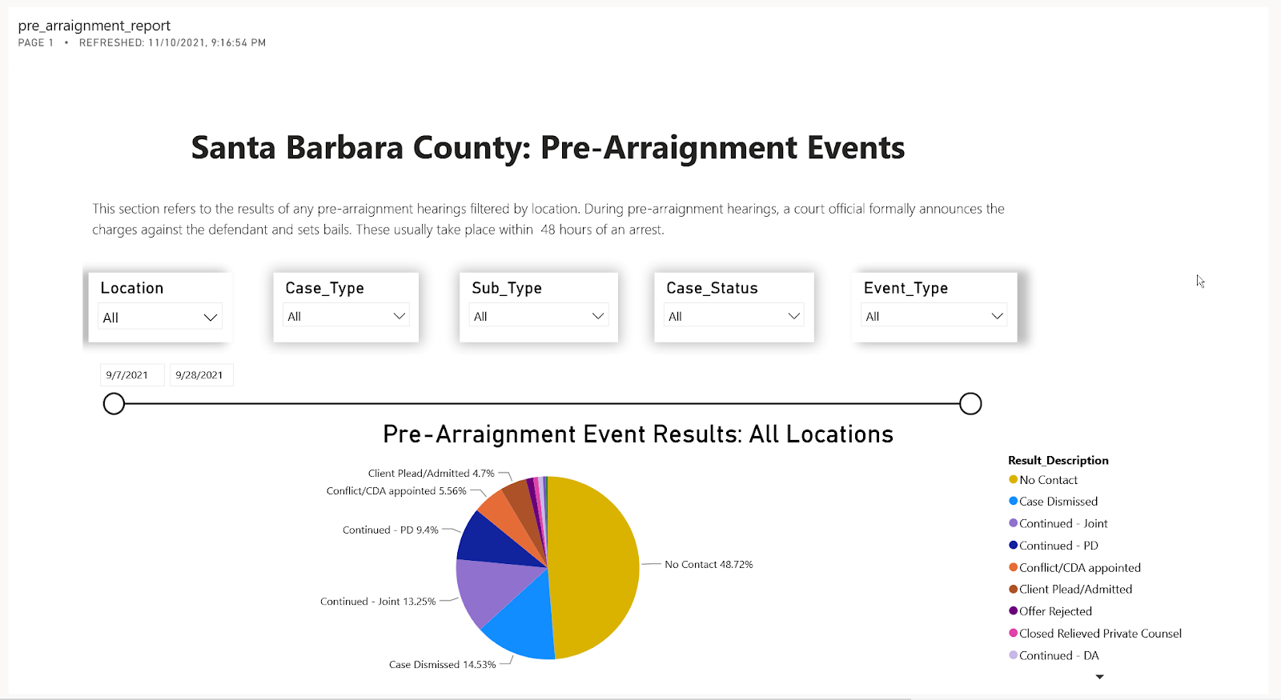
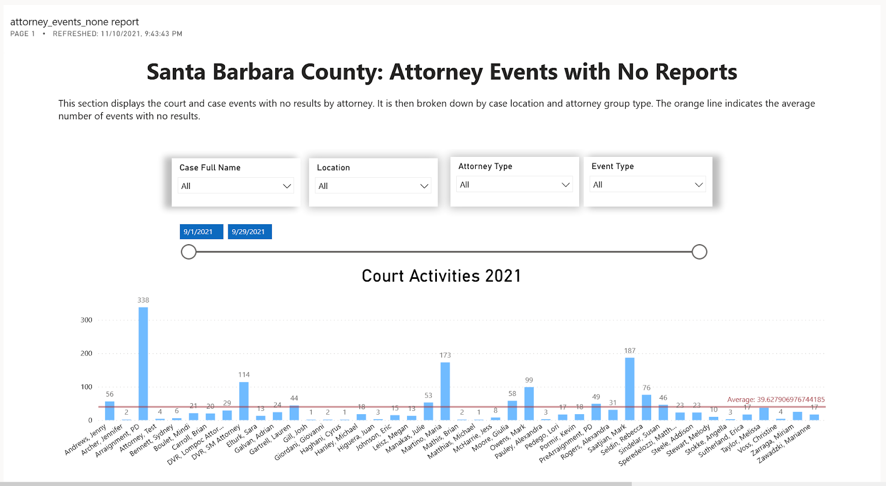
Datasets and Reports Contd.
By location
Notes:
Jiajun Gu

Slide 9
Resources Used
Mock Data Generators:
Mockaroo
Redgate SQL Data Generator
Data Storage:
Microsoft SQL Server
Data Visualization:
PowerBI
Notes:
Jevon

Slide 10
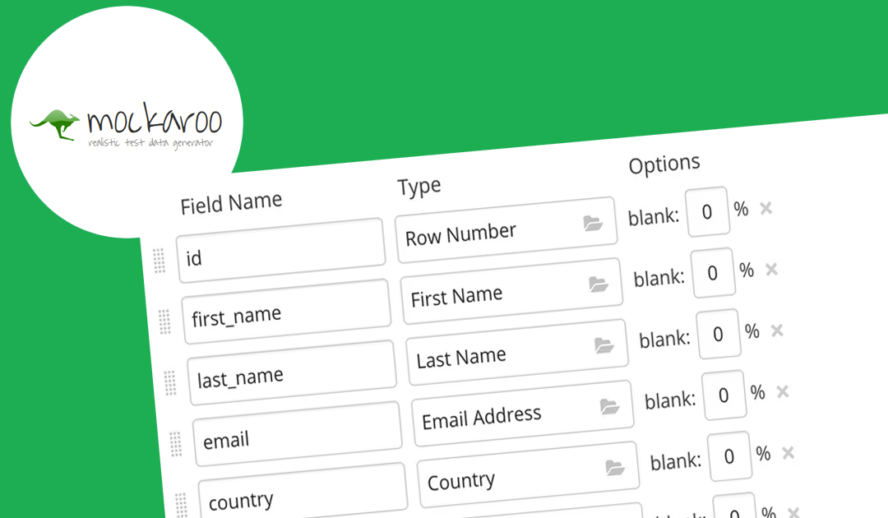
Data Generations
Issues early on with acquiring data needed to create PowerBI visuals
Attempted to create a data generator
Turned to web based data generator
Notes:
Jevon

Slide 11
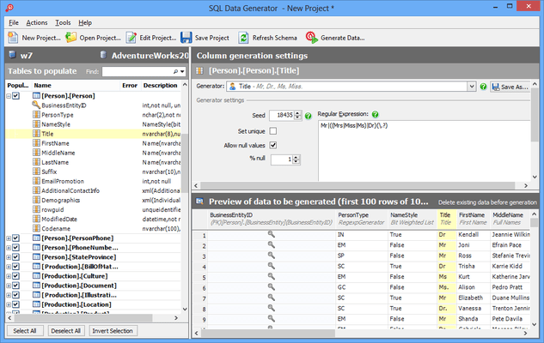
Data Generations
Software program able to handle loads of data generation
Easy to generate schemas with multiple properties to store in SQL server
Notes:
Jevon

Slide 12
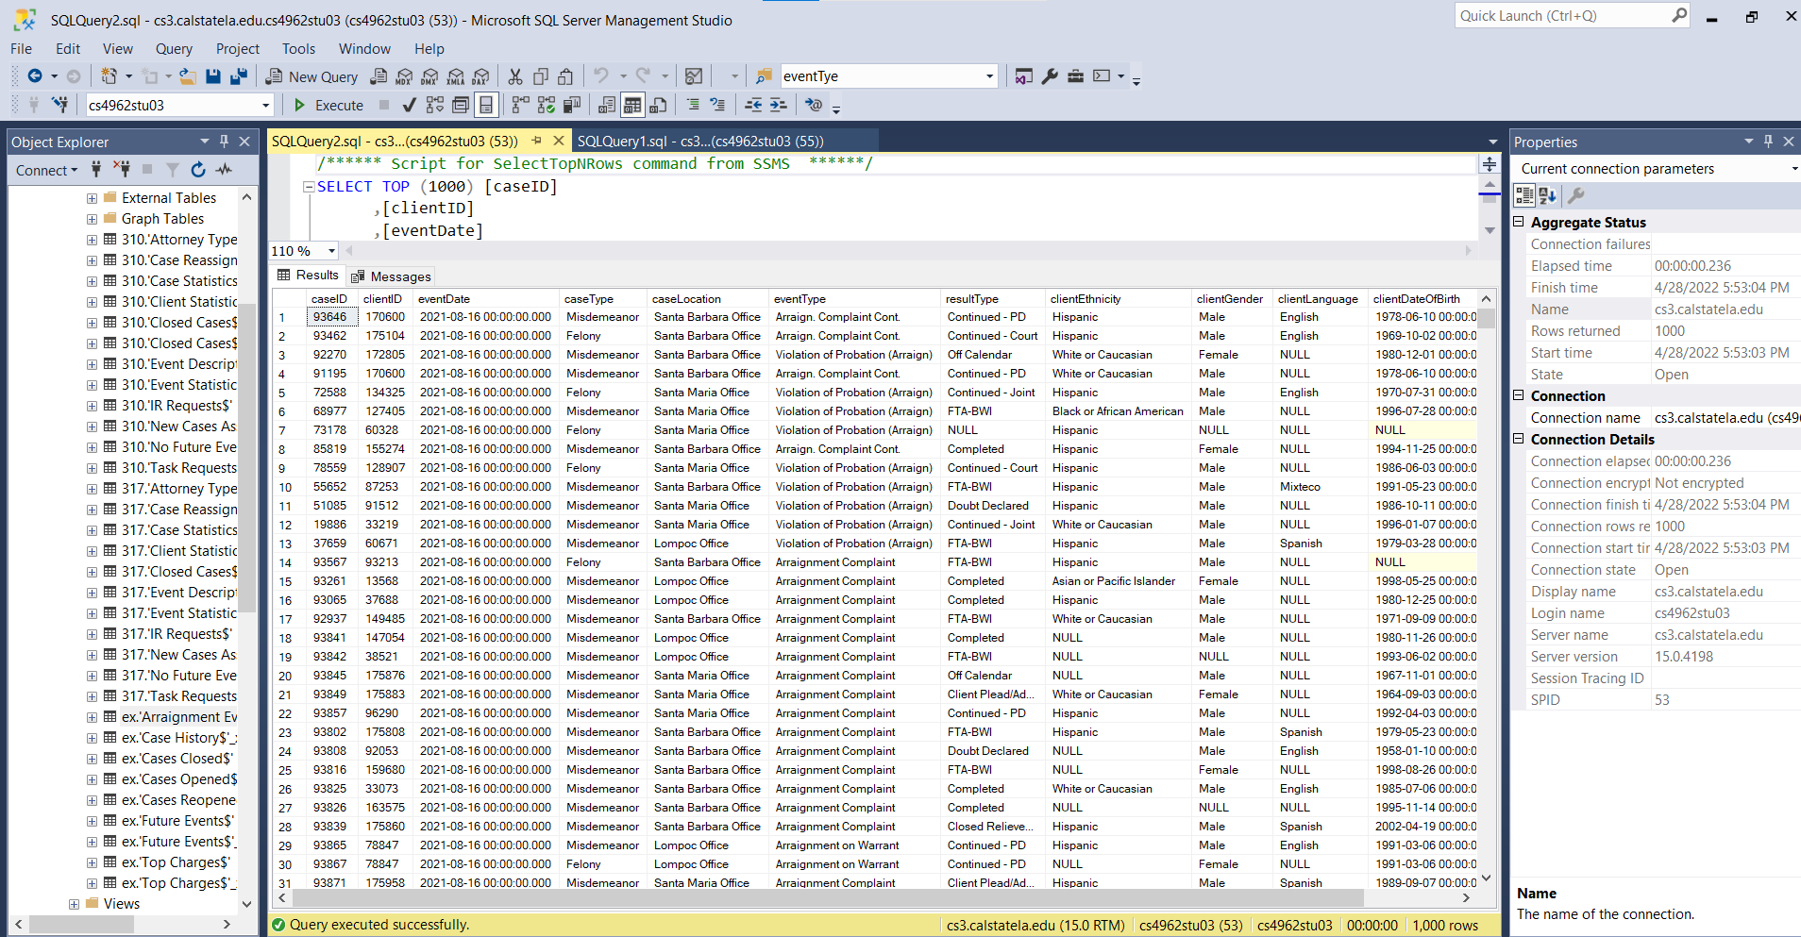
Data Storage
Microsoft SQL Server
Data are stored based on client’s schema
Tables from the database are imported to Power BI
Only queries data can also be imported without whole table
Queries results are used to generate the desired reports in Power BI
Notes:
Suresh

Slide 13
What is PowerBI?
Business analytic tool / service created by Microsoft.
First introduced in July of 2011.
Part of the Microsoft Power Platform.
Data → Interactive Visuals
Notes:
Mark

Slide 14
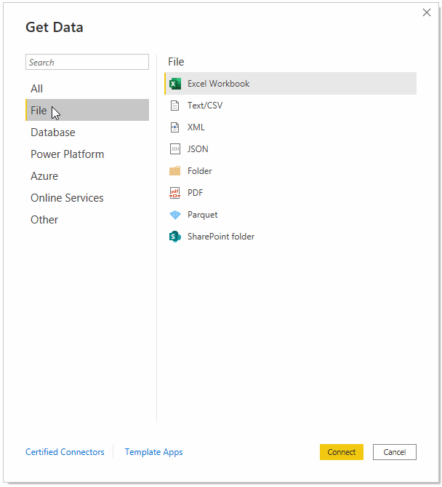
Power BI Data Sources
Supports several dataset and constantly growing compatibility.
https://docs.microsoft.com/en-us/power-bi/connect-data/desktop-data-sources
Dataset categorized into 6 groups:
File
Database
Power Platform
Azure
Online Services
Other
Mainly be using a SQL Server, CSVs, and Excel Workbooks files.
Notes:
Mark

Slide 15
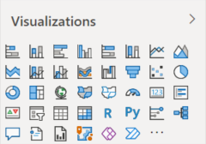
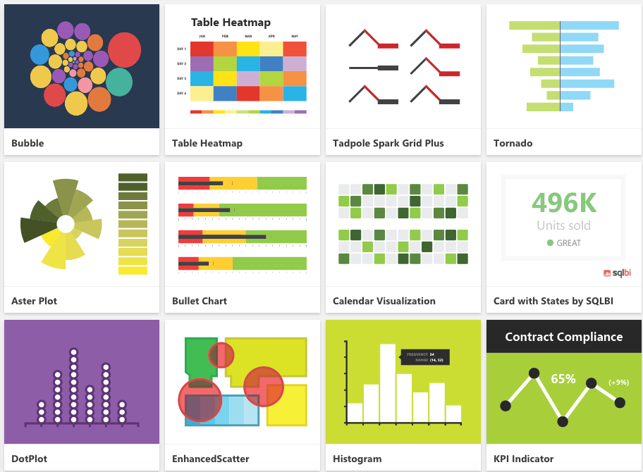
Different Visualization Types
Range from Area and Column Charts → Maps, Decomposition Trees, Ribbon Charts, etc.
Only worked with column, tables, cards, and funnels.
Looking into:
Maps, Mapbox, Waterfall, Doughnut, Gauge, and Zebra Tables.
Notes:
Mark

Slide 16
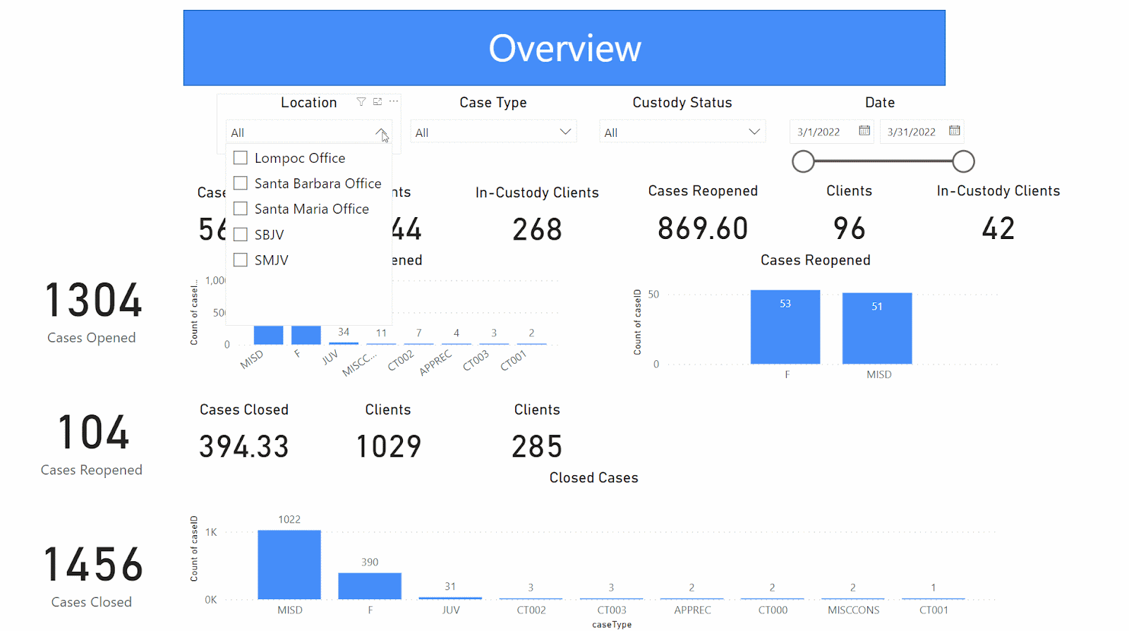
Data Visualization: External Dashboard Overview
Notes:
Mark \External Dashboard\ Shows a little summary of the underlying data. Uses bar charts to visualize the different amount of cases whether they are open, reopened, or closed.

Slide 17
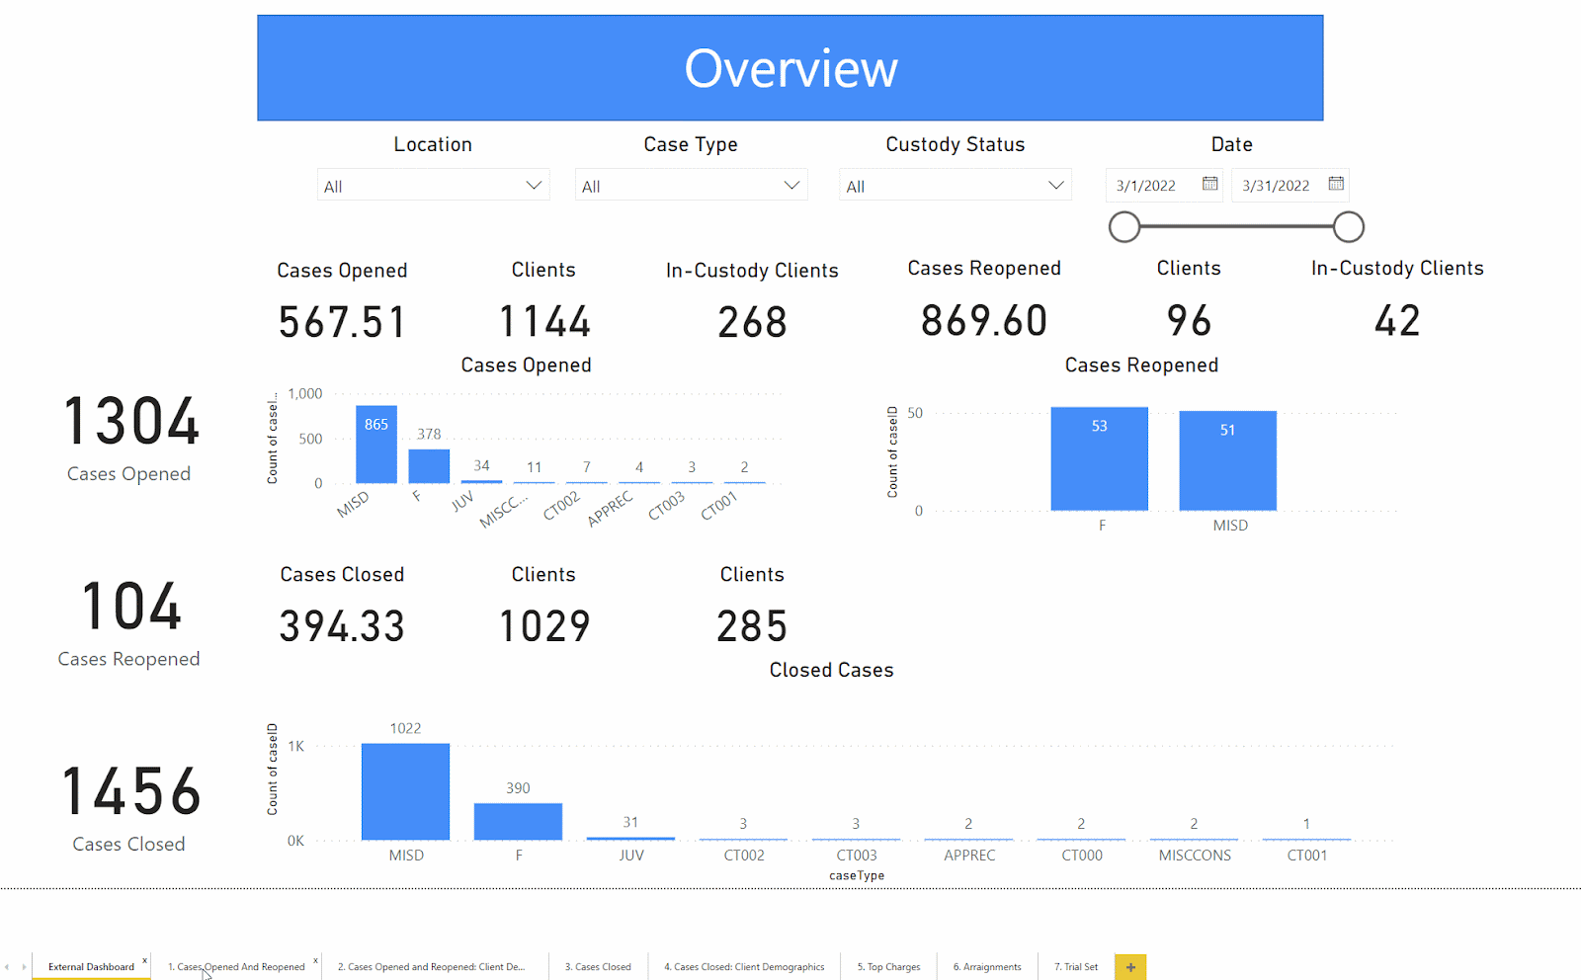
Data Visualization: External Dashboard Additional Reports
Notes:
Mark \Additional reports included with the external dashboard\ Go slightly more into detail. Focuses on Cases whether they are open reopened or closed, top charges found in cases, arraignments, and trials set. Each of them using a mixture of horizontal bar charts and pie charts to show things such as the total number of clients and the client demographic: gender, age, ethnicity, and their primary language.

Slide 18
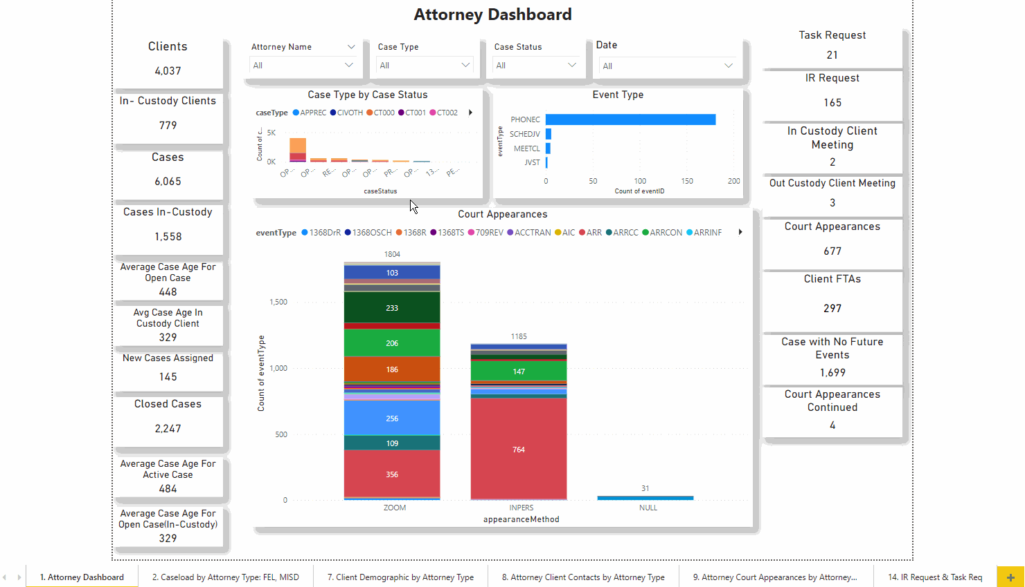
Data Visualization: Internal Dashboards
Notes:
Tommy

Slide 19
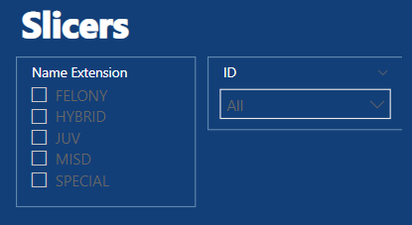
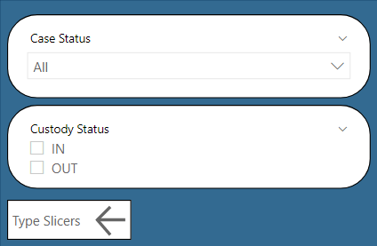
User Interactivity: Slicers
Visual sorters.
Allows users to select specific attributes to narrow down report visualizations.
This Power BI project employs the use of vertically positioned responsive slicers, relative date slicers, and sync slicers (selecting one parameter affects multiple charts).
Notes:
Tommy

Slide 20
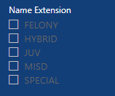
UX/UI Design
Dashboards are operational and analytical.
Color Palette: White, Blue and Gold.
Maximum of 5 graphs or charts on a single dashboard.
Dashboards are interactive (buttons, drop-down menu)and user-friendly.
Notes:
Elton

Slide 21
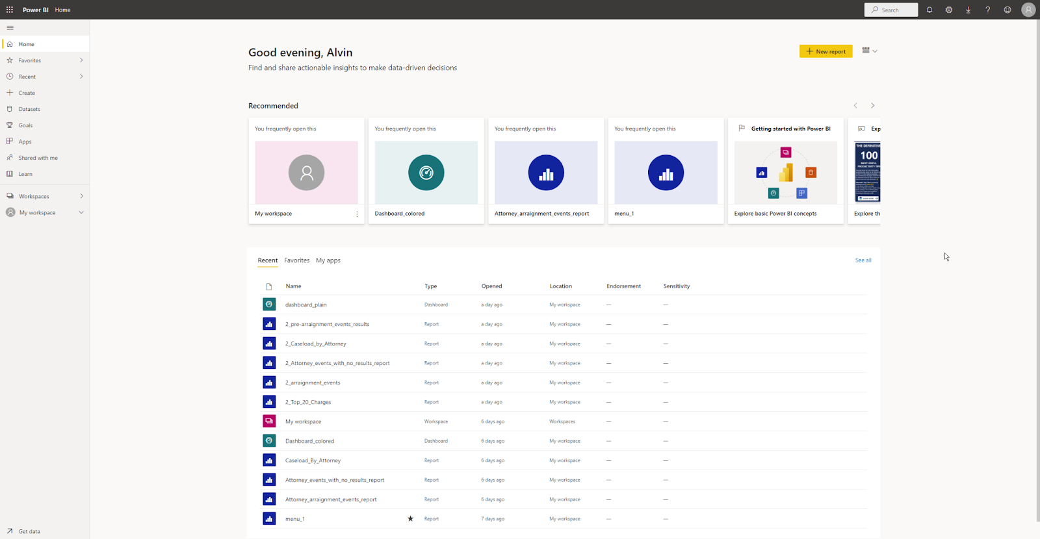
PowerBI Web App
Notes:
Alvin

Slide 22
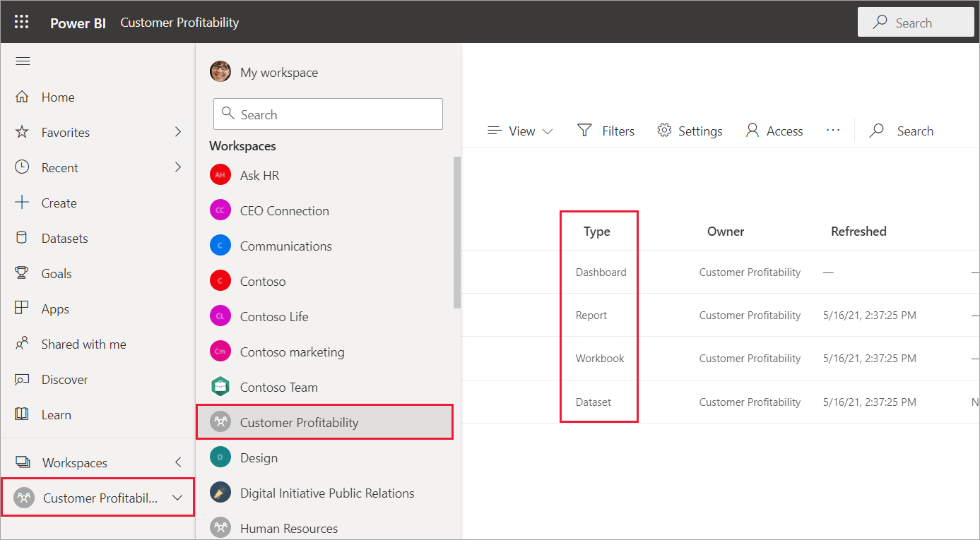
Workspaces
Ability to share workspaces with other colleagues.
Bundle collection of dashboards and reports into an app.
Personal Sandbox.
Notes:
Alvin

Slide 23
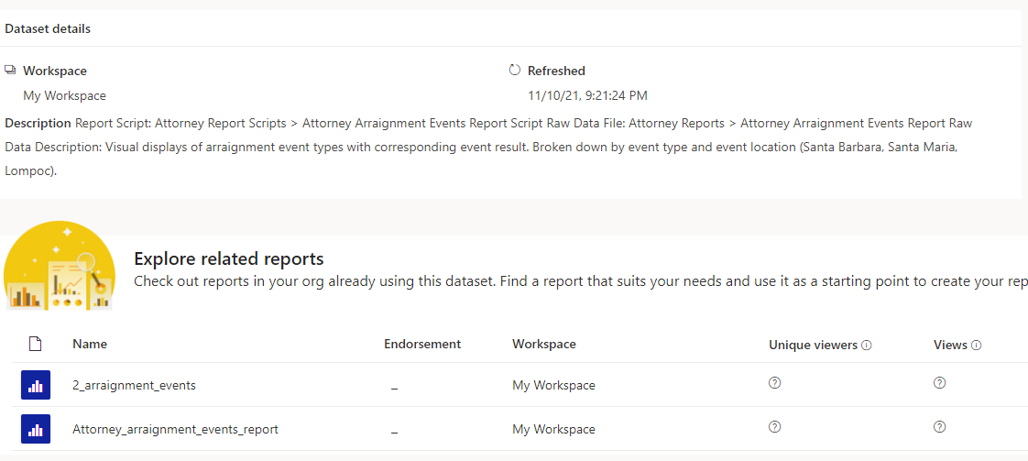
Datasets
Detailed information of a report.
Source of data available for one or more reports.
Notes:
Alvin

Slide 24
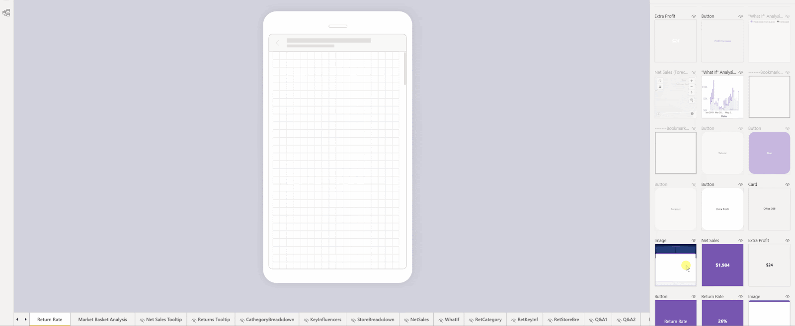
Phone Reports
Notes:
Alvin

Slide 25
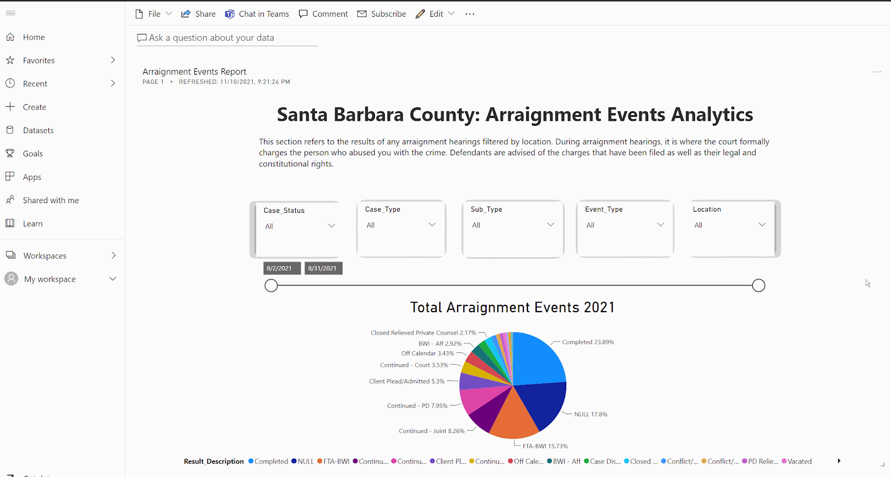
Dashboard
Notes:
Alvin

Slide 26
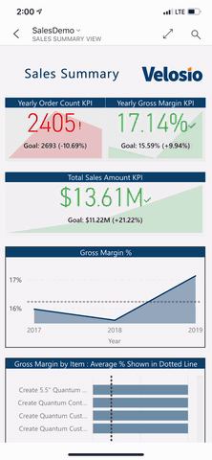
Mobile Application
Available on Android, iOS, and Windows devices.
Mobile application allows user to easily track their data on the go.
User is able to access their workspace, which includes Dashboards and Reports tabs.
Notes:
Yara

Slide 27
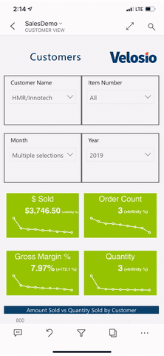
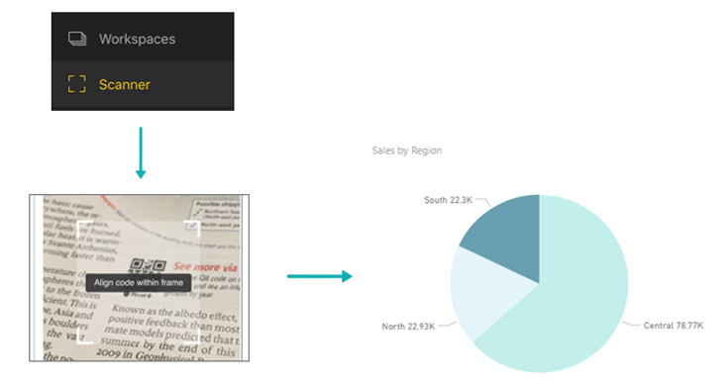
Features
Annotate Feature allows user to make notes on your reports and dashboards and share them with other people on your team.
Geo Filter: User can use current location to filter a report.
QR Scanner: Scanning a QR code will immediately open a report.
Notes:
Yara

Slide 28
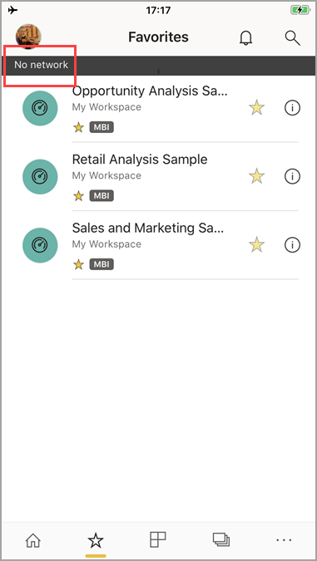
Limitations
Users cannot create visualizations using the mobile app.
Power BI can cache up to 250 MB of data offline.
Reports base on DirectQuery or live connection are not available offline.
Notes:
Yara

Slide 29
Conclusion & Future Work
Summary :
Used Redgate SQL and Mockaroo to transform Excel files into SQL queries.
Stored those queries into Microsoft SQL Server and connect to Power BI Desktop.
Explore Microsoft Power BI functionality, like slicer allows users to select specific attributes to narrow down report visualization and drill down to explore deeper information.
Export Power BI flies into Power BI Service and customize its unique dashboard design.
Publish and Subscribe
Overall benefit it’s to help the Power Bi Team and the future customer to more easily understand the data and make efficient decision.
For the future :
Provide more valuable dashboards.
Looking for the possibility of automating manual processes.
Notes:
DQ

