Slide 1
Image Analysis and Geometry Reconstruction
Client: Dr. Mathias Brieu (Mechanical Engineering)
Advisor: Dr. Negin Forouzesh (Computer Science)

Slide 2
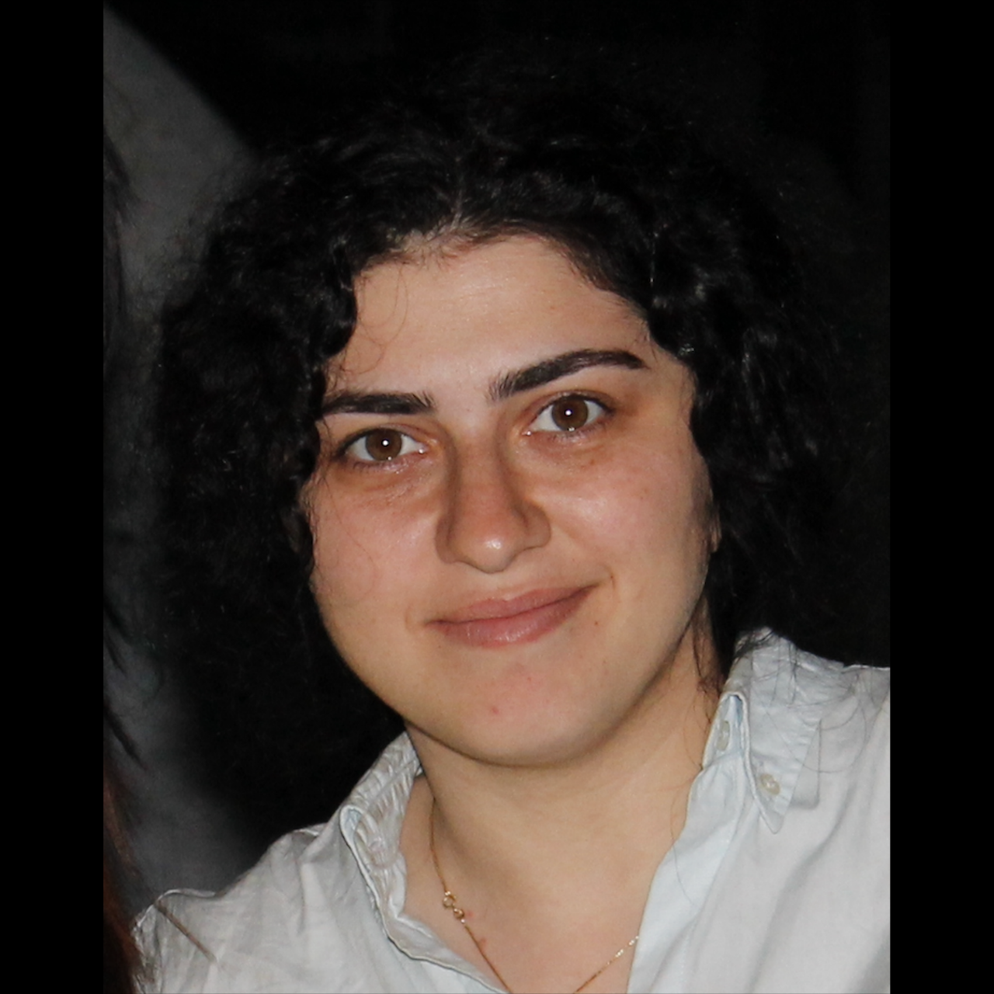
Meet the Team
Ralph Belleca Project Lead, Front-end
rbellec@calstatela.edu
Robin Mok Front-end
rmok2@calstatela.edu
Alejandra Olvera Front-end
aolver14@calstatela.edu
Sabino Ramirez Front-end
srami207@calstatela.edu
Mary Semerdjian Front-end Lead
msemerd2@calstatela.edu

Slide 3
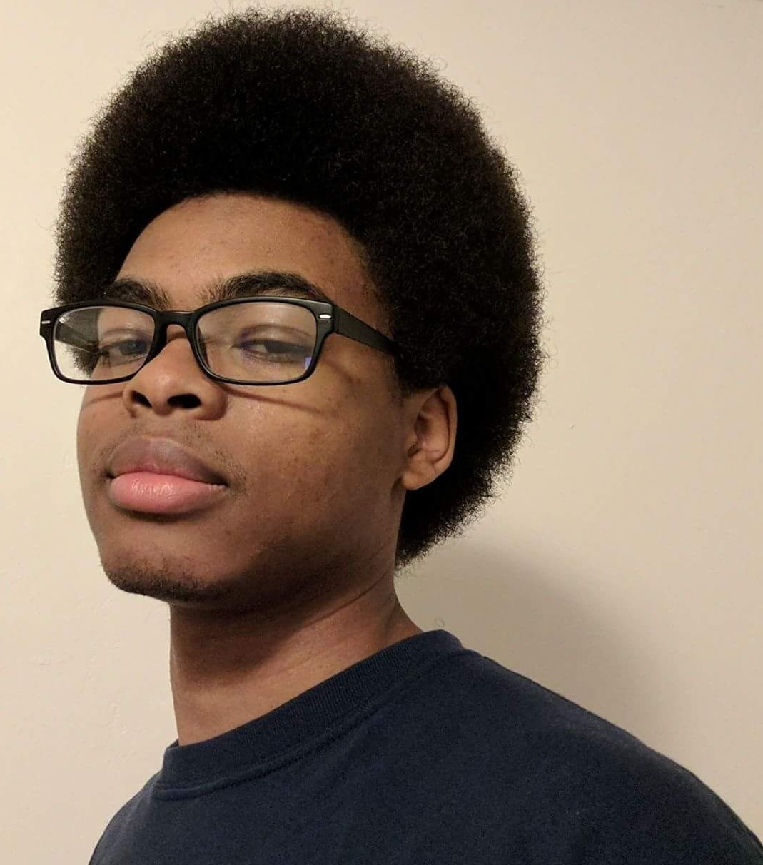
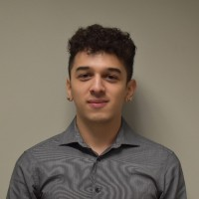
Meet the Team
Nicol Barrios Back-end Lead
abarri53@calstatela.edu
Ted Kim Back-end
tkim56@calstatela.edu
Silvano Medina Back-end
Documentation Lead
smedin63@calstatela.edu
Demetrius Parker Back-end
dparke11@calstatela.edu
Jason Tejada Back-end,
Customer Liaison
jtejad12@calstatela.edu

Slide 4
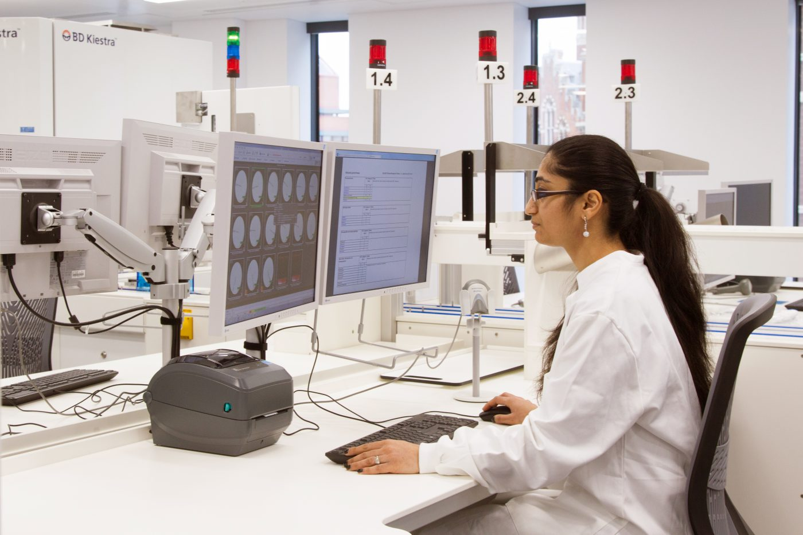
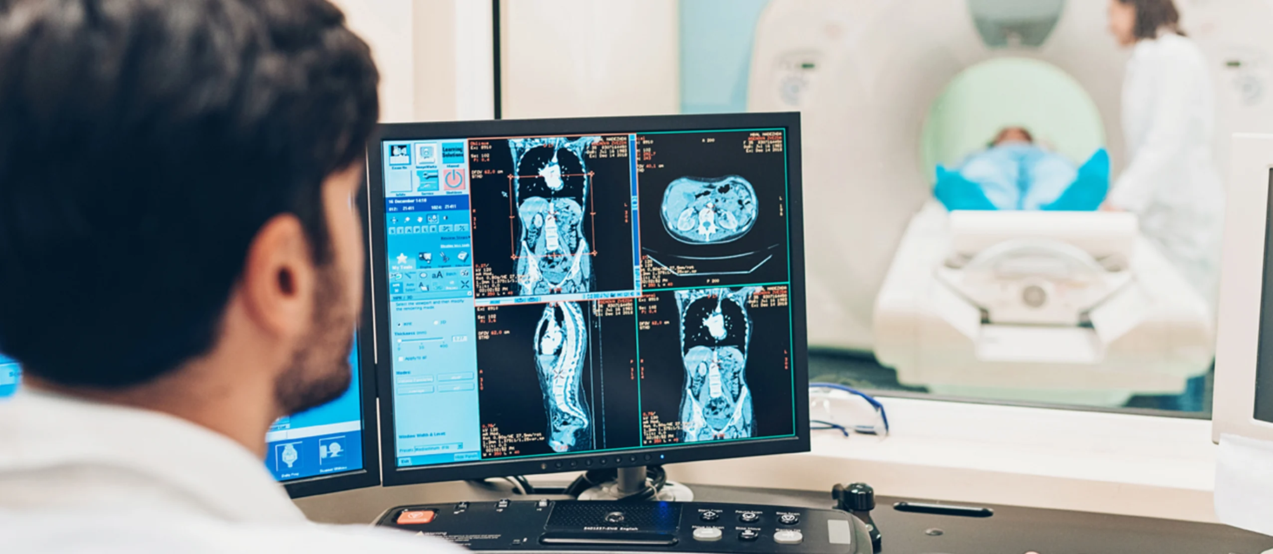
Problem
Currently, it can be tedious to get a clear 3D model out from an MRI image.
The process of improving the images is no less demanding
There is a clinical need for a more efficient, easy-to-use solution

Slide 5
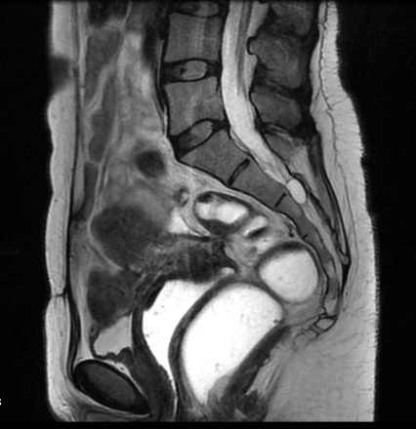
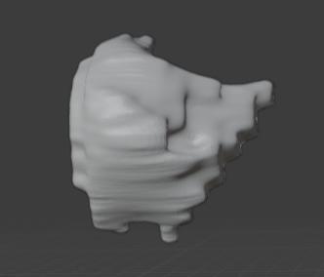
Goal
Create a program that streamlines the 3D model-making process
Integrate artificial intelligence into current process

Slide 6
Traditional Approach
3D Slicer
Blender
Manual
Threshold
INPUT
CREATE
REFINE
OUTPUT

Slide 7
Team’s Approach
3D Slicer
Manual
Threshold
DICOM Cleaner
Nvidia AIAA
Auto-Segmentation
Boundary Points
INPUT
ANONYMIZE
OUTPUT
Deep Grow

Slide 8
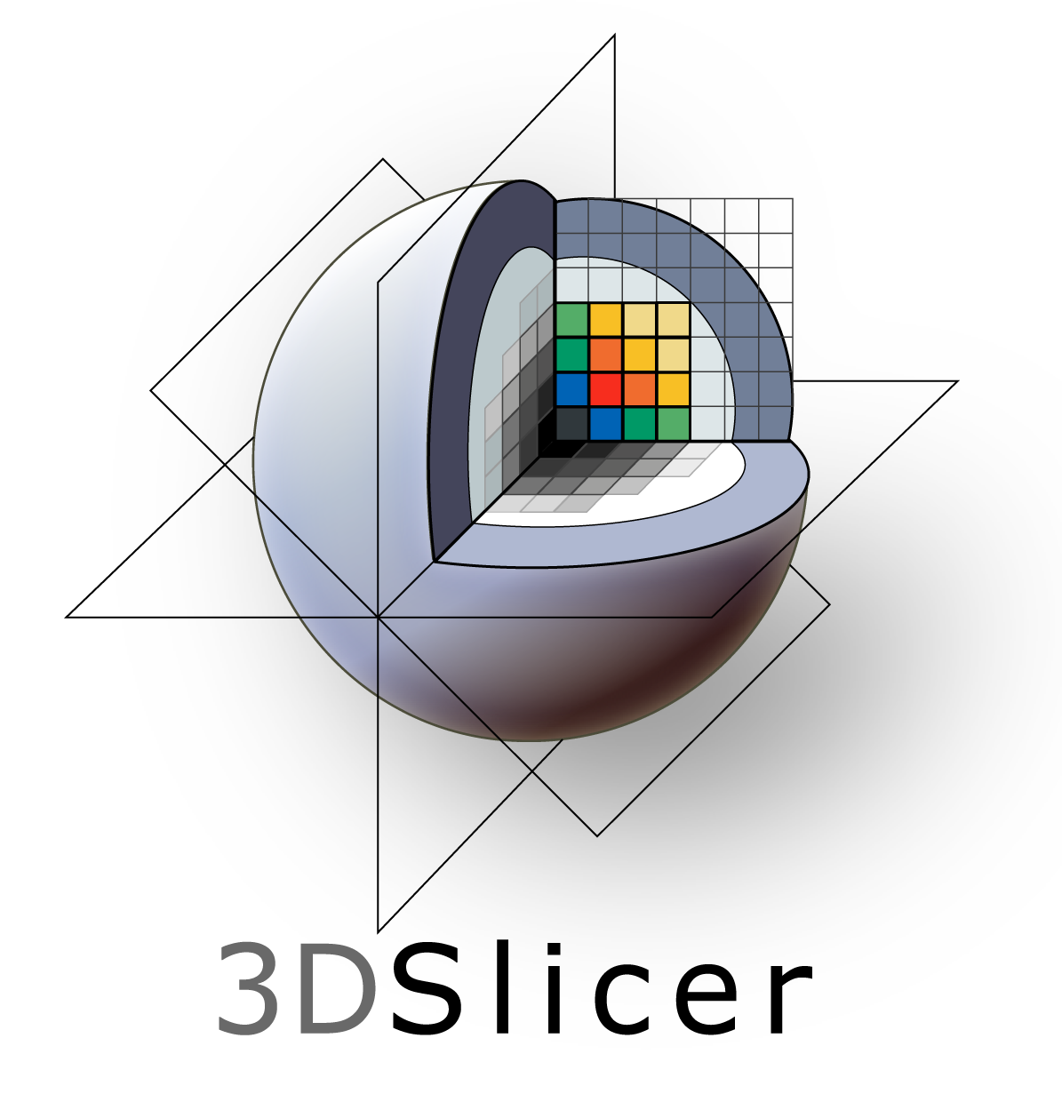
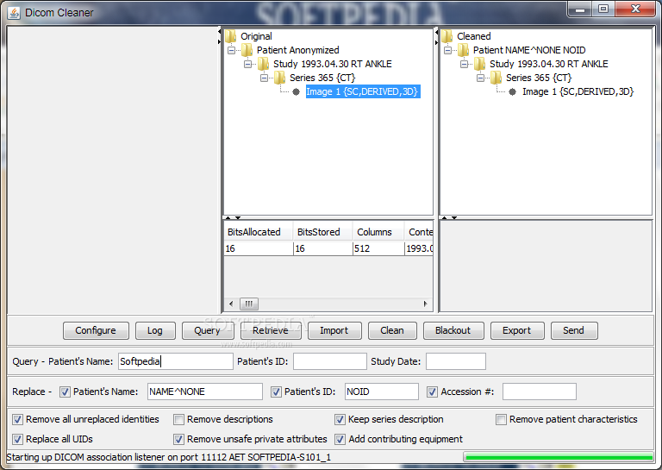
Used Software
3D Slicer
Blender
Dicom
Cleaner
[Plugin]
Nvidia AIAA

Slide 9
Dicom Cleaner
Clean private/anonymized data

Slide 10
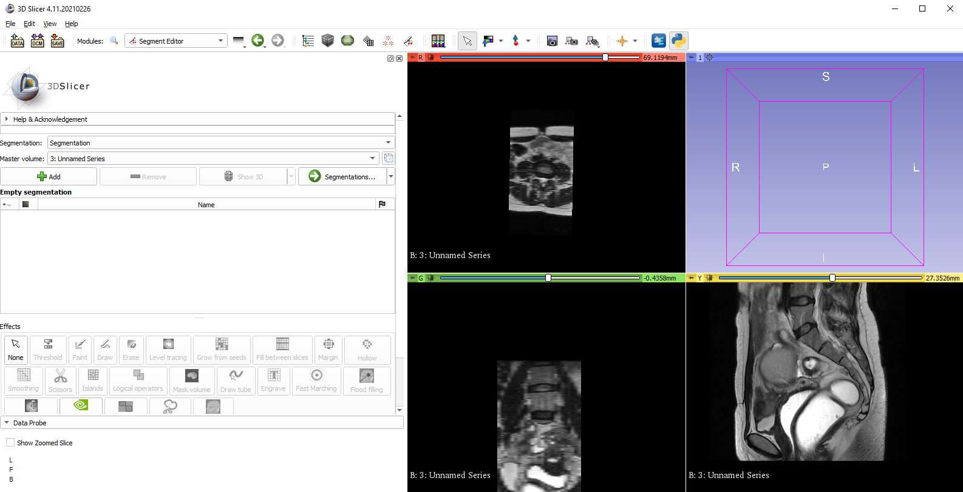
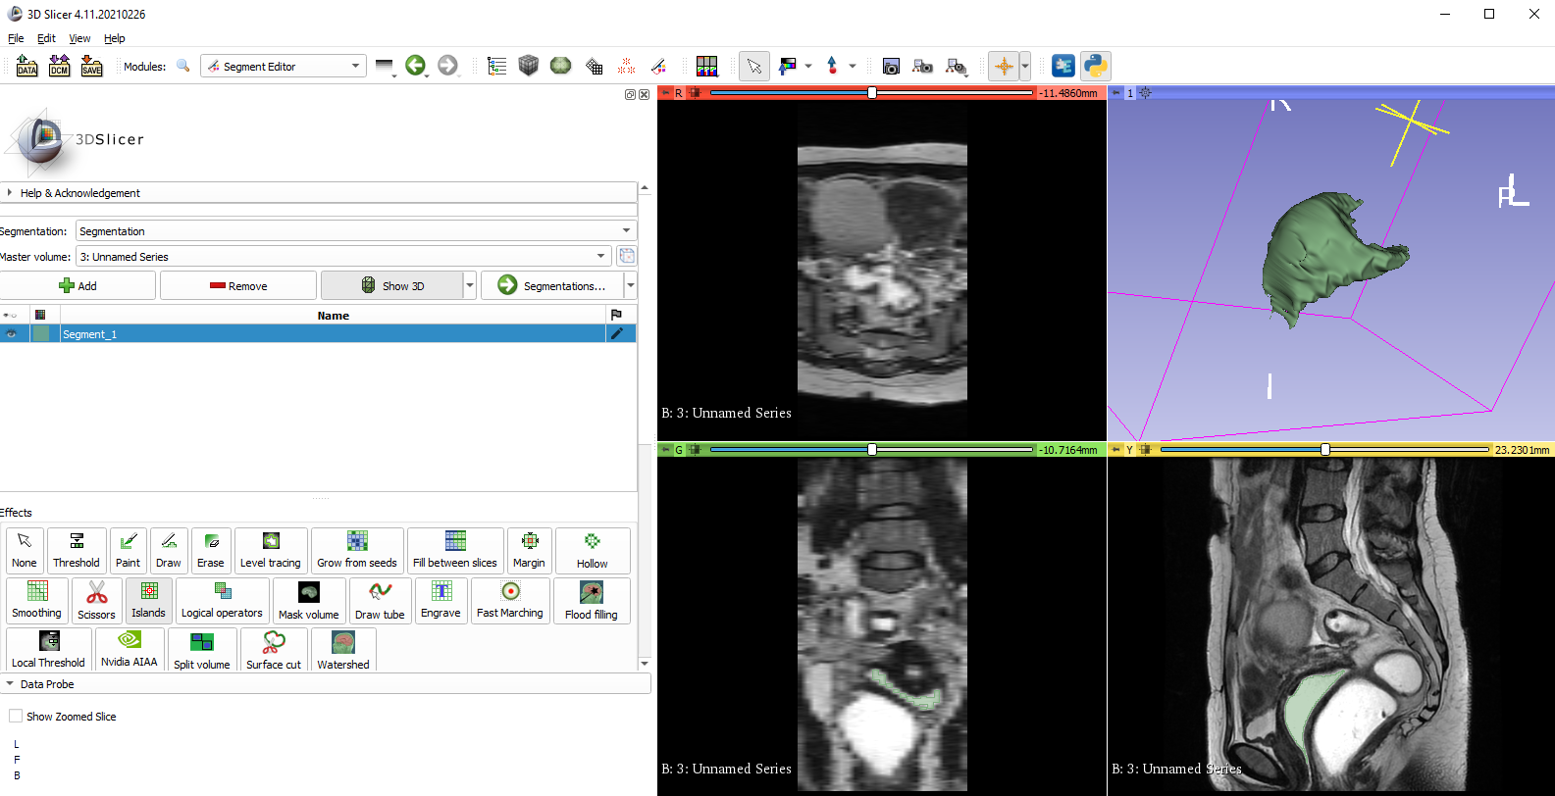
3D Slicer
Open Scans
Focus on Area of Interest
Form 3D from 2D
Export STL files

Slide 11
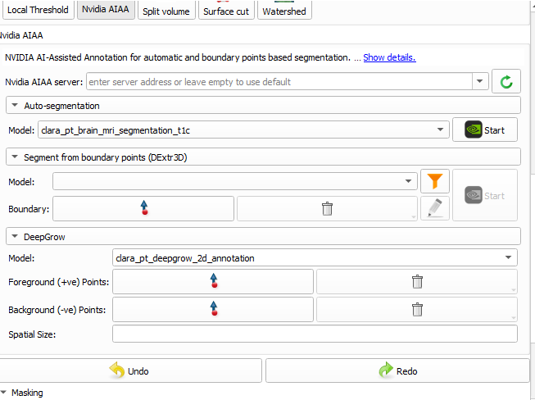
Nvidia AIAA
AI Assisted Annotation
Plugin
Lower skill requirement
Automate

Slide 12
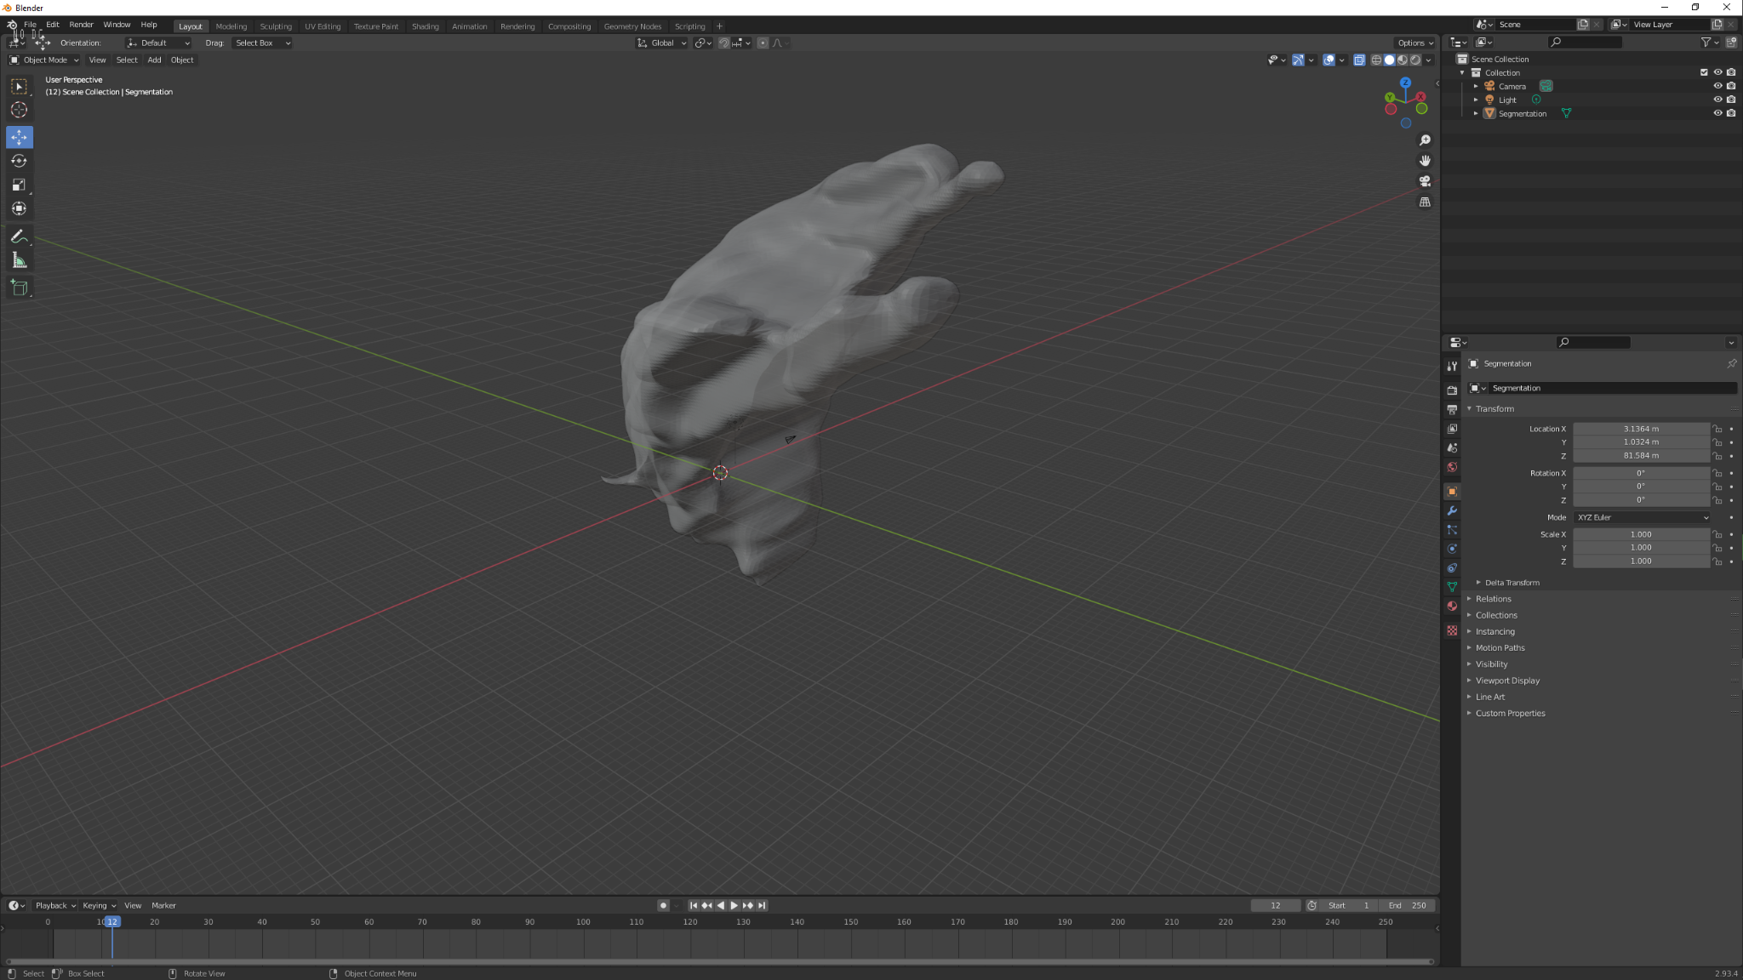
Blender
View
Manipulate
Smoothing

Slide 13
Manual Thresholding
(Traditional Method)

Slide 14
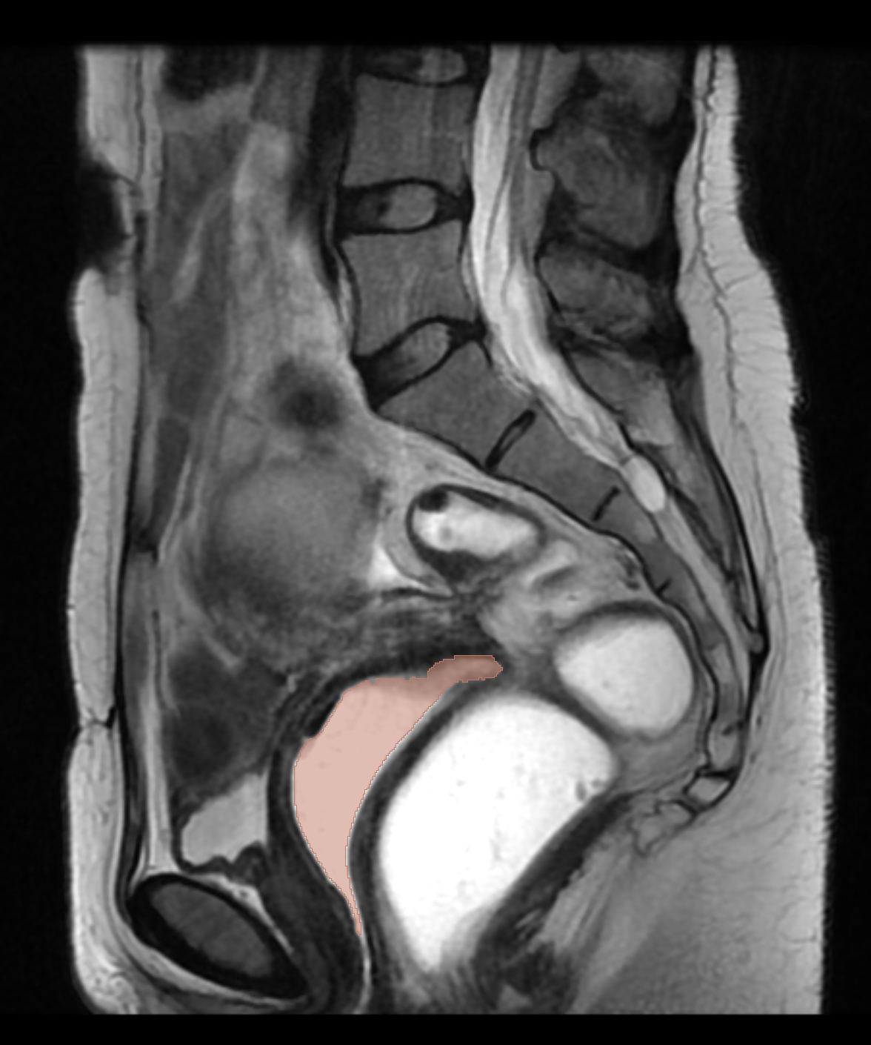
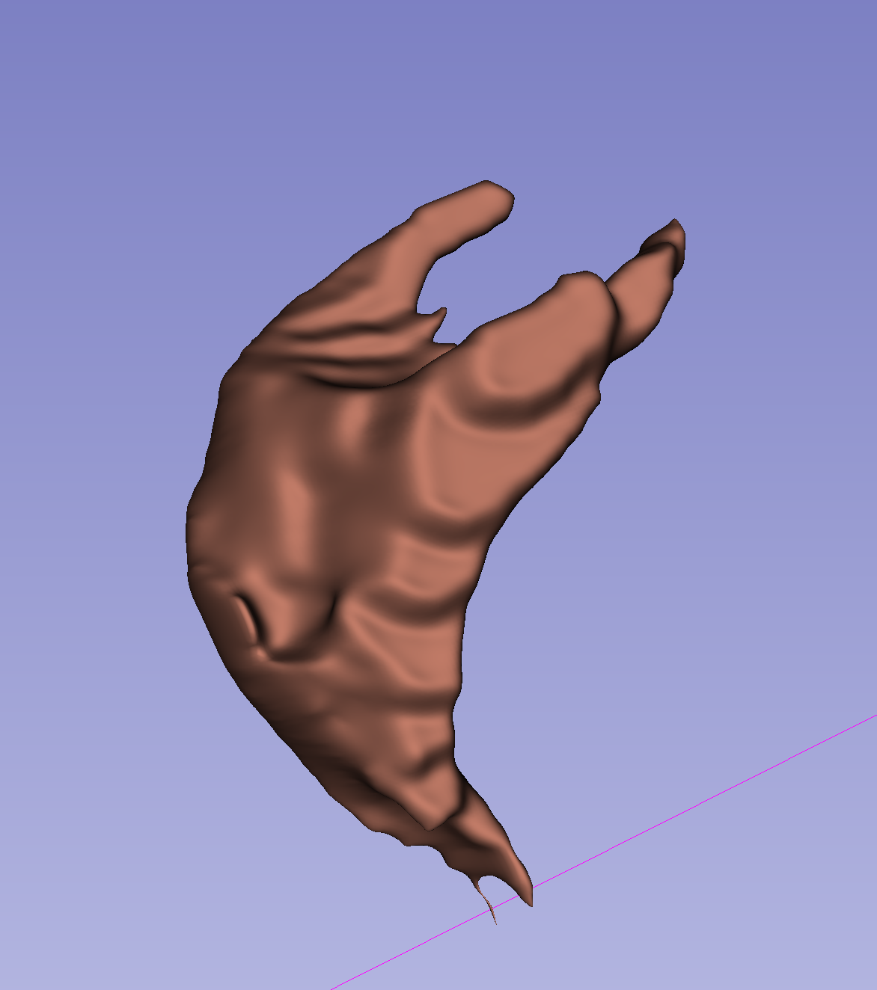
Method #1:
Manual Thresholding
(Traditional Method)
Start from scratch and use traditional, manually used techniques to get the best possible 3D shape and output of the female pelvis and its specific key organs
Notes:
Summarize it (add image to make it more engaging )
2. Output -> Highlight screenshots
(Max. 1 minute)

Slide 15
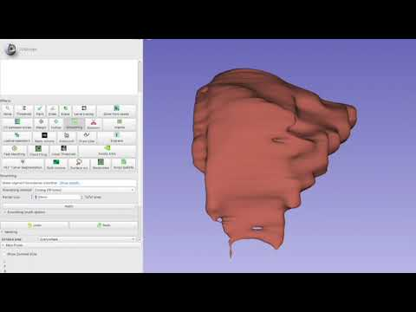
DEMO: Method #1: Manual Thresholding (Traditional Method)
Notes:
Use the demo to describe what is being said in the step slides. Delete STEP slide
1. For the recording: MRI Upload, Manual Thresholding; This demo will be accompanied by a live voiceover. (Max. 1 minute)

Slide 16
Method #1: Manual Thresholding
(Traditional Method)
Pros
Very fast and effective
Threshold
Islands
Smoothing
Requires less time for CPU clock speed
Cons
Refinement takes time
Paint
Paint edges that need filling in the gaps
Scissors
Cut unnecessary fillings, trim sides
Notes:
Add slide with pros and cons. State the pros and cons of Manual Threshold.
3. Pro and Cons for using this methodology (2-3 points for each) (Max. 1 minute)

Slide 17
Nvidia AIAA:
Boundary Points

Slide 18
Method #2: Nvidia AIAA
(Boundary Points)
Requires user to specify input points near the edge of the structure of interest, one on each side to create a 3D model of specific organs in the female reproductive system.

Slide 19
DEMO: Method #2: Nvidia AIAA
(Boundary Points)
Notes:
Use the demo to describe what is being said in the step slides.

Slide 20
Method #2: Nvidia AIAA
(Boundary Points)
Pros
Segmentation typically takes less than a minute.
Very little input required from user.
Better accuracy than Manual Thresholding
Cons
Inconsistent - the organ can be distorted due to lack of Vagina, bladder or rectum model.
Incompatibility with editing tools - eraser, scissors and drawing switched the shape of the organ
Notes:
Add slide with pros and cons. State the pros and cons

Slide 21
Nvidia AIAA:
DeepGrow
Notes:
Hello everyone my name is Alejandra and I will be talking out Nvidia's AIAA method DeepGrow

Slide 22
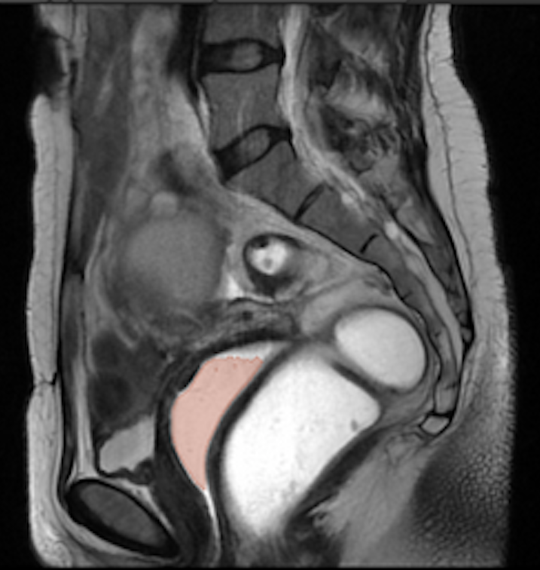
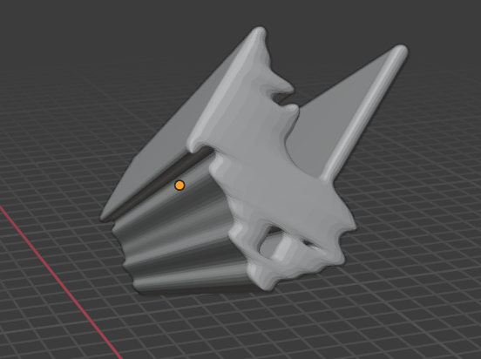
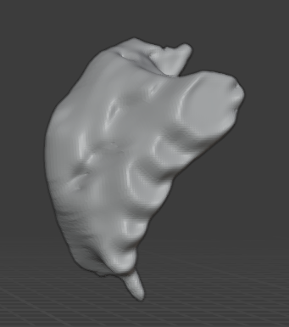
Method #3:
Nvidia AIAA
(Deep Grow)
Requires user to specify few input points (foreground/background) on the structure of interest. This is a 3D operation.
Notes:
Deep grow requires the user to place input points known as foreground and background points on the structure of interest and displays a 3D model as an output.
As you can see on the top figure we have used this method to create a 3D model of the vagina.

Slide 23
DEMO: Method #3: Nvidia AIAA
(Deep Grow)

Slide 24
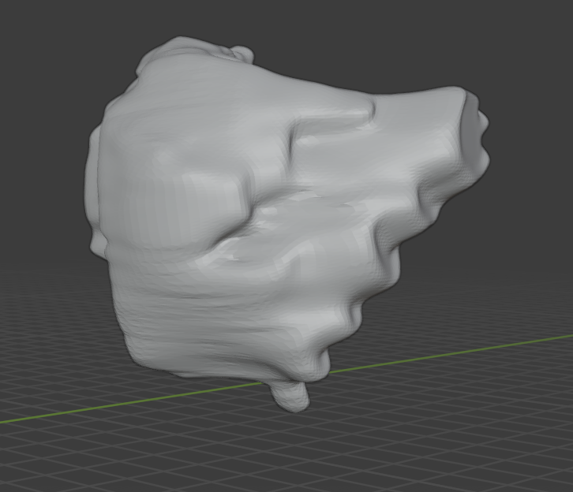
Method #3: Nvidia AIAA
(Deep Grow)
Pros
Less input from user
Works like Boundary points
Straightforward Refinement
Foreground Points
Background Points
Clear 3D model
Cons
Inconsistent
Worked for some members and not others
Time of completion
Each single point typically takes about 4 seconds.
Notes:
Some pros of Nvidia's AIAA Deepgrow are it requires less inputs from the user compared to the traditional methods

Slide 25
Methodology Comparison

Slide 26
Purpose
Time
How long to produce a model.
Accuracy
The quality of the model produced.
Demetrius

Slide 27
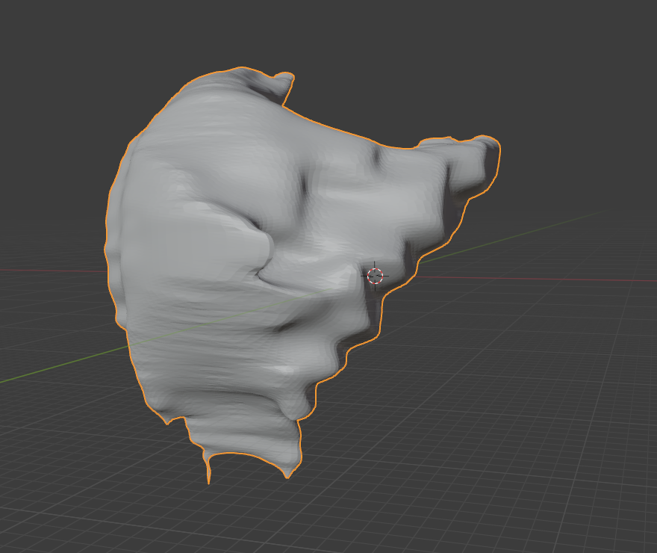
Traditional Method
(Manual Thresholding)

Slide 28
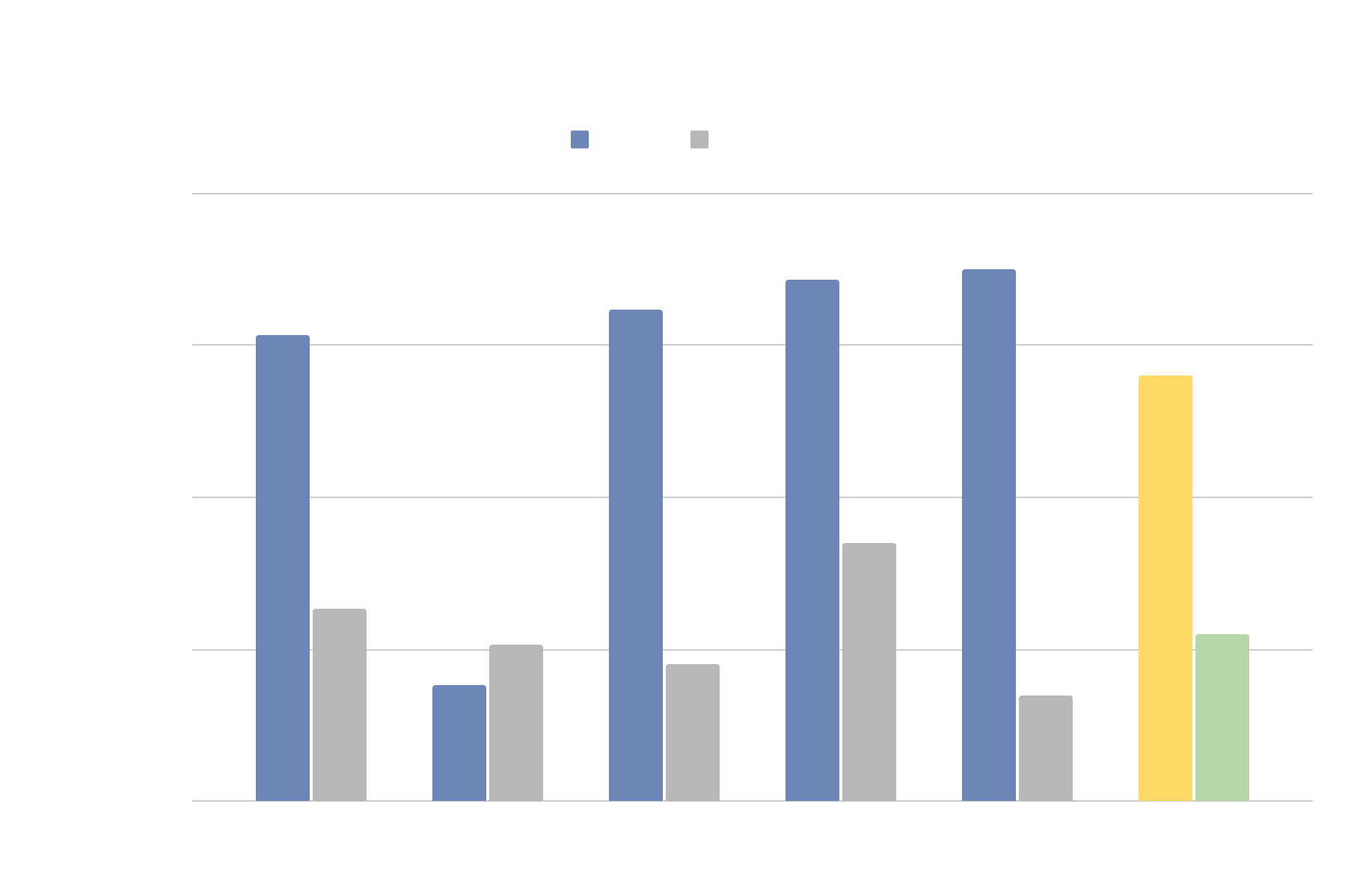
Manual Thresholding time comparison chart
Demetrius

Slide 29
Reported times are biased
Guidance
List of instructions
Familiarity
Experience
Hardware
Different computers
Demetrius

Slide 30
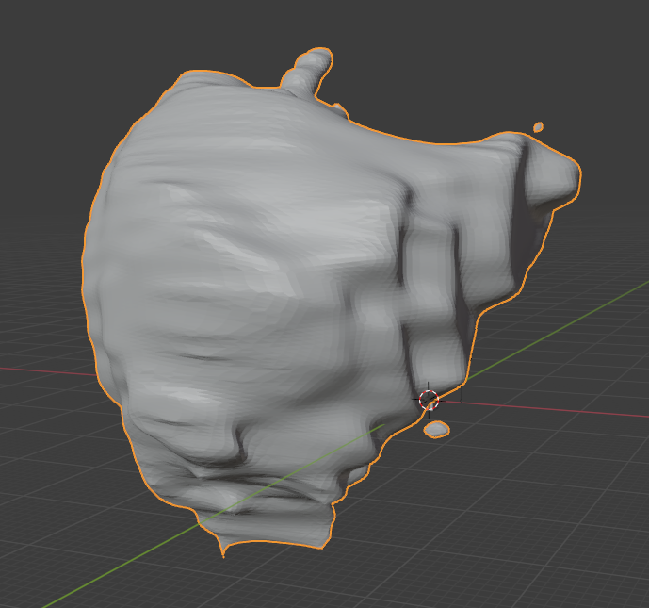
Boundary Points
Demetrius

Slide 31
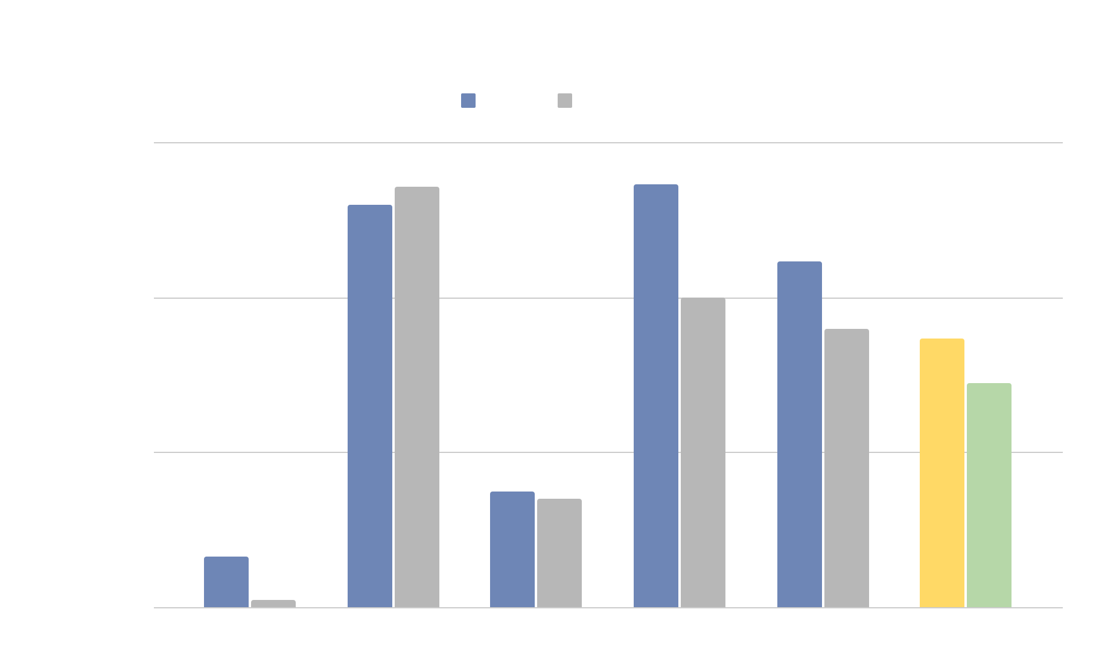
Boundary-point time comparison chart
Demetrius

Slide 32
Reported times are biased
No guidance
No set instructions
Hardware
Different computers
Demetrius

Slide 33
Deep Grow
Demetrius

Slide 34
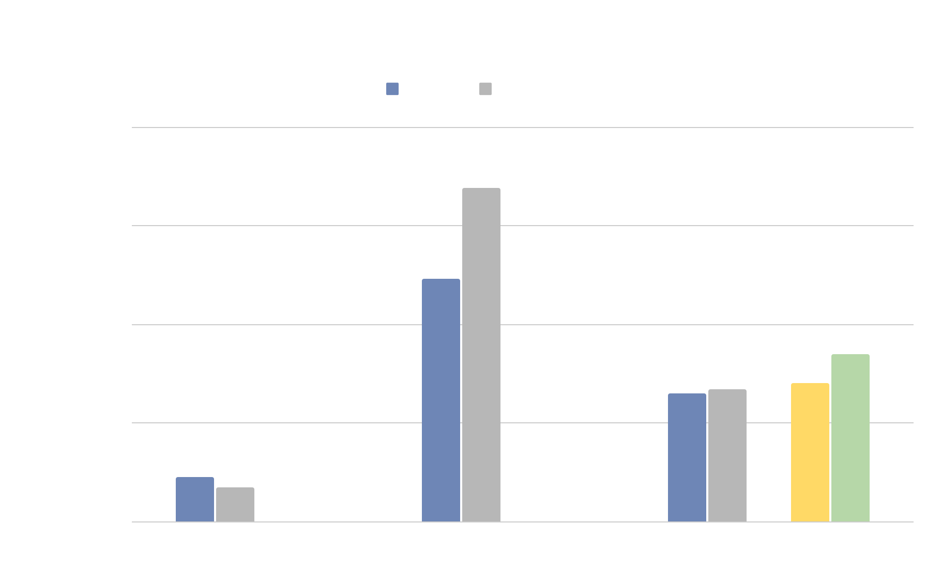
DeepGrow time performance comparison chart.
Demetrius

Slide 35
Reported times are biased
No guidance
No instructions.
Hardware
Different computers
Demetrius

Slide 36
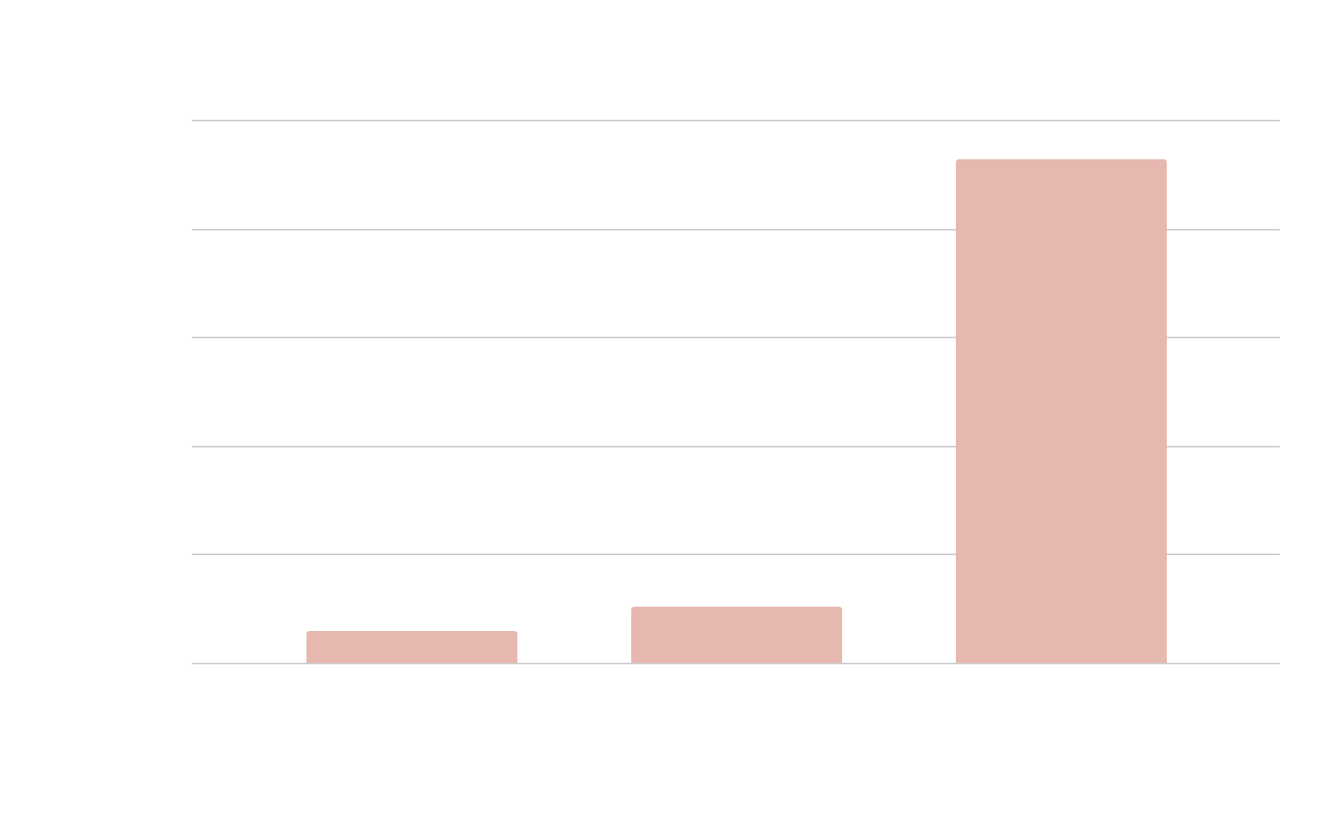
Average
Traditional
1 minute 29 seconds.
Boundary
2 minutes 36 seconds.
DeepGrow
23 minutes 16 seconds.
Demetrius

Slide 37
Time Results
Traditional
Fastest but requires training.
Boundary
Slightly longer than Traditional but does not require training
DeepGrow
We will not use due to quality amount of time.
Demetrius

Slide 38
Accuracy Comparison
Manual Thresholding
DEXTR3D
DeepGrow

Slide 39
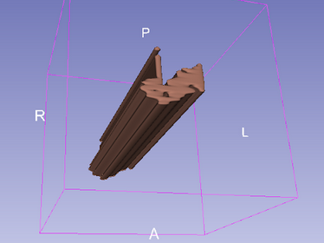
Accuracy Results
Traditional
Accurate but requires smoothing.
Boundary
More accurate than traditional but still requires smoothing
DeepGrow
Most accurate but not reliable due to quality inconsistency and amount of time.
Demetrius

Slide 40
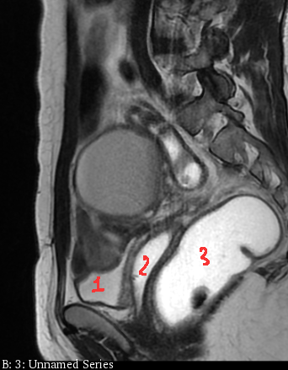
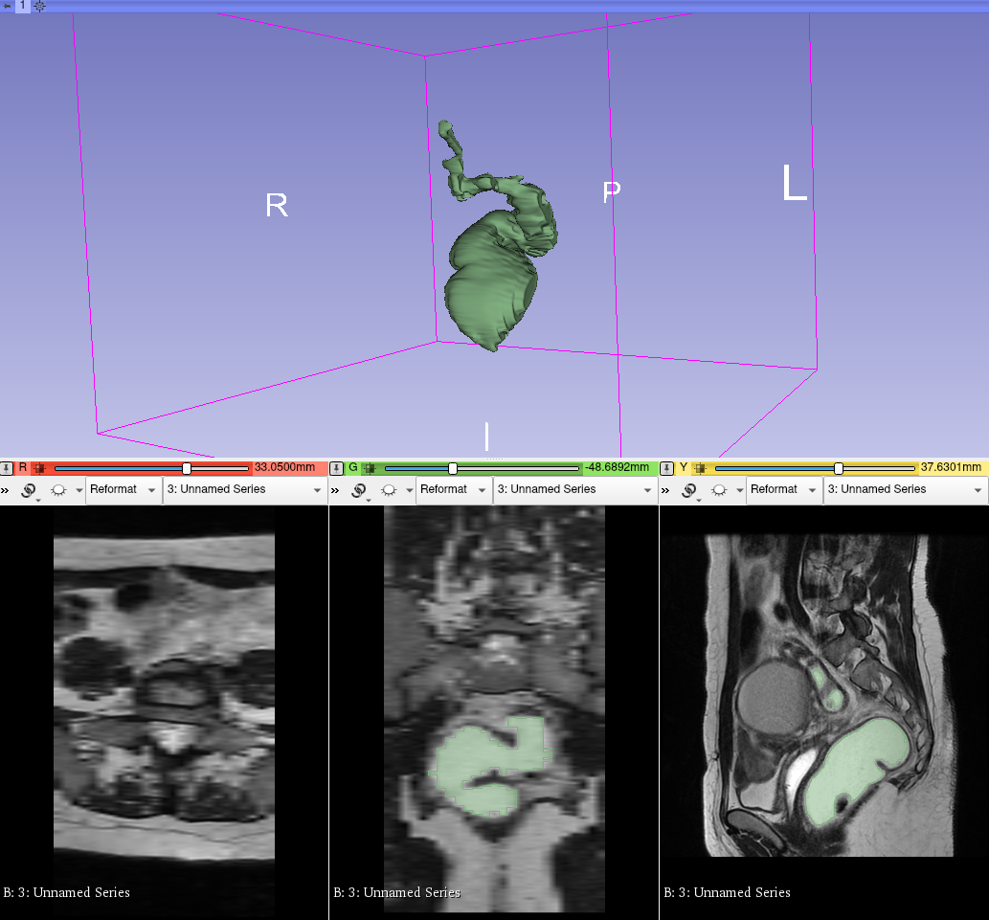
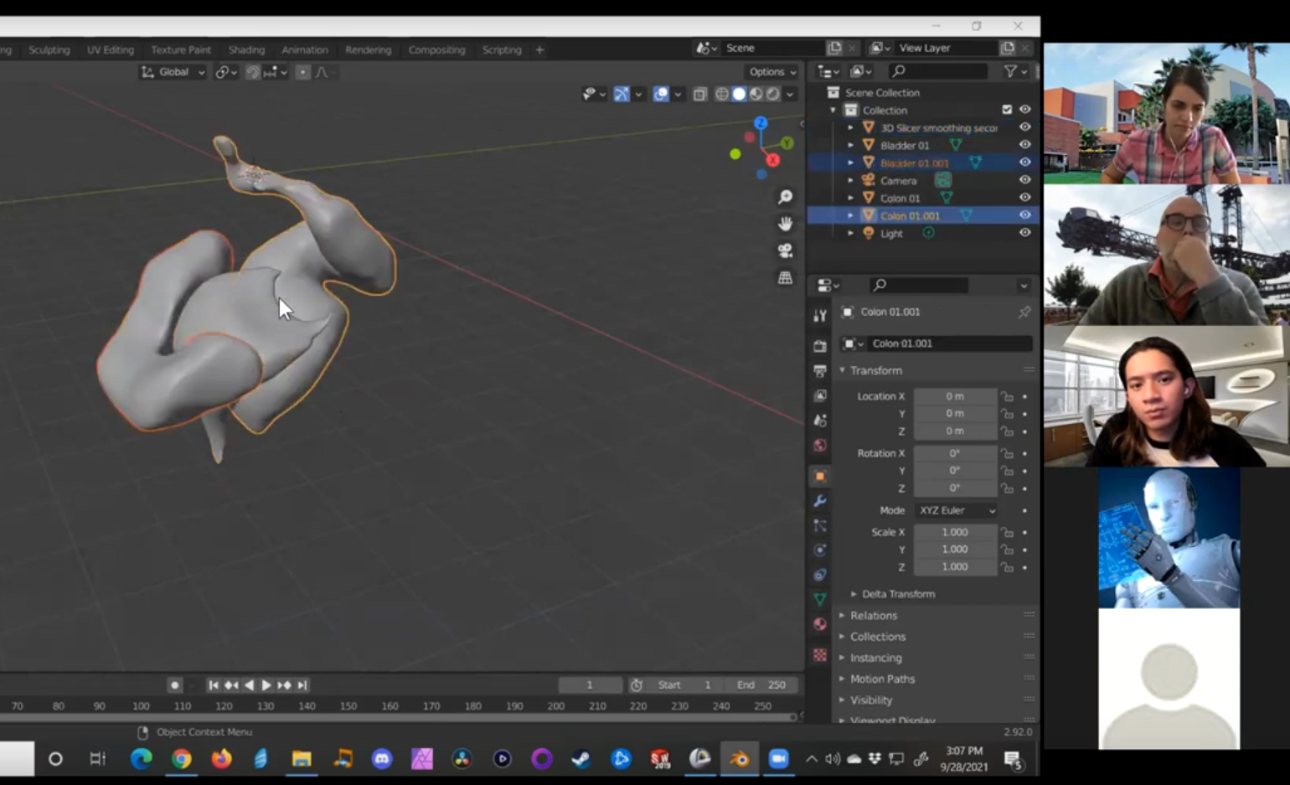
Challenges (Fall Semester)
Understanding the context
Learning about female pelvic anatomy
Identifying the bladder, vagina, and rectum
Learning Curve with 3D Slicer
Learning how to create a 3D model using traditional methodology
Identifying & modeling the right organs in 3D Slicer

Slide 41
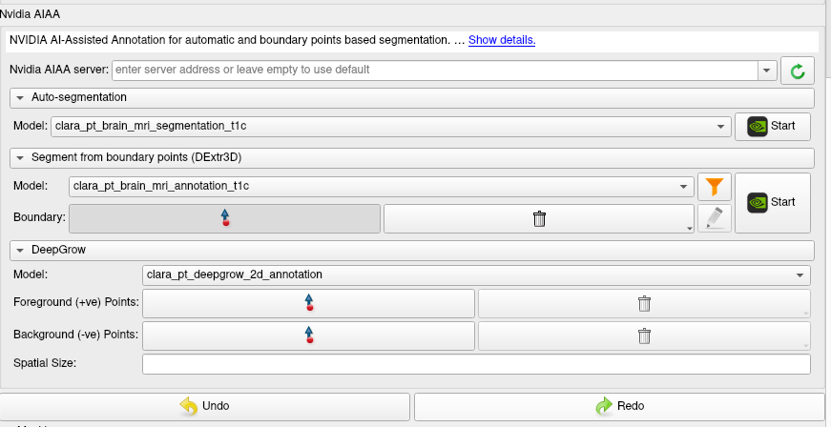
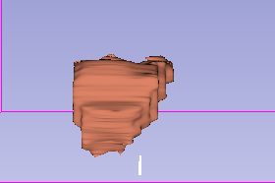
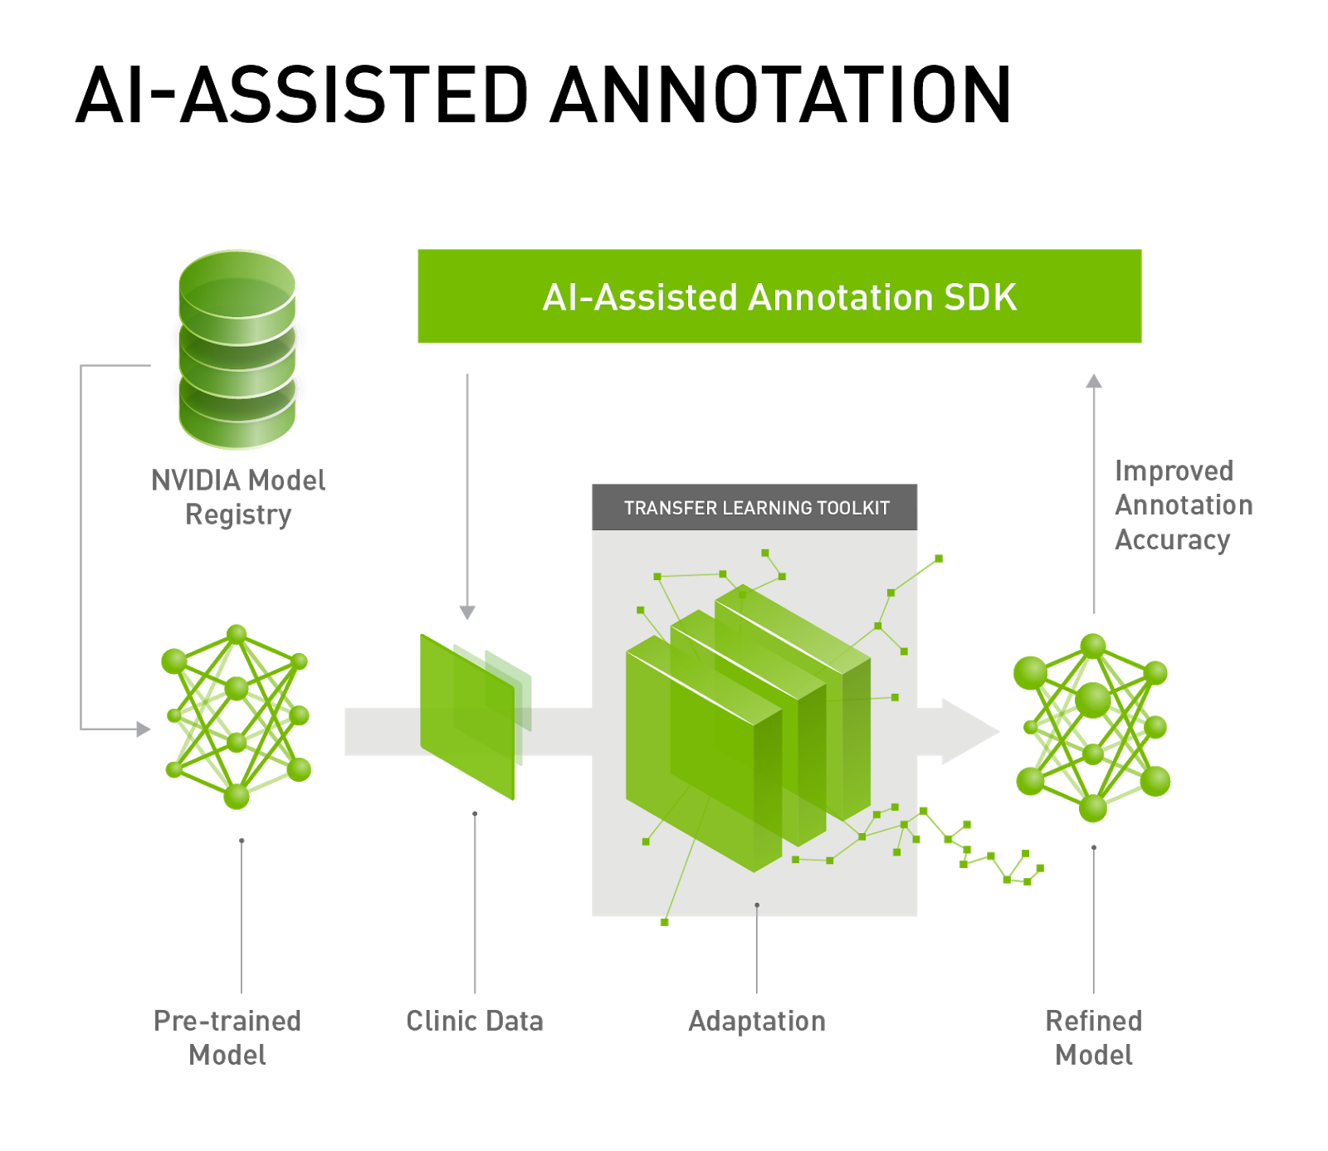
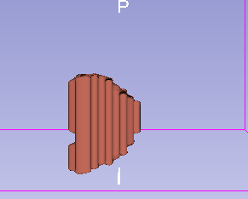
Challenges (Fall Semester)
Learning Curve with Nvidia AIAA
Learning how to use Boundary Points and DeepGrow using available models from Nvidia
Privacy (& Getting More Data?)
Preserving patient anonymity
Storing sensitive data on servers
Finding more MRI scans to work with

Slide 42
Current Prospect
Focusing on “Boundary Points”
Out of the 3 Nvidia AIAA features, Boundary Points is the most consistent
Currently using brain model, hence the need to create our own female pelvic model
3D Slicer
Manual
Threshold
Nvidia AIAA
Goal
Auto-Segmentation
Boundary Points
Deep Grow

Slide 43
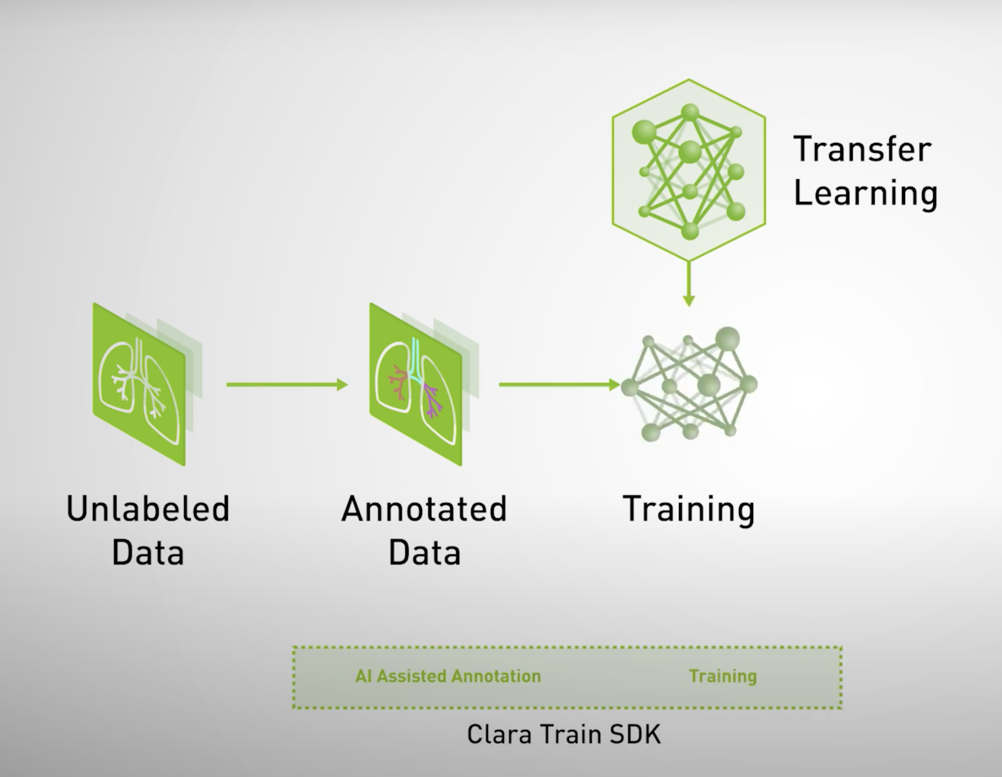
Current Prospect
Exploring Clara Train SDK
A framework that enables model training
Challenges: Requires GPU (Windows-specific)
Expectations: To be able to train our own pelvic model which will render a better quality 3D model

Slide 44
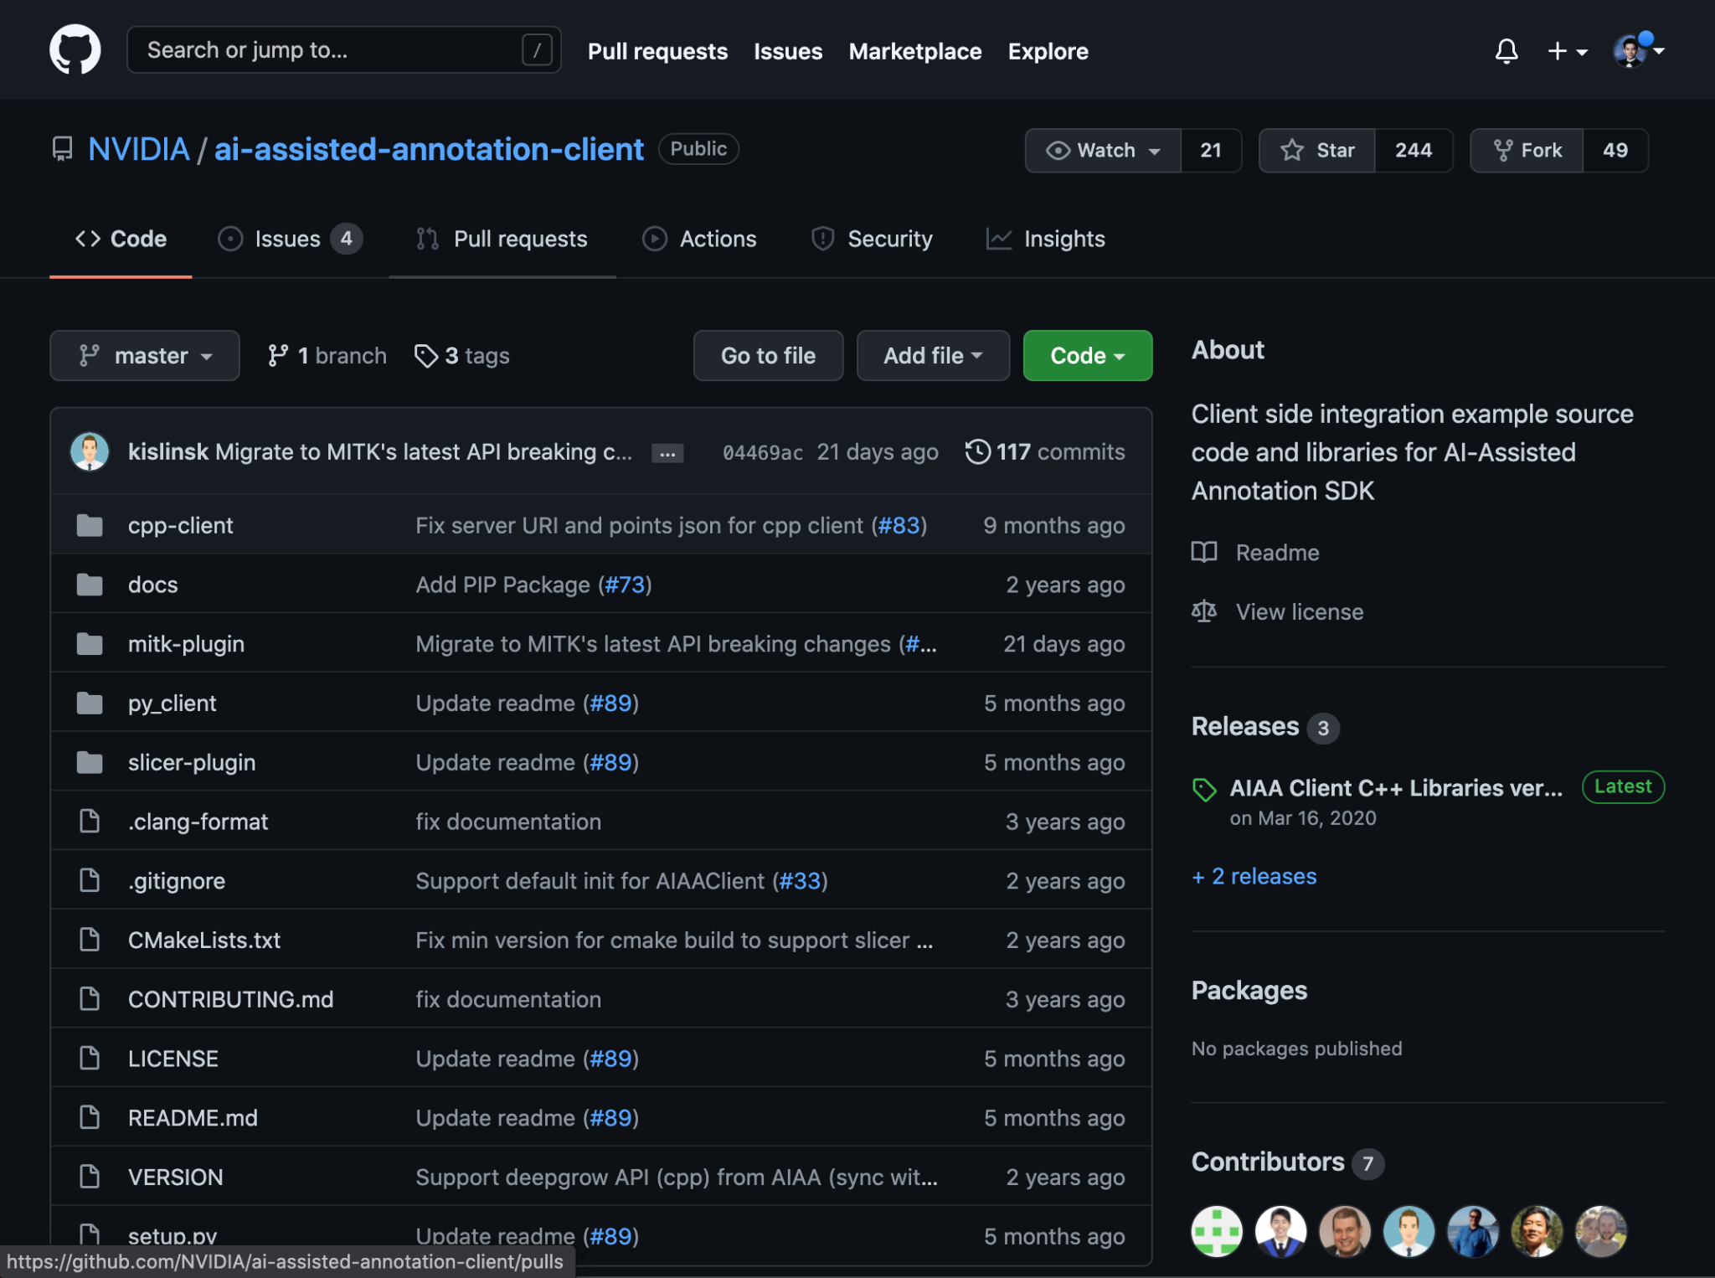
Current Prospect
Accessing Nvidia AIAA’s Github
Currently trying to implement features without using the user interface
Meaning, implementing through back-end code!

Slide 45
Current Prospect
Acquiring More Data
Given the nature of the project, data is very limited
Finding open data
Client (10)
The Cancer Imaging Archive (TCIA) (8)
Generative Adversarial Networks (GANs algorithm)

Slide 46
Future Direction
Priority - Streamline imaging analysis process
Gain better understanding Nvidia AIAA and 3D slicer’s Github repo
Clara Train SDK

Slide 47
Thank you for listening!

