Slide 1
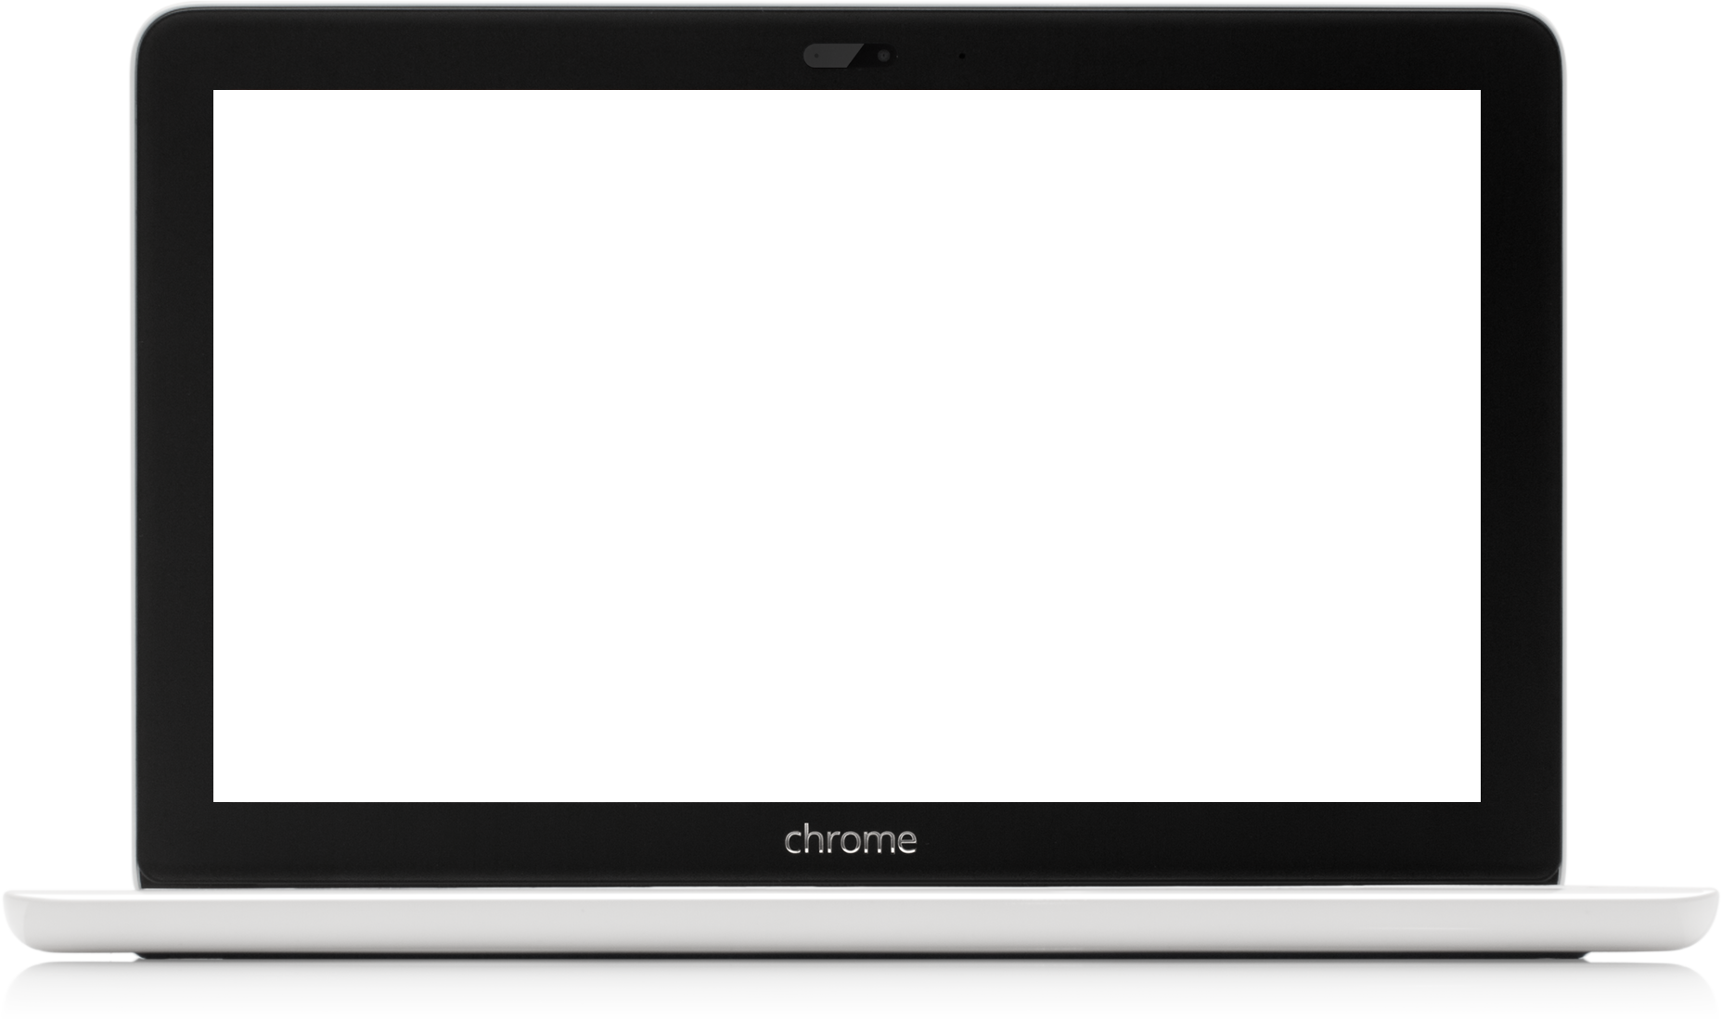
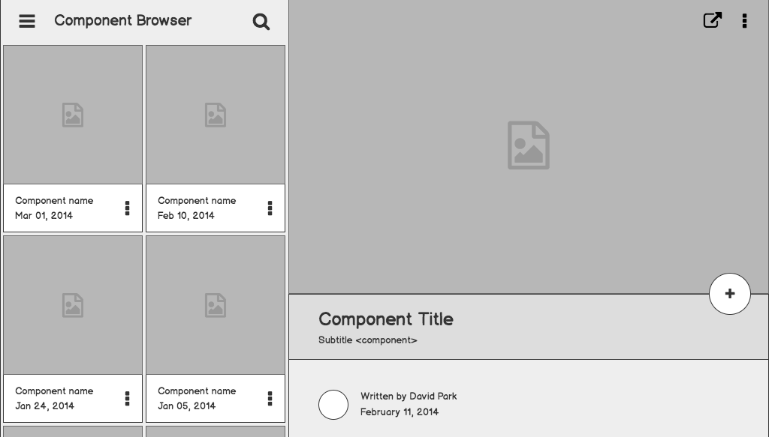
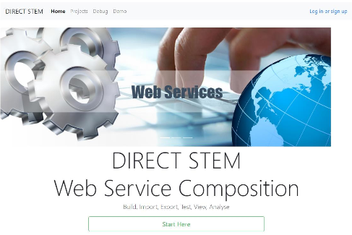
DIRECT-STEM
Visualization Tool for Composition
of Cloud Computing Services
Faculty Advisor:
Dr Jiang Guo
Graduate Advisor:
Davis Louie
Team:
Zolangi Ramirez
Hongsuk Choi
Sudip Baral
Gonzalo Serrano
Johnson Truong

Slide 2
Team Roles
Front End:
Zolangi - Project Lead
Choi - QA Lead
Sudip - Components Lead
Back End:
Johnson - Requirements Lead
Gonzalo - Documentation Lead

Slide 3
Outline
What is It?
Tools Required
Project Challenges
Project Components
Demo of Project
Back End
Progress
Timeline

Slide 4
What is the Visualization Tool for Composition of Cloud Computing Services?

Slide 5
Visualization Tool for Composition of Cloud Computing Services (VTCCCS)
Combination of Web Services
A web application used to create a web service out of already existing web services
Users will be able to use this visualization tool to model the architectures of cloud computing services based systems.
Example: Weather & Maps = get temperature for location
Temperature in Fahrenheit? Use celsius conversion service, get new service

Slide 6
Tools used to setup Project

Slide 7
Tools
Front End
Angular 4
Node.js
Npm
Angular CLI
D3
Back End
Java
Apache Tomcat
Maven
MySQL

Slide 8
Challenges we encountered

Slide 9
Project Challenges
Understanding Web Services
Backend
Will be discussed later
Learning Angular
Architecture
Components
Templates
Etc.

Slide 10
Using Angular

Slide 11
Angular
Template
You define a component’s view with its companion template. A template is a form of HTML that tells Angular how to render the component.
Component
A component controls a patch of the screen called a view.
Notes:
https://angular.io/guide/architecture

Slide 12
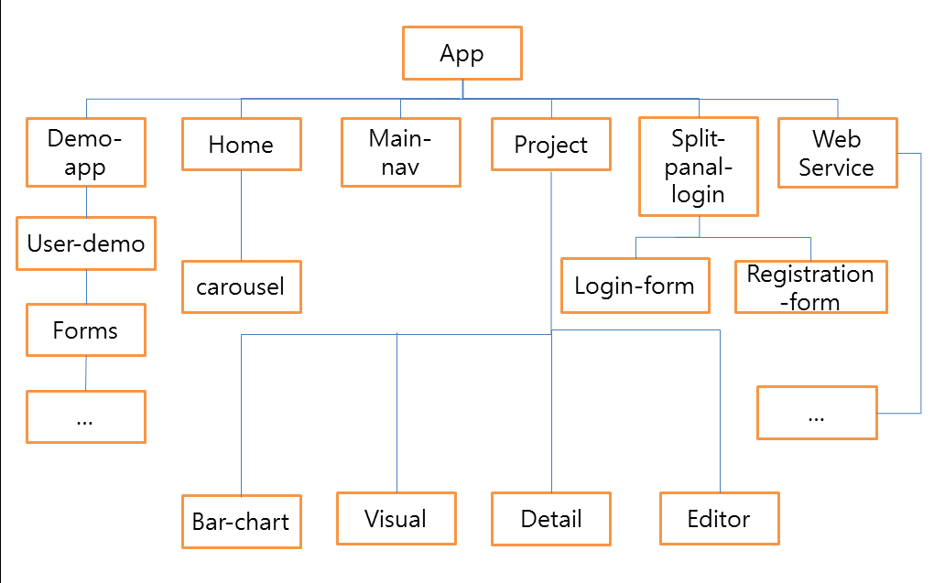
Notes:
Replace image with image of tutorial completed version image

Slide 13
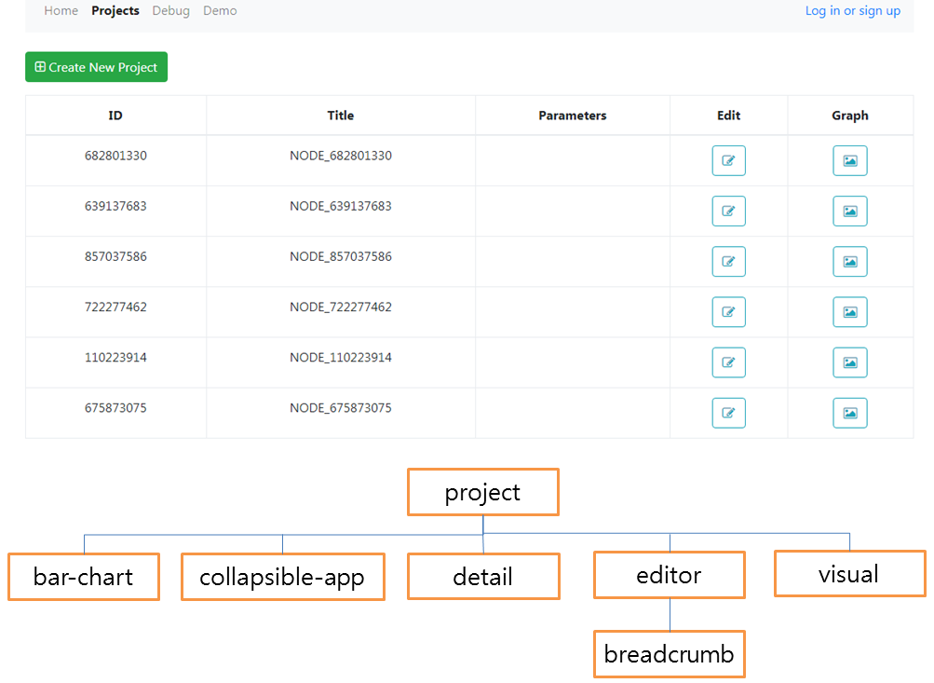

Slide 14
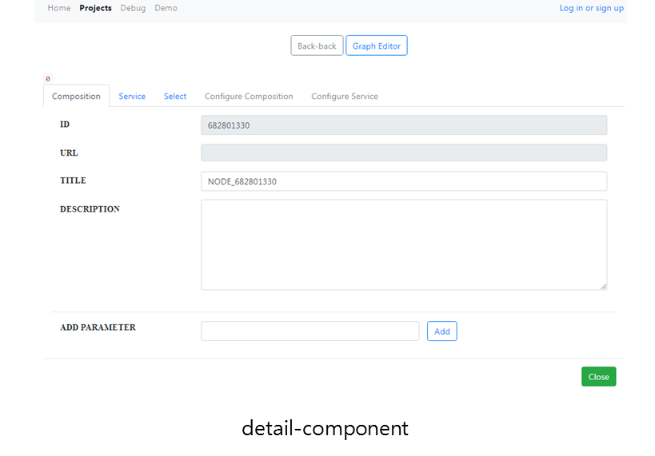

Slide 15
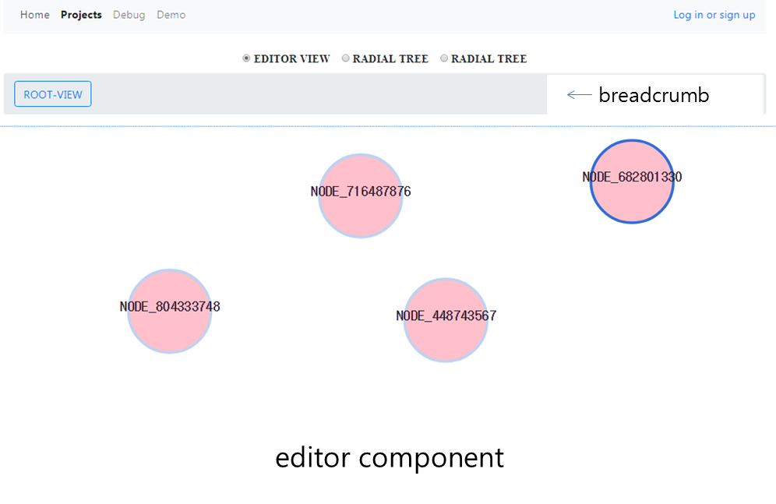

Slide 16
Demo of Project

Slide 17
Notes:
Let me give a quick demonstration on our project.
This component let us create an user or if you already have registered than you can just login.
This part of the web page allows the administrator to list the users and delete if needed.
Let me now create a new project.
This way we can create a project here.
These nodes represent a container.
it accepts one or more parameters.
We need to setup a web service either existing or one made by us into the node so you could get the output.
Thank you

Slide 18
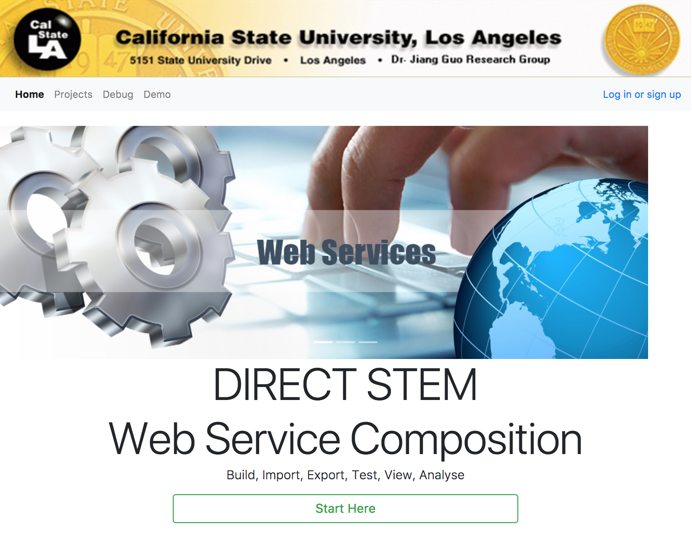

Slide 19
Backend
Implemented MySQL Database Schema
Learning Angular to connect backend to frontend
REST web services
CRUD operations in Angular
Implemented/Modified Node classes and other Java code
Notes:
What is a REST web service?
MySQL Basic tables
Create user, Retrieve user, Update user, Delete User

Slide 20
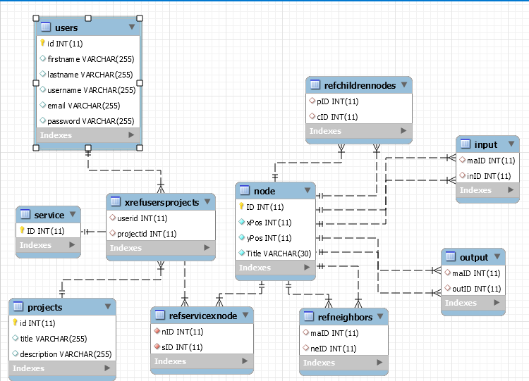
Database EER Diagram

Slide 21
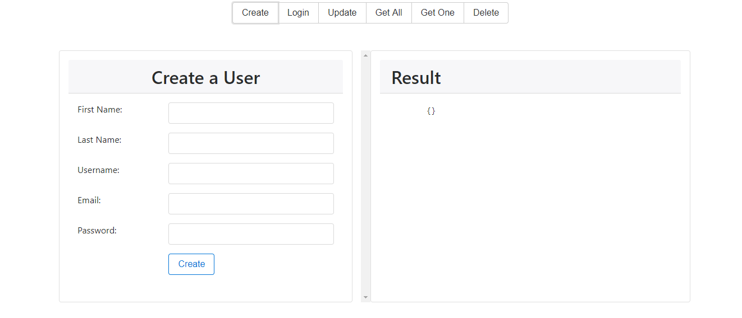
Database test site
Notes:
Shell for front end to see the message that will pass to the back end
Working on shell to test project saving and loading

Slide 22
Some Backend problems
Lots of redundant data
Children & neighbors
Node format difficult to store
Need shell for testing project saving/loading

Slide 23
Progress
Login Page
Administration Page
Connect to Database

Slide 24
Timeline: Future Work
DEC
JAN
FEB
MAR
APR
MAY
JUN
D3
Project Saving
External Web Service Integration
Visuals for Project
Performance
User testing
Finishing Touches

Slide 25
Questions?

