Slide 1
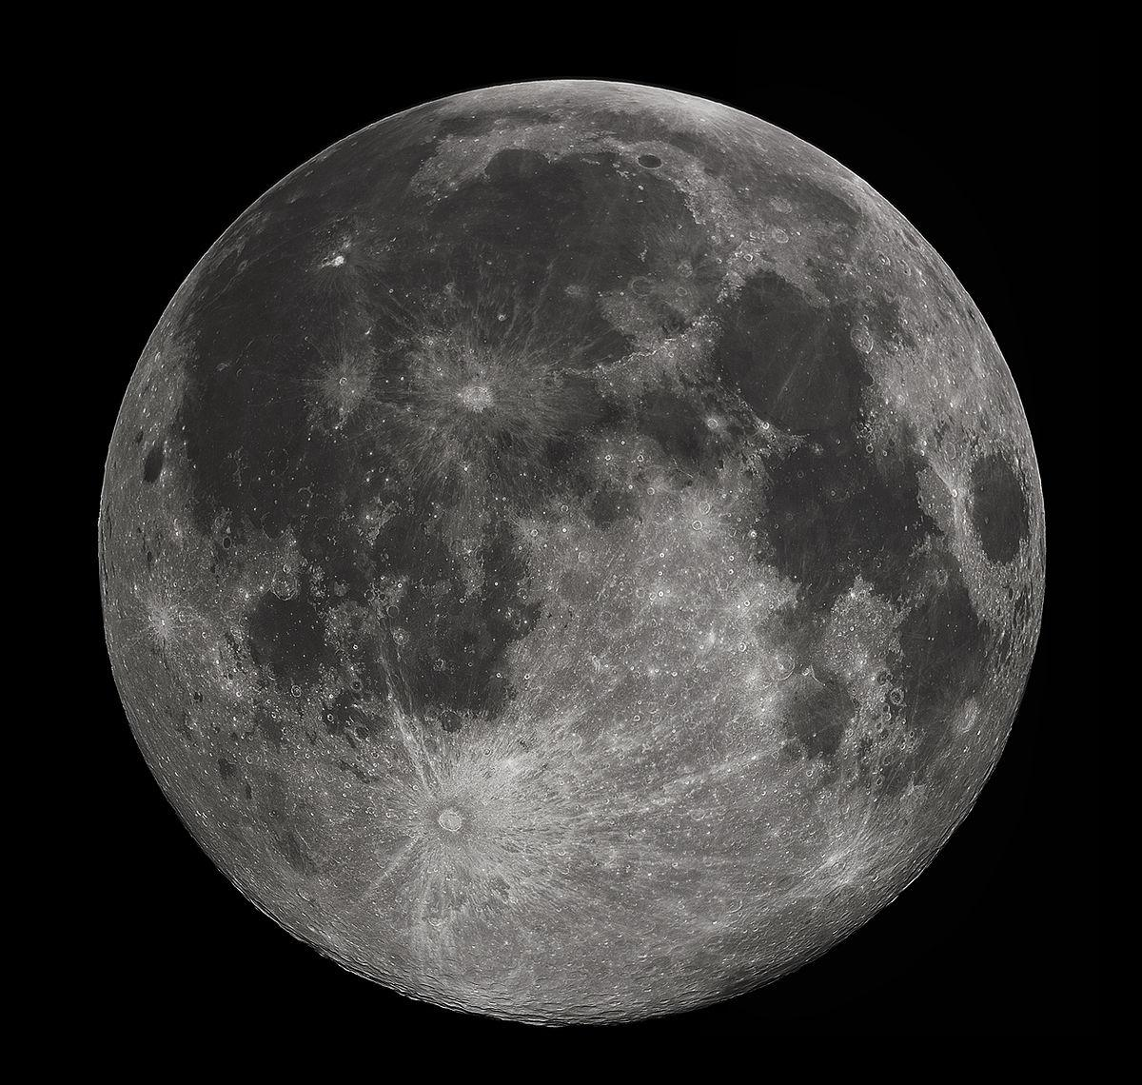
Networked Collaboration Features for Moon Trek
Senior Design 2021 - 2022
Presented By: Sean Chung, Aldo Gil I, Tommy Lay, Allen Marquez, Tam Nguyen, Alex Sahakian, Andy Tsan, Srivats Venkataraman, Jian Wu, Anna Yesayan
Project Advisor: Dr. David Krum
Liaison: Emily Law

Slide 2
01
02
03
04
Agenda
Introduction, Overview & background
Timeline &
Dev Cycle
Wrap up &
Next Steps
Data Flow &
Features
Srivats Venkataraman

Slide 3
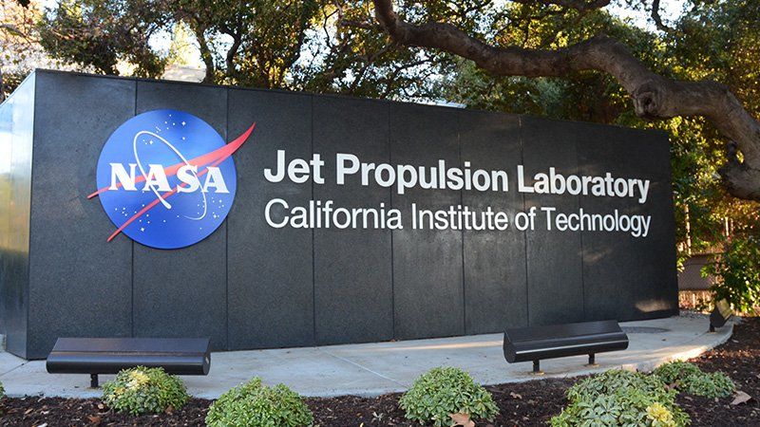
1. Introduction, Overview & Background
Srivats Venkataraman

Slide 4
Introduction
Sponsor
Goal
Jet Propulsion Laboratory (JPL)
Liaison: Emily Law
JPL Team: Eddie Arevalo, George Chang, Richard Kim, Shan Malhotra
Migrate last year’s project to Moon Trek framework
Ensure it meets the deployment standards
Faculty Advisor
Dr. David Krum
Srivats Venkataraman

Slide 5
The Team
Sean Chung | Document Lead
Aldo Gil | Researcher
Tommy Lay | Lead Developer
Allen Marquez | Customer Liaison
Tam Nguyen | Project Co-Lead
Alex Sahakian | Component Lead
Andy Tsan | Researcher
Srivats Venkataraman | Project Lead
Jian Wu | Researcher
Anna Yesayan | Researcher
Jian Wu

Slide 6
Overview
Solar System Treks (SST)
Collaborative Visualization (CV)
Underlying software for Trek Lite
Provides data of planets, asteroids and moons
Gathered by NASA and international space agencies
Provides various features such as satellite images, 3D terrain models etc.
User’s can join rooms to view the same data together- chat capabilities, waypoints, and markup drawings.
Collectively work on new ideas and projects in real time
Ultimately, CV is useful since it will allow people (scientists, students, etc.) analyze the enormous planet surface maps provided by NASA together in real time.
Jian Wu

Slide 7
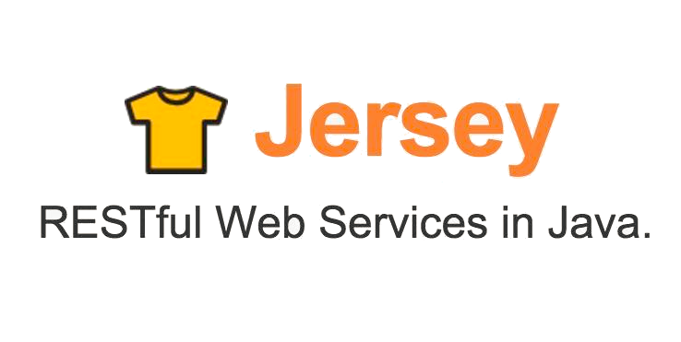
Languages/Framework
Frontend
Backend
Sean Chung

Slide 8
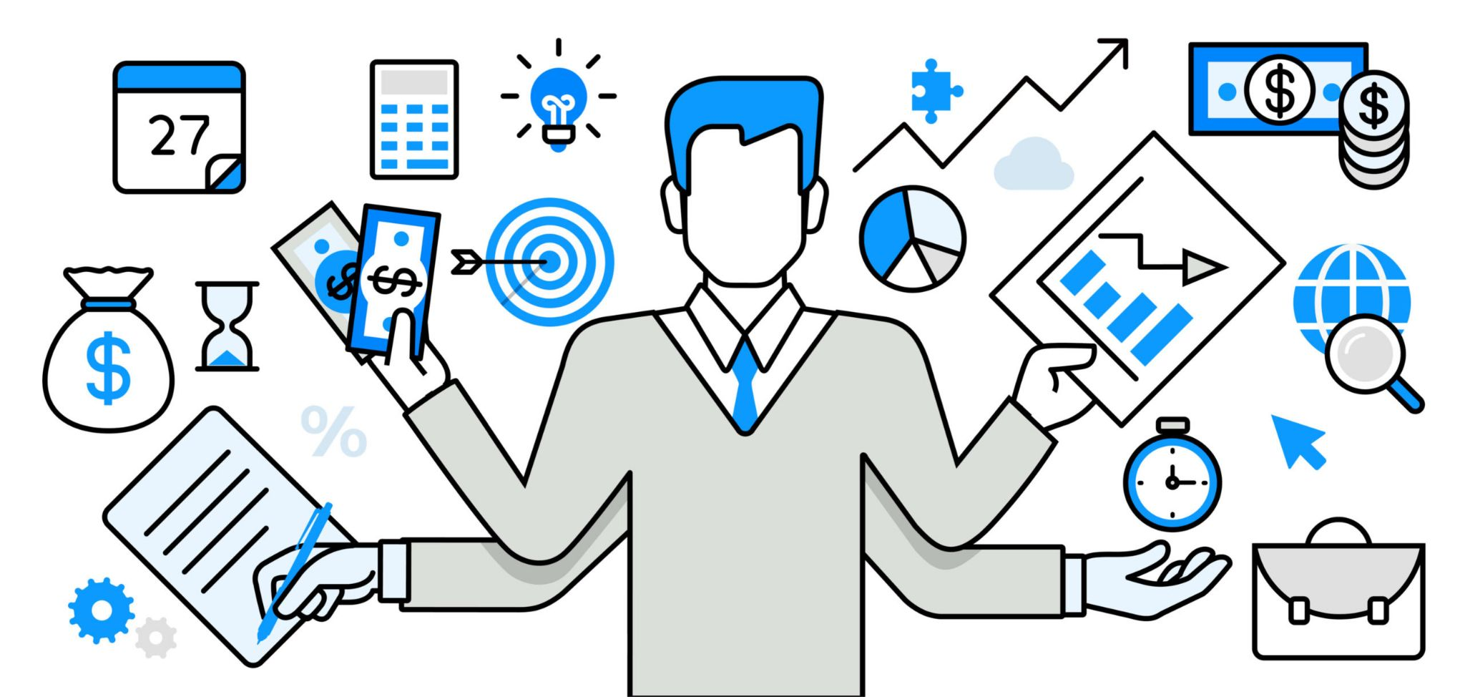
2. Timeline & Dev Cycle
Sean Chung

Slide 9
Project Planning:
Software Development Cycle
Waterfall Project Management
Agile Project Management
More linear methodology of project management
Phases are only begun once the previous phase of the project is completed
Executed during the construction of the SDD and SRS documents and preplanning stages of the software application.
More flexible methodology of project management
Phases are not completely defined
Flexibility to adjust project during development cycle based on feedback
Implemented during the development phase of the software application
Sean Chung

Slide 10
Project Planning: Communication Cycle
Meeting with
JPL Team
Days between meetings
Team Meetings
Preparation for next meeting
Prepare a list of questions or concerns.
Prepare a summary on the status of the project.
Check progress of each member.
Set goals and assign tasks for next week.
Set deadlines.
Discuss ideas and progress.
Raise questions or concerns regarding project.
Work on action items.
Update code base or documentation.
Andy Tsan

Slide 11
3. Data Flow & Features
Tam Nguyen

Slide 12
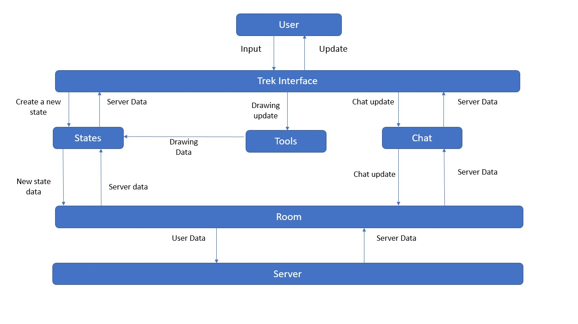
Data Flow
Tam Nguyen

Slide 13
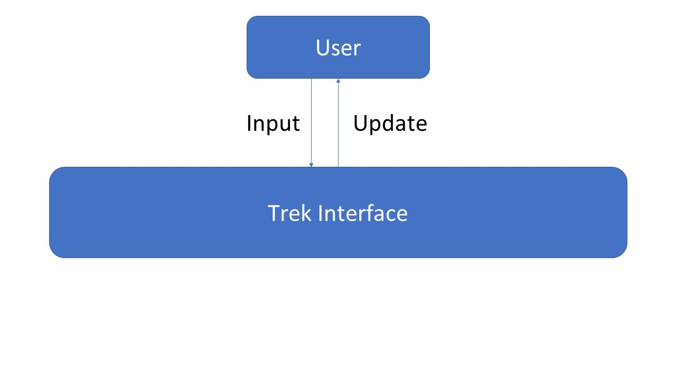
Data Flow
Tam Nguyen

Slide 14
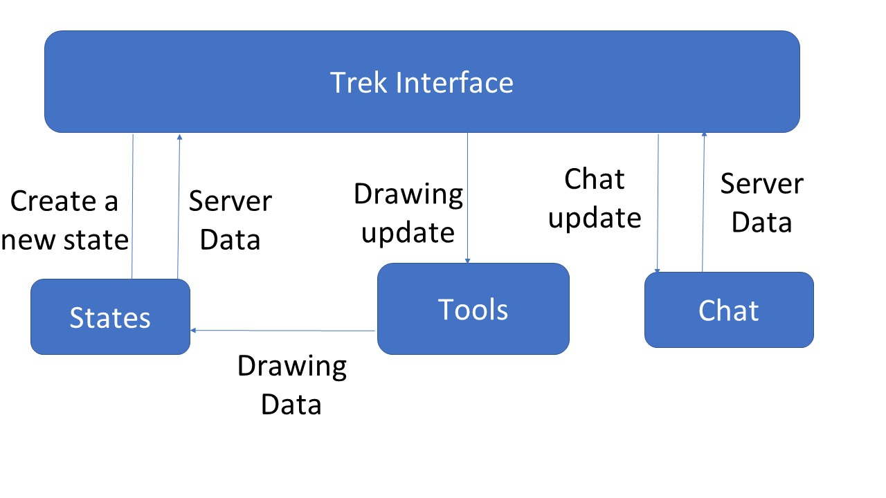
Data Flow
Tam Nguyen

Slide 15
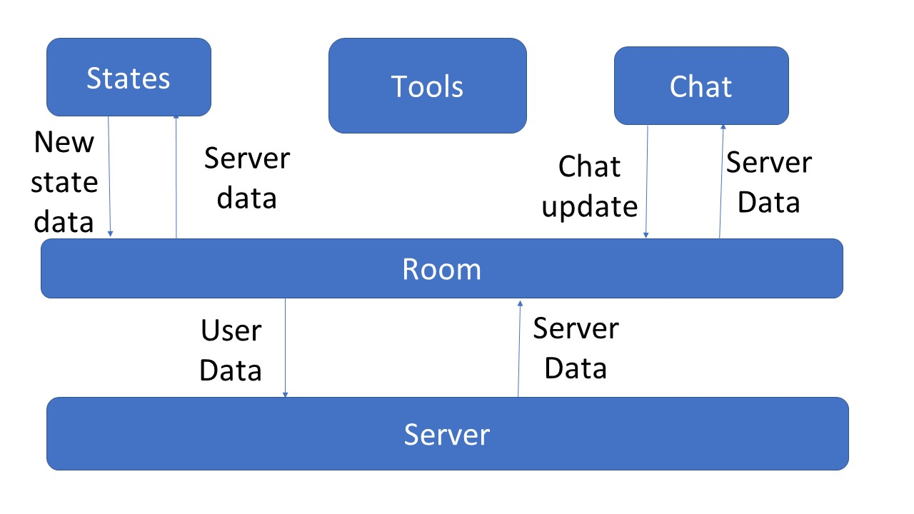
Data Flow
Tam Nguyen

Slide 16
Feature List
Collaboration Rooms Users can create and invite collaborators to rooms for interacting with diagrams
State(s) Users can edit and switch between multiple states
Annotations User have the ability to create markups on the terrain
Waypoints Users have the ability to place markers on the diagram to specify a certain location
Fly To Users can easily pan to a location in the map without having to use the mouse to drag
Text Chat
Users can use the integrated chat system to converse with each other in real-time
Aldo Gil

Slide 17
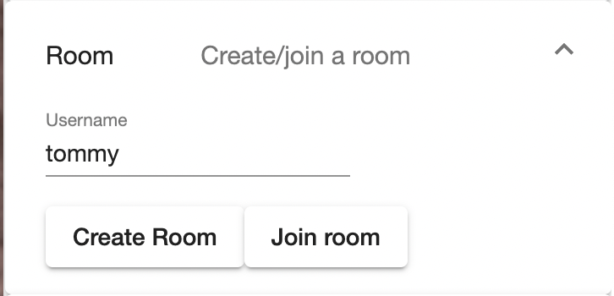
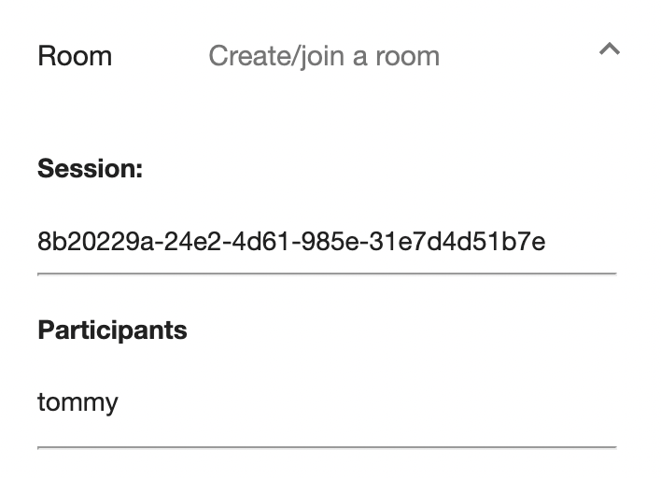
Collaborative Rooms
Accomplishments
Users are able to join or create rooms for collaboration
Users are able to see other users that are within the same room
How It Works
Open the room module located in the menu
Creating a room will generate a session ID
Joining a room will require a session ID
Participants are then showed within the same menu component
Aldo Gil
Notes:
include a picture

Slide 18
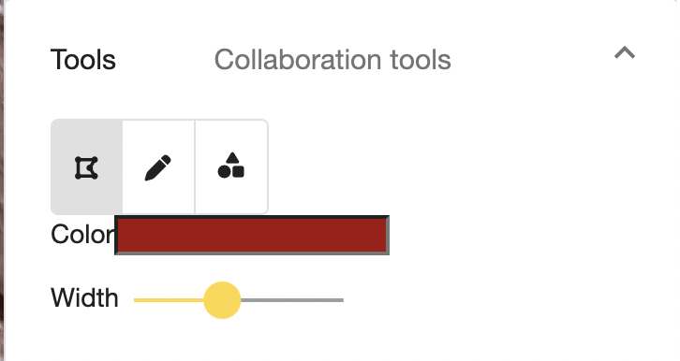
Annotation
Accomplishments
Users are able to use multiple markup tools that include multi line, freehand and shapes
These markup tools provide customization for color and width
All users in a room can see these drawings updated in real-time
How It Works
Select a tool under the tools component
Customize color and width once tool is selected
Drawing on the map
Tommy Lay

Slide 19
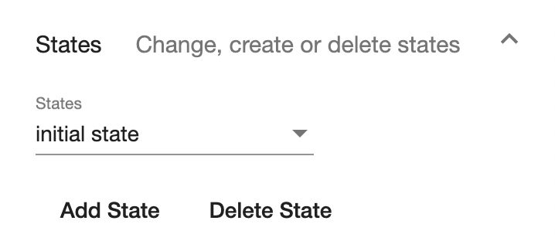
States
Accomplishments
Users are able to create and switch between different states
Multiple users can be working on different states at the same time
How It Works
Switch states by selecting a state in the drop down list
Add a state by clicking on the Add State button
Drawing in a state will only show if you have that state currently selected
Tommy Lay

Slide 20
Waypoints
Accomplishments
Users are able to save waypoints to state
How It Works
Click on the waypoints marker
Click to select a lat/long point on the map
Upon entering the name of the waypoint, this will be saved to the current state
Tommy Lay

Slide 21
Fly To
Accomplishments
Users are able to pan the map to a certain coordinate location, where a temporary graphic will be shown on the exact coordinate
How It Works
Click on the Fly To button and provide a lat, long coordinate
Tommy Lay

Slide 22
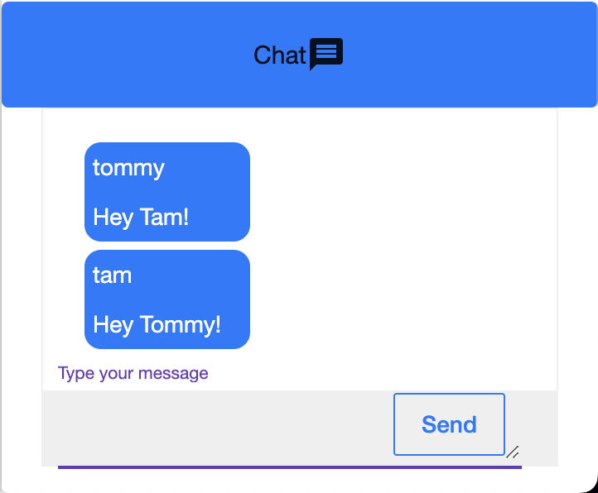
Chat
Accomplishments
Users joined in the same room are able to communicate with each other through text
How It Works
Open the chat component located at the bottom of the window
Messages will send to all clients in the same room
Tommy Lay

Slide 23
4. Wrap up & next steps
Anna Yesayan

Slide 24
Project Timeline
Stage | Timeline
Project Planning | August 30, 2021 - September 24, 2021
System Requirement Documentation(SRD) | September 25, 2021 - October 29, 2021
System Design Documentation(SDD) | November 1, 2021 - November 29, 2021
Design | November 1, 2021 - January 30, 2022
Anna Yesayan

Slide 25
Project Timeline
Stage | Timeline
Implementation | February 1, 2022 - April 8, 2022
Testing | April 9, 2022 - April 22, 2022
Closure | April 26, 2022 - May 5, 2022
Anna Yesayan

Slide 27
Next Steps
01
02
03
04
Allow users to extract and share session states to other users
Add VR and AR functionality to the software application
Improvements on collaborative features
Implement State Management in the frontend
Alex Sahakian

Slide 28
Conclusion
01. Who is this project for?
02. Waterfall & Agile
03. Integration of collaborative features & documentation
04. Accomplishment, Reflection and learning
Allen Marquez
Notes:
Key takeaways from our project:
talk about use cases of the project,
talk about how we had to focus on waterfall methodology this term to finish a majority of our documentation that was needed for this semester,
then transitioning to an agile methodology, talk about our next steps integrating all the features of the prototype into the current system that can integrate with the jpl website. Also talk about continuously updating documentation since we will be in agile where requirements can change rapidly. Then conclude with what our project goal is again

Slide 29
Additional info
SRD & SDD Available:
https://csns.cysun.org/department/cs/project/view?id=7873467
Recorded Vid:
https://youtu.be/Y46aQE65_f0
Anna Yesayan

Slide 32
Thank You!
Does anyone have any questions?

Slide 33
Credits
This is where you give credit to the ones who are part of this project.
Did you like the resources on this template? Get them for free at our other websites.
Presentation template by Slidesgo
Icons by Flaticon
Images created by Freepik, rawpixel, mrsiraphol, kjpargeter, asierromero - Freepik

