Slide 1
CSULA Medtronic
Advisor(s):
Dr. Mohammad Pourhomayoun
Engineers:
Yosep Kim
Christopher Fong
Wun Woo
Koenrad MacBride
Andrew Padilla

Slide 2
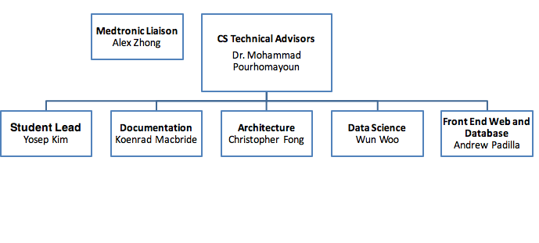
Organizational Chart

Slide 3
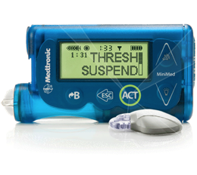
Contents:
Project Background
Project Objectives
Real Time Data Stream
Insight Engine
Prediction Extraction Engine

Slide 4
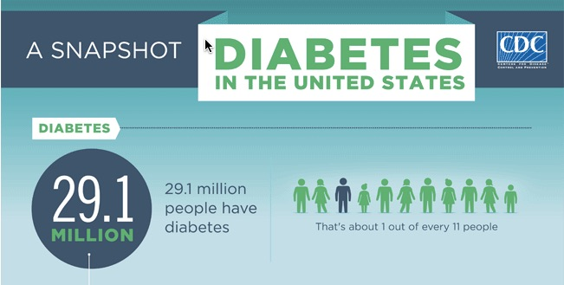
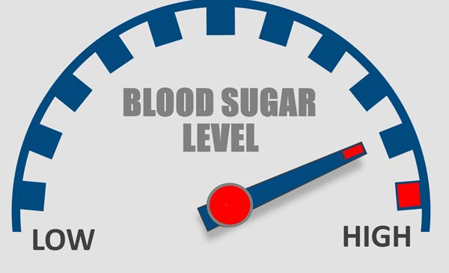
Project Background
What are Diabetes?
CDC: 1 in 11 Diabetes
1 out of 3 adults, 86 million have PreDiabetes
3 in 15 Americans by 2050
Type 1 Diabetes
Type 2 Diabetes
Hypoglycemia
Hyperglycmia

Slide 5
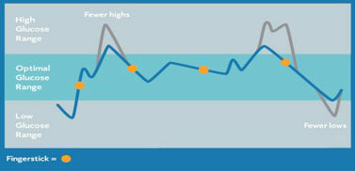
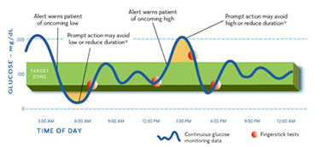
Objectives
Purpose:
The purpose of this project is to design a Microservices Architecture that uses a back-end platform based on data analytics and data science algorithms for predicting the continuous glucose levels of diabetic patients, provide patients with insight and recommendations, and display to each patient in real time.
Notes:
From poster

Slide 6
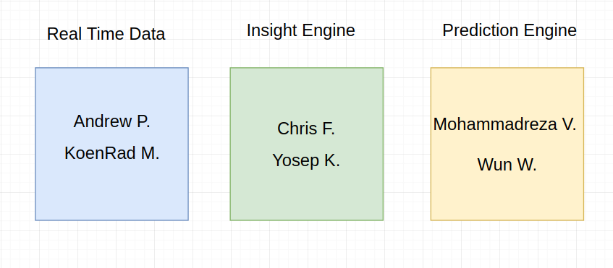
Task Chart

Slide 7
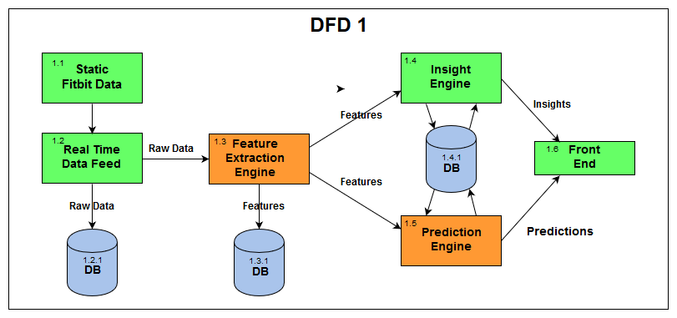
Data Flow Overview

Slide 8
Real Time Data
&

Slide 9
Notes:
Brokers are scalable to accommodate for high data throughput
They are managed by a zookeeper

Slide 10
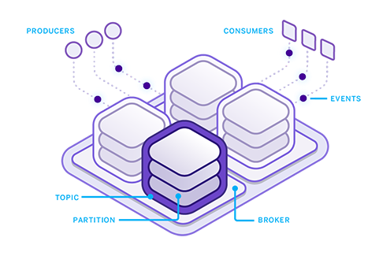
Apache Kafka Implementation
Producer
Processes, “Cleans” and formats data into streams
Our java based producer encapsulates patient JSON data into “data packets”
It also serves as a real time data packet simulation program
“data packets” are sent to the Broker.
Broker
A medium for Consumers to access Producer streams through a topic
Brokers are scalable: many computers can be part of a single broker to accommodate for larger stream throughput.
Consumer
Our consumer is a Storm Spout in our Storm Topology
Our consumer is part of our Feature Extraction Engine.
It takes the main data stream and splits it according to data type.
Notes:
Start with why we need apache kafka (real time data in microservices system, big data)
Process data from many patients into a stream

Slide 11
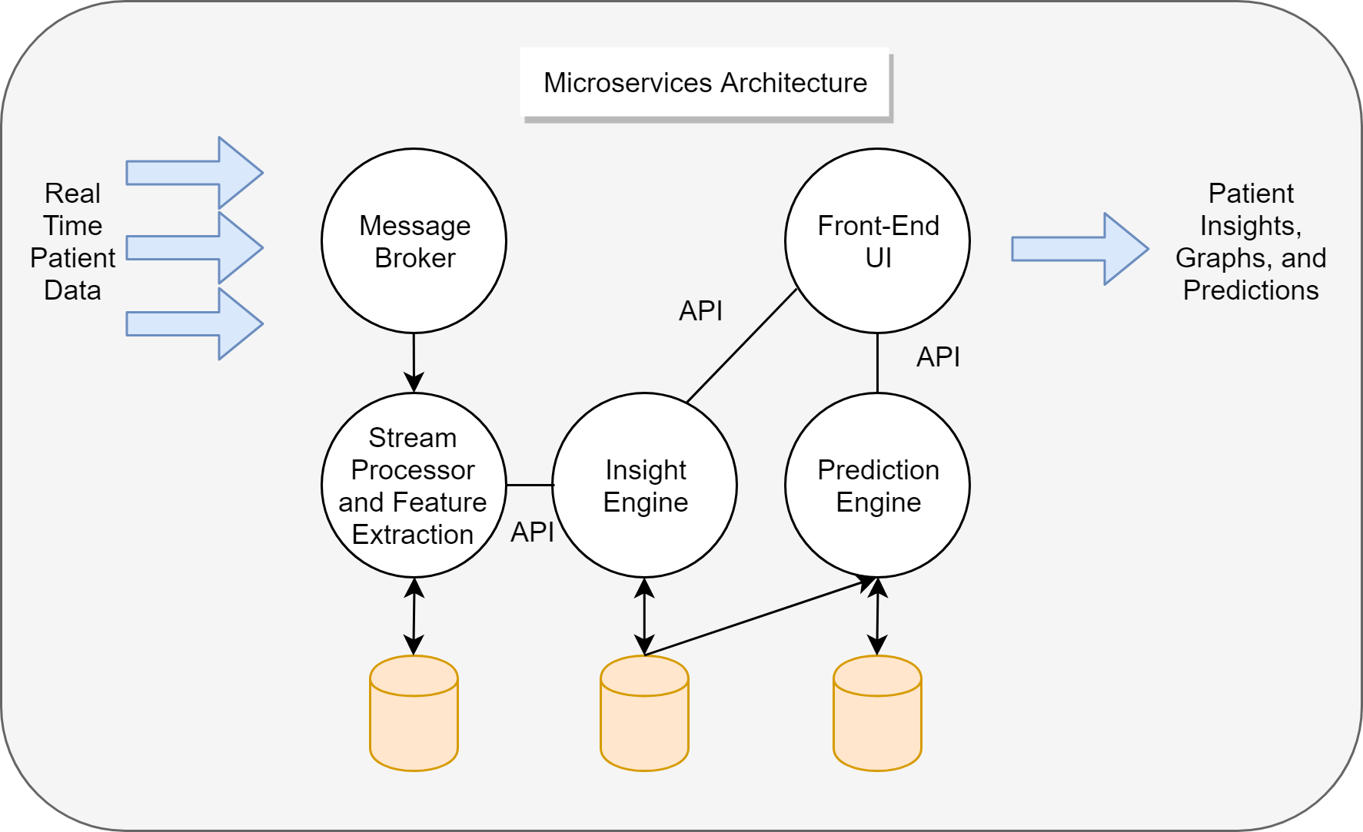
Notes:
Most programs are built using a monolithic architecture.
This means your application is written as one cohesive unit of code whose components are designed to work together, and they share the same memory space and resources
Whereas a Microservice Architecture means that your app is made up of lots of smaller, independent applications capable of running their own memory space and scaling independently from each other.
Microservices are a fairly new technology
Not language dependent **
Monolithic: All code is written in a same language
A microservice can be written in java, and another can be written in python for example.
Each microservice works independently, and communicates with others using an API such as RESTful
Updating Code **
Monolithic: Make sure that when you update code, all parts that it is connected to has to be changed as well
It wont affect other parts of the program when adding more and more microservices.
Scalability ******
Monolithic: can get disorganized when adding more and more to your application.
The bigger your microservice gets, it will still be easy to manage, because you don’t need to update other parts of the project.
2:30

Slide 12
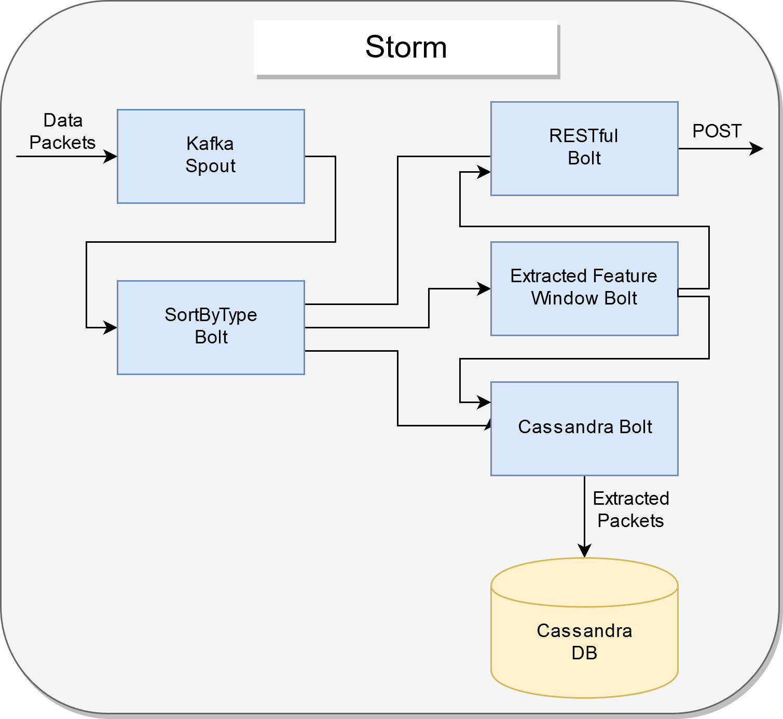
Apache Storm
We use Apache Storm as a real-time stream processing engine
Kafka Spout
Consumes data stream from Kafka topic
SortByType Bolt
Routes main stream into N streams
RESTful Bolt
POSTS raw and extracted data as JSON to Insight engine
Extracted Feature Window Bolt
Applies M-minute sliding window to some data
Easily implement new extracted features in the future
Cassandra Bolt
INSERTS data into Cassandra DB
Notes:
Start with why we need apache kafka (real time data in microservices system, big data)
Process data from many patients into a stream

Slide 13
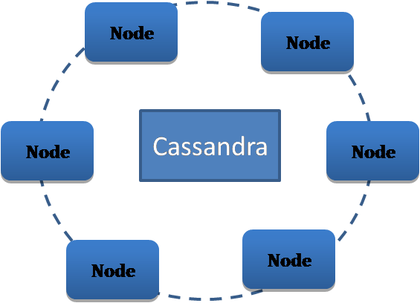
Apache Cassandra DB
Cassandra DB is a noSQL data store by Apache
Cassandra DB 1.2.1 stores raw incoming FitBit and Blood Glucose levels and log by time.
Cassandra DB
1.3.1 stores a superset of data from 1.2.1. It also stores raw data, extracted data and generated insights. It sorts data by newest first.
Cassandra DB
1.4.1 stores personal patient models for prediction.
Notes:
We use cassandra as a database because it is easy to integrate with kafka and it is nosql/

Slide 14
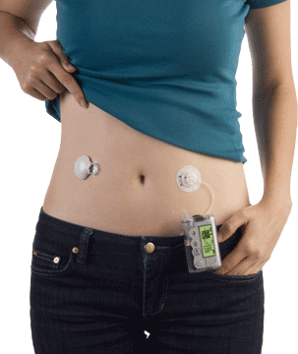
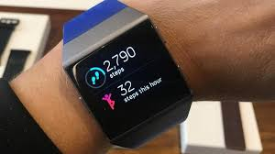
Specific Features of The Json Data
CGM Data
BOLUS_DT | BOLUS_PROGRAMMED_U
BOLUS_DELIVERED_U | BOLUS_DURATION_MIN
BOLUS_TYPE | BOLUS_CR_SETID
BG | MBG
BG_DT | MBG_DT
MARD | BIAS
BW_DT | BW_CR_SETID
BW_TOTAL_ESTIMATE_U | BW_FOOD_ESTIMATE_U
BW_CORRECTION_ESTIMATE_U | . . .
caloriesOut | caloriesOutDt
metabolic | metabolicDt
Steps | StepsDt
floors | floorsDt
heartrate | heartrateDt
mets | metsDt
elevation | elevationDt
minutesAsleep | minutesAwake
timeInBed | . . .
Notes:
Fitbit devices that count floors have an altimeter sensor that can detect when you're going up or down in elevation. Your device registers one floor when you climb about ten feet at one time. It does not register floors when you go down.
Bolus = unit of insulin delivered

Slide 15
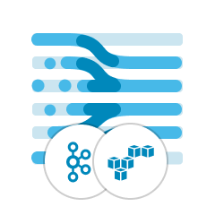
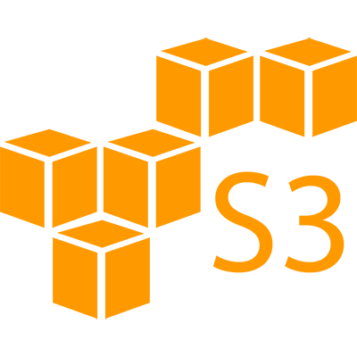
Data Packet Simulator
Our Kafka Producer is equipped with a data packet simulator.
The simulator takes existing patient JSON data and creates data packets per feature per patient then puts them into a list.
The simulator relies on the Cassandra DB to sort the packets by date and time and transmits data to the Kafka Producer when processing has completed
Each data packet contains a Patient ID, Data Type, Data Value and TimeStamp
Notes:
Fitbit devices that count floors have an altimeter sensor that can detect when you're going up or down in elevation. Your device registers one floor when you climb about ten feet at one time. It does not register floors when you go down.

Slide 16
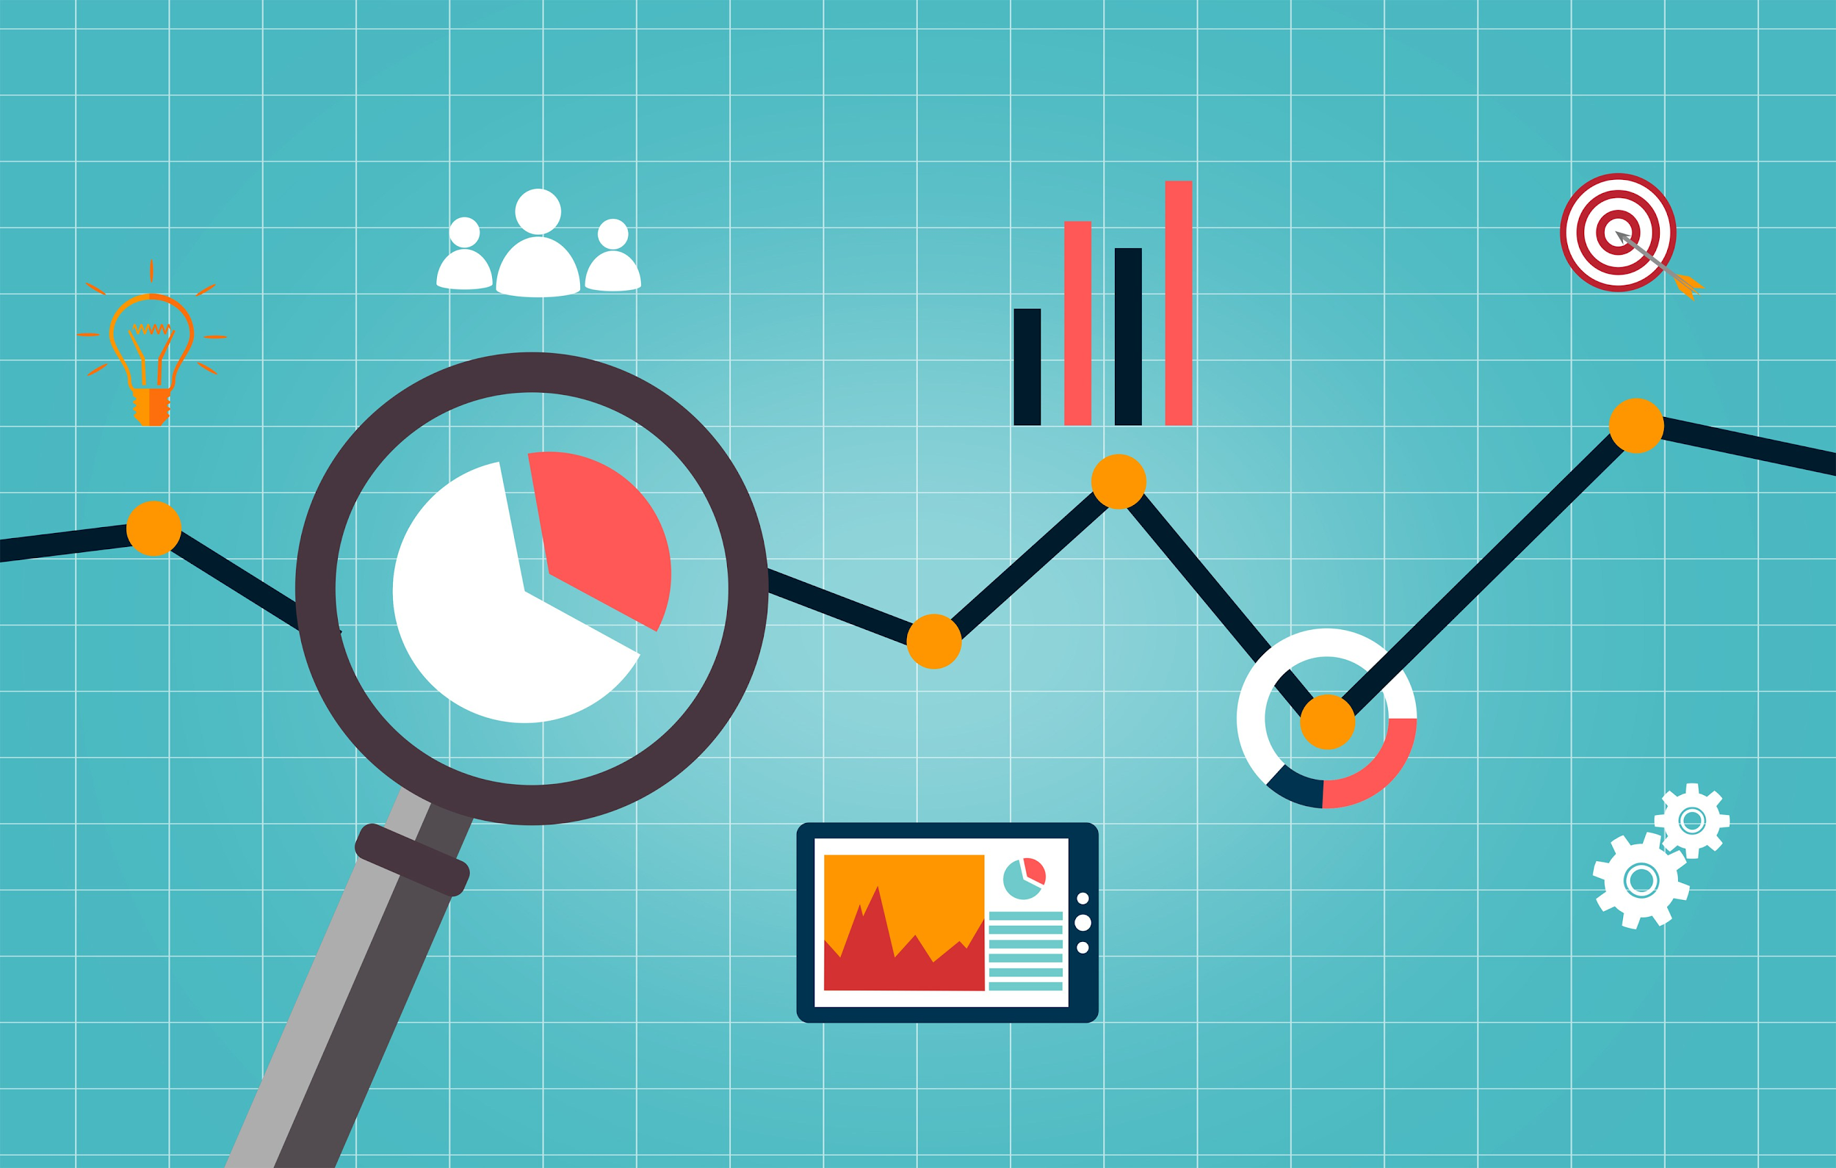
Insight Engine
Notes:
The insight engine provides insights and recommendations to patients and their caregivers, as ways to improve their medical conditions.
such as giving suggestions to reduce their hyperglycemia and hypoglycemia levels.

Slide 17
Steps
Data Preprocessing
Feature Extraction
Generate Insights
Display Insights to user
Notes:
The Insight Engine takes in Sensor Glucose Data, Fitbit Data, and Nutritional Data as raw JSON and will preprocess the data, which transforms the data to be used by the model.
The engine then extracts features from the preprocessed data. Some examples of features extracted are, Duration of hyperglycemia events, hypoglycemia events, Duration of sleep, and Number of carbohydrates consumed in a day.
Then, based on the data that it receives, it will automatically generate insights for each individual patient.
The insights are then displayed as a suggestion, accompanied with a graph, to help each patient monitor their sugar levels better.

Slide 18
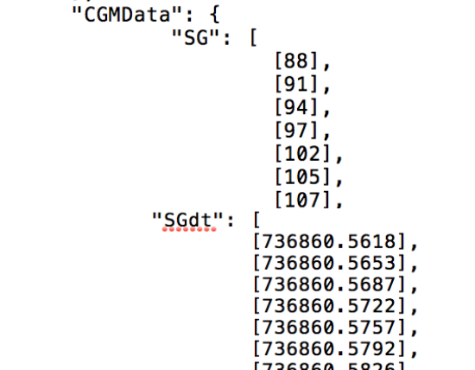
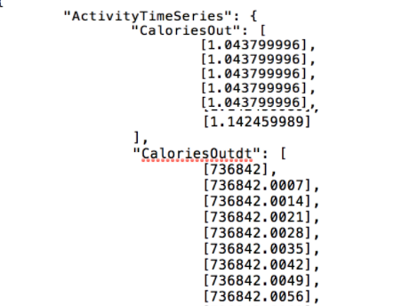
Patient Data
Notes:
This is an example of the json data that we received from medtronic before it goes through preprocessing

Slide 19
Notes:
Here is the Dataframe after preprocessing and feature extraction
Some features shown here are hyper hypo etc.
And they are averaged or summed up daily

Slide 20
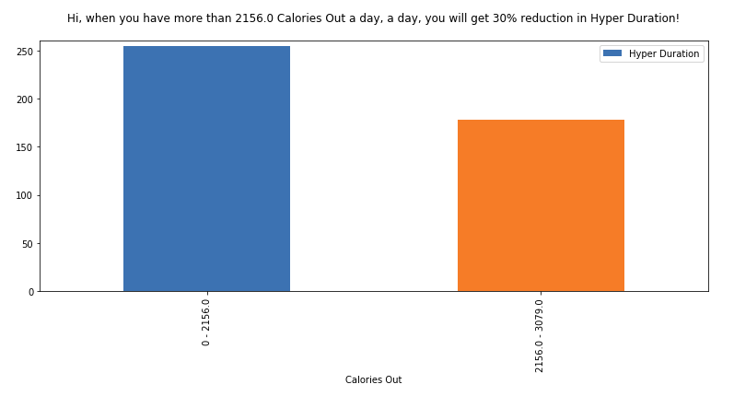
Hyper Duration vs Calories Out
Notes:
Example of the insight and recommendation provided to a patient based on historical data of the patient
In this case,
It comes up with this insight, finds a threshold for the calories out
And recommends the patient to do a certain amount of exercise to get a 30% reduction in hyperglycemia
The insight engine does this personally for each individual patient, because not all patients are the same

Slide 21
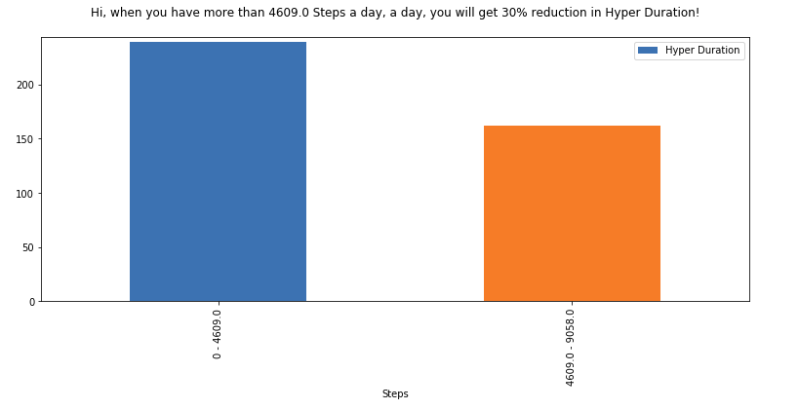
Hyper Duration vs Steps

Slide 22
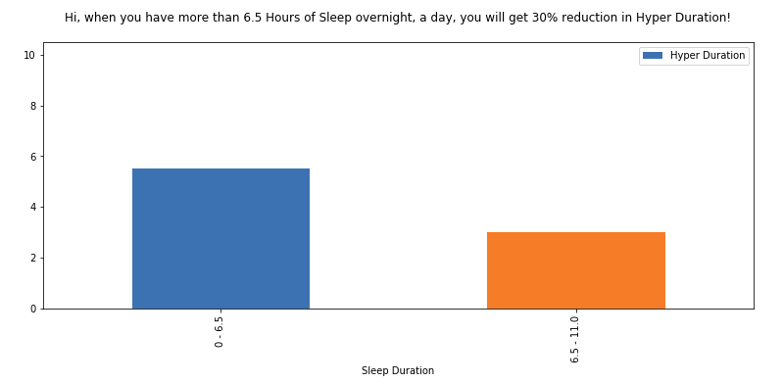
Hyper Duration vs Sleep Duration

Slide 23
Prediction Engine

Slide 24
Method
1. Data Preprocessing
194,891 data samples for all patients
2. Missing Value Imputation
Step 1 (personalized missing value imputation)
Step 2 (overall missing value imputation)

Slide 25
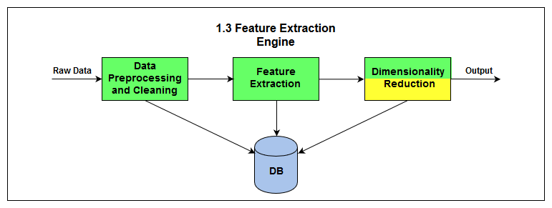
Method
3. Feature Extraction
2 hour and 6 hour
93 features
4. Feature Selection
The highest score

Slide 26
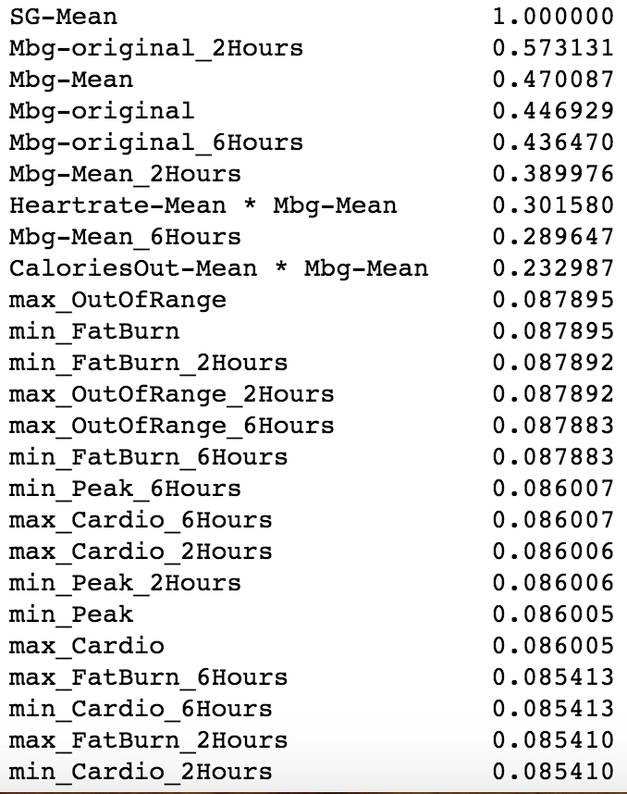
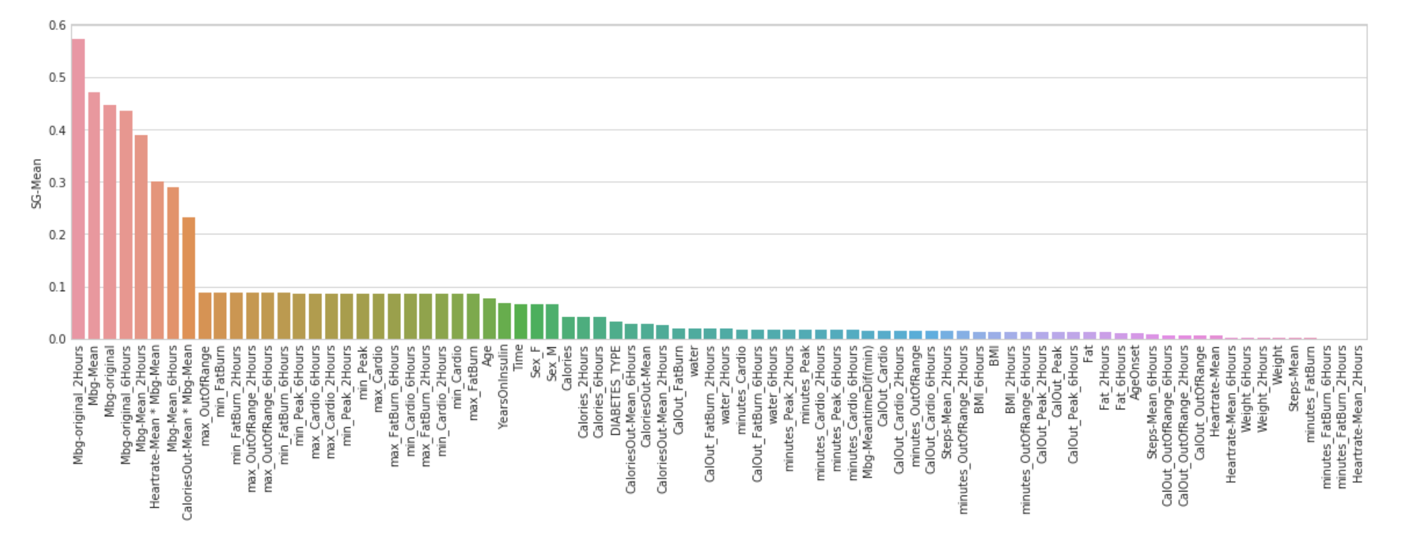
Feature Selection

Slide 27
Machine Learning
1. Random Forest Regressor
2. Neural Network algorithm
Notes:
mean absolute percentage deviation

Slide 28
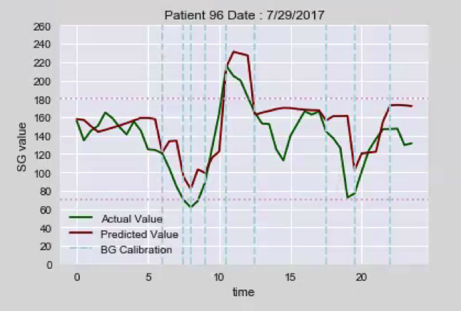
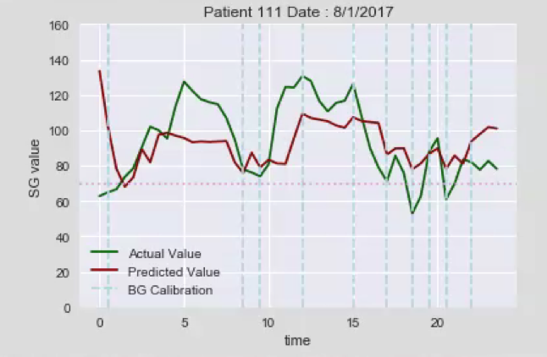
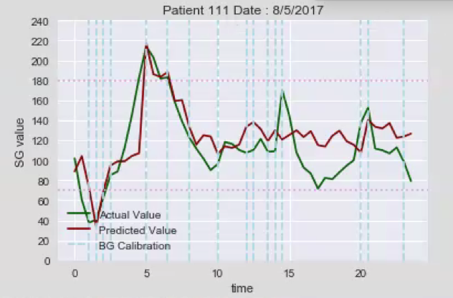
Results and Conclusion
Notes:
Predictive engine result

Slide 29
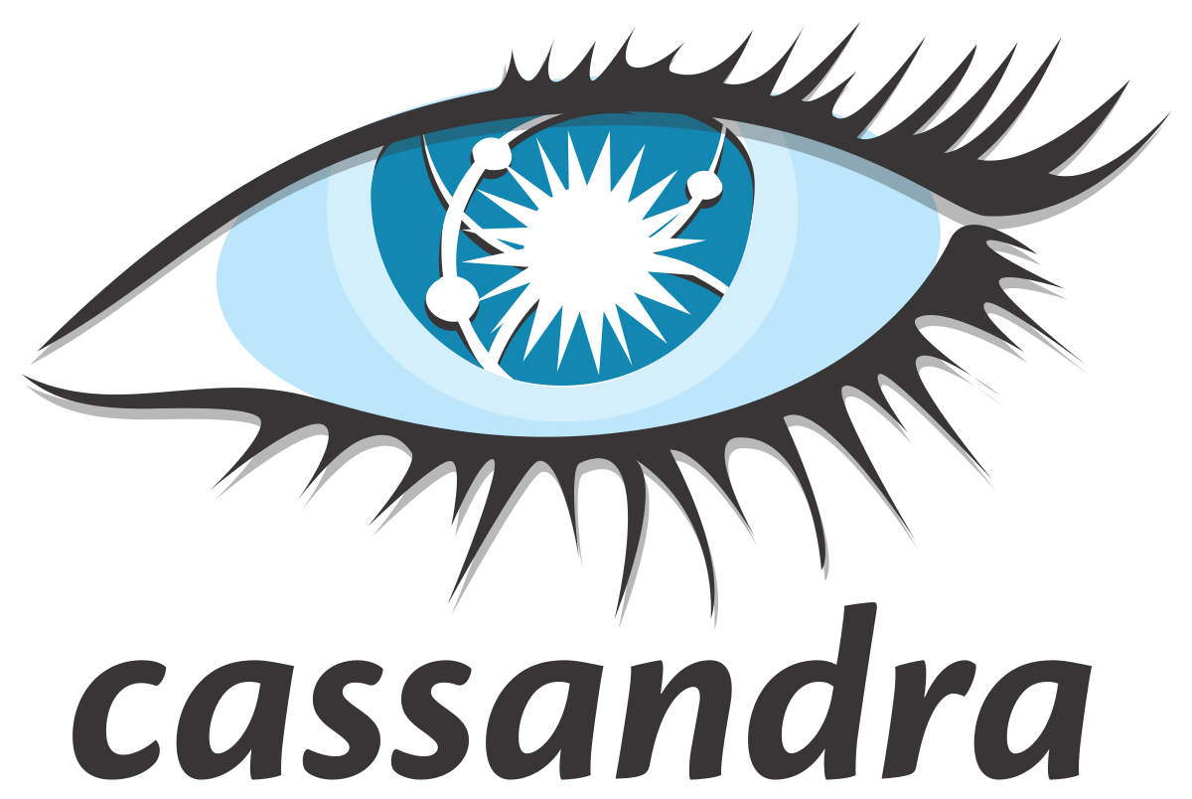
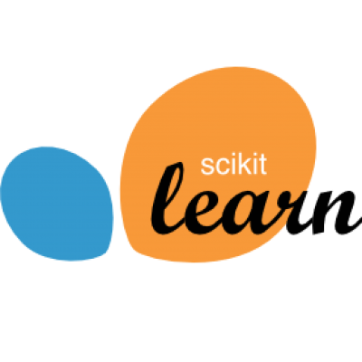
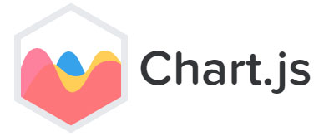
Technologies
Notes:
Cite submitted , based on this research we have done, Mohammad V. has have written a research paper for submission for
K. Sawada, M. W. Clark, Z. Ye, N. Alshurafa, and M. Pourhomayoun, “Predictive Analytics to Determine the Potential Occurrence of Genetic Disease and their Correlation: Osteoporosis and Cardiovascular Disease,” the Proceeding of The Tenth International Conference on Bioinformatics, Biocomputational Systems and Biotechnologies, 2018.

Slide 30
Thank You!
M. Reza, Y. Kim, C. Fong, W. Woo, A. Padilla, K. Macbride, and M. Pourhomayoun, “Predicting Continuous Blood Glucose Levels in Type 1 Diabetic Patients Based on Physiological and Activity Data,” Proceeding of The Fourteenth International Conference on Data Science, 2018.
Notes:
It’s worth mentioning that this research led to a research paper that will be submitted to the 14th International Conference on Data Science

