Slide 1
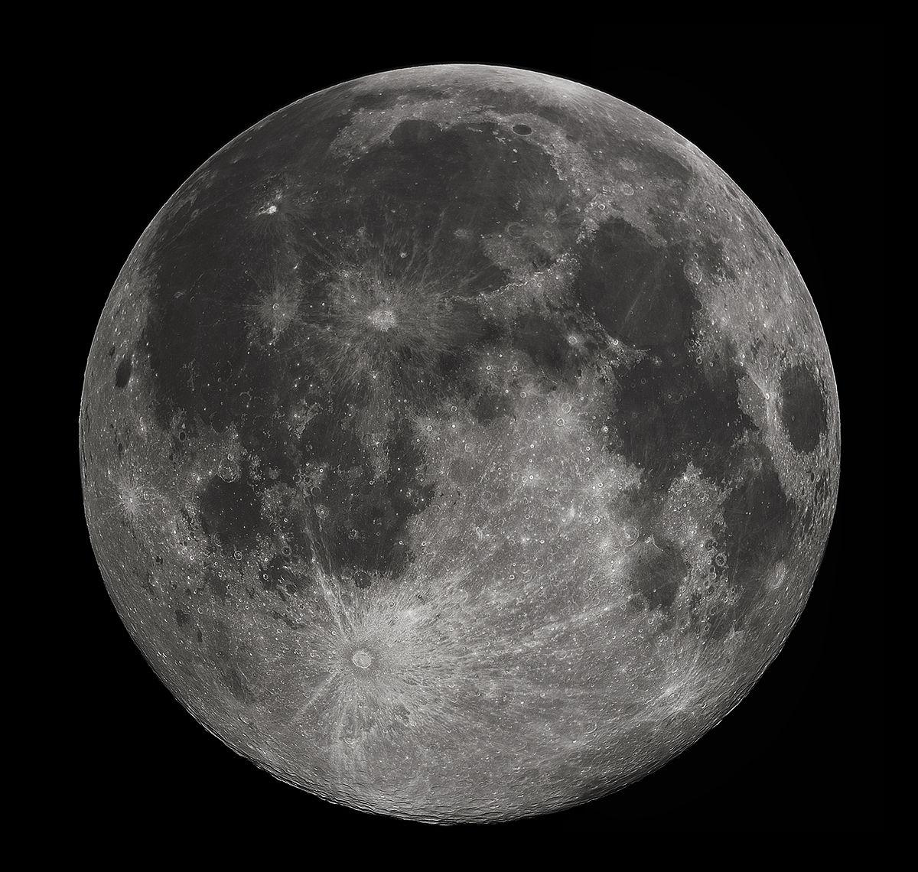
Networked Collaboration Features for Moon Trek
Senior Design 2021 - 2022
Presented By: Sean Chung, Aldo Gil I, Tommy Lay, Allen Marquez, Tam Nguyen, Alex Sahakian, Andy Tsan, Srivats Venkataraman, Jian Wu, Anna Yesayan
Project Advisor: Dr. David Krum
Liaison: Emily Law

Slide 2
01
02
03
04
Agenda
Introduction & Overview
Project Planning
Project Timeline & Next steps
Requirements
Presented By: Srivats Venkataraman

Slide 3
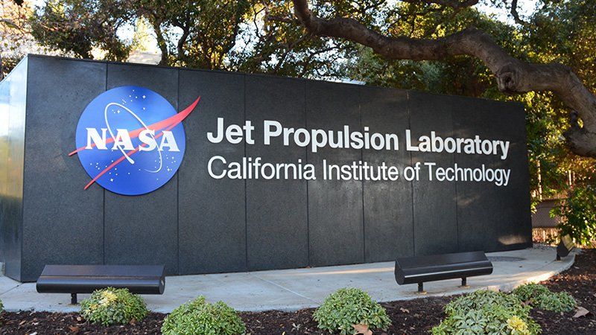
1. Introduction & Overview
Presented By: Srivats Venkataraman

Slide 4
Introduction
Sponsor
Goal
Jet Propulsion Laboratory (JPL)
Liaison: Emily Law
JPL Team: Eddie Arevalo, George Chang, Richard Kim, Shan Malhotra
Migrate last year’s project to moon trek lite
Ensure it meets the deployment standards
Presented By: Srivats Venkataraman

Slide 5
The Team
Project Advisor: Dr. David Krum
Team Members:
Sean Chung Document Lead
Aldo Gil Researcher
Tommy Lay Presentation Lead
Allen Marquez Customer Liaison
Tam Nguyen Project Co-Lead
Alex Sahakian Component Lead
Andy Tsan Researcher
Srivats Venkataraman Project Lead
Jian Wu Researcher
Anna Yesayan Researcher
Presented By: Jian Wu

Slide 6
Overview
Collaborative Visualization (CV)
Solar System Treks (SST)
Provides data of Planets, asteroids and Moon
Gathered by NASA and International Space agencies
Provides various features such as satellite images, 3D terrain models etc.
User’s can join rooms to view the same data together
Collectively work on new ideas and projects in real time
Presented By: Jian Wu

Slide 7
Last Year’s
Progress
Collaboration Rooms Users can create and invite other individuals into collaboration rooms to interact with the diagram.
Annotations User have the ability to draw and comment on the surface diagrams.
Import/Export State Users can import/export states of a given terrain and it’s current markups
Waypoints Users have the ability to place markers on the diagram to specify a certain location.
Text Chat
Users can use the integrated chat system to converse with each other in real-time.
Presented By: Aldo Gil

Slide 8
Problems
Dojo Toolkit Issues
Nodejs Backend
Presented By: Aldo Gil
Notes:
add pictures or text here

Slide 9
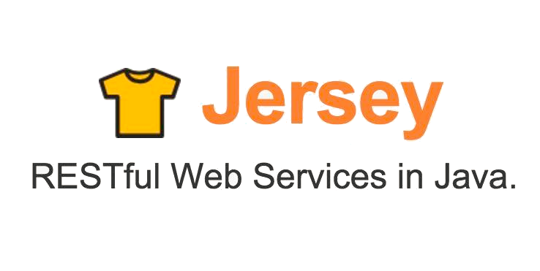
Tools
Presented By: Aldo Gil

Slide 10
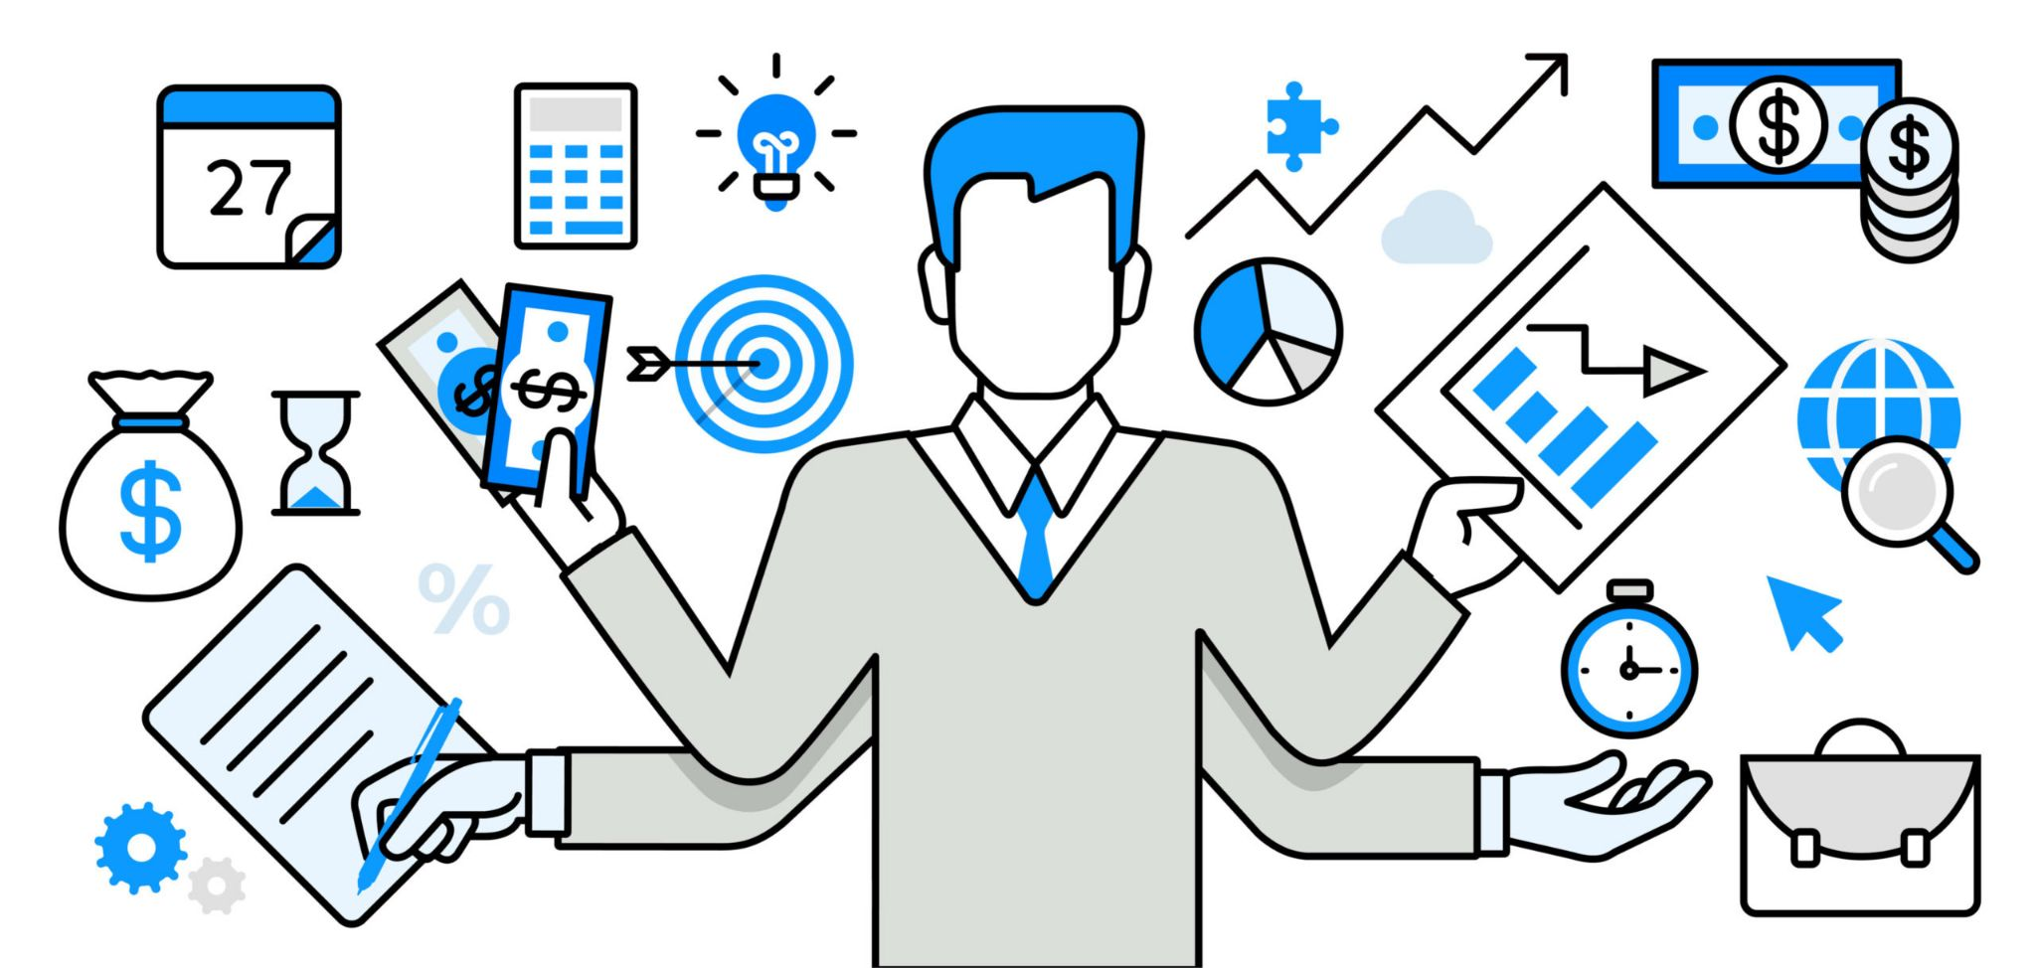
2. Project Planning
Presented By: Andy Tsan

Slide 11
Project Planning
Communication
Planning
Execution
Define goals and deadlines
Define responsibilities of each member
Create predefined meeting topics
Analyze code base
Identifying Deliverables
Zoom
Outlook Mail
Discord
Work on assigned portion of project
Update team on current status of project
Presented By: Andy Tsan

Slide 12
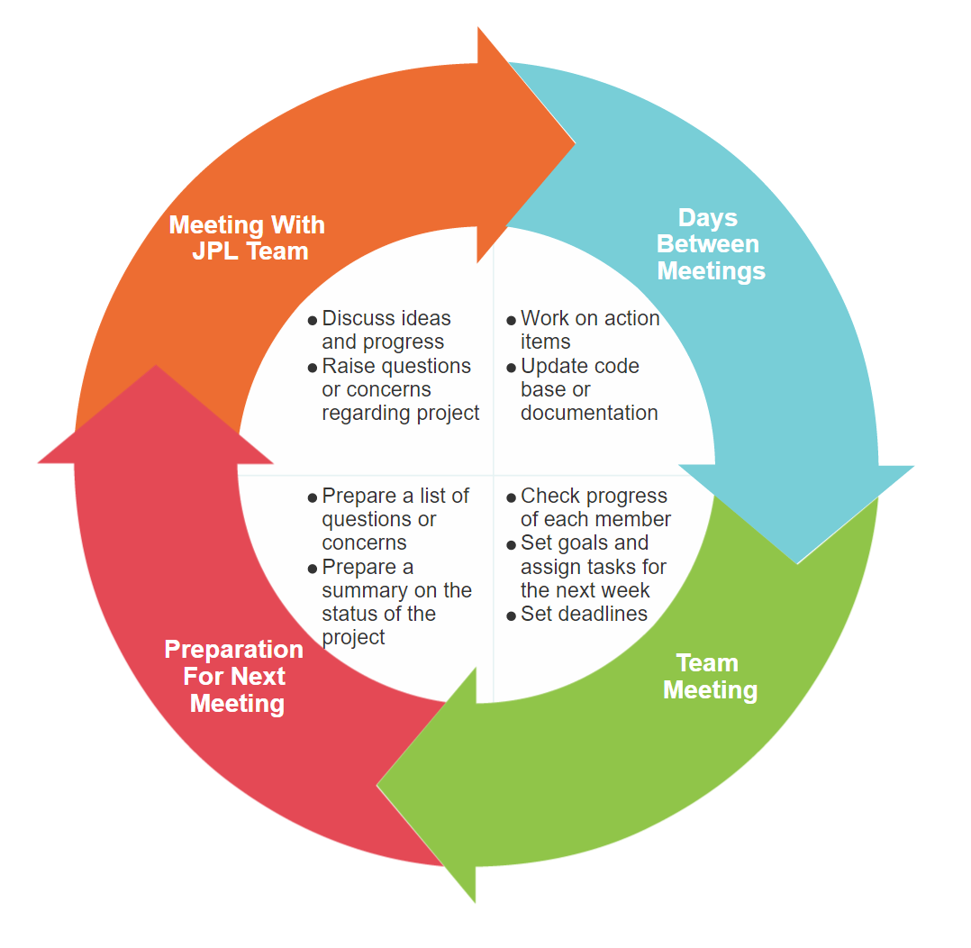
Project Planning: Communication Cycle
01
02
04
03
Presented By: Sean Chung

Slide 13
Project Planning:
Software Development Cycle
Waterfall Project Management
Agile Project Management
More linear methodology of project management
Phases are only begun once the previous phase of the project is completed
Executed during the construction of the SDD and SRS documents and preplanning stages of the software application.
More flexible methodology of project management
Phases are not completely defined
Flexibility to adjust project during development cycle based on feedback
Will be implemented during the development phase of the software application
Presented By: Sean Chung

Slide 14
3. Requirements
Presented By: Tam Nguyen

Slide 15
- Functional
Requirements
- Non-Functional Requirements
Presented By: Tam Nguyen

Slide 16
Functional Requirements
2d/3d Annotations
Collaborative Sessions
Host Admin Powers
Waypoints
States
Presented By: Tommy lay
Notes:
4.1.1 The system shall allow users to host a “collaborative session”
4.1.2. The system shall provide tools for markup onto 2D/3D Solar System terrain in varying sizes and colors.
4.1.3 The system shall allow users to create interactive navigation waypoints on 2D/3D Solar System terrain.
4.1.4 The system shall provide administrative powers to a session’s host.
4.1.5 The system shall allow users to create multiple “SST states” (See Section 1.4) within a session.
4.1.6 The system shall allow users to save their current “SST state”.
Don’t forget to mention that most of the visual examples are taken from last years prototype.
2d/3d annotations
collaborative session

Slide 17
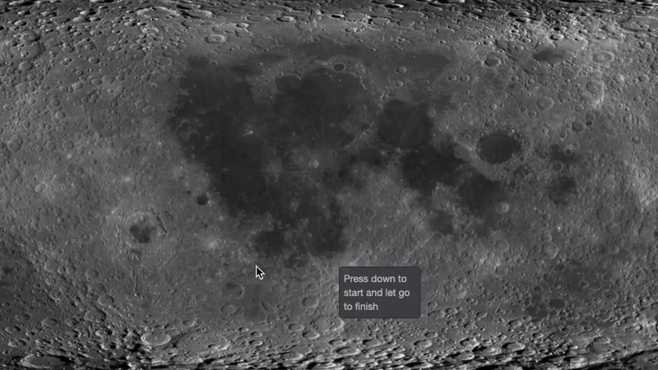
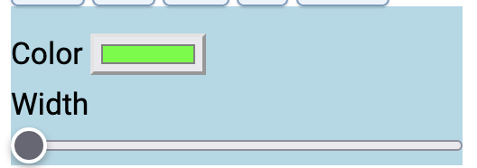
2d/3d Annotations
Different drawings, colors, width
Freehand annotation
Changing color/width
Presented By: Tommy lay

Slide 18
Collaborative Session
Reflecting visuals amongst users in the same room
User 2
User 1
Presented By: Tommy lay

Slide 19
Collaborative Session
Text communication system
User 1
User 2
Presented By: Tommy lay

Slide 20
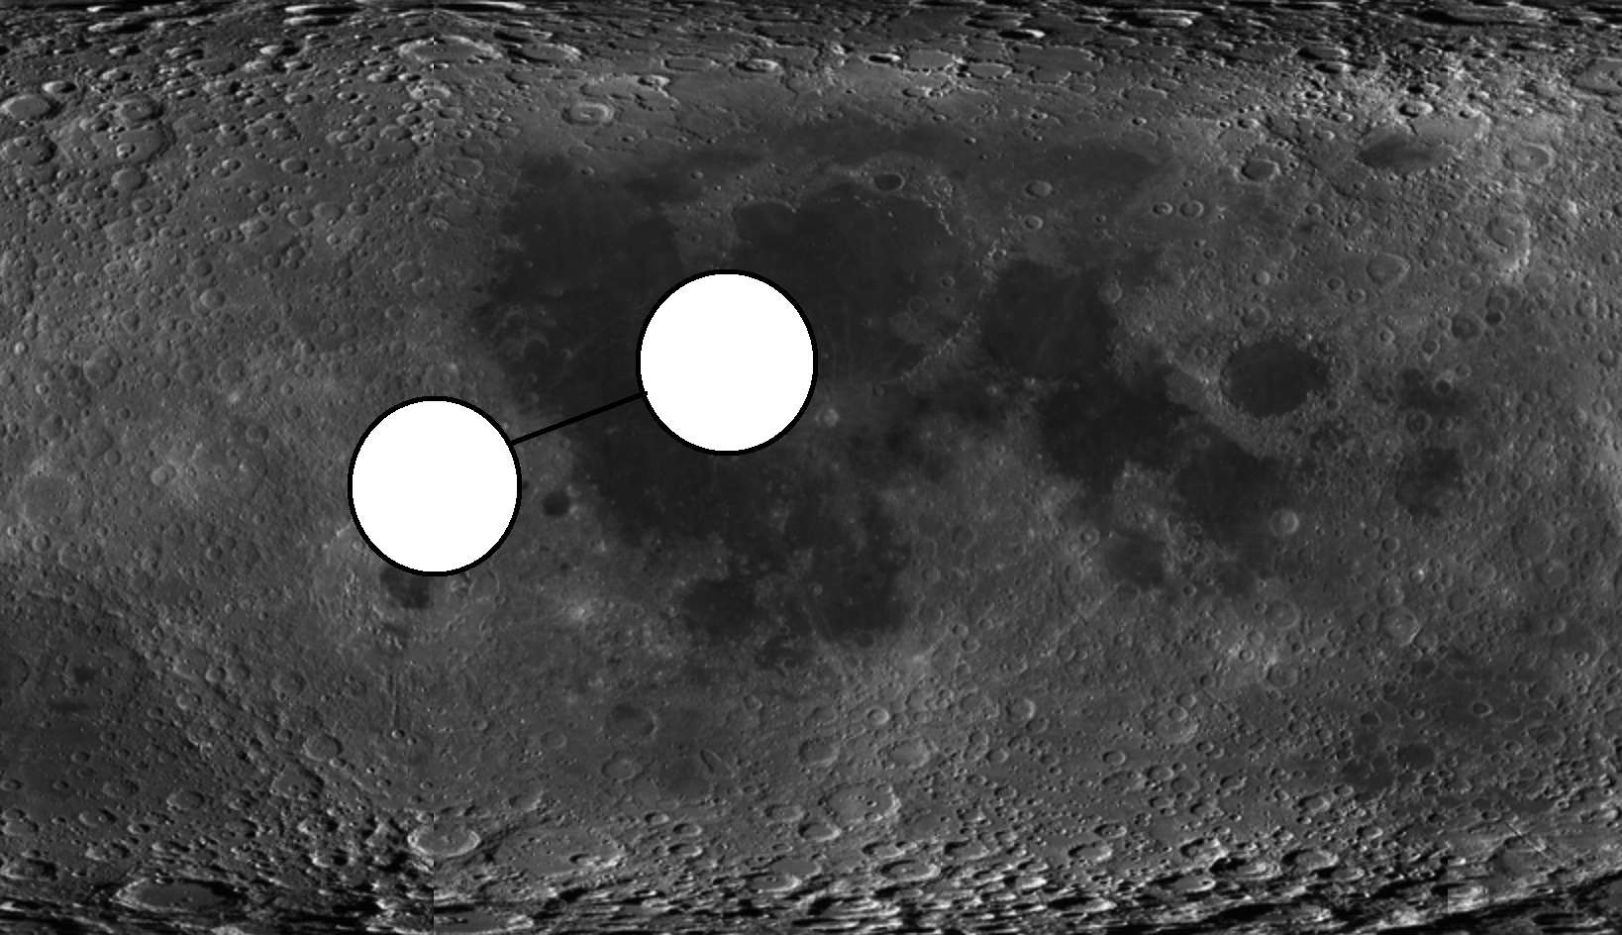
Waypoints and Host Admin
Creating Navigational Waypoints
Disabling Tools as Admin
Presented By: Tommy lay
Notes:
talk about waypoints requirement

Slide 21
States
Presented By: Tommy lay
Notes:
talk about states requirement

Slide 22
Non-Functional Requirements
Presented By: Tam Nguyen

Slide 23
4. Project Timeline & Next Steps

Slide 24
Project Timeline
Project Planning 8/30/21-9/24/21
Requirements
-SRD, SDD 9/25/21-10/29/21, 11/1/21-11/29/21
Design 11/1/21-1/10/22
Implementation 1/10/22-3/1/22
Testing 3/1/22-5/2/22
Closure 5/2/22-5/15/22
Presented By: Anna Yesayan

Slide 25
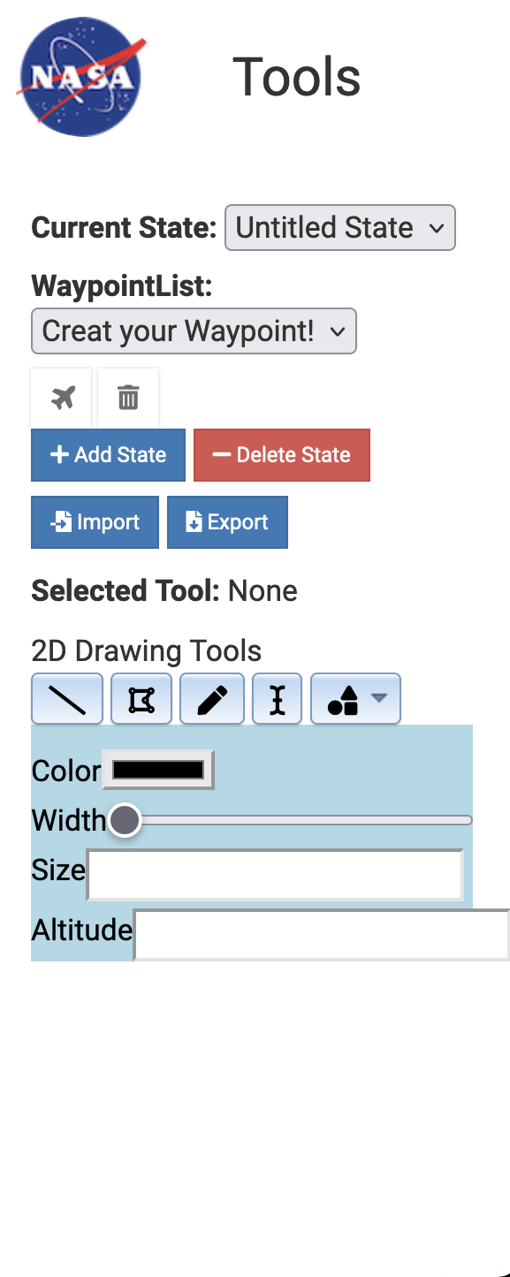
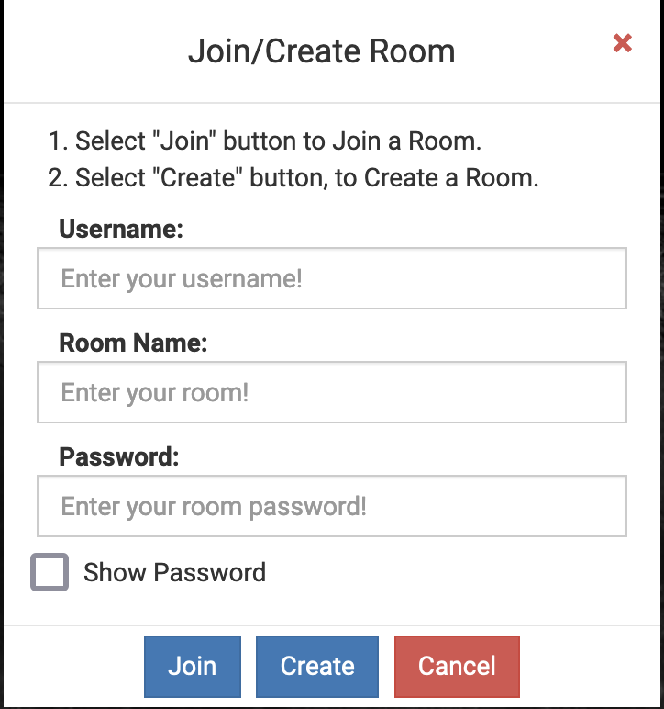
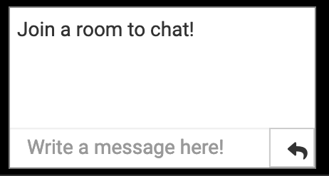
Next Steps
Getting UI components added to the system
Presented By: Alex Sahakian
Notes:
Talk about how our immediate next steps is to work on ui features, we have split our group into 5 teams of two to work on first ui features for our first sprint

Slide 26
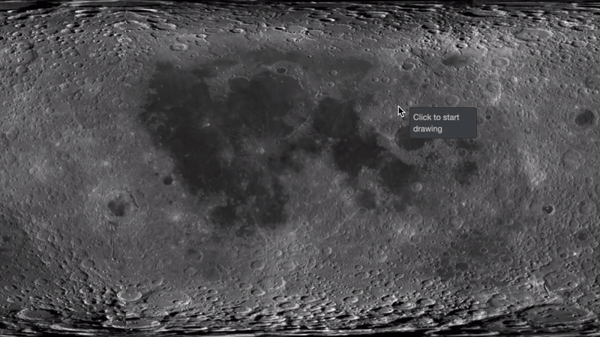
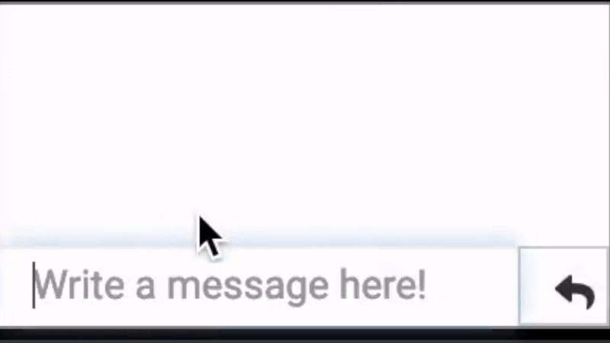
Next Steps
Creating websocket server for collaboration
Presented By: Alex Sahakian
Notes:
Talk about how our immediate next steps is to work on ui features, we have split our group into 5 teams of two to work on first ui features for our first sprint

Slide 27
Conclusion
-Who is this project for?
-Waterfall and Agile
-Integrating collaborative features and documentation
-This years goal
Presented By: Allen Marquez
Notes:
Key takeaways from our project:
talk about use cases of the project,
talk about how we had to focus on waterfall methodology this term to finish a majority of our documentation that was needed for this semester,
then transitioning to an agile methodology, talk about our next steps integrating all the features of the prototype into the current system that can integrate with the jpl website. Also talk about continuously updating documentation since we will be in agile where requirements can change rapidly. Then conclude with what our project goal is again

Slide 28
Thank You!
Does anyone have any questions?

Slide 29
Credits
This is where you give credit to the ones who are part of this project.
Did you like the resources on this template? Get them for free at our other websites.
Presentation template by Slidesgo
Icons by Flaticon
Images created by Freepik, rawpixel, mrsiraphol, kjpargeter, asierromero - Freepik

