Slide 1
QTC PDF Web Viewer

Slide 2
QTC Senior Design Team Composition
Cristian Corrales (Team Lead)
Sean Ybarra (Software Architect)
Phoebe Castanedo (Software Architect)
Chandel Buelna (Lead Software Engineer / Project Planner)
David Sanchez (Documentation Author / Project Planner)
Ares Ton-That (Documentation Author)
Brandon Gonzalez (Quality Assurance)
Joaquin Robles (Quality Assurance)
Roman Arias (Public Relations)
Ares Ton-That

Slide 3
Overview of QTC
Who they are
QTC is the largest provider of disability and occupational health examination services.
QTC was founded in 1981 on the principles of Quality, Timeliness, and Customer Service.
QTC has spent over 35 years focusing on delivering high quality technology-driven exam solutions for their clients.
What they do
QTC provides medical examination and diagnostic testing services.
QTC offers a complete one-stop shop for medical, disability and occupational health services.
Since 2000, they have been conducting approximately 9 million physical examinations and reports.s Ton-Th
Ares Ton-That
Notes:
Ares Ton-That

Slide 4
Initial Project: Provider Credential Web Portal
Problem: QTC needed a more efficient way of recording medical providers’ credentials spread across various medical credential websites and validating the data.
Possible Solution: A web crawler that would auto populate an entry field tool with client information and would periodically match the recorded data.
Roman Arias

Slide 5
Initial Project: Provider Credential Web Portal
The web crawler would auto populate a data entry tool with the required information such as
License Numbers
Names
Expiration Dates
Etc
The data gathered would be checked for accuracy by checking it against provider websites such as these.
Roman Arias

Slide 6
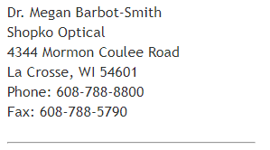
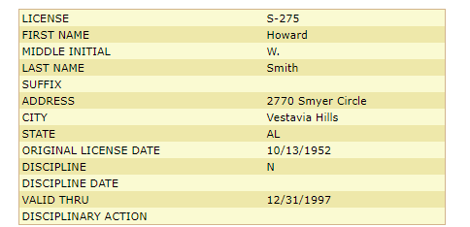
Initial Project: Provider Credential Web Portal
Arkansas Optometry Board
Alabama Board of Optometry
Roman Arias

Slide 7
Research regarding previous projects
Goal: To automate the process of validating QTC’s medical data via web crawler
What we did:
Searched for an API or endpoint to assist in structuring software
Researched how the websites structured their data
Brandon Gonzalez

Slide 8
Research regarding previous projects
Problems with the project
Legal issues regarding web crawler
Unique web crawler for each website
Some websites require payment for accessing data
Some websites had captchas to access data
No API or endpoints
Brandon Gonzalez

Slide 9
Research regarding previous projects
Legal Issues
Some websites prohibit web crawling
The management of sensitive data can potentially be leaked
May fall under commercial use, can be problematic
Brandon Gonzalez

Slide 10
Research regarding previous projects
Automation
The process was mainly done by hand
Reduce the manual work as much as possible
Reduce or eliminate input errors by employee
Joaquin Robles

Slide 11
Research regarding previous projects
Web Crawler
Website layouts vastly different from one another
Captchas presented an issue
Initially feasible; eventually impractical
Joaquin Robles

Slide 12
Research regarding previous projects
Lacking tools
There was no clear API to utilize with the sites
Endpoints would have helped but were not available
Open source software was not looked into before project was dropped
Joaquin Robles

Slide 13
Current Project: PDF Web Viewer
Problem: QTC requested an efficient way to view and sort through multiple medical records.
Possible Solution: A web based PDF viewer application that would concatenate files and sort through them using their metadata.
Roman Arias

Slide 14
Current Project: PDF Web Viewer
Using a PDF viewer software our application would be able to open folders of medical record PDFs and concatenate them into one view.
Within the application the user would be able to sort through the medical records using their metadata.
Ex. Using the keyword ‘Pediatric’ the application would then show related records.
Roman Arias

Slide 15
Research regarding current project
PDF Web Viewer/Filter
Grab Multiple PDF files and display them onto a web browser as 1 seamless document
Filter documents through metadata and keywords
Atalasoft
3rd party software that would allows us to display the files onto the web browser.
Can do multiple functions but we wanted
Insert, reorder, remove, concatenate modify
Pricey
Chandel Buelna

Slide 16
Atalasoft DotImage SDK
Front end viewer control
Displays document stored in any accessible web repository
Displays multipage documents
Easily add viewing, scanning, converting, editing, and annotating to your web, mobile and desktop applications
DotImage supports the ability to convert an image from a supported format to a PDF
Chandel Buelna

Slide 17
Research: 3rd party software
Search for an alternative
Doconut
PDF Kit
DocuVieware
Dynamic PDF
Aspose.PDF
All potential alternatives to Atalasoft
Variety of features
Modify, merge, append, split, View, cut, reorder
David Sanchez

Slide 18
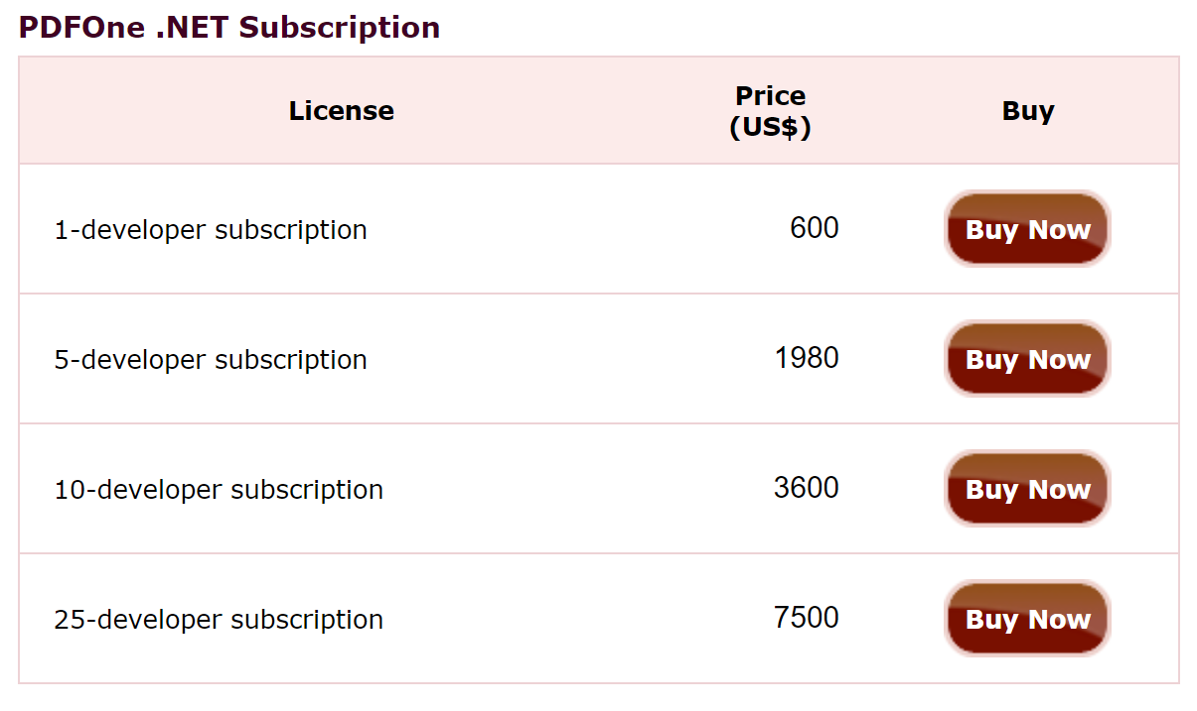
Pricing
Too expensive
Majority of the Software were Per Developer
License
Acquired an Atalasoft license
Atalasoft DotImage SDK
Move forward with our project
David Sanchez

Slide 19
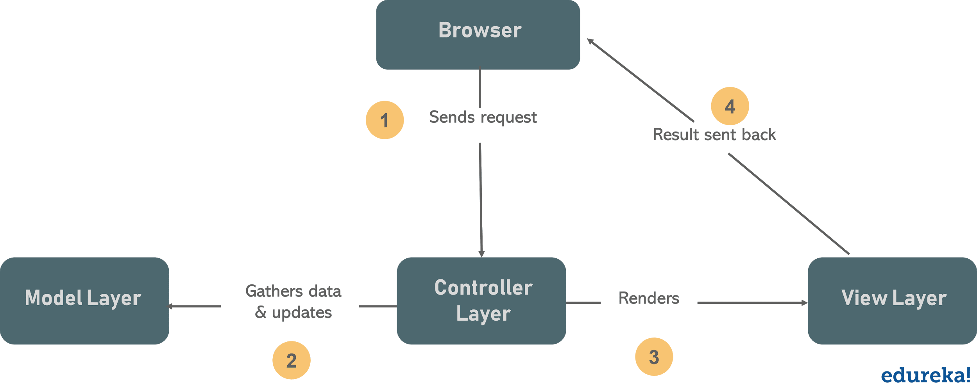
Methodology: MVC
MVC Architecture
Model, View, Controller
A way to design and structure web applications
The Model processes data, the View presents it, and the Controller acts as intermediary between the two
It is popular for its separation of low-level (data handling, logic) and high-level (user interface) processes
████
Phoebe Castanedo

Slide 20
Methodology: ASP .NET and C#
ASP .NET
open-source framework from Microsoft for web development
An extension of the more generic .NET framework
back-end code is in C#, F#, or Visual Basic
integrates with JS frameworks
Development takes advantage of its integration in VS with MVC
Vs. alternatives (e.g Django/Python, Spring/Java)?
ASP .NET meets the standards of QTC's web applications
Other pros of ASP .NET over others: extensive documentation, plenty of 3rd party libraries, preferred by many companies for dependability
Phoebe Castanedo

Slide 21
Project Structure
The overall project structure can be reduced down to 3 key features:
1.) PDF viewer with file cluster concatenation,editing, and searching features.
2.) Uploading and downloading files PDF files to QTC’s company’s database.
3.) A simple yet robust GUI that meets QTC’s UI/UX standards.
Additional feature can be implemented after completing these three.
Sean Ybarra

Slide 22
Main Functionality
The main functionality of this web application is to allow users to view, search, and parse PDF files that correlate to respected clients.
This will be achievable through the MVC architecture of ASP.NET framework.
The Atalasoft SDK.
concatenating PDFs will be implemented in the controllers.
Additional modifications in conjunction with Atalasoft SDK will achieve desirable search/parsing results .
Sean Ybarra

Slide 23
Receiving and Storing PDF Documents
Locally stored PDF files will be used to help with testing.
This aims to help simplify testing of the main functionality of the application.
QTC’s databases will the practical location to store files post development.
PDF files will be stored on a QTC database for security purposes.
Requests to pull and update PDF files will be handled by SQL queries through controllers.
Sean Ybarra

Slide 24
Graphical User Interface (GUI)
The GUI focuses on the overall aesthetic of the user interface as well as the overall user experience of the web application.
will consist of HTML,CSS,Bootstrap,and javascript.
They will be registered as views for the corresponding controllers they are meant to serve.
The UI will have to meet the aesthetics of QTC, while UX will be intuitive and simple to understand. Both UI and UX will be in accordance with the standards of QTC.
Sean Ybarra

Slide 25
Additional Features
Collaboration over contract negotiation is an essential part of the agile development process, and applies to the overall structure of the project.
Although the essential functions have been laid out according to their precedence that doesn’t imply that other features can’t be added later on.
This means that any other additions to the functionality of the application will be added only after the completion of the 3 main features listed.
Sean Ybarra

Slide 26
QTC’s Transition to Agile Development
QTC initially designed software using the Waterfall Model.
The Waterfall Model is highly inefficient and ineffective (Linear Progression).
QTC started searching for a new development strategy, but continued using the Waterfall Model.
Huge software failure in 2013.
QTC transitioned to Agile Development to improve efficiency and prevent future software failures.
QTC analytics demonstrated that Agile development drastically improved software production.
No additional major software failures.
Ares Ton-That

Slide 27
Agile - What is Agile
What is Agile?
Individuals and interactions over processes and tools
Working software over comprehensive documentation
Customer collaboration over contract negotiation
Responding to change over following a plan
Cristian Corrales

Slide 28
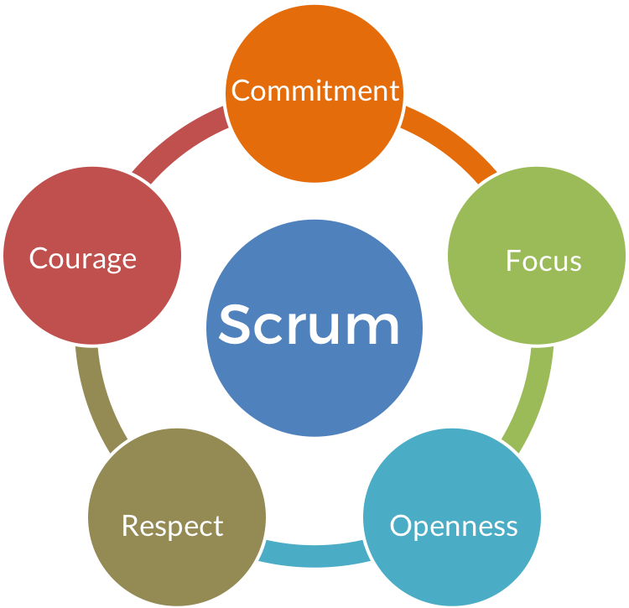
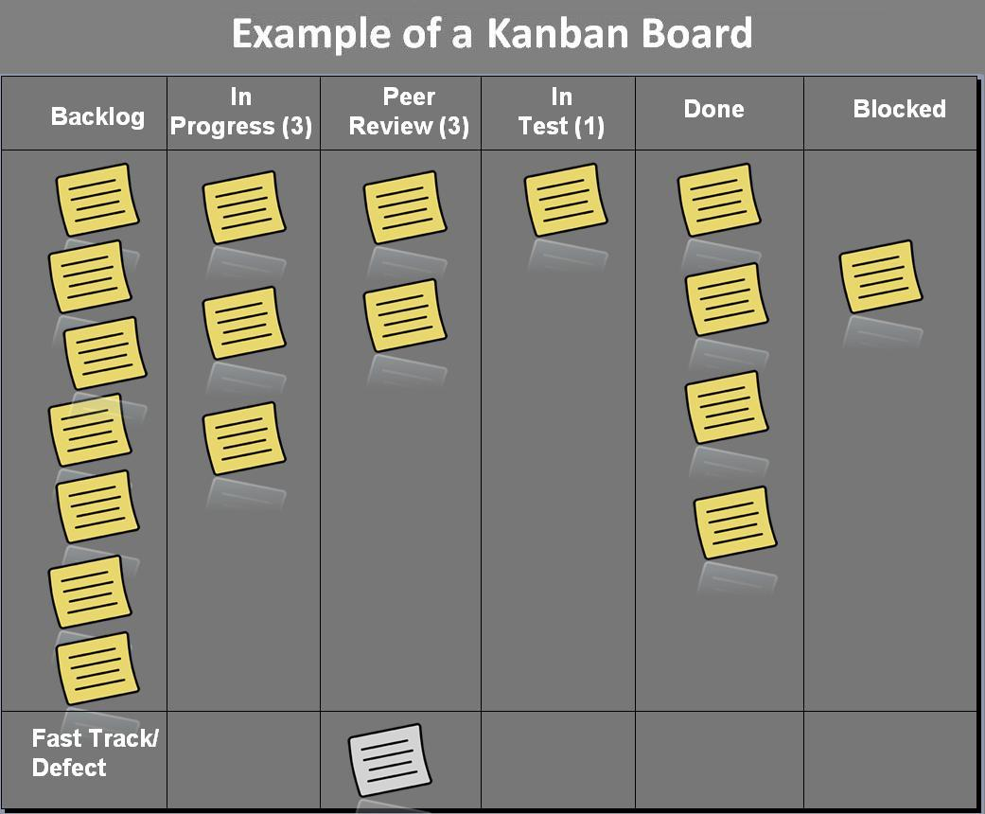
Agile - Frameworks
Frameworks
Most popular: Scrum and Kanban
Kanban
visualisation of workflow
Drives evolutionary change
Scrum
Build a product in a series of fixed-length iterations (Sprints)
Allows for teams to work together
Encourages teams to reflect on wins and losses
Cristian Corrales

Slide 29
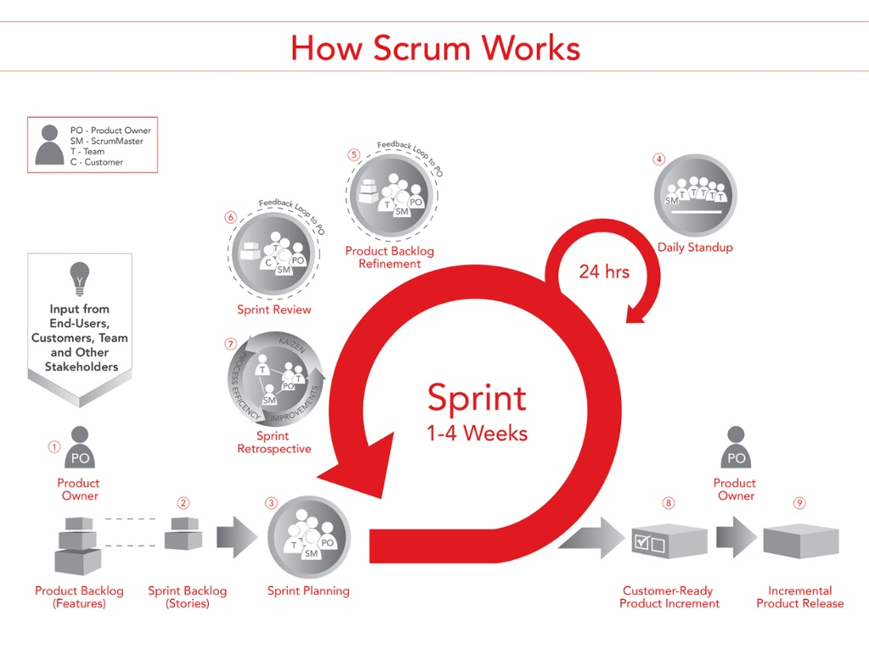
Agile - Senior Design Team
Sprints will start on Friday and end on Wednesdays
Week long sprints
At the beginning of the sprint (Sprint Planning)
In the middle of the sprint (Stand ups)
At the end of the sprint (Sprint Review / Backlog Grooming)
QTC ( Sprint Review)
Senior Design Team (Backlog Grooming)
Cristian Corrales

Slide 30
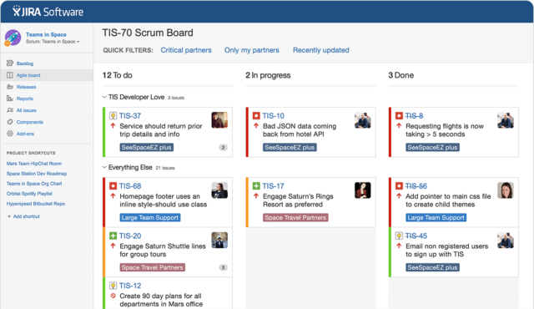
Agile - Ensure Success
Deploy Fully working Software
Test Driven Development Strategy
Workflow Visualization
Jira Tool
Cristian Corrales

Slide 31
Source Control
Git and Github
Allows for a collaborative environment
The repo will be private unless asked otherwise
Cristian Corrales

