Slide 1
The F.E.W.W.
Patrick Hanna Erik Sorto
MingYang Liu Adan Constanzo
Advisor: Dr. Elaine Kang
Liaison: Prof. Sylke Rene Meyer
College of ECST (Engineering, Computer Science and Technologies)
IA (Institute for Interactive Arts, Research, and Technology)

Slide 2
Agenda
Introduction
Storyline
Social Issues
Game Feature
Battle System
Menu
Dialogue
Demo
Conclusion

Slide 3
Introduction

Slide 4
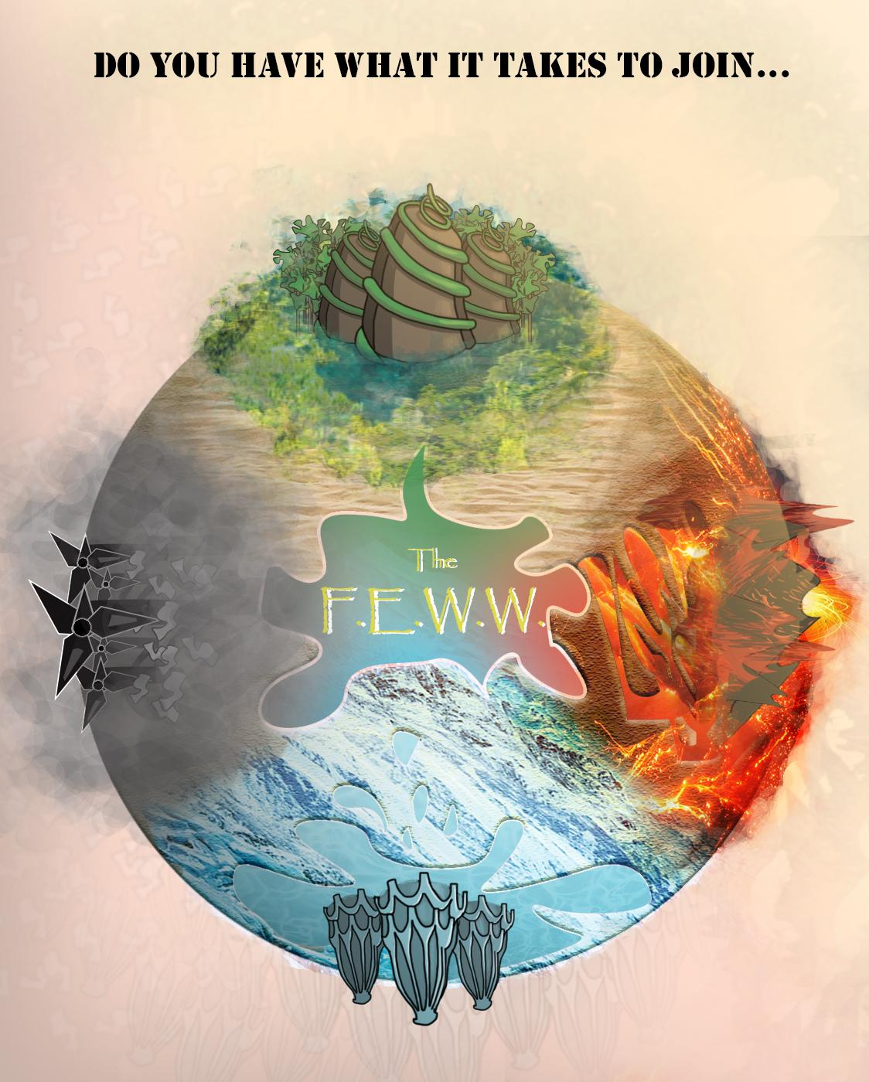
The F.E.W.W. Storyline
The four elements and towns are: Earth - town of Enthral, Water - town of Wulopa, Fire - town of Furburkan, and Wind - town of Whisivil
A world on the brink of a revolution
Follow chuma as she attempts to prove herself and join in the revolution.

Slide 5
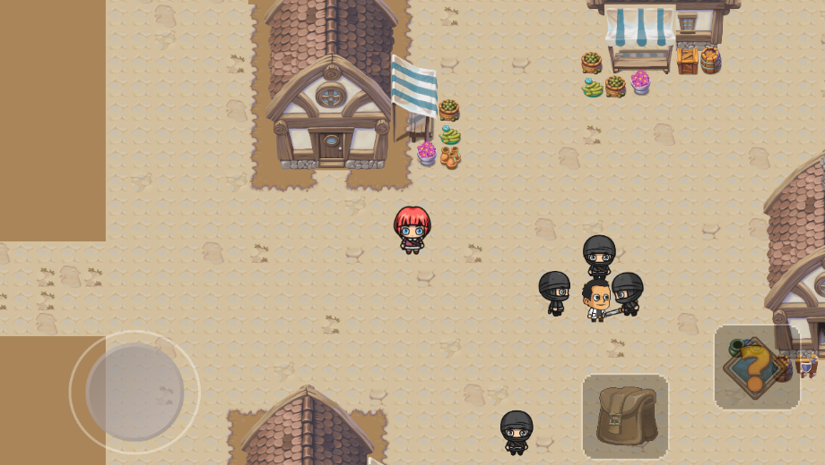
Illustrating Social Issues
People of Enthral occupy most other countries
Subjugate and oppress the other races
Faburkans are prideful, blame Chuma’s parents for their current situation,
Some shun Chuma as a result

Slide 6
Game Features

Slide 7
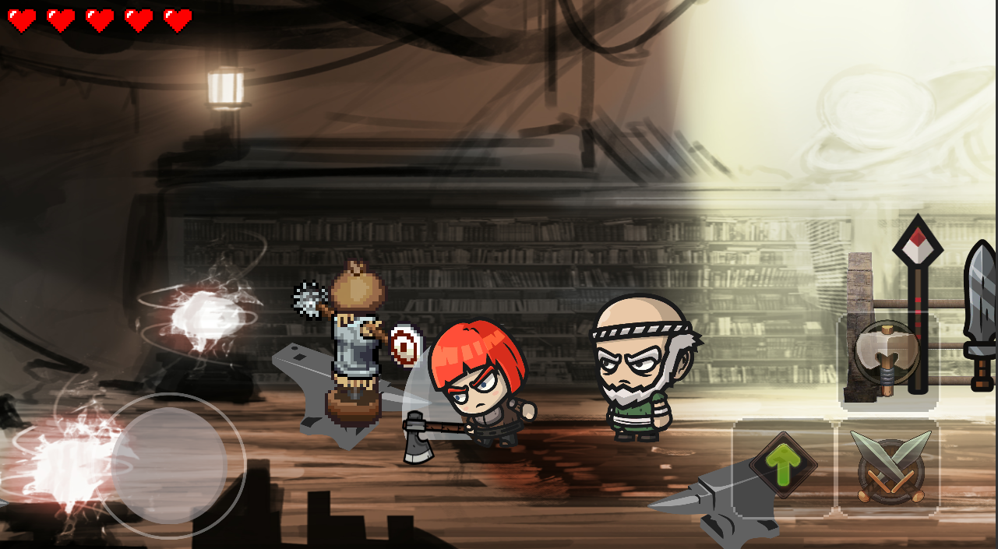
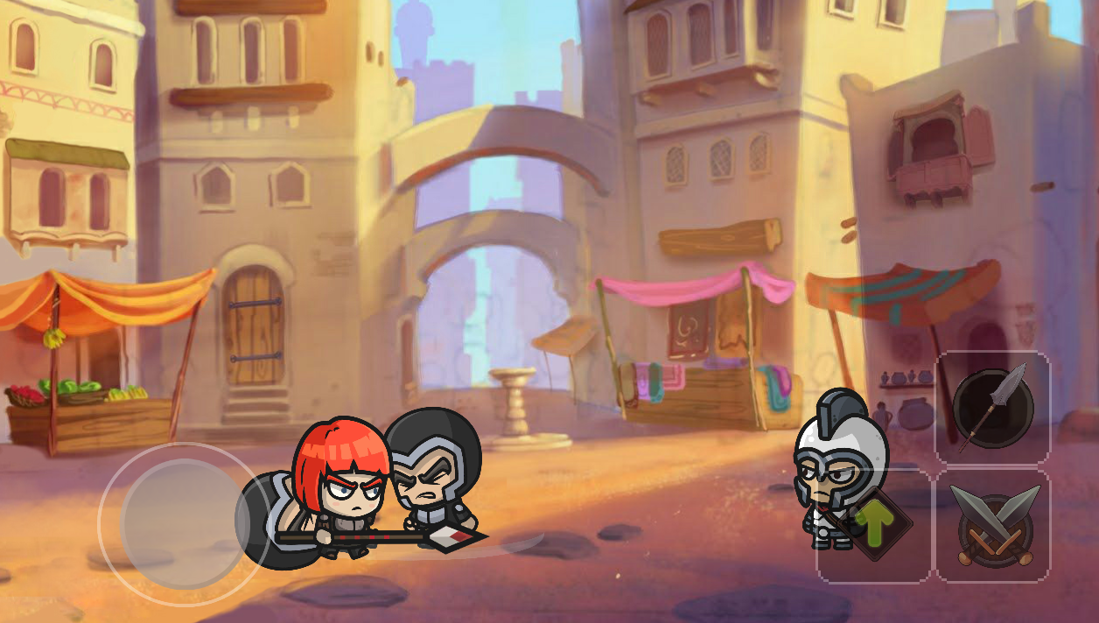
Real Time Battle System

Slide 8
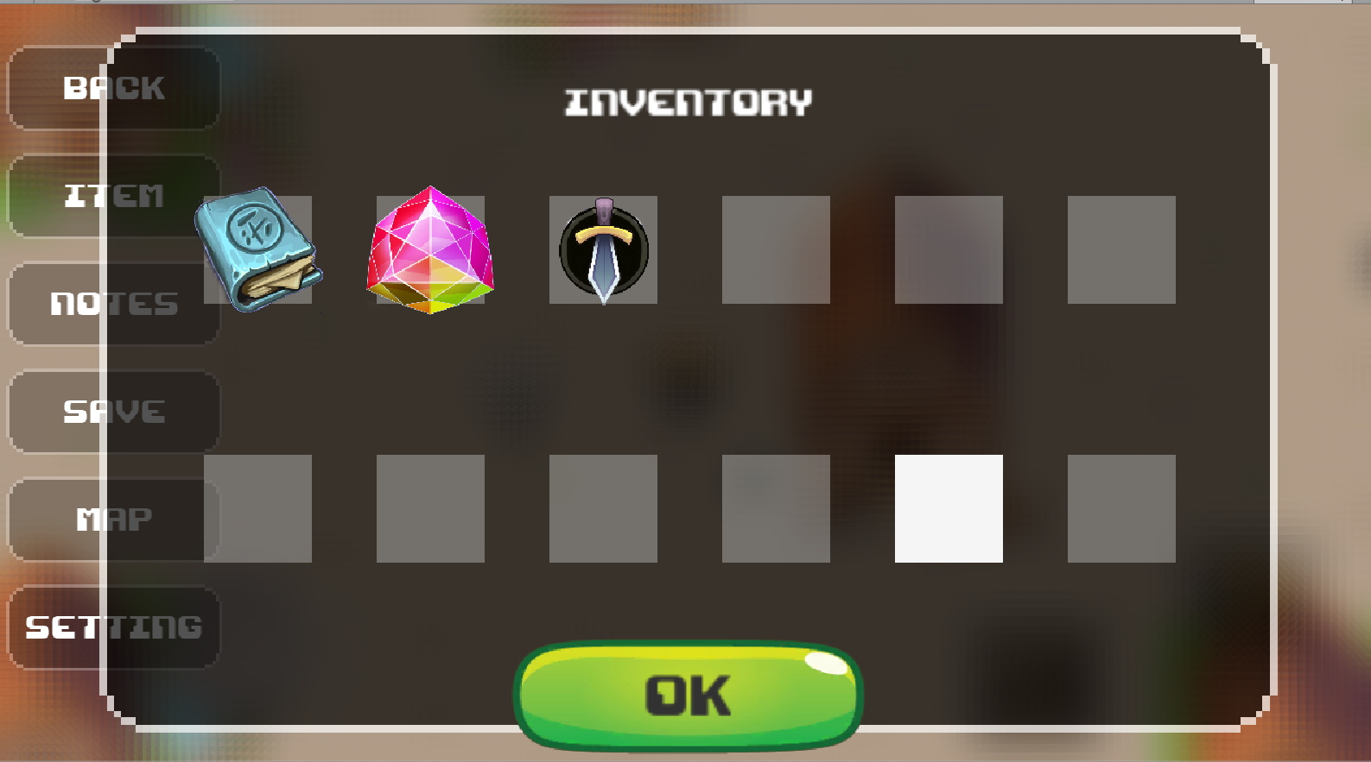
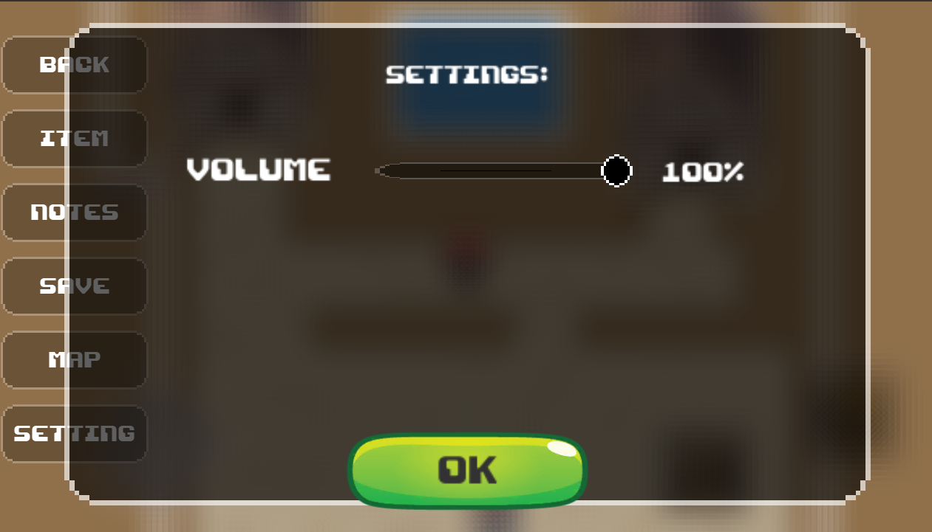
In Game Menu

Slide 9
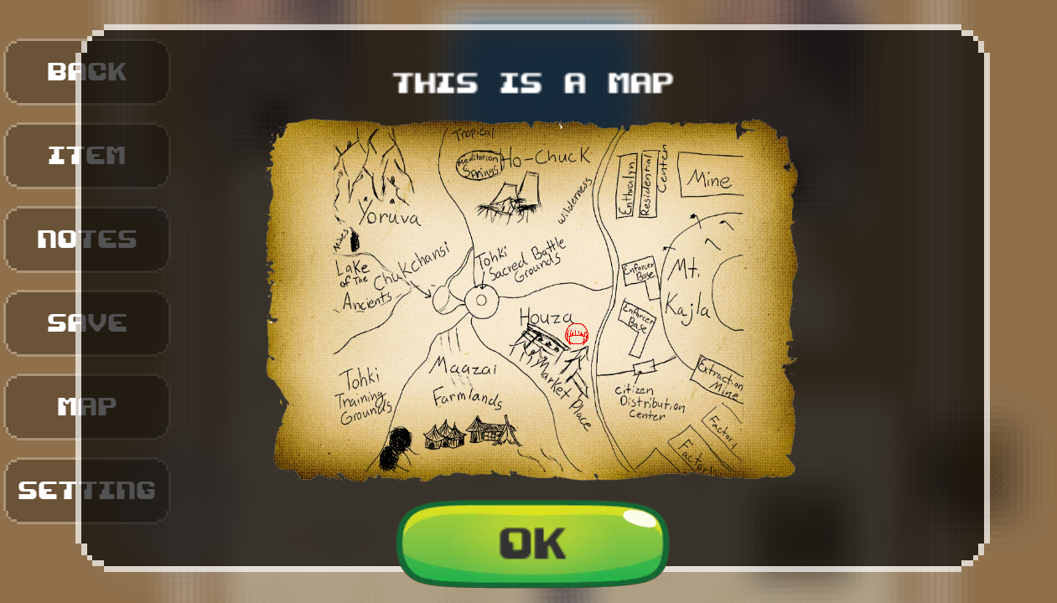
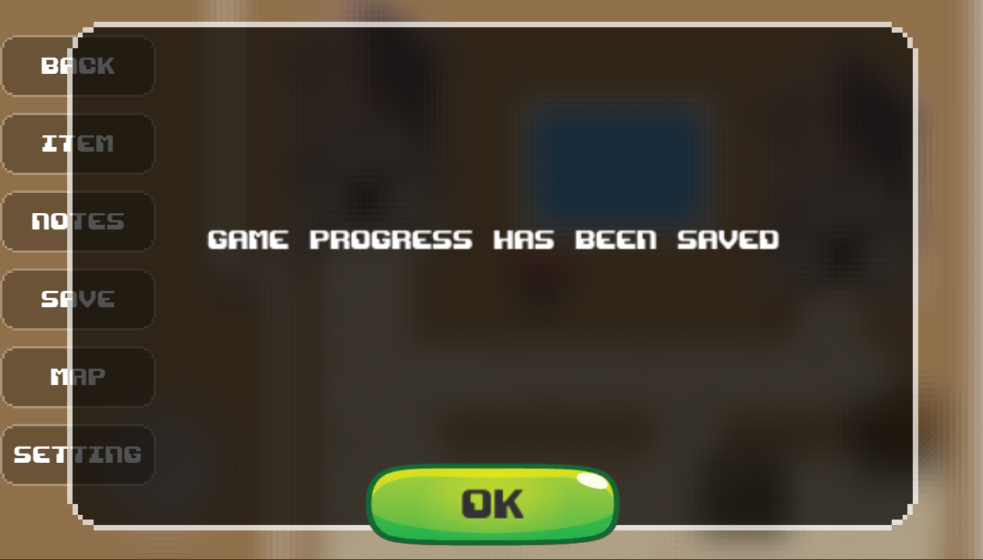
In Game Menu

Slide 10
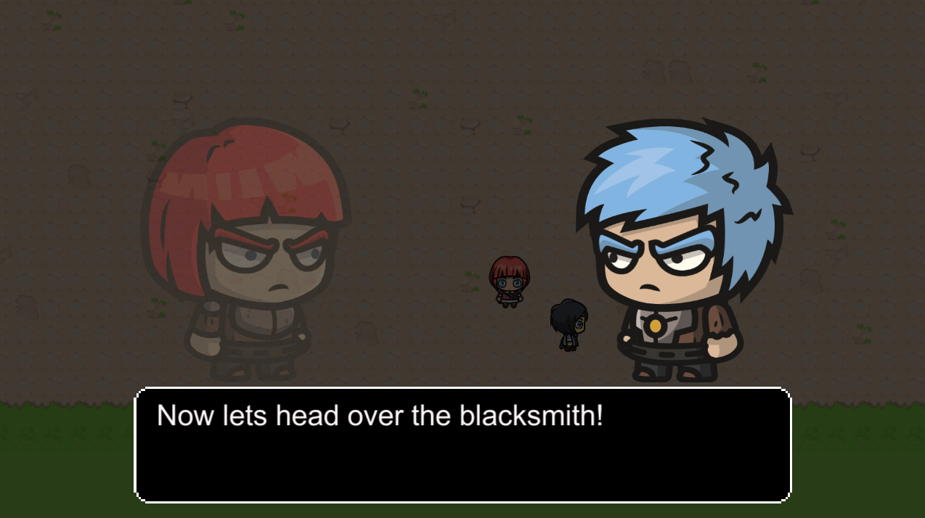
Dialogue

Slide 11
Demo

Slide 12
Conclusion

