Slide 1
Artificial Intelligence for Air Pollution Prediction and Visualization
Members: Hector Rucobo, Alejandro Alatorre, Emmanuel Cocom, Aldo Ruiz Cruz, Vidal Zazueta
Sponsors: NASA and LA City
Advisor: Mohammad Pourhomayoun

Slide 2
Agenda
1.
Definitions and Causes
2.
Significance
3.
Purpose of Project
4.
Technology and Progress
5.
Future Goals

Slide 3
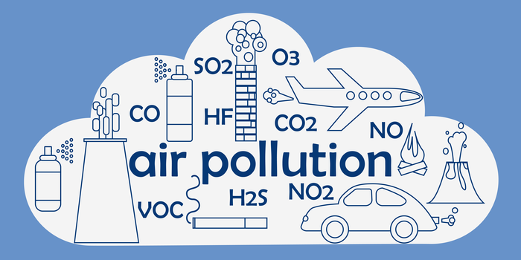
Definitions
What is air pollution?
Air pollution is the contamination of the indoor or outdoor environment by any chemical, physical or biological agent that modifies the natural characteristics of the atmosphere.
Most prevalent type is smog (ground-level O3) and soot (PM).
Other types include black carbon (BC), nitrogen oxides(NO and NO2), and sulfur dioxide (SO2).

Slide 4
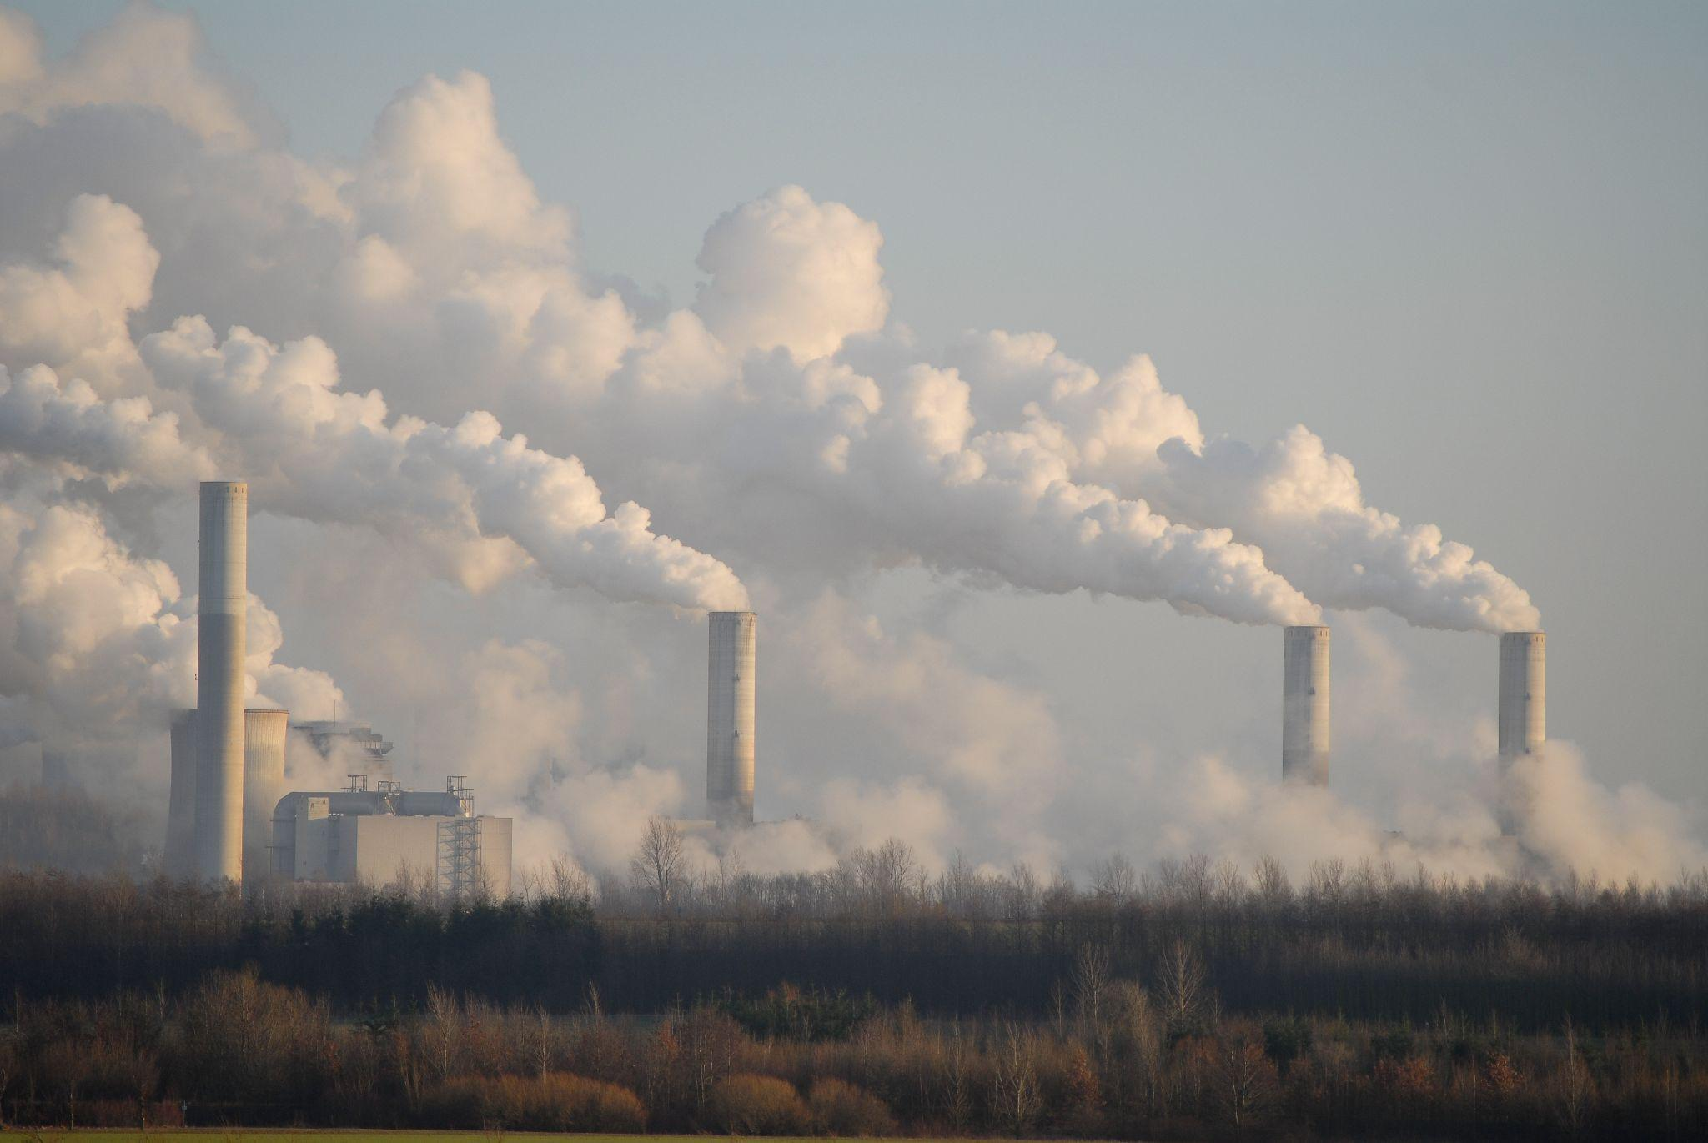
Causes - Anthropogenic
Particulate matter (PM)
Transportation, factories, power plants, incinerators
Black carbon (BC)
Burning fuel, wood, carbon
Nitrogen oxides (NO and NO2)
Transportation
Ground-level Ozone (O3)
Combustion and fossil fuels
Sulfur Dioxide (SO2)
Metal extraction and smelting, coal, ship engines

Slide 5
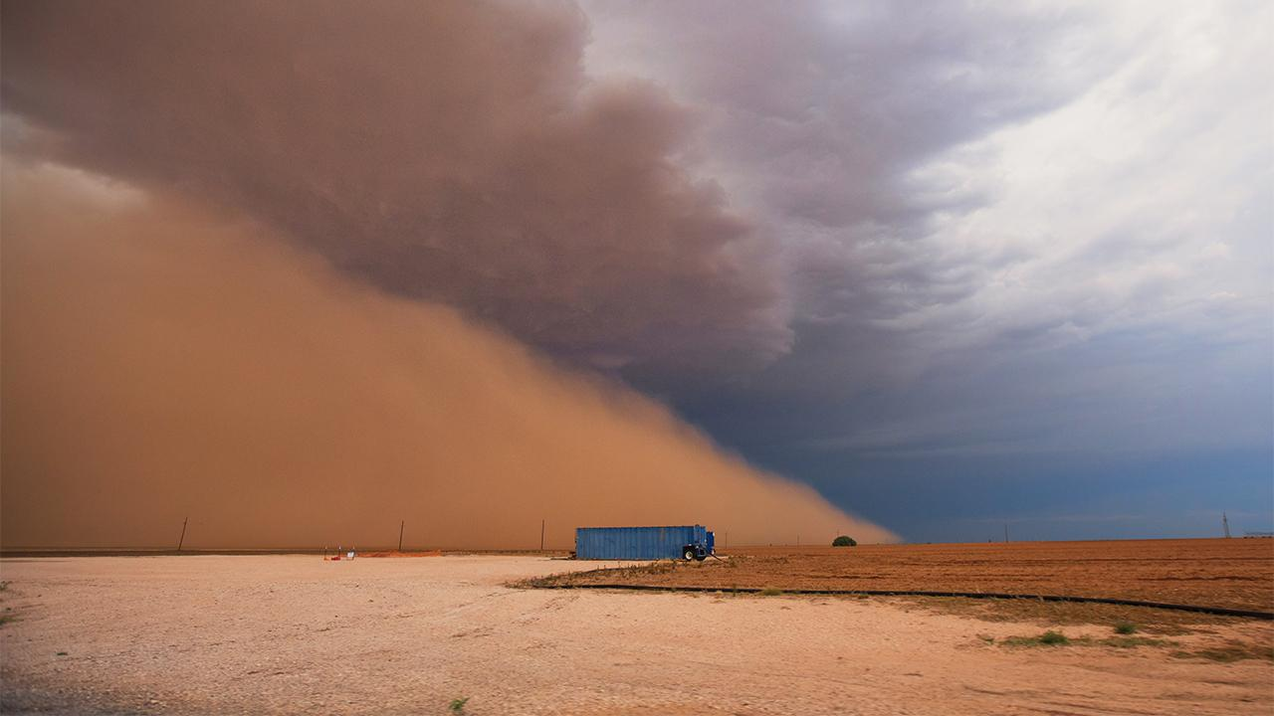
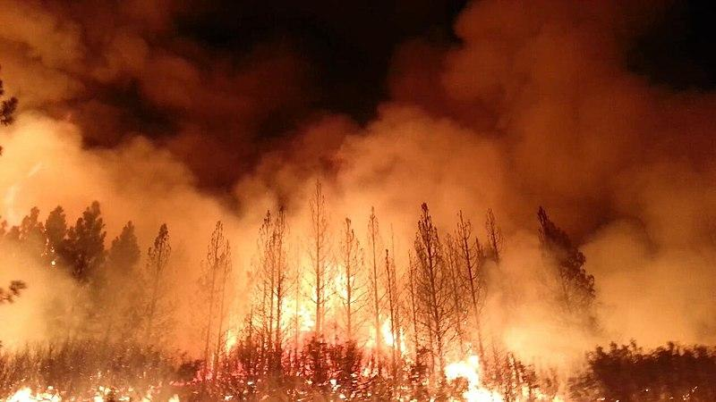
Causes - Natural
Dust
Large areas with open land, little vegetation, and lack of precipitation naturally produce dust storms.
Particulate matter gets added to the air.
Wildfires
Smoke and carbon monoxide caused by fires contribute to carbon levels in the atmosphere.
Volcanic Activity
When an eruption occurs, a tremendous amount of sulfuric, chlorine, and ash products are produced.
These are released into the atmosphere and picked up by winds which disperse them over large areas.

Slide 6
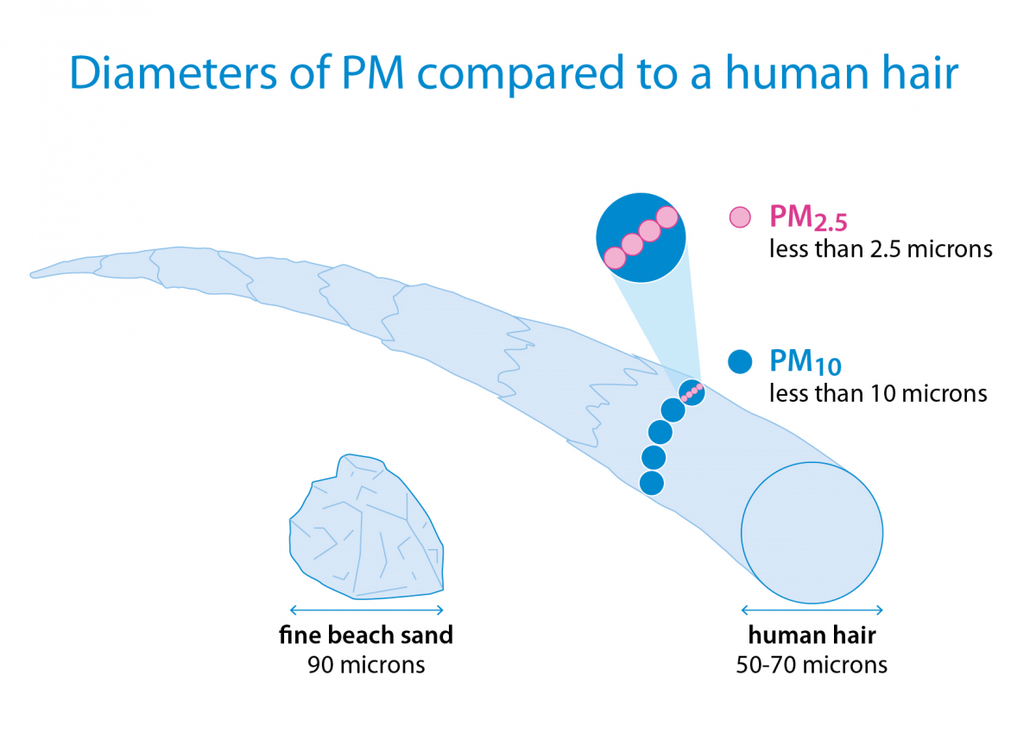
Particulates:
Air pollution comes in several shapes. -PM 2.5 or 10: small fine solid or liquid particles -origin:dust,soot,smoke,industry, volcanos,polen, soil.
It is our focus.

Slide 7
Significance:
-Short term: discomfort and irritation to the eyes,nose, throat and skin
- more serious are illnesses: bronchitis and pneumonia.
-long term: acute chronic illness, decreased lung function for prolonged periods, higher hospitalization rates
-death in compromised or weakened groups

Slide 8
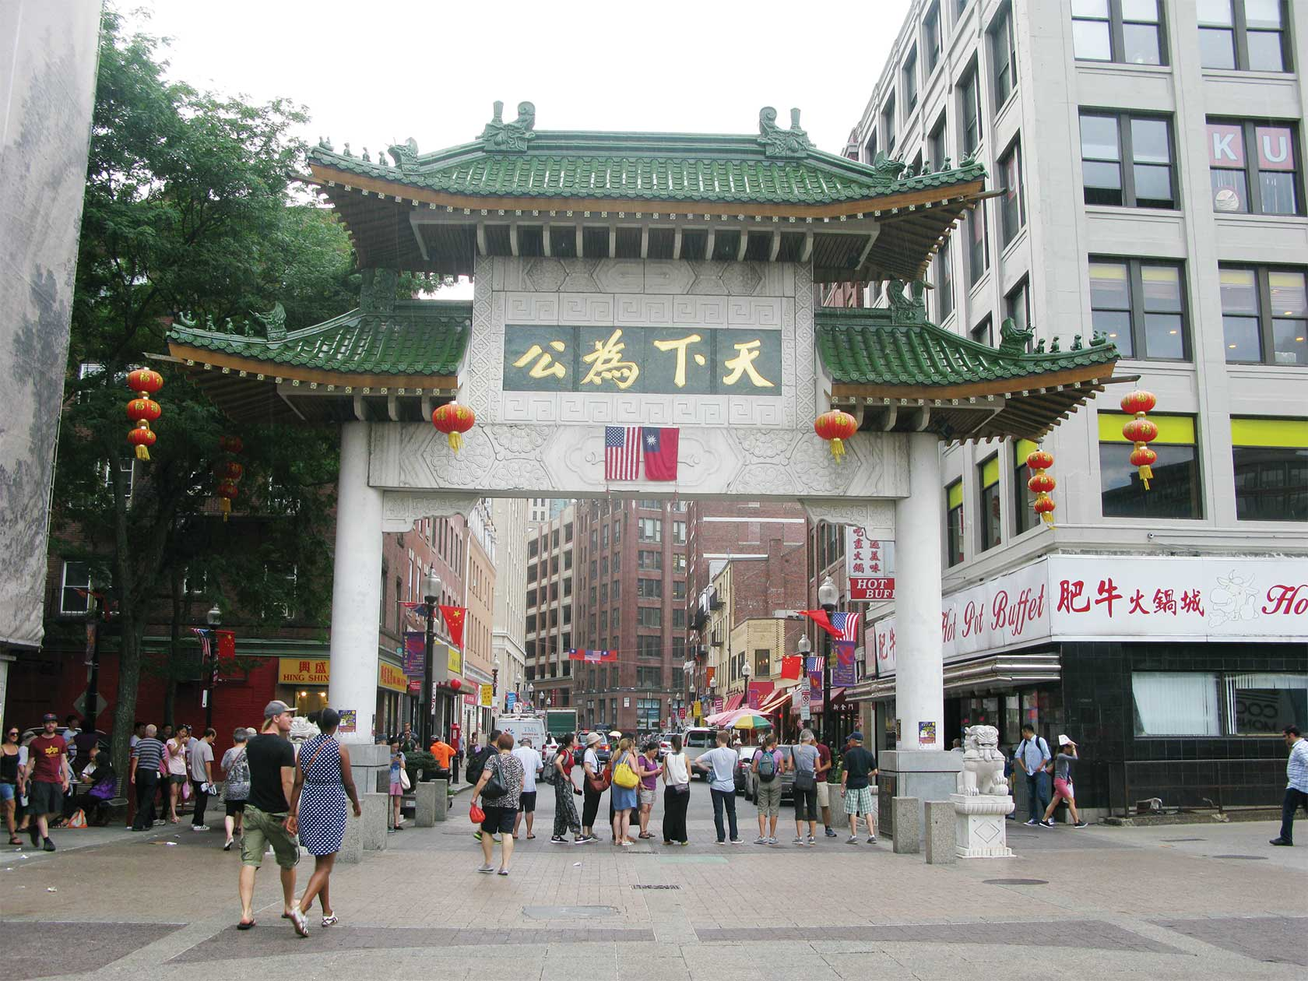
Significance:
-Los Angeles and its surrounding areas have continuously had horrible pollution rates -Chinatown (the worst polluted place) 2016-2017 air pollution was dangerous 117 times.

Slide 9
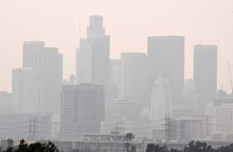
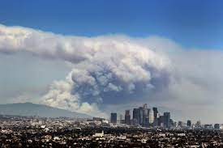
Los Angeles:
-a basin: it traps in all the bar particles
-about 40% of imports come through Los Angeles -fossil fuel usage
-Forest Fires

Slide 10
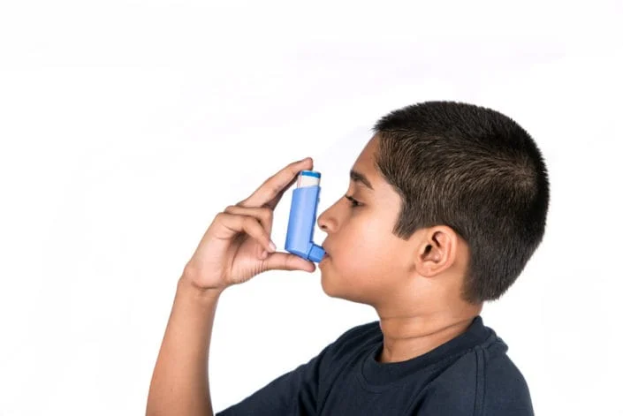
Who is at risk?
-Everyone
-Immune compromised individuals
-Children

Slide 11
Goals and Purpose
● Goals:
○ Develop an web application and mobile app that provides
Easy access to current and forecasted air quality information that is also based on user location
a variety of visualization aids
● Purpose:
○ Means to make better informed outdoor activity choices
Lung and heart chronic conditions
○ Earlier response opportunities to government officials (city, country or state)

Slide 12
Examples
City of Los Angeles
Using forecasted data, city or county can send advisory notices to its residents when poor air quality surges.
Vulnerable Groups
Residents with health conditions and chronic conditions and other vulnerabilities (pregnancy) can stay in doors or limit outdoor activity.
Lungs and heart conditions i.e asthma, heart disease

Slide 13
Technology Used for Website
-React
-JavaScript
-Node.js
-Heroku
-CSS
-ArcGIS
-HTML

Slide 14
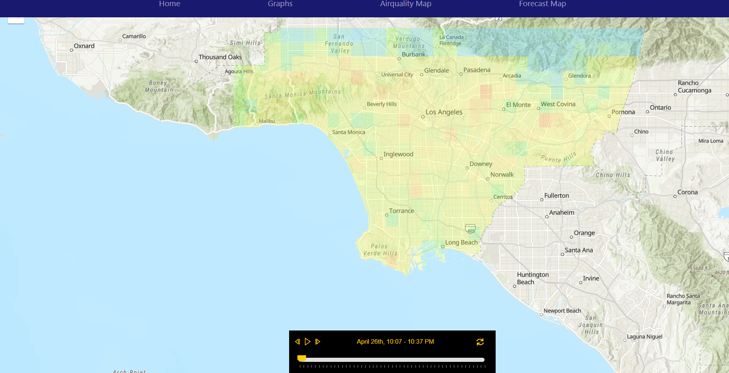
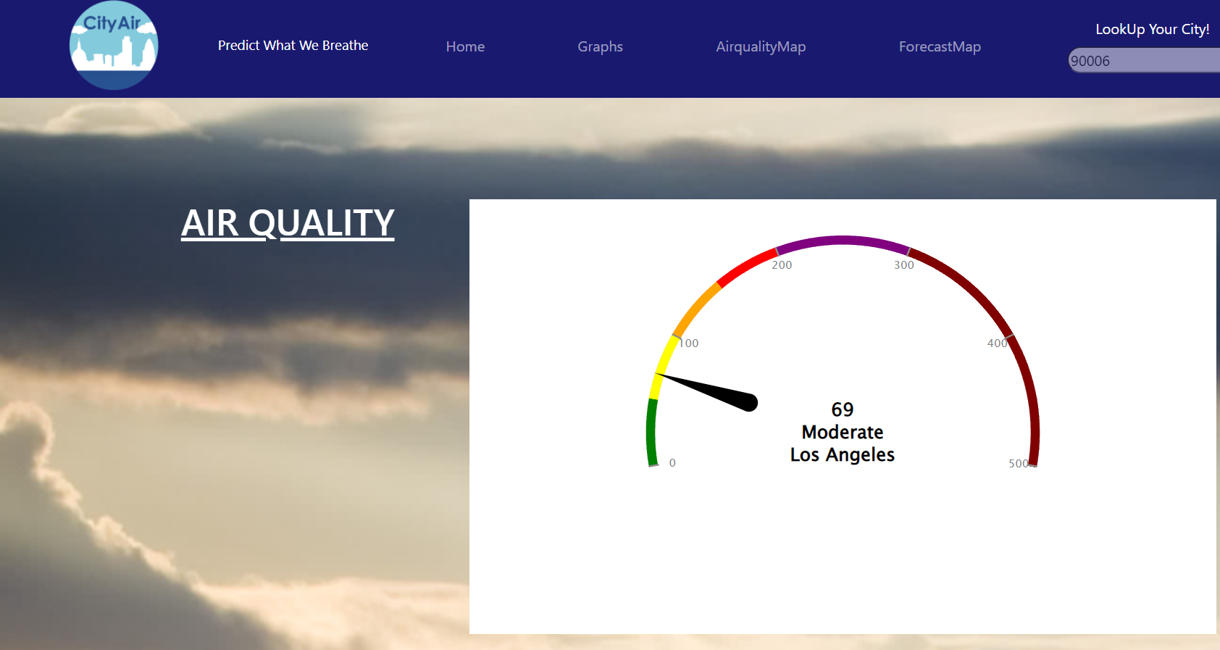
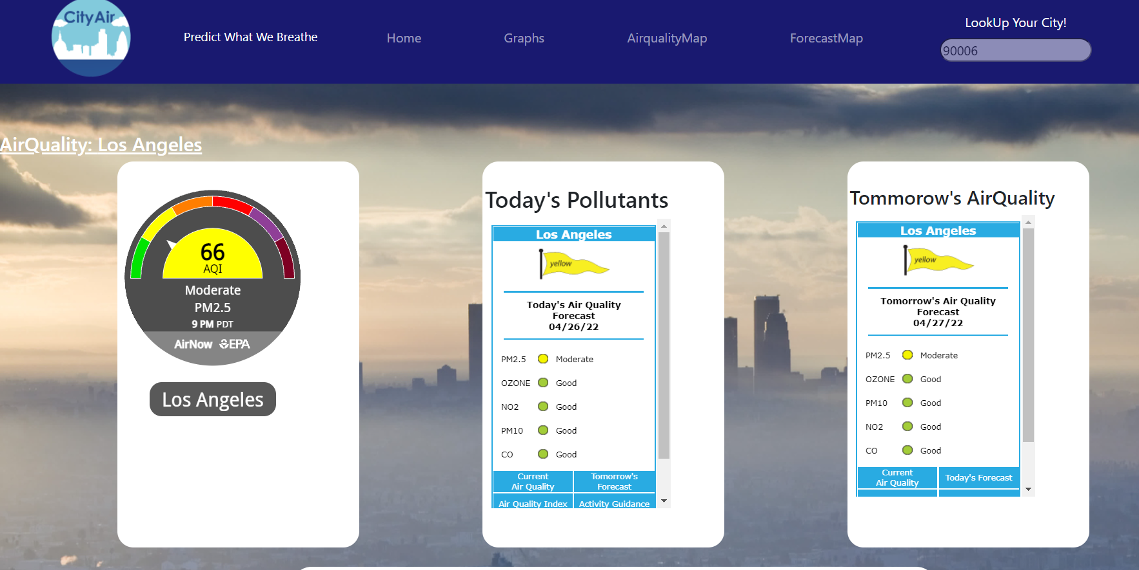
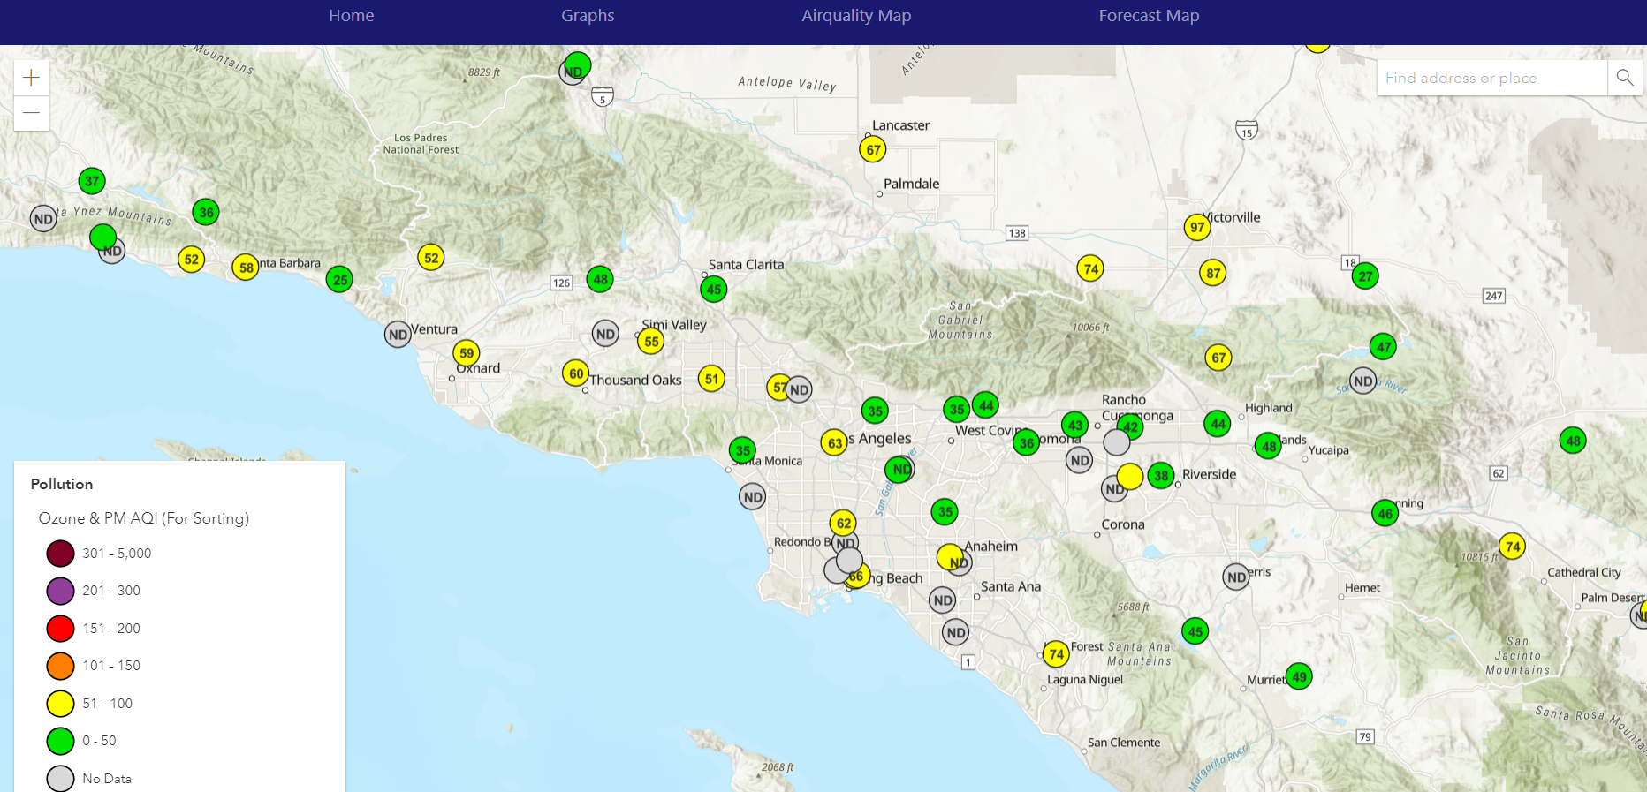
Implemented Items for Website
-Home Page, Graphs Page, Air Quality Map Page, and a Forecast Page.

Slide 15
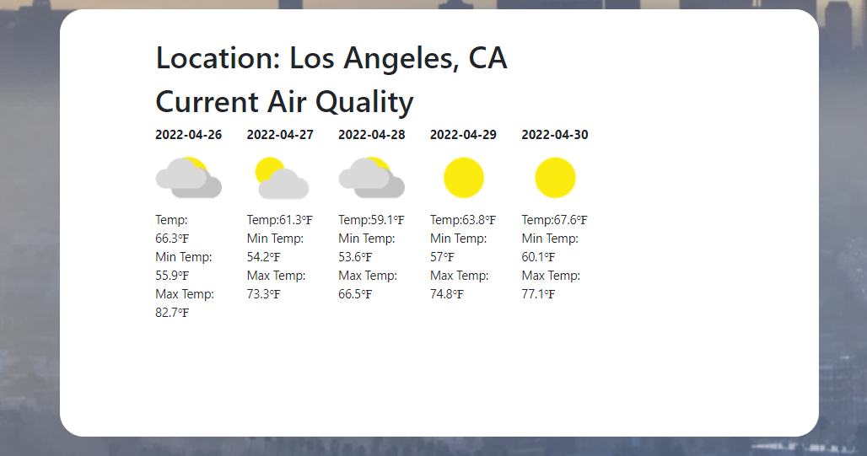
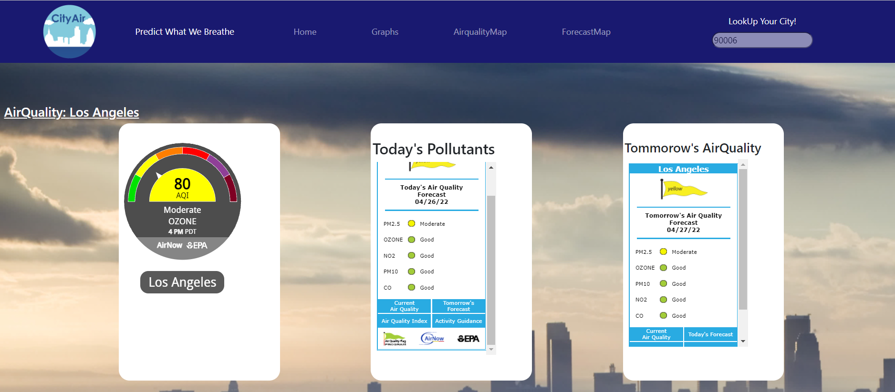
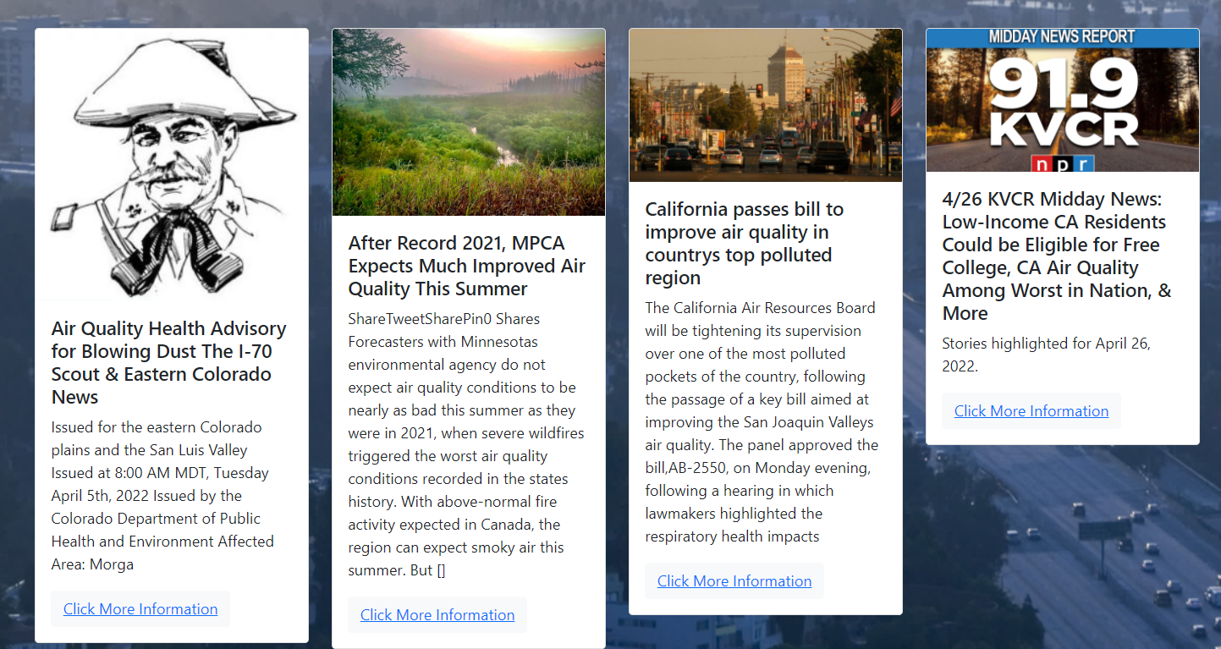
Home Page
-Presented when website is opened
-Will have a gauge to display the current air quality, another gauge to display the types of pollutants and another gauge to display tomorrow’s air quality
-Will also have a weekly forecast of the weather and temperature’
-Can search a location by inputting a zip code in the search bar
-At the bottom, several news articles that will redirect you to their websites when selecting “Click for More Information”

Slide 16
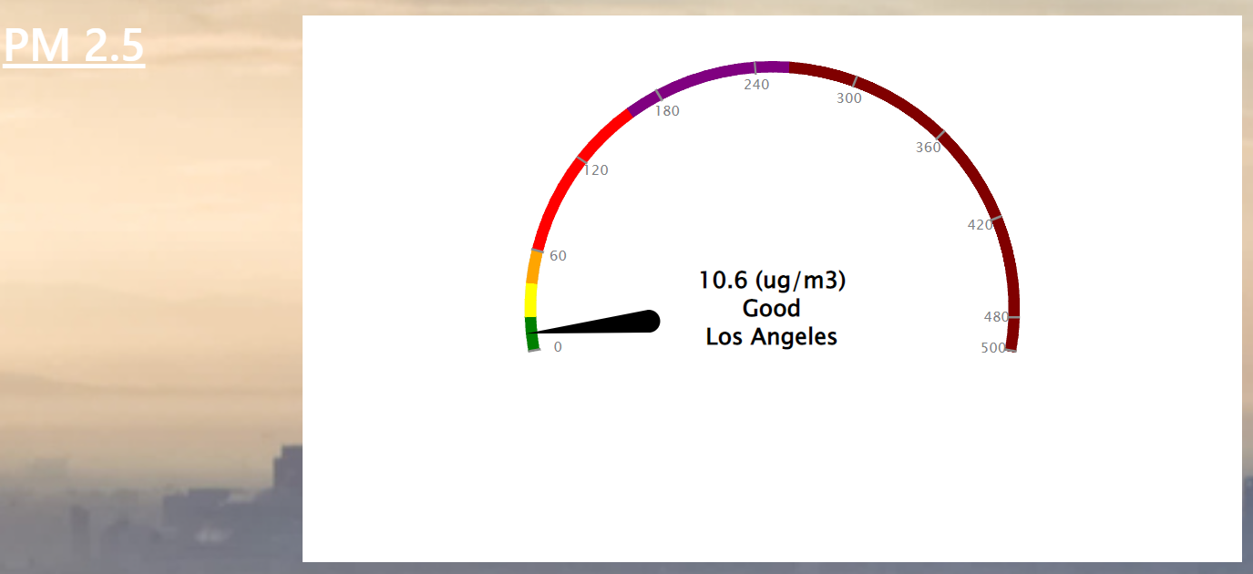
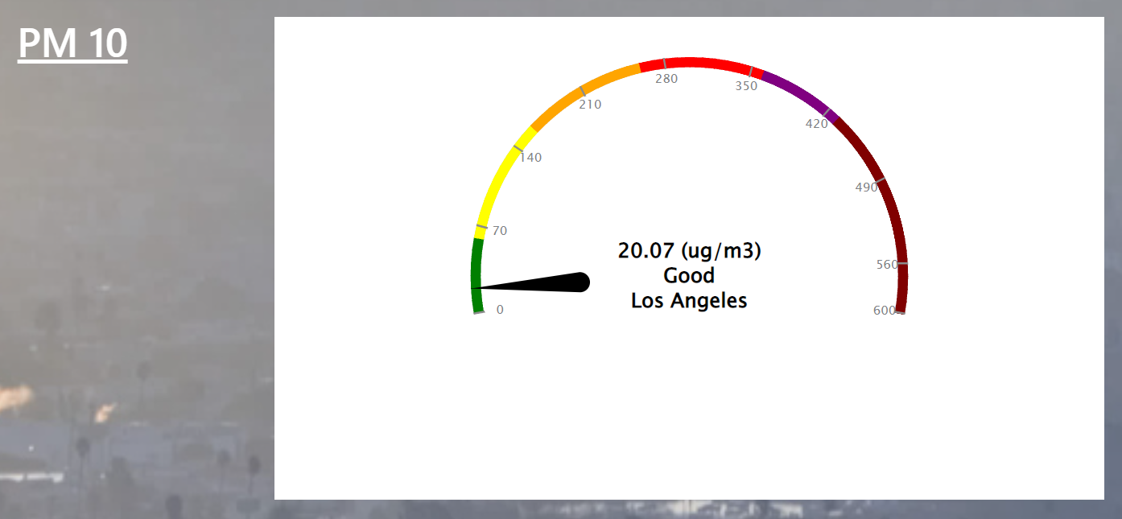
Graphs Page
-Several gauges that will display different information depending for a location
-Location can be specified by inputting a zip code on the search bar
-A gauge for PM 2.5, PM 10, Ozone (O3), and Nitrogen-oxide (NO2)

Slide 17
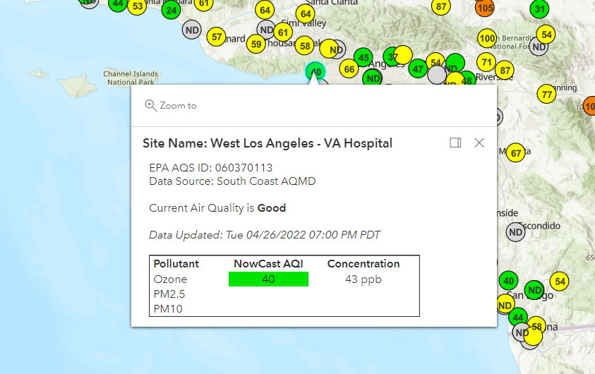
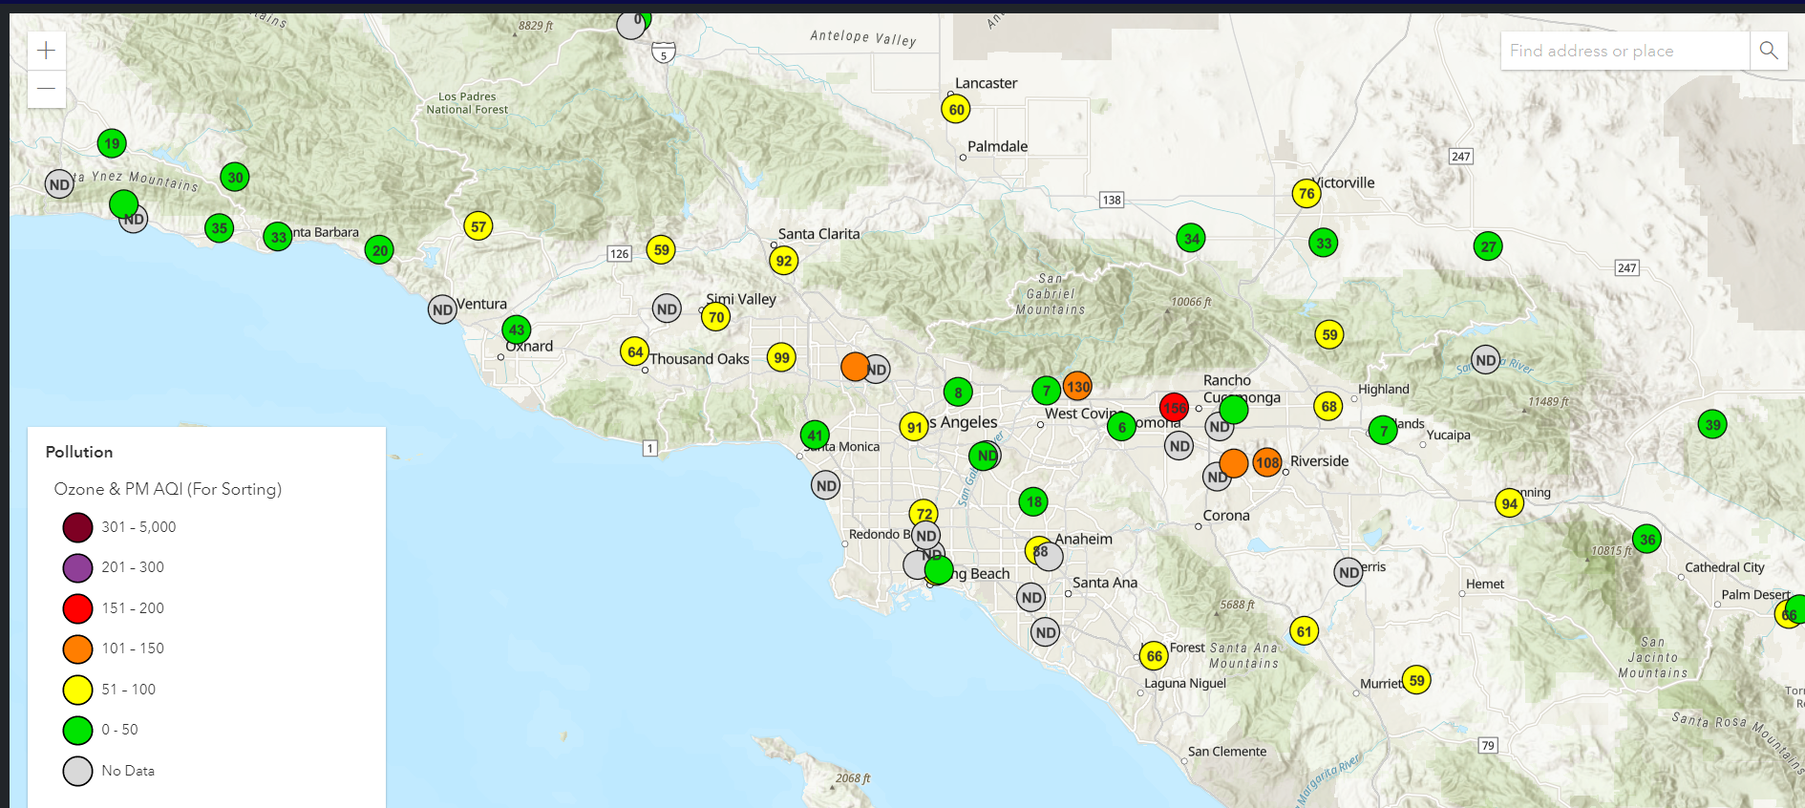
Air Quality Map
-An interactive map that displays air quality sites around the United States if a site is available
-Sites are identified by any colored circle
-Air Quality index in the bottom left
-Clicking on any circle will display more information such as the site name, the type of pollutants, and the air quality if available

Slide 18
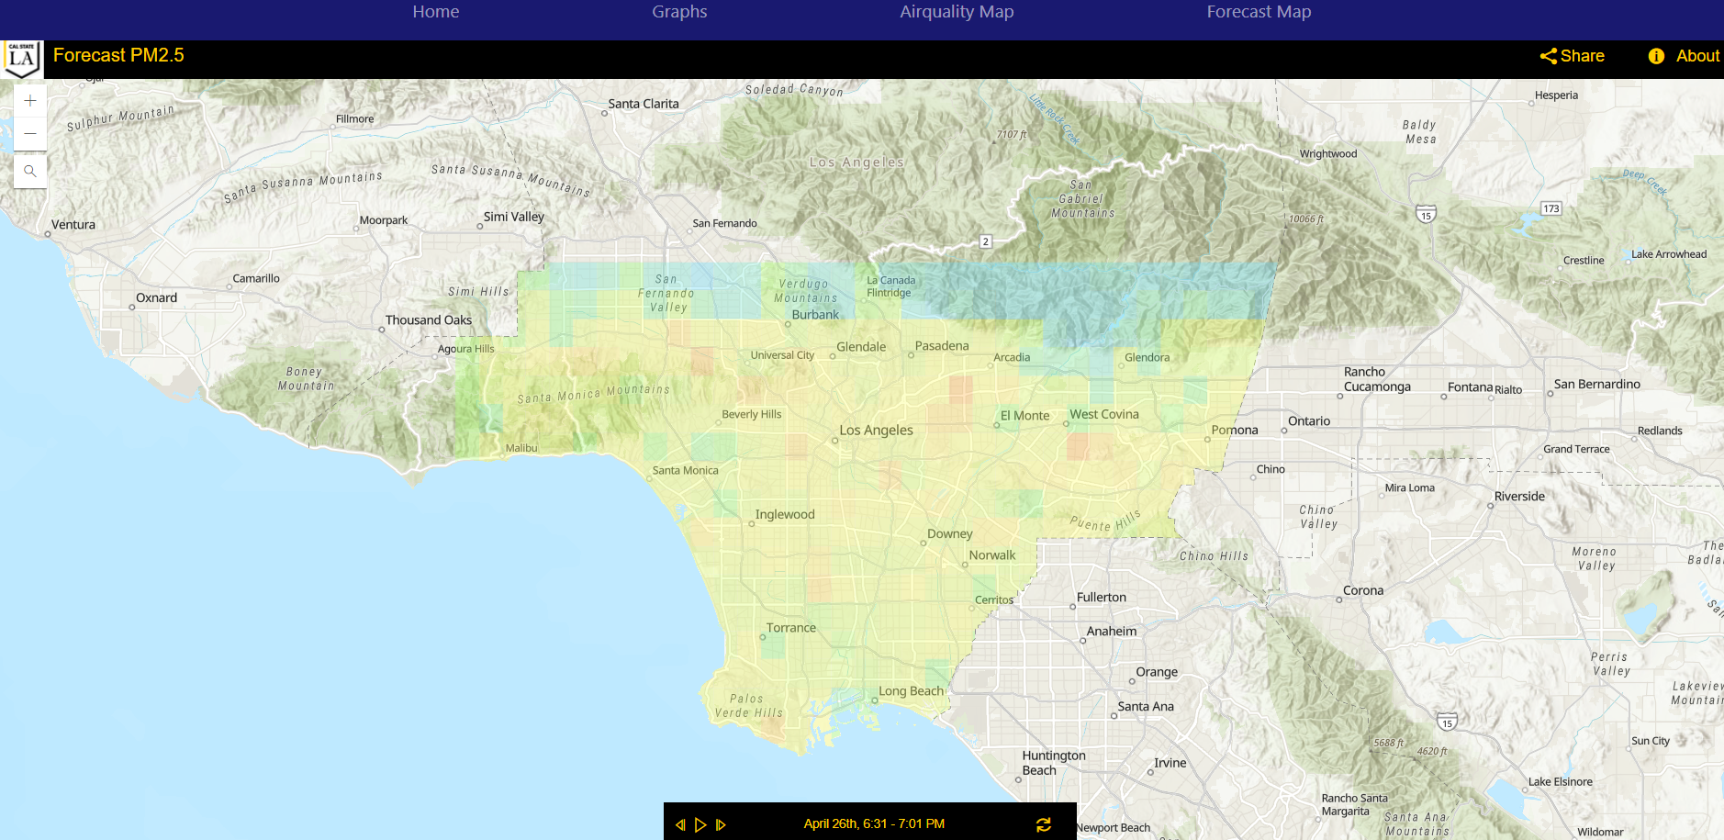
Forecast Map
–An interactive map that displays the forecast of the air quality around Los Angeles
-Up to 24 hour forecast prediction
-The pollutant that is being displayed is PM 2.5
-Data provided by utilizing an advanced artificial intelligence and machine learning algorithm provided by the Research Team
-User can press play button to get an automatic display of the forecast
-Can go backwards or forwards using the back and forward buttons

Slide 19
Mobile App
To develop the Mobile App we used Android Studio, ArcGIS, and Kotlin as our technology tools.

Slide 20
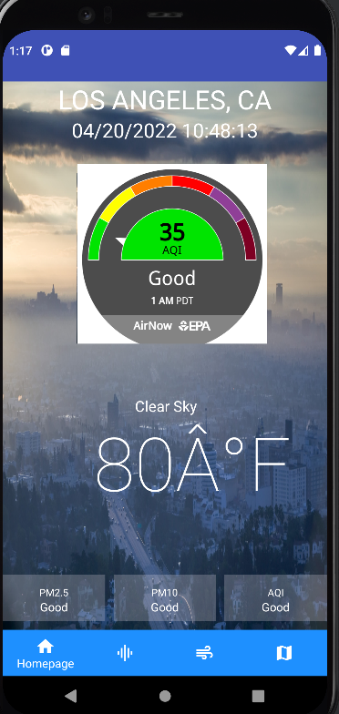
Home/Landing Page
- Default location of Los Angeles, CA
- Current Date and Time is shown
- Displays the current air quality in the current location, for now it is defaulted to Los Angeles
- The gauge shows a live AQI number from AirNow of Los Angeles
- AQI Updated every hour
- The weather and the bottom 3 boxes are a work in progress, which should display a measure AQI for PM 2.5 and PM 10 at the bottom and stating if its good or bad.

Slide 21
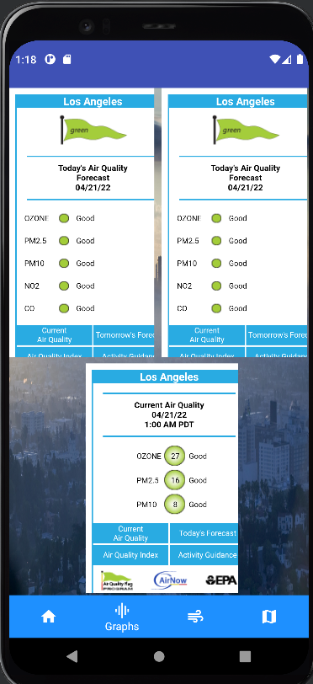
Graphs Page
Displays Today’s Air Quality Forecast
Displays Tomorrow's Air Quality Forecast, Indicating if the pollutants would be good or not Tomorrow
The bottom Graph shows the Air Quality Index number in real time, with the different types of pollutants that there is in that certain location.
Data updated every Hour

Slide 22
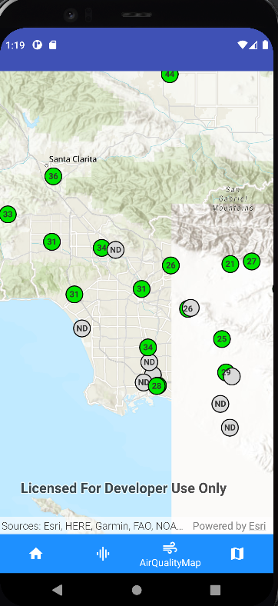
Air Quality Map
This is an interactive map that shows the different AQI Index Numbers.
Display the Air Quality map showing different places where AQI numbers can be read.
The AQI number shown from the map is a certain pollutant in that certain area.
AQI number updated every Hour

Slide 23
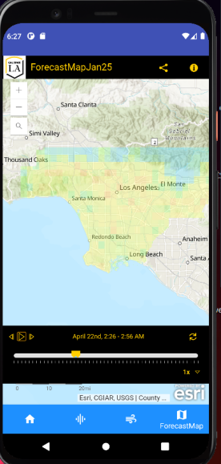
Forecast Page
-Displays a 24 hour forecast prediction for LA County
-The user has an option to go forwards or backwards to change the hour of the Air Quality predictions.
- The user has the option to auto-play to show each layer at certain times
-The user is able to zoom in and out of the map
- Predictions layers made with very Advanced Data Science Machine Learning Algorithms

Slide 24
ArcGIS Model
Advanced geoprocessing tools and Python working together to create layers.
Model begins with GeoTIFF files created by advanced machine learning algorithm.
AWS allows us to manage these files.
Fully automated process utilizing task scheduling and ArcGIS Online.

Slide 25
Live Demo!
Demonstration of a live demo of our website and our mobile app.

Slide 26
Future Goals:
Website: Personalized User Experience
Social Media Sharing
Text alerts for dangerous conditions
Mobile
User location air quality readings
Air quality readings based on zip code searches
Notes:
Air Quality Information based on Search Location on the Mobile App
Connect real time AQI pollutants and live Weather on the HomePage of the App

Slide 27
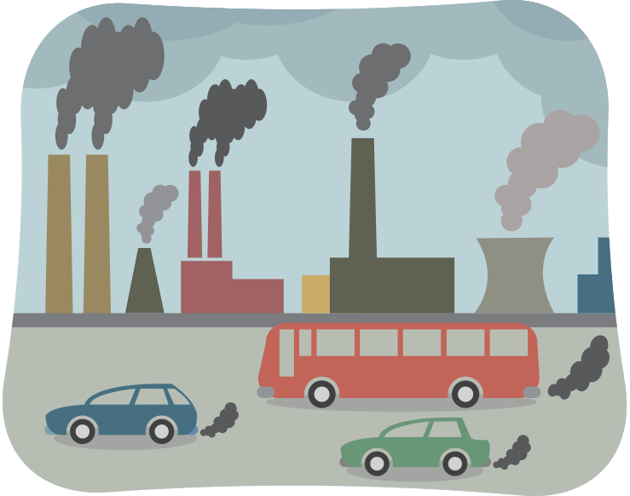
Final Thoughts
Air Pollution contributes annually to millions of deaths worldwide and must be taken seriously
Making Air Quality readings and forecasting accessible will help in making more timely response

Slide 28
Thank You!

Slide 29
Special Thanks to the Professor Mohammad, Sponsors & Research Team

