Slide 1
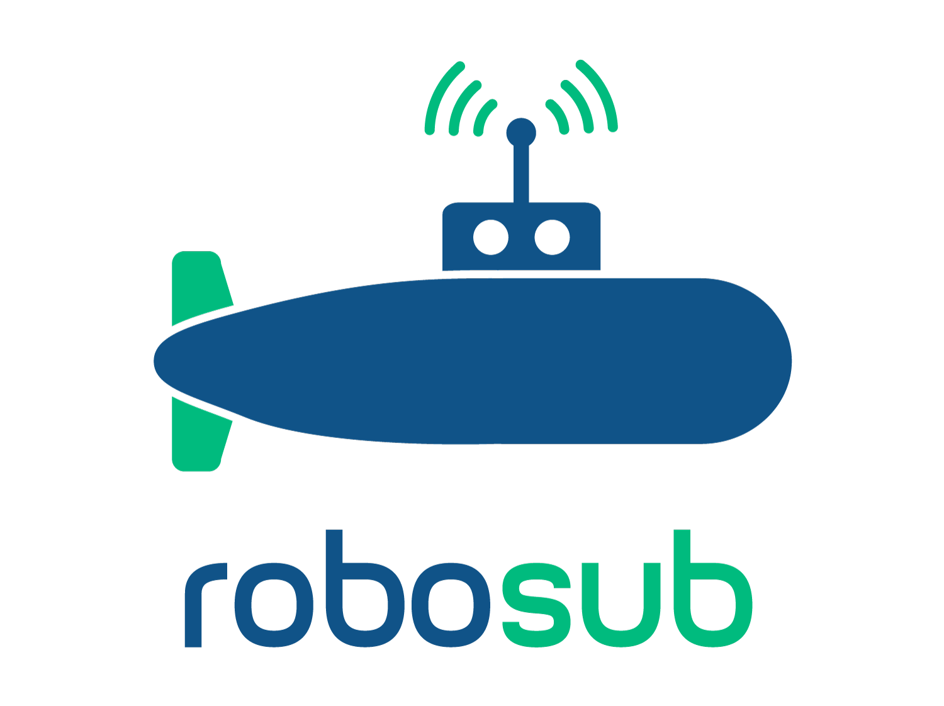
CSULA - RoboSub
Ricardo Medina
By: Heriberto Gonzalez, Ricardo Medina, Horacio Mondragon, Gabriela Cortes-Mejia, Brandon Pham, Sana Shaikh, Wilson Weng, Kevin Williams, Albert Chew

Slide 2
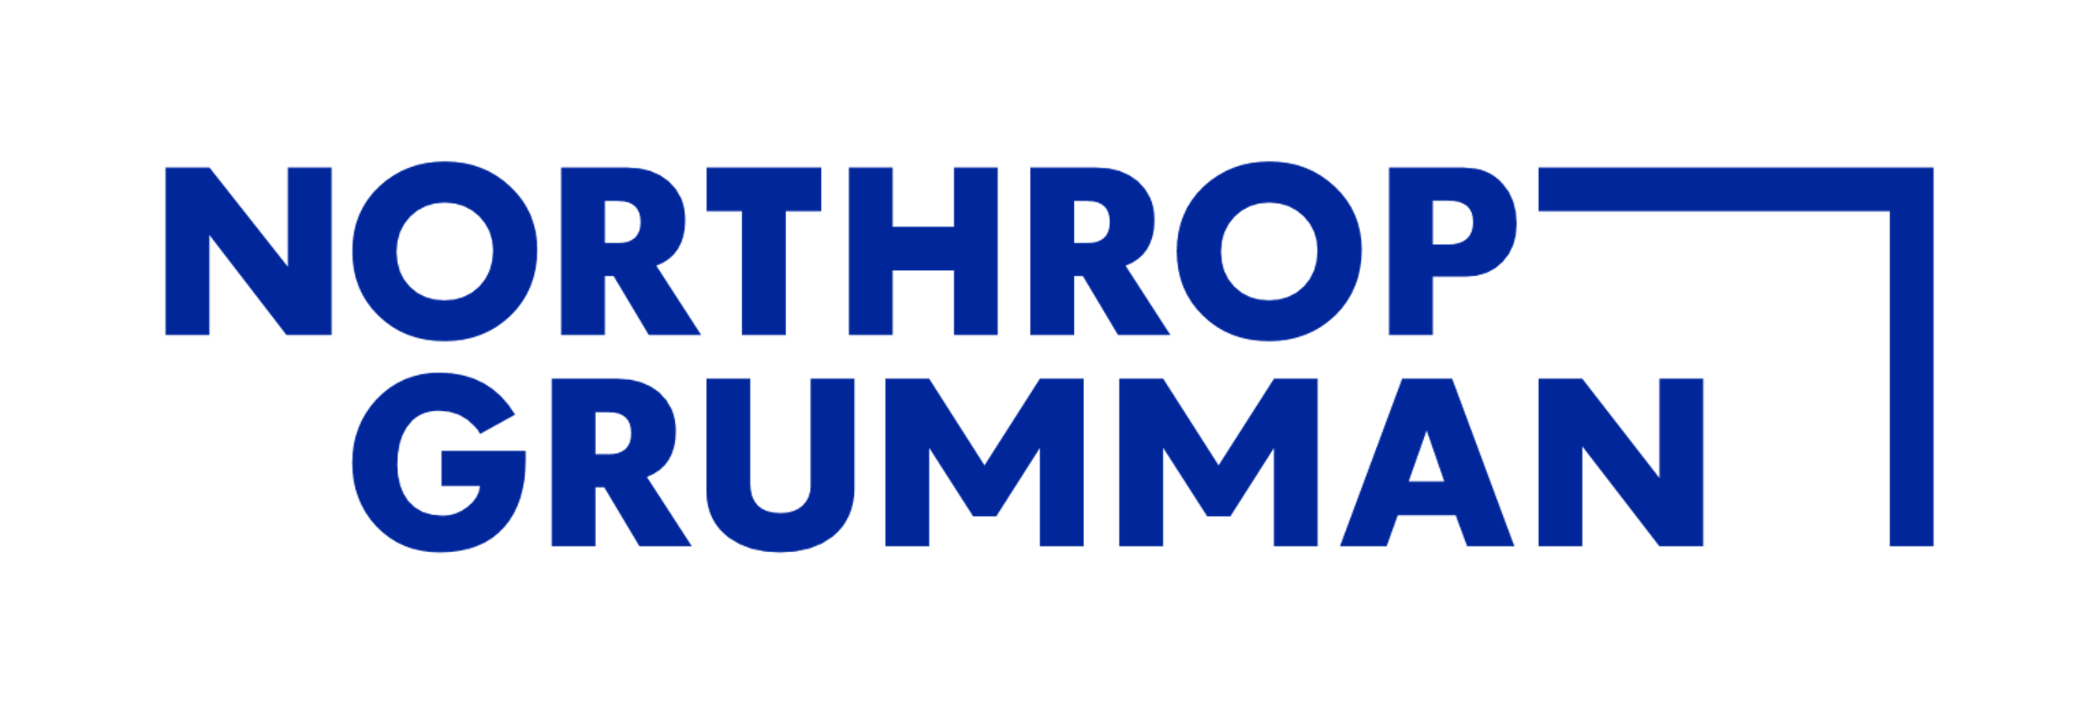
What is RoboSub?
Ricardo Medina
Purpose - To foster ties between young engineers and the organizations developing AUV technologies.
Competition Goal - Design an Autonomous Underwater Vehicle (AUV) demonstrate its autonomy by completing a series of tasks.
Competition Sponsors:

Slide 3
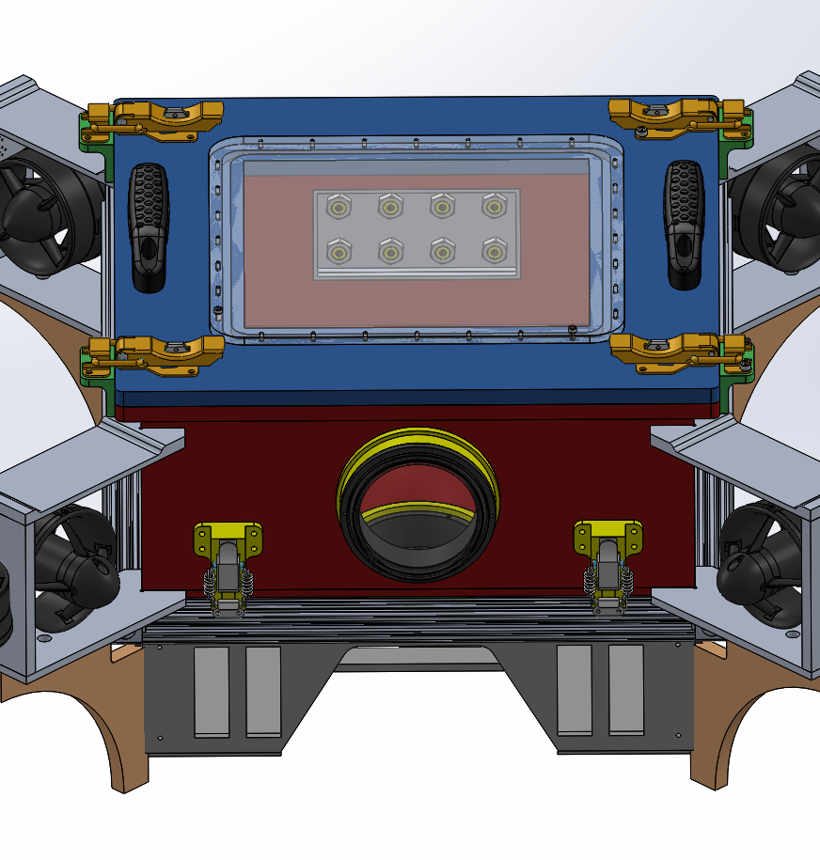
Project Composition
Ricardo Medina
Computer Science Senior Design Team
Team of 9 Computer Scientists
Objective:
Design and implementation of AUV Software
Mechanical/Electrical Engineering Team
Team of 10 Mechanical & Electrical Engineers
Objective:
Design and construction of the AUV
RoboSub Club Team
Team of undergrads from ME/EE/CS
Objective:
Build a secondary AUV for the competition
Learn skills needed for future senior design teams

Slide 4
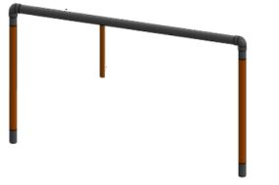
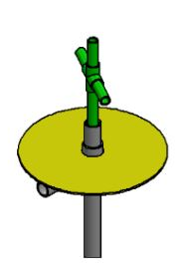
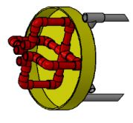
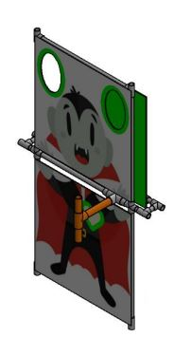
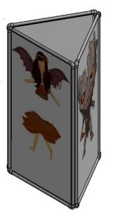
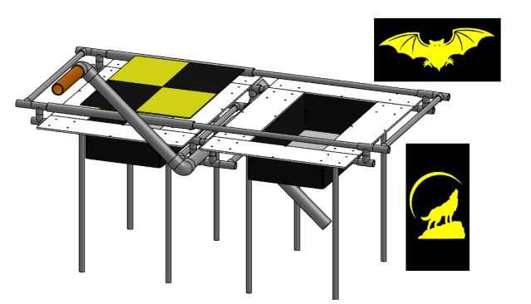
Ricardo Medina
Gate Task (Enter the Undead Realm)
Paths
Pickups
Buoy Task (Slay Vampires)
Bins Task (Drop Garlic)
Torpedo Task (Stake through Heart)

Slide 5
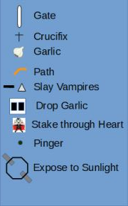
Competition Map
Ricardo Medina
Ricardo Medina
200' by 300' and 38' deep

Slide 6
Ricardo Medina
Artificial Intelligence
Object recognition
Autonomous Movement & Navigation
Sensor Data Acquisition
Peripheral controls
Competition
Requirements

Slide 7
Senior Design Team Breakdown
Ricardo Medina
Mission Planning
Controls
Navigation
Computer Vision

Slide 8
Mission Planning
Brandon Pham
Objective:
Design and implement AI to control the functions of the sub to clear tasks
To allow the subsystems to interact and transfer requested data so the sub can complete its current objective.
Task:
Communicate with teams to establish what data each subsystems require from others
Implement the actions required for each task
Use ROS to interface the subsystems for the AI

Slide 9
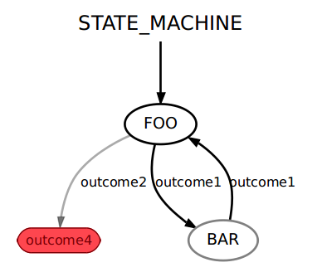
ROS and Smach
Brandon Pham
Robot Operating System
Libraries and tools to help with the development of robot applications
Publishers/Subscribers
A Publisher continually broadcasts a message
A Subscriber receives these messages
Smach: A package within ROS
ROS-independent Python library
Hierarchical state machines
Mainly for complex plans
The state machine on the right is a flow chart that shows different states with given outcomes that determine how the states transition

Slide 10
Wilson Weng

Slide 11
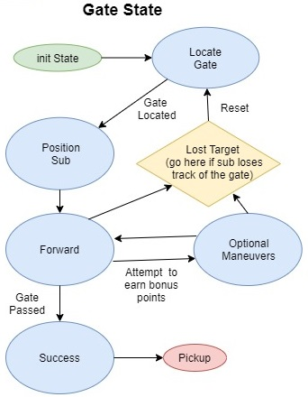
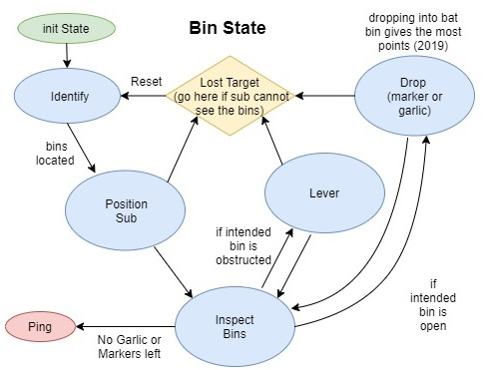
Wilson Weng

Slide 12
Controls
Albert Chew
The Control Sub-Team's goals are to analyze the Robo-sub control section requirements and to code in Arduino and implement the code.
Hardware Structure and Software:
ROS-Melodic and Arduino IDE
The Robo-sub consists of eight Thrusters.
Four Thrusters purpose are to balance, emerge, and submerge the Robo-sub.
Another four Thrusters purpose make Robo-sub to move forward, backward, left, and right.

Slide 13
Software Interfaces
Albert Chew
Interface with Navigation System through ROS.
Balance the AUV. Arduino Sketch will subscribe pitch and roll angles from ROS Topic.
Maintain target depth. Arduino Sketch will subscribe depth(distance) from ROS Topic
Move forward or backward. Arduino sketch subscribes distance from ROS Topic.
Change Heading. Arduino sketch subscribes yaw angle from ROS Topic.

Slide 14
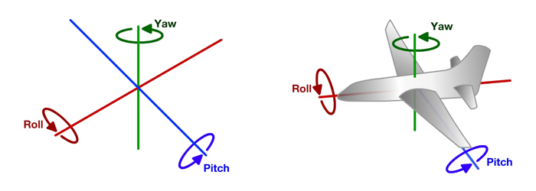
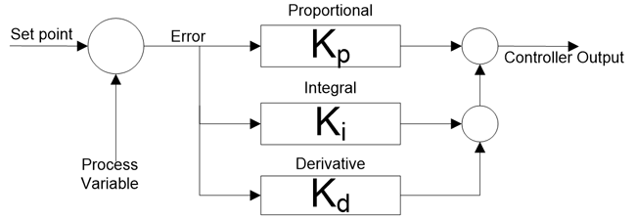
PID Research
Gaby Cortes
An algorithm that combines proportional, integral and derivative calculation to move a sub from its actual state to its desired state.
Pitch Axis
The sub tilts forward or backwards
Roll Axis
The sub moves to the left and right side
YAW
The sub rotates right and left
Determine proportional, integral, and derivative values

Slide 15
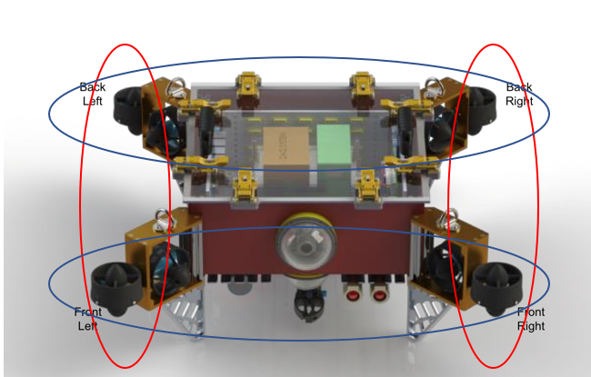
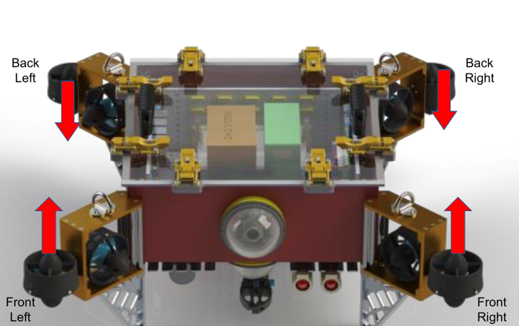
Controls – Thruster Movement
Gaby Cortes
The red circles represent Roll, while the blue circles represent Pitch. The front and back thrusters are grouped together
The PID controllers will help balance the sub if it tips up or down. The arrows represent the direction the sub will move while balancing

Slide 16
Gaby Cortes

Slide 17
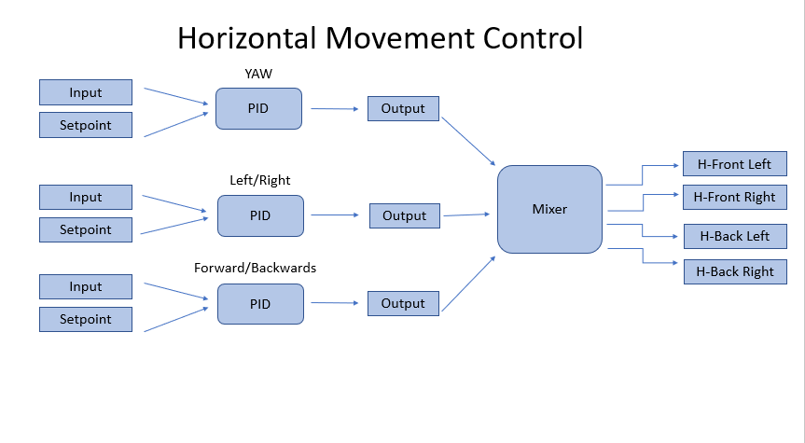
Sana Shaikh

Slide 18
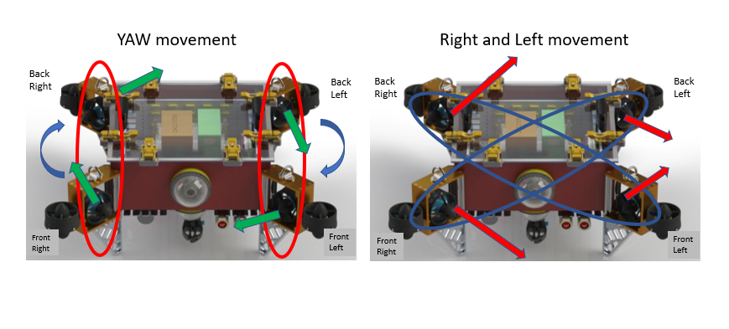
Controls – Angled Thruster Movement
Sana Shaikh

Slide 19
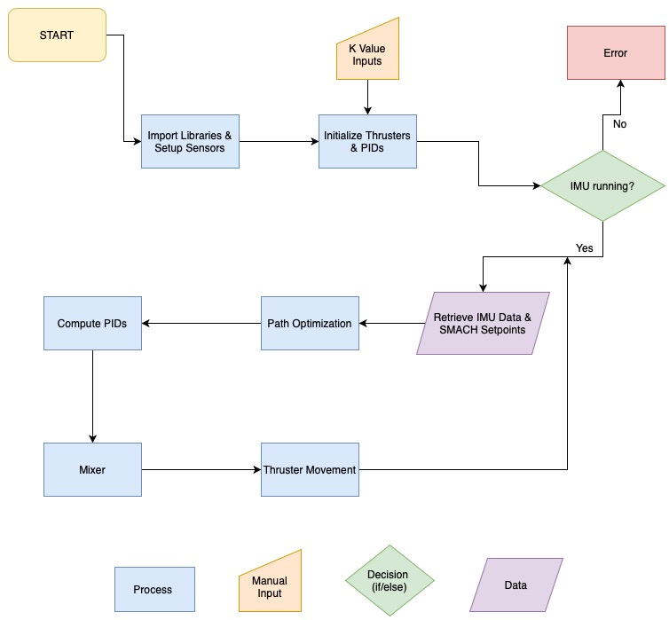
Sana Shaikh
Controls Code Flowchart

Slide 20
Navigation
Kevin Williams
Objective:
Object Detection
Output distance from objects
Object Avoidance
Provide sensor data to subsystems for decision making
Pathfinding
Maneuver AUV to each task

Slide 21
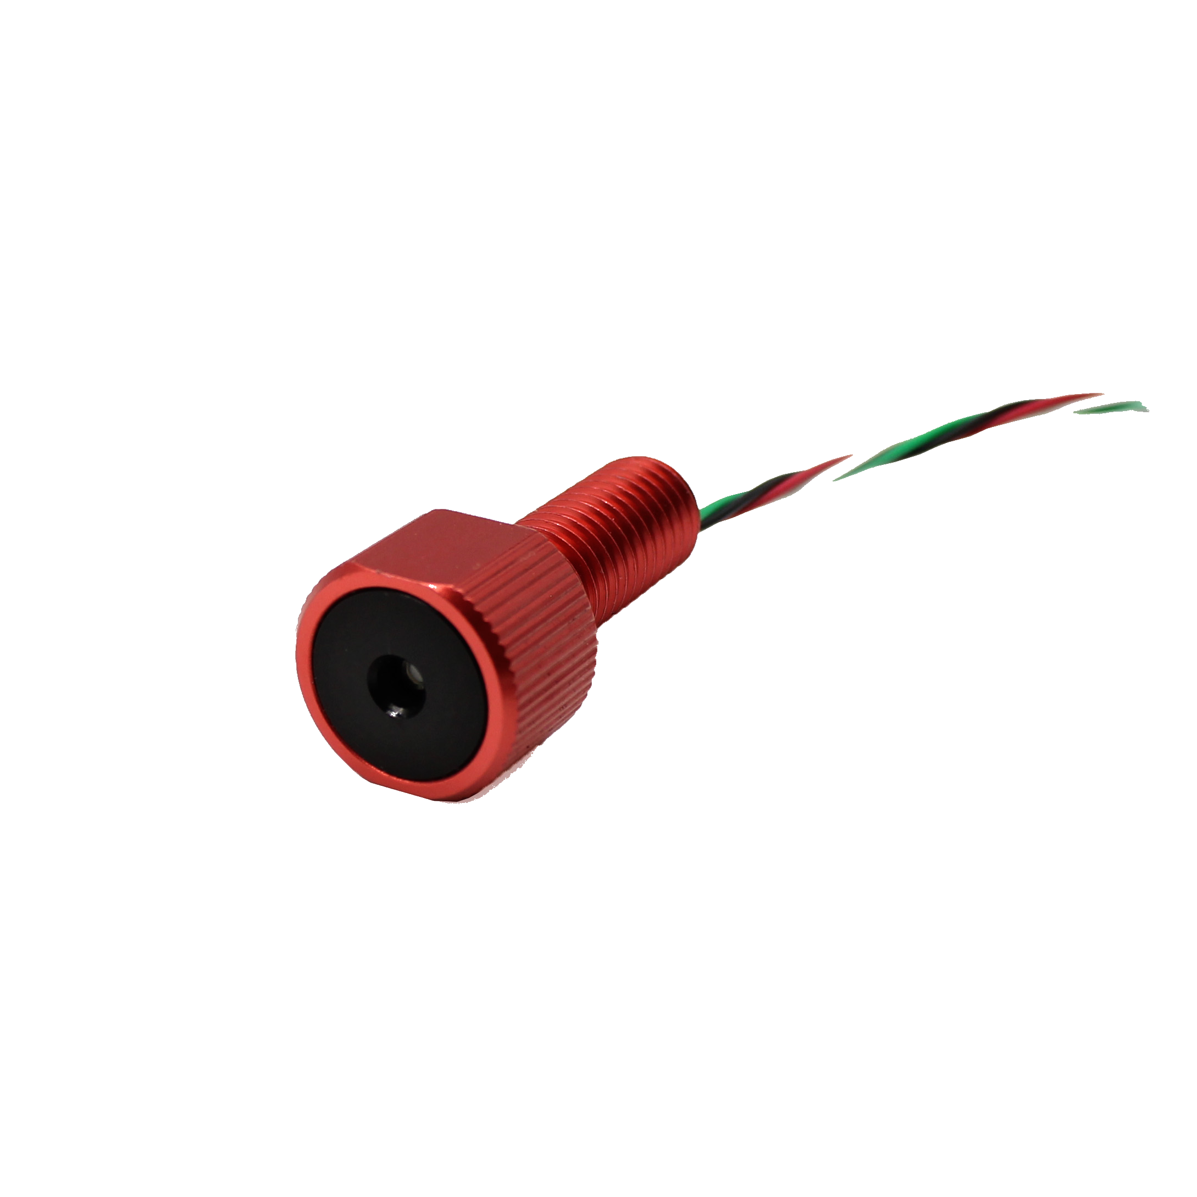
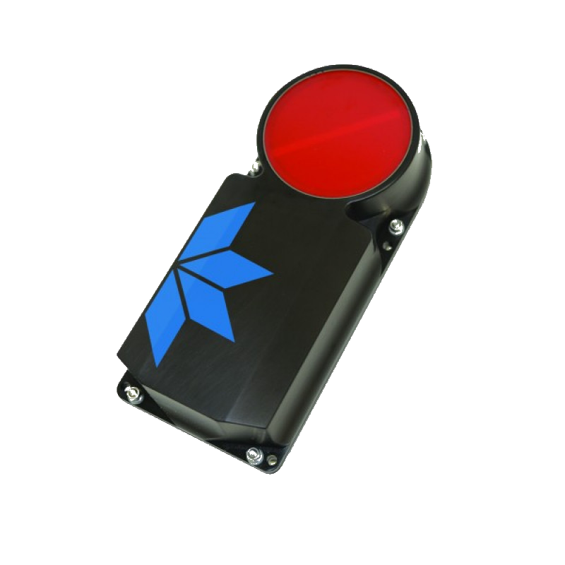
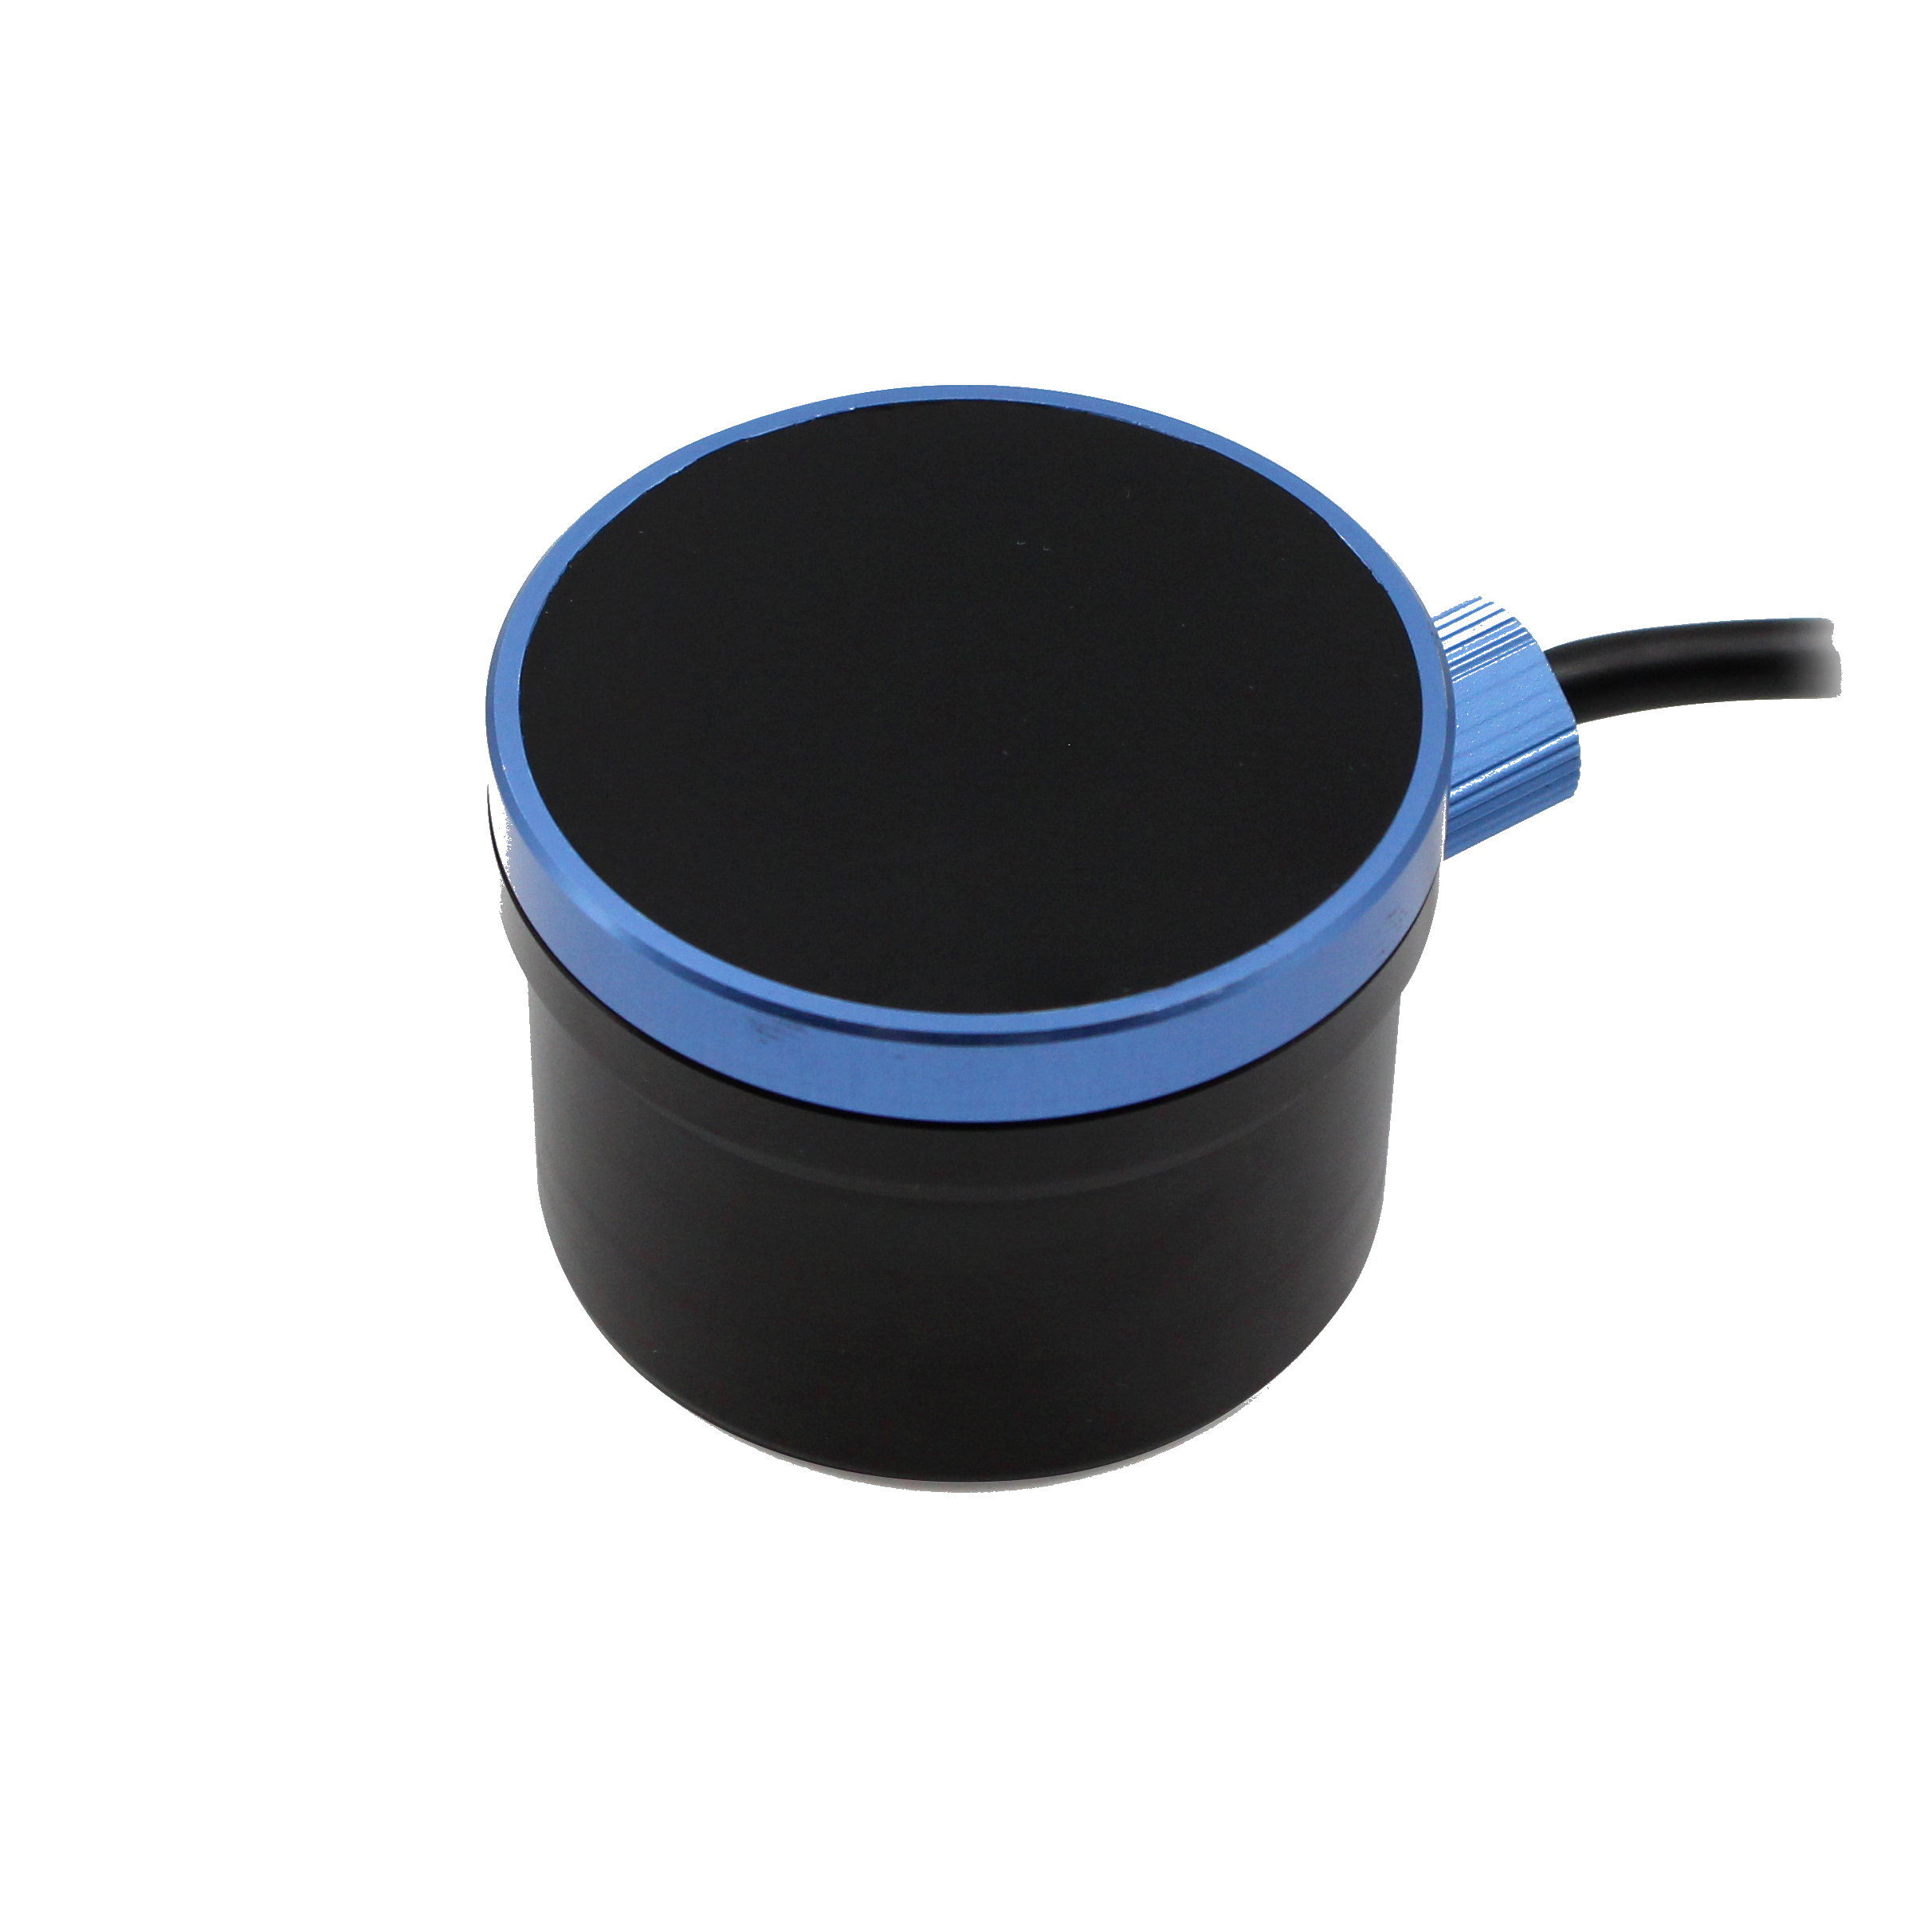
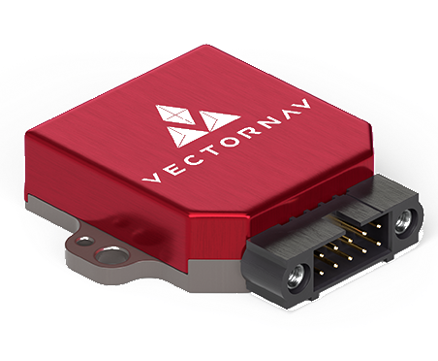
Kevin Williams
Navigation: Onboard Sensor
Name: VectorNav - 100 IMU
Details:
Pitch, Yaw, Roll of sub
C++ library
Serial Connection
Name: Bar30 Pressure Sensor
Details:
Pressure reading
Correlates to depth
Used in conjunction with DVL
Arduino Library
I2C connection
Name: Teledyne Pathfinder DVL
Details:
Tracking Translational Movement
Depth
Python Serial Connection
Name: AS-1Hydrophones
Details:
Angle to underwater Pinger relative to front of sub
Python Libraries
Reading from Amplifier
Array of Hydrophones connected to amplifier
Name: Blue Robotics Ping Sonar
Details:
Large object detection
Arduino Library / Python

Slide 22
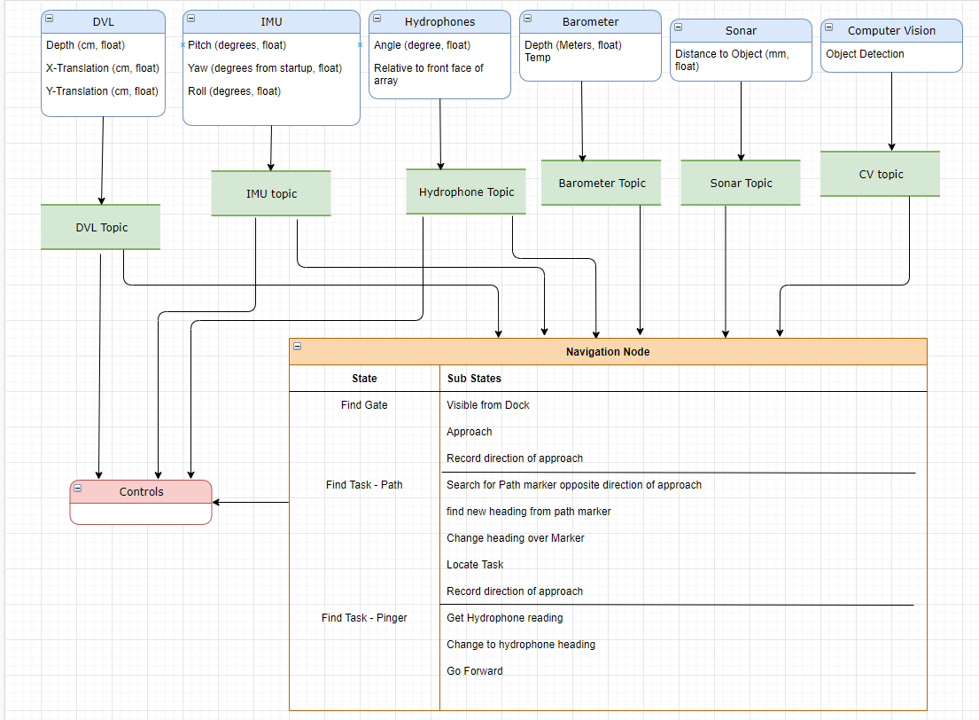
Navigation Overview
Kevin Williams

Slide 23
Computer Vision
Heriberto Gonzalez
Objective:
Object Detection – Be able to detect when an object of interest is present in view of our AUV
Object Recognition – Classify and Recognize the various objects throughout the course
Output Objects Estimated Location – Once an object of interest has been Detected and Recognized we should be able to output roughly where in frame our object is at, relative to the angle of the camera
Task:
Use Convolutional Neural Network to develop a Deep Learning Model to detect and classify objects
Gather and develop an image dataset of the objects from the competition to be used to train the CNN Model

Slide 24
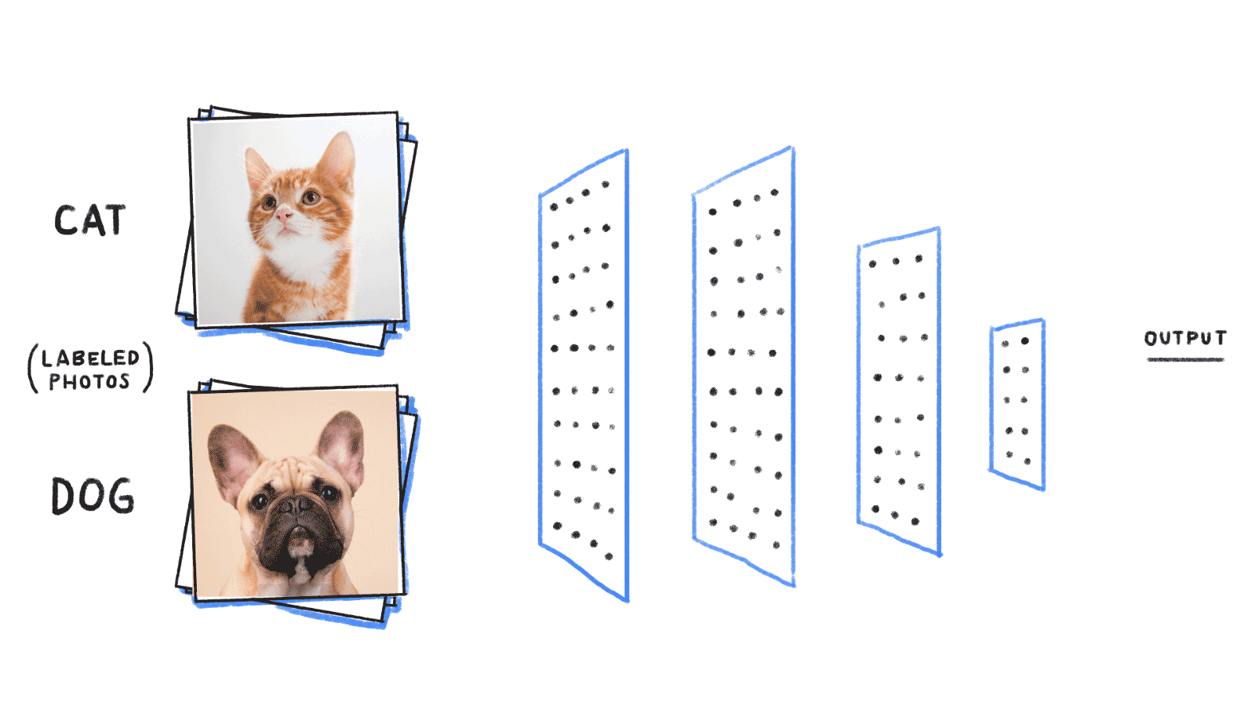
Deep Learning – Convolutional Neural Networks (CNN)
Heriberto Gonzalez
Convolutional Neural Networks
Deep Learning algorithm which can take in an input image, assign importance to various aspects/objects in the image and be able to differentiate one from the other
Darknet:
Darknet is an open-source neural network framework written in C and CUDA
Allows us to train our CNN using our GPU (Graphics Processing Unit)
YOLOv4:
Convolutional Neural Network algorithm for real-time object detection

Slide 25
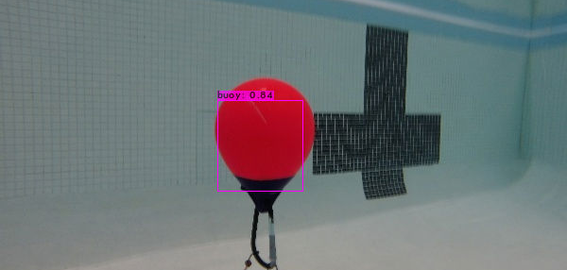
Computer Vision
Horacio Mondragon
The images to help us train the model are thousands of pictures of underwater buoys, bins, and gates.
In the beginning the software mislabeled the buoys. With proper training and modifications to the software we were able have proper classification to have better the accuracy of labeling the buoys.

Slide 26
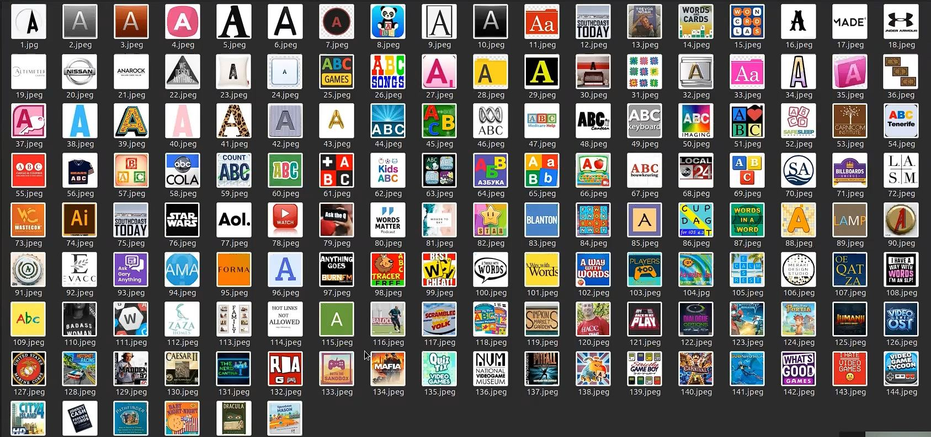
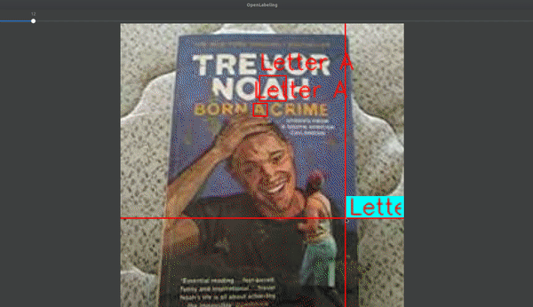
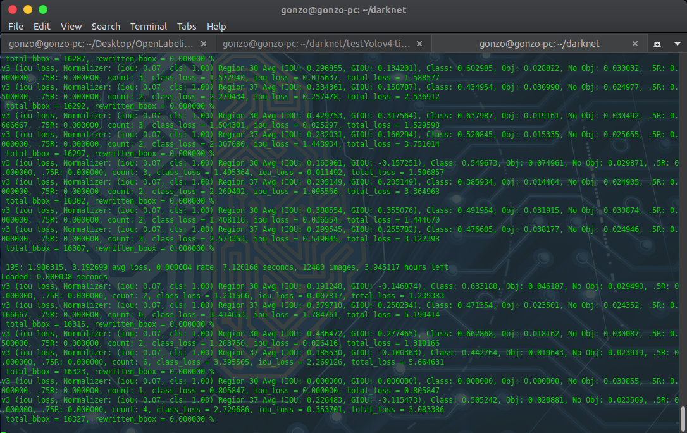
Image Dataset
OpenLabeling
Heriberto Gonzalez
Darknet + YOLOv4 Training
YOLOv4: 'A' Classifier
4 Hours to Train
Avg Fps: 15-20fps

Slide 27
CSULA - RoboSub
Ricardo Medina
By: Heriberto Gonzalez, Ricardo Medina, Horacio Mondragon, Gabriela Cortes-Mejia, Brandon Pham, Sana Shaikh, Wilson Weng, Kevin Williams, Albert Chew
Thank You!!!

