Slide 1
Program
Review
Information
System
Management
David, Leanne ■ McLees, Andrew ■ Sarenas, Justin ■ Solis, Ben
Notes:
Mention team members

Slide 2
AGENDA
Program Review Process
What is PRISM?
PRISM Design
Summary and Future Timeline

Slide 3
WHAT IS A PROGRAM REVIEW?
A process that:
Examines a program’s standing
Validates a program’s strength
Identifies areas for improvement in a program
Maintains accreditation
Handled by Program Review Subcommittee (PRS)
Notes:
Say a few sentences of what’s a program and what’s a program review and why there’s a program review
Slow down a little bit on some explanation

Slide 4
Program Review Overview

Slide 5
THE LAUNCH MEETING
The Program Review Subcommittee (PRS) discusses the following:
Program review process
Programs up for review
PRISM (in future)

Slide 6
SELF-STUDY DOCUMENT
Discusses the progress made over the past 5 years
Completed by the program undergoing the review
Approved by the College
Dean must sign final document
Sent to PRS

Slide 7
EXTERNAL REVIEWERS
Peers from distinguished programs in or outside of the CSU system
During the visit, they consult with:
Students
Staff
Administrators
Dean approves the reviewers
Submit an external review report

Slide 8
MEMORANDUM OF UNDERSTANDING
(MOU)
A report containing recommendations and commendations for the program
Summary Report is used
Report completed by the PRS
Collaboration between College Dean, Chair, & Department Representatives

Slide 9
PRISM Requirements
Track review process progress
Manage review process documents
Track Program Review Subcommittee (PRS) meetings
Store other documents
Notes:
Have a description of the process and motivation for the system BEFORE this slide
Describe current review process

Slide 10
Browser
REST API
Server
Notes:
High level design
Frontend <-> REST API <-> Backend (?)
REST API easier to separate and develop each independently. Also test each independently
Combine high-level design slide and technologies slide
Client-side app lives INSIDE of the browser
User -> | Angular [SPA] ||||||||||||||| [Nodejs/Express/Webapp] - [Mongoose] - [MongoDB]
------------------------------------------------------------------------------------------------------
Browser REST API Server
Express used for passport and rest api endpoints

Slide 11
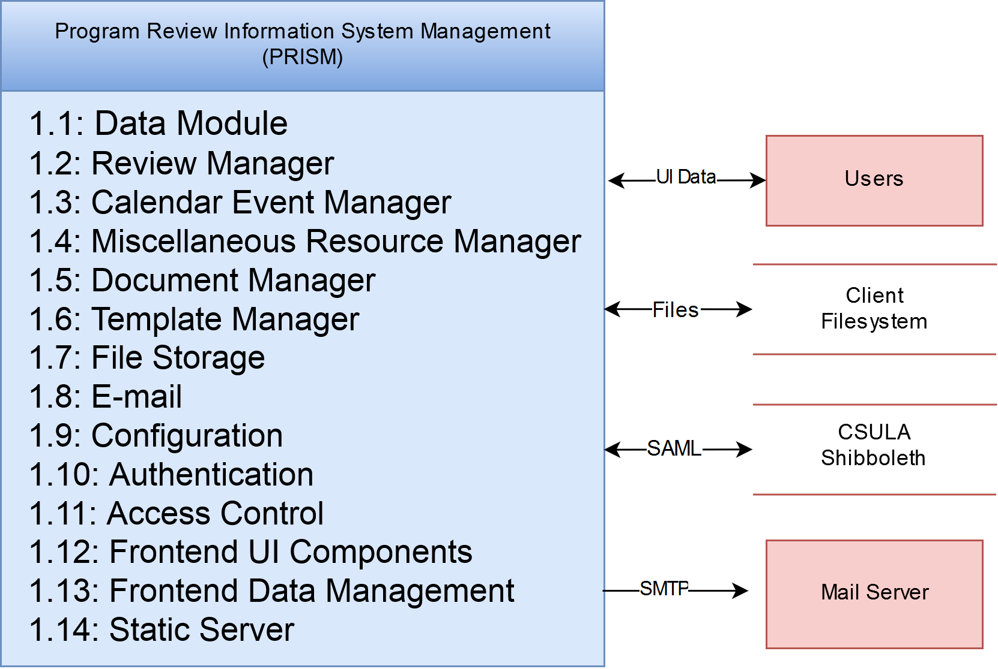
Notes:
Bi-directional arrows instead
Go through the inputs and outputs

Slide 12
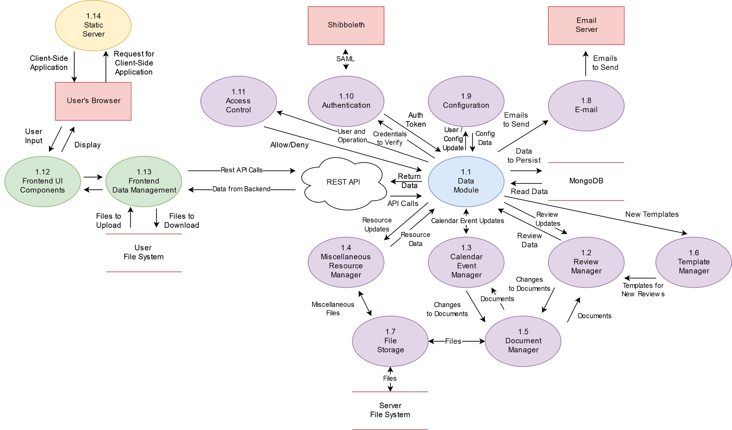
Functionality Goals
Provide an overview of the review process' progress to PRS members
Provide a versioning system and commenting system for each document
Provide access to documents based on user type
Send emails to people involved at various levels
Notes:
Research DFDs
Change Rest API shape to another one; Oval = component, Rest API is an API, browser is a software… etc
Each module should be self-contained, only knows what it needs to know
Email module shouldn’t need to know about the internal stuff on how reviews are
Speaker: Go through Review manager, Calender Manager, Miscelleneous resource is files everyone needs to download .
Review Manager - Tracks

Slide 13
Modeling the Review Process
Methodology
Build a hierarchy mirroring the university's hierarchy
Separate
Overall review information
Progress tracking
Individual document versioning and comments
Notes:
First few models are straightforward
More important is the review and stage models are used to track the status
How the document model is not only a file but keeps track of revisions and comments
First three just say it follows the same hierarchy as the university
Review tracks process specific to review such as lead reviewer
Stage tracks the document process, overall state of review as
Documents - comments and versioning
File itself, when it was created, all the details of particular version of the file, date it was uploaded, version message, user upload

Slide 14
User Interface
Notes:
Leanne David

Slide 15
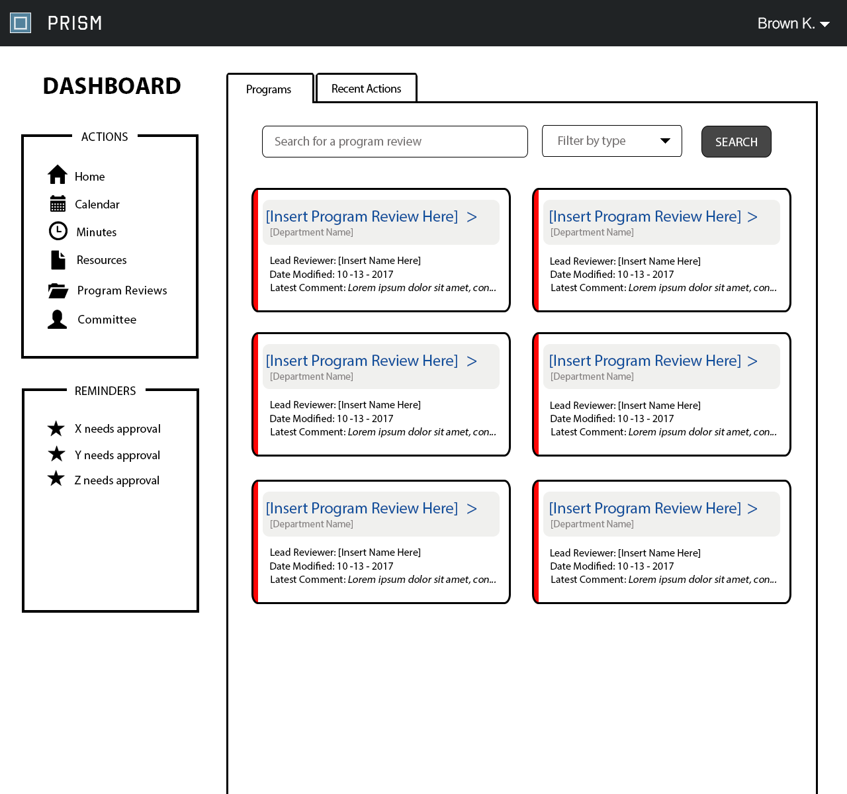
Dashboard Page
Administrator User
Actions Menu + Reminders sidebar
PROGRAMS Tab
List all active program reviews
RECENT ACTIONS Tab
Tracks the latest actions done
Notes:
Recent actions - just a log model (have a log model) - live on the server - list of strings

Slide 16
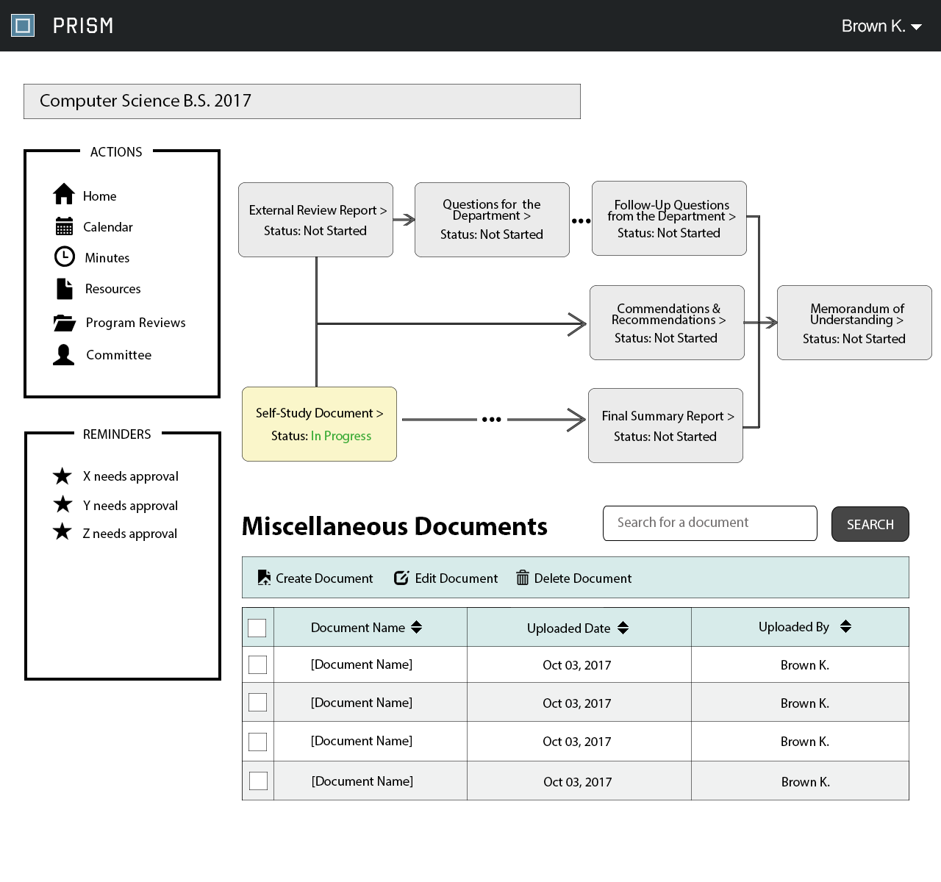
Program Review Page
Shows a tree of the overall review process
Clickable components to a specific document
Current status of each stage
Table to upload, edit, and delete miscellaneous documents
Notes:
Flow chart or workflow of the review process instead of calling it a “tree”
Not all the documents are not exactly in sequence as it implies

Slide 17
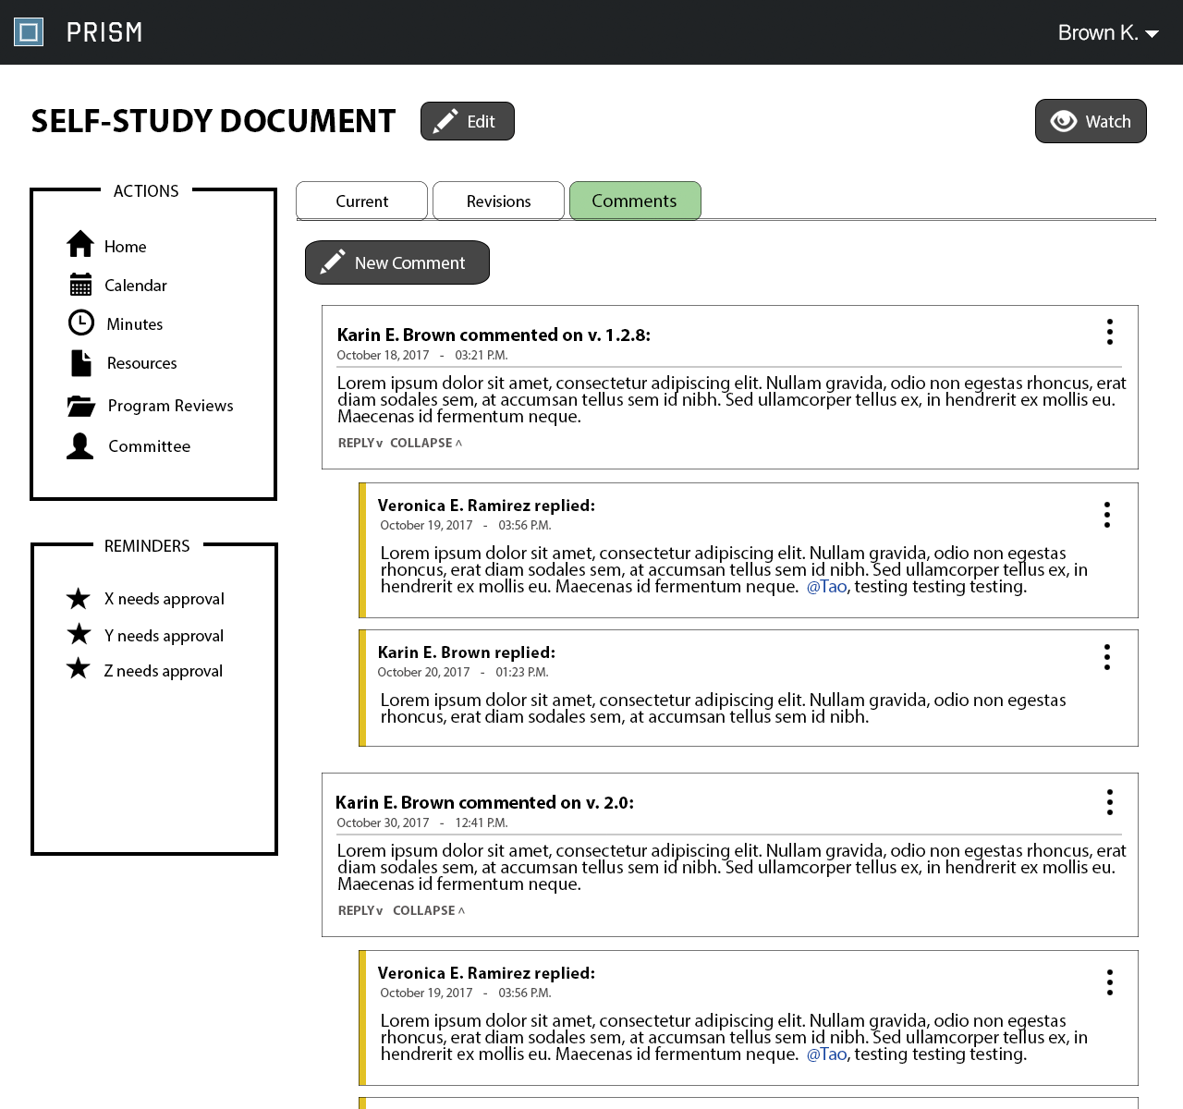
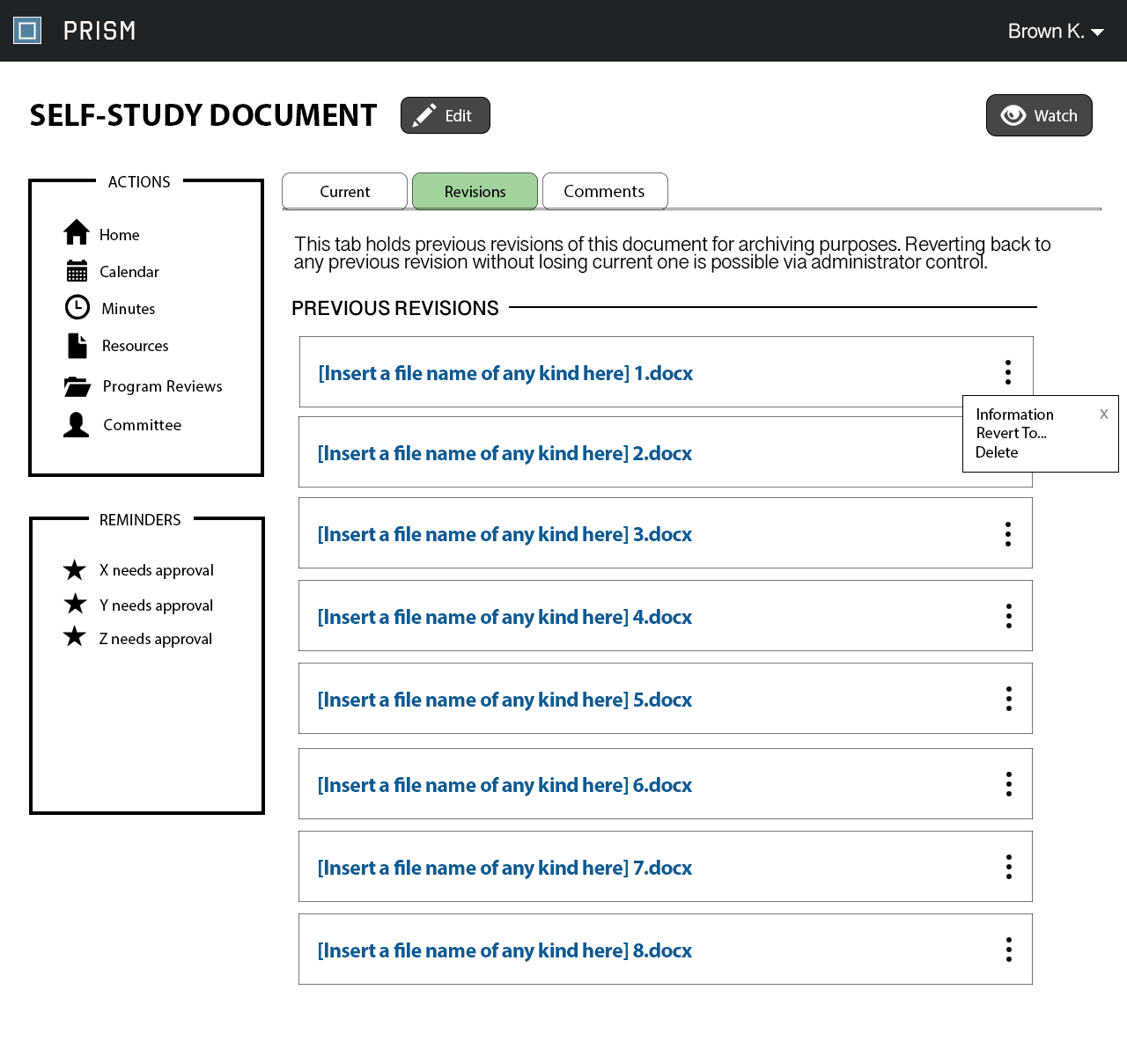
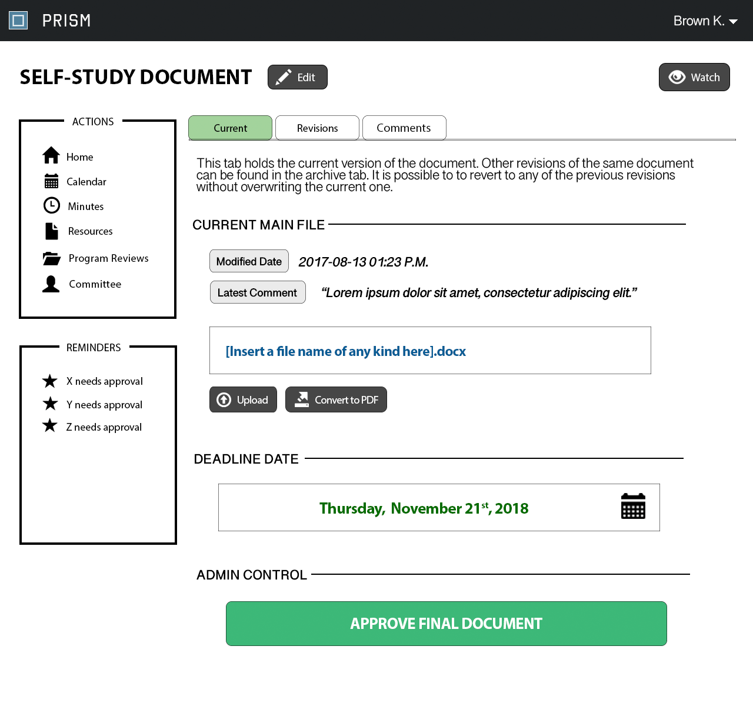
Document Page
3 tabs per document page of a review
CURRENT Tab
Holds the most recent uploaded file by default
Upload file/convert to PDF
REVISIONS Tab
Stores all previous uploaded files
Can revert to or delete any revision
COMMENTS Tab
Two-level system
Hold discussions of a specific revision before final status
Notes:
Leave the UI pages here as static

Slide 18
Summary of Progress Made
Completed requirements document
Preliminary design document
Model implementation
Development environment
Learning technologies

Slide 19
Future Timeline
Winter Intersession
REST API Design
Begin on backend implementation
Begin on frontend implementation
Spring Semester
Finish backend implementation
Finish frontend implementation
Finish user manual
Conduct testing
Train users
Notes:
Spring:
Testing, documentation, user training

Slide 20
Thank You
David, Leanne ■ McLees, Andrew ■ Sarenas, Justin ■ Solis, Ben Jair

