Slide 1
Digitization of PD Onboarding & Approval Process
Presented by: Rawad Moussa, Tabassuma Torosa, Adrian Palomares, Paul Clef Ube, Audelia Valdovinoz, Javier Garcia, Pierce Wei, Marlito Refuerzo, Christopher Rodriguez
Sponsored by: Los Angeles County Public Defender
Liaisons: Mohammed Al Rawi & Gratia Dsouza
Project Advisor: Dr. Chengyu Sun

Slide 2
Los Angeles County Public Defender’s Office
Pierce Wei
Widely considered the finest client-centered criminal defense firm in the nation, working to reduce incarceration and the collateral consequences of contact by 2025
Provides treatment courts, juvenile advocacy, immigration, mental health assistance mainly for criminals
Giving back to community and representing minorities that are often overlooked

Slide 3
Los Angeles County Public Defender’s Office (cont.)
Pierce Wei
32 offices located throughout the country, team of more than 1,200 employees, 700 attorneys, and more staff composed of:
Paralegals, investigators, psychiatric social workers, and admin/support staff
Shows that there is a need for a good IT system for people doing important work

Slide 4
Project Overview
Pierce Wei
Project 1 (INITIAL): Migrate legacy content management system and databases to Salesforce.
Currently this project is on hold because the PD IT staff are busy with a new system going online.
Project 2 (CURRENT): Online Employee/Contractor Enrollment Application
Allow users to request forms that will be generated via back-end communication with Adobe Sign API; saved in Adobe Sign account when signed

Slide 5
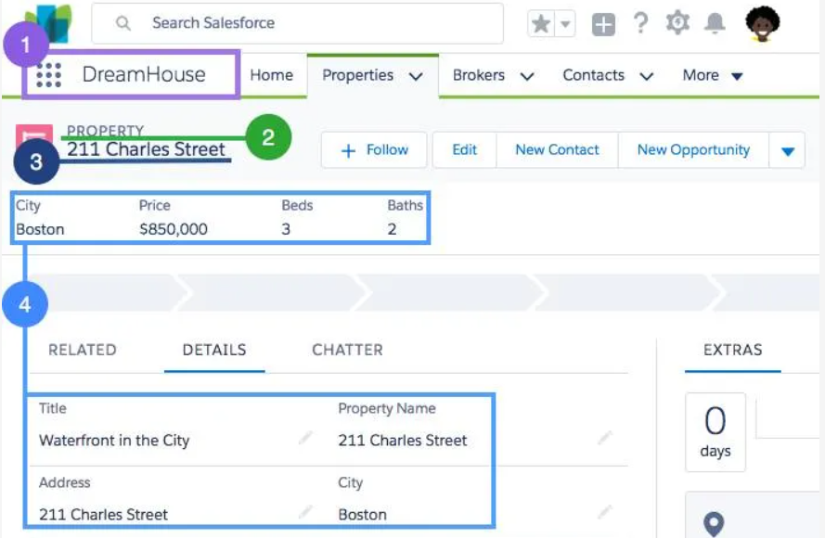
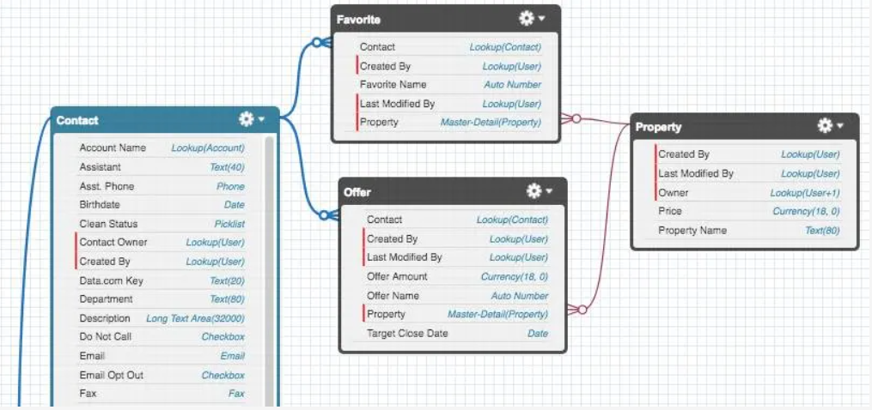
Our Progress with Salesforce
Christopher Rodriguez
Import and export data
Create schema to model data
Deploy customized app in Salesforce app store
Notes:
-less details, more what we learned

Slide 6
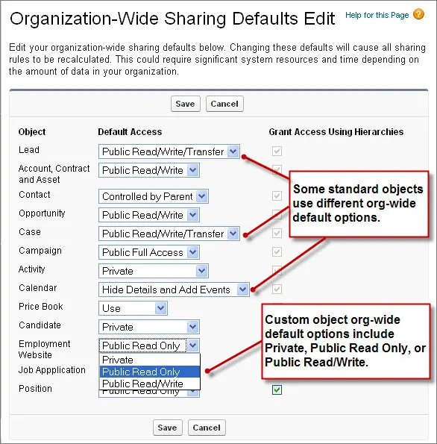
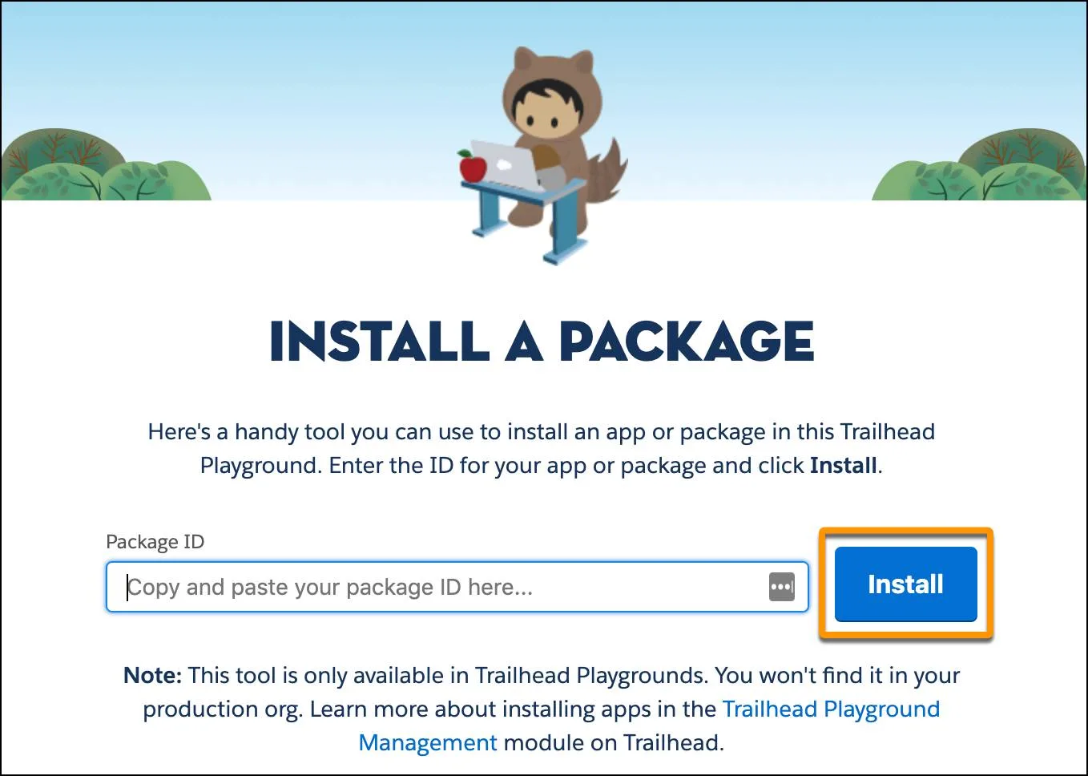
Our Progress with Salesforce
Christopher Rodriguez
Install apps/packages
Limiting access and setting up role hierarchy within an organization
Notes:
-less details, more what we learned

Slide 7
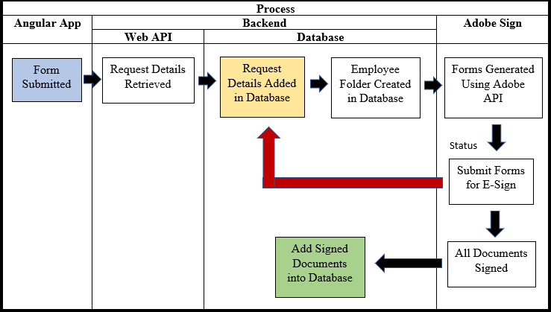
Enrollment Application Project
Presenter: Marlito Refuerzo
Angular app is used to submit employee & contractor requests.
Includes Request Status page where the user can search certain fields
Requestor is sent a RequestID
Backend retrieves and stores request details to database.
Employee Folder is added within the Database
Notes:
Notes:
Angular App
Develop Custom Form using Angularjs to capture employee/contractor form specific info
Request Status pg + Searchable [Request ID • EmployeeID • Contracting Company • FirstName • LastName]
Form Submission
Request recorded. Entry added to database. Status → "Initial Request Sent". “RequestID” sent to requestor.
Generate folder in BOX for employee under In Progress folder.
Template generation
PDF templates provided. For empl/contr type, generate specific forms & input data captured in forms.
Send generated docs to Requestor for review (esign)
Requestor reviews docs & sends forms to parties for review
Successful completion → docs parked in BOX

Slide 8
Enrollment Application Project (cont.)
Presenter: Marlito Refuerzo
Corresponding forms are generated within Adobe Sign and filled with requestor provided data.
Generated documents are sent to appropriate requestors for review and for their electronic signature
Once all forms have been signed, the document is sent back to the database
Notes:
Notes:
Angular App
Develop Custom Form using Angularjs to capture employee/contractor form specific info
Request Status pg + Searchable [Request ID • EmployeeID • Contracting Company • FirstName • LastName]
Form Submission
Request recorded. Entry added to database. Status → "Initial Request Sent". “RequestID” sent to requestor.
Generate folder in BOX for employee under In Progress folder.
Template generation
PDF templates provided. For empl/contr type, generate specific forms & input data captured in forms.
Send generated docs to Requestor for review (esign)
Requestor reviews docs & sends forms to parties for review
Successful completion → docs parked in BOX

Slide 9
Project Requirements
Presenter: Marlito Refuerzo
Developed w/ a Custom Form using Angularjs for specific form information
Request Status page w/ specific searchable fields via Angular App
Request (through Form Submission) is recorded and adds an entry to the database
Values inputted in specific PDF templates (based on type) generates the specific forms and inputs the data into the new forms
Sends generated and filled out form to the Requestor for review through the use of Adobe Sign
Allows Requestor to review, prep, sign, and send forms to others for review
Upon completion, stores document

Slide 10
Employee Fields
Contractor Fields
Searchable Fields
First Name
Last Name
Telephone
Address (Street, City, State, Zip)
Email ID
Employee Type (Defaults to Employee)
Employee ID
Submission Date (Defaults to Current Date)
Requestor Name
Requestor Email
Approvers
Department Number
Department Name
First Name
Last Name
Contracting Company
Telephone
Address (Street, City, State, Zip)
Company Email ID
Employee Type (Defaults to Contractor)
Employee ID (Only Available if Type is set to Employee)
Submission Date (Defaults to Current Date)
Requestor Name
Requestor Email
Approvers
Department Number
Contract Work Order Number
Contract Expiration Date
Business Street Address
Department Name
Request ID
Employee ID
Contracting Company
First Name
Last Name

Slide 11
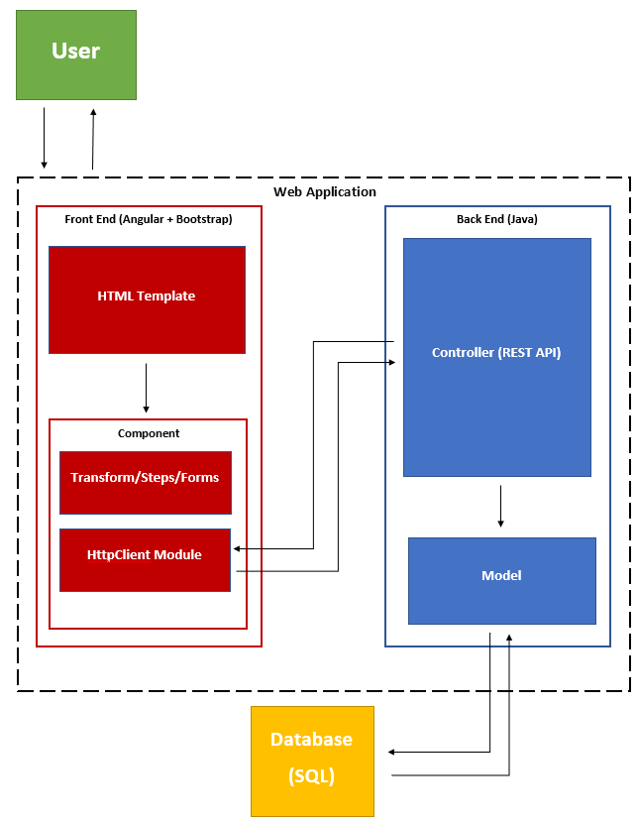
Overall System Architecture Diagram
Presenter: Paul Clef Ube

Slide 12
Overall System Architecture
Presenter: Paul Clef Ube
User: Make requests and receive responses to the Web Application
Web Application: Contains a Front End and Back End. The web application sends the HTML template (user interface) to the user to interact and fill out forms.
Front End: Has an HTML template that interacts with Angular components. The HttpClient Module then sends service requests and receive responses from the Back End controller.
Back End: Receives service requests from Front End, models data in Java, stores in relational database.
Database: Keeps data in storage. It sends requested data to the model of the Back End.

Slide 13
Backend Operations
Presenter: Rawad Moussa
Technologies
The backend infrastructure uses the following Java-based frameworks:
Spring Boot: A streamlined extension of the Spring application framework. The built-in libraries and server functionalities lead to greater efficiency as many low-level configurations are already accounted for.
Hibernate: An object-relational mapping framework. Provides an intuitive interface between the object-oriented Java and relational SQL data models via the intermediary language HQL (Hibernate Query Language).

Slide 14
Front End Operations
Presenter: Rawad Moussa
Built with Angular
Easy to build user interfaces
Reusable code
Material UI
Styled with Bootstrap

Slide 15
Results & Achievements
Presenter: Rawad Moussa
Front End Achievements
Improving the user interface
Back End Achievements
Connecting to Adobe Sign
General Achievements
Implementing an admin system
Connecting front end and back end

Slide 16
Live Program Demo
Presenters:
Adrian Palomares, Tabassuma Torosa, Audelia Valdovinoz, Javier Garcia

