Slide 1
/Admin Microsoft Liaison: Sam Stokes Faculty Advisor: Dr. Elaine Kang
Ryan Bogle
Gabor Kondas
Imtiaz Razzak
Jacob Zac Skinner

Slide 2
Agenda
Motivations
Innovations & Gameplay
Trailer
Current Progress
Tools
Challenges
Accomplishments
Imagine Cup
Future Plans

Slide 3
Motivations
Zac Skinner

Slide 4
Motivations
Something for the Forgotten Hardcore Gamers
Make Innovations in a Stale Game Market
Great New Devices with no Engaging Games
Expanding Mobile Game Market

Slide 5
Innovation & Gameplay
Imtiaz Razzak

Slide 6
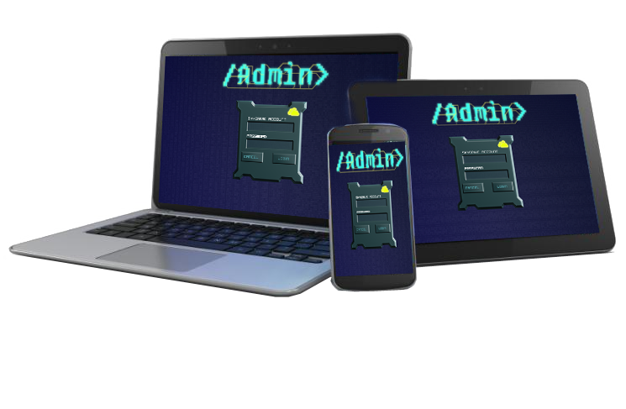
Innovation
Playable on Any Device
Persistent Experience
Intuitive Controls
Borrow Gameplay Elements
Role Playing
Simulation
Internet Themed (Educational)

Slide 7
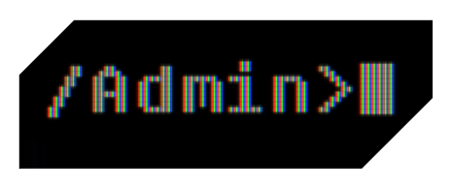
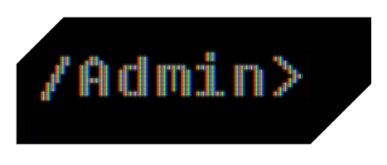
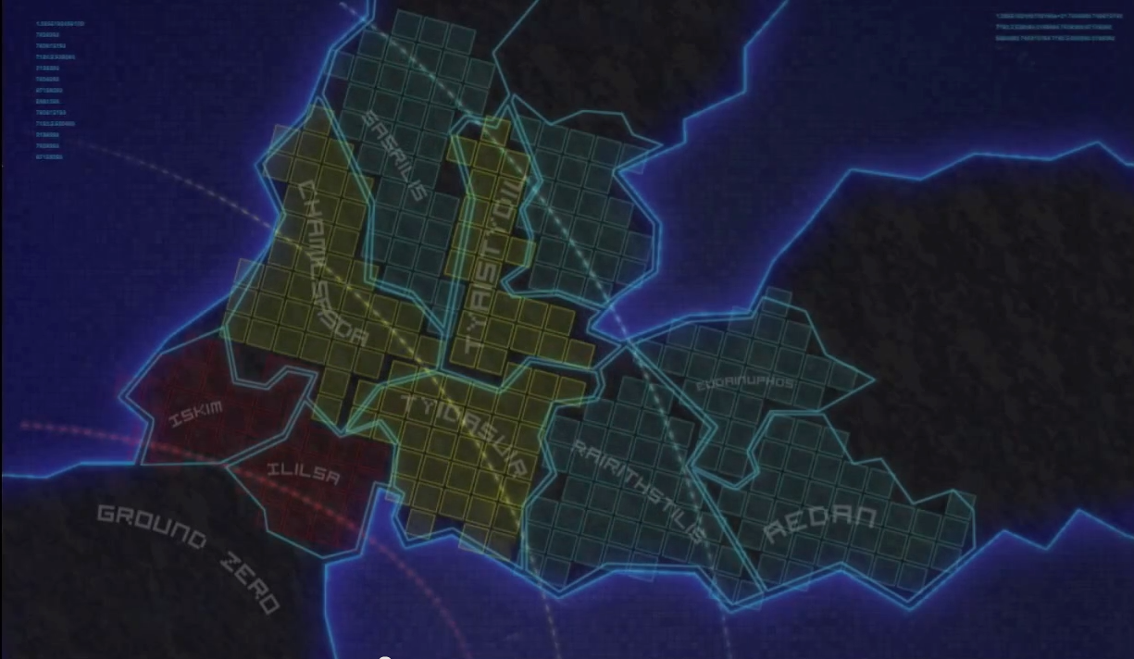
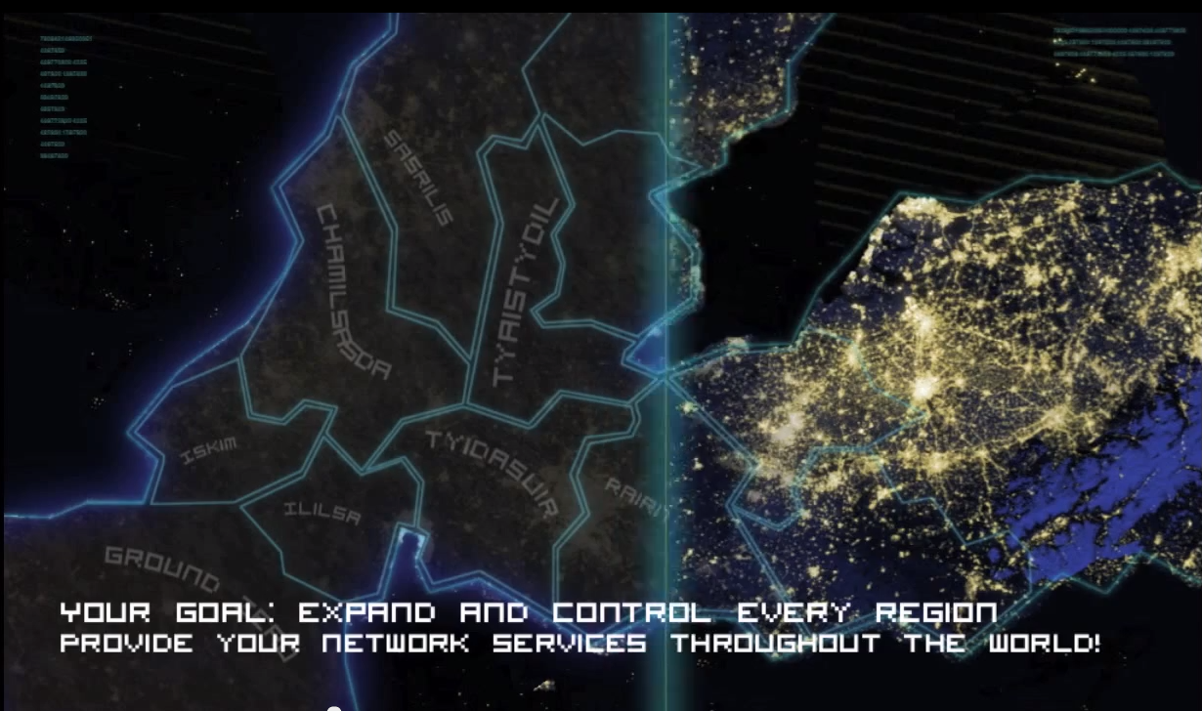
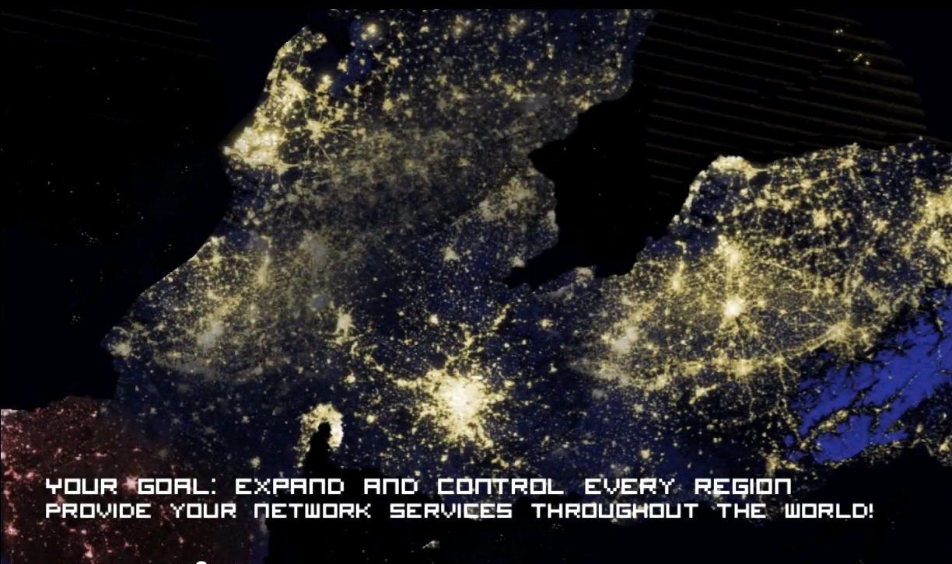
The Story
Welcome to the New Digital Age

Slide 8
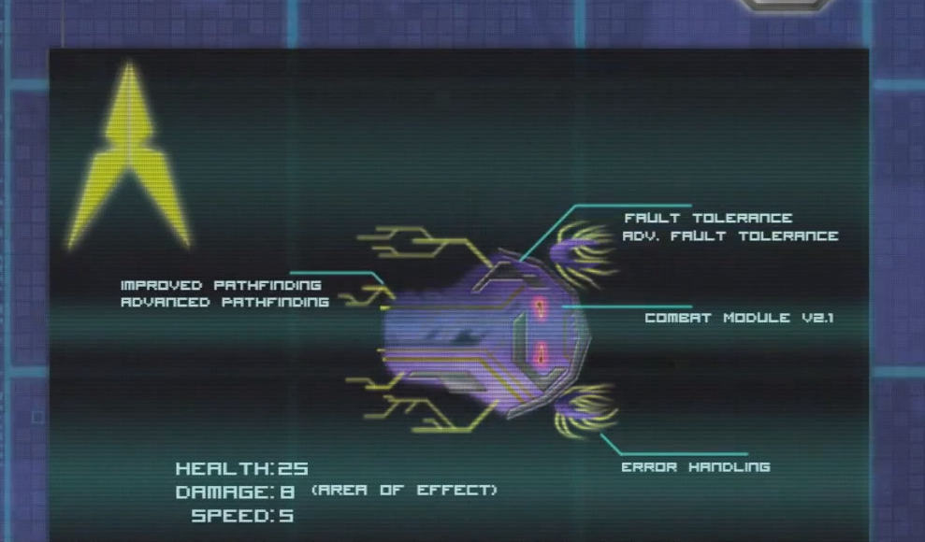
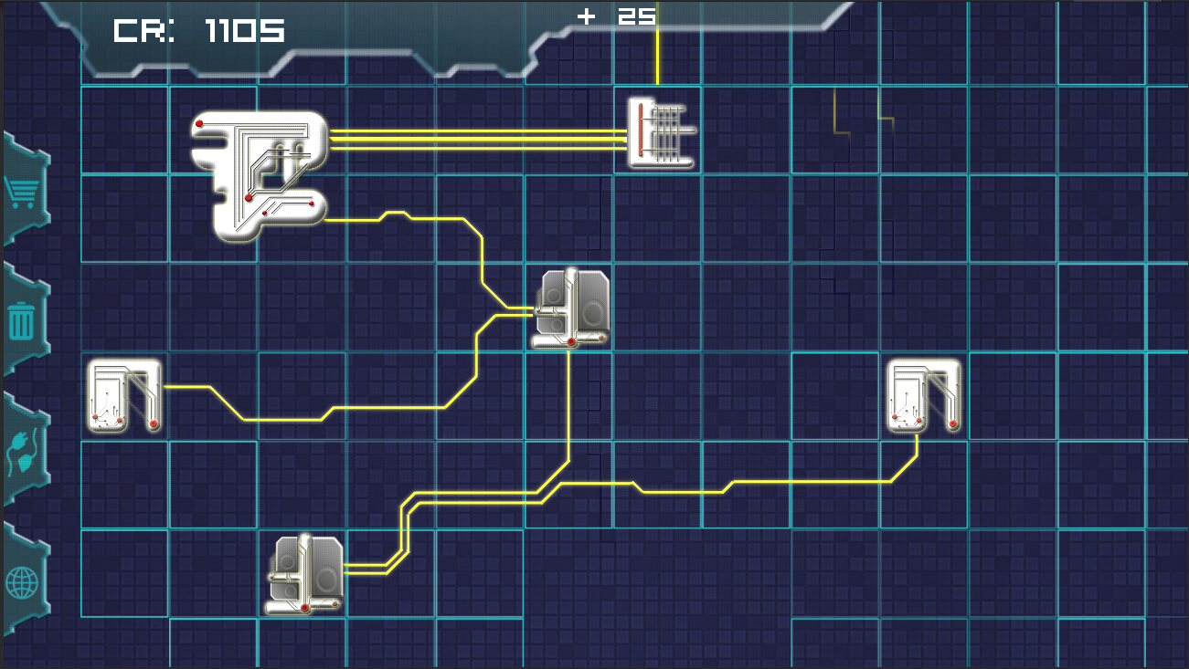
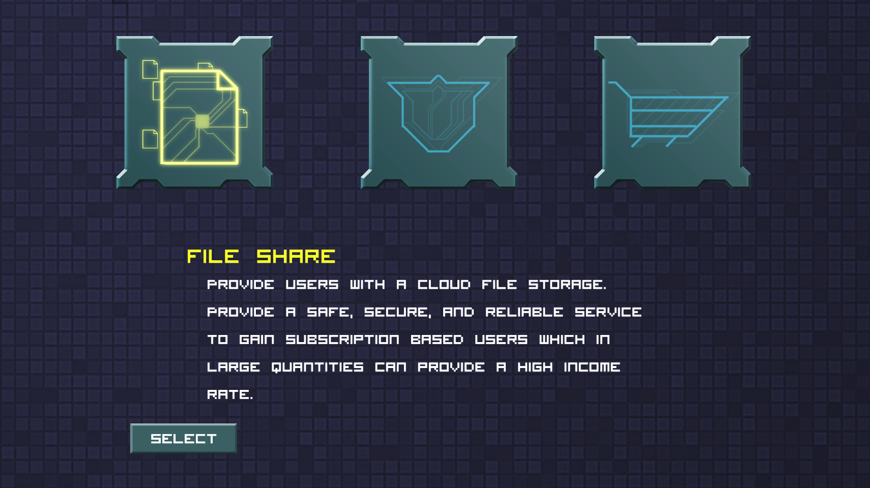
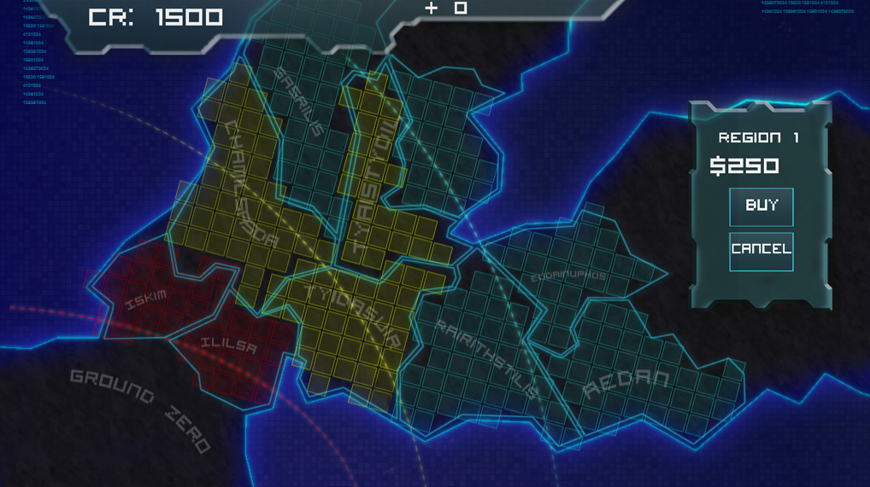
Gameplay
EIDOs
World Map
Class Selection
Network Construction

Slide 9
Trailer

Slide 10
Current Progress
Gabor Kondas

Slide 11
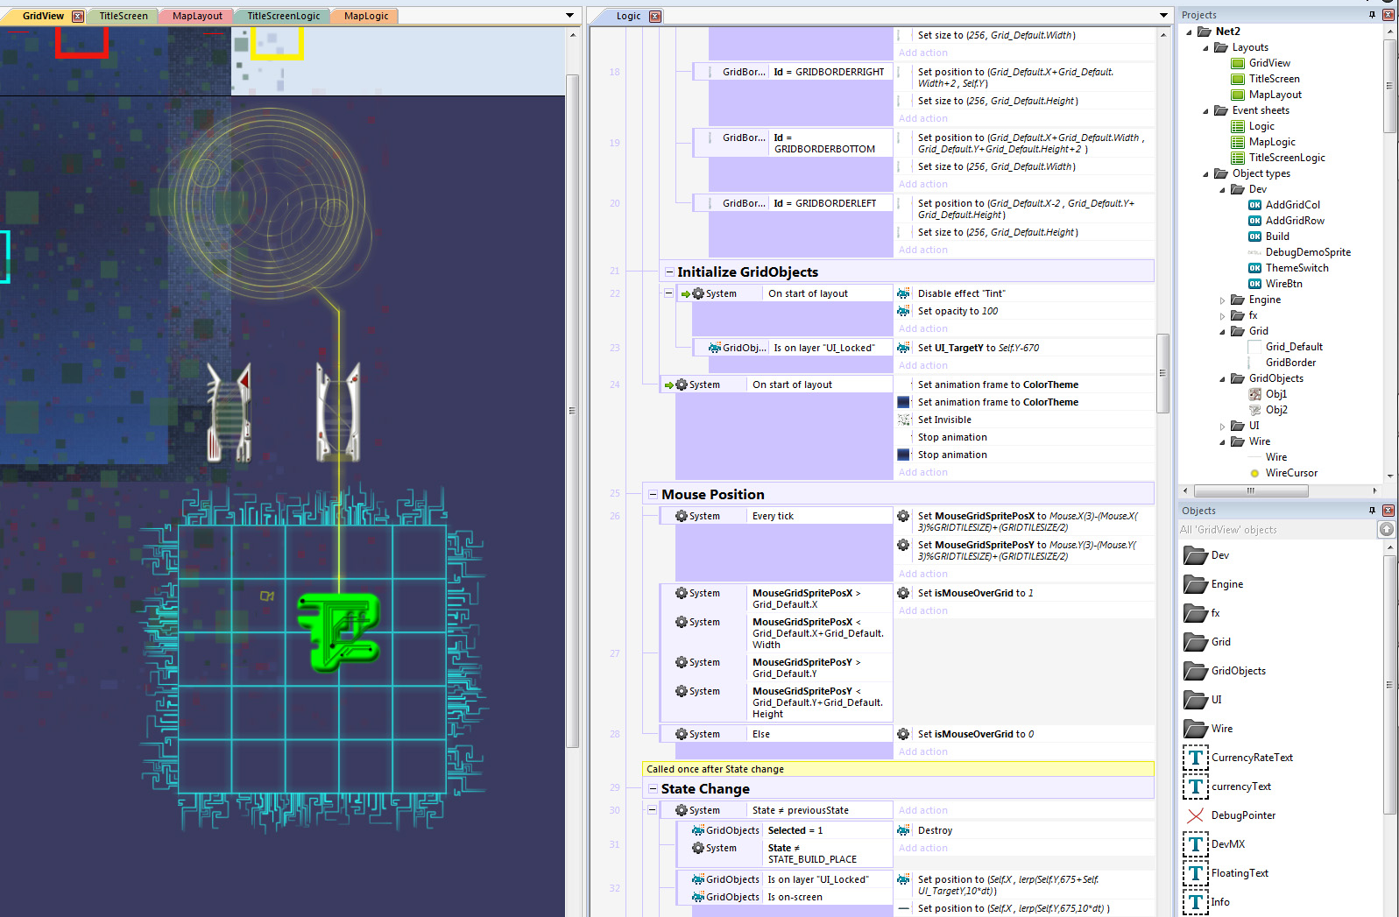
Construct Prototype
Built in Construct 2
Implemented
World Map
Network Building
Wiring
Currency
No Combat
Desktop Interface

Slide 12
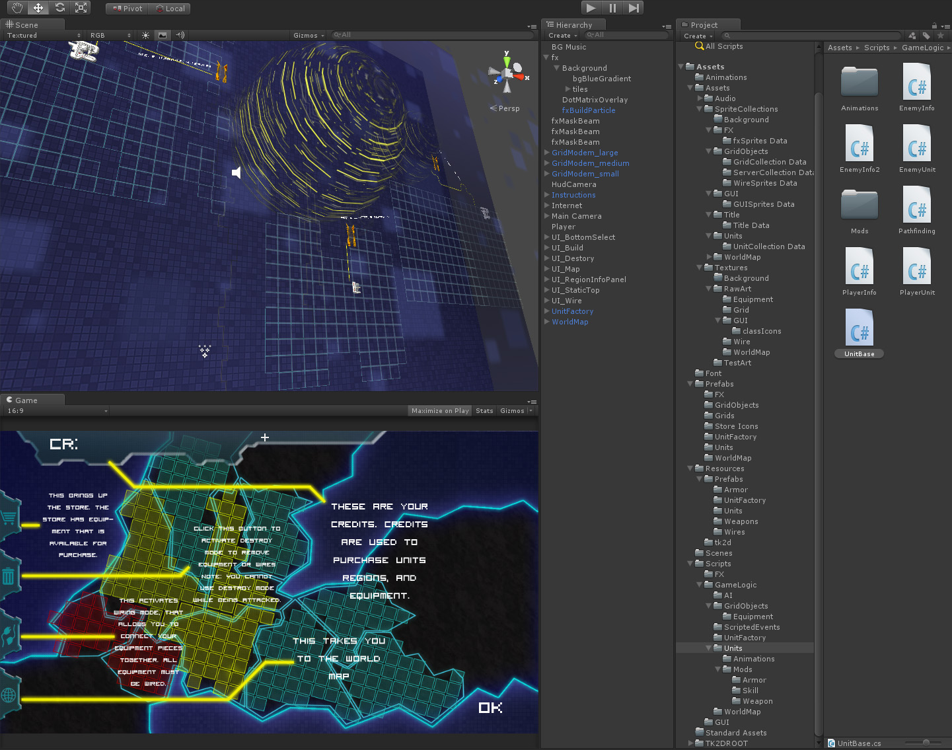
Unity 3D Prototype
Implemented
Classes
World Map
Network Building
Wiring
Currency
Units & Combat
Added a Tutorial
Player Level & XP

Slide 13
Tools
Unity 3D 4
2D Toolkit Plugin
Unity Asset Server
Visual Studio / Mono Develop
Photoshop
Asana / Trello
Dropbox / SkyDrive
Samsung Series 7 Slates
Windows Azure
Bit Bucket

Slide 14
Challenges
Ryan Bogle

Slide 15
Challenges
No Dedicated Artist
No Sound Engineer
Learning C#
Learning Unity 3D
Component Based Design
Two Sets of Deadlines

Slide 16
Accomplishments
Ryan Bogle

Slide 17
Microsoft Imagine Cup
Largest Worldwide Programming Competition for Students
US Accelerator
Trailer and Description
Started in January
US Competition
500+ Entered
Game Prototype, Instructions Document, Overview Video
Asked to Compete in US Finals
Earned “Top Accelerator Team” Award

Slide 18
Future Plans
Ryan Bogle

Slide 19
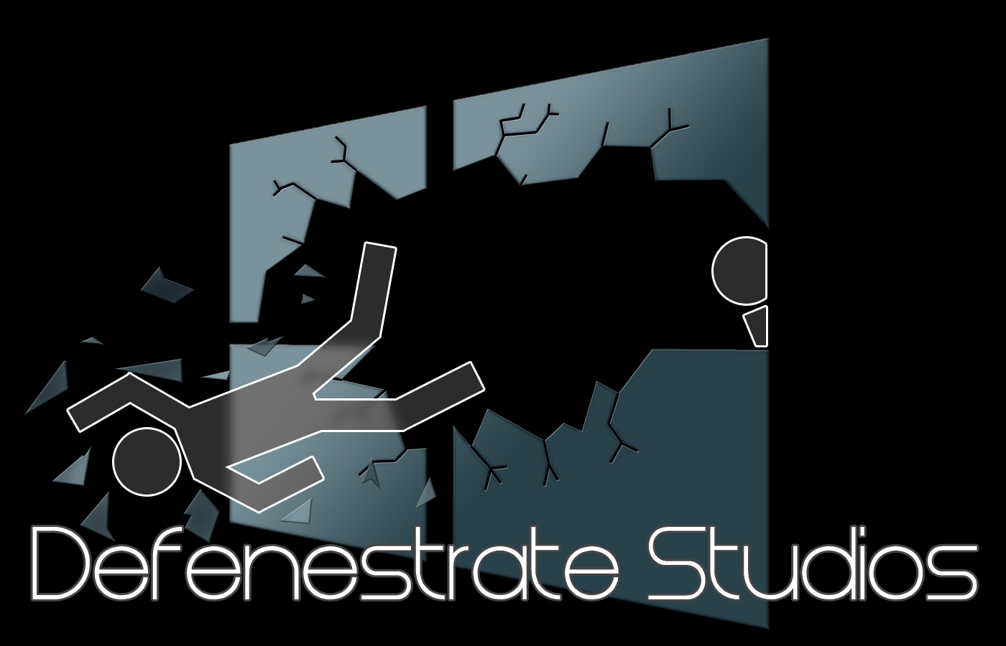
Looking Forward
Continue Working Together
Start-Up Defenestrate Studios
Continue Developing /Admin
Continue Learning Unity 3D
Start Smaller Projects
Expand the Team
Artist
Sound Designer

Slide 20
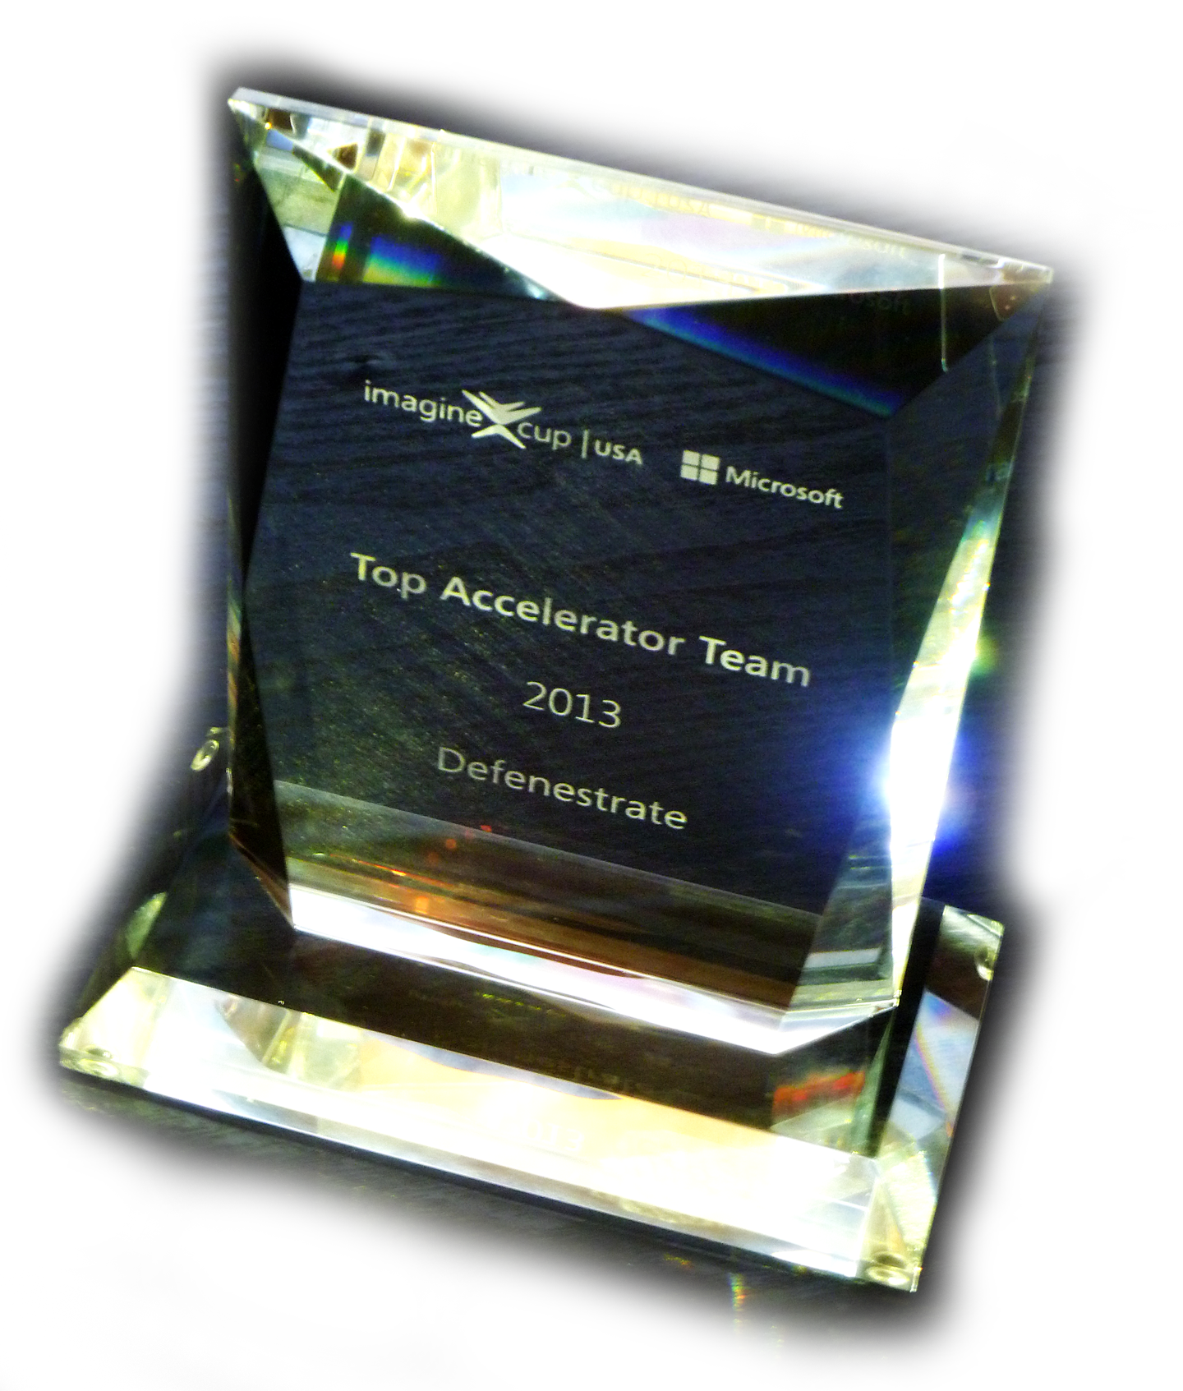
Questions?

Slide 21
The Market
Capture Strategy and RPG players
Nearly 50% of the best selling games fall into one of these two genres
Mobile Sales Continue to Increase
Use the Mobile Market to drive sales
Use Multiple delivery Methods
Long Release Cycle leaves room for new entries

