Slide 1
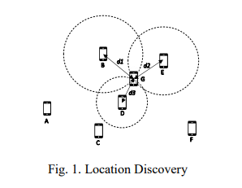
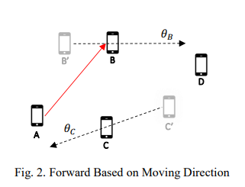
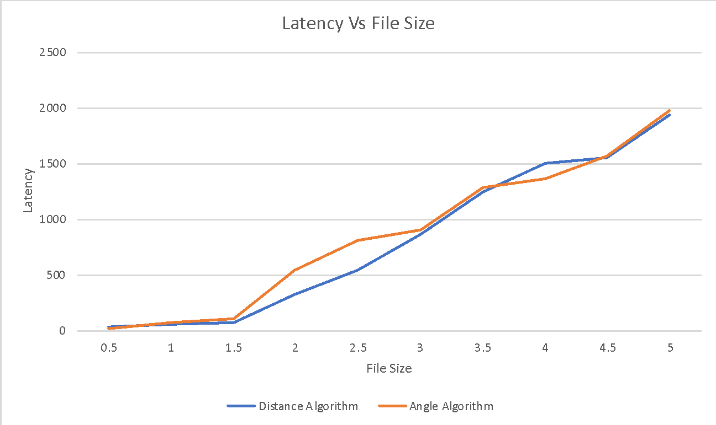
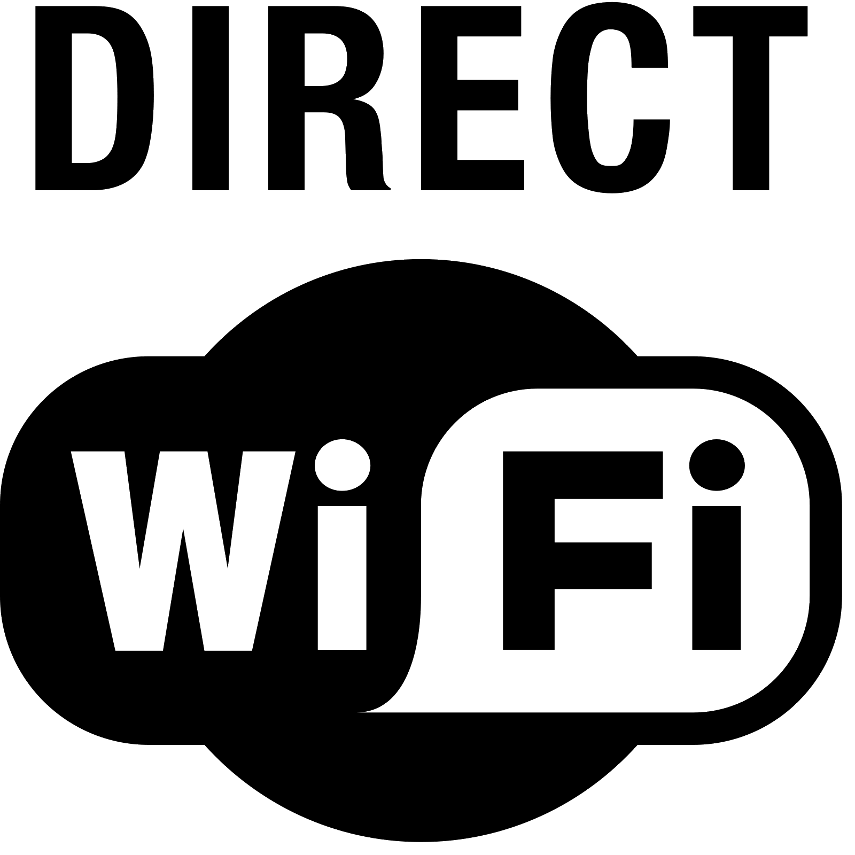
A Location-Based Intelligent Forwarding Strategy for NDNWIFI Team Members: Antonio Garcia, Saba Mahbub, Michael Oceguera, Kevin Tong, Hieu Tran Faculty Advisor: Dr. Zilong Ye Liaison: Fujitsu Department of Computer Science College of Engineering, Computer Science, and Technology California State University, Los Angeles
Objective
Location Discovery
To allow communication between Android users when connection services are scarce such as a national park or post-disaster scenarios using Named Data Networking(NDN). Wi-Fi hardware (through Wi-Fi Direct) can still be used to connect to one another even though internet connectivity is limited or non-existent, similar to Bluetooth or an airdrop.
Main objective is to forward connection to users based on location. Location can be determined by either distance or angle between users.
The location of devices can be found via the use of GPS coordinates. We can then use these coordinates to calculate bird’s eye distance with the Haversine formula. We can also calculate angle and/or direction of movement through bearing formulas.
NDN
Named Data Networking is a future internet architecture that focuses on “what” content is instead of “where” the content is, using name-based routing and cache content store. The underlying principle is that a communication network should allow a user to focus on the data he or she needs, rather than have to reference a specific, physical location where that data is to be retrieved from.
Wi-Fi Direct
Forward Based on Moving Direction
Wi-Fi Direct is a Wi-Fi standard enabling devices to easily connect with each other without requiring a wireless access point. We use free spectrum channels to conduct the data communication, without Internet infrastructure.
Each user tracks their current and previous location. The algorithm also detects the user’s moving direction. Based on these aspects, intelligent routing can be made.
Requesting Data
The first step in the process is sending an Interest with the name of the content that the customer is looking for (i.e. /ndn/calstatela/senior_project)
Returning Data
The Interest will be routed based on the name instead of the IP of the destination. The Data will be returned by either the content store (which provides the cached data) or the data provider.
Application
Latency Comparison
The layout of our application is shown below. In addition, we have implemented a few algorithms to forward data, such as location based or angle-based, and also first-hit and hit-aware. Our results regarding these strategies are shown below.
In our experiments, we sent multiple files of various sizes and tested the latency from the origin to destination. As we see from the graph there isn’t much difference between using angles or distance to determine who to send to.
Notes:
Have students check that the logo is the appropriate one to use.

