Slide 1
Artificial Intelligence for Air Pollution Prediction and Visualization
Members: Hector Rucobo, Alejandro Alatorre, Emmanuel Cocom, Aldo Ruiz Cruz, Vidal Zazueta
Sponsors: NASA and LA City

Slide 2
Agenda
1.
Definitions and Causes
2.
Significance
3.
Purpose of Project
4.
Technology and Progress
5.
Future Goals

Slide 3
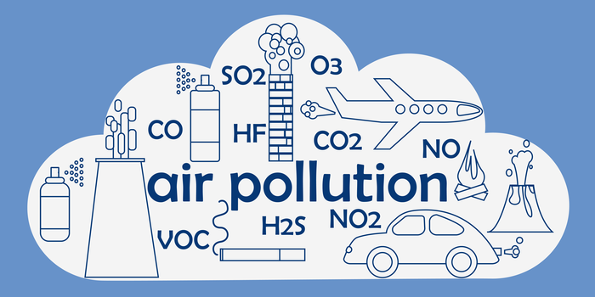
Definitions
What is air pollution?
Air pollution is the contamination of the indoor or outdoor environment by any chemical, physical or biological agent that modifies the natural characteristics of the atmosphere.
Most prevalent type is smog (ground-level O3) and soot (PM).
Other types include black carbon (BC), nitrogen oxides(NO and NO2), and sulfur dioxide (SO2).

Slide 4
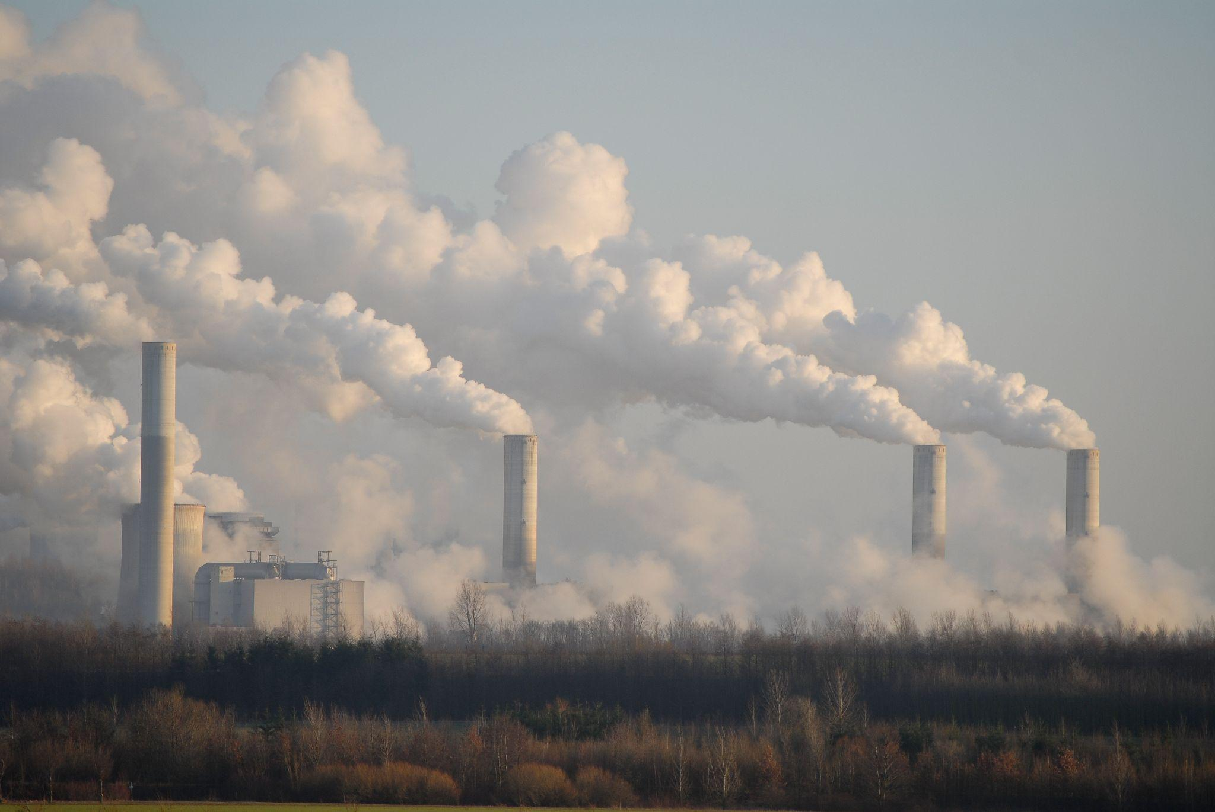
Causes - Anthropogenic
Particulate matter (PM)
Transportation, factories, power plants, incinerators
Black carbon (BC)
Burning fuel, wood, carbon
Nitrogen oxides (NO and NO2)
Transportation
Ground-level Ozone (O3)
Combustion and fossil fuels
Sulfur Dioxide (SO2)
Metal extraction and smelting, coal, ship engines

Slide 5
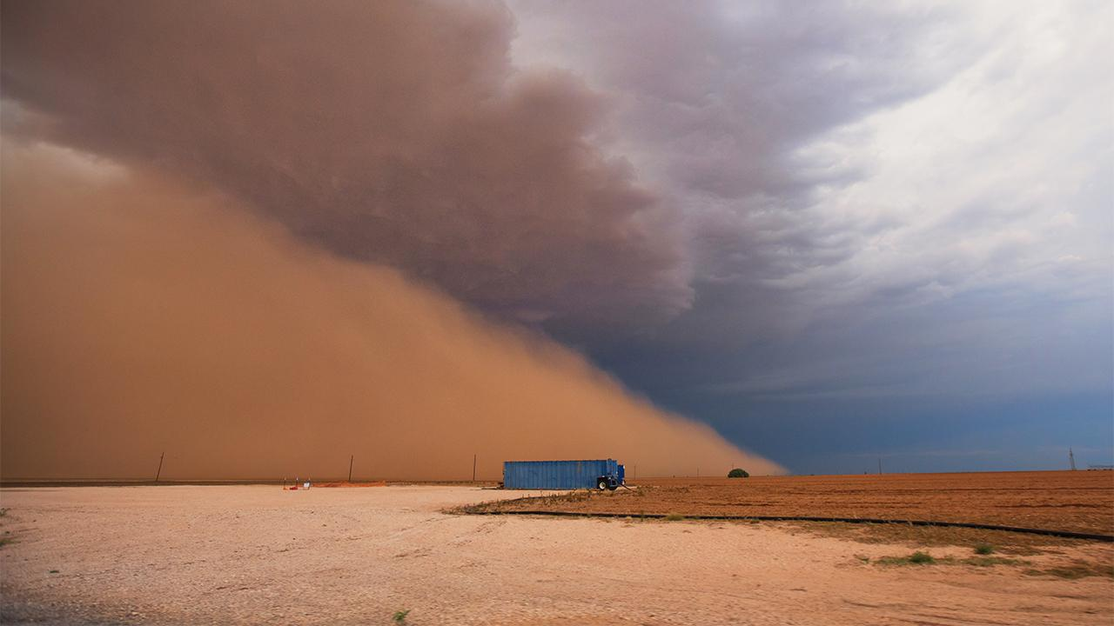
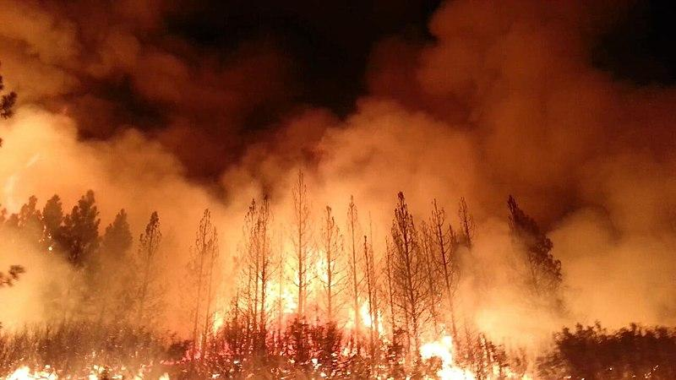
Causes - Natural
Dust
Large areas with open land, little vegetation, and lack of precipitation naturally produce dust storms.
Particulate matter gets added to the air.
Wildfires
Smoke and carbon monoxide caused by fires contribute to carbon levels in the atmosphere.
Volcanic Activity
When an eruption occurs, a tremendous amount of sulfuric, chlorine, and ash products are produced.
These are released into the atmosphere and picked up by winds which disperse them over large areas.

Slide 6
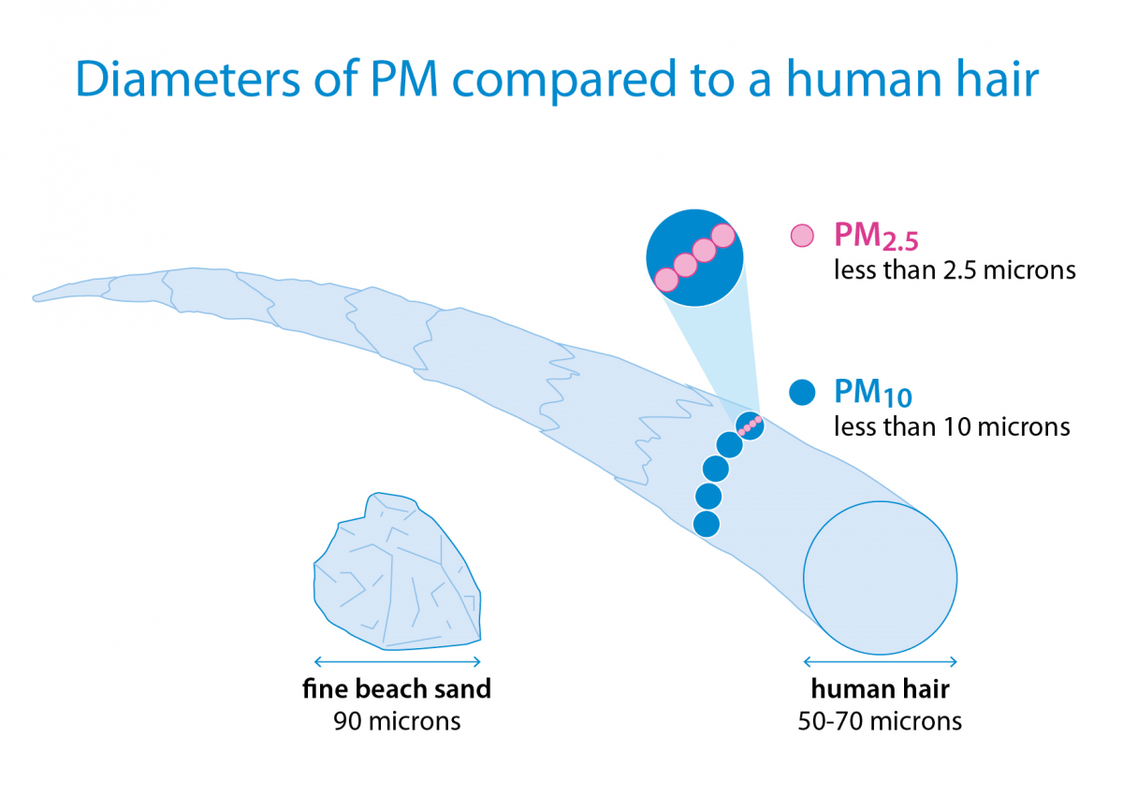
Particulates:
Air pollution comes in several shapes. -PM 2.5 or 10: small fine solid or liquid particles -origin:dust,soot,smoke,industry, volcanos,polen, soil.
It is our focus.

Slide 7
Significance:
-Short term: discomfort and irritation to the eyes,nose, throat and skin
- more serious are illnesses: bronchitis and pneumonia.
-long term: acute chronic illness, decreased lung function for prolonged periods, higher hospitalization rates
-death in compromised or weakened groups

Slide 8
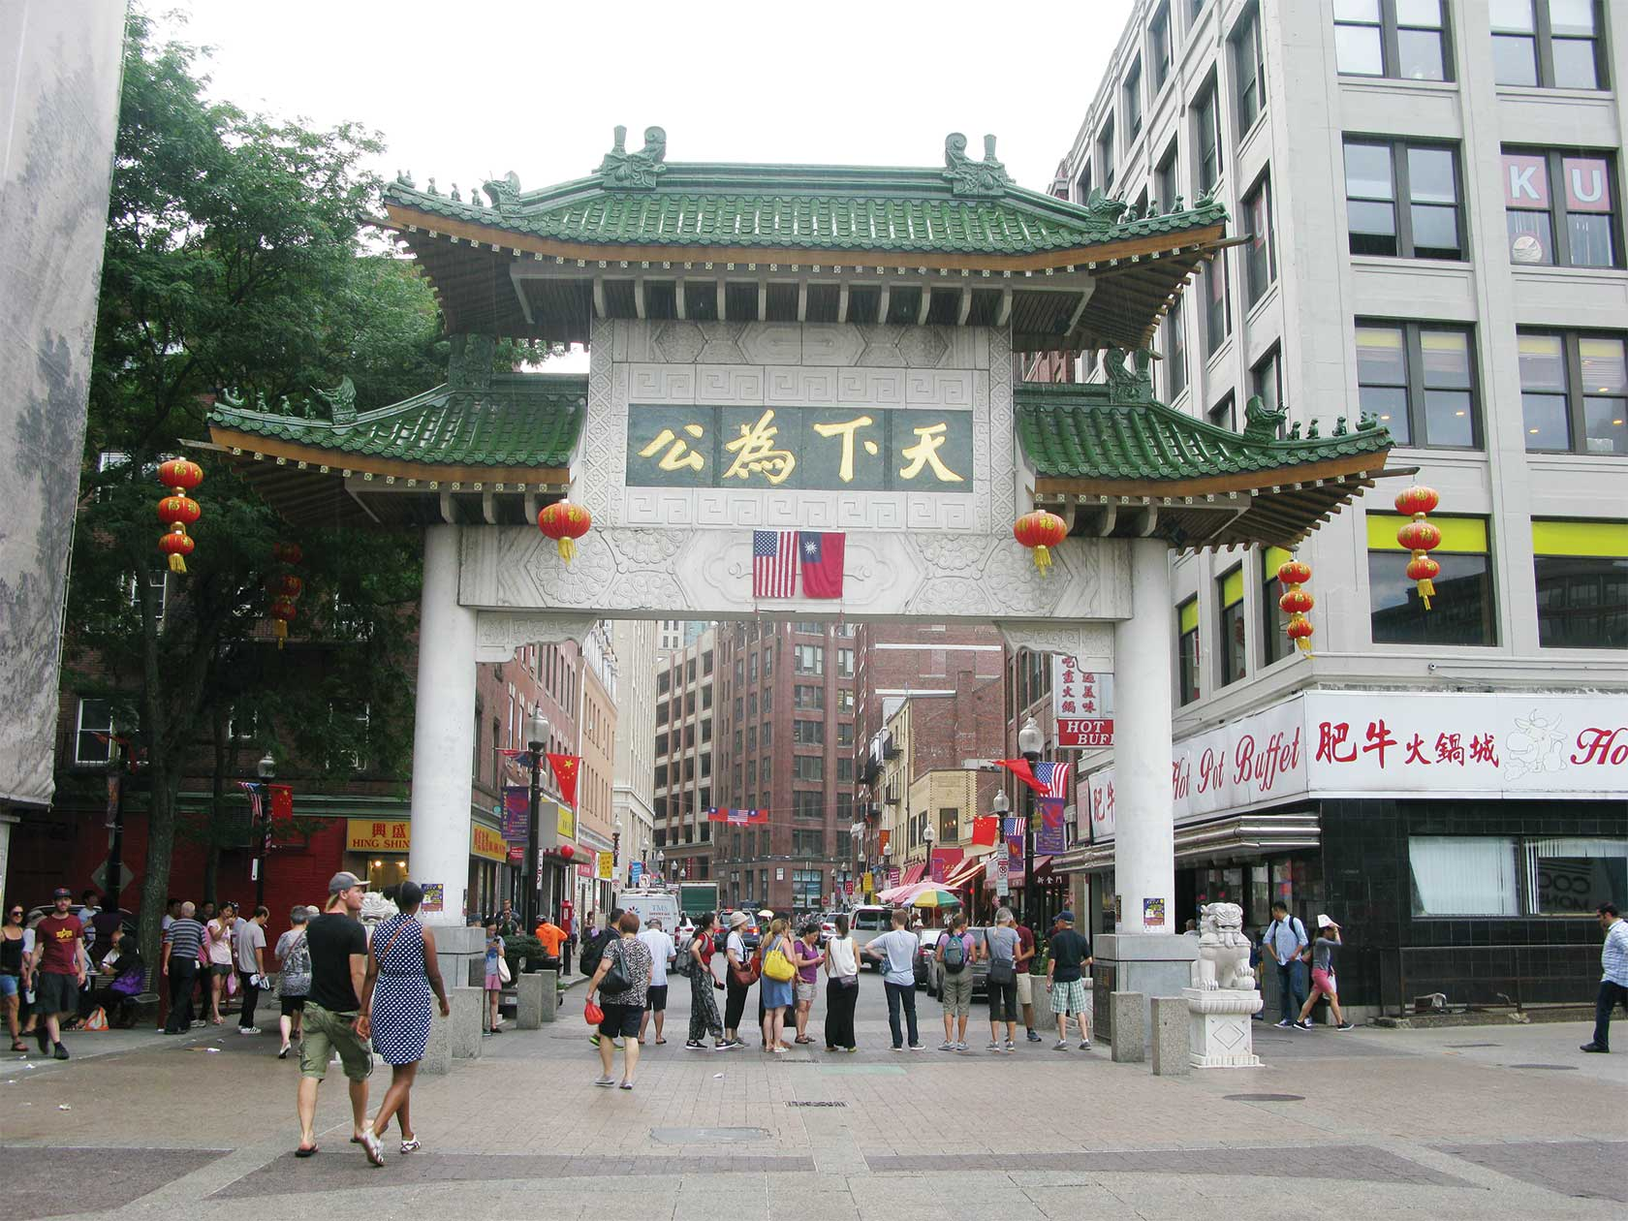
Significance:
-Los Angeles and its surrounding areas have continuously had horrible pollution rates -Chinatown (the worst polluted place) 2016-2017 air pollution was dangerous 117 times.

Slide 9
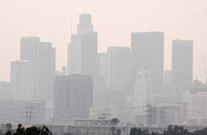
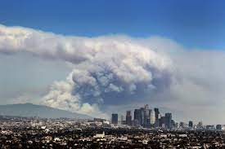
Los Angeles:
-a basin: it traps in all the bar particles
-about 40% of imports come through Los Angeles -fossil fuel usage
-Forest Fires

Slide 10
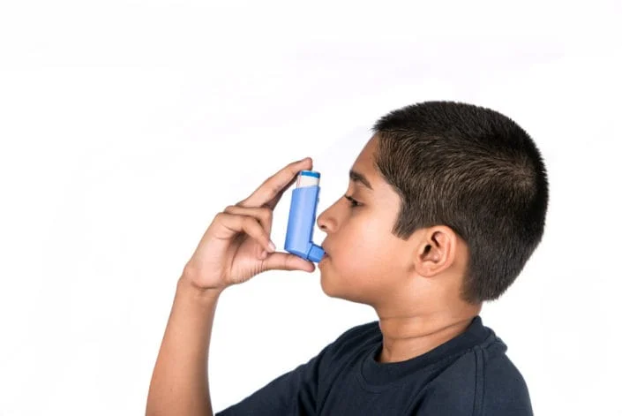
Who is at risk?
-Everyone
-Immune compromised individuals
-Children

Slide 11
Goals and Purpose
● Goals:
○ Develop an web application that provides
Easy access to current and forecasted air quality information that is also based on user location
a variety of visualization aids
● Purpose:
○ Means to make better informed outdoor activity choices
Lung and heart chronic conditions
○ Earlier response opportunities to government officials (city, country or state)

Slide 12
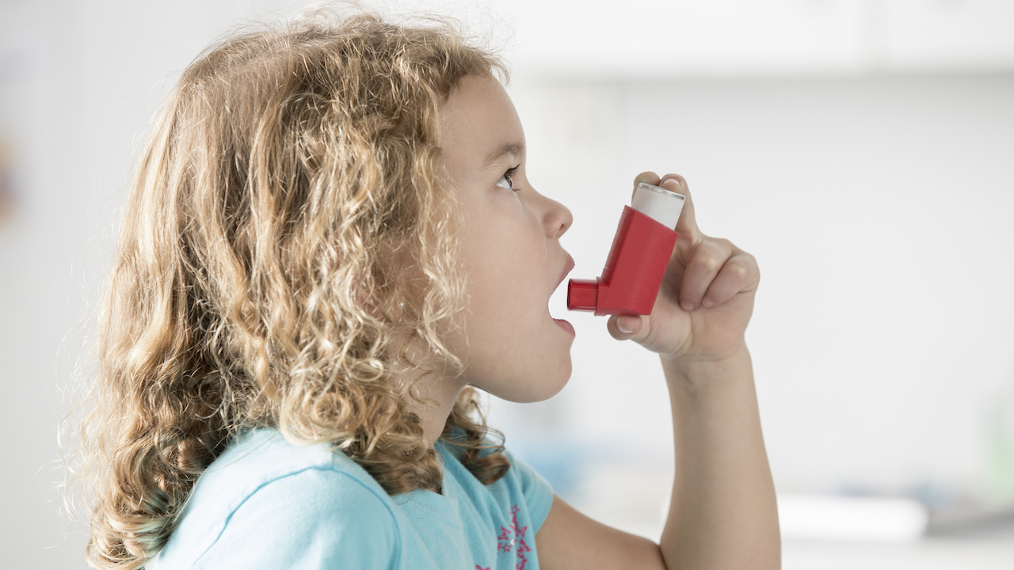
Examples
City of Los Angeles
Using forecasted data, city or county can send advisory notices to its residents when poor air quality surges.
Vulnerable Groups
Residents with health conditions and chronic conditions and other vulnerabilities (pregnancy) can stay in doors or limit outdoor activity.
Lungs and heart conditions i.e asthma, heart disease
Notes:
heart or lung disease (including asthma and chronic obstructive pulmonary disease-COPD), older adults, and children.

Slide 13
Technology We Used
-React
-JavaScript
-Node.js
-Heroku
-CSS
-ArcGIS
-HTML

Slide 14
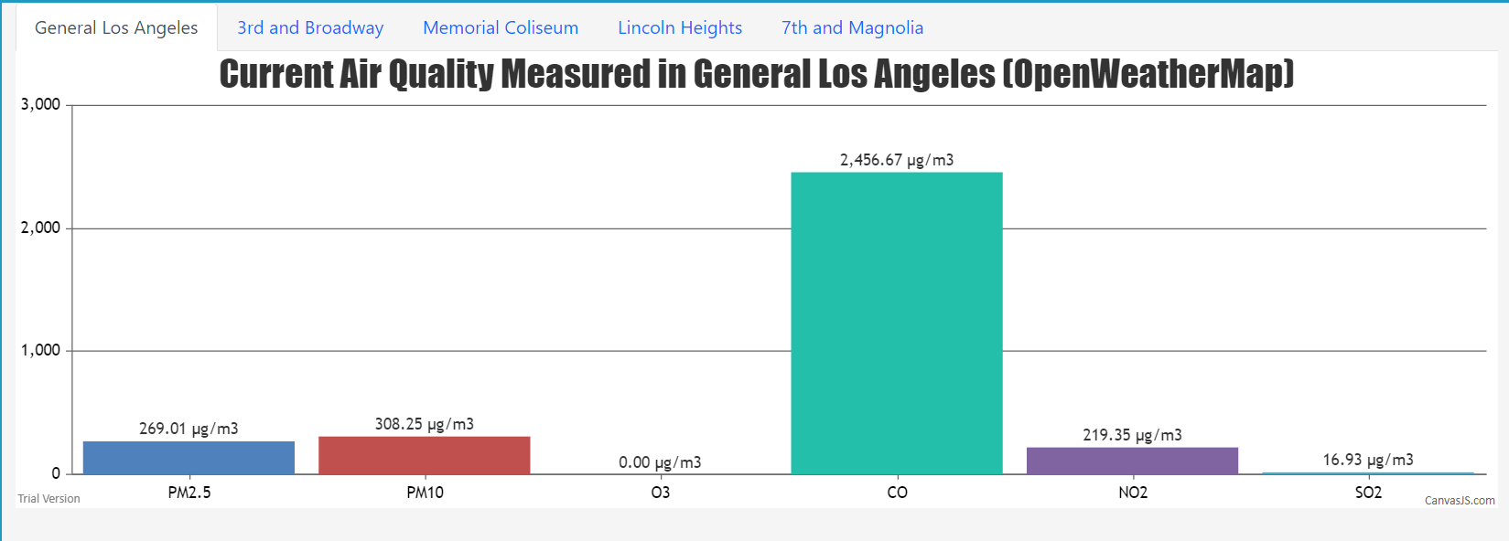
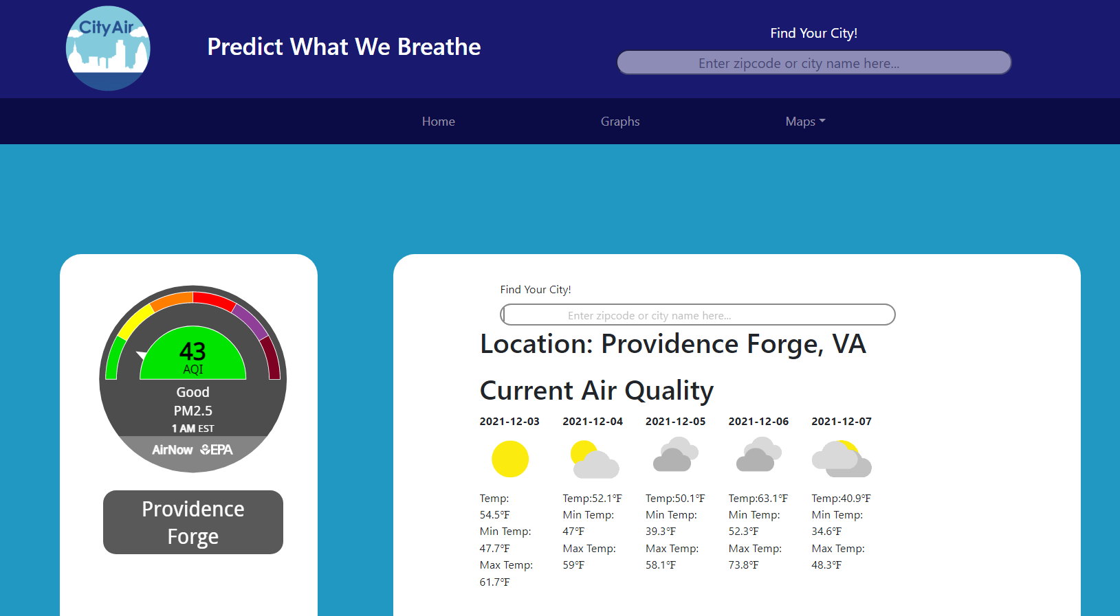
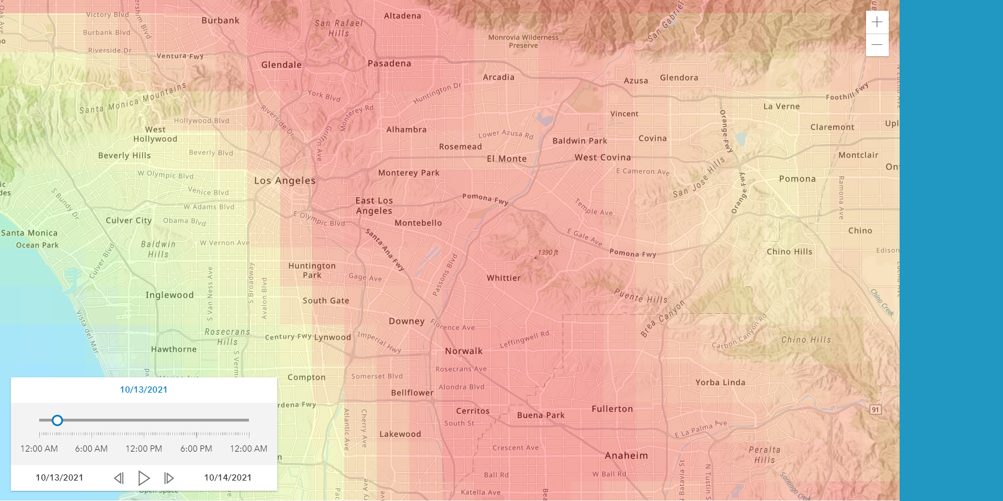
Implemented Items
-Home Page, Graphs Page, Maps Page

Slide 15
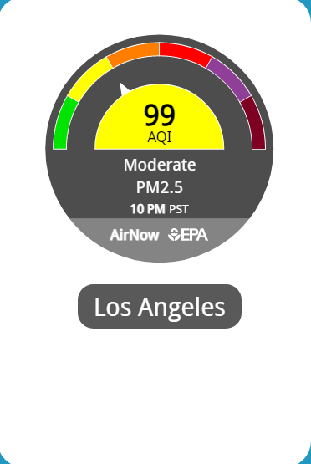
Home Page
-Presented when website is opened
-AQI Widget
-Search Bar to find current AQI and weekly forecast based on zip code
-Weekly Weather and Temperature data

Slide 16
Graphs Page
-3 Graphs per tab with 5 Tabs
-Tabs:General LA, 3rd and Broadway, Memorial Coliseum, Lincoln Heights, 7th and Magnolia
-Each graph has current air quality, air quality past 3 days, and trend since 1980s

Slide 17
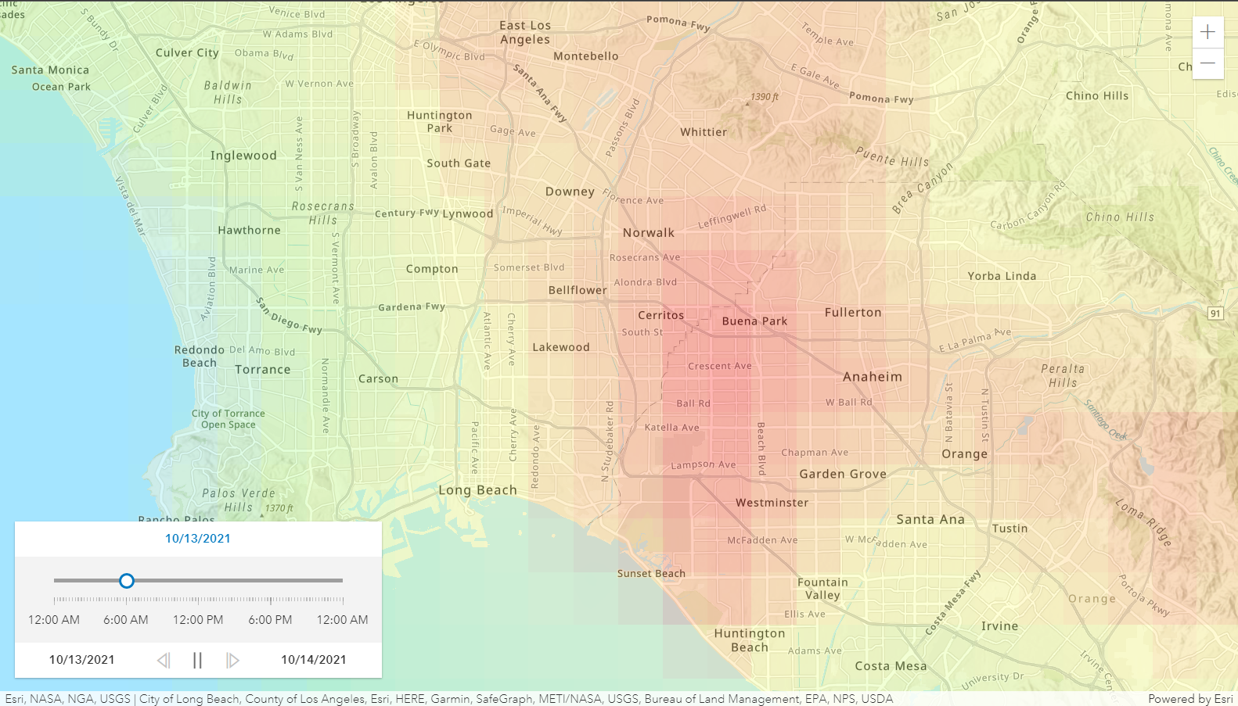
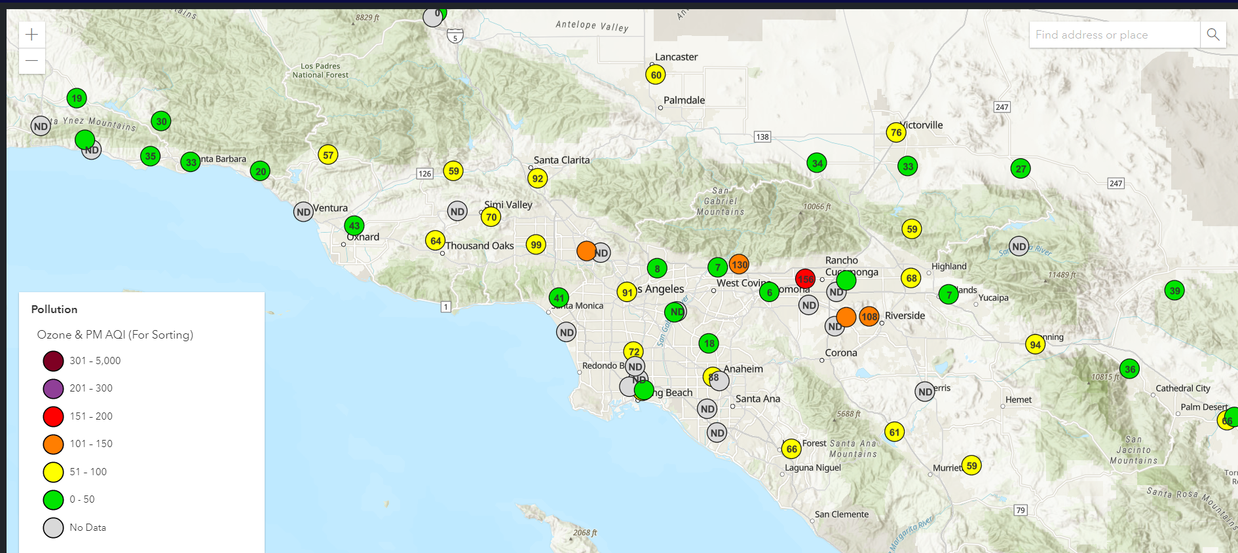
Maps
-3 Maps from Dropdown menu: air quality map;forecast map, and forecast video
-Shows the air quality map that is displayed from the home page
-Shows the air quality by provide a layer over the area that provides shades of color based on air quality
-forecast video to demonstrate change of air quality per hour

Slide 18
Live Demo!
I will demonstrate a live demo of our website.

Slide 19
Future Goals:
Air Quality Information based on Search Location
Add more Gauges of Air Quality Pollutants
Future Forecast Graphs
Mobile Application

Slide 20
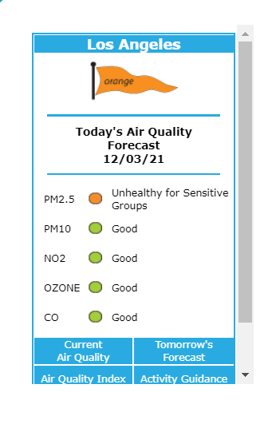
Future Goals: Air Quality based on Location
Based on the zip code all the Air quality Information should be within that specific location
New air quality pollutants
No2, Co, PM10
Detailed visualizations accessible by zip code or city name

Slide 21
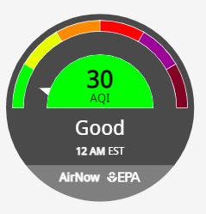
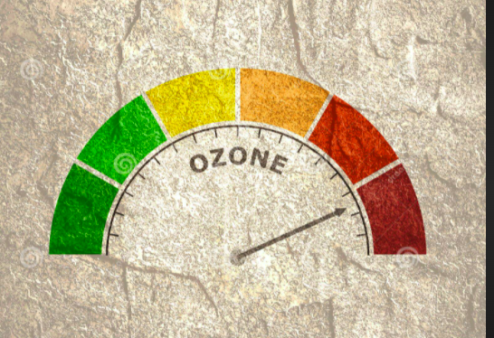
Future Goals: Gauges for Different Air Quality Pollutants
There are many Air Quality Pollutants such as:
Particulate Matter (PM10, PM2.5)
Ozone (O3)
Nitrogen dioxide (NO2)
Carbon Monoxide (CO)
Sulphur dioxide(SO2)

Slide 22
Future Goals: Future Forecast Map
In the Future we want to find a way to have the future data of Air Quality be updated automatically on an hourly basis
Most Modern Air Quality Websites have an automatic way of having data be updated every hour or so.

Slide 23
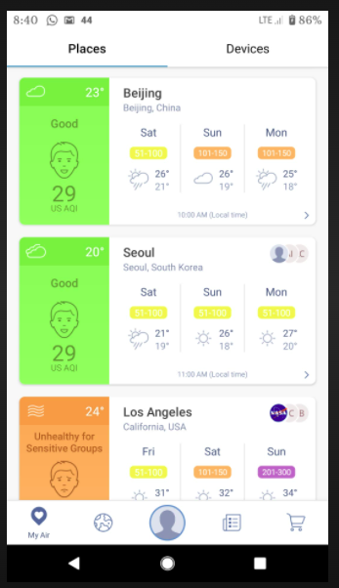
Future Goals: Mobile App
A development of a Mobile App would gain broader audience since most people have cell phones
We used React as our platform to make it easier when developing the mobile app
Using React-Native for Mobile App

Slide 24
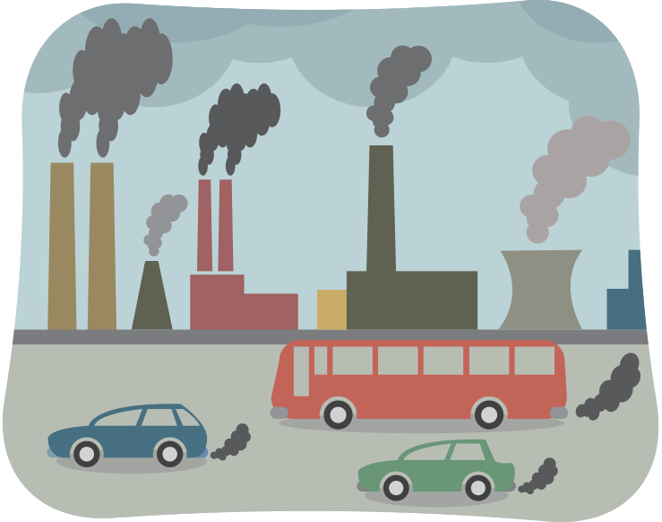
Final Thoughts
Air Pollution contributes annually to millions of deaths worldwide and must be taken seriously
Making Air Quality readings and forecasting accessible will help in making more timely response

Slide 25
Thank You

