Slide 1
Collaborative Visualization for Solar System Treks (CVSST)
Senior Design 2020-2021
Presented by: Montague La France, Stanley Do, Abdullah Alshebly, Christopher Smallwood, Jose Garcia, Johnny Lee, Odasys Soberanes, David Tang, Zipeng Guo, Miguel Sanchez
Project Advisor: Dr. David Krum
Liaison: Emily Law

Slide 2
Overview
Solar System Treks (SST)
JPL web portal.
NASA data of planets, asteroids, and moons.
Satellite photography and 3D terrain models.
CVSST
Multiple users can examine the data together.
Collectively work on new ideas and projects in real time.
Integrate into SST.
Miguel Sanchez

Slide 3
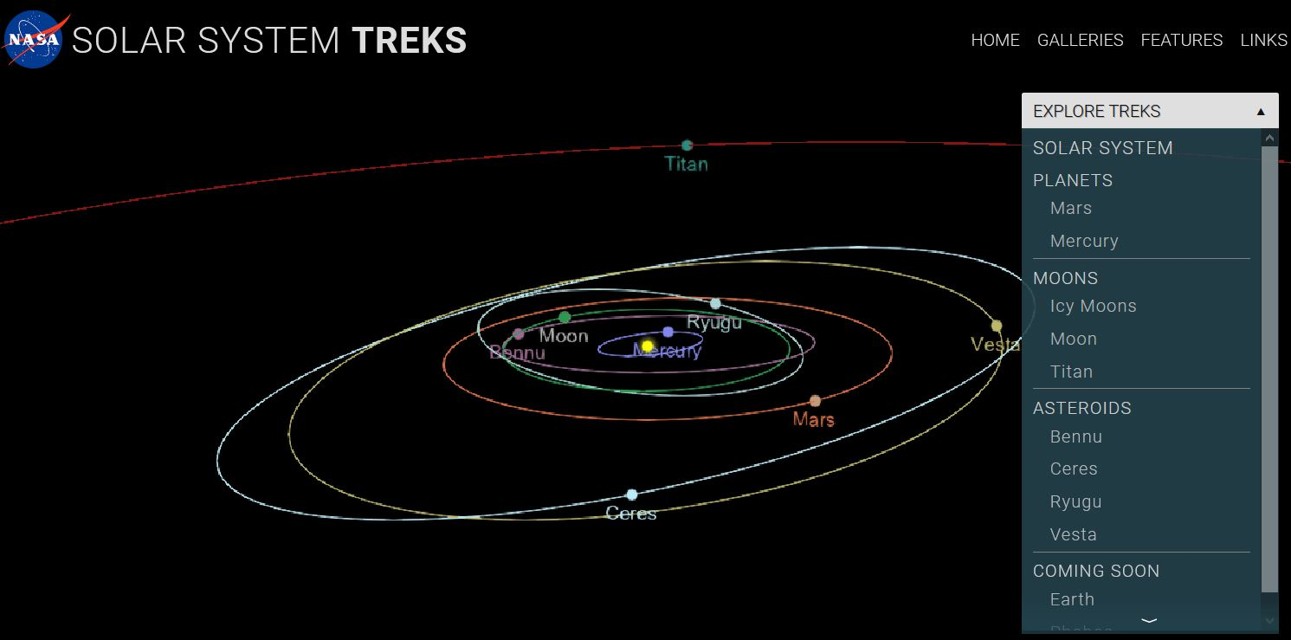
SST

Slide 4
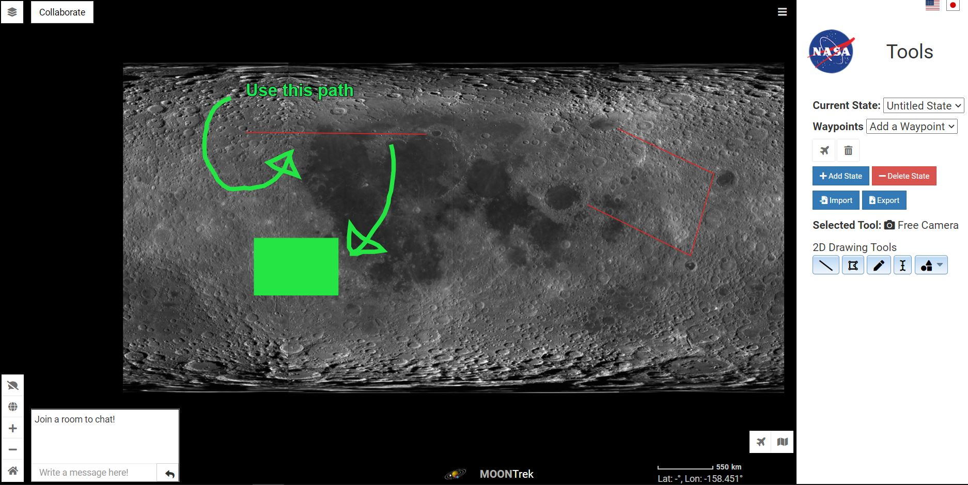
CVSST: 2D View

Slide 5
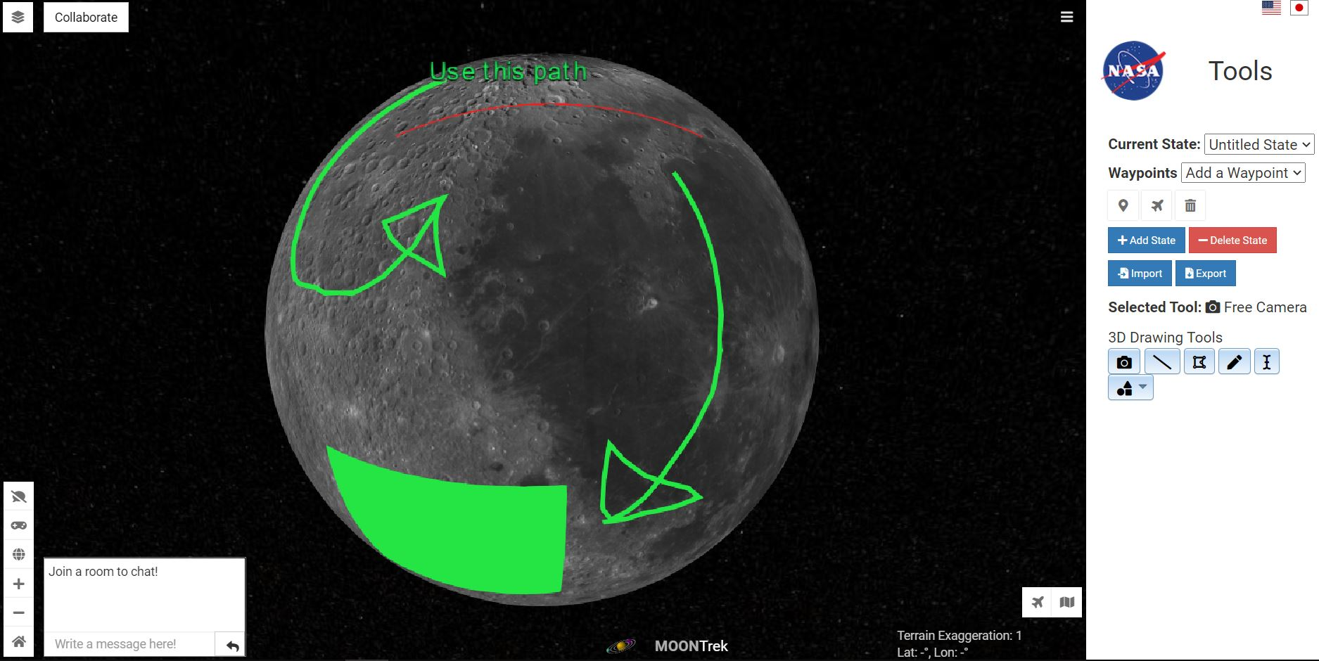
CVSST: 3D View

Slide 6
Outline
Liaison & Team Introduction
Project Planning
Feasibility Assessment
VR in Solar System Treks
Avenues of Research Explored and Decision
Software Requirements Document
Project Timeline
Personas, Use Cases, Scenarios
Documentation
Collaborative Session Functionality (2D/3D)
Tools Module Functionality
Conclusion & Demo
Miguel Sanchez

Slide 7
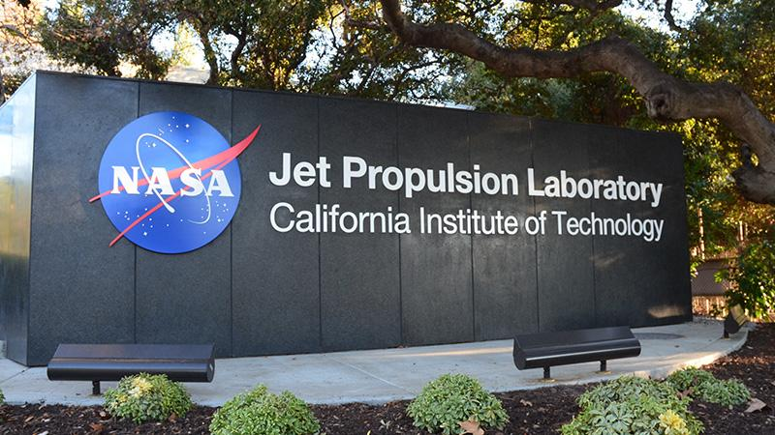
Introduction
Sponsor: JPL
Liaison: Emily Law
JPL Team: Eddie Arevalo, George Chang, Richard Kim, Shan Malhotra
Goal:
Develop networked visualization software to support collaborative markup of solar system terrain.
Miguel Sanchez

Slide 8
Introduction: Members and Roles
Project advisor: Dr. David Krum
Project lead: Montague La France
Project co-lead: Stanley Do
Customer liaison/requirements lead: Christopher Smallwood
Architect lead: Abdullah Alshebly
Documentation lead: Zipeng Guo
Demo/presentation lead: Miguel Sanchez
QA lead: David Tang
Components (UI, backend, database): Jose Garcia, Odasys Soberanes, Johnny Lee
Miguel Sanchez

Slide 9
Project Planning
Pre Preparation
Preparation
Implementation/Testing
Closure
Christopher Smallwood

Slide 10
Project Planning: Communication
Team Meeting
- Accomplishments
- Action Items for the team
- Events
Proper Prior Planning Prevents a Poor Performance
Time Between Meetings
Liaison Meeting
- Work on Action Items
- Contact Resources
- Update Deliverables
- Relay Team Meeting
- Discuss Ideas
- Address Concerns
- Action Items for the Liaisons
Briefing Email
- Restates events of the Liaison Meeting
- Schedule Meetings
- Documentation Delivery
Christopher Smallwood

Slide 11
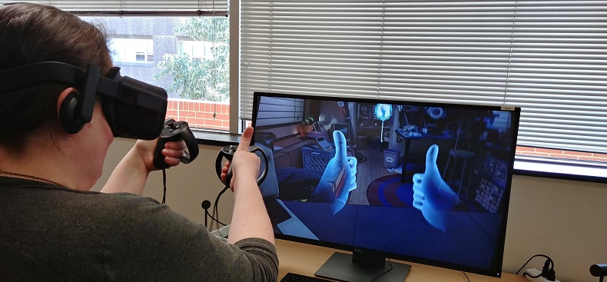
Virtual reality (VR)
What is Virtual reality (VR) ?
Virtual reality (VR) creates an immersive artificial world that can seem quite real.
Through a virtual reality viewer user can have full 360 view.
Virtual reality has many use-cases : Entertainment, Gaming, educational, or training tool.
Abdullah Alshebly
Notes:
VR was an interest, not a requirement.

Slide 12
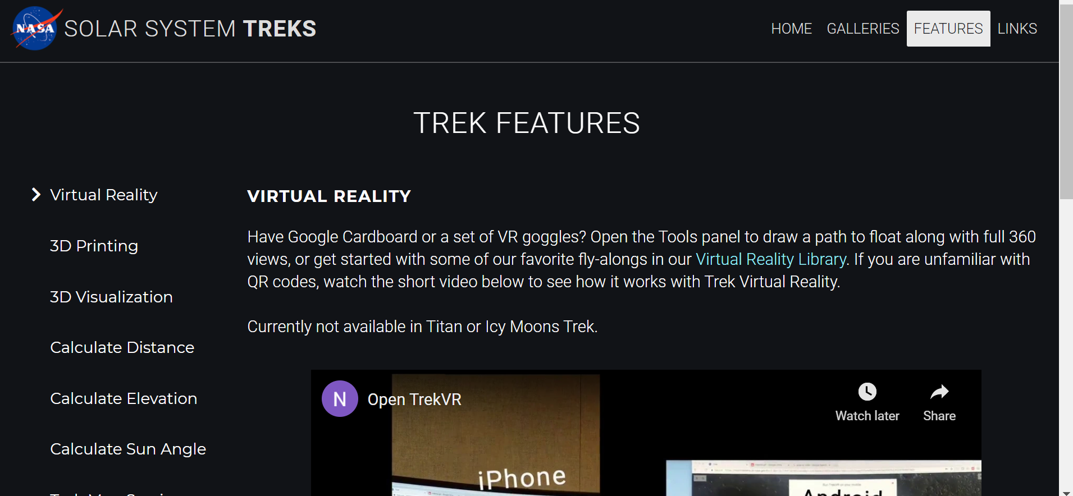
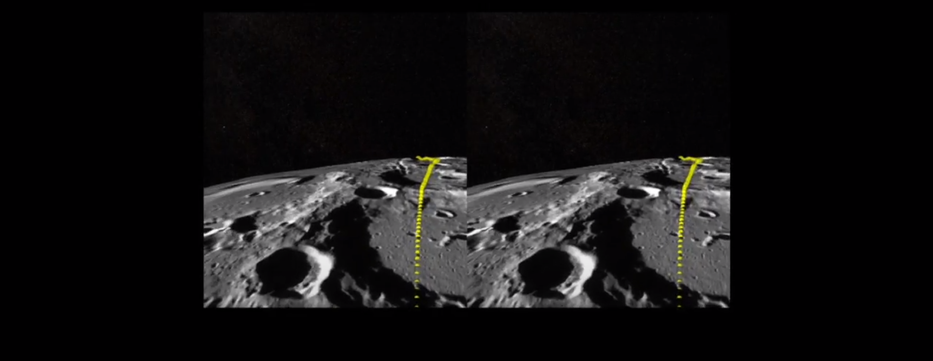
VR in Solar System Treks
Trek VR (Features)
Trek VR (View)
Abdullah Alshebly

Slide 13
Feasibility Assessment
Research & Discovery
Risk Assessment
Feasible Development Paths
Decision and Requirements
How does it help us?
Lets us understand the current software and technologies in use.
Keeps the amount of time on documentation and development in mind.
Builds a path towards a more successful project.
Helps the customer know our limitations and clarifies requirements.
Montague La France

Slide 14
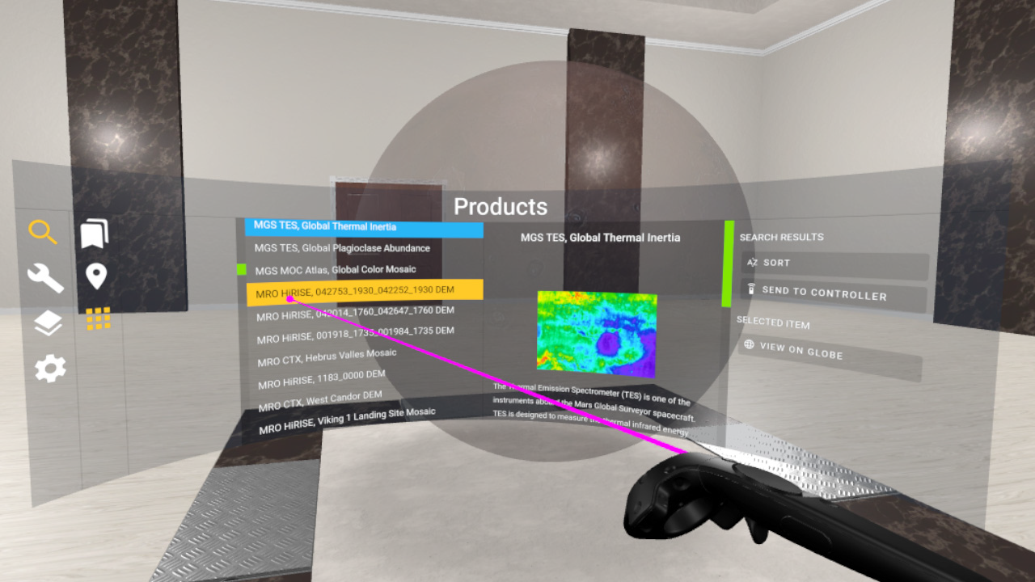
Avenues of Research Explored & the Decision
Unity & VR Room
Unity
Powerful platform.
Ease of manipulation for 3D data.
VR & AR quality support.
VR Room
Existing Software to expand upon.
Utilized the Solar System Trek tools.
Problem
WebGL
Does not support mobile while deployed on web.
Montague La France

Slide 15
Avenues of Research Explored & the Decision
Web Based Technologies
Greater access to users and the public.
Cesium
A powerful framework for 3D geospatial visualization.
Esri (ArcGIS)
A geographic system for working with 2D maps and geographic information.
Node Js
Utilized websockets
Seamless integration with existing software.
Montague La France

Slide 16
Software Requirements Document (SRD)
A software requirements Document (SRD) includes in-depth descriptions of the software that will be developed.
Drafted requirements from Personas, Use cases, and Scenarios.
Revised document throughout the project.
Functionality of the software.
Future Team
Odasys Soberanes

Slide 17
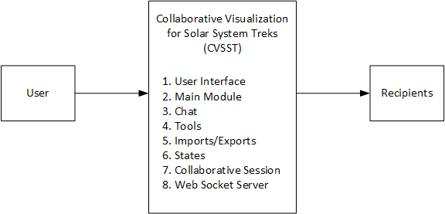
Software Design Document (SDD)
DFD Level 0
Odasys Soberanes

Slide 18
Personas, Use Cases, Scenarios
Represents different user types.
Personas examples:
John is an ex-military, 35-year-old Mission Planner who works for NASA.
Nick is a 20-year-old college student with a love for space.
Tom is a 40-year-old high school teacher who is currently teaching a science class.
Zipeng Guo

Slide 19
Personas, Use Cases, Scenarios
Use Cases and Scenarios
Provides one or more scenarios.
Illustrates interaction between end users and the system.
Importance:
Shows how our software might be used.
We can draft the requirements and Clarify about what we should do next.
Example:
Nick is a 20-year-old college student with a love for space.
Nick and his friends want to be able to collaborate in a smooth way.
We provide: Create a room, share the waypoint location, Real Time Collaboration (Send Live Chat Messages).
Zipeng Guo
Notes:
Each use case provides one or more scenarios, which illustrate how the system interacts with end users or other systems, that is, who can use the system to do what to achieve a clear business goal.

Slide 20
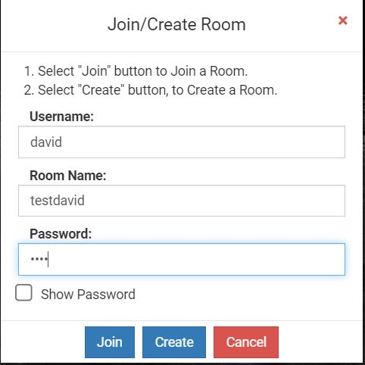
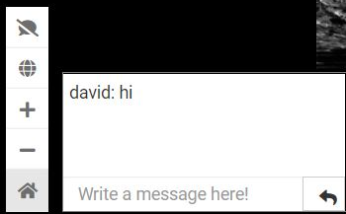
Collaborative Session Features
Room
Create room
Join room with password
Chat
Text
David Tang

Slide 21
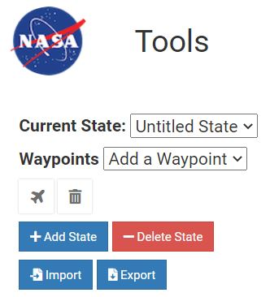
Collaborative Session Features
States
States saves a copy of the planets data.
Export a state
Creates a JSON file with data.
Import a state
Upload a JSON file with data.
David Tang

Slide 22
2D Tools

Slide 23
3D Tools

Slide 24
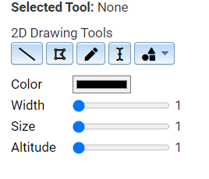
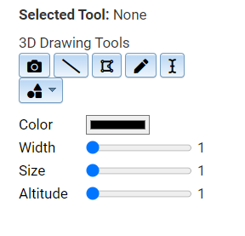
Tools Module
Tools
Line Drawing
Polyline Drawing
Freehand Drawing
Write Text/Point
Waypoints (3D only)
Free Camera (3D only)
Shape Drawings
Circle
Squares
Triangle
Jose Garcia

Slide 25
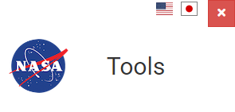
Tools Module: Improvements
2D drawings uses Esri’s ArcGIS.
3D drawings uses Cesium.
Missing curvature of lines in 3D
Waypoints only works for 3D.
Write Text/Point can be improve.
Importing/Exporting States might have a few bugs.
Jose Garcia

Slide 26
Project Timeline & Next Steps
Planning (8/28/20 - 10/30/20)
Requirements (10/26/20 - 12/11/20)
Design (11/27/20 - 1/5/21)
Implementation (1/5/21 - 2/26/21)
Testing (2/26/21 - 4/30/21)
Closure (5/1/21 - 5/14/21)
Johnny Lee

Slide 27
Conclusion
Technical Cliffs
The Dojo Toolkit is fairly outdated.
Older versions of software resulting in technical debt.
Difficulty with adapting to code.
Passing the Torch
Expand on the collaboration features.
Implementation of collaborative VR/AR capabilities.
Implementation of a Database.
Stanley Do

Slide 28
Live Demo
Stanley Do
Notes:
Empty Slide

