Slide 1
Current Developers
Matthew Frias, Jesus Gonzalez, Kevin Kazaryan, Daniel Lee, Stewart McKenzie, Erica Payne, Erica Santos, Leslie Segovia, Bryan Sosa, Elio Vences
Advisor
John Hurley
Liaisons
Cynthia Wang, Zachary Vernon
Notes:
Starting with Erica P.

Slide 2
Agenda
Background/History of The arqive
Project Requirements
Content Moderation
Security
Gamification
Project Challenges
Development
Deployment
Mobile
Frontend
Gamification
Demonstration
Notes:
Erica P.

Slide 3
What is The arqive?
The arqive is a digital online storytelling map for LGBTQ+ stories that seeks to provide the full range of queer stories and then geolocates them and digitally preserves them.
Users have a safe platform where they can share personal, historical, and community stories, as well as have access to information about safe spaces.
The arqive is both a web and mobile application.
Notes:
Erica P.
Change it up to not read off of

Slide 4
Background of The arqive
The arqive is an archive of personal, community and historical moments in history as well as resources and organizations.
The arqive’s main purpose is to give LGBTQ+ people the opportunity to map out their stories, giving them a place in the world and in history.
“By sharing stories, we can give each other hope.”
-Cynthia Wang
Notes:
Erica P.

Slide 5
History of The arqive
2014 - The arqive was founded by Cynthia Wang
2019 - Cynthia was joined by Zachary Vernon, Assistant Professor of Art (Graphic Design/Visual Communication)
2019-2020 - Senior Design team creates a new website
2020-2021 - Senior Design team develops the mobile application
Notes:
Erica P.

Slide 6
Project Requirements
Notes:
Erica P

Slide 7
Project Technologies
Django REST Framework
Web APIs
OpenStreetMap
React
React Native/Expo
ReactJS
Hosting: Digital Ocean
Ubuntu 18.04 (Server OS)
PostgreSQL
SciKit-learn
Notes:
Leslie
And now we’ll go over technologies we are currently using for this project.
Django Rest Framework which is a powerful and customizable toolkit for building Web APIs in Python mainly used for The arqive’s web application
Web API’s via OpenStreetMap which is an editable geographic database of the world.
React Native, an Open source mobile application framework
And this goes in hand with using Expo, An open-source platform for making universal native apps for Android, iOS, and the web with JavaScript and React
We also use React JS, an Open source front end framework for developing websites
We are also currently hosting the applications on Digital Ocean using Ubuntu
Next we have
PostgreSQL: A popular open source database
And finally
SciKit-learn: a Machine learning framework

Slide 8
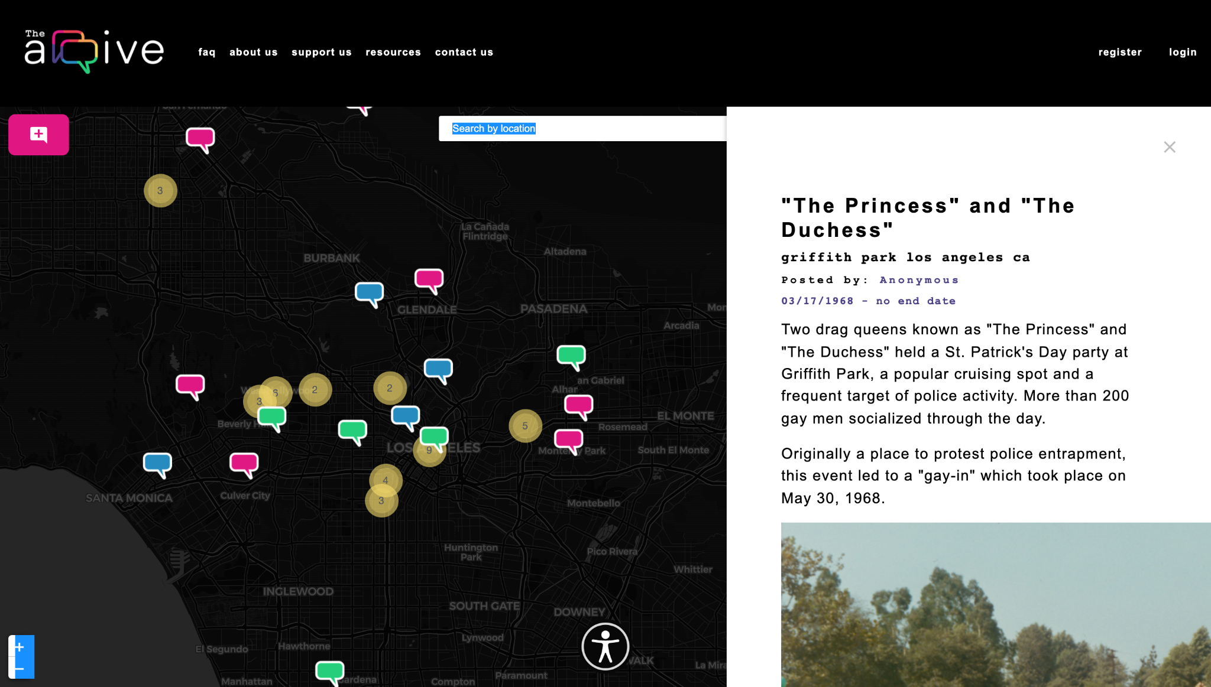
Overview of The arqive
Users
Login
Add/Edit/Delete story
Bookmark/Unbookmark user
Flag posts
Manage profile
Anonymity
Admin
Login
Add/Edit/Delete story
Bookmark/Unbookmark user
Anonymity
Review/Remove flagged posts
Review/Remove flagged comments
Remove users
Notes:
Leslie
To tie everything in together, here is a brief overview of the archive and the functions a user and admin should be able to do.
This includes basic functionality of the app as implemented by the previous teams such as Adding/Editing/ and Deleting, booking marking and unbookmarking stories for all users. For admins, they are able to review and remove flagged posts and comments and determine if they want to remove them based on any identified toxicity.
And on the left we have a screenshot of the arqive website viewing the pins of posted stories on the map and a historical post submitted by an anonymous user.
In all, We hope to implement and improve these features soon which brings us to our Project Goals with Daniel

Slide 9
Project Goals
This year's project for The arqive will focus on expanding the website and mobile applications. Expansion includes:
Implement content moderation
Add further security measures for users who choose anonymity
Enhance gamification features to improve user engagement
Link posts to other social media sites
Add AR/VR features
Notes:
Daniel effect - > integrate
Integrating content moderation for offensive posts
A non ymity

Slide 10
Incremental Changes
Improvements
Email validation
Pin load time and amount loaded per location
Geolocation on load
Social media sharing
Bug Fixes
Fix to API keys to allow access to features
UI fixes for menu and pages causing issues
Notes:
Daniel
And now we’ll go over some incremental changes made to the arqive. We’ve been able to improve email validation, pin load time for a smoother experience for users to see stories on the map, use of geolocation when a user loads in (i.e. the process or technique of identifying the geographical location of a person or device by means of digital information processed via the internet and using that to load a pin in response to that location), and finally being able to share the arqive website and app across social media for all to see.
Among these improvements, we were able to perform bug fixes such as allowing access to features through the use of API Keys and multiple UI fixes for the menu and pages that may have affected the overall user experience.

Slide 11
Content Moderation
Notes:
And now Matthew will discuss Content Moderation

Slide 12
Main Idea and Concept
The main idea of content moderation is to develop and train a classifier that flags possible toxic comments and posts for admin review.
Flagged post reflects in database
Flags only visible to admin
Original author notified if post removed
Notes:
Matthew

Slide 13
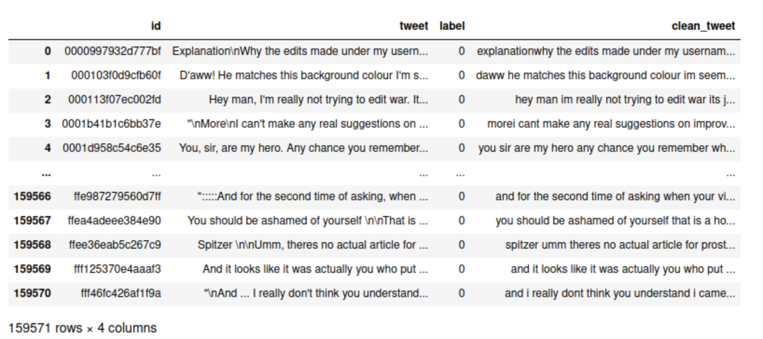
Dataset
Notes:
Kevin
Clarify that the issues we face will be different

Slide 14
Steps in Creating Trained Model
Current model is trained on pre-classified toxic/non toxic comments
Testing phase consisted of a similar dataset of unclassified text
Classifier trained and tested for overall accuracy of 94.65%
Good starting point for a classifier that runs as intended
As more data is input, real world accuracy will improve
Notes:
Kevin
-Explain second bullet point in depth for those who have not taken data science

Slide 15
Model Prediction Example
Non Toxic Comment: Prediction of 0 means comment is NOT toxic
Toxic Comment: Prediction of 1 means comment IS toxic
Notes:
Kevin

Slide 16
Future Plans: Content Moderation
Classifier trained, but not implemented
Handling l33t5p34k (aka leetspeak)
Hope to have more accurate model aiding admin review
Possibility of detecting hate speech where specific toxic words are not used
Notes:
Matthew

Slide 17
Security
Notes:
Elio

Slide 18
Security: Log Files
Malicious individuals can use that information to see what’s happening on the application but we can also use that information for security reasons
Solution:
Accomplished by using Logrotate
Essentially every day, logs will rotate and every three days, old logs will be deleted
Notes:
Elio
What are log files
What info do they contain
How log files can be used against us and use them for our benefit
Solution/Security Measure to help minimize the problem
Though not full prove, the window of opportunity is smaller

Slide 19
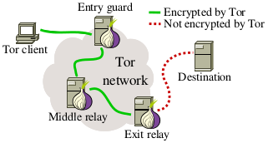
Security: Tor Browser/Onion Services
Tor Browser is a web browser that anonymizes web traffic by using the Tor Network
Benefits?
Delete cookies, history upon closing
Access blocked websites
Onion services are services that never
leave the Tor network
Can’t have “100%” security
Notes:
Elio
what is tor browser - encrypted 3 times before connecting to server (traffic goes through tor network and exit to the normal network)
What is onion service ( service that never leaves the tor Network)
improvement to use tor over other web browsers like google chrome etc… .onion only in tor aka extra anonymity
Can only access .onion services with Tor browser

Slide 20
Future Plans: Onion Service Deployment
As of right now, it’s been tested on few test servers and it has shown results
Custom address to give the application a sense of identity.
Example:
asfklgkjeiurubv78sad5a67cn87.onion
to
arqive45kgjlkdfgjk24f56g0000.onion
More custom characters, more time to process
Notes:
Elio
Been tested, find a way to make site display the actual site even if the server is in the tor network
Solution: essentially map django urls with onion and remove bad error 404
More characters, more time

Slide 21
Security: Second Database Backup Location
The arqive database is currently being stored on DigitalOcean, with backups created weekly.
Two possible issues can arise if
1. Current database becomes compromised through either code mishandling or hacker attack.
2. DigitalOcean servers go down, therefore no way to retrieve database.
Inability to access backup database in the event an issue arises can lead to security issues and vulnerabilities.
Notes:
Jesus

Slide 22
Second Database Backup Location (Continued)
Current solution: Implement Cron-job to download and send backup database to discrete location.
Backup database is usable without the need of DigitalOcean.
Current solution is acceptable due to the amount of users and features currently available.
Location of backup will need to change as the website grows.
Notes:
Jesus

Slide 23
Gamification
Notes:
Daniel

Slide 24
Future Content: Achievement/Badge System
Include gamifying system that only reflects personal journey
Removed all sense of competition other achievement systems offer
Offer a personalized journey rather than competition between users
More incentive to use the app
Offer a variety of time-based and performance-based achievements
Example: Posting a certain number of stories
Notes:
Daniel (I should have made this future plans or more around gamification itself; discuss this with me once you guys can.)

Slide 25
Future Plans: Augmented Reality (AR)
The goal is to implement an AR experience that introduces elements of gamification, while still holding true to the purpose of The arqive.We agreed on the idea of allowing users to add 3D text messages in the real world, at physical pin locations.
Persistent 3d messages at pin locations revealed through your phone's camera
Geo placement accuracy
Both public and anonymous messages
Content moderation for the 3d text
Notes:
Stewart
Here are a few of our goals!
We are aiming to have persistent, 3d text messages that can only be revealed if you are physically looking around the area of a pin. This would give a bit of a scavenger hunt feel to the experience and can promote real world engagement or even communities around pins
We also wanted to have text placement be true to where the user placed it from their perspective. Meaning if you were to take out your phone and add a ‘hello’ at the entrance to your favorite coffee shop. Other users would be able to see that same text through their phone in the same place
We are also aiming to allow 3d messages to be public or anonymous and must be content moderated like anything else on our app
And now onto the bryan with the Challenges our team faced across different areas of the project.

Slide 26
Project Challenges
Notes:
And now onto the Project Challenges our team faced across different areas of the project.
Bryan

Slide 27
Project Challenges: Development
Challenges
Complex development environment setup
Bug fixes needed
Outdated / expired software
Complex GitHub repositories
Solutions
Updated software to current versions
Refactor and combine into one repository
Notes:
Bryan
Getting this setup on our end and learning the ins and outs
When working on it we created our own bugs on top of bugs already existing
Software that needed to be brought up to current updates so we have an easier time developing and getting things out to our users
Github being complex many repos and trying to combine them for a nicer project

Slide 28
Challenge: Deployment
A few bugs
Information missing needed to deploy
Coordinating with last year’s team
Apple deployment
Outdated Ubuntu server
Notes:
Bryan
Overall goal is to streamline deployment to get our users updates and improvements to their experience for both mobile apps and website.
A few bugs that came up when moving folders and updating permissions on the server
Some missing information such as logins or keys for deployment
Coordinating with last years team for that information
Lack of apple product for ios deployment
The server being a bit outdated that caused a few issues to deploy features

Slide 29
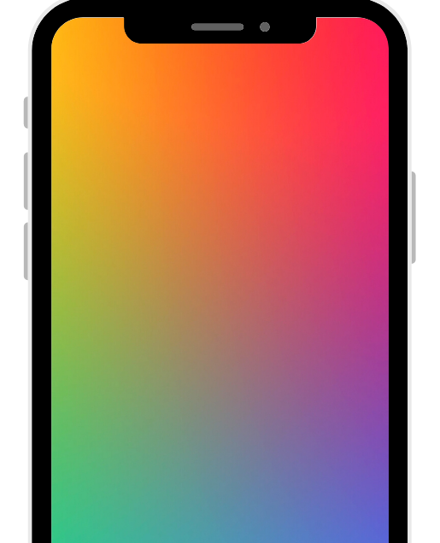
Challenge: Mobile
Learning mobile store procedures
Connecting to the backend
Updating code for future releases
Updating SDK
Fixing bugs
Notes:
Erica S.
With the mobile application, some challenges we have faced are:
Getting familiar with the Apple App Store and Google Play Store procedures for deploying apps for review and update
Making sure the backend is connected with the mobile apps
Which is important for user experience, for example without this fix, a user couldn’t stay logged in
Getting the code updated for future software updates such as keeping the SDK updated and fixing other bugs
If we go to the next slide, we also have challenges for the frontend...

Slide 30
Challenge: Frontend
Our goal is to have fully functional applications with a user-friendly design.
Challenges
Select parts of the mobile application are not completely finished
Expo (our main build tool) bars access to native code
Small updates for responsiveness and UI are needed
Need to update CDN keys and SDKs
Notes:
Erica S.
In reaching our goal to have fully functional applications with a user-friendly design, we were challenged in that..
Example of select parts: user profile
Explain what expo is: Expo is react native, just with a layer of tools and systems built on top of it.It allows us to create, debug, and share app builds easily without ever having to touch swift or java. This is great in general, but the drawback is you cannot not access that swift or java code if you need to add something 100% natively.

Slide 31
Challenge: Frontend (Continued)
Solutions
We are completing the code based on the previous requirements
We have started ejecting (removing) expo from the app
Updates to packages, CDNs, and SDKs that do not cause breaking changes
We have added breakpoint responsive CSS and a few new UI features are being implemented
Notes:
Stewart
So for our solutions starting with the parts of the mobile app that weren’t completely fleshed out. We basically have a skeleton for the missing aspects, we just need to actually implement it. We are using that skeleton and referring to last year's requirements for guidance as we complete it
A few features we are trying to implement require access to native code so we have started to ejected expo. You can think of this as just peeling back the layer of tools and systems that allow us to build specifically with react native javascript only. This will allow us to continue to build our app in react native ,but also gain access to the underlying native code. The process itself is simple in theory ,but is extremely error prone
Also most of the packages, cdns, and the sdks for both apps are either outdated or have expired.So we have slowly been working through the most importants ones and upgrading them without causing breaking changes
We have added breakpoint based css to the web app so that it is responsive on smaller screens and we are also in the process of adding new elements to the ui so that it is more interactive
Speaking of interactivity here is Daniel with some of our gamification challenges

Slide 32
Challenge: Gamification
One additional topic at hand is on gamification: application of typical game-like elements to other areas of activity.
The major challenges:
What can we entice users with?
What can we encourage users with?
How can we let users return to the app besides the basic features?
How can we make these features non-competitive?
Notes:
Daniel
What is a possible feature to add onto this application to have users engaged more into the application?

Slide 33
Demonstration

Slide 34
Notes:
Live demo preferred

